Slide 1

DAYANANDA SAGAR COLLEGE OF ENGINEERING Shavige Malleshwara Hills, Kumaraswamy Layout, Bangalore-560078 (An Autonomous Institute affiliated to VTU, Approved by AICTE &ISO 9001: 2008 Certified) Accredited by National Assessment & Accreditation Council (NAAC) with ‘A’ Grade Department of Mechanical Engineering
Batch Number 35
Mini Project phase 1 Presentation
Title: Artificial Intelligence (AI) - Desktop Voice Assistant using python programming language.
Guide Name | MRS. G PADMAVATHI
Designation | Assistant Professor
Student Name | 1. Harsh Raj | 2. Kushagra Sinha | 3. Pratyush Nandan | 4. Likhith Gowda Bs
USN | 1DS20ME030 | 1DS20ME040 | 1DS20ME059 | 1DS20ME041

Slide 2
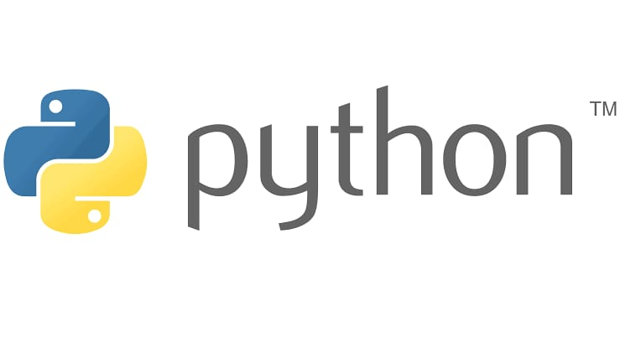
Abstract
This project is to create a Voice Activated Desktop Assistant with the use of Python programming language. This AI virtual Assistant project will get us a kick start and move towards the world of AI and ML(Machine Learning)..
Voice assistants are software agents that can interpret human speech and respond via synthesized voices. Apple’s Siri, Amazon’s Alexa, Microsoft’s Cortana, and Google’s Assistant are the most popular voice assistants and are embedded in smartphones or dedicated home speakers.

Slide 3
Literature survey
Faruk Lawal Ibrahim Dutsinma et.al[1], Voice assistants (VAs) are computer programs capable of understanding and responding to users using synthetic voices. A report in indicates that 4.2 billion VAs were adopted and used in 2020 alone, with a projected increase to 8.4 billion by 2024.Usability is a critical factor in the adoption of voice assistants. Their study aimed to understand what is currently employed for measuring voice assistant usability, and we identified the different independent variables, dependent variables, and the techniques used. Furthermore, they also focused on using the ISO 9241-11 framework to measure the usability of voices assistants. Their study classified five independent variable classes used for measuring the dependent variables. These separate classes were categorized based on the similarities between the member groups.
Vishal Kumar Dhanraj et.al[2], have discussed about Personal Virtual Assistant for Windows made Using Python. Virtual assistant makes life easier to humans. Virtual assistant is the flexibility to contract for just the services they need. As like Alexa, Cortana, Siri, Google assistant they also make virtual assistant using python for all windows versions. They use Artificial Intelligence technology for their project .Virtual Personal Assistants are effective way to manage or organize your schedule. Virtual Personal assistants are also reliable than Human Personal Assistant because, virtual personal Assistants are more portable, loyal and available to use anytime.

Slide 4
Literature survey
Dr.S.Brindha et.al[3],The paper describes a new emerging service for the user. The Voice Assistance provides an intelligent computer secretarial service for any professionals. The new service is based on convergence of internet and speech recognition technology. This Voice assistant minimizes the interruption of the user, improves the utilization of user’s time, and provides a single point of communication for all their messages, contacts, schedule, and source of information. The paper proposes a decision structure as well about Computer hardware. However, it is expected to become a standard feature for millions of other users. It overcomes many of the drawbacks in the existing solutions. It is mainly built to make a much more efficient Voice Assistant that they can be brought into much more practical day to day uses. But the system has its own limitation. Though the efficiency is high the time consumption for each task to complete maybe higher than the other Voice assistants and the complexity of the algorithms and the concepts would make it very tough to tweak it if needed in the future.

Slide 5
Objectives of the project:
The main Objective of this project is to implement coding in the field of mechanical aspect in order to drive the mechanical components more effectively and efficiently.
This project is used to activate Servo Motor using voice command with the use of Python programming language.
By making this voice activated Servo Motor , Our project can be extended further, such as in making robotic arms , automatic door , mini plotter.

Slide 6
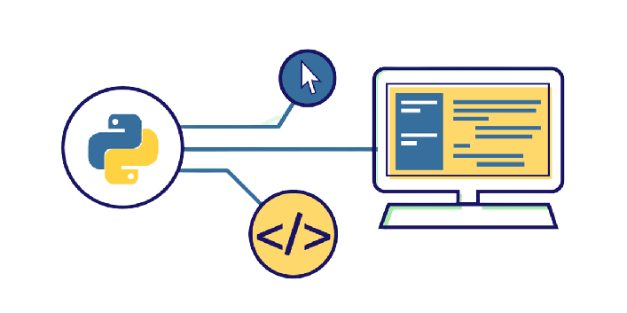
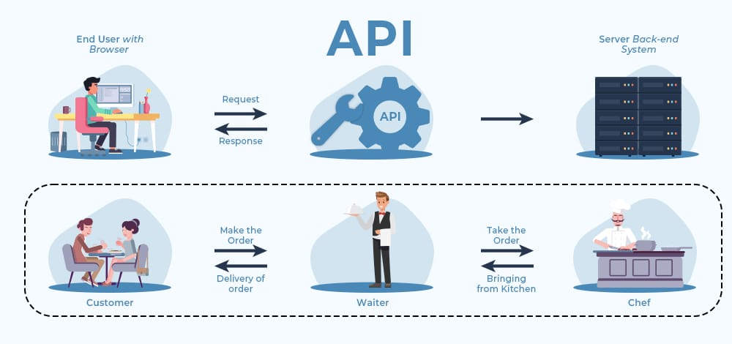
Method and Methodology:
The Desktop virtual assistant uses NLP(Natural Language Processing) to match the users textbook or voice input with executable commands. When a user asks her particular Assistant a question to perform a task, the natural language voice signals are converted into practicable commands or digital data that can be automized by software.
1) Speech Recognition-This system uses Google's online speech recognition system to convert voice input into textbook. It allows a user to speak and admit textbook from a microphone in exchange for speech input.
2) Python backend- The whole program is written in Python backend. The Python backend functions to gain affair in Exchange for speech input handed by the user through a speech recognition machine, relating whether given commands are environment birth, API calls, and system calls.
3) API Calls- Operation Programming Interface is a software conciliator, the work of API is he allows two operations to communicate with each other. In short, an API is a runner that sends a user request to a provider and returns a response to the user.

Slide 7
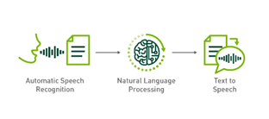
Method and Methodology:
4) System Calls- System calls take a programmatic approach where a computer program requests services from the running operating system kernel.B. Penetrating the hard fragment, creating and running new processes, and communicating with the process diary. It provides an important interface between processes and the operating system.
5) Google Text- to- Speech- Text-to- Speech is principally used to convert speech from textbook handed by the user. In other words, the TTS machine converts the written form of the textbook into phonemic representations, also converts the phonemic representations into waveforms to induce tones. TTS has evolved significantly and comes with a variety of languages offered by third- party providers.

Slide 8
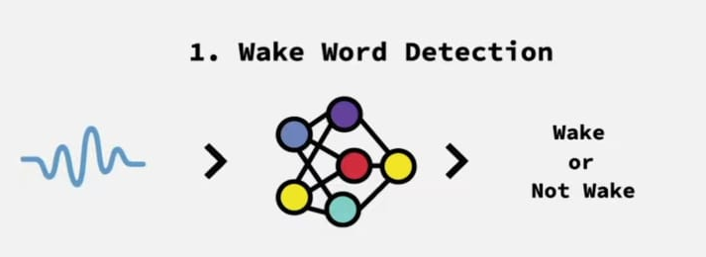
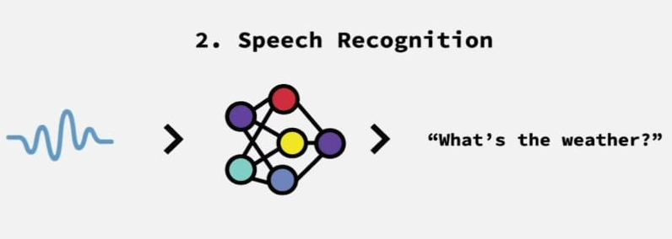
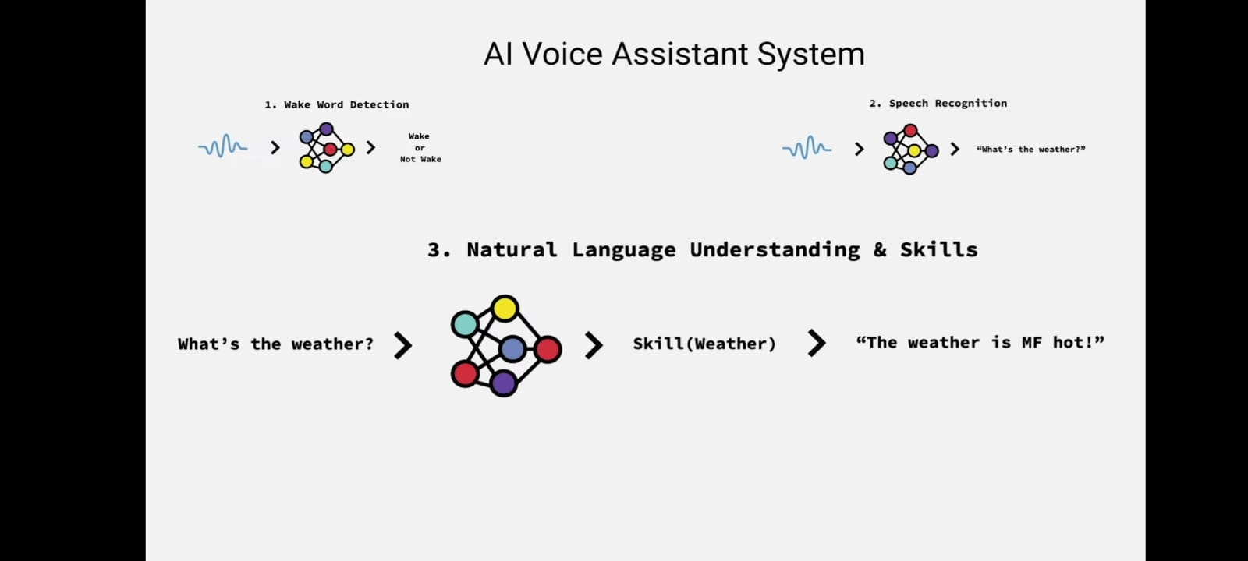
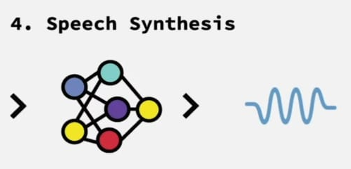
VOICE ASSISTANT SYSTEM – FLOW CHART
This is used to wake up the AI ,
Like “hey siri” or “hey google”.
This takes in a voice query and transcribed that into text.
It enables the program to perform specific task.
This helps to map the transcribed texts to some skill , which returns with a response.

Slide 9
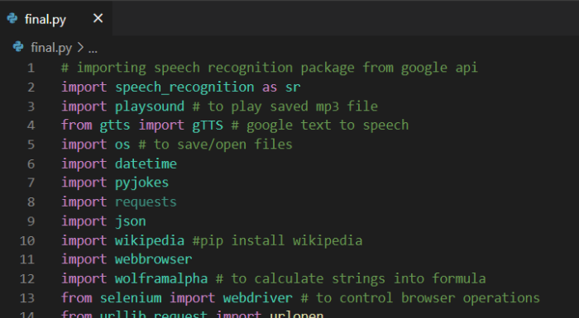

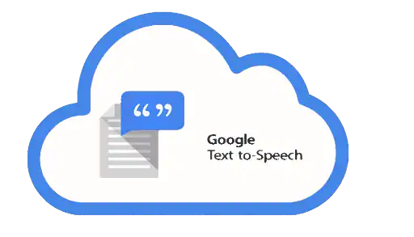
Model Analysis
1.) Speech recognition- Speech recognition means that when humans are speaking, a machine understands it. In our project we are using Google Speech API in Python to make software which is used to run machines on command.
2.) gTTS- Google’s text-to-speech packages converts your audio questions command to text. The response from the look-up function that you write for fetching answer to the question or command is converted in an audio form by gTTS. This package interface with Google Translate’s API.

Slide 10
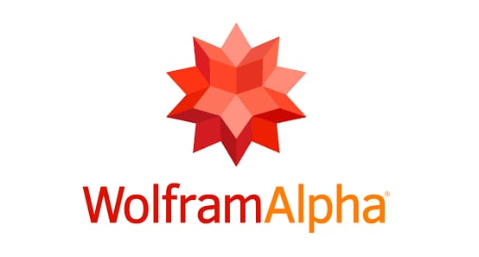
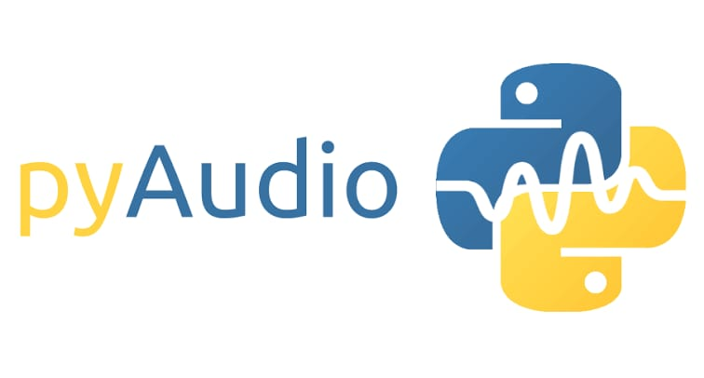
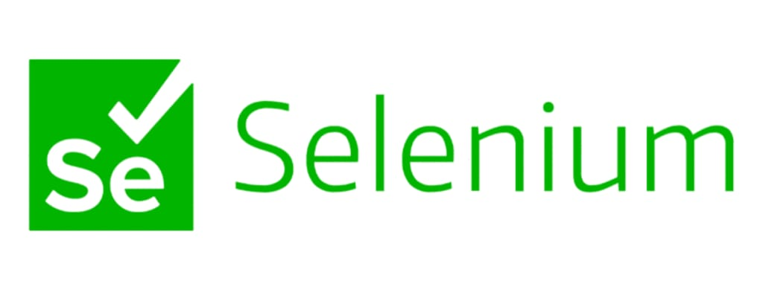
3.) WolframAlpha- It is used to compute expert-level answers of any command using Wolfram’s algorithms, knowledgebase and AI technology. It answers factual queries by computing answers from externally sourced data.
4.) Pyaudio- PyAudio provides Python bindings , the cross-platform audio I/O library. With PyAudio, you can easily use Python to play and record audio on a variety of platforms, such as GNU/Linux, Microsoft Windows, and Apple macOS.
5.) Selenium WebDriver - WebDriver is a web framework that permits you to execute cross-browser tests. This tool is used for automating web-based application testing to verify that it performs expectedly. Selenium WebDriver allows you to choose a programming language to create test scripts .

Slide 11


BUDGET DETAILS
Placement Data Structure and Algorithm course by APNA COLLEGE worth Rs 5000/- .
Coding blocks course Worth Rs. 3500/.

Slide 12
References
[1] F. L. I. Dutsinma, “A systematic review of voice assistant usability,” A springer nature journal, p. 23, 2022.
[2] Dr.S.Brindha, "Intelligent AI based voice assistant," International Journal of creative research thought (IJCRT), vol. 10, no. 6, pp. 1-5, 6 June 2022.
[3] V. K. Dhanraj, "Research paper on Desktop Voice Assistant," International Journal of Research in Engineering and sciences (IJRES), vol. 10, no. 2, pp. 15-20, 2022.
[4] N. Arora, "Geek for Geeks," 6 April 2020. [Online]. Available: https://www.geeksforgeeks.org/selenium-basics-components-features-uses-and-limitations/.
[5] "JAVA T POINT," [Online]. Available: https://www.javatpoint.com/python-tutorial

