Slide 1
Entropy

Slide 2
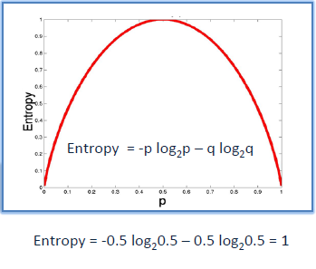

Slide 3
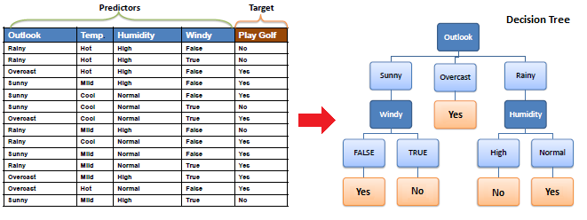

Slide 4
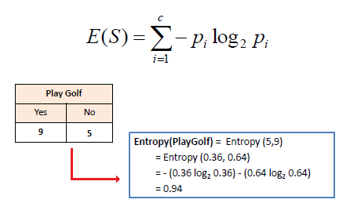

Slide 5
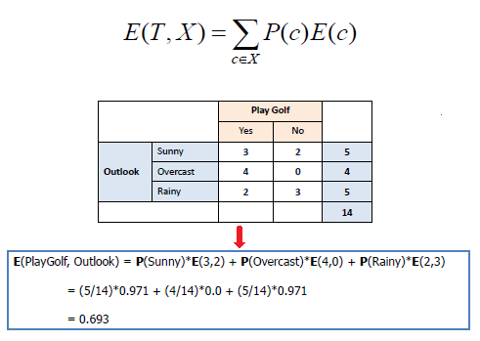

Slide 6
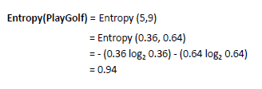
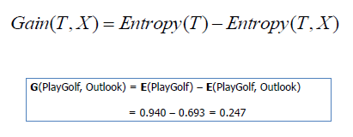
Information Gain

Slide 7
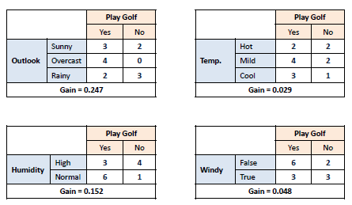

Slide 8
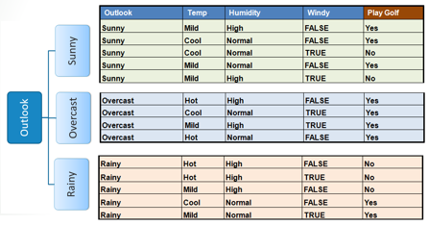

Slide 9
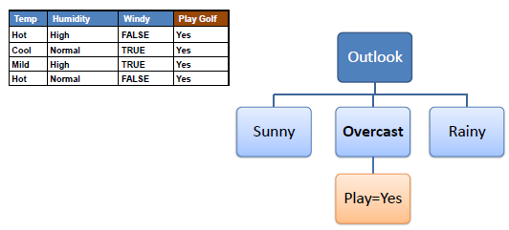

Slide 10
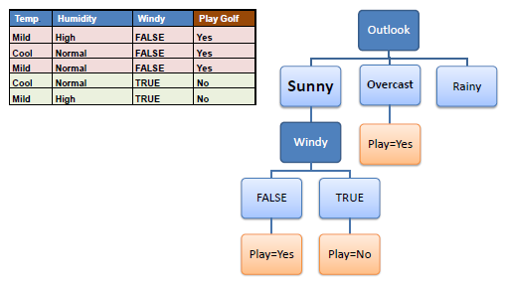

Slide 11
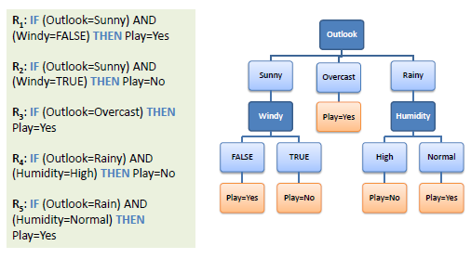

Slide 12
Entropy:
The entropy measures the expected uncertainty in X.
Conditional entropy:
H(X|Y ) is the entropy of one random variable conditional upon knowledge of another.
Mutual information:
We call the reduction in uncertainty mutual information.
I(X; Y ) = H(X) − H(X|Y )
the maximum rate of transmission over a given channel p(Y |X), such that the error probability goes to zero, is given by the channel capacity: C = max p(X) I(X; Y )
Theorem Relationship between mutual information and entropy
I(X; Y ) = H(X) − H(X|Y )
I(X; Y ) = H(Y ) − H(Y |X)
I(X; Y ) = H(X) + H(Y ) − H(X, Y )
I(X; Y ) = I(Y ; X) (symmetry)
I(X; X) = H(X) (“self-information”)

Slide 13

Relative entropy :
A very natural way to measure the distance between two probability distributions is the relative entropy, also sometimes called the Kullback-Leibler divergence.

Slide 14

Relative Entropy is related to the mutual information in the following way
In the case of continuous random variables,

