Slide 1
Development of a machine learning-based web application to predict health risks AND GIVE THE SUGGESTION OF THE RATE OF POLICY.
MINI PROJECT
BY : SUNDAY_ENGINEER’S
Kalinga Institute of Industrial Technology

Slide 2
PRESENTED BY:
SUNDAY_ENGINEER’S
LEADER : | HARSH RAY (ROLL NO : 22052297)
CO-LEADER : | GAURAV KUMAR(ROLL NO : 2205209)
MEMBER 1 : | HARSH RAJ(ROLL NO : 22051681)
MEMBER 2 : | AMAN KUMAR(ROLL NO : 22051663)
MEMBER 3 : | AAKASH RAJ(ROLL NO : 2205695)
MEMBER 4 : | KANISHKA MUDGAL(ROLL NO : 22053960)
Más información: SLIDESGO | SLIDESGO SCHOOL | FAQS
Visita nuestros proyectos: FREEPIK | FLATICON | STORYSET | WEPIK | VIDFY

Slide 3
Development of a machine learning-based web application to predict health risks AND GIVE THE SUGGESTION OF THE RATE OF POLICY.
Introduction
Overview: Development of a machine learning-based web application to predict health risks.
Motivation: Early detection of potential health issues can lead to timely interventions.
Problem Statement: How can machine learning models predict health risks based on user inputs?

Slide 4
gOALS
01
02
03
Develop an application that predicts health risks using user data.
Compare the performance of multiple machine learning models.
Deploy a user-friendly web interface for predictions.

Slide 5
System Architecture Overview

Slide 6
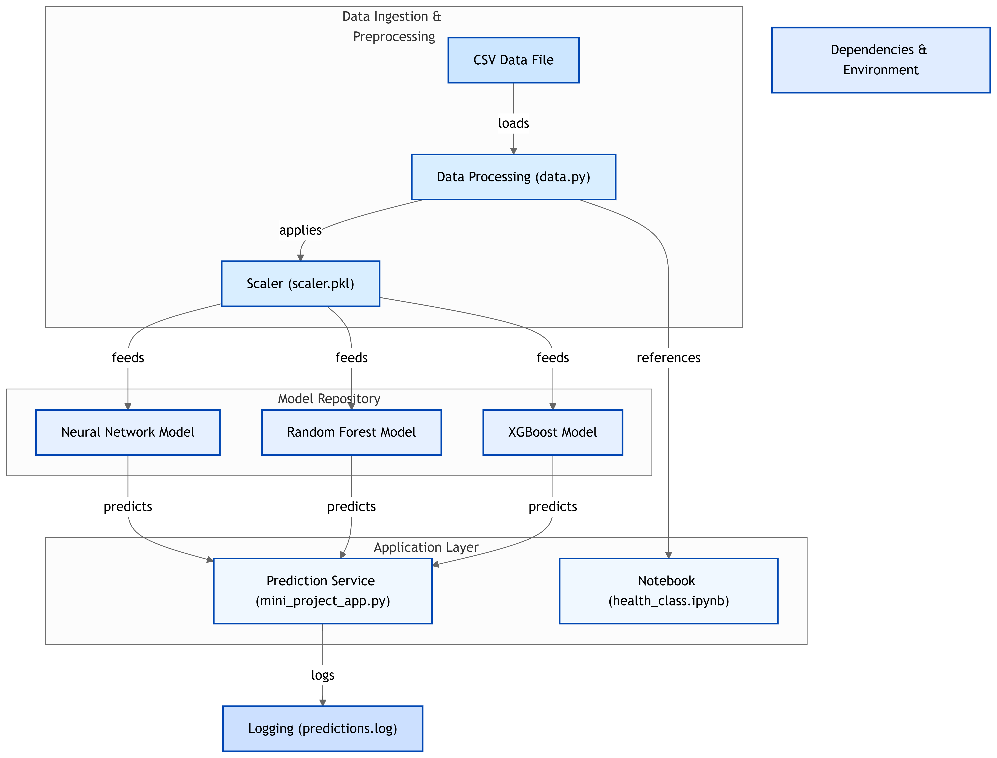

Slide 7
—ALGUIEN FAMOSO
“Esta es una cita. Son palabras llenas de sabiduría que alguien importante dijo y que pueden inspirar a quien las lea”

Slide 8
Dataset Description
Dataset Used
Features:
Data Type:
Age, BMI, blood pressure, lifestyle choices, etc.
Classification labels indicating health risk levels.
health_risk_dataset.csv

Slide 9
Data Ingestion & Preprocessing
Script:
Processes:
data.py
Loading data from CSV.
Handling missing values.
Encoding categorical variables.

Slide 10
Feature Scaling
Importance:
Method:
Scaler Used:
scaler.pkl
Standardizes data to improve model performance.
StandardScaler from scikit-learn.

Slide 11
Models Implemented:
models Implemented:
Neural Network
Random Forest
XGBoost
random_forest_model.pkl
xgboost_model.pkl
neural_network_model.h5

Slide 12
02
NUESTROS PROFESORES
NUESTROS
PROFESORES
Describe en qué consiste esta sección si lo necesitas

Slide 13
Neural Network Model
Architecture:
Performance
Input Layer:
Hidden Layers:
Output Layer
Accuracy, Precision, Recall

Slide 14
Random Forest Model
Parameters:
Feature Importance
PErformance
This is calculated based on how much each feature decreases impurity (e.g., Gini or entropy) across all decision trees in the forest.
[precision :99%
recall : 100%
f1-score : 100%]

Slide 15
Service
Prediction

Slide 16
XGBoost Model
Boosting Technique:
Hyperparameters
Performance
Learning rate, max depth, number of estimators.
Gradient Boosting
[Accuracy, Precision, Recall]

Slide 17
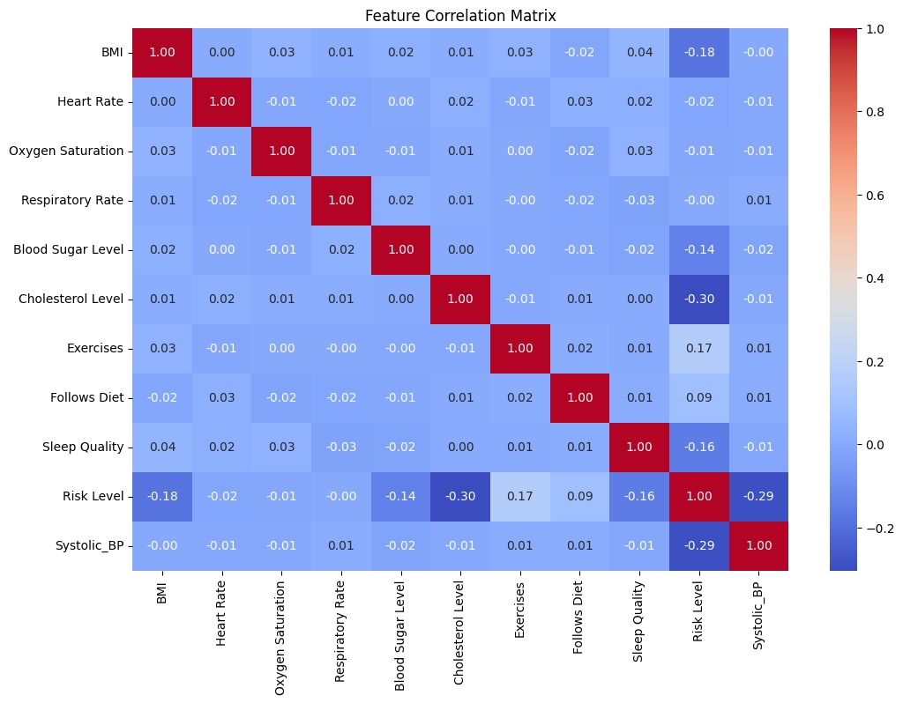
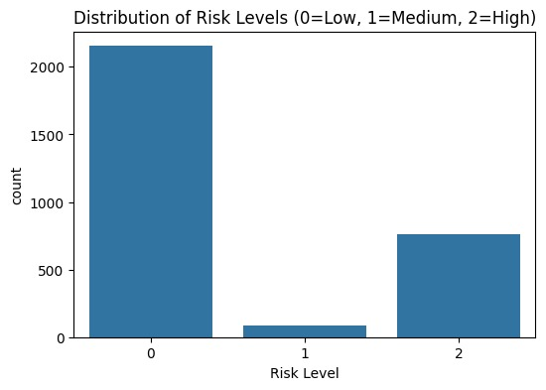
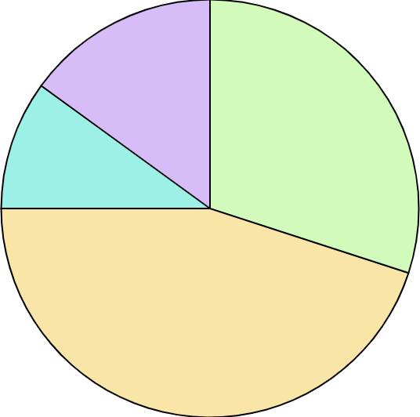
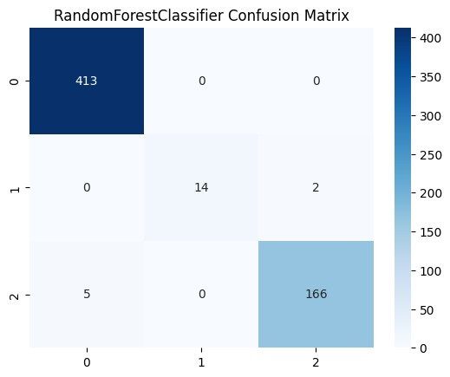
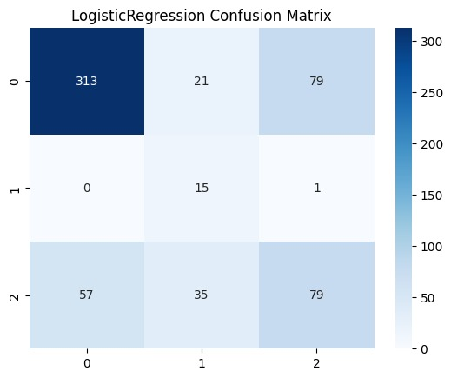
eda graphs
15%
30%
10%
45%

Slide 18


flow chart

Slide 19
Dependencies & Environment
Python Version
[Version Used]
Required Libraries
Listed in requirement.txt

Slide 20
Challenges Faced
Sl no. | challenges | technique
1 | Data Quality | Handling missing or inconsistent data entries.
2 | Model Performance | Balancing bias and variance.
3 | Deployment | Ensuring the application runs smoothly across different environments.

Slide 21
Future Work
Develop a graphical user interface using Streamlit or Flask.
Integrate additional health indicators
Implement real-time data processing capabilities.

Slide 22
Conclusion & Q&A
Successfully developed a machine learning application for health risk prediction.

