Slide 1
Claims Adjudication Agent
CA-3 | AGENTIC AI | DOMAIN-SPECIFIC PROOF OF CONCEPT
Five cooperating software agents decide whether to pay a health-insurance claim, and know when to ask a human
1
Planner
2
Extractor
3
Executor
4
Critic
5
Decision
GROUP MEMBERS
Harsh Salunkhe
Dharna Sharma
24070126066
24070126053
Notes:
Introduce yourselves and the project in one breath: five software agents that make the first decision on a health-insurance claim, and hand the doubtful ones to a person. About 15 seconds.

Slide 2
Manual claim review is slow, uneven and costly
~25 min
assumed manual first-pass time for one claim
Why this domain suits agents
1
Rule-heavy
waiting periods, sub-limits, exclusions
15
policy clauses an officer applies by hand
Document-heavy
itemised bills and discharge summaries
2
3
Errors are costly
wrong payouts and missed fraud
Varies
two officers can decide the same claim differently
4
Needs an audit trail
every decision cites a clause
Domain: health insurance claims, in the back office of an insurer or TPA
Notes:
About 40 seconds. When you are treated in hospital, the hospital sends the insurer a claim. Someone has to decide whether to pay, how much, or whether it looks wrong. That is rule-heavy and document-heavy work, mistakes are expensive, and every decision must be explainable. The 25 minute figure is our assumption, not a measured number.

Slide 3
Five agents in a loop, not a pipe
1
Planner
2
Extractor
3
Executor
4
Critic
5
Decision
Chooses a quick or thorough check from claim risk
Reads the summary, with a local language model
Runs checks with Python tools
Re-verifies maths, limits, fraud cover
Applies precedence, cites clauses
REPLAN: add checks or recompute, max 2 rounds
Executor tools: documents, policy status, waiting periods, exclusions, duplicates, filing window, procedure match, bill integrity, high value, tariff check, fraud score, payout
Plus a local language model (Ollama, llama3.2:3b) and synthetic policy, member and hospital stores.
Notes:
About 40 seconds. Walk left to right. The key idea is the dashed arrow: the Critic can send the claim back to the Planner, so this is a loop and not a straight pipe. The Planner keeps cheap claims on a quick plan and only adds fraud checks when risk shows up. If the Critic notices a risk the plan missed, or a wrong calculation, it triggers a re-plan, at most two rounds, then escalates to a human.

Slide 4
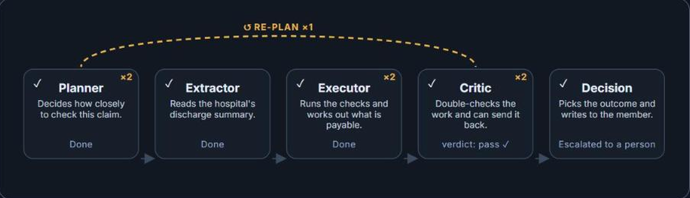
Watch it run: the Critic sends a claim back
1
A small claim at a normal hospital gets a quick plan, with no fraud check.
2
The Critic spots a bill 2.4 times the normal cost and sends it back (dashed arrow).
3
Second round adds the fraud check. Score 60 out of 100, so a person decides.
Notes:
About 40 seconds. This is a screenshot of our live app on claim CLM-26-0019. Point at the dashed arrow and the RE-PLAN 1 counter: the Planner and the Critic each ran twice. The quick plan skipped the fraud check because the claim looked small and normal. The Critic noticed the price was about 2.4 times the normal cost, so it sent the claim back, and the second round ran the fraud check.

Slide 5
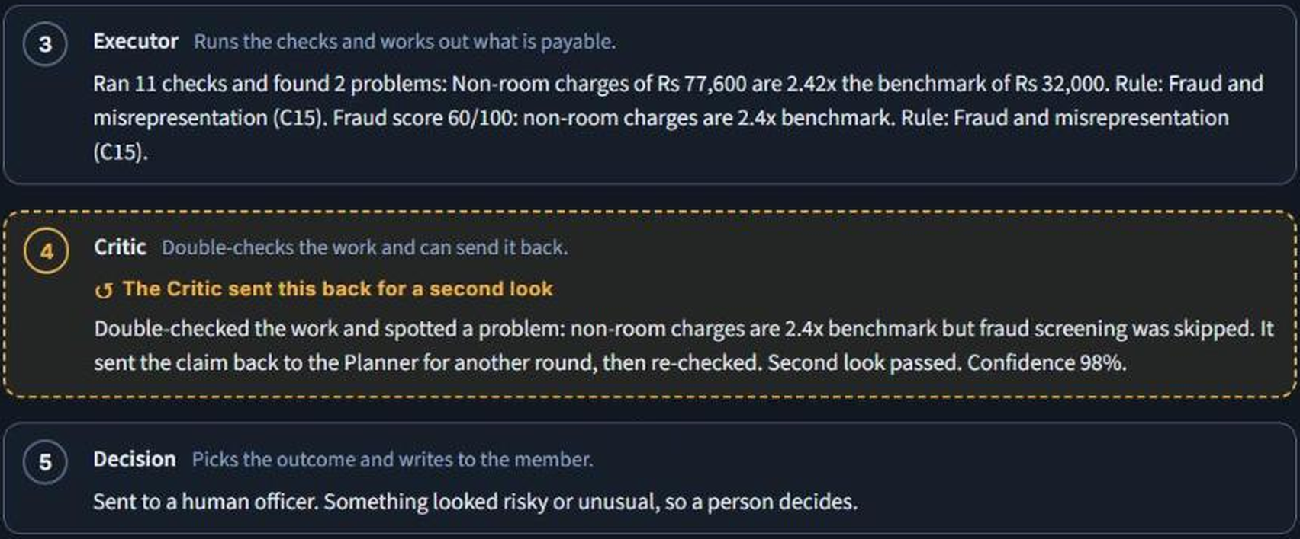
The app explains every decision in plain English
Live app, claim CLM-26-0019. Each outcome comes with its reason and the policy rule behind it.
Notes:
About 30 seconds, then switch to the live app and run the demo. Every outcome comes with a plain-English reason and the policy rule behind it, which is the audit trail. The gold box is the moment the Critic sent the claim back.

Slide 6
Decisions follow a fixed precedence
1 REJECT
hard rule broken: waiting period, exclusion, lapsed policy, duplicate
C
What the Critic re-checks
2 QUERY
mandatory document missing or unreadable
Payout reconciles with deductions
Within claim and sum insured
Every finding cites a real clause
Extraction agrees with the form
Fraud screening matched the risk
3 ESCALATE
fraud score 60+, tampered bill, mismatch, high value, late filing
4 PARTIAL
deductions apply: room rent, sub-limit, co-pay, non-medical
Any failure sends the claim back to the Planner. After two rounds it goes to a human.
5 APPROVE
every check passed, no deduction
Notes:
About 30 seconds. Read the ladder top to bottom: a hard rule failure always wins, then missing documents, then risk flags, then deductions. Every outcome cites policy clause ids. The Critic on the right is a separate validator that recomputes the payout and asks whether the fraud screening matched the risk.

Slide 7
First, hardening the rules with noisy claims
89/89
main labelled set
23/23
boundary cases, e.g. 29 vs 30 days
94.8%
on unseen abbreviations, 23 of 240 risky claims wrongly paid
UNSEEN rows were added after the fixes, so they have no first-run bar.
Notes:
About 50 seconds, and be candid. The main set scores 89 of 89, but its labels come from the same design as the rules, so that proves coverage, not real-world accuracy. So we built a harder test: 445 held-out claims, five kinds of noise, and 23 boundary cases. The first run, the grey bars, exposed real weaknesses and we fixed them. The two UNSEEN rows were added after the fixes and were not tuned against. Clinical abbreviations like TKR or k/c/o DM-2 are still a real gap: 23 risky claims slipped through. That motivates a language-model extractor.

Slide 8
Then a real language model closes the gap
Abbreviations
5 to 0
risky claims wrongly paid, of 48
Telegraphic notes
8 to 0
risky claims wrongly paid, of 48
Needless holds
0
of 164 payable claims held by mistake
Same 89 claims for both columns. The model's prompt was tuned on other claims; telegraphic notes were written after tuning.
Notes:
About 50 seconds. Same claims, same rules, two ways of reading the discharge summary. The grey bars are the rules-only parser; the green bars add the local language model. On shorthand like abbreviations and telegraphic notes, the model reads what the parser cannot, and the number of risky claims wrongly paid falls. The third card is the safety check: a model can also invent a condition that is not there and cause a wrongful hold, so we count those too. The model must quote the summary, and we verify the quote, which is what keeps that number low.

Slide 9
Limitations and what comes next
Limitations
Future scope
All data is synthetic and the summaries are templated
Clinical abbreviations can hide a pre-existing condition
Fraud weights and tariffs are hand-set, not learned
The 25-minute manual baseline is an assumption
Language-model extractor for real, messy documents
OCR for scanned bills and summaries
Strict mode: hold any claim whose history cannot be verified
Learn fraud weights from real outcomes, with human review feedback
Notes:
About 30 seconds. Limitations first, because the evaluators will ask. The abbreviation gap is the one we know about and measured. The next step is a language-model extractor, which our pluggable model layer already supports, plus a strict mode that trades more manual reviews for fewer missed pre-existing conditions.

Slide 10
Thank you
Questions welcome
GROUP MEMBERS
Harsh Salunkhe
Dharna Sharma
24070126066
24070126053
Code: github.com/HarshSalunkhe2005/claims-adjudication-agent (full code also submitted as a zip)
Runs on a laptop: local language model through Ollama, no cloud services
Notes:
Close, then take questions. Both members should be ready to answer on any slide.

Slide 11
Appendix: the four demo claims
CLM-26-0001
PARTIAL
CLM-26-0007
REJECT
Room rent above the plan cap
Pre-existing condition inside 24 months
Proportionate deduction, clause C6
Early exit, remaining checks skipped, clause C3
CLM-26-0019
ESCALATE
CLM-26-0003 + error
APPROVE
Quick plan misses an inflated bill
Executor overpays by 15% on purpose
Critic sends it back, fraud score, human review
Critic catches it, recomputes, passes
Notes:
Backup slide. In the live app these are the demo buttons: part payment, rejection, the second-look loop, and the simulated calculation error.

Slide 12
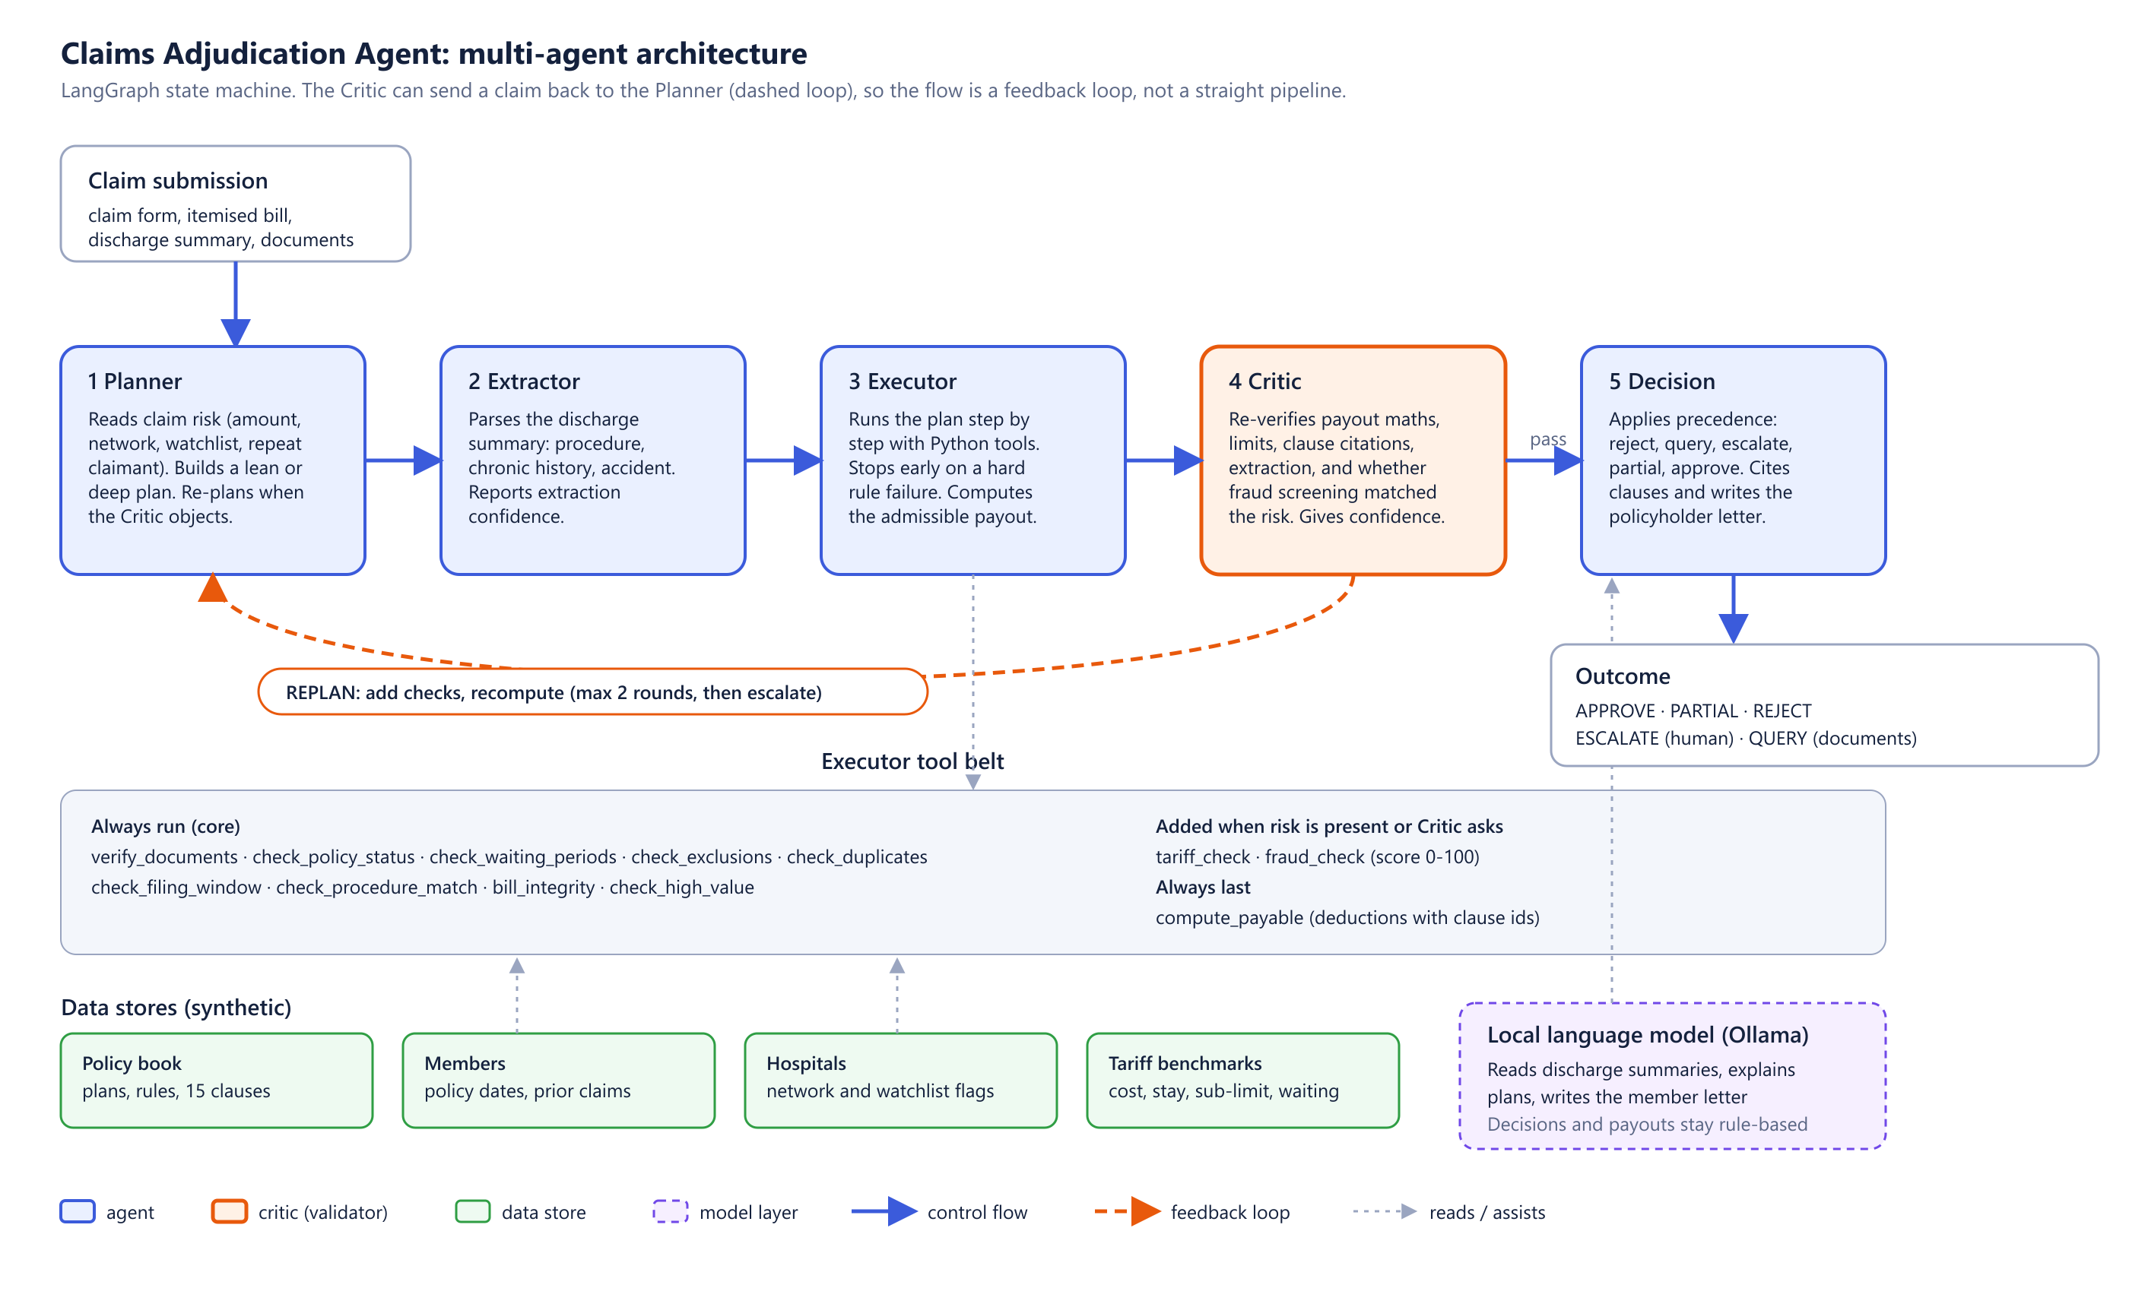
Appendix: full architecture diagram
Notes:
Backup slide with the complete architecture: agents, tool belt, data stores, model layer and the feedback loop.

