Slide 1
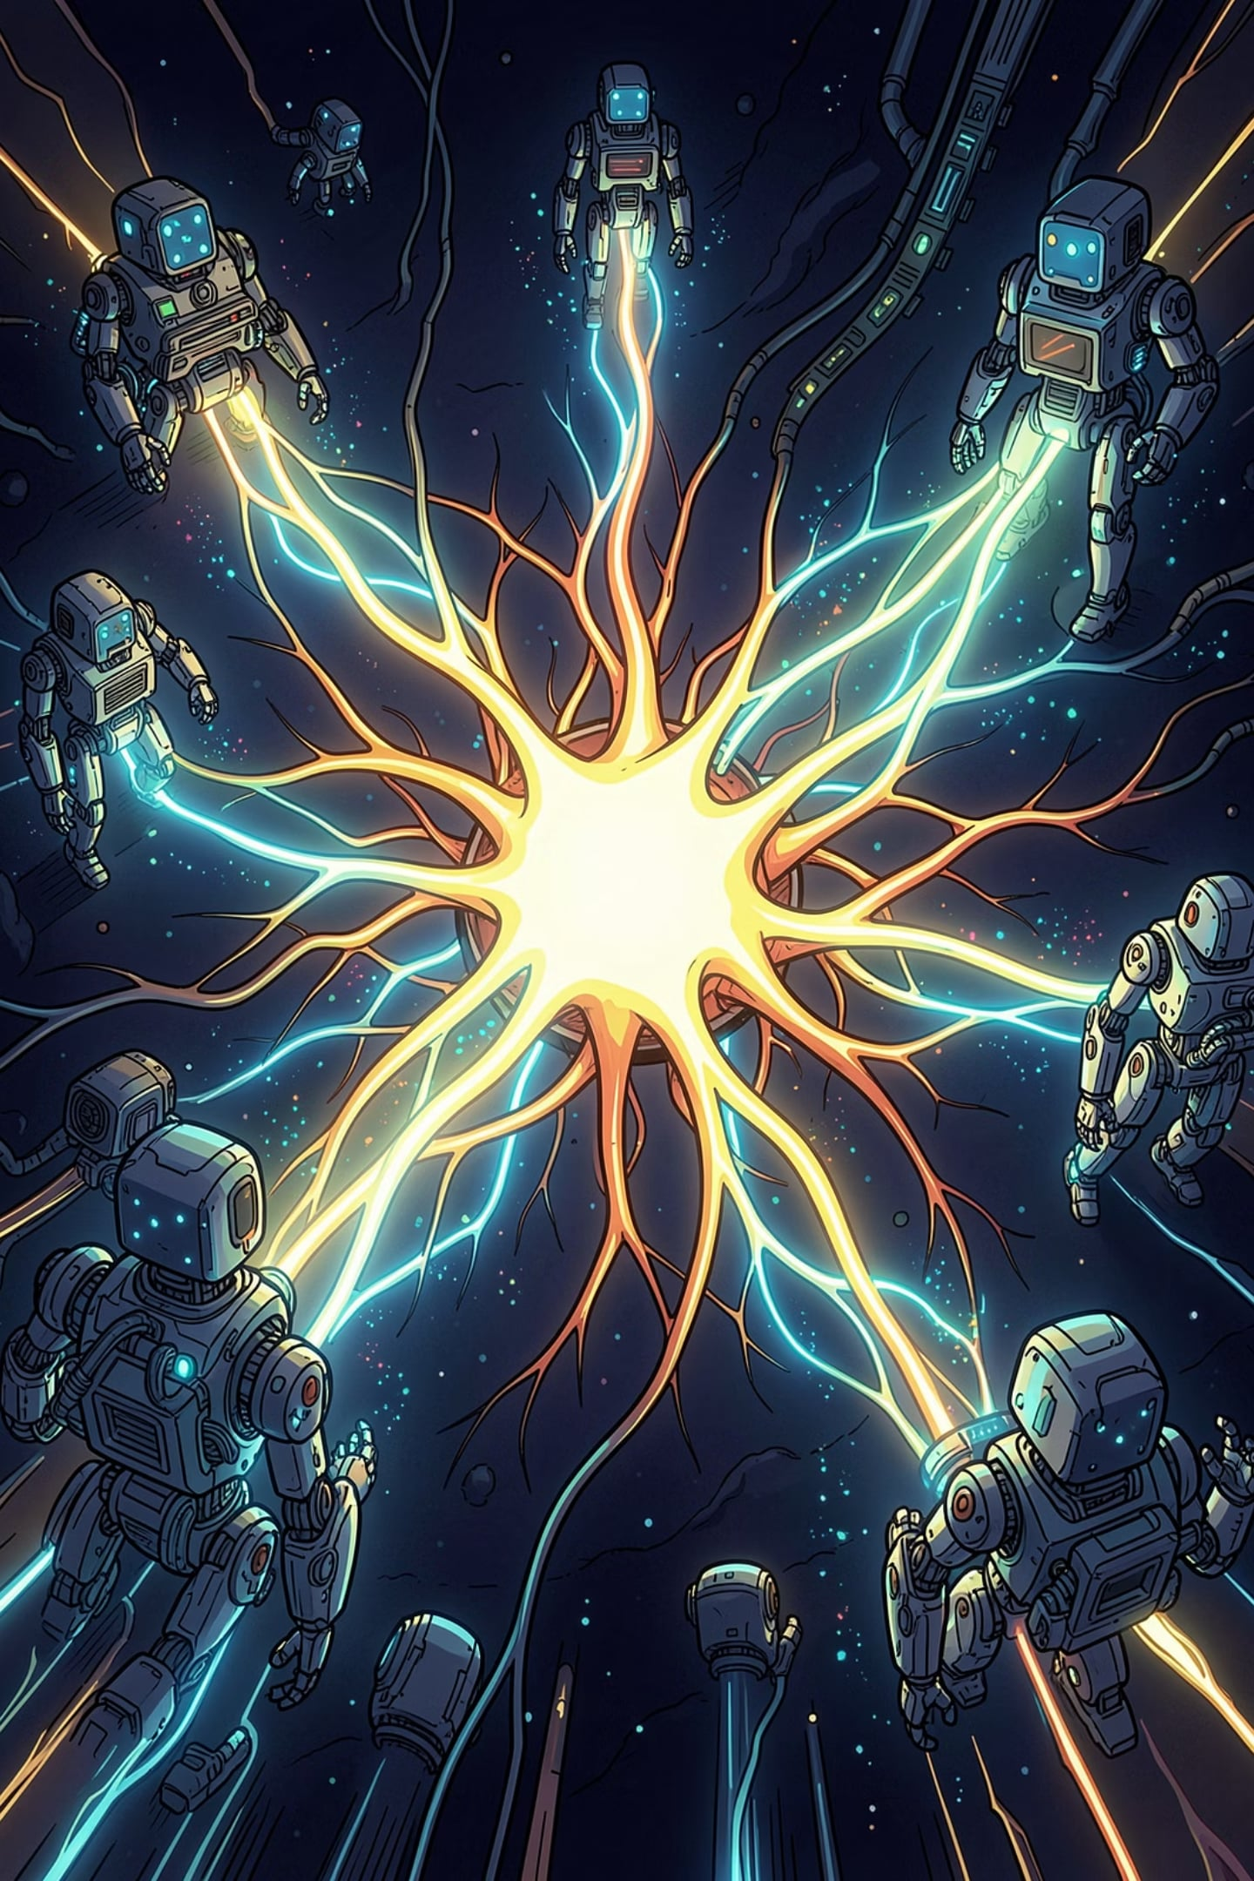
Agentic AI: Building Intelligent Autonomous Systems
From Deep Learning → Generative AI → Agentic AI — a course designed to take you from understanding how AI thinks to building systems that act, plan, and collaborate.
SEMESTER V · COMPUTER SCIENCE ENGINEERING

Slide 2

Why Agentic AI?
AI is no longer just reactive — it now plans, decides, and acts. Organizations are deploying autonomous agents to automate complex workflows, collaborate with humans, and operate at scale.
Autonomy
Collaboration
AI systems plan and execute tasks without step-by-step human guidance.
Agents work alongside humans and other AI agents to solve complex problems.
Adoption
ChatGPT, Claude, Gemini, Copilot, Perplexity — agentic AI is already in production.

Slide 3

What Is This Course About?
This course covers the concepts, architectures, reasoning strategies, memory systems, and deployment methods used to build intelligent autonomous AI agents.
You will learn how modern AI assistants work — and how to design, evaluate, and deploy safe, reliable, and scalable agentic AI systems.
Intelligent Agents
LLMs & RAG
Multi-Agent Systems
AI Safety

Slide 4
Learning Objectives
By the end of this course, you will be able to:
01
02
03
Understand Intelligent Agents
Build LLM-Powered Reasoning Agents
Design Memory-Enabled AI
Grasp autonomous systems, agent architectures, and environment interaction.
Implement RAG pipelines and vector databases for knowledge grounding.
Apply chain-of-thought, ReAct, and planning strategies.
04
05
Develop Multi-Agent Systems
Evaluate Safe & Responsible AI
Coordinate collaborative agents using MCP and role-based architectures.
Assess reliability, security, bias, and ethical governance.

Slide 5





Prerequisites
Programming
Python basics — variables, loops, functions, and libraries.
AI & Deep Learning
Machine learning fundamentals and neural network basics.
NLP Basics
Tokens, embeddings, and a working understanding of language models.
Mathematics
Basic linear algebra and probability concepts.

Slide 6






Complete Course Roadmap
Five units, one mini-project, and a final assessment — each unit builds on the last.
Unit 1
Unit 2
Unit 3
Intelligent Agents & Agentic AI
LLM Strategies & Reasoning
RAG & Agent Memory
Unit 4
Unit 5
Multi-Agent Systems & MCP
Evaluation, Safety & Governance
Key Message: Each unit builds on the previous one — from understanding agents → reasoning → memory → collaboration → safety.

Slide 7
Unit 1 & Unit 2 at a Glance
Unit 1 — Intelligent Agents
Unit 2 — LLM Strategies
Agent–Environment Interaction
Perception–Reasoning–Action Cycle
LLM-Powered Agent Architectures
Design Patterns & Applications
Chain-of-Thought, Tree-of-Thought, Self-Consistency
ReAct Framework & Observation–Action Cycle
Task Decomposition & Hierarchical Planning
Tool Integration: APIs, Code, Search, Databases
Structured Outputs: JSON & Function Calling
Examples: Robot vacuum, self-driving car, ChatGPT, Alexa

Slide 8
Unit 3 & Unit 4 at a Glance
Unit 3 — RAG & Agent Memory
Unit 4 — Multi-Agent Systems & MCP
Short-Term vs. Long-Term Memory
Document Chunking & Embedding Generation
Vector Databases & Similarity Search
Hybrid Retrieval, Re-Ranking & Multi-Hop
Distributed AI & Collaborative Intelligence
Model Context Protocol (MCP) Architecture
Planner, Research, Executor & Critic Agents
Swarm Intelligence & Emergent Behavior
API Deployment, Monitoring & Scaling

Slide 9

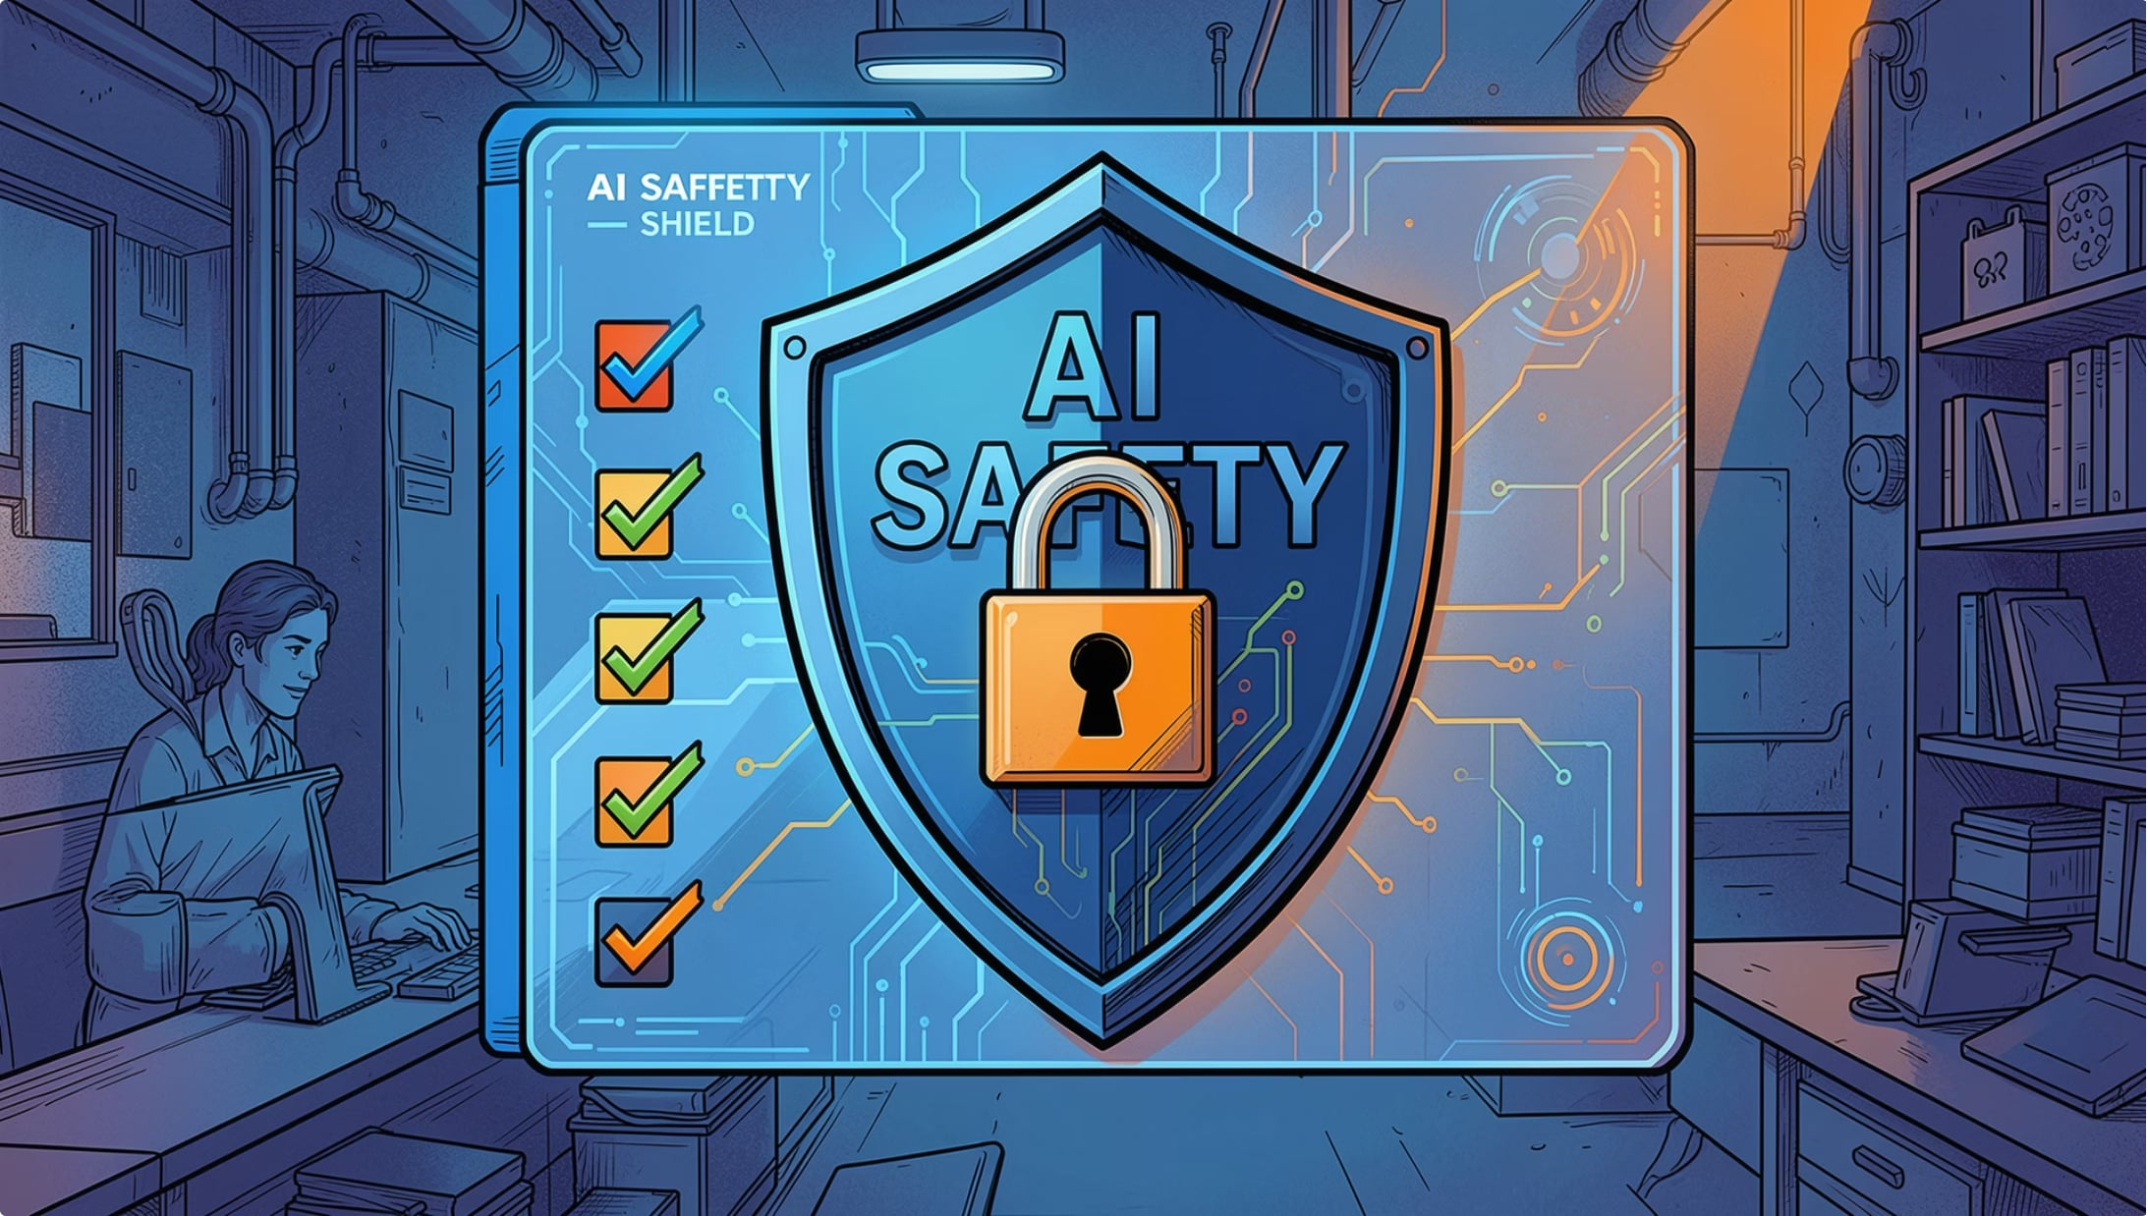
Unit 5 — Evaluation, Safety & Governance
Evaluation Metrics
Task completion, tool efficiency, latency, cost benchmarking.
Hallucination Mitigation
Fact verification and retrieval grounding to reduce errors.
Security & Guardrails
Prompt injection defense, data leakage prevention, tool restrictions.
Responsible AI
Bias mitigation, transparency, explainability, and ethics.

Slide 10


What You Will Gain
🏗️ Build
Design and deploy intelligent AI agents and RAG-powered assistants.
🤝 Collaborate
Develop multi-agent systems using MCP for real-world coordination.
🔒 Secure
Evaluate AI systems for safety, reliability, and ethical governance.
🚀 Launch
Be ready for roles like AI Engineer, LLM Engineer, or Agentic AI Developer.
Next Lecture: Unit 1 — What is an Intelligent Agent? We begin with agent–environment interaction and the Perception–Reasoning–Action cycle.

