Slide 1
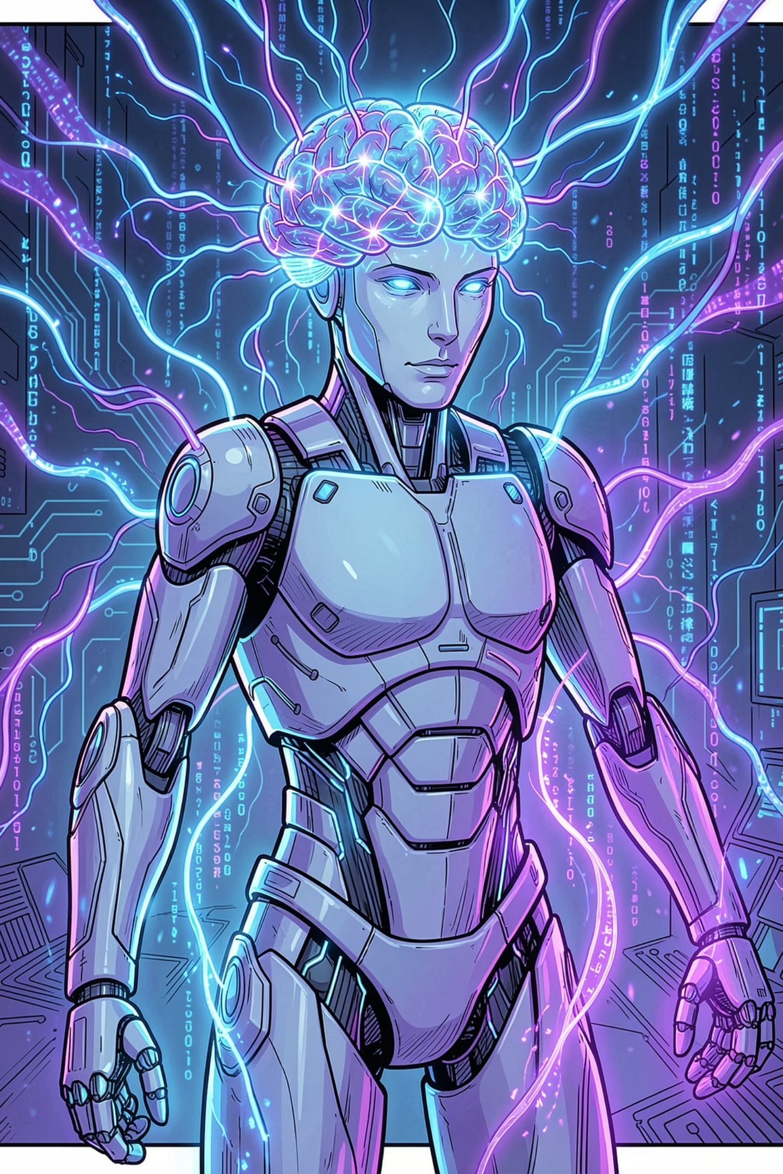
Agentic Artificial Intelligence
UNIT 1 · PART 1
B.TECH CSE · SEMESTER V
Introduction to Intelligent Agents & Autonomous Systems — the foundations of AI that thinks, plans, and acts on its own.

Slide 2
Learning Outcomes
By the end of Unit 1, you will be able to:
01
02
03
Define Intelligent Agents
Explain Autonomous Systems
Classify Agent Types
Understand perception, reasoning, and action.
Describe how systems operate with minimal human input.
Distinguish simple reflex, model-based, goal-based, and utility-based agents.
04
05
Explore Agentic AI
Identify Applications
Understand LLM-powered agents and modern architectures.
Recognize agent applications across industries.

Slide 3





Why Study Agentic AI?
Today's AI is moving beyond chatbots. Modern agents think, plan, use tools, and make decisions — Agentic AI is the next frontier.
Rule-Based AI
Fixed logic
Machine Learning
Learns from data
Deep Learning
Neural networks
Generative AI
Creates content
Agentic AI
Plans & acts

Slide 4
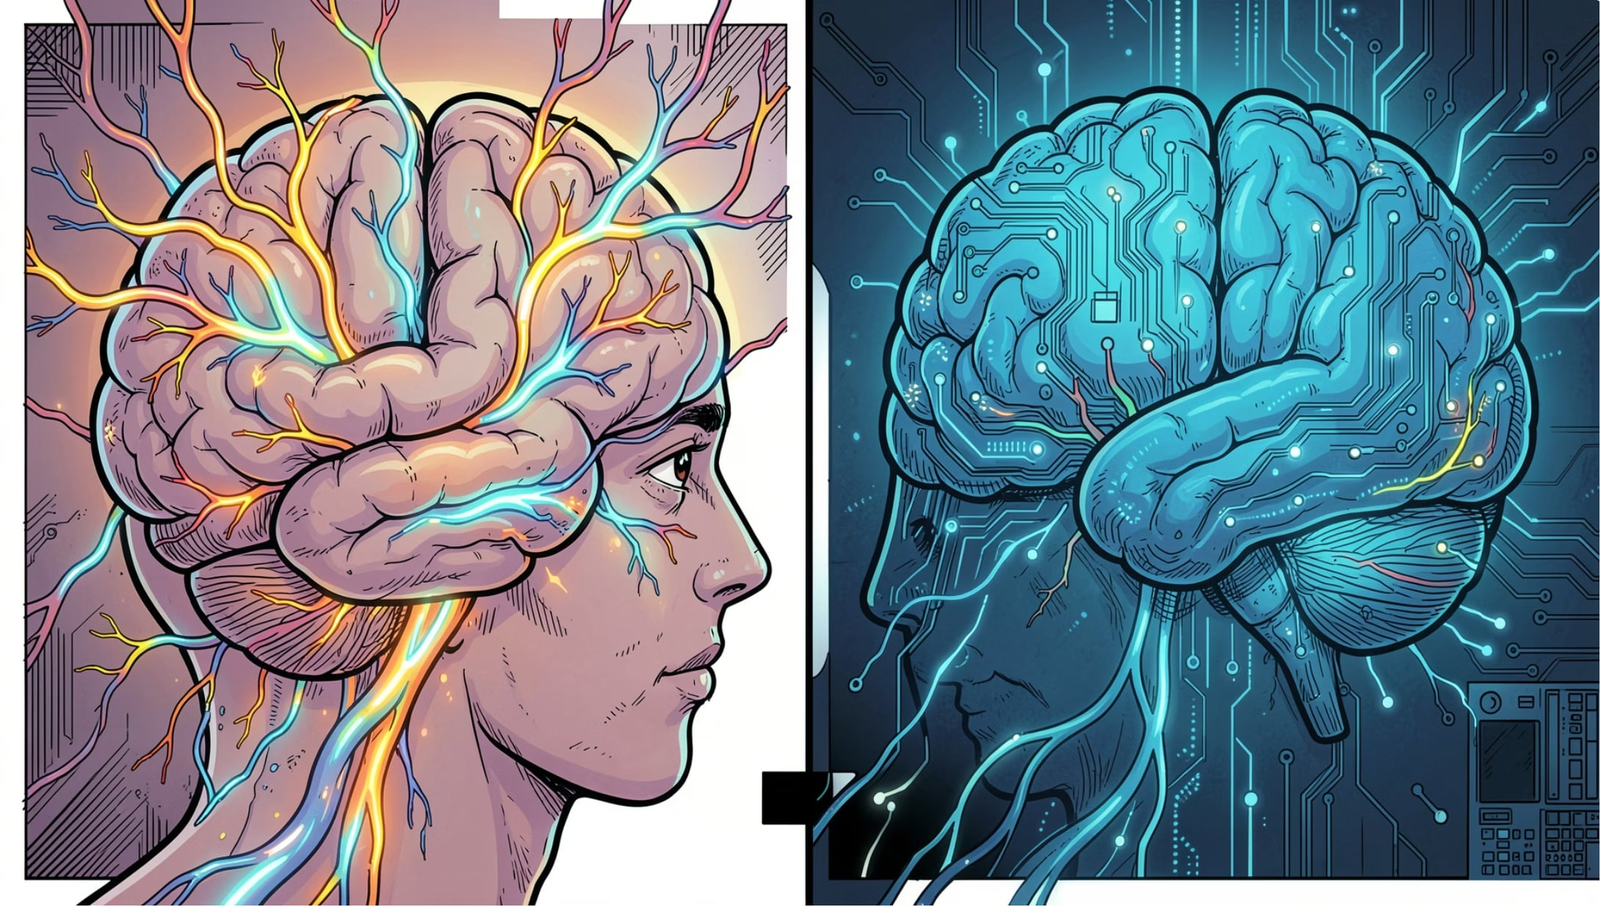

What Is Intelligence?
Human Intelligence
Learns from experience
Understands context and nuance
Thinks logically and creatively
Adapts to new situations
Artificial Intelligence
Learns from data at scale
Performs statistical reasoning
Makes predictions from patterns
Executes tasks autonomously
Core abilities: Learn · Understand · Reason · Solve · Adapt · Decide

Slide 5
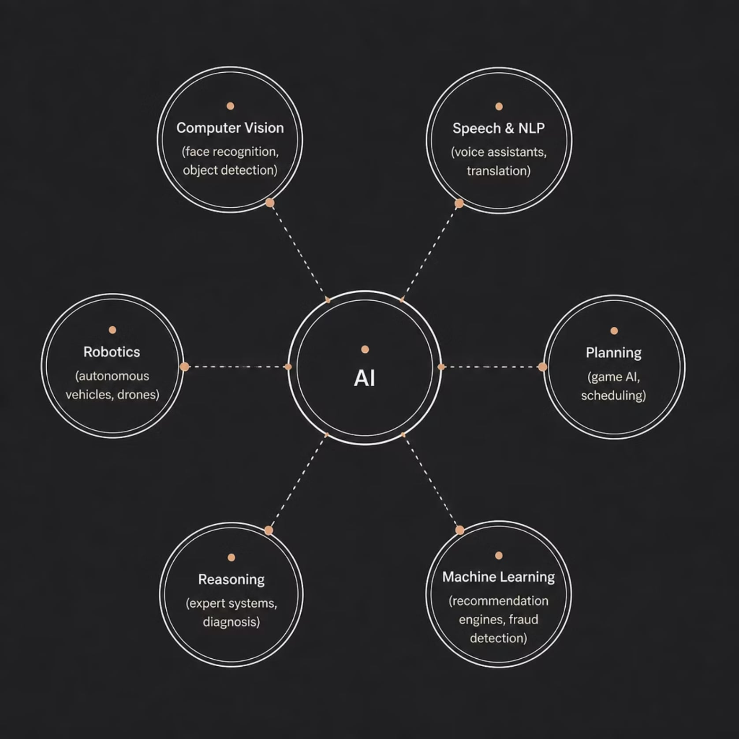
What Is Artificial Intelligence?
AI is the branch of computer science that builds systems capable of performing tasks that normally require human intelligence.
Real-World Examples
Speech Recognition — Siri, Alexa, Google Assistant
Face Recognition — iPhone Face ID, security systems
Recommendation Systems — Netflix, Spotify, Amazon
Self-Driving Cars — Tesla Autopilot, Waymo
Medical Diagnosis — AI radiology, drug discovery

Slide 6
Evolution of Artificial Intelligence
1956 — Birth of AI
1
Dartmouth Conference coins "Artificial Intelligence"
2
1980 — Expert Systems
Rule-based systems for business & medicine
1997 — Deep Blue
3
IBM defeats Kasparov — AI beats humans at chess
4
2012 — Deep Learning
AlexNet wins ImageNet — neural networks surge
2022 — Generative AI
5
ChatGPT, DALL·E — AI creates text & images
6
Today — Agentic AI
Agents that plan, act, and use tools

Slide 7
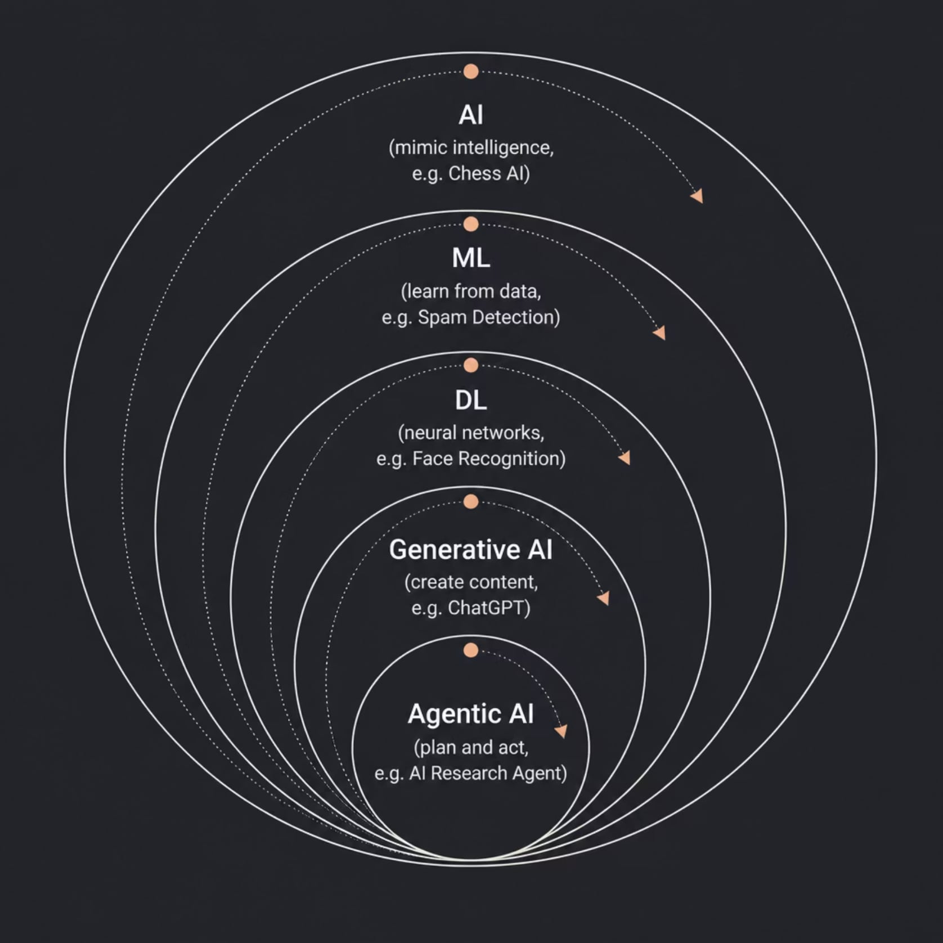
AI → ML → DL → GenAI → Agentic AI
Each layer is a subset of the one before it. Agentic AI sits at the cutting edge — combining reasoning, generation, and action.
How They Relate
AI — Mimics intelligence (e.g., Chess AI)
ML — Learns from data (e.g., Spam Detection)
DL — Uses neural networks (e.g., Face Recognition)
GenAI — Creates content (e.g., ChatGPT)
Agentic AI — Plans and acts (e.g., AI Research Agent)

Slide 8
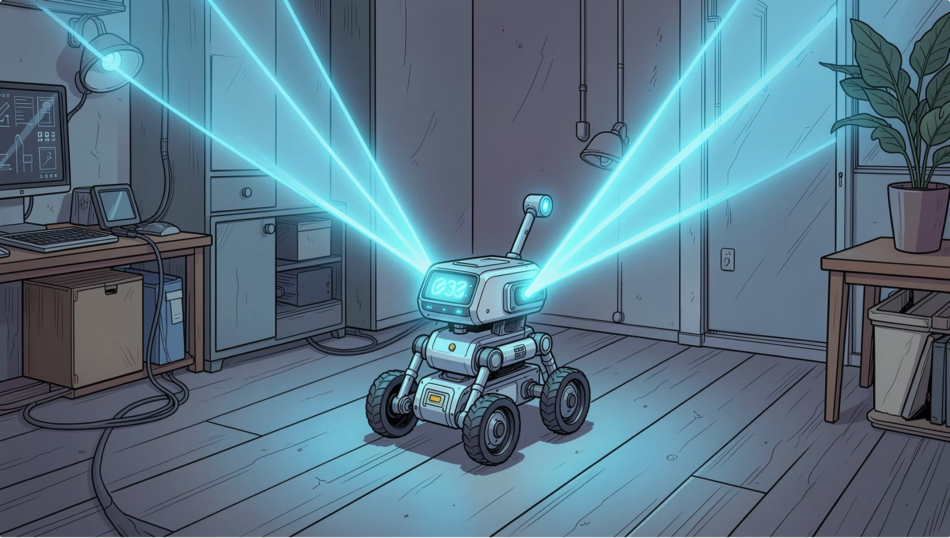

What Is an Intelligent Agent?
Definition
An Intelligent Agent is any entity that perceives its environment through sensors, reasons about what to do, and acts through actuators to achieve its goals.
Agent = Perception + Reasoning + Action
Key Characteristics
Autonomous & Reactive
Proactive & Goal-Oriented
Rational & Adaptive
Capable of Learning
Examples: Robot · Alexa · Siri · Tesla · Drone

Slide 9
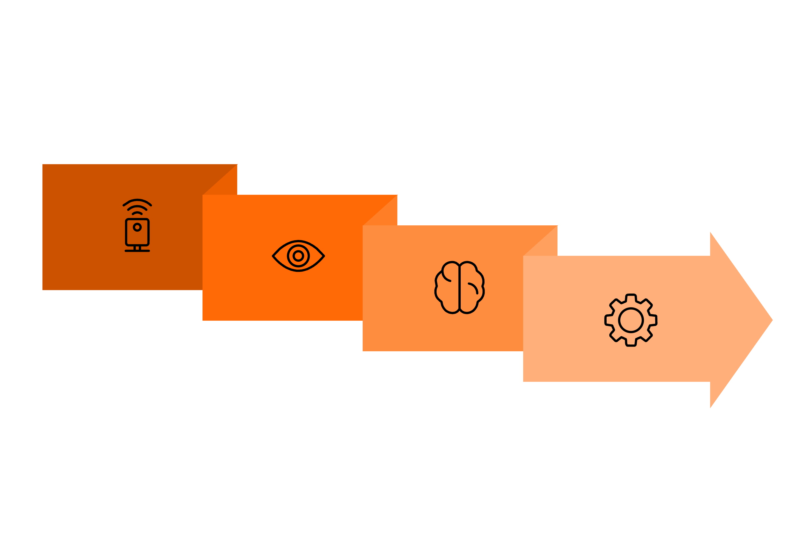
Agent Architecture & Autonomous Systems
Perception
Actuators
Sensors
Reasoning
Sensors feed perception into a knowledge base, reasoning selects the best action, and actuators execute it back on the environment.
Autonomous Systems
Agent vs. Autonomous System
Systems that perform tasks independently with minimal human intervention.
Intelligent Agent
Autonomous System
Self-Driving Cars (Tesla)
Robot Vacuums (Roomba)
Warehouse Robots (Amazon)
Delivery Drones
Makes decisions
Executes tasks
Focus: intelligence
Focus: independence
Often software-only
Usually includes hardware
Uses reasoning
Uses sensors + actuators

Slide 10
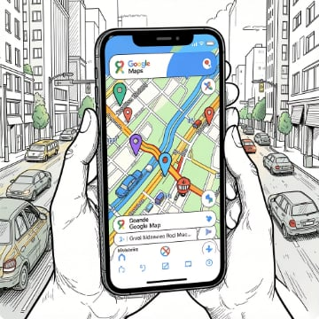



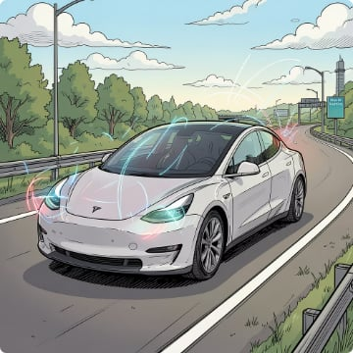


Real-World Agents & Unit 1 Wrap-Up
Google Maps
Netflix
Amazon
ChatGPT
Routes, traffic, ETA
Personalized recommendations
Product recommendations
Conversational AI agent
Tesla
Alexa
Autonomous driving
Voice-controlled assistant
Up Next — Unit 1, Part 2: PEAS Framework · Environment Types · Perception–Reasoning–Action Cycle · Agent Architectures · Industry Case Studies

