Slide 1

UNIT 1 · PART 8
LLM-Powered Agents, Architectures & Applications
How large language models evolve from passive chatbots into autonomous, goal-driven agents capable of reasoning, planning, and acting in the real world.

Slide 2






SLIDE 62
What is an LLM-Powered Agent?
An intelligent system using an LLM as its reasoning engine, combined with memory, planning, and tools to complete tasks autonomously.
LLM
Reasoning Engine
Memory
Understands and generates language
Determines next steps
Stores context across interactions
Tools
Environment
APIs, search engines, calculators
Executes actions in real or digital systems
Key Takeaway: An LLM becomes far more powerful when combined with memory, planning, and external tools.

Slide 3

SLIDE 63
How Does an LLM-Powered Agent Work?
Classroom Example
"Summarize this PDF and email it to my manager."
Reads and parses the PDF
Summarizes key content
Drafts a professional email
Sends it via an email tool
The LLM is the brain; planning, memory, and tools enable real-world action.

Slide 4
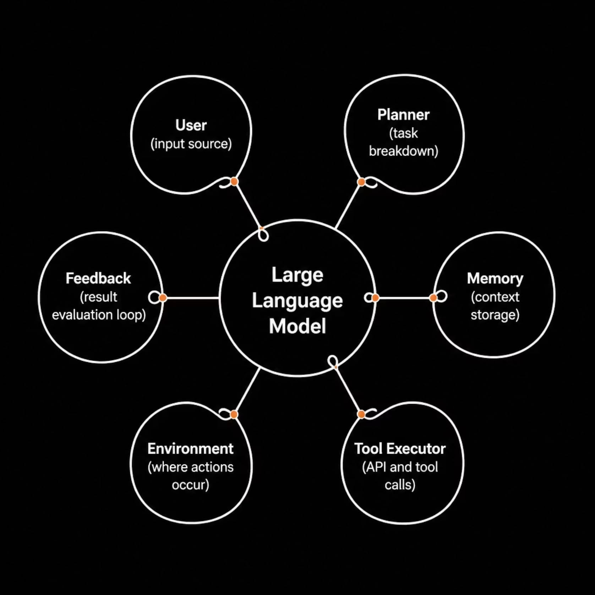
SLIDE 64
Agent Architecture
Agent architecture defines how components collaborate to achieve a goal. Each has a distinct responsibility.
The Core Loop
The LLM sits at the center, orchestrating all components:
Planner breaks goals into sub-tasks
Memory retains context across steps
Tool Executor interacts with external systems
Feedback enables self-correction and refinement

Slide 5







SLIDE 65
Agent Design Patterns
A design pattern is a reusable structure for organizing how an AI agent performs tasks. Different problems demand different designs.
Single-Agent
One agent handles the entire task. e.g., ChatGPT answering a question.
Planner–Executor
One component plans; another executes. e.g., AI project management assistant.
Multi-Agent
Multiple specialized agents collaborate. e.g., AI software development team.
Reflection
The agent reviews its own output before responding. e.g., AI proofreading an essay.

Slide 6




SLIDE 66
Applications of Agentic AI
Virtual Assistants
Research Assistants
Productivity Automation
Siri, Alexa, Google Assistant — answering questions, setting reminders, scheduling meetings, and controlling smart devices.
Automating literature reviews, summarizing papers, comparing documents, and generating structured reports.
Email drafting, calendar scheduling, meeting summarization, report generation, and task management at scale.
Key Takeaway: Agentic AI automates repetitive work and assists users in completing complex tasks efficiently.

Slide 7

SLIDE 67
Industry Applications of Agentic AI
Healthcare
Patient assistance, medical report summarization
Finance
Fraud detection, investment analysis
Education
AI tutors, personalized learning pathways
Retail
Product recommendations, customer support
Logistics
Route optimization, warehouse automation
Manufacturing
Predictive maintenance, quality inspection
Legal
Contract review, legal document summarization
Class Discussion: Which industry will benefit most from Agentic AI, and why?

Slide 8
SLIDE 68
Benefits & Challenges of Agentic AI
Benefits
Challenges
Saves time on repetitive tasks
Supports faster decision-making
Increases overall productivity
Operates continuously without fatigue
Scales to large, complex workloads
Hallucinations and factual errors
Incorrect or unsafe tool usage
Privacy and data security risks
High computational cost
Ethical concerns and data dependency
Key Takeaway: Agentic AI offers significant advantages but must be designed responsibly and evaluated carefully.

Slide 9

SLIDE 69
Summary of Unit 1
From foundational agent theory to modern LLM-powered systems — a complete journey through intelligent agent design.
Intelligent Agents
Agent Types
Reflex, model, goal, and utility-based agents
Foundations of agent behavior and autonomy
Environment & PEAS
LLM-Powered Agents
Define tasks, sensors, actuators, objectives
Architecture and design for modern agents
Each stage builds on the last, forming a complete picture of how intelligent agents are designed, classified, and applied in modern AI systems.

Slide 10
SLIDE 70
Unit 1 Recap & Classroom Activity
Activity: Analyze an AI System
Reflection Questions
Choose one: ChatGPT, Google Maps, Alexa, Amazon Recommendations, or Tesla Autopilot.
How is Agentic AI different from traditional AI?
Why are memory and planning important?
What role does an LLM play in an AI agent?
Why do modern agents need external tools?
Which application of Agentic AI is most impactful?
What is the agent's goal?
Which agent type best describes it?
What environment does it operate in?
Does it use memory and planning?
Traditional AI or Agentic AI?
What tools or resources does it use?
What are its strengths and limitations?

