Slide 1

UNIT 1 · PART 4 · SLIDES 42–45
Model-Based Intelligent Agents
When the world can't be fully observed, agents need memory. A Model-Based Agent maintains an internal representation of its environment — combining current percepts with past observations to make smarter, context-aware decisions.

Slide 2


DEFINITION
What Is a Model-Based Agent?
A Model-Based Agent maintains an internal state (memory) of the environment. It combines the current percept with past observations to make informed decisions — even when the environment is only partially observable.
Unlike a Simple Reflex Agent, it remembers previous states and uses that history to understand incomplete or changing situations.

Slide 3

MOTIVATION
Why Do We Need Model-Based Agents?
Simple Reflex Agents fail when information is incomplete. Model-Based Agents fill that gap.
Dynamic Environments
Adapts when the world changes over time.
Partial Observability
Infers missing information from past experience.
Context-Aware Decisions
Past events shape smarter future actions.
Continuous Learning
Updates its internal model as new data arrives.

Slide 4
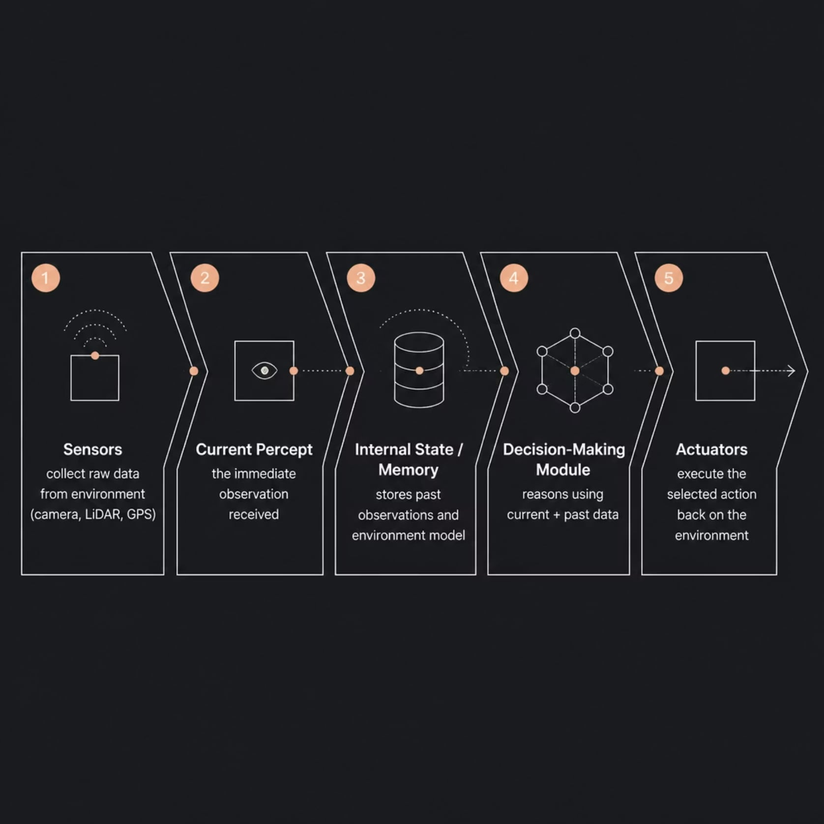
ARCHITECTURE
Core Components
Key Characteristics
Maintains an internal state (memory) across time steps
Handles partially observable environments
Infers missing information from previous experiences
Continuously updates its knowledge as the world changes
Produces more intelligent decisions than reflex agents

Slide 5
WORKFLOW
How a Model-Based Agent Works
01
02
03
Perceive
Update Internal Model
Analyze Situation
Sensors collect current data — camera, LiDAR, GPS, temperature.
New information merges with stored history; internal state refreshes.
Reasoning engine evaluates current observation, past data, and environment model.
04
05
Select Best Action
Execute
Agent determines the most appropriate action based on its understanding.
Actuators perform the selected action on the environment.

Slide 6
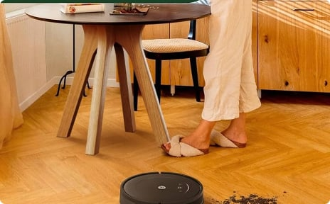
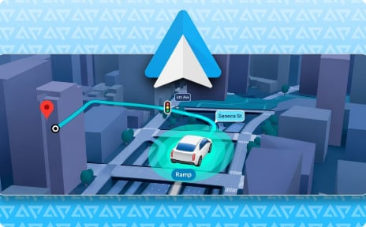
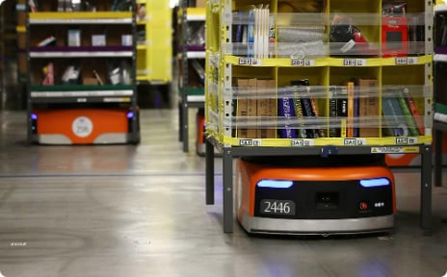
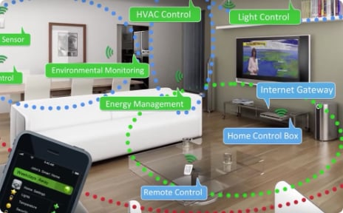
EXAMPLES
Real-World Examples in Action
Robot Vacuum Cleaner
GPS Navigation System
Warehouse Robots
Smart Home Systems
Maps the room, stores obstacle locations, and avoids repeated collisions.
Remembers your position, updates traffic data, and recalculates routes dynamically.
Track inventory locations, plan optimal paths, and coordinate with other robots.
Learns user behavior patterns and adjusts lighting, temperature, and security automatically.

Slide 7
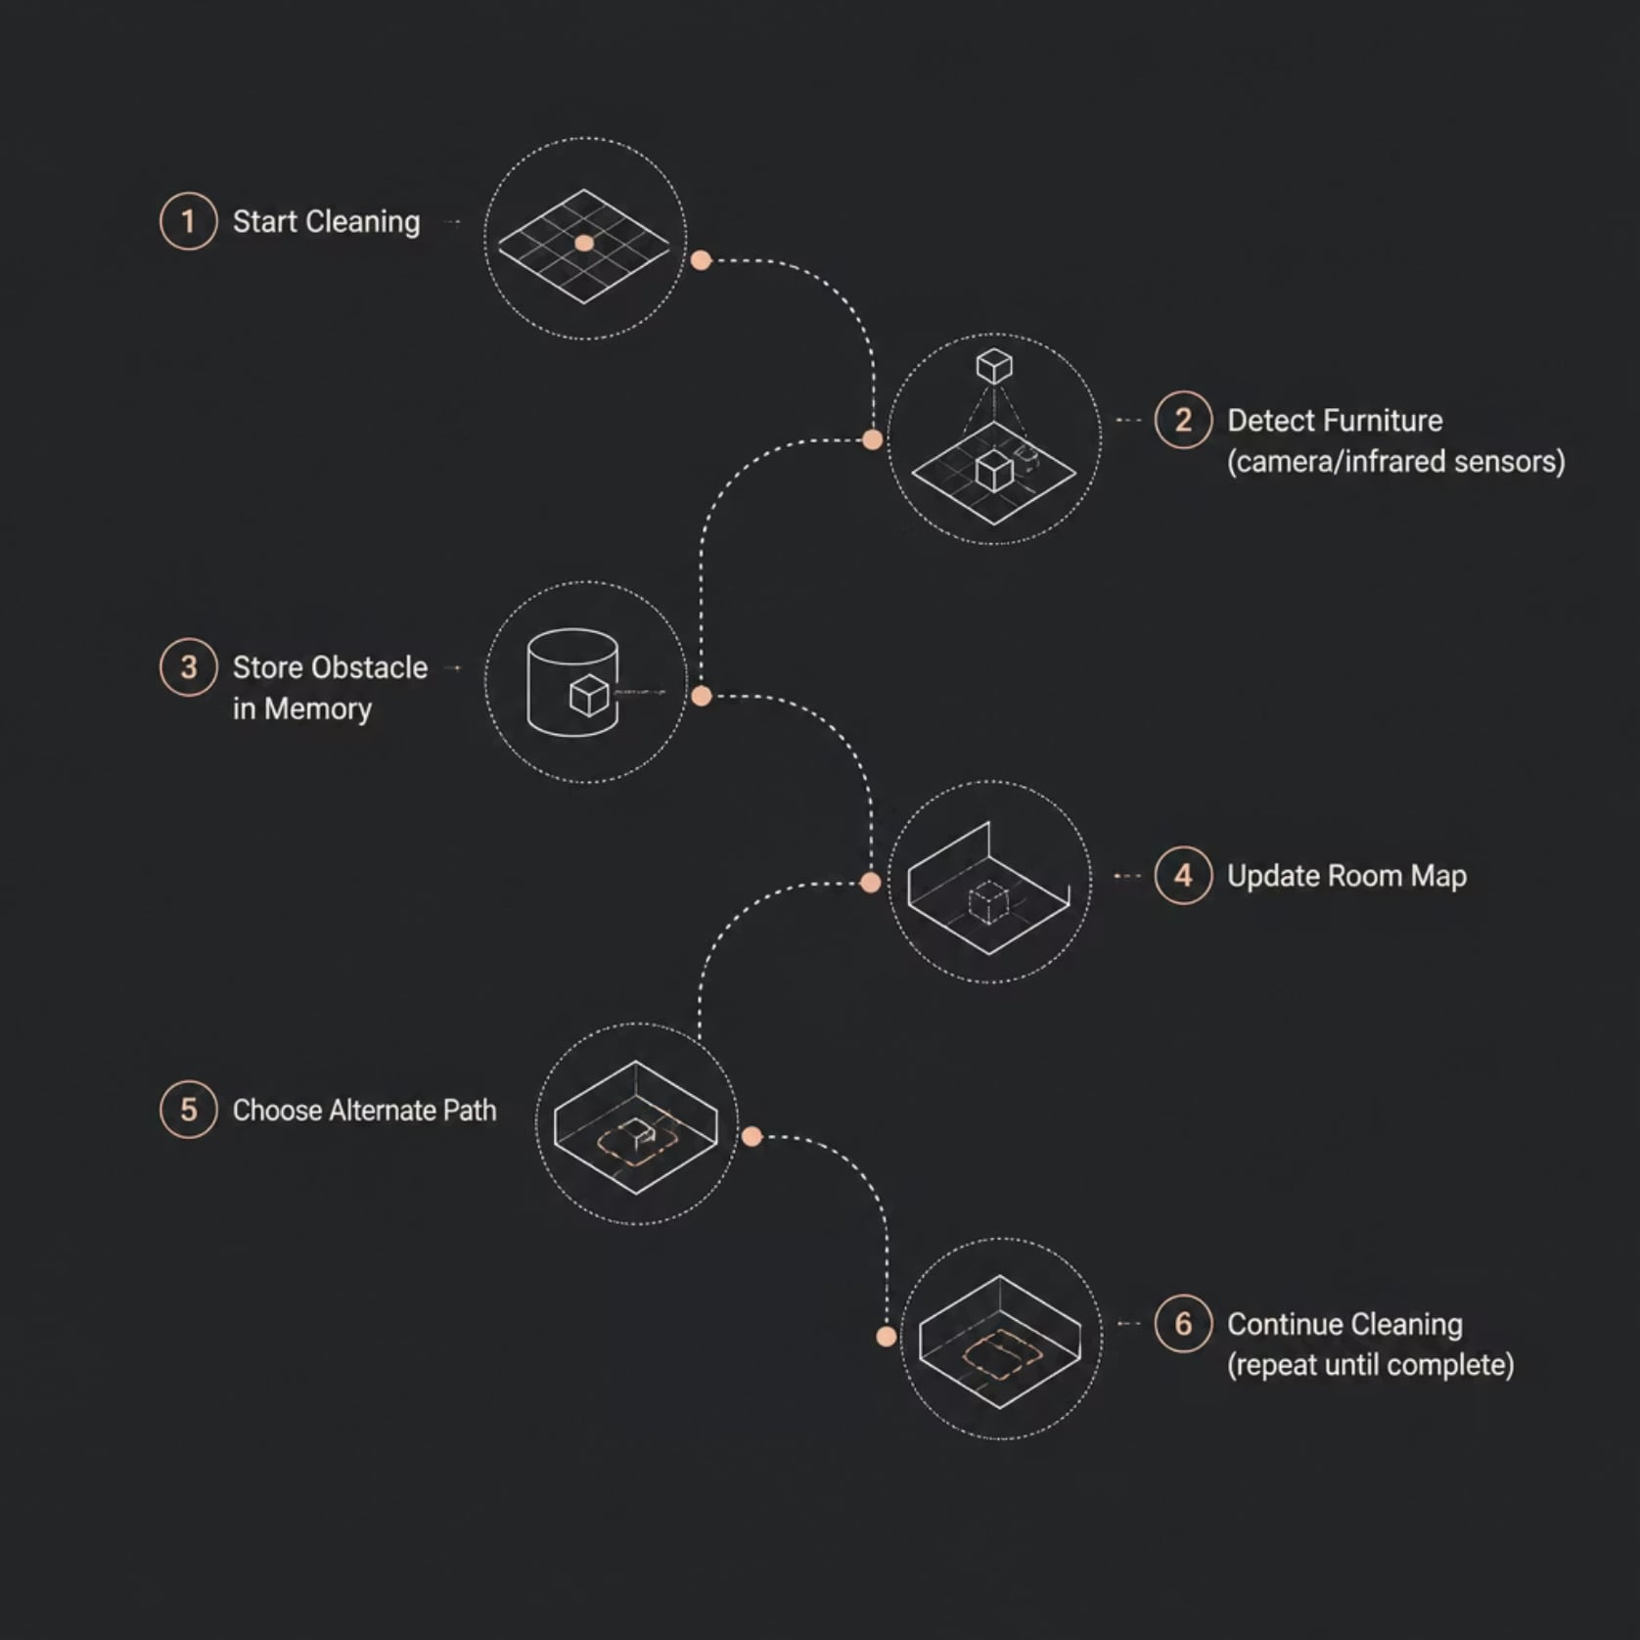
CASE STUDY
Robot Vacuum: A Model-Based Agent in Your Home
The Problem
How does a robot vacuum clean an entire room without repeatedly hitting the same obstacles?
Its Internal Model Stores:
Room map and layout
Obstacle locations (chairs, walls)
Already-cleaned areas
Battery status

Slide 8

COMPARISON
Simple Reflex vs. Model-Based Agent
Simple Reflex Agent
Model-Based Agent
No memory of past states
Maintains internal state (memory)
Reacts only to current percept
Reasons using past + present data
Same mistakes repeated
Learns and avoids past errors
Fails in partial observability
Infers missing information
Suitable for simple, static tasks
Suitable for complex, dynamic tasks
Low computational cost
Higher memory and processing needs
Key insight: The Model-Based Agent's ability to remember and reason is what separates reactive behavior from intelligent behavior.

Slide 9
EVALUATION
Advantages, Limitations & Applications
✅ Advantages
🏭 Industry Applications
Remembers previous events and context
Handles incomplete or partial information
Adapts to changing, dynamic environments
Reduces repeated mistakes over time
Robotics: Amazon Kiva, iRobot Roomba, delivery drones
Transportation: Tesla Parking Assist, GPS systems
Manufacturing: Assembly line and inventory robots
Smart Systems: Home automation, security systems
⚠️ Limitations
More complex architecture to design
Requires additional memory and compute
Incorrect internal models lead to poor decisions

Slide 10



CLASS ACTIVITY
Think & Discuss
Test your understanding with these discussion prompts:
🤔 Scenario Question
A robot vacuum encounters a chair. Will it remember the location? How does this improve future cleaning? What if its memory were erased?
🔍 Classification Activity
Identify which systems use Model-Based Agents: Robot Vacuum, GPS Navigation, Warehouse Robot, Smart Home Hub, Autonomous Lawn Mower. Explain why each requires memory.
💡 Key Takeaway
A Model-Based Agent combines current perception with stored knowledge — making it far more capable than a Simple Reflex Agent in real-world environments.

