Slide 1

UNIT 1 · PART 6 · SECTION D
Utility-Based Agents
Intelligent agents that don't just reach a goal — they find the best possible path by evaluating and comparing all available alternatives using a utility function.

Slide 2
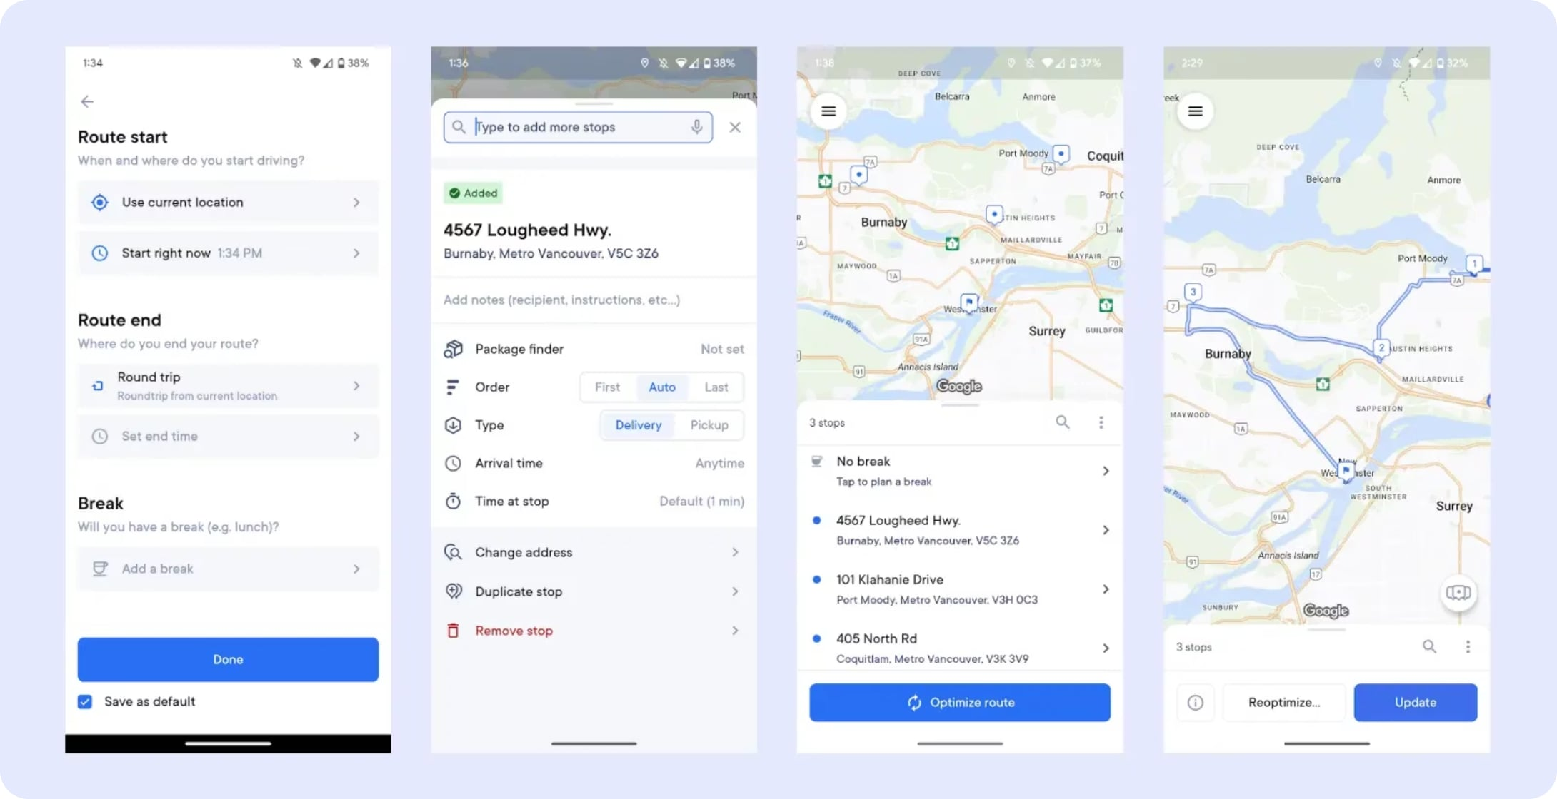
What Is a Utility-Based Agent?
A Utility-Based Agent selects the action that maximizes overall utility — the best balance of benefit, safety, cost, and efficiency — among all feasible alternatives.
Goal-Based Agent
Utility-Based Agent
"Did I reach the destination?"
"Which route is safest, fastest, and most efficient?"

Slide 3





Why Do We Need Utility-Based Agents?
In many real-world problems, multiple paths lead to the same goal. A Utility-Based Agent identifies the best option — not merely any working option.
Navigation
Several routes to a destination — which is fastest, safest, and most fuel-efficient?
Finance
Multiple investment opportunities — which balances risk and return optimally?
Healthcare
Different treatment options — which maximizes patient outcomes with minimal side effects?
Supply Chain
Various suppliers for the same product — which offers the best cost, quality, and reliability?

Slide 4

The Utility Function
A Utility Function assigns a numerical score to each possible outcome. The agent selects the option with the highest score, balancing competing factors such as time, cost, safety, and quality.
Route
Time
Cost
Traffic
Utility Score
Route A
25 min
₹80
High
65
Higher utility = Better choice. The function encodes the agent's preferences across all relevant dimensions.
Route B ✓
30 min
₹40
Medium
82
Route C
22 min
₹120
Low
78
Route ? wins — best balance of cost and time, despite not being the fastest.

Slide 5
How a Utility-Based Agent Works
01
02
03
Observe
Generate Alternatives
Evaluate
Gather environment data via sensors (GPS, camera, LiDAR).
List all feasible actions (e.g., Route A, B, C).
Score each action using the utility function (time, cost, safety).
04
05
Select & Execute
Monitor & Recalculate
Choose the highest-utility action and perform it.
Re-evaluate if conditions change; adapt dynamically.

Slide 6

Example: Food Delivery App
The app must assign the best rider by balancing ETA, rating, and cost simultaneously.
Rider
ETA
Rating
Cost
Rider A
15 min
4.2 ★
₹50
Rider B ✓
18 min
4.9 ★
₹35
Rider C
12 min
3.8 ★
₹70
Rider B is selected — the best overall balance of speed, quality, and affordability.

Slide 7

Advantages & Limitations
✅ Advantages
Produces optimal decisions, not just acceptable ones
Handles multiple objectives simultaneously
Works well in uncertain, dynamic environments
Balances competing constraints (time, cost, safety)
⚠️ Limitations
Designing an accurate utility function is challenging
Requires greater computational resources
Utility values can be subjective or biased
Incorrect calculations lead to poor decisions

Slide 8
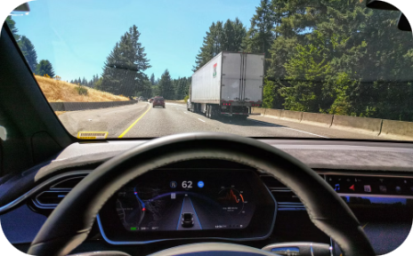
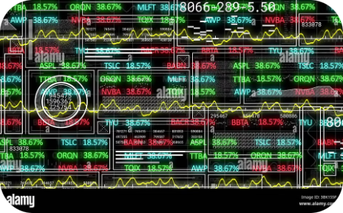
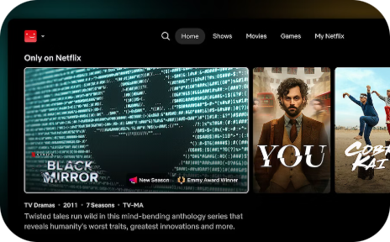

Real-World Applications
Transportation
Finance
E-Commerce & Media
Healthcare
Tesla Autopilot, Uber route optimization, smart traffic management
Portfolio optimization, fraud detection, algorithmic risk assessment
Amazon recommendations, Netflix engine, Google Ads optimization
Treatment recommendations, clinical decision support, resource allocation

Slide 9
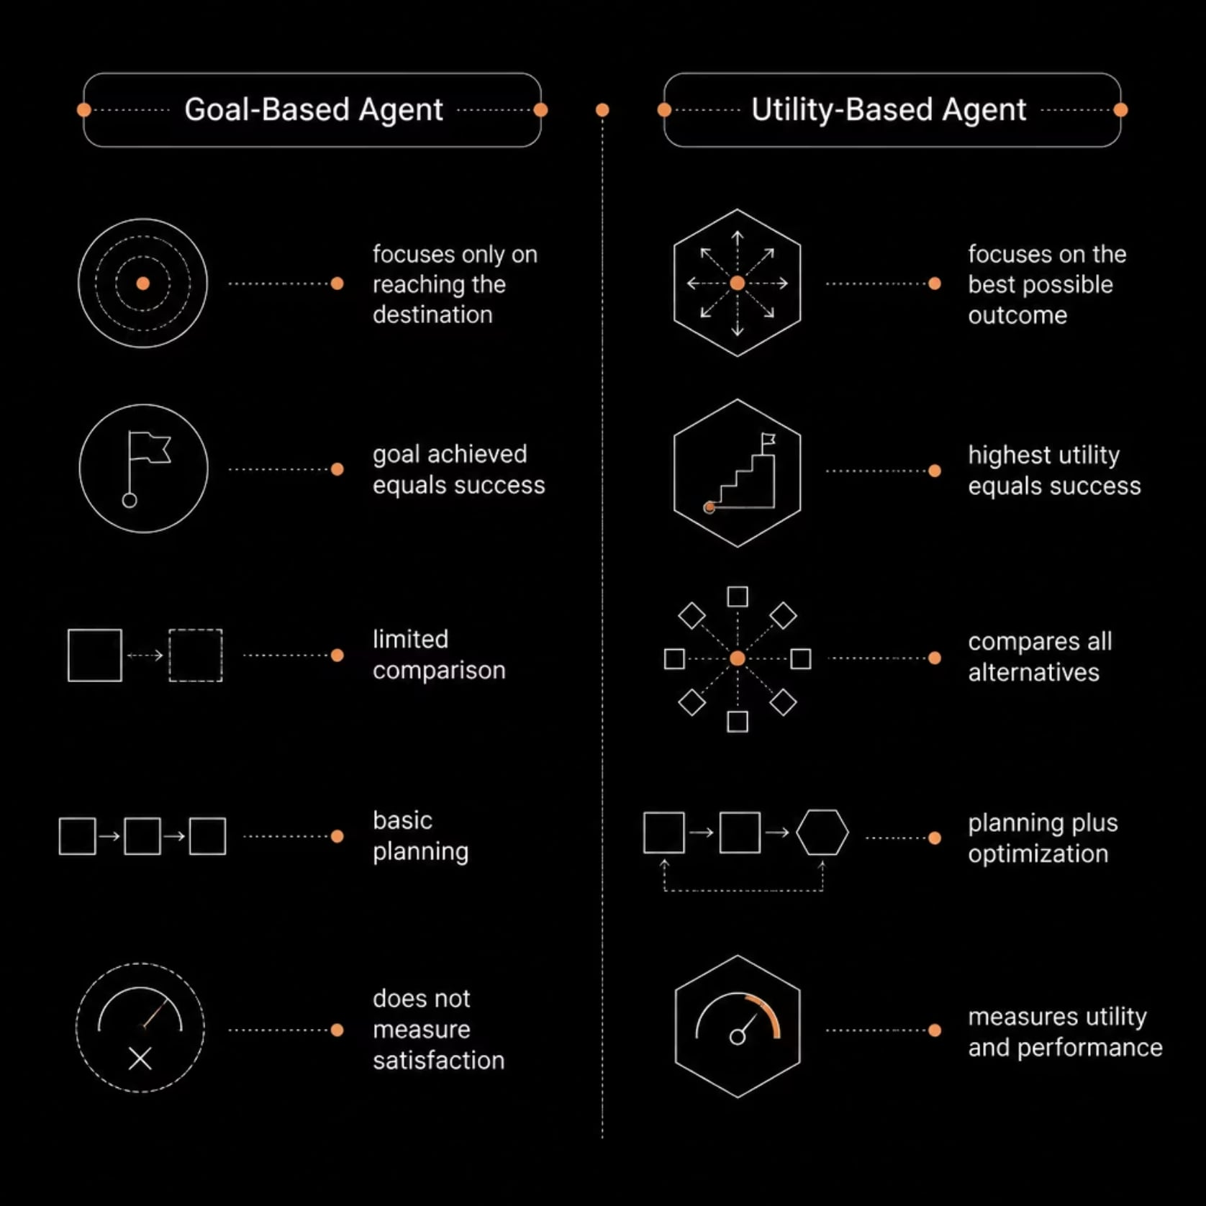
Case Study: Self-Driving Car
At an intersection, the car evaluates three routes across time, safety, fuel, and traffic. Route B wins with the highest utility score (92), despite not being the fastest.
Route
Time
Safety
Fuel
Traffic
Utility
Route A
⭐⭐⭐⭐⭐
⭐⭐⭐
⭐⭐⭐
Heavy
72
Route B ✓
⭐⭐⭐⭐
⭐⭐⭐⭐⭐
⭐⭐⭐⭐
Moderate
92
Route C
⭐⭐⭐
⭐⭐⭐⭐
⭐⭐⭐⭐⭐
Low
85

Slide 10


Key Takeaways
Best Solution, Not Just Any Solution
A Utility-Based Agent optimizes across all alternatives — it doesn't stop at the first working option.
The Utility Function Is the Core
It encodes preferences numerically, enabling objective comparison of complex, multi-factor decisions.
Adaptive by Design
Agents continuously monitor and recalculate — if the environment changes, a better action may be chosen.
Think & Discuss
Should speed always dominate? Classify: Uber matching, airline pricing, Netflix recommendations — are they Utility-Based Agents?

