Slide 1
DEEP LEARNING · UNIT — FOUNDATIONS
The Sigmoid Neuron
From a hard threshold to a smooth, differentiable decision
Perceptron / MP Neuron → Sigmoid Neuron

Slide 2
01 · MOTIVATION
Why Move Beyond the Perceptron / MP Neuron?
1
All-or-nothing output
2
Abrupt, discontinuous jumps
The perceptron's step function fires only 0 or 1 — there is no sense of "how strongly" the neuron believes its output.
A tiny change in weights or inputs can flip the output instantly from 0 to 1, making learning unstable.
3
Not differentiable
4
No principled learning rule
The step function has a derivative of 0 almost everywhere (undefined at the threshold) — gradient descent has nothing to work with.
The perceptron update rule is a heuristic; it does not come from minimizing a smooth loss function.
Sigmoid neuron fix: replace the hard step with a smooth, bounded, differentiable curve.
Sigmoid Neuron | Deep Learning
2

Slide 3
A HARD EDGE VS. A SMOOTH CURVE
Step Function vs. Sigmoid Function
Perceptron — Step Function
Sigmoid Neuron — Smooth Curve
Sigmoid Neuron | Deep Learning
3

Slide 4
02 · DEFINITION
Inputs, Output and Equation
x₁
Σ wᵢxᵢ + b
σ(z)
x₂
y
sigmoid function
x₃
output ∈ (0, 1)
⋮
xₙ
Equation of the Sigmoid Neuron
y = σ(w·x + b) = 1 / (1 + e⁻⁽ʷˣ⁺ᵇ⁾)
where w = weight vector, x = input vector, b = bias, z = w·x + b (pre-activation)
Unlike the perceptron, inputs and output are real-valued — not restricted to 0/1.
Sigmoid Neuron | Deep Learning
4

Slide 5
02 · DEFINITION
The Sigmoid Function — Graphically
KEY PROPERTIES
S-shaped curve, bounded between 0 and 1
Continuous and smooth — no sudden jumps
Differentiable everywhere → gradients exist
Steepest around z = 0; flattens at the extremes
Output can be read as a probability-like confidence
Sigmoid Neuron | Deep Learning
5

Slide 6
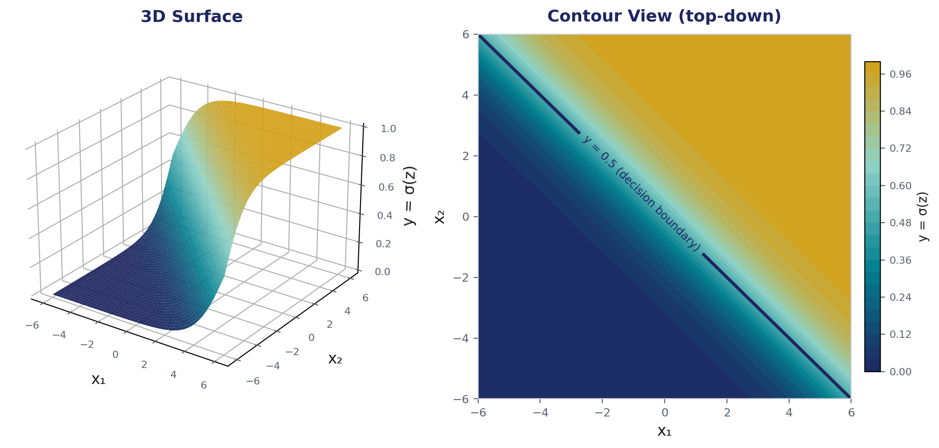
02 · DEFINITION
The Sigmoid Function with Two Inputs
With two inputs, z = w₁x₁ + w₂x₂ + b and y = σ(z). The 1-D S-curve becomes a smooth S-shaped sheet over the (x₁, x₂) plane.
The 0.5 contour (navy line) is a straight decision boundary — sigmoid smooths the sharp perceptron edge into a gradual transition around it.
Sigmoid Neuron | Deep Learning
6

Slide 7
03 · PARAMETERS
Parameters of the Sigmoid Neuron
The sigmoid neuron has the same two parameters as the perceptron — weights (w) and bias (b) — but they now shape a smooth curve instead of a hard threshold.
w
Weight vector (w₁, w₂, …, wₙ)
b
Bias (scalar)
Controls the steepness / slope and orientation of the curve.
Shifts the curve left or right along the input axis — moves the decision point.
Sigmoid Neuron | Deep Learning
7

Slide 8
03 · PARAMETERS
Effect of Changing w and b on the Curve
Varying w (b = 0)
Varying b (w = 1)
Change | Effect on the curve
w ↑ (larger magnitude) | Curve becomes steeper — transition from 0 to 1 happens more sharply
w ↓ (smaller magnitude) | Curve becomes gentler / flatter — more gradual transition
w changes sign (+ → −) | Curve flips — becomes a decreasing function of x
b ↑ (more positive) | Curve shifts left — neuron activates for smaller x
b ↓ (more negative) | Curve shifts right — neuron activates for larger x
Sigmoid Neuron | Deep Learning
8

Slide 9
04 · LEARNING
Learning Algorithm — Gradient Descent
Goal: find w, b that minimize the loss L(w, b) over all training points.
ALGORITHM 1 — Gradient Descent for the Sigmoid Neuron
Input: dataset {(xᵢ, yᵢ)}, learning rate η, epochs T Output: learned parameters w, b
1:
initialize w, b ← small random values
2:
for epoch = 1 to T do
3:
for each (xᵢ, yᵢ) in dataset do
4:
zᵢ ← w·xᵢ + b
// pre-activation
5:
fᵢ ← σ(zᵢ)
// forward pass
6:
end for
7:
Compute loss L(w,b) = Σᵢ (yᵢ − fᵢ)²
// compute loss
8:
Compute partial derivative of loss wrto w - ∂L/∂w
// gradients
9:
Compute partial derivative of loss wrto b - ∂L/∂b
10:
w ← w − η·∂L/∂w
// update w
11:
b ← b − η·∂L/∂b
// update b
12:
end for
13:
return w, b
Sigmoid Neuron | Deep Learning
9

Slide 10
05 · LOSS
Loss Function of the Sigmoid Neuron
Squared Error Loss
L(w, b) = ½ Σᵢ ( yᵢ − f(xᵢ) )² where f(xᵢ) = σ(w·xᵢ + b)
1
Sums the squared difference between true label yᵢ and predicted output f(xᵢ) across all N examples.
2
Because σ(z) is smooth and differentiable, L(w, b) is differentiable too — gradients ∂L/∂w and ∂L/∂b can always be computed.
3
This is exactly what the perceptron's step function could not offer — its loss surface has flat regions with zero gradient almost everywhere.
4
Minimizing L(w, b) via gradient descent moves the sigmoid curve so its predictions get closer to the true labels.
Sigmoid Neuron | Deep Learning
10

Slide 11
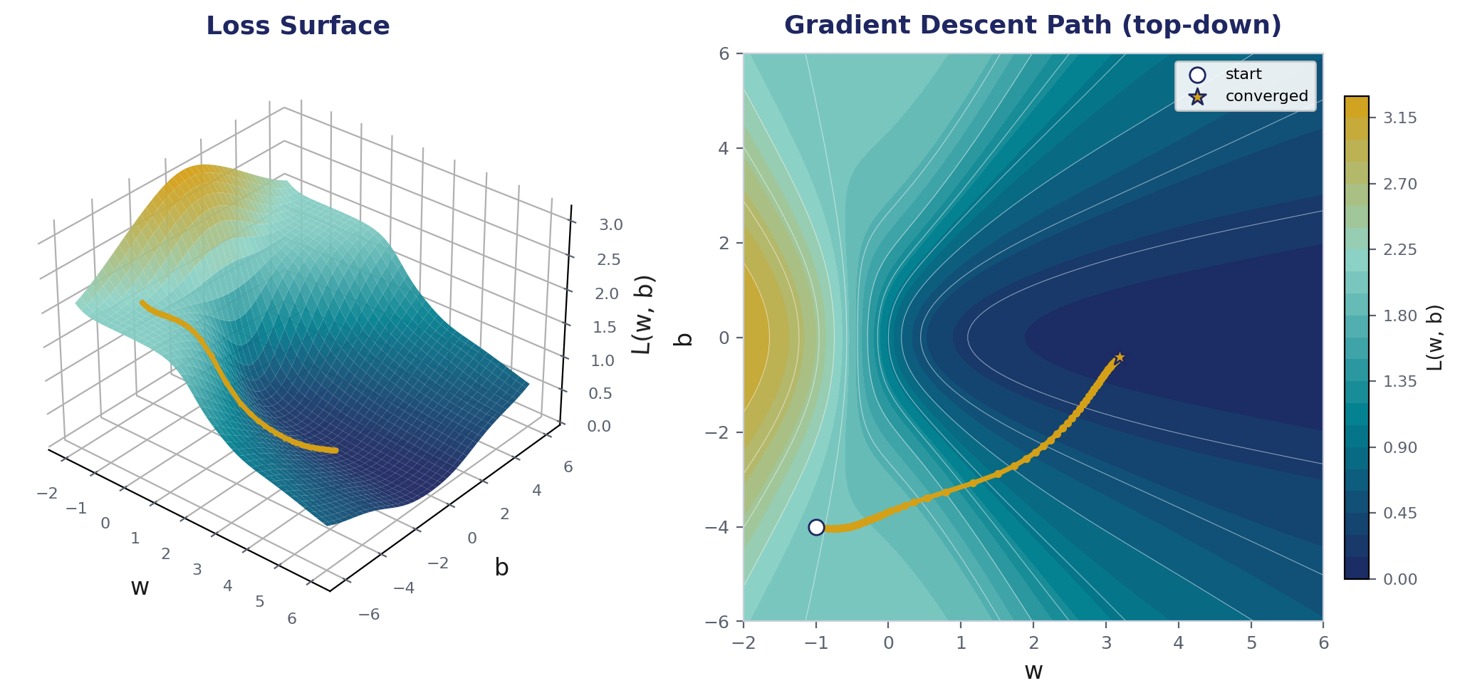
05 · LOSS
How the Loss Changes with w and b
L(w, b) forms a smooth bowl-shaped surface over parameter space. Gradient descent walks downhill along this surface toward the minimum loss.
Gold path: each gradient-descent update (w, b) takes a step toward lower loss until it settles near the minimum.
Sigmoid Neuron | Deep Learning
11

Slide 12
SUMMARY
Perceptron vs. Sigmoid Neuron
Aspect | Perceptron / MP Neuron | Sigmoid Neuron
Activation | Hard step function | Smooth sigmoid, σ(z)
Output range | {0, 1} only | Continuous (0, 1)
Differentiable? | No (undefined at threshold) | Yes, everywhere
Sensitivity to input | Abrupt flip | Smooth, gradual change
Learning rule | Heuristic update rule | Gradient descent on a loss function
Sigmoid neuron: same building blocks as the perceptron (w, x, b) — but a smooth, differentiable activation makes gradient-based learning possible.

Slide 13
def f(w, b, x):
# sigmoid with parameters w, b
return 1.0 / (1.0 + np.exp(-(w*x + b)))
def error(w, b):
err = 0.0
for x, y in zip(X, Y):
fx = f(w, b, x)
err += 0.5*(fx - y)**2
return err
def grad_b(w, b, x, y):
fx = f(w, b, x)
return (fx - y) * fx * (1 - fx)
def grad_w(w, b, x, y):
fx = f(w, b, x)
return (fx - y) * fx * (1 - fx) * x
def do_gradient_descent():
w, b, eta = -2, -2, 1.0
max_epochs = 1000
for i in range(max_epochs):
dw, db = 0, 0
for x, y in zip(X, Y):
dw += grad_w(w, b, x, y)
db += grad_b(w, b, x, y)
w = w - eta * dw
b = b - eta * db
Learning algorithm
The Four Steps
1
Model
f(w, b, x) — sigmoid neuron prediction
2
Loss
error(w, b) — squared error over all points
3
Gradients
grad_w, grad_b — partial derivatives of the loss
4
Update
w, b nudged opposite the gradient, scaled by η

Slide 14

Interactive Quiz

