Slide 1
NEURAL NETWORKS · DEEP LEARNING
Activation Functions
The non-linear spark that lets neural networks learn — and we won't just define them, we'll race them.
Sigmoid
Tanh
ReLU
Swish
GELU
Softmax
Activation Functions
1
Notes:
Hook: today we treat activation functions as an experiment, not a glossary. We'll actually train tiny networks, swap only the activation, and let the data pick a winner. Tell them: keep a mental bet on which function wins the spiral — we vote later.

Slide 2
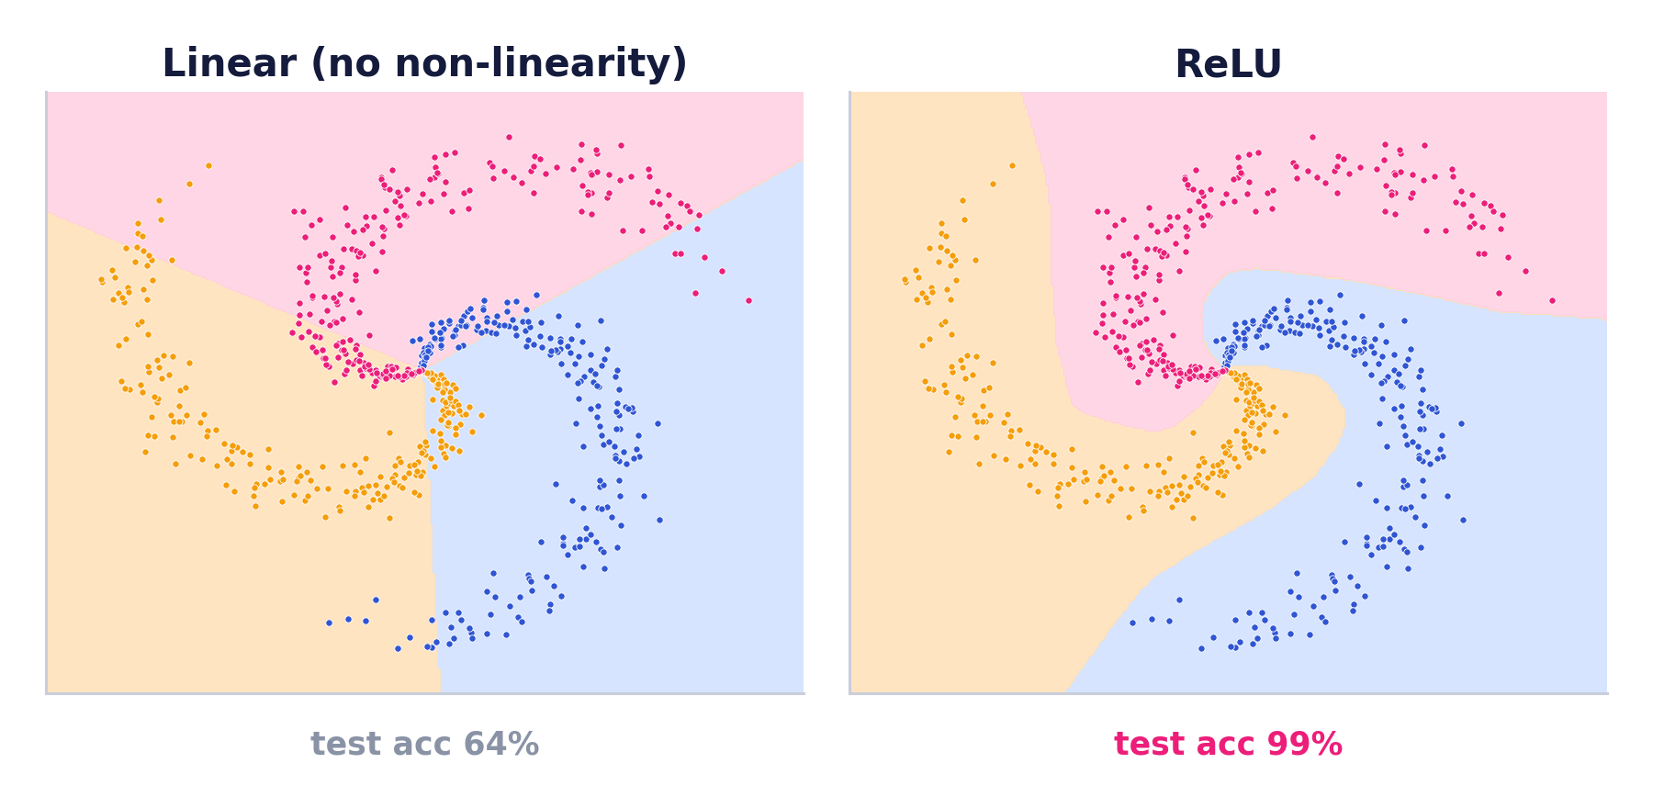
MOTIVATION
Why do we even need them?
Stack linear layers and you still get one line. A network with no non-linear activation collapses to a single linear map — no matter how many layers you add.
Linear ∘ Linear ∘ Linear = Linear
Same network, same spiral, same everything — I changed only the activation.
Left: no non-linearity, the boundary can only be straight cuts → 64%. Right: ReLU bends the space → 99%.
Activation Functions
2
Notes:
Lead with evidence, not a claim. This is the whole lecture in one slide: non-linearity is the difference between 64% and 99% on the same data. Everything after this is choosing WHICH non-linearity.

Slide 3
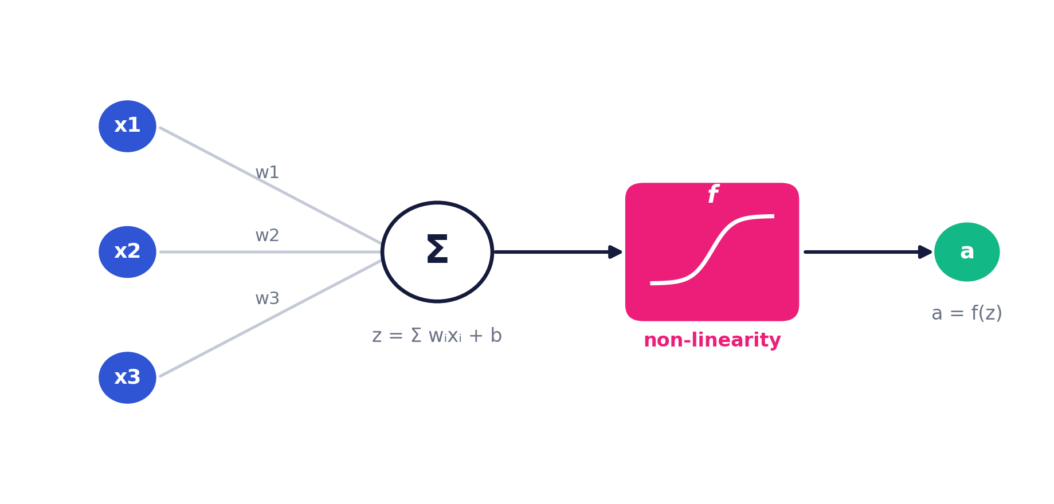
THE BASICS
Where the activation lives
Each neuron computes a weighted sum z = Σwᵢxᵢ + b, then passes it through an activation f to produce its output a = f(z). The activation is the only non-linear step.
Activation Functions
3
Notes:
The sum is linear; the activation f is where all the non-linearity enters. Weights decide WHAT to combine; the activation decides HOW the neuron responds.

Slide 4
THE BASICS
What makes a good activation?
∿
Non-linear
∂
Differentiable
↗
Well-behaved gradient
Lets the network model curved, complex relationships.
Gradients must flow for backprop to train.
Smooth, non-vanishing gradients ease optimisation.
↔
Right output range
⚡
Cheap to compute
◉
Zero-centered
Bounded or unbounded to suit the layer's job.
It runs millions of times — speed matters.
Outputs around 0 help gradients converge faster.
Activation Functions
4
Notes:
No function ticks every box — the whole field is trade-offs. Keep this list in mind; every function later wins some boxes and loses others. That tension is what the experiments will expose.

Slide 5
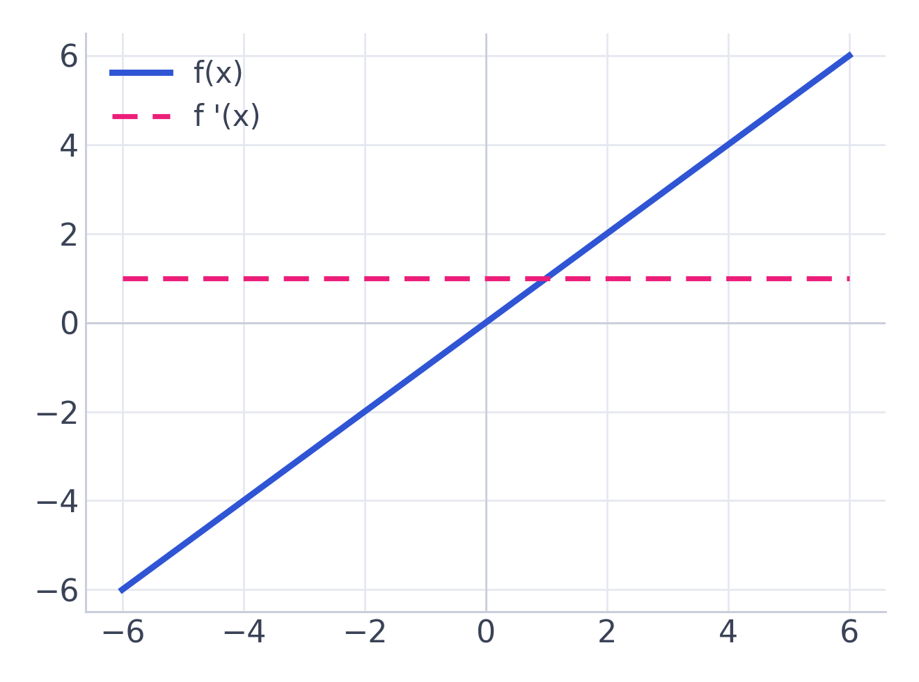
LINEAR FAMILY
f
Identity / Linear
f(x) = x
Range: (−∞, +∞)
PROS
✓
Simple; output is unbounded
✓
Right choice for regression outputs
CONS
✗
Derivative is constant (= 1)
✗
Stacking stays linear — no learning power
USE FOR the final layer of a regression model
Activation Functions
5
Notes:
Useful ONLY at the output of a regressor. As a hidden activation it's useless — that's exactly what slide 2 showed.

Slide 6
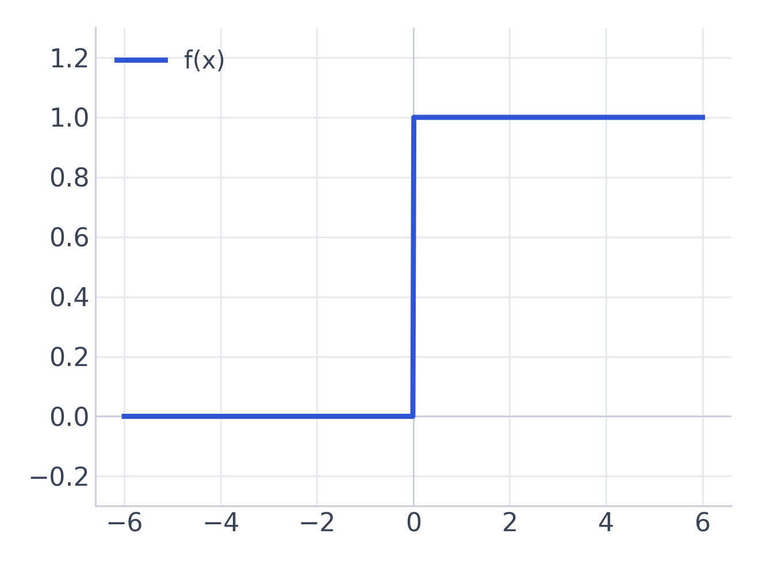
CLASSIC
⊓
Binary Step
f(x) = 0 if x<0 ; 1 if x≥0
Range: {0, 1}
PROS
✓
Intuitive on/off firing rule
✓
Basis of the original perceptron
CONS
✗
Gradient is 0 — can't train by backprop
✗
No graded output; no multi-class
USE FOR historical / theoretical interest only
Activation Functions
6
Notes:
Where it all began, and why we moved on: a flat gradient means backprop has nothing to learn from. Everything after is a smooth stand-in for this step.

Slide 7
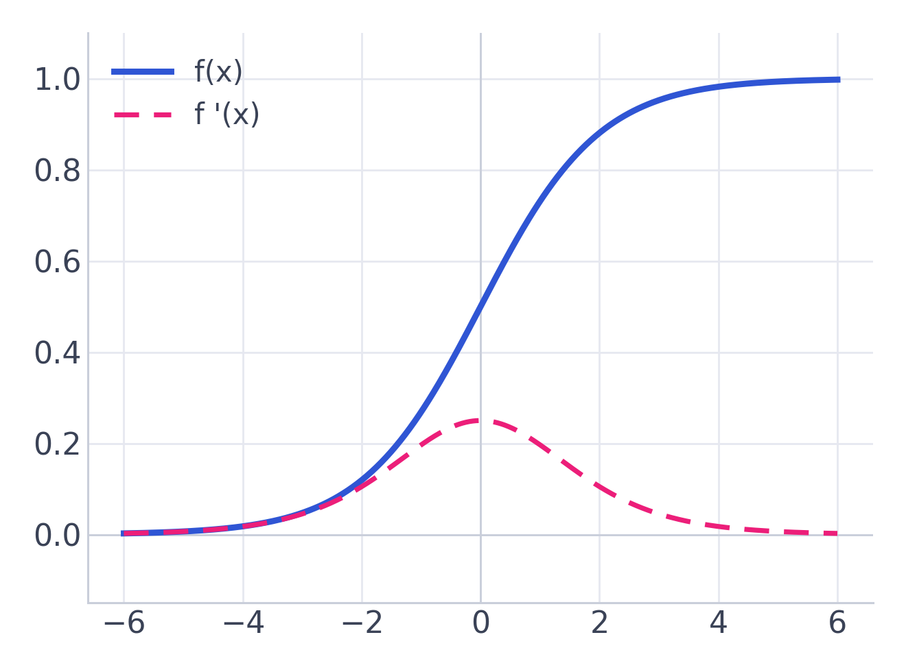
CLASSIC
σ
Sigmoid (Logistic)
σ(x) = 1 / (1 + e⁻ˣ)
Range: (0, 1)
PROS
✓
Smooth, differentiable everywhere
✓
Output reads as a probability
CONS
✗
Saturates → vanishing gradients
✗
Not zero-centered; slower training
USE FOR a binary-classification output unit
Activation Functions
7
Notes:
Great as a probability at the OUTPUT. As a hidden activation it saturates and its gradient vanishes — we'll measure exactly how badly in the lab.

Slide 8
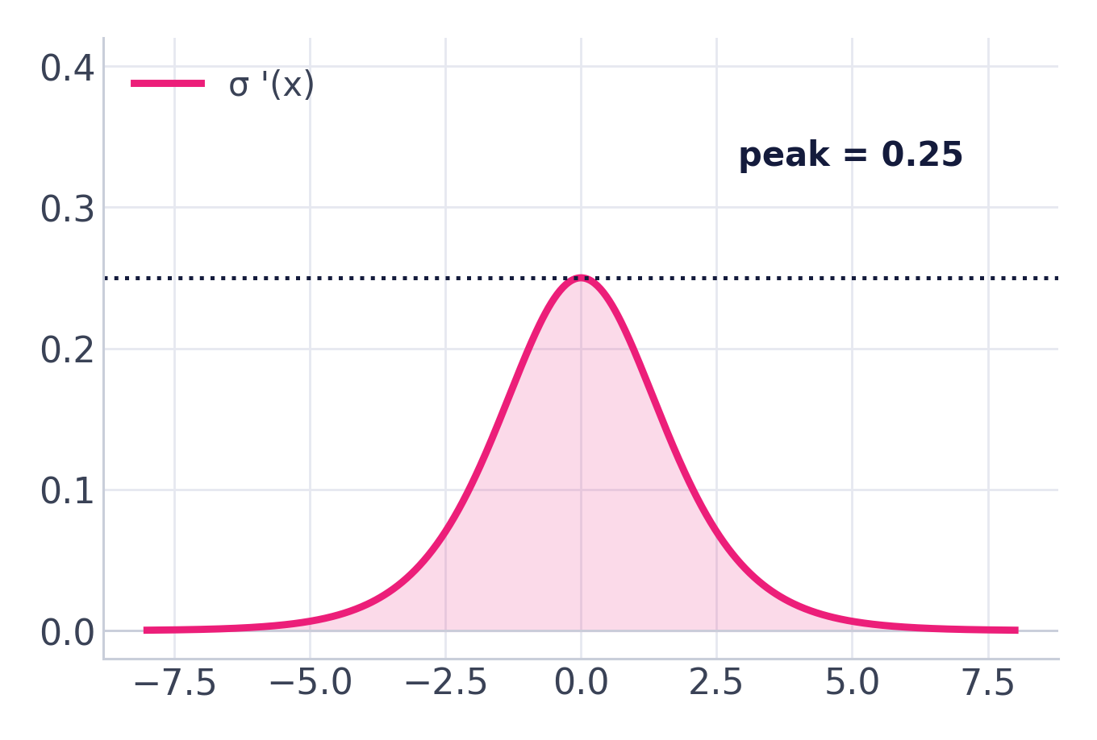
DEEP DIVE
Sigmoid's Achilles heel
The vanishing-gradient problem
The derivative peaks at just 0.25 and shrinks toward 0 for large |x|.
In a deep net these small numbers multiply layer-by-layer and collapse.
Early layers stop receiving signal — training stalls.
Outputs are always positive (not zero-centered), so weight updates zig-zag.
In the lab (slide 21): we'll watch a sigmoid's input-layer gradient sit ~10 orders of magnitude below its output layer.
Activation Functions
8
Notes:
This slide makes the CLAIM. Point forward: we don't ask them to trust it — Experiment 1 measures it on a real 18-layer network.

Slide 9
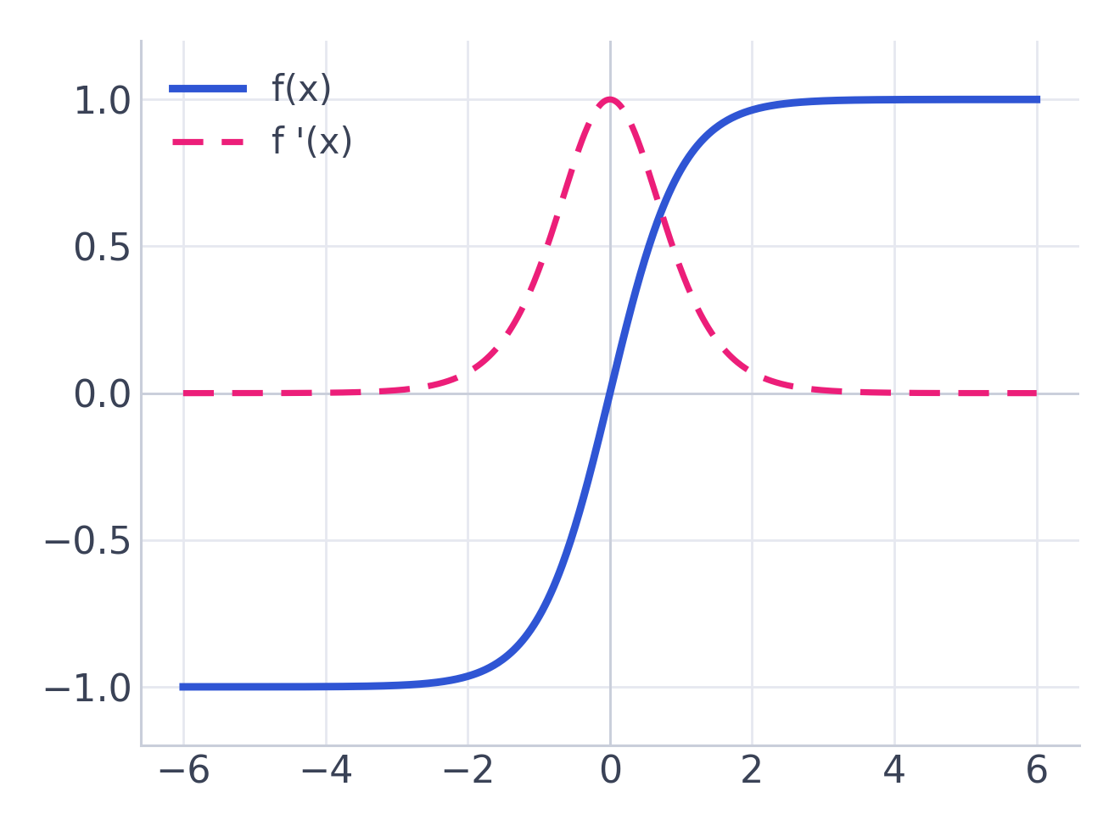
CLASSIC
th
Tanh
tanh(x) = (eˣ−e⁻ˣ)/(eˣ+e⁻ˣ)
Range: (−1, 1)
PROS
✓
Zero-centered — faster than sigmoid
✓
Stronger gradients near the origin
CONS
✗
Still saturates at the extremes
✗
Vanishing gradients persist in deep nets
USE FOR RNN hidden layers; shallow networks
Activation Functions
9
Notes:
The zero-centered upgrade to sigmoid. Interesting lab surprise: with matched init, tanh's gradients hold up far better than sigmoid's — being zero-centered genuinely matters.

Slide 10
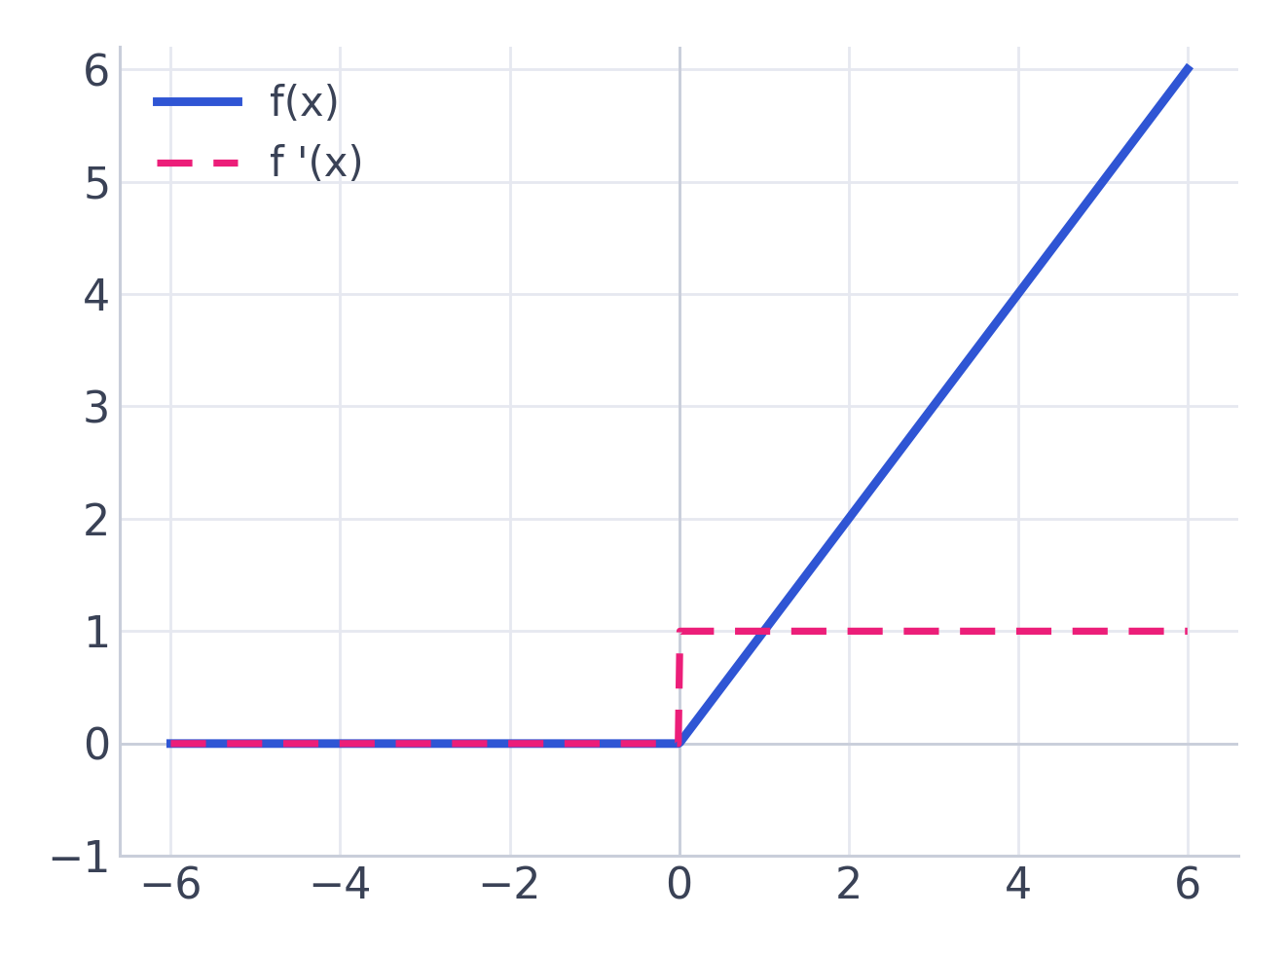
MODERN WORKHORSE
R
ReLU
f(x) = max(0, x)
Range: [0, +∞)
PROS
✓
Extremely cheap — just a comparison
✓
No saturation for x>0 → fast training
CONS
✗
Not zero-centered
✗
“Dying ReLU”: stuck-at-0 neurons stop learning
USE FOR the default for CNN & MLP hidden layers
Activation Functions
10
Notes:
The function that made deep learning practical. One comparison, no exponentials. Its one real failure mode — dying neurons — we'll trigger on purpose in the lab.

Slide 11
DEEP DIVE
Why ReLU took over — and its catch
✓
Why it won
✗
The dying ReLU
Gradient is just 0 or 1 — no vanishing for positive inputs.
Sparse activations (many exact zeros) are efficient.
Trains deep nets far faster than sigmoid or tanh.
If a neuron's input stays negative, its gradient is always 0.
It then outputs 0 forever — effectively dead.
A large learning rate can knock out many neurons at once.
→ Leaky ReLU, PReLU and ELU were invented to cure the dying-ReLU problem.
Activation Functions
11
Notes:
Balanced view: ReLU's strengths are real, and so is its one weakness. Tease the fixes on the next slides — and note we'll DEMONSTRATE the dying problem in Experiment 4.

Slide 12
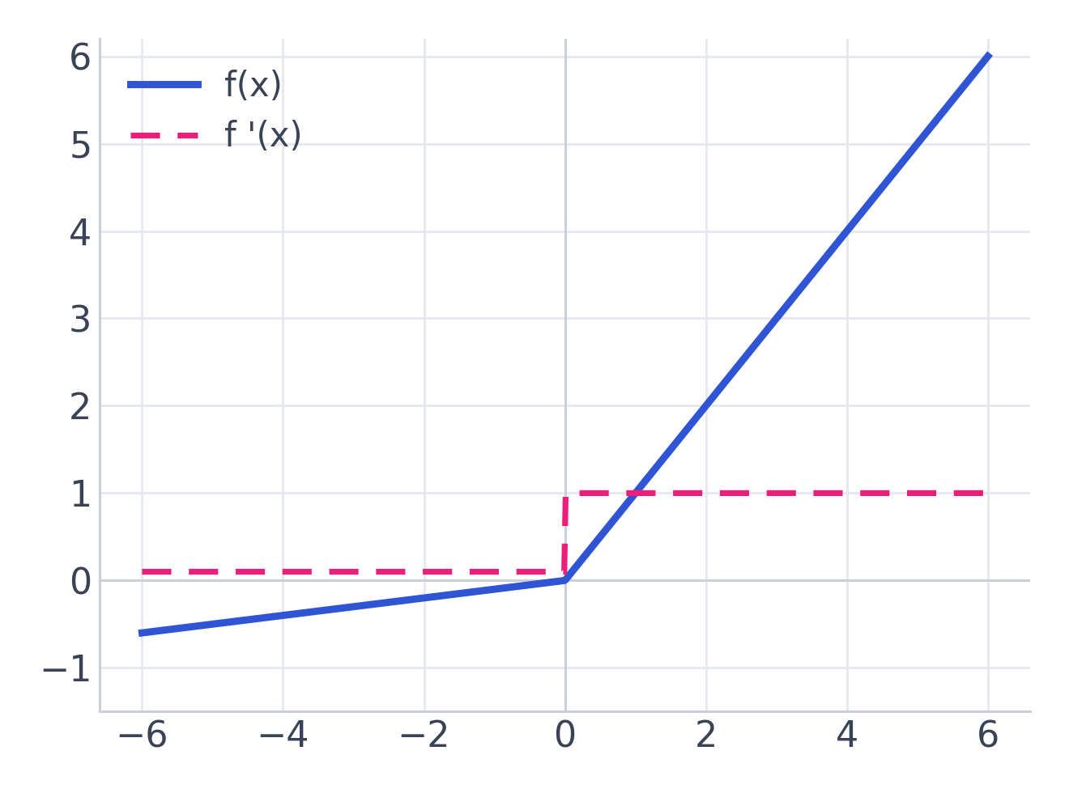
RELU FAMILY
L
Leaky ReLU / PReLU
f(x) = x if x>0 ; αx if x≤0
Range: (−∞, +∞)
PROS
✓
Small negative slope keeps neurons alive
✓
Fixes the dying-ReLU problem
CONS
✗
α is an extra hyper-parameter (PReLU learns it)
✗
Gains over ReLU are inconsistent
USE FOR when your ReLU units keep dying
Activation Functions
12
Notes:
The minimal fix: let a little signal leak through on the negative side so a neuron can always recover. Experiment 4 shows leaky neurons essentially never die.

Slide 13
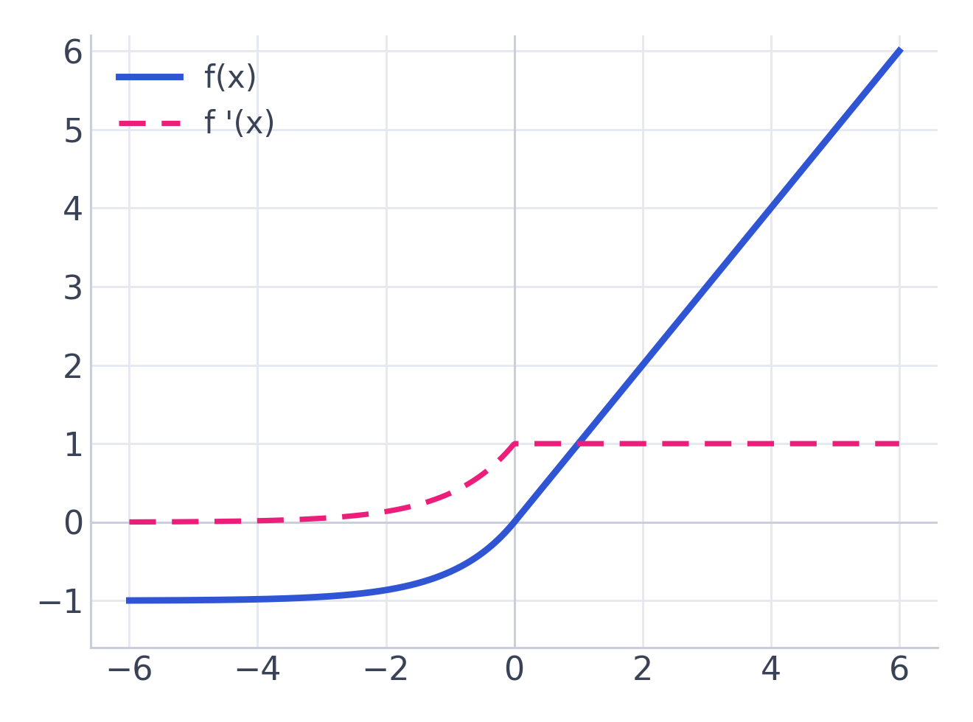
RELU FAMILY
E
ELU
f(x) = x if x>0 ; α(eˣ−1) if x≤0
Range: (−α, +∞)
PROS
✓
Smooth negative curve, closer to zero-mean
✓
Pushes activations toward zero-centered
CONS
✗
Exponential makes it costlier than ReLU
✗
α still needs tuning
USE FOR deeper nets wanting robust convergence
Activation Functions
13
Notes:
A smoother, zero-centered cousin. Buys robustness at the price of an exponential — the lab's cost plot shows that price.

Slide 14
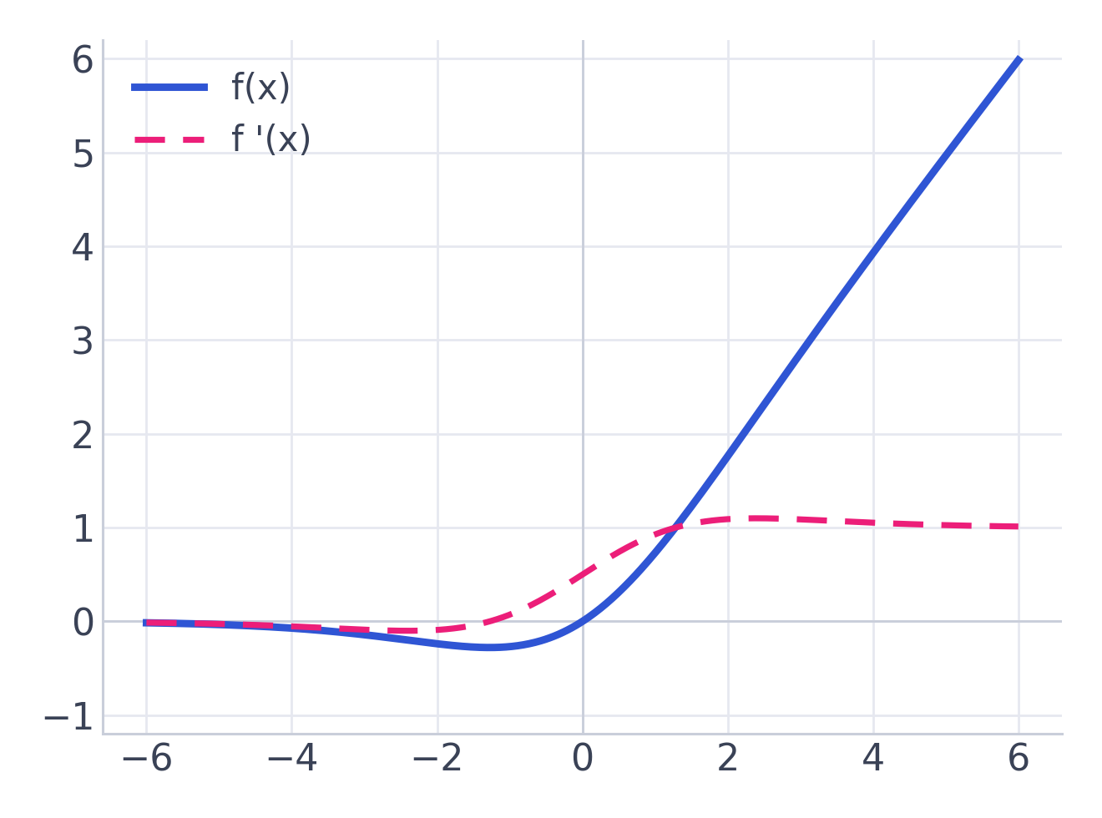
SELF-GATED
Sw
Swish / SiLU
f(x) = x · σ(x)
Range: (≈ −0.28, +∞)
PROS
✓
Smooth & non-monotonic — a small dip below 0
✓
Often beats ReLU on deep models
CONS
✗
Sigmoid inside → more compute than ReLU
✗
Gains are model-dependent
USE FOR deep CNNs (EfficientNet) & transformers
Activation Functions
14
Notes:
The self-gated generation: the input gates itself. Note the little dip below zero — that non-monotonic wiggle is the point, and it's visible in the boundary plot's smooth curves.

Slide 15
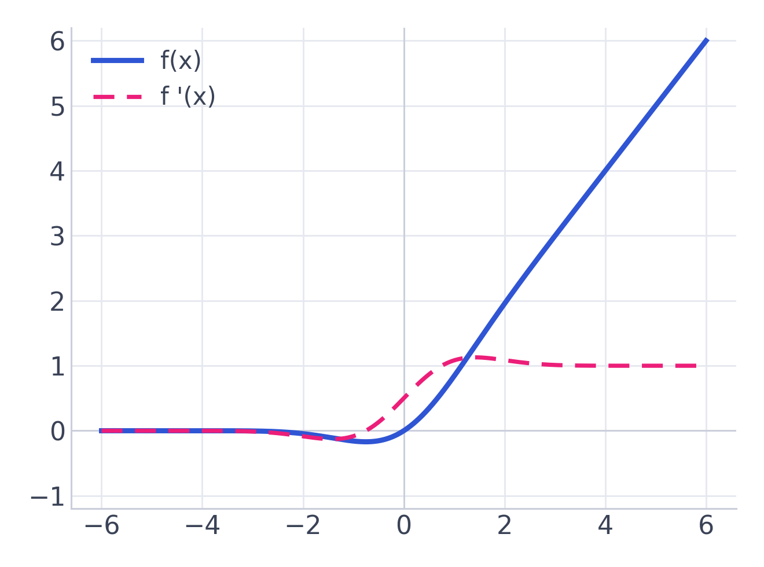
SELF-GATED
G
GELU
f(x) = x · Φ(x)
Range: (≈ −0.17, +∞)
PROS
✓
Weights inputs by their Gaussian probability
✓
Smooth; strong empirical results
CONS
✗
More expensive; usually approximated
✗
Behaviour less intuitive than ReLU
USE FOR the transformer standard (BERT, GPT)
Activation Functions
15
Notes:
If you use a transformer, you use GELU. Same photo-finish accuracy as ReLU in our lab, at higher per-call cost — which is why frameworks fuse and approximate it.

Slide 16
PART II
The Lab
Enough describing. Let's measure. One fixed network, one hard dataset — we swap only the activation and let the data pick the winner.
Dataset
3-class spiral · 660 points · not linearly separable
Network
2 → 64 → 64 → 64 → 3, same weights init every run
Rule
Change ONE thing: the activation function
Activation Functions
17
Notes:
Set the experimental contract out loud: only the activation changes, so any difference in the results is caused by the activation and nothing else. This is what makes it a fair test.

Slide 17
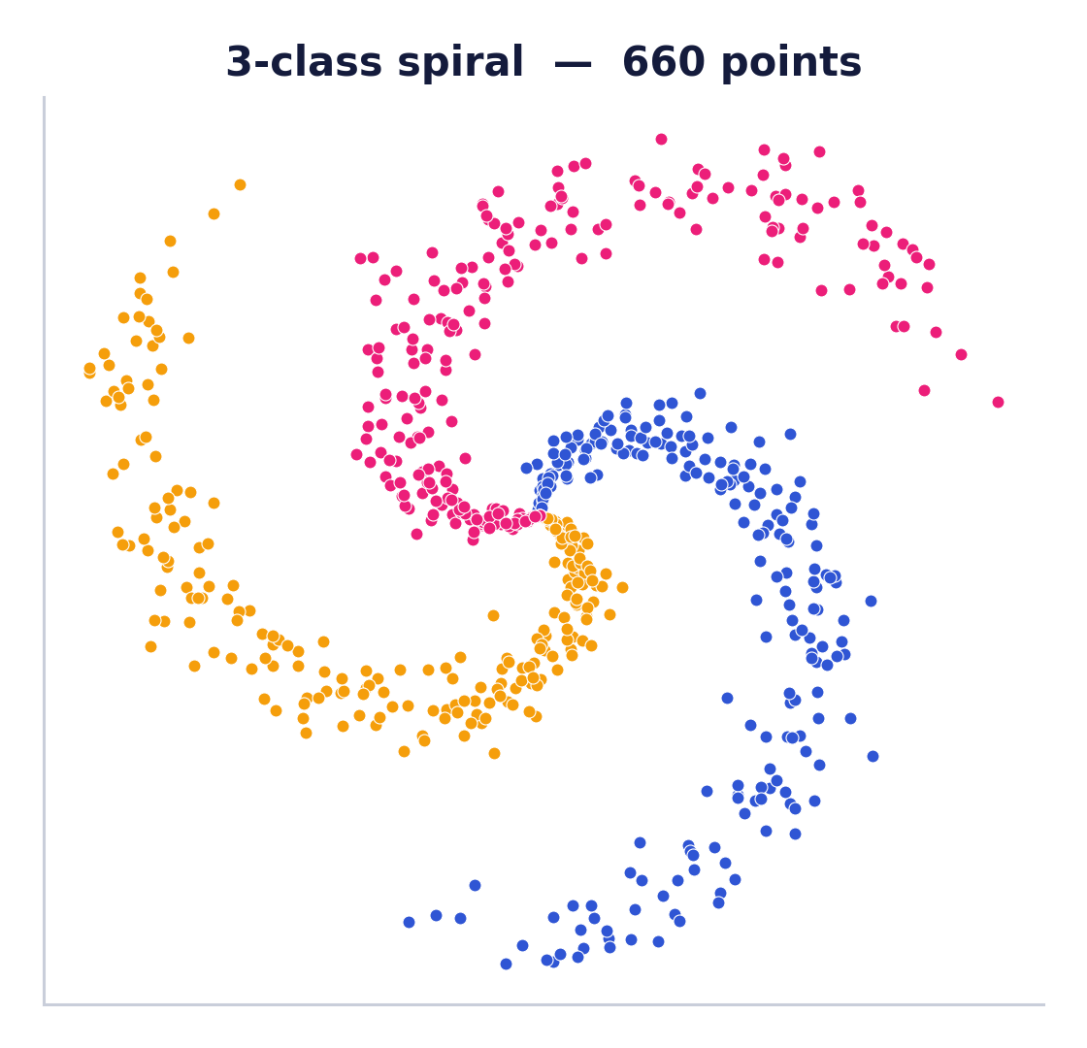
YOUR TURN · VOTE
Before we run it — place your bet
This is the spiral every network below must learn to separate. On the same architecture, which activation ends up most accurate? Commit to a guess now.
A
Sigmoid
B
Tanh
C
ReLU
D
GELU / Swish
Activation Functions
18
Notes:
Run an actual show-of-hands or a live poll. Predictions make people care about the result — they've now got skin in the game. Most rooms vote ReLU or GELU; the surprise is that the top four essentially tie, and the real story is WHY the losers lose.

Slide 18
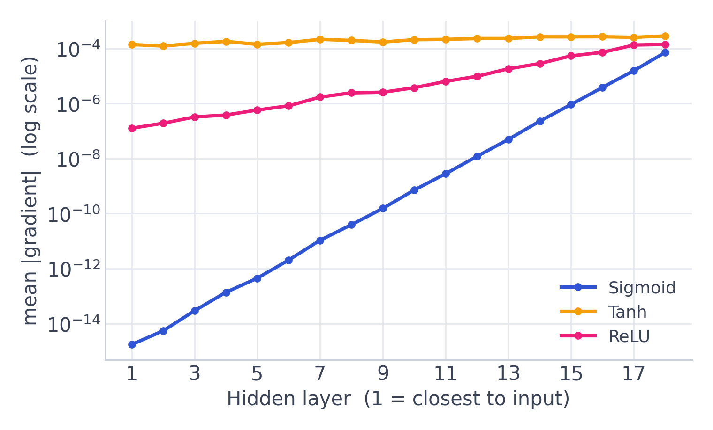
EXPERIMENT 1
The vanishing gradient, measured
A single backward pass through an 18-layer network. We plot the average gradient reaching each hidden layer.
Sigmoid's input layer sees a gradient ~10¹⁰× smaller than its output layer — signal gone.
ReLU decays only mildly.
Tanh holds nearly flat — zero-centering plus matched init pays off.
Verdict. Slide 8's claim, confirmed on real numbers. Saturating + not-zero-centered = catastrophic.
Activation Functions
19
Notes:
Payoff for the promise on slide 8. The log axis is doing real work: sigmoid drops off the bottom of the chart. Note the honest nuance — tanh survives here, which tells you zero-centering, not just saturation, is what really hurt sigmoid.

Slide 19
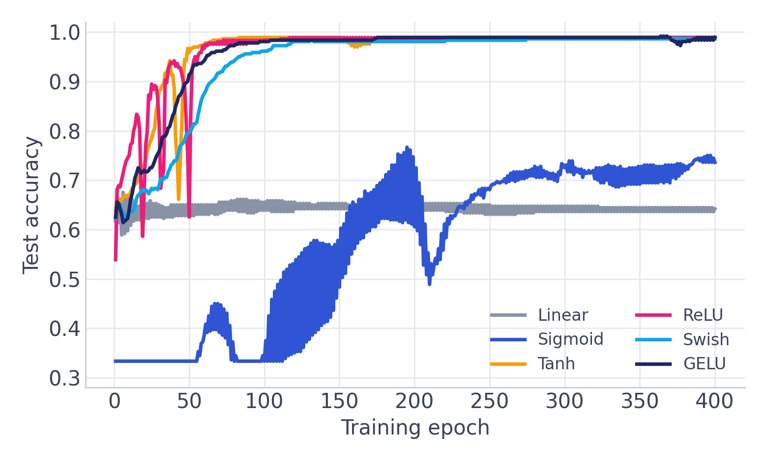
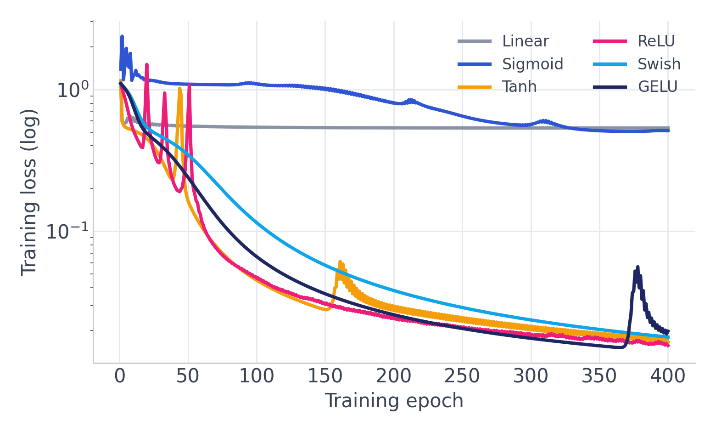
EXPERIMENT 2 · THE REVEAL
The great bake-off
Left: test accuracy. Right: training loss (log). Linear is stuck at 64%. Sigmoid thrashes and stalls near 74%. Everyone non-saturating rockets to ~99%.
Activation Functions
20
Notes:
The vote reveal. Watch the sigmoid curve thrash — that instability IS the vanishing/saturation problem showing up in training. Linear never even leaves the ground. The moderns are a blur at the top; that blur is the real headline for the next slide.

Slide 20
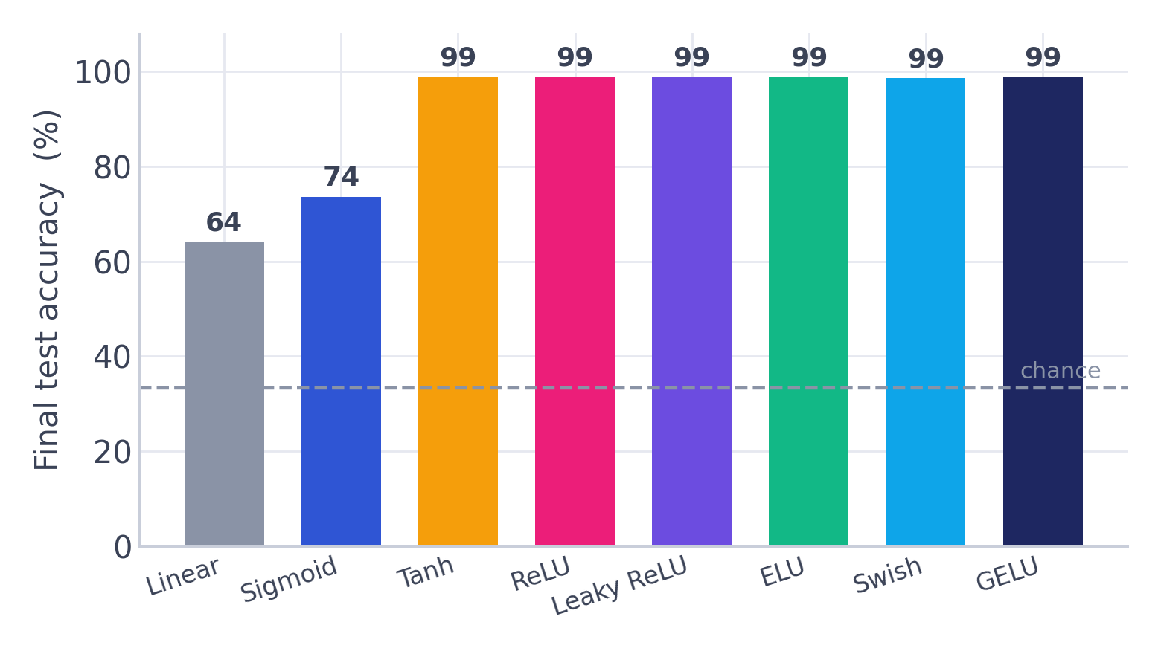
EXPERIMENT 2 · SCOREBOARD
So who actually won?
It's a photo finish
Non-linearity is decisive: linear 64% vs the rest.
Sigmoid pays for saturation — a distant 74%.
Tanh, ReLU, Leaky, ELU, Swish, GELU all land at ~99%.
On an easy problem, final accuracy does NOT separate the modern activations.
So how do we choose? If accuracy ties, the tie-breakers are stability, cost, and robustness — the next three experiments.
Activation Functions
21
Notes:
Key mindset shift: 'best' is not a single number. The moderns tie on accuracy here, so the decision has to be made on other axes. This reframes the rest of the lab and kills the naive 'which one is best' question.

Slide 21
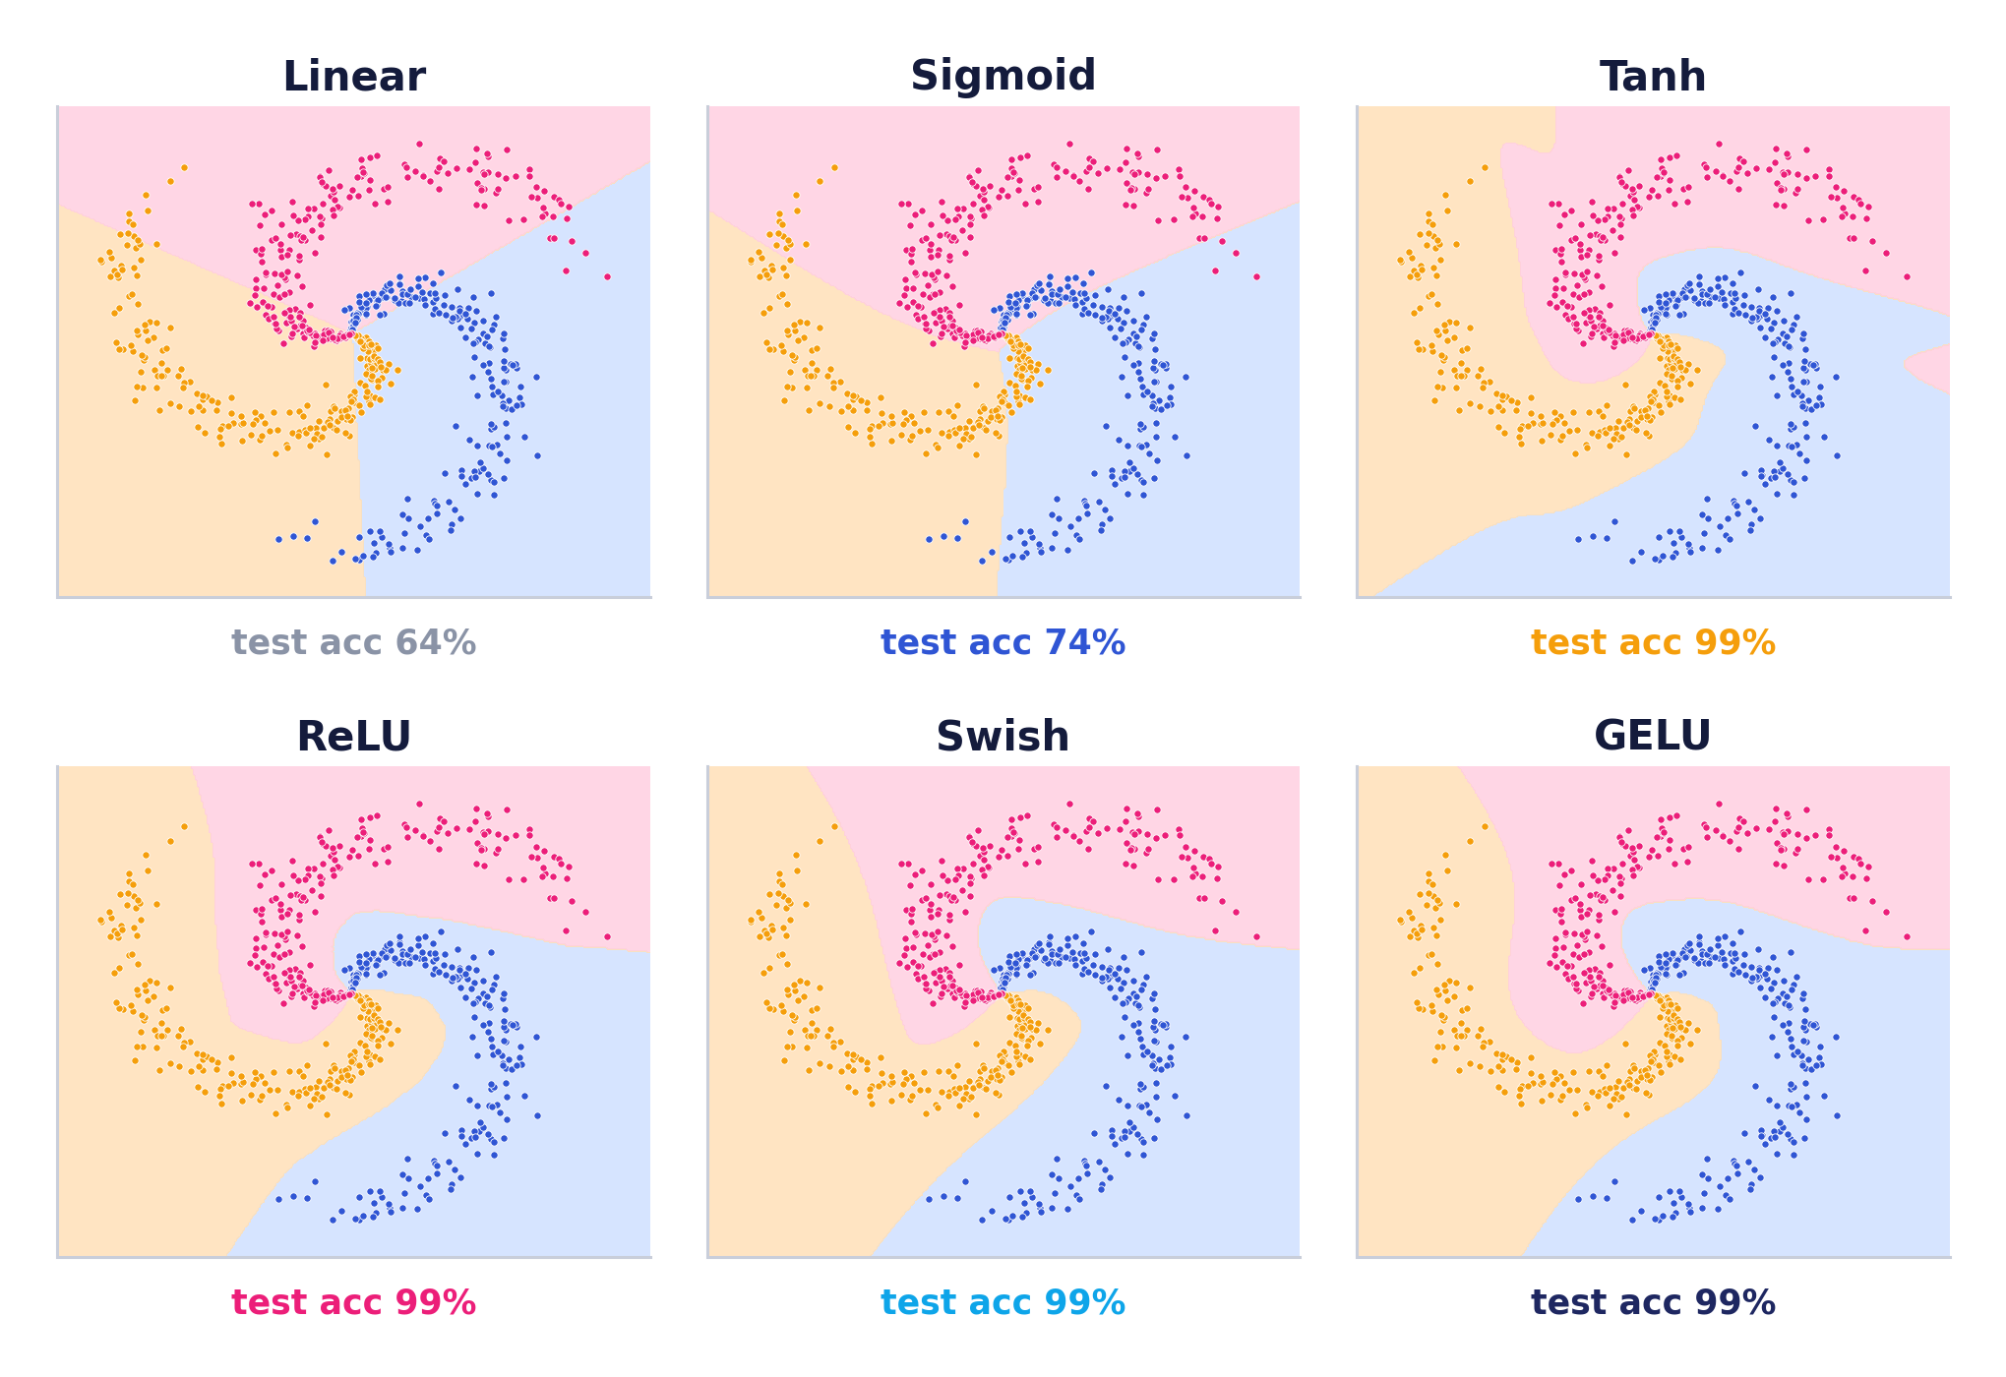
EXPERIMENT 3
What each network actually learned
Read the shapes
Linear can only cut with straight lines — the spiral defeats it.
Sigmoid bends a little but still can't wrap the arms.
ReLU carves the spiral with sharp, piecewise-linear facets.
Swish & GELU trace it with smooth curves — same accuracy, different texture.
Activation Functions
22
Notes:
The visual that sticks. Have them stare at ReLU vs GELU: identical accuracy, visibly different boundary character (angular vs smooth). This is what 'the activation shapes the function class' means — you can literally see it.

Slide 22
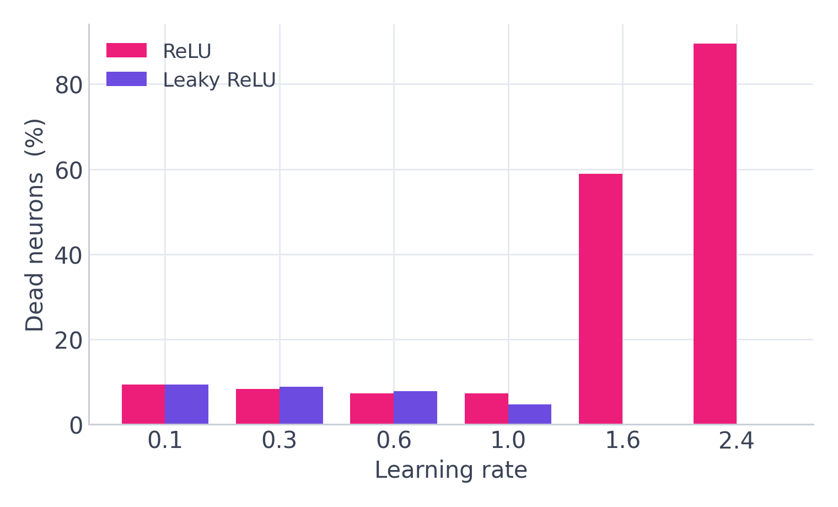
EXPERIMENT 4
Dying ReLU, caught in the act
We crank the learning rate and count neurons that output 0 for every single training point.
At sane rates, ~7% of ReLU units are idle — harmless.
Past LR ≈ 1.6 the death rate explodes: 59%, then 90%.
As the neurons die, ReLU's accuracy collapses to chance (33%).
Leaky ReLU keeps a trickle of negative gradient — its neurons essentially never die.
Lesson. The dying ReLU is real, but it's a symptom of too-high LR. Leaky/ELU are the insurance.
Activation Functions
23
Notes:
We didn't just assert dying ReLU — we caused it and measured it. Tie it back to slide 11. The practical takeaway: if ReLU is dying, your learning rate is probably too high; leaky/ELU are the cheap insurance.

Slide 23
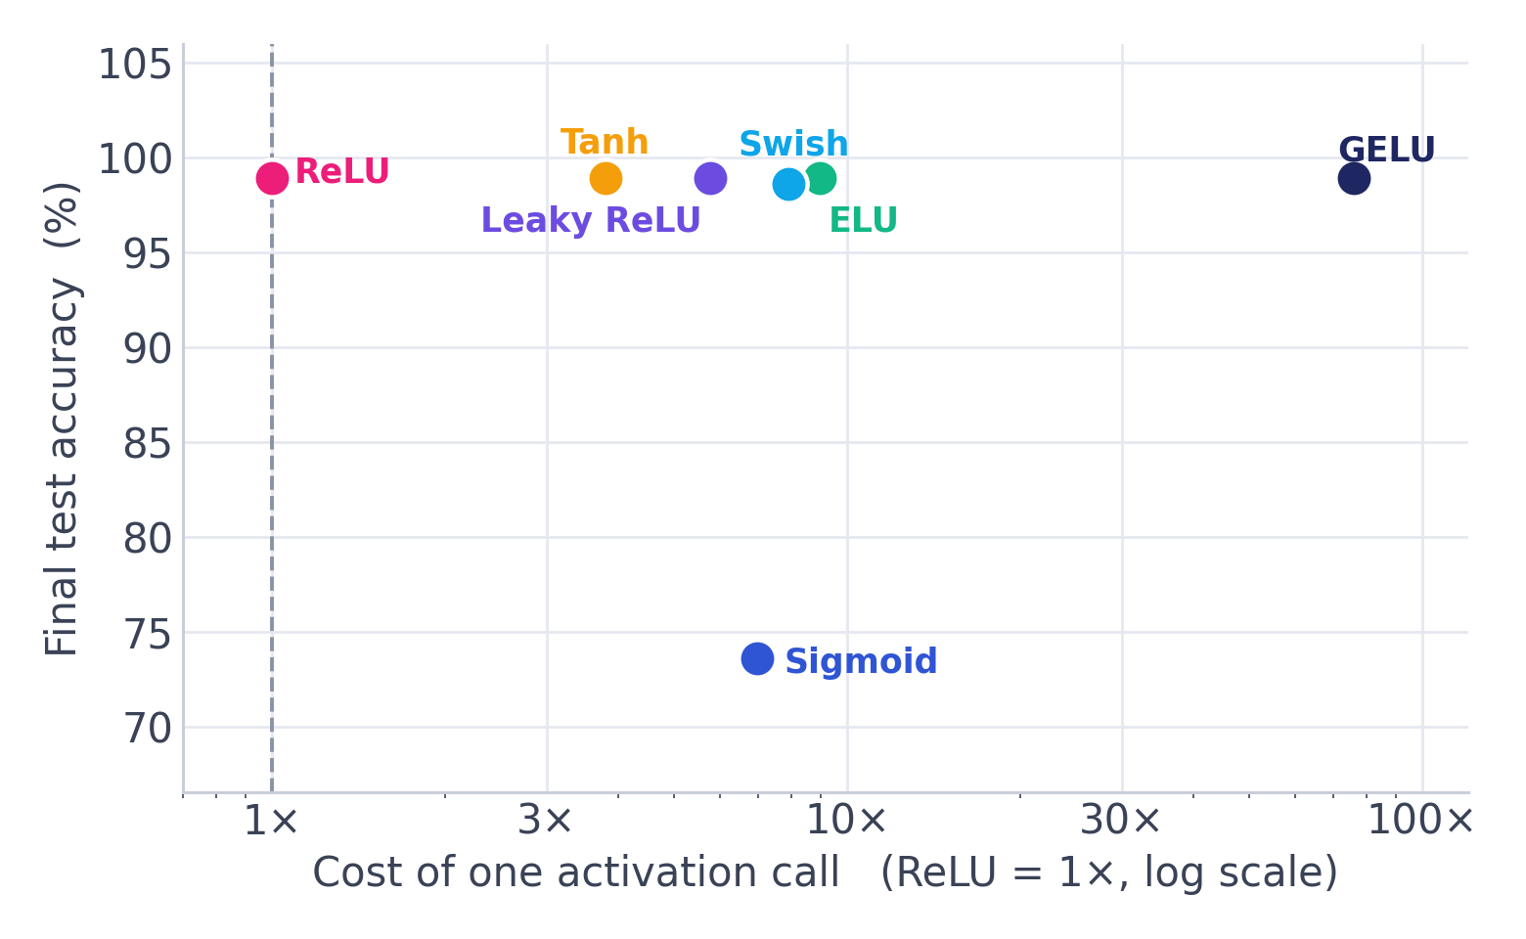
EXPERIMENT 5
“Best” has more than one axis
Cost is the tie-breaker
Top-left is best: high accuracy, low cost. ReLU sits there alone.
Sigmoid is the worst of both worlds — costly AND inaccurate.
Moderns match ReLU's accuracy but cost several × more per call.
ReLU's real edge isn't accuracy — it's being a single comparison.
Activation Functions
24
Notes:
Honesty slide: I flag that my cost numbers overstate the modern activations because pure NumPy doesn't fuse kernels. The DIRECTION is right though — ReLU is genuinely the cheapest op. 'Best' depends on which axis you optimise.

Slide 24
THE VERDICT
Is there a single best activation?
No — and the experiments show why. Match the function to the job:
DEFAULT
IF IT DIES
DEEP / NLP
OUTPUT
ReLU
Leaky / ELU
GELU · Swish
Sigmoid · Softmax
Cheapest, ~99% on the spiral. Start here for CNNs & MLPs.
Insurance against dead neurons at higher learning rates.
Same accuracy, smoother; the transformer standard.
Binary → sigmoid, multi-class → softmax. Not for hidden layers.
The evidence-based rule: non-linearity is non-negotiable; among the moderns, choose on cost and stability, not a leaderboard.
Activation Functions
25
Notes:
Synthesise the whole lab into a decision, not a ranking. The line to land: 'best' is context — the experiments replaced opinion with a rule you can defend.

Slide 25
CHEAT SHEET
Every function at a glance
Function | Formula | Range | Best used for
Sigmoid | 1/(1+e⁻ˣ) | (0, 1) | Binary output
Tanh | (eˣ−e⁻ˣ)/(eˣ+e⁻ˣ) | (−1, 1) | RNN hidden layers
ReLU | max(0, x) | [0, ∞) | Default hidden layers
Leaky ReLU | x if x>0 else αx | (−∞, ∞) | Dying-ReLU fix
ELU | x if x>0 else α(eˣ−1) | (−α, ∞) | Robust deep nets
Swish | x·σ(x) | (≈−0.28, ∞) | Deep CNNs
GELU | x·Φ(x) | (≈−0.17, ∞) | Transformers
Softmax | eˣⁱ / Σ eˣʲ | (0,1), Σ=1 | Multi-class output
Activation Functions
26
Notes:
The printout slide — tell them to photograph this one. It's the summary they'll actually reuse.

Slide 26
TAKEAWAYS
Five things to remember
1
Non-linearity is the whole point
4
“Best” is multi-dimensional
Without it, a deep net collapses to one line — 64% vs 99% on the same data.
On easy tasks the moderns tie on accuracy — choose on cost and stability.
2
ReLU is the default
5
Match the output to the task
One comparison, no exponentials, ~99% accuracy. Start here, then tune.
Sigmoid for binary, Softmax for multi-class, Linear for regression.
3
Mind the gradients
Small formulas, huge impact on what a network can learn.
Sigmoid's signal vanishes 10¹⁰× by the input layer. Zero-centered, non-saturating flows.
Activation Functions
29
Notes:
Close on the reframe: they arrived expecting a glossary and leave with a decision rule backed by their own experiments. Point back to the vote — the data, not intuition, settled it.

