Slide 1
BackPropagation and Dropout
Introduction to Deep Learning

Slide 2
Slide Credits
https://www.youtube.com/watch?v=tIeHLnjs5U8&list=RDCMUCYO_jab_esuFRV4b17AJtAw&start_radio=1

Slide 3
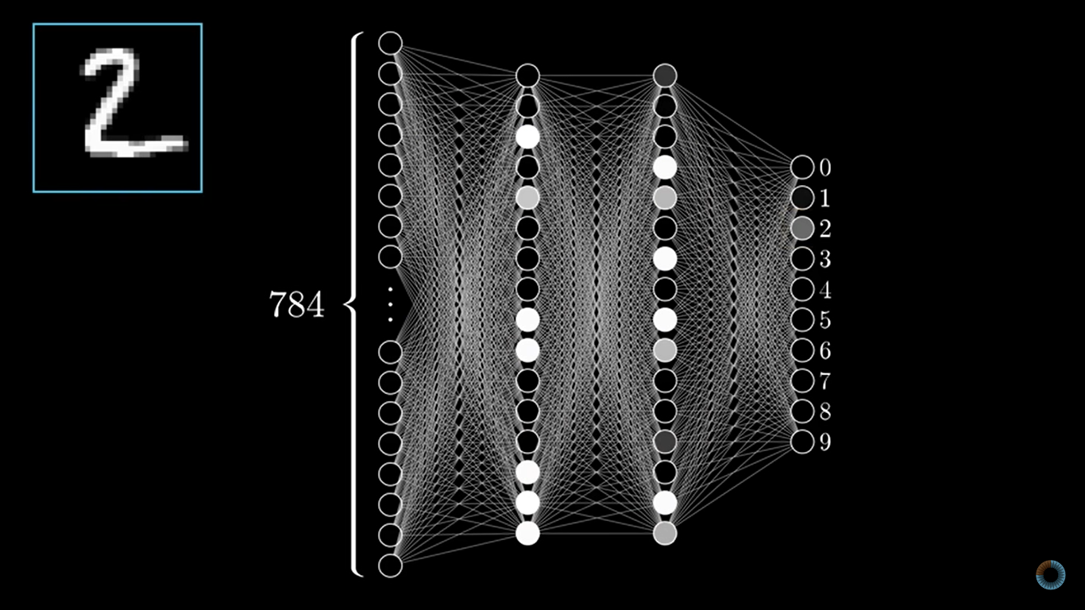

Slide 4
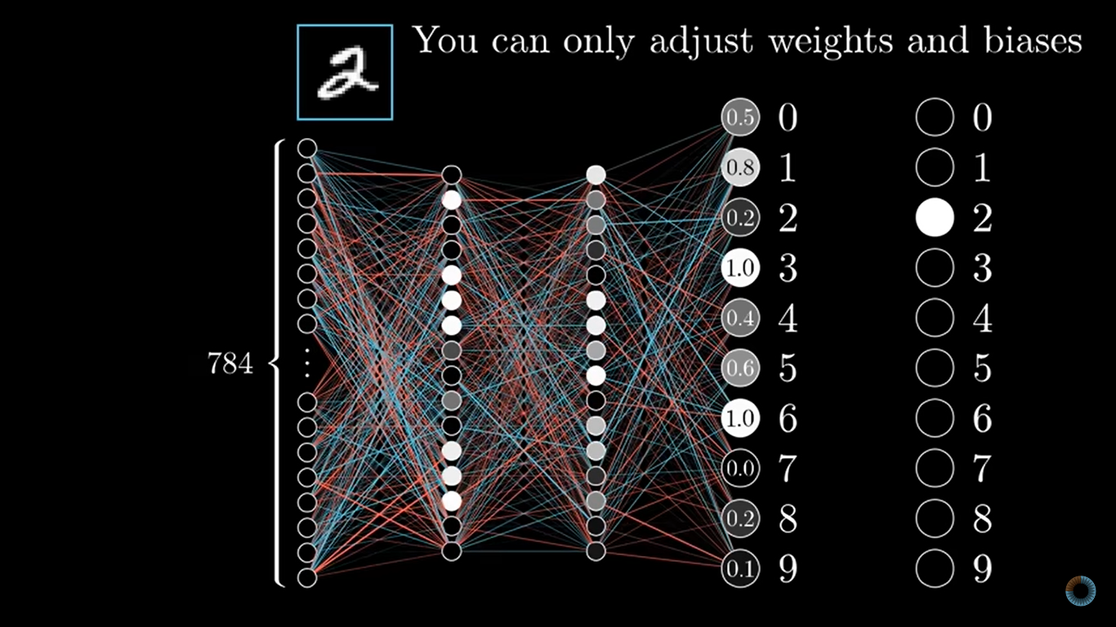

Slide 5
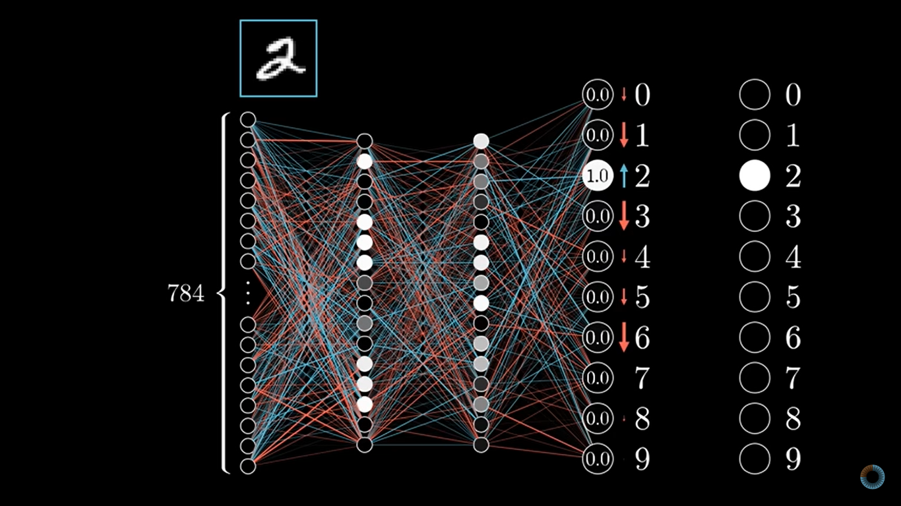

Slide 6
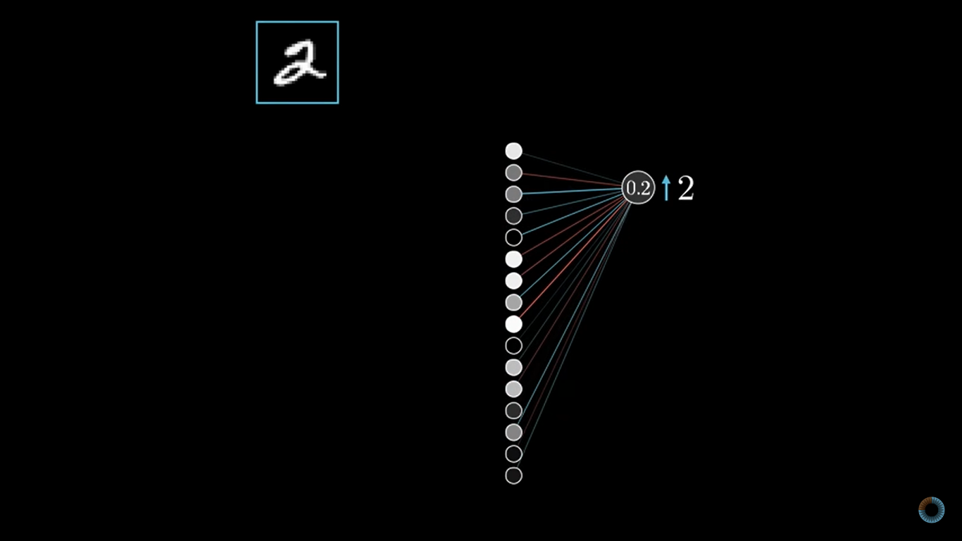

Slide 7
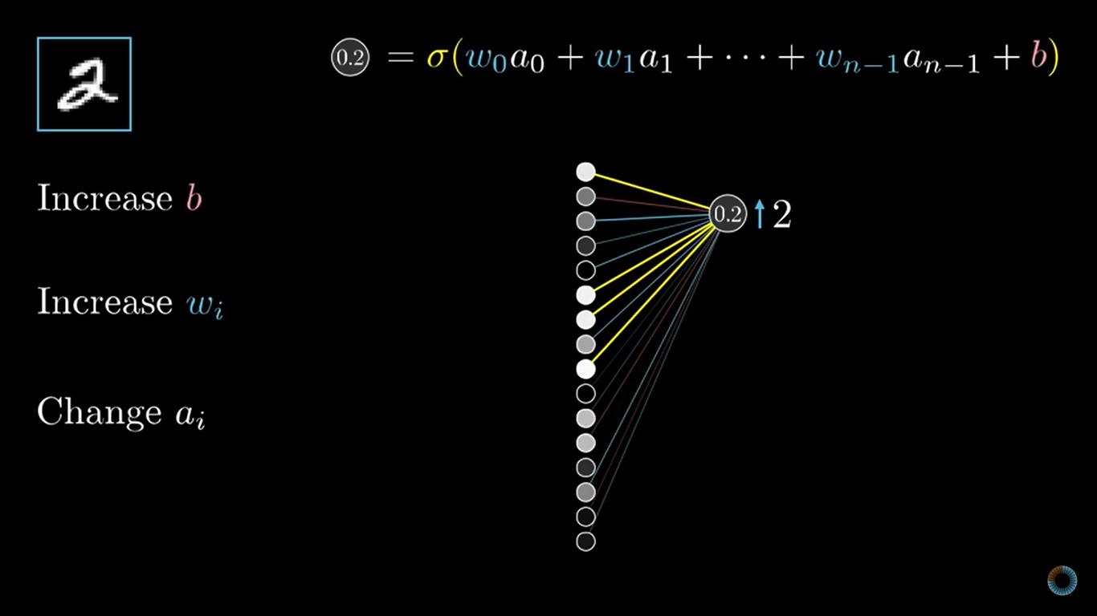

Slide 8
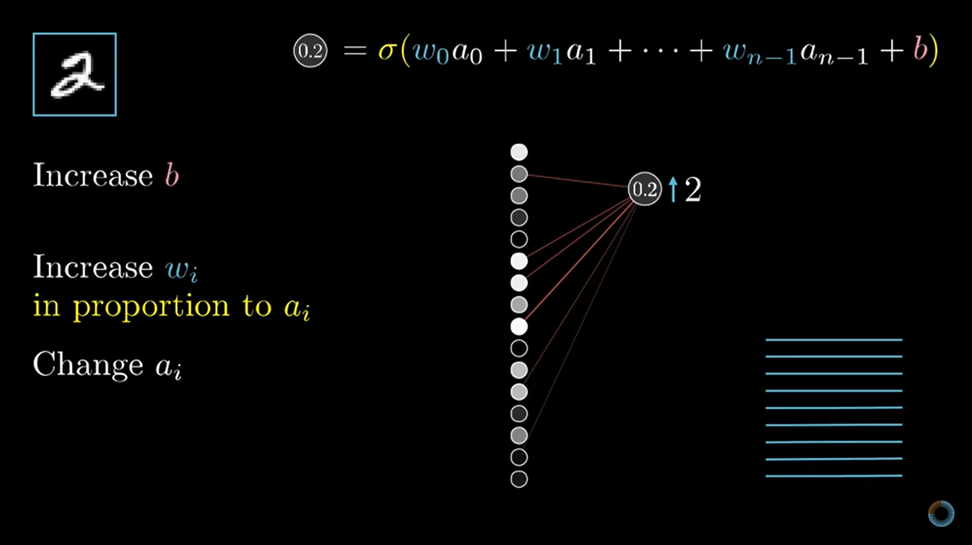

Slide 9
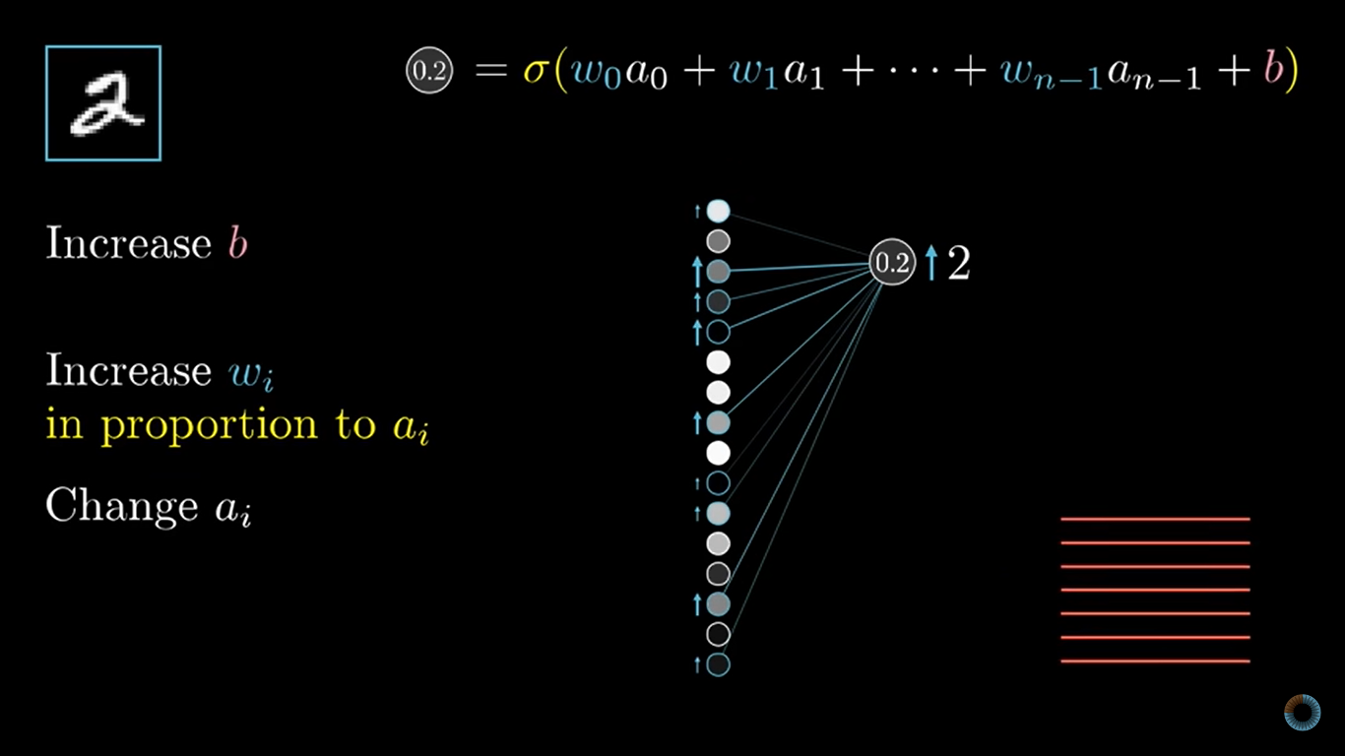

Slide 10
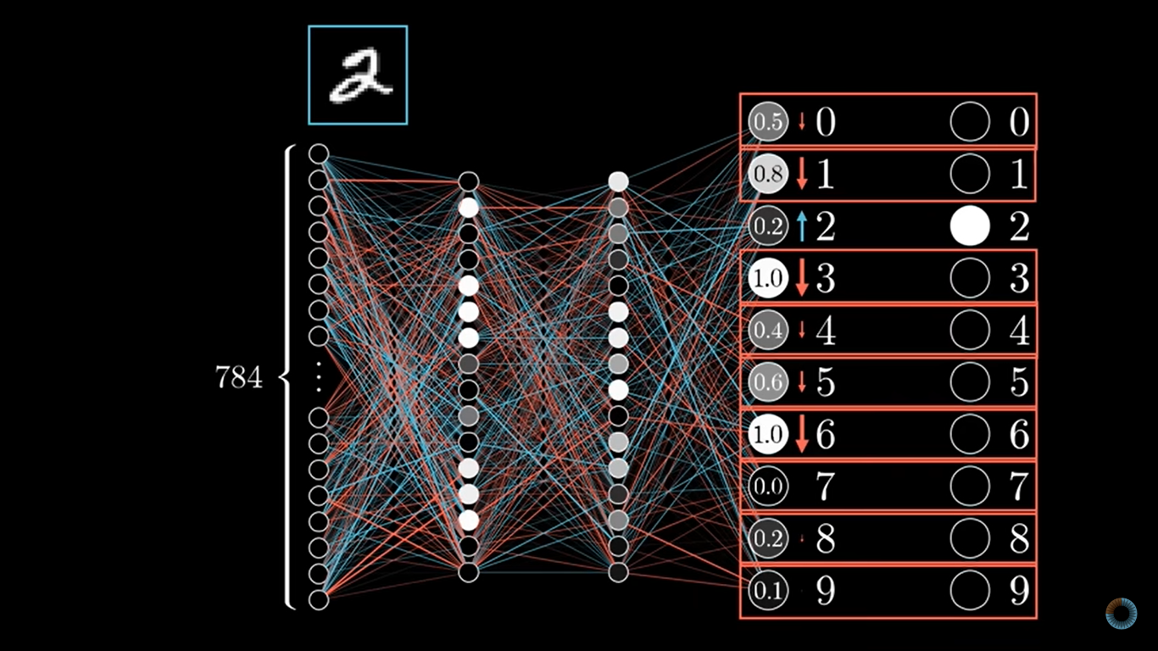

Slide 11
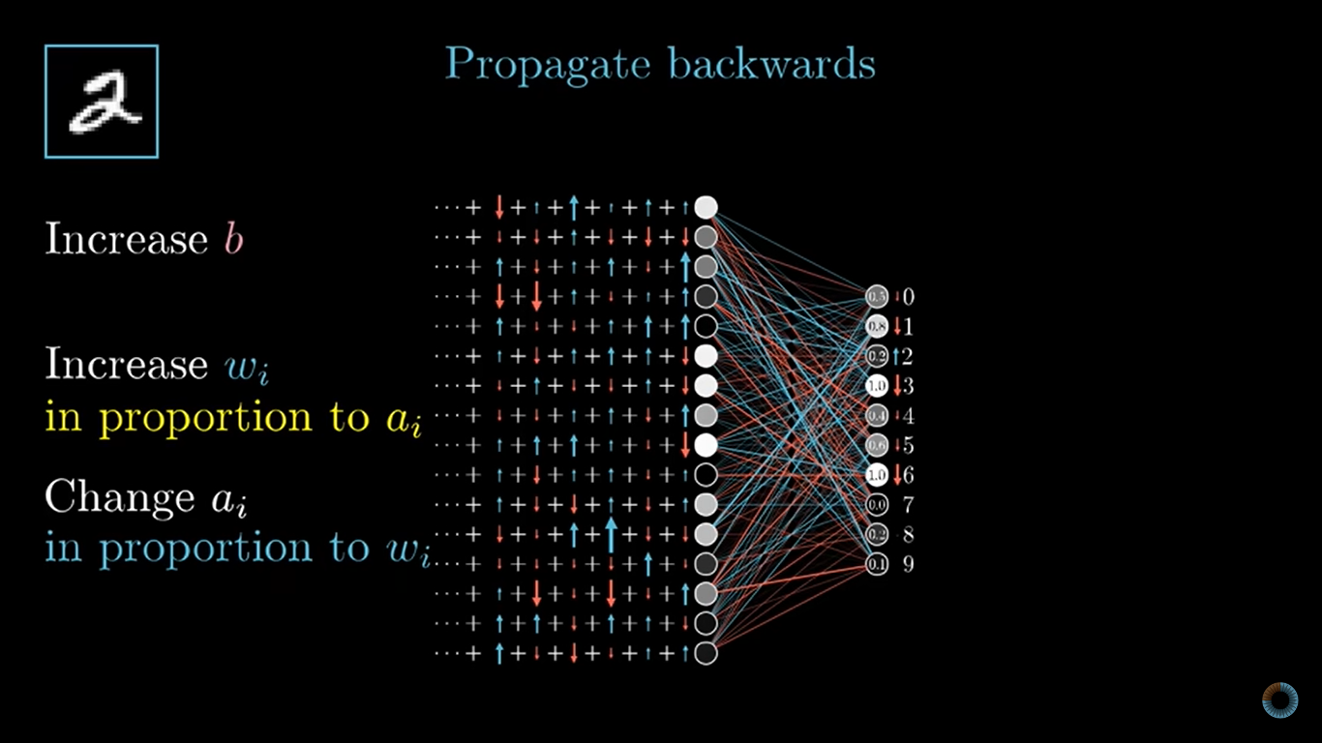

Slide 12
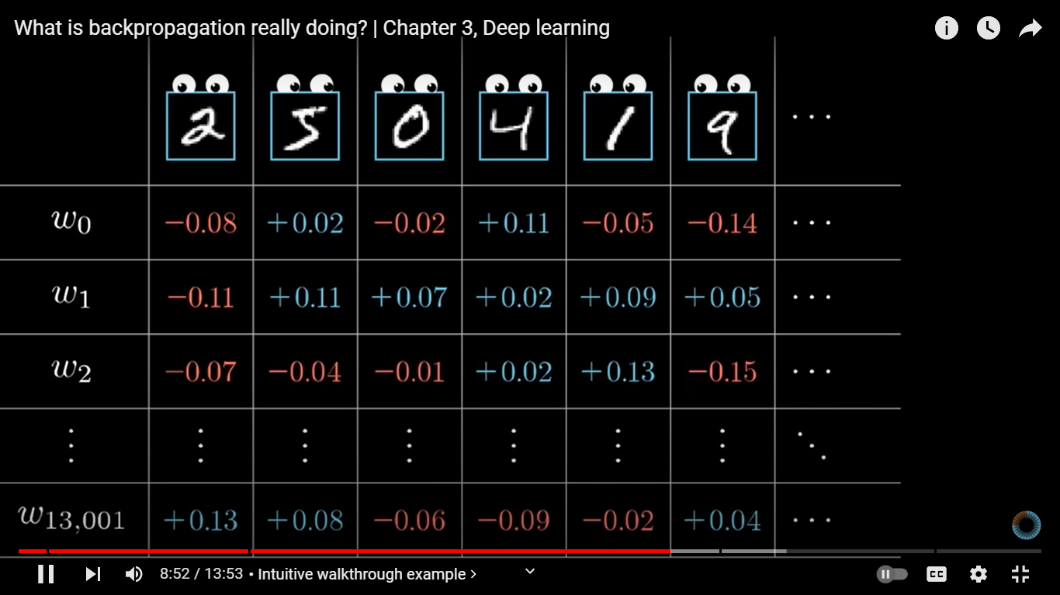
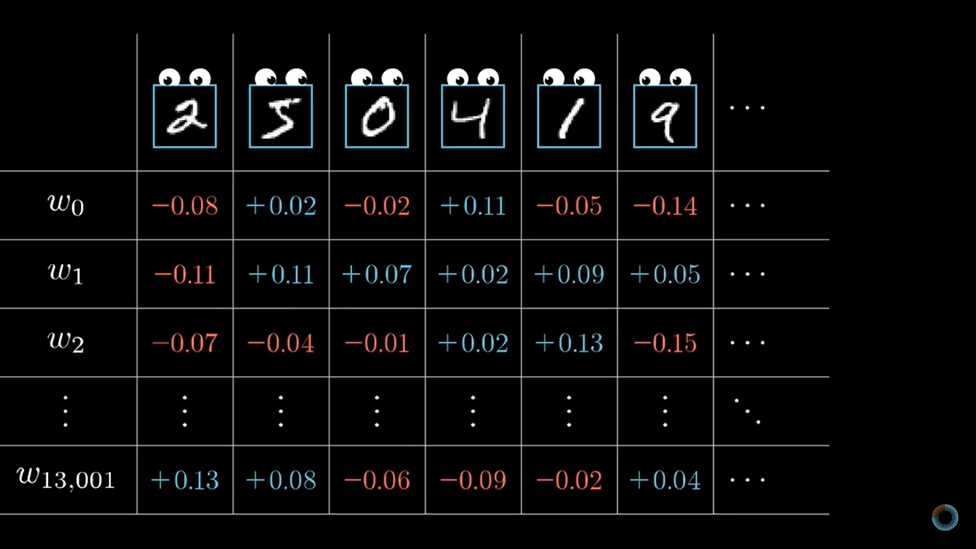

Slide 13
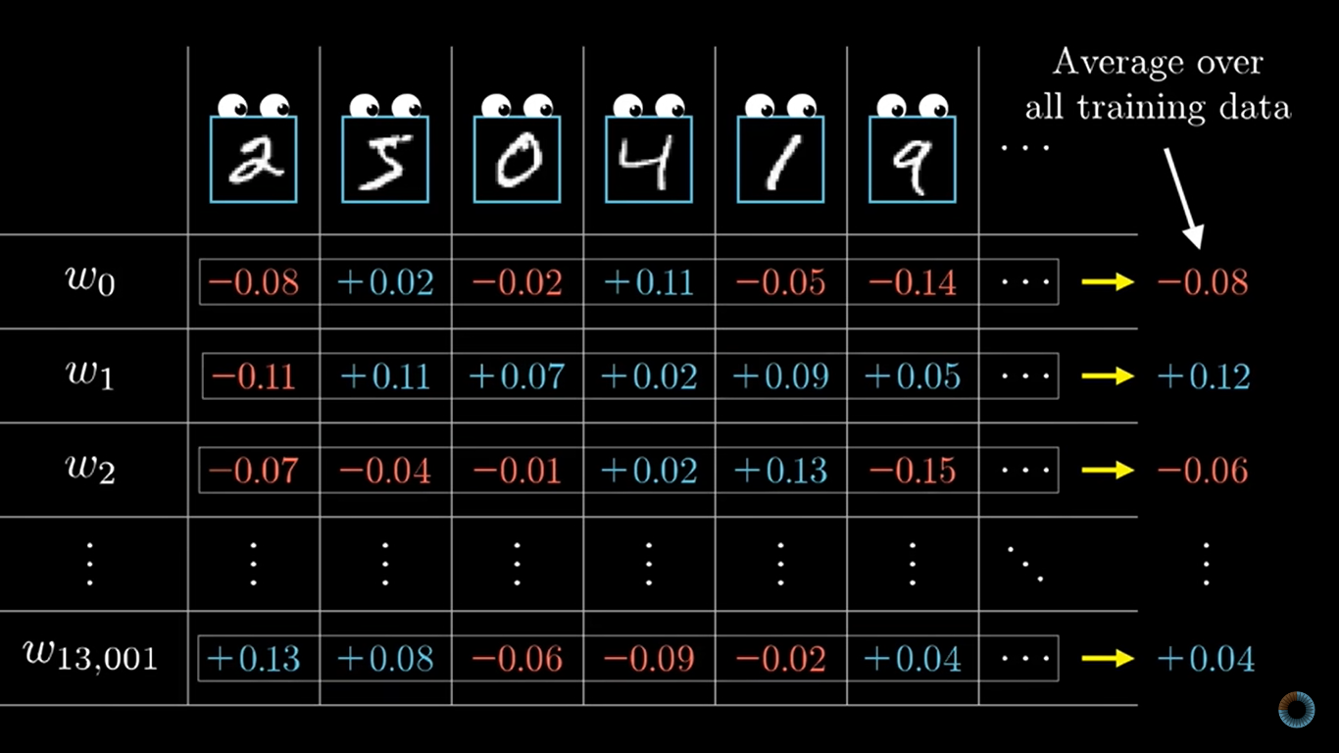

Slide 14
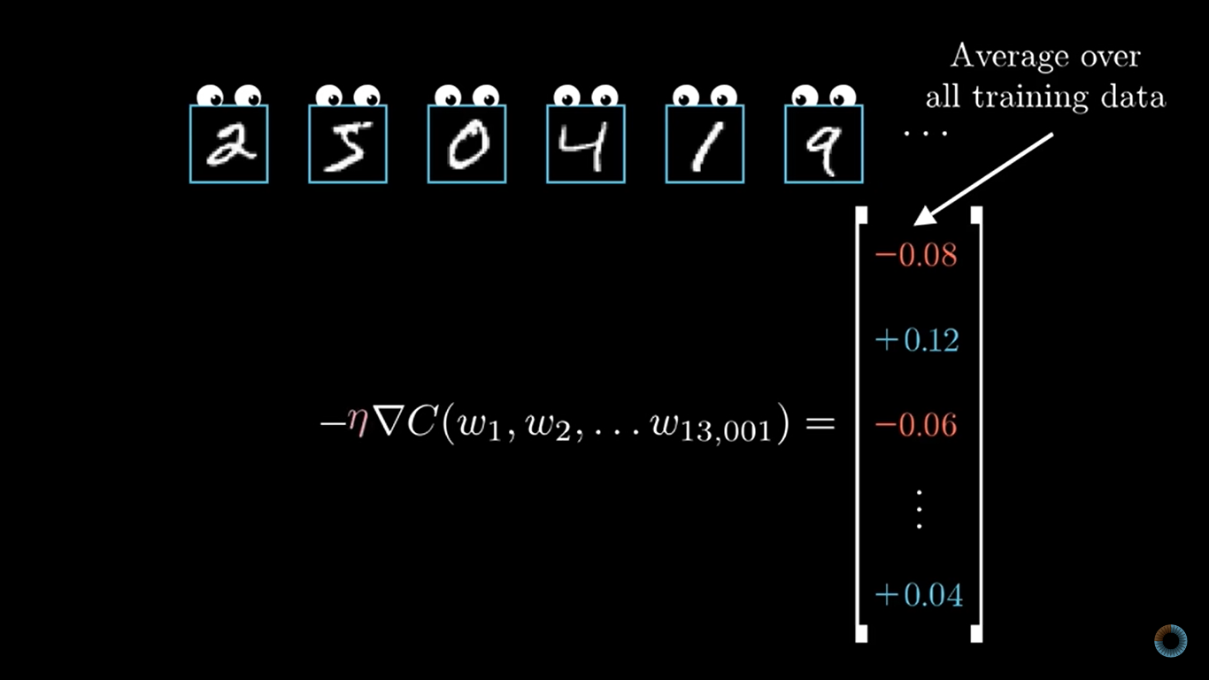

Slide 15
Lets assume a simple network

Slide 16
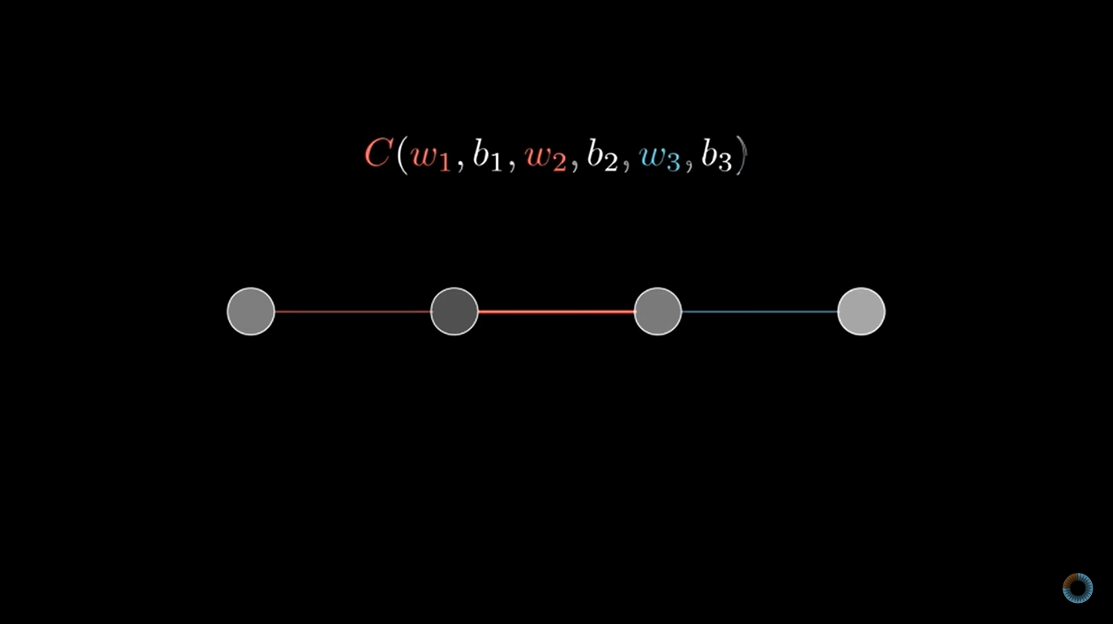

Slide 17
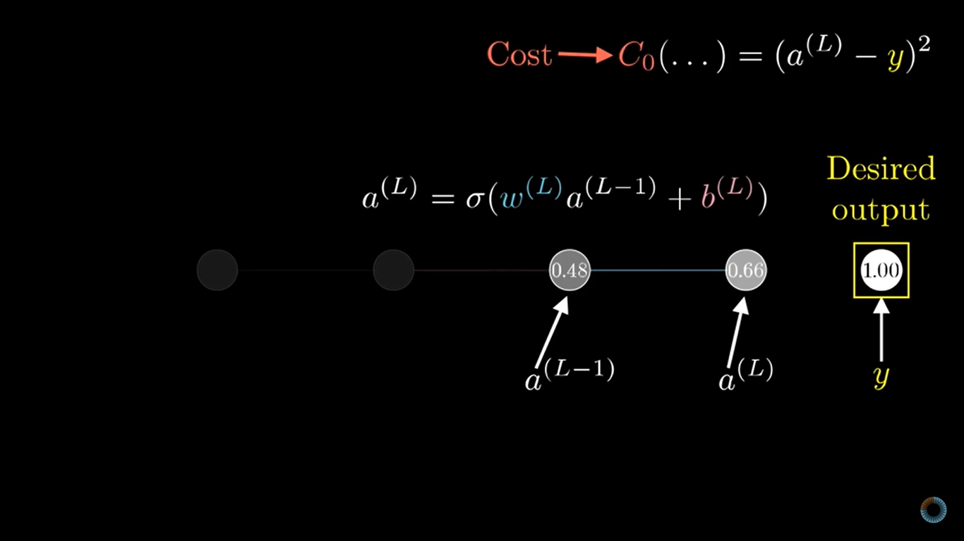

Slide 18
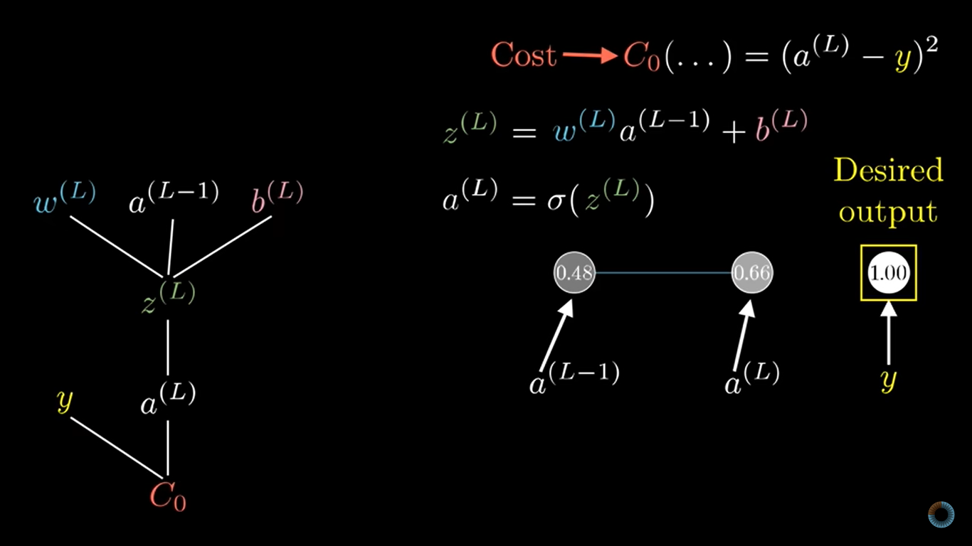

Slide 19
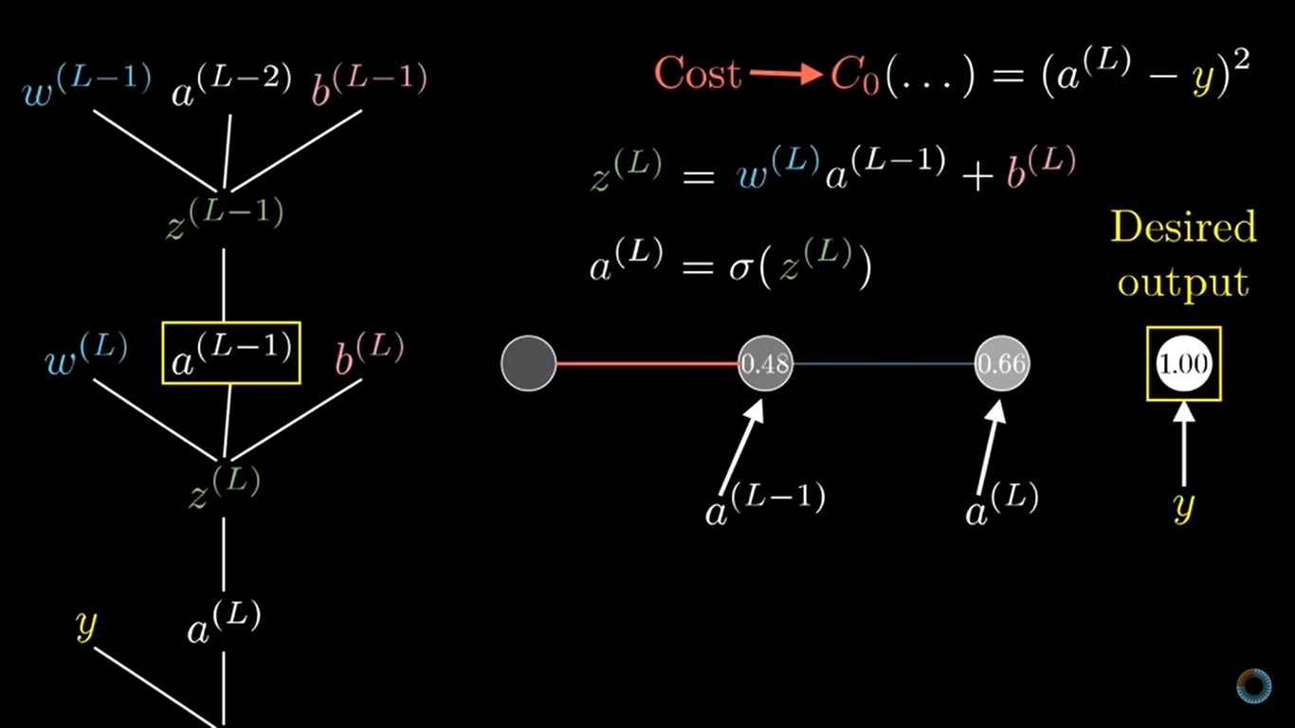

Slide 20
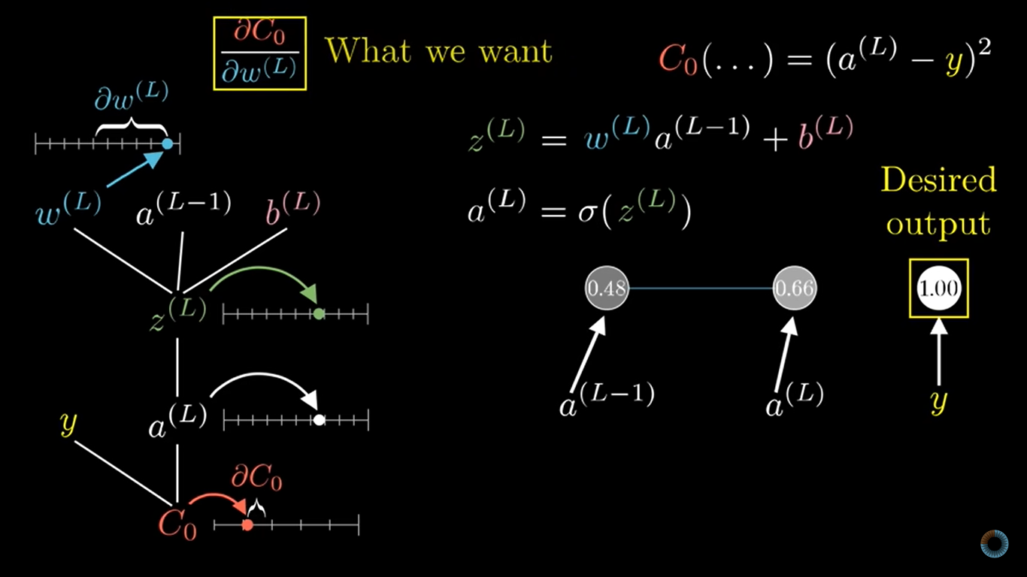

Slide 21
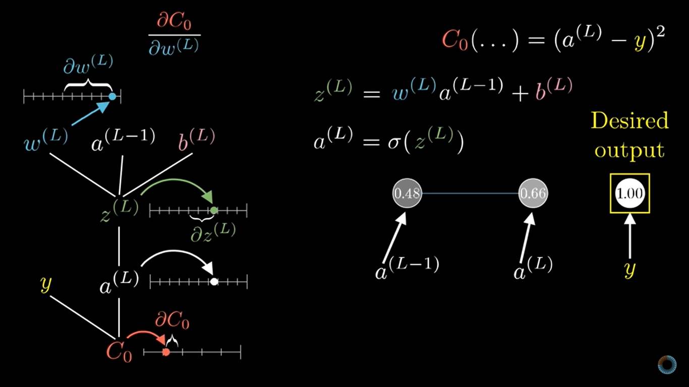

Slide 22
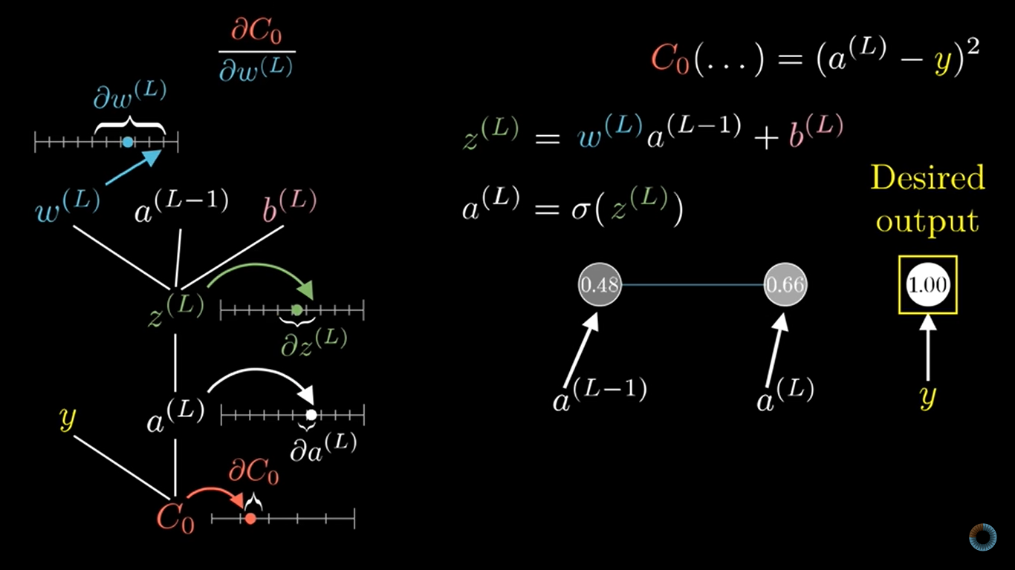

Slide 23
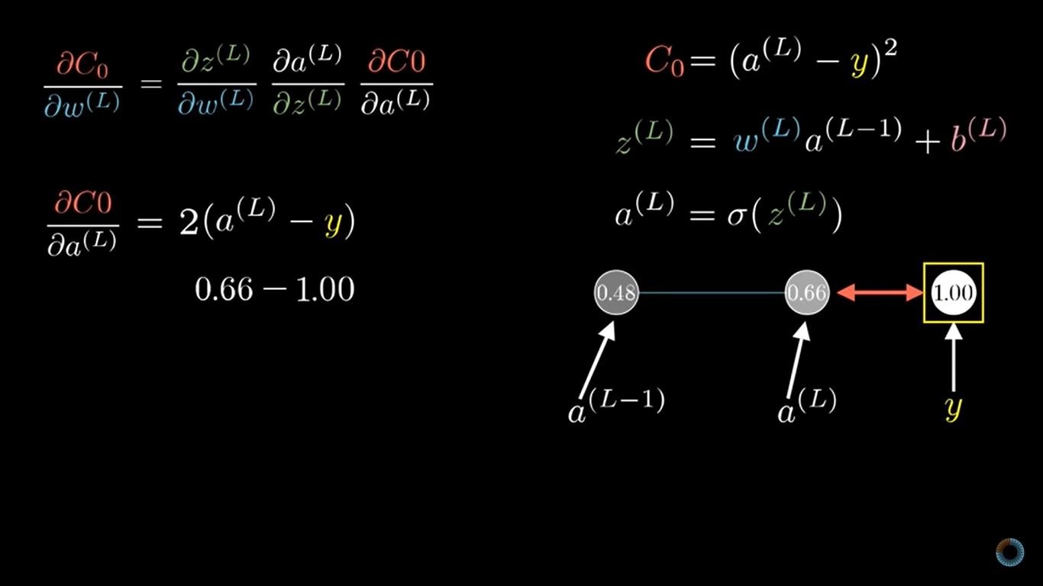

Slide 24
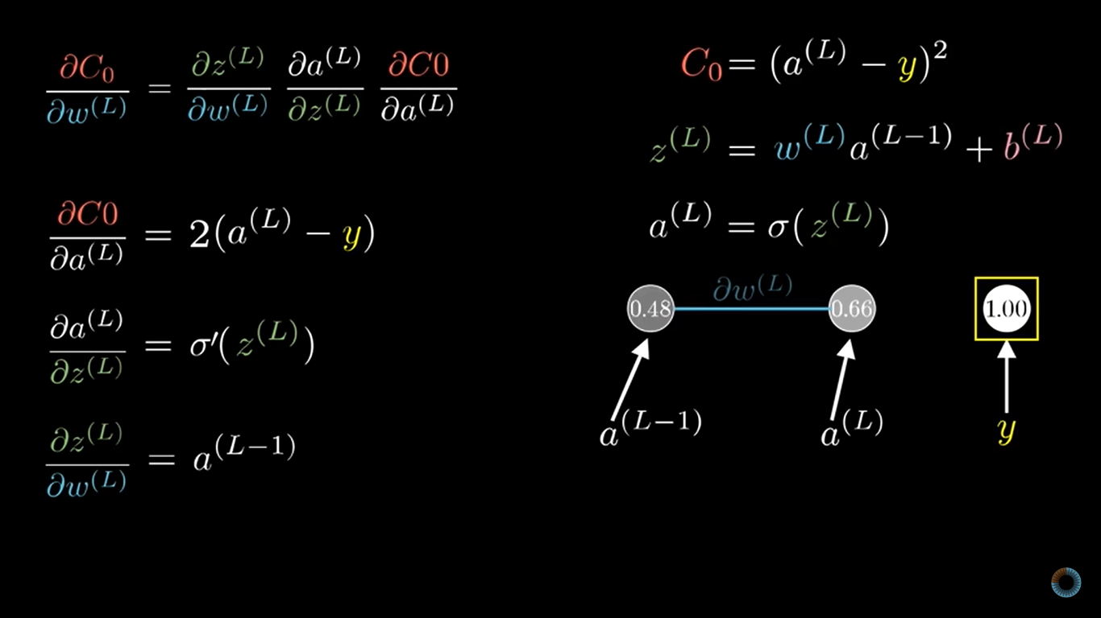

Slide 25
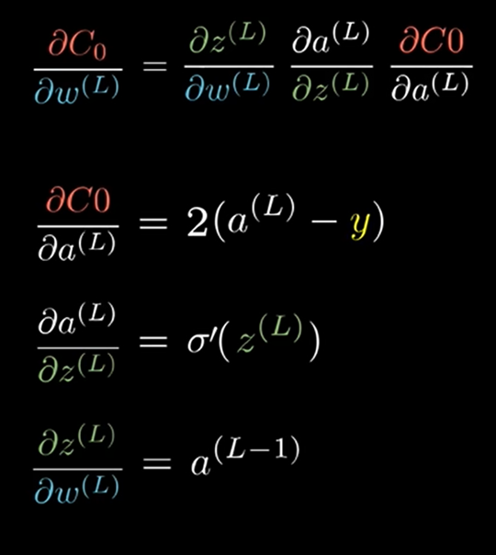
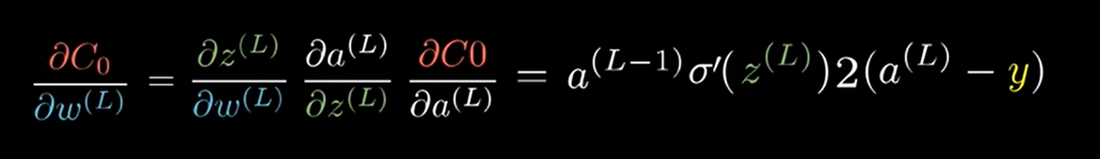

Slide 26
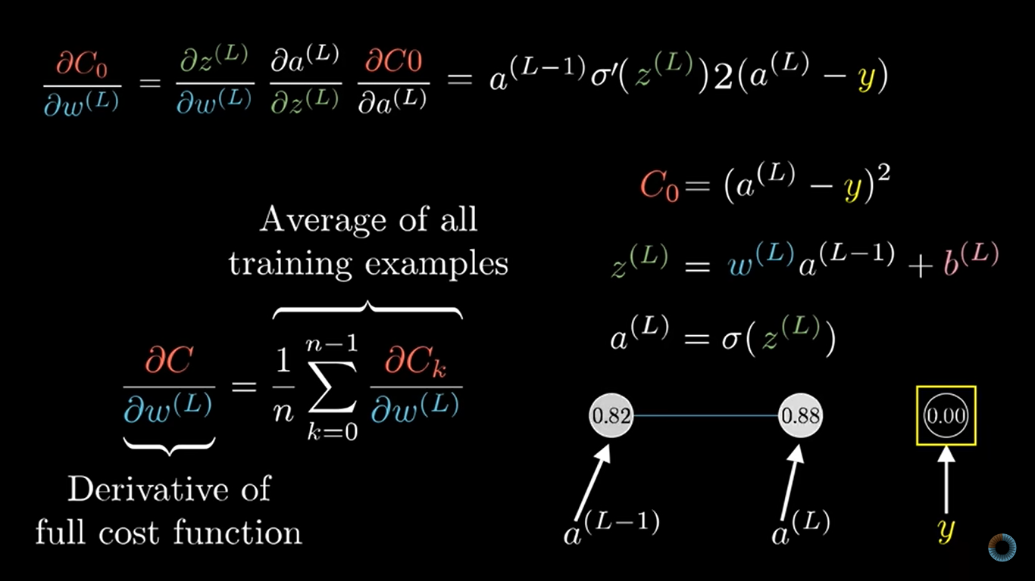

Slide 27
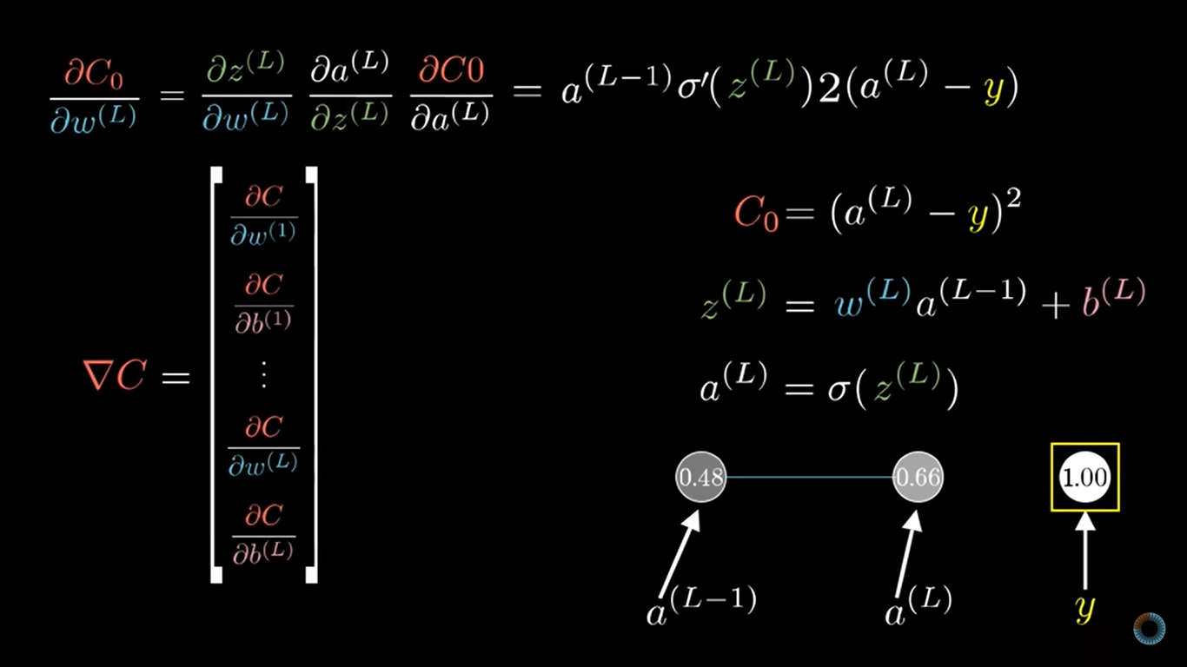

Slide 28
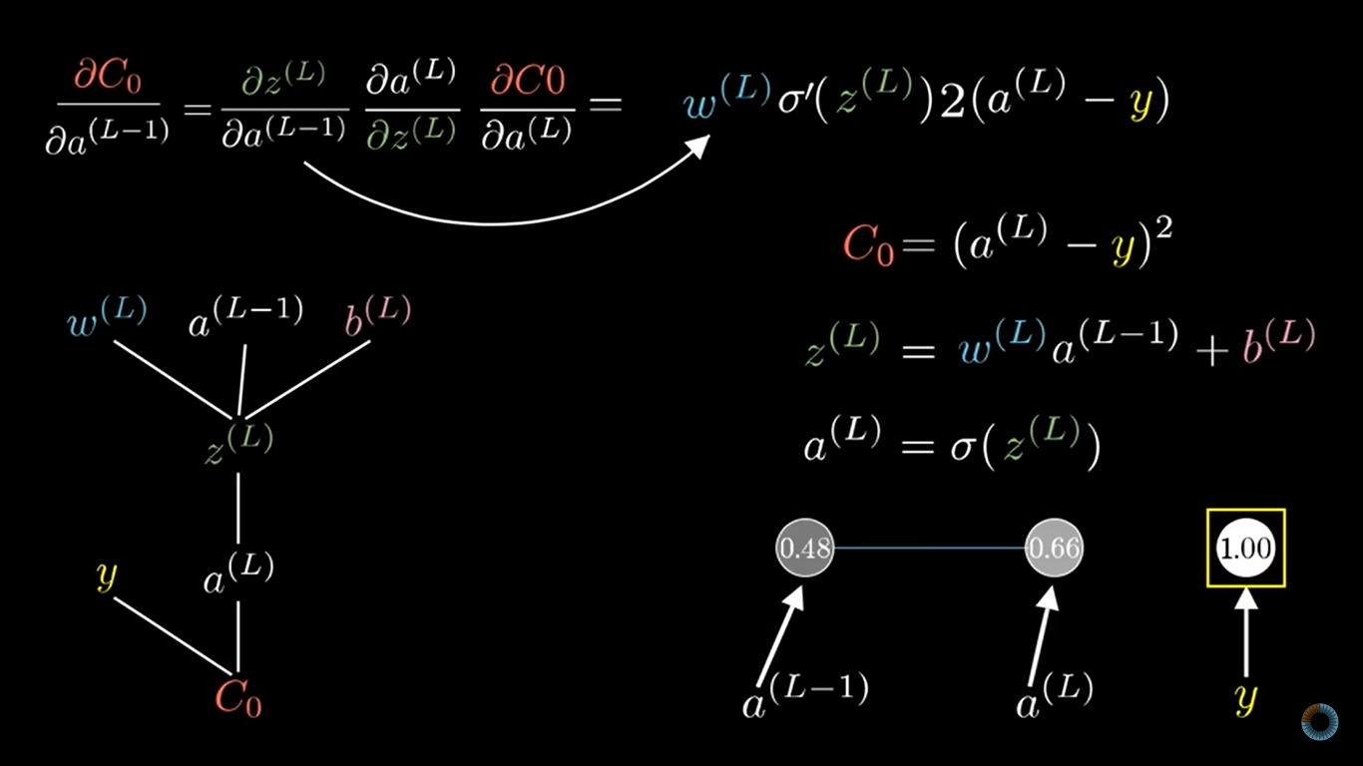

Slide 29
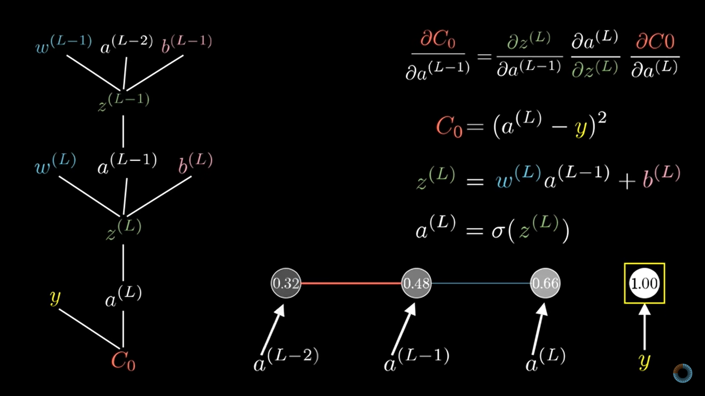

Slide 30
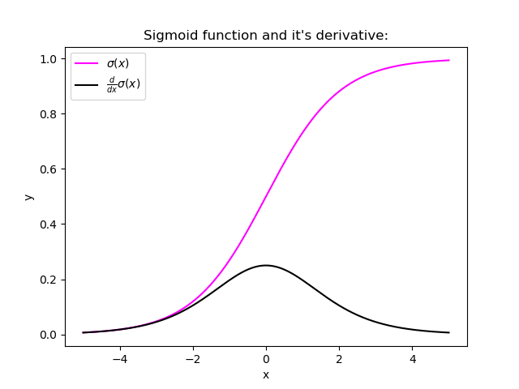

Problem: Vanishing Gradient
Or, bad Property
A small gradient means that the weights and biases of the initial layers will not be updated effectively with each training session. Since these initial layers are often crucial to recognizing the core elements of the input data, it can lead to overall inaccuracy of the whole network.

Slide 31
Dropout
Training:
Each time before updating the parameters
Each neuron has p% to dropout

Slide 32
Dropout
Training:
Thinner!
Each time before updating the parameters
Each neuron has p% to dropout
The structure of the network is changed.
Using the new network for training
For each mini-batch, we resample the dropout neurons

Slide 33














Dropout
Training of Dropout
Testing of Dropout
Assume dropout rate is 50%
No dropout
$$w_{1}$$
$$0.5×$$
$$w_{1}$$
$$w_{2}$$
$$z$$
$$0.5×$$
$$w_{2}$$
$$z^{′}$$
$$w_{3}$$
$$0.5×$$
$$w_{3}$$
$$w_{4}$$
$$0.5×$$
$$w_{4}$$
Notes:
important

Slide 34
Dropout is a kind of ensemble.
Training Set
Ensemble
Set 1
Set 2
Set 3
Set 4
Network
1
Network
2
Network
3
Network
4
Train a bunch of networks with different structures

Slide 35
Dropout is a kind of ensemble.
Ensemble
Testing data x
Network
1
Network
2
Network
3
Network
4
y₁
y₂
y₃
y₄
average

Slide 36
Dropout is a kind of ensemble.
minibatch
1
minibatch
2
minibatch
3
minibatch
4
Training of Dropout
M neurons
……
2^{M} possible networks
Using one mini-batch to train one network
Some parameters in the network are shared

Slide 37
Dropout is a kind of ensemble.
Testing of Dropout
testing data x
All the weights multiply p%
……
y₁
y₂
y₃
average
≈
y
Notes:
0,0 -> 0
1,0 -> 1
0,-1 -> -2
1,-1 -> -1
½, -1/2 -> -0.5
1,2
Geometric Mean?

Slide 38
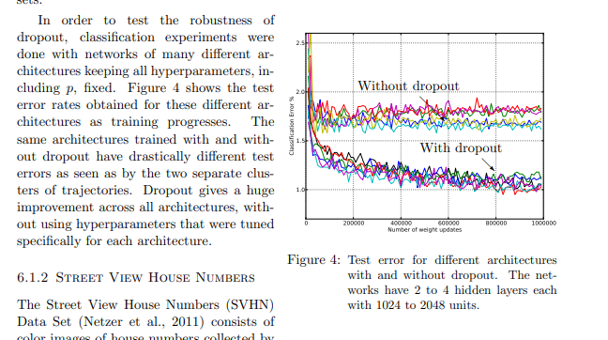
Some Results
Paper Name: Dropout: A Simple Way to Prevent Neural Networks from Overfitting

