Slide 1

Introduction to Deep learning
TEE7273
Tanveer Ahmed

Slide 2

Outline
Introduction to Deep Learning (DL)
Why deep learning?
Machine learning (ML)
Features
Weights
Artificial Neural Networks (ANN)
Loss function
Cost function
History of Deep Learning

Slide 3
Evaluation policy

Slide 4
Real Self Driving Cars
https://youtu.be/TUDiG7PcLBs
Notes:
We have autonomous vehicles and self-driving cars but before they can hit the road, they have to train and tested for different road situations. Obviously, newly created autonomous vehicles cannot be put on real roads. So there is a need to create a simulated environment for them to learn different road scenarios. Vista 2.0 is a simulator that presents the environment for self driving cars to learn. Using such simulation tools, the vehicle can be tested in different scenarios quickly and cost effectively. This reduces the need for physical road tests. Because simulation is conducted in a virtual environment, it continues to be faster, less expensive

Slide 5
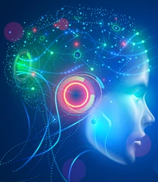
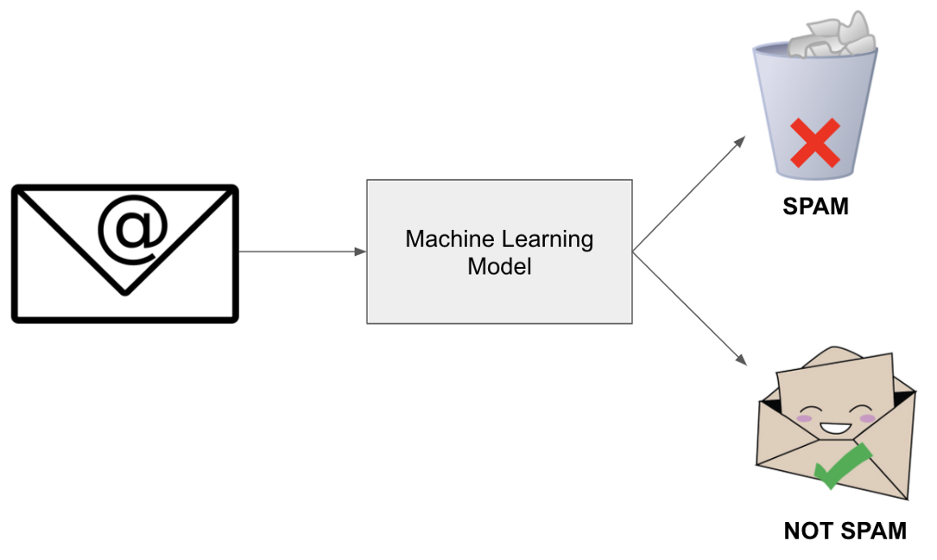
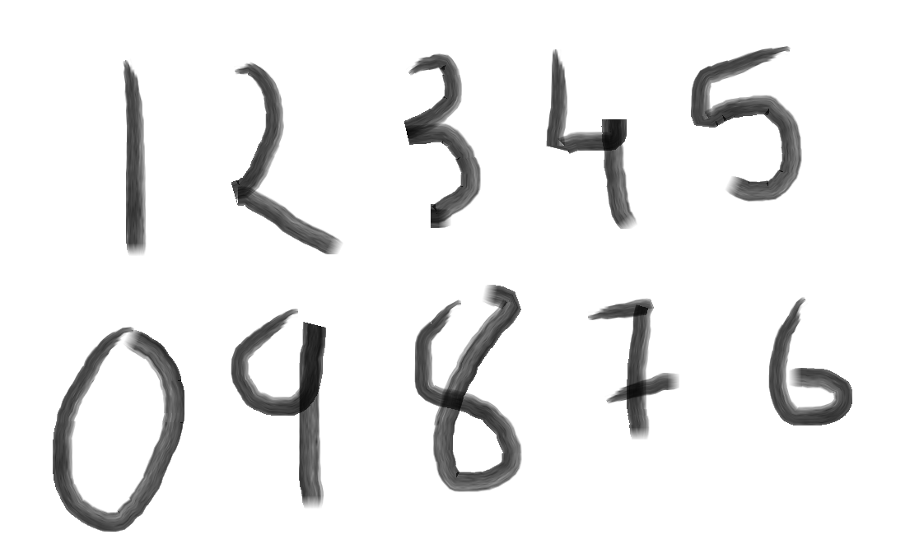
What is Deep learning?
Artificial Intelligence
Any technique that enables computers to mimic human behavior
Machine Learning
Ability to program without being explicitly programmed
Deep Learning
Extract patterns from data using neural networks
Notes:
Before we move on to understanding what is deep learning and how it distinguishes it from AI and ML. Who will tell me what is Intelligence?
So intelligence is taking some input data, process it, and make some useful meaningful well-informed decisions based on it. When computers try to do the same, it is known as artificial intelligence.
Machine learning is a subset of AI and focuses on teaching a computer to learn from data or experiences without being explicitly programmed. So when we make machine learning algorithm, we do not provide rules with the help of which it solves different tasks. It learn to generate rules and do that itself.
Deep learning is a subset of Machine Learning which uses neural networks that automatically learn useful features/patterns from the data and make decisions.

Slide 6
Machine Learning (ML)
ML gives computers the ability to learn without being explicitly programmed
Labeled/Unlabeled Data
Machine Learning Algorithm
Training
Test Data
Learned model
Prediction
Testing
Notes:
ML algo typically learn using the set of rules and features of the data.

Slide 7
Deep Learning (DL)
Input Data
Feature Engineering
Traditional ML Algorithms
Costs lot of time
Input Data
Deep Learning Algorithms
Notes:
In deep learning, the key highlight is the features are learned automatically from the data. So we just need to provide the data to the DL model, and it will itself select appropriate features and learn from them to take decisions. Deep learning learn these features in a hierarchical manner.

Slide 8
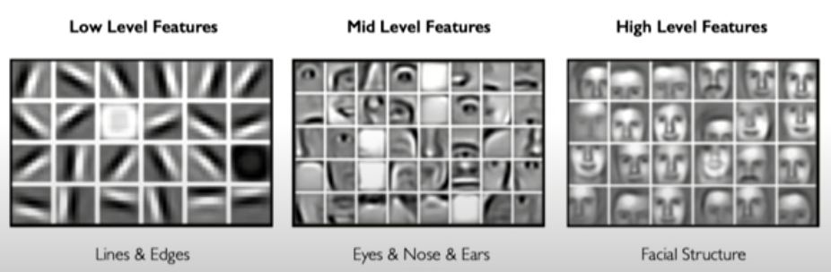
Deep Learning
Deep learning uses its multiple layers to learn these hierarchical features, so that it can apply machine learning on it to take decisions
Notes:
For example, let’s say the task is to detect faces from a set of images. So a training image set is provided to the DL model. Now first it will learn low-level features such as edges. Then build up those edges to make eyes, nose, or other facial features, and then build up the whole face structure features based on mid-level features.
So, Deep learning using its multiple layers learn these hierarchical features, so that it can apply machine learning on it to take decisions.

Slide 9
Deep Learning (DL)
A subfield of machine learning where data representation is learned
Deep learning algorithms attempt to learn (multiple levels of) representation by using a hierarchy of multiple layers
Require tons of data before it begins to understand it and respond in useful ways.

Slide 10
Why Deep Learning (DL)
Manually designed features are often over-specified, incomplete, time-consuming, and non-scalable.
Deep learning learns the features directly from data
Notes:
May be in facial image, we just specify the filter to extract edges, but as a low-level feature, blobs are also extracted by DL, and if we had to specify the features we just specify edges and not blobs.
A Blob, in a sense, is anything that is considered a large object or anything bright in a dark background, in images, we can generalize it as a group of pixel values that forms a somewhat colony or a large object that is distinguishable from its background.

Slide 11
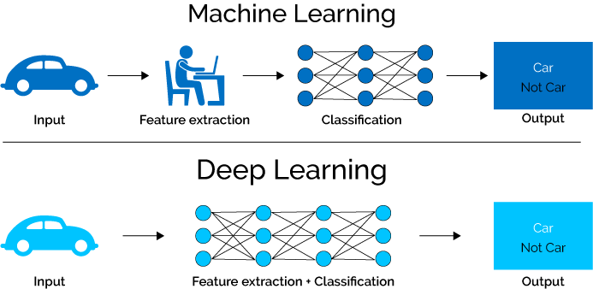

Slide 12

“Traditional” machine learning:
handcrafted features
learned classifier
cat
Deep, “end-to-end” learning:
learned low-level features
learned mid-level features
learned high-level features
learned classifier
cat

Slide 13
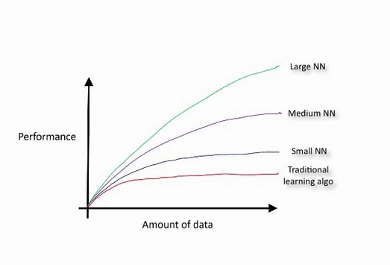
Performance of different algorithms with increasing amount of data

Slide 14
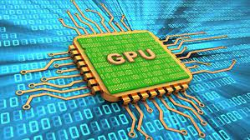


Why Deep Learning (DL)
Neural networks (NN) were first proposed in 1940’s and many different architectures of NN have been proposed since then,
So why is the sudden explosion of use of Deep learning now?
Big Data
Hardware
GPUs
Software
New models and toolboxes
Notes:
Deep learning is nothing but Deep neural networks. And neural networks existed from 1940’s and multiple different architectures of it have been proposed so far, so why in past 10 years its use and importance has grown so much.
It is because in the past decade only, the amount of data has grown so much so that we can say that we are living in the era of big data, and deep learning requires large amount of data to work efficiently. So it is one of the driving force to the much use of DL now-adays.
Secondly, the DL models are parallelizable and thus can benefit from GPUs (that is modern hardware). Such hardware didn’t exist in the past when all NN architectures were proposed.
Thirdly, now we have open source toolboxes like tensorflow using which we can build and deploy DL algorithms.

Slide 15
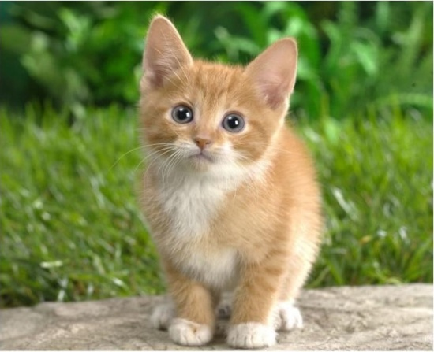
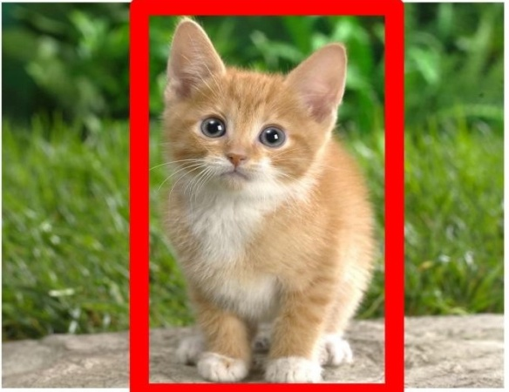
Deep Learning applications
Classification
Classification + Localization
Notes:
In the past decade deep learning gained popularity because of its groundbreaking application in areas like image classification, speech recognition, machine translation. Not to self driving cars, voice assistants, speech to text transcription, etc.

Slide 16
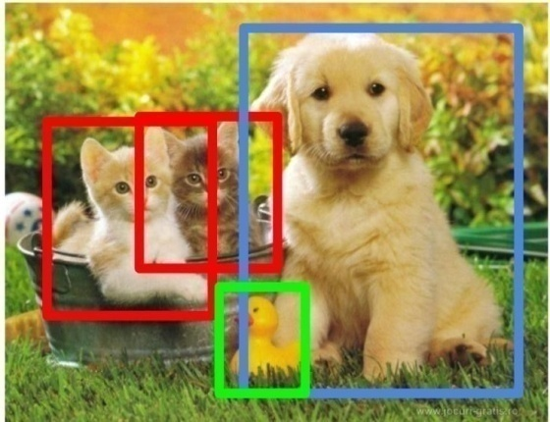
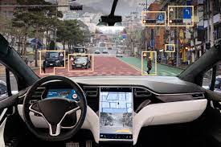

Deep Learning applications
Object Detection
Speech Recognition
Voice assistant
Self-driving cars

Slide 17
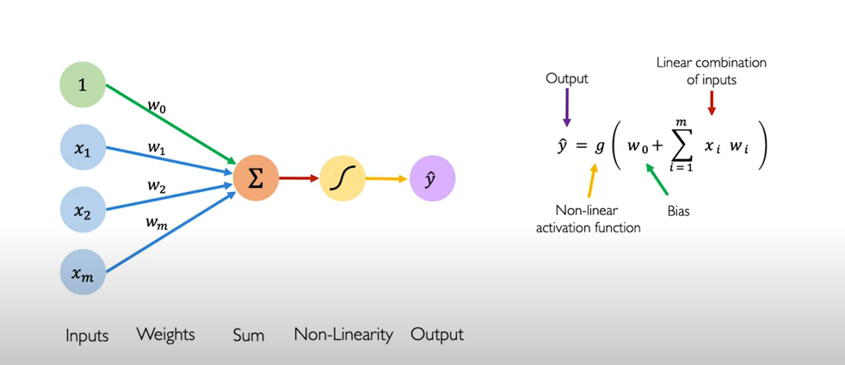
Artificial Neural Network (ANN)
Perceptron (Single layer neural network) is the structural building block of deep learning models
Notes:
So we quickly revisit, neural network or perceptron which is a building block of deep learning models.
Here on left we have a toy perceptron drawn out and on the right we have its mathematical equation.
In the diagram of this toy perceptron, on the left hand side we have the inputs and on the right side we have the output.
First we multiply, inputs with their corresponding weights and sum them, this aggregated num (or weighted sum is termed as net input) is then passed to the non-linear activation function.
The output from the activation function will give us our prediction y hat.
We have a bias term here, denoted as w0 (sometimes denoted as b). Bias is nothing but threshold term and it helps us to shift out input to the activation function to the left or to the right.
In the equation, g represents the activation function that is applied on the sum of linear combination of inputs.

Slide 18
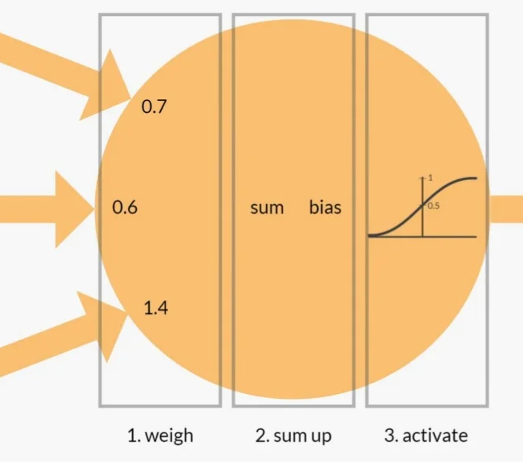
Artificial Neural Network (ANN)
Neuron forward pass

Slide 19
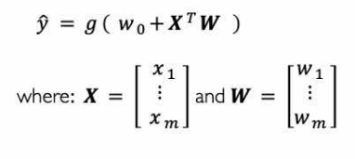
Artificial Neural Network (ANN)
Notes:
We can also represent the mathematical equation in the form of linear algebra like we have done here.
We have written down sum of inputs in the form of vectors X transpose (Vector of inputs x1 to xm) and W vector (Vector of weights). And it means the same thing right. (Show them the multiplication). Taking the dot product will give us the same answer.

Slide 20
Activation function
A neural network is comprised of layers of nodes and learns to map examples of inputs to outputs.
For a given node, the inputs are multiplied by the weights in a node and summed together. This value is then transformed via an activation function and defines the specific output or “activation” of the node.
The simplest activation function is referred to as linear activation, where no transform is applied at all.
A network comprised of only linear activation functions is very easy to train but cannot learn complex mapping functions. Linear activation functions are still used in the output layer for networks that predict a quantity (e.g., regression problems).
Nonlinear activation functions are preferred as they allow the nodes to learn more complex structures in the data.
Notes:
We use the term activation function, we mean non-linear activation function

Slide 21
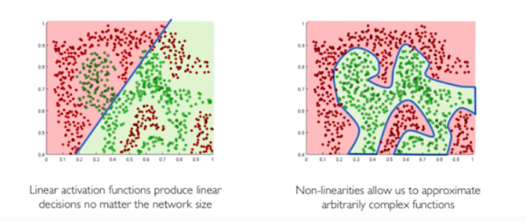
Activation function
Activation function introduce non-linearity in the network
Non-linear functions approximate complex functions that make neural networks extremely powerful
Notes:
Significance of using activation function is it introduce non-linearity in the system. Suppose we have to separate these red and green points and we just have a single line to do that, it would not be possible to separate them.
So using linear activations would not help no matter how many neurons we have or how deep is our network.
However, a non-linear line would be able to do that easily.

Slide 22
Non-linear activation functions
Sigmoid function: Non-zero centered
Vanishing gradient problem
Tanh function: Zero-centered
Vanishing gradient problem
ReLu function: Non-zero centered
Vanishing gradient problem does not exist
More reading on activation functions:
https://www.analyticsvidhya.com/blog/2021/04/activation-functions-and-their-derivatives-a-quick-complete-guide/
Notes:
Sigmoid and Relu are non-zero centered functions: meaning that the mean of the act func is not zero, mean is either towards the positive or towards the negative.
Therefore, the output of the layer always move towards the positive or towards the negative, which makes the training slower and hence it takes long to converge.
Therefore, zero-centered is a desirable property not necessary.
Zero activation means the mean is at zero, means the data is normalized, hence faster convergence. Solution is batch normalization.
Vanishing gradient problem means the gradient or the derivative is 0, it is a problem in learning because in gradient descent , we calculate derivatives and backpropagate the error, So, if the derivatives are close to 0, the learning becomes extremely slow.

Slide 23
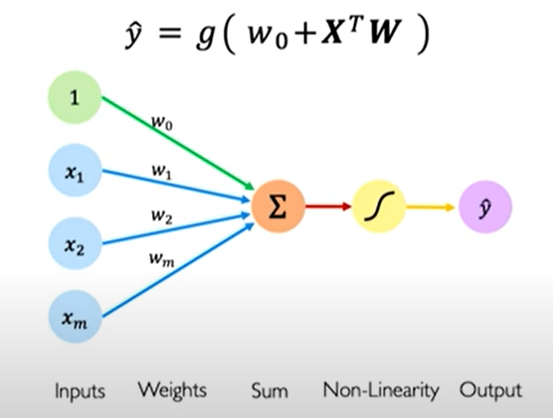
Perceptron
3 steps of Perceptron:
Dot product (Inputs multiplied with weights)
Add bias
Apply non-linearity
Notes:
The functionality of a perceptron can be defined in three steps:

Slide 24
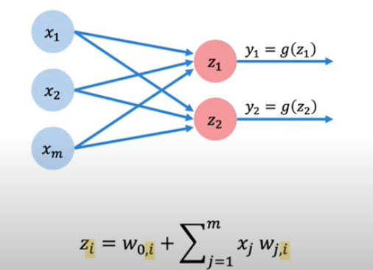
Multi-output perceptron
Here all inputs are connected to all outputs, these layers are called dense layers
Notes:
We have removed the bias from the diagram for simplicity. Assume there are weights on the edges.
Here, z is our net input (that is, dot product + addition of bias)
G is applying non-linearity to z. g is activation function.
Here, two different neurons have different set of weights on the edges, therefore z1 and z2 are different.

Slide 25
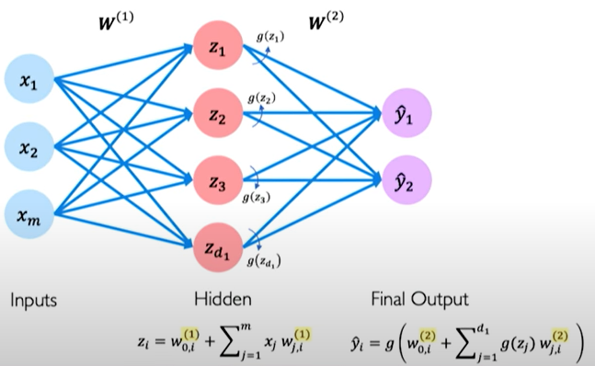
Single layer neural network
Here all inputs are connected to all outputs, these layers are called dense layers
Notes:
Looking at a single perceptron individually.

Slide 26
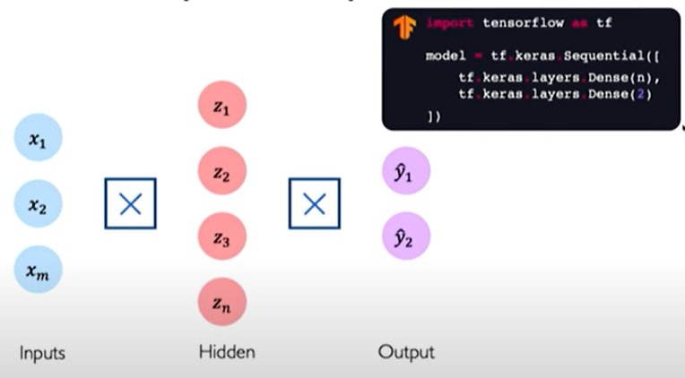
Single layer neural network
Notes:
A simplified neural network. Here this cross symbol denotes the dense layer that is, every input is connected to every output.

Slide 27
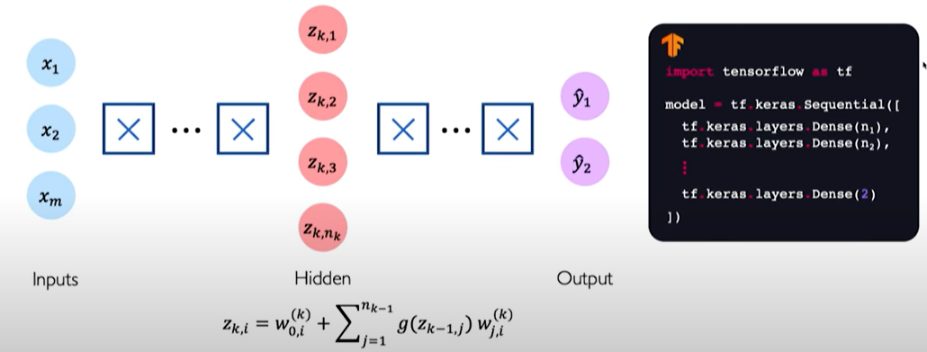
Neural network
Notes:
We can stack these hidden layers on over another in a sequential manner to get the deep neural network.

Slide 28
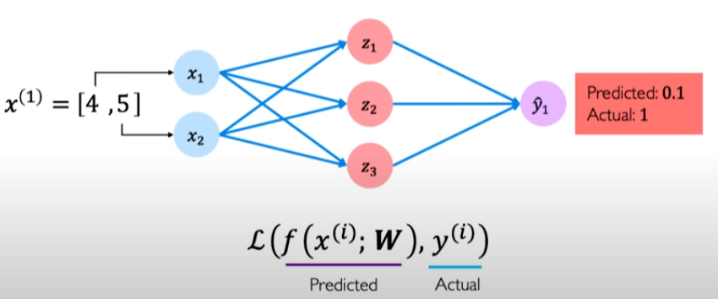
Loss function
The loss function measures the cost incurred by incorrect predictions.
Notes:
Lets say for a problem, we give input to the model as [4,5] and predicted output is 0.1 and actual is 1. It is a binary classification problem. Obviously the prediction is wrong and it is because the model has never been trained.
The difference between the predicted value and actual value is loss.

Slide 29
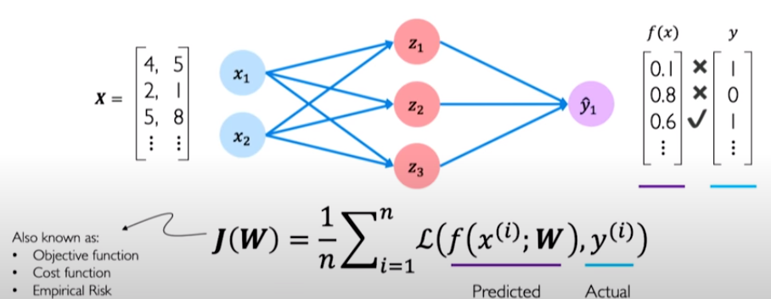
Empirical loss/cost function
Notes:
Empirical loss is the total loss incurred by all the inputs. Mean of all loss function of our data set.
While training the network, we want to minimize the empirical loss.

Slide 30
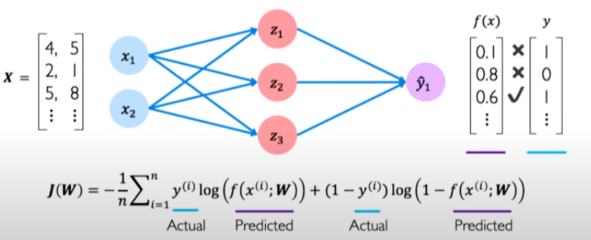
Binary Cross Entropy Loss
Output a probability between 0 and 1
Notes:
For classification problems, we can use binary cross entropy loss

Slide 31
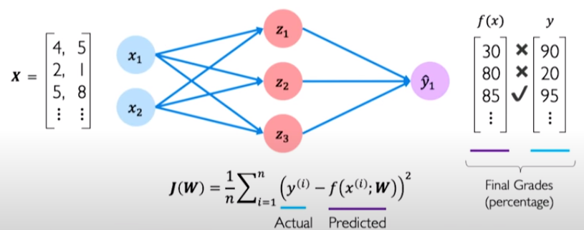
Mean Squared Error Loss
Used for regression models; Output continuous numbers
Notes:
For regression problems, mean sq error is used. Ex we want to predict the grade of students.
With the loss function, we can tell when our model is making a mistake, we train the neural network by optimizing this loss function.

Slide 32
Thank You

