Slide 1

Deep Learning
Tanveer Ahmed

Slide 2
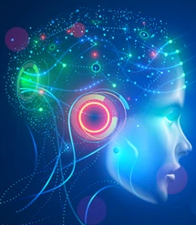
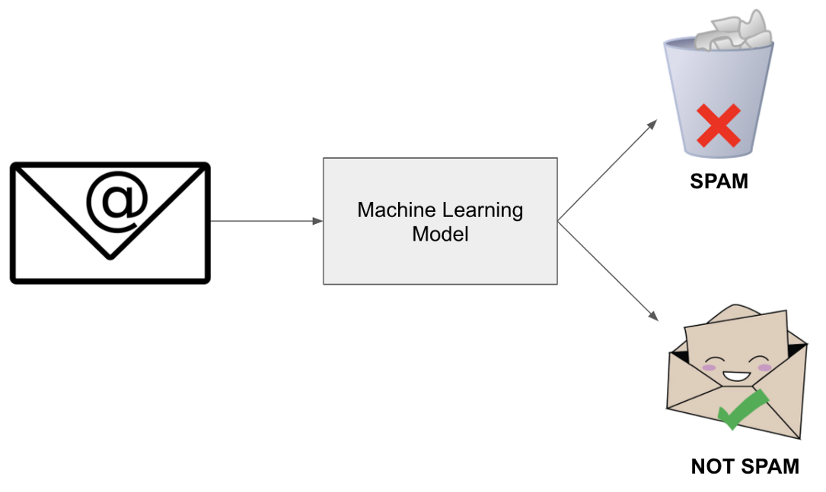
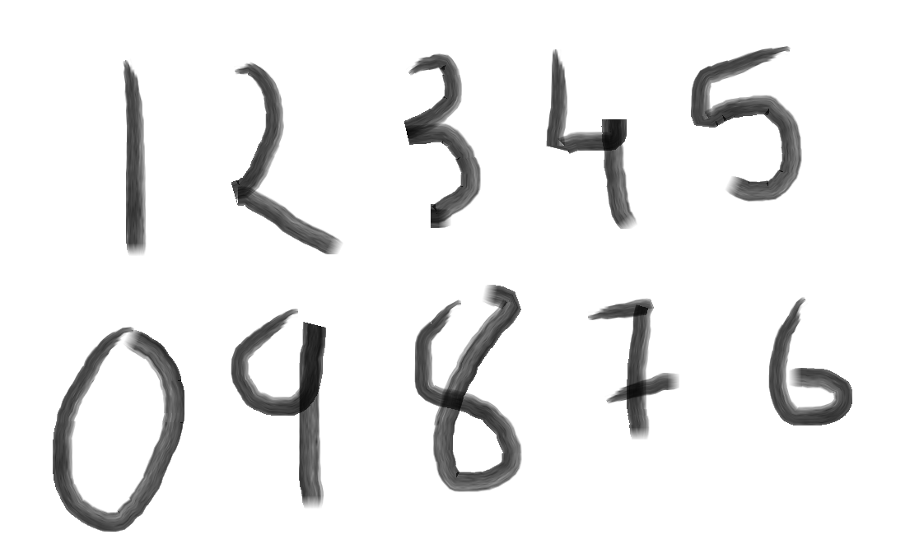
What is Deep learning?
Artificial Intelligence
Any technique that enables computers to mimic human behavior
Machine Learning
Ability to program without being explicitly programmed
Deep Learning
Extract patterns from data using neural networks
Notes:
Before we move on to understanding what is deep learning and how it distinguishes it from AI and ML. Who will tell me what is Intelligence?
So intelligence is taking some input data, process it, and make some useful meaningful well-informed decisions based on it. When computers try to do the same, it is known as artificial intelligence.
Machine learning is a subset of AI and focuses on teaching a computer to learn from data or experiences without being explicitly programmed. So when we make machine learning algorithm, we do not provide rules with the help of which it solves different tasks. It learn to generate rules and do that itself.
Deep learning is a subset of Machine Learning which uses neural networks that automatically learn useful features/patterns from the data and make decisions.

Slide 3
Machine Learning (ML)
Why Deep learning?
ML gives computers the ability to learn without being explicitly programmed
Labeled/Unlabeled Data
Machine Learning Algorithm
Training
Test Data
Learned model
Prediction
Testing
Notes:
ML algo typically learn using the set of rules and features of the data.

Slide 4
Deep Learning (DL)
Why Deep learning?
Input Data
Feature Engineering
Traditional ML Algorithms
Costs lot of time
Input Data
Deep Learning Algorithms
Notes:
In deep learning, the key highlight is the features are learned automatically from the data. So we just need to provide the data to the DL model, and it will itself select appropriate features and learn from them to take decisions. Deep learning learn these features in a hierarchical manner.

Slide 5
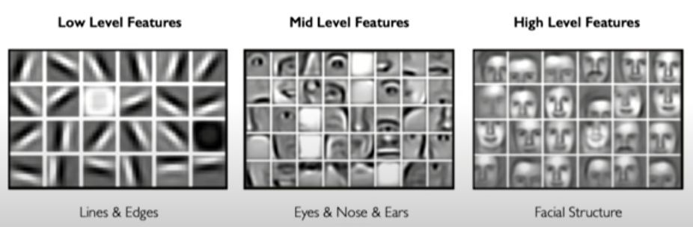
Deep Learning
Deep learning uses its multiple layers to learn these hierarchical features, so that it can apply machine learning on it to take decisions
Notes:
For example, let’s say the task is to detect faces from a set of images. So a training image set is provided to the DL model. Now first it will learn low-level features such as edges. Then build up those edges to make eyes, nose, or other facial features, and then build up the whole face structure features based on mid-level features.
So, Deep learning using its multiple layers learn these hierarchical features, so that it can apply machine learning on it to take decisions.

Slide 6

“Traditional” machine learning:
handcrafted features
learned classifier
cat
Deep, “end-to-end” learning:
learned low-level features
learned mid-level features
learned high-level features
learned classifier
cat

Slide 7
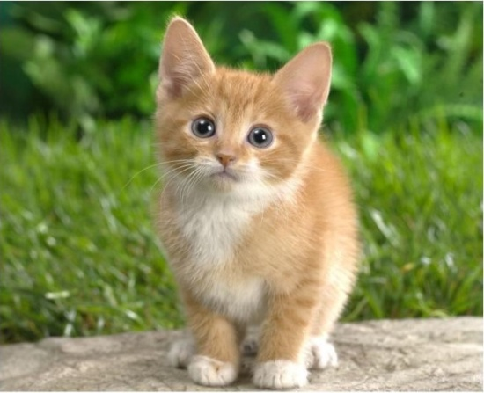
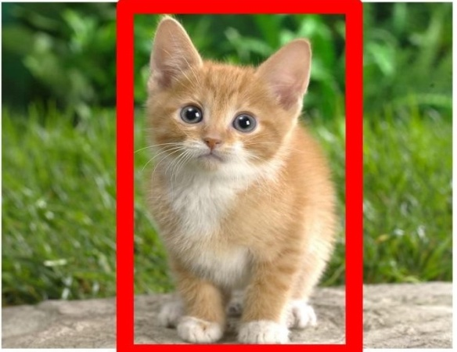
Deep Learning applications
Classification
Classification + Localization
Notes:
In the past decade deep learning gained popularity because of its groundbreaking application in areas like image classification, speech recognition, machine translation. Not to self driving cars, voice assistants, speech to text transcription, etc.

Slide 8
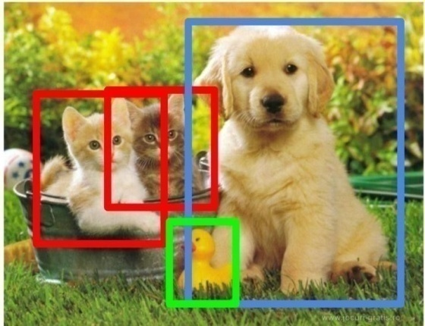
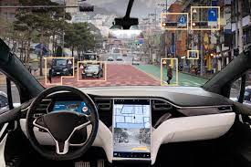

Deep Learning applications
Object Detection
Speech Recognition
Voice assistant
Self-driving cars

Slide 9
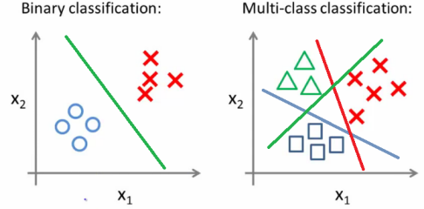
Classification Problems
A classification problem with only 2 classes is referred to as binary classification
The output labels are 0 or 1
E.g., benign or malignant tumor, spam or no-spam email
A problem with 3 or more classes is referred to as multi-class classification

Slide 10
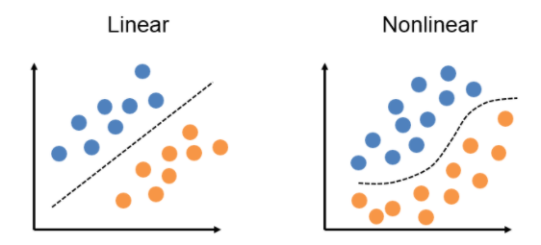
Linear vs Non Linear
Both the binary and multi-class classification problems can be linearly or non-linearly separated
Figure: linearly and non-linearly separated data for binary classification problem

Slide 11
No Free Lunch Theorem
Wolpert (2002) - The Supervised Learning No-Free-Lunch Theorems
The derived classification models for supervised learning are simplifications of the reality
The simplifications are based on certain assumptions
The assumptions fail in some situations
E.g., due to inability to perfectly estimate ML model parameters from limited data
In summary, No-Free-Lunch Theorem states:
No single classifier works the best for all possible problems
Since we need to make assumptions to generalize

Slide 12
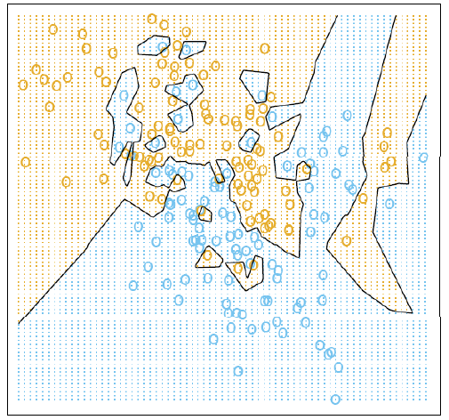
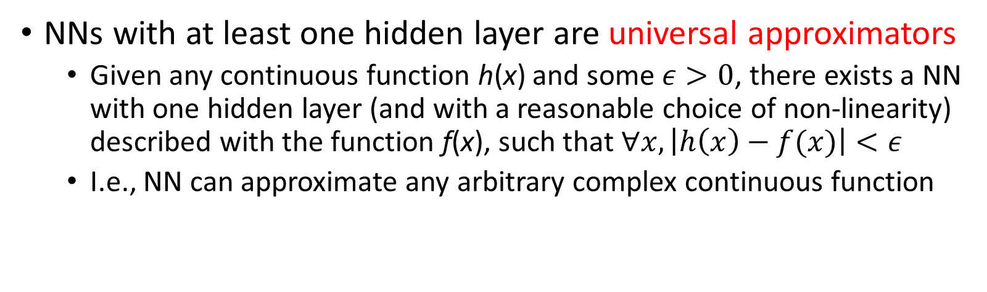
Power of Deep learning
NNs with at least one hidden layer are universal approximators
Given any continuous function h(x) and some $ε>0$, there exists a NN with one hidden layer (and with a reasonable choice of non-linearity) described with the function f(x), such that $∀x, \left|h\left(x\right)−f(x)\right|<ε$
I.e., NN can approximate any arbitrary complex continuous function
NNs use nonlinear mapping of the inputs x to the outputs f(x) to compute complex decision boundaries
But then, why use deeper NNs?
The fact that deep NNs work better is an empirical observation
Mathematically, deep NNs have the same representational power as a one-layer NN

Slide 13
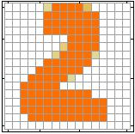
Neural Network Working
Handwritten digit recognition (MNIST dataset)
The intensity of each pixel is considered an input element
Output is the class of the digit
Input
Output
y₁
is 1
0.1
y₂
is 2
0.7
The image is “2”
……
……
……
y₁₀
0.2
is 0
16 x 16 = 256
Ink → 1
No ink → 0
Each dimension represents the confidence of a digit

Slide 14


y₁
Machine
y₂
“2”
……
……
$$f:R^{256}→R^{10}$$
y₁₀
The function $f$ is represented by a neural network

Slide 15


Elements of a Neural Nets
NNs consist of hidden layers with neurons (i.e., computational units)
A single neuron maps a set of inputs into an output number, or $f:R^{K}→R$
$$a=σ\left(z\right)$$
…
…
output
Activation function
weights
input
bias

Slide 16
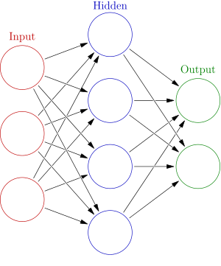




A NN with one hidden layer and one output layer
Weights
Biases
$$output layer y=σ(W_{2}h+b_{2})$$
Activation functions
$$y$$
4 + 2 = 6 neurons (not counting inputs)
[3 × 4] + [4 × 2] = 20 weights
4 + 2 = 6 biases
26 learnable parameters
$$x$$
$$h$$

Slide 17
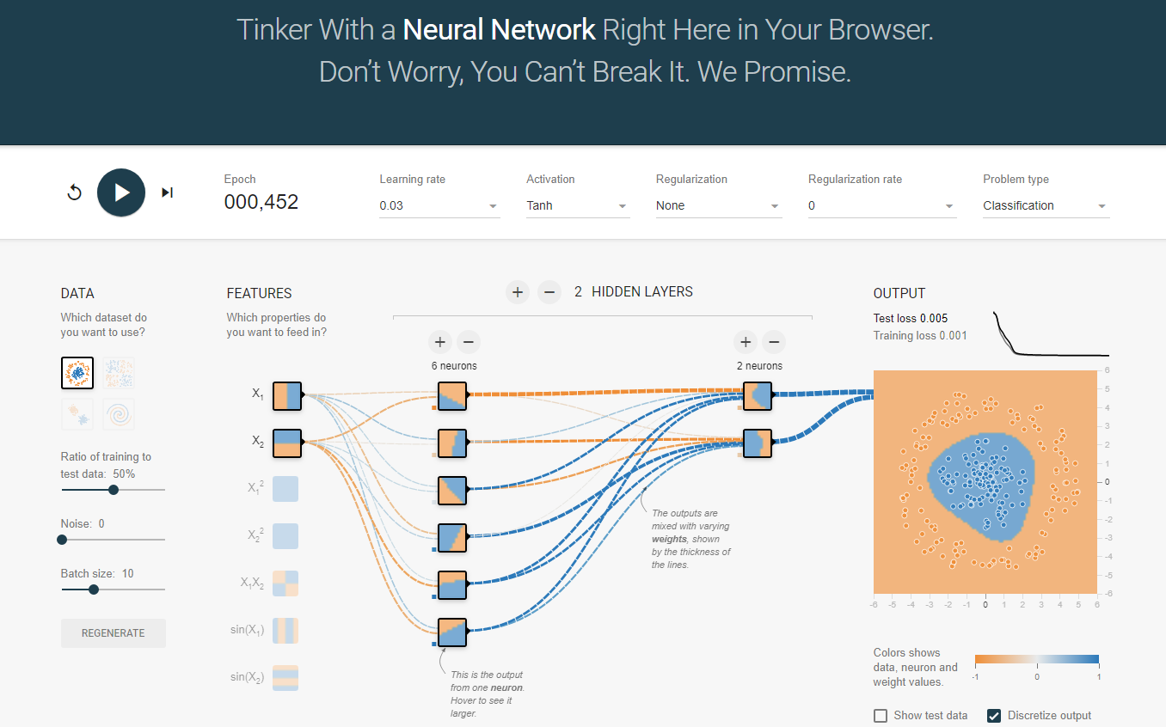
Play with your own neural network

Slide 18
Deep Neural Network
Deep NNs have many hidden layers
Fully-connected (dense) layers (a.k.a. Multi-Layer Perceptron or MLP)
Each neuron is connected to all neurons in the succeeding layer
Input
Layer 1
Layer 2
Layer L
Output
……
y₁
……
y₂
……
……
……
……
……
……
y_{M}
Input Layer
Output Layer
Hidden Layers

Slide 19
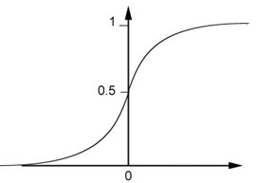

Simple Example
$$\left(1∙1\right)+\left(−1\right)∙\left(−2\right)+1=4$$
0.98
Sigmoid Function
1
4
1
-2
1
-1
-2
0.12
-1
1
0
1 $∙ \left(−1\right)+\left(−1\right)∙1+0=$-2

Slide 20
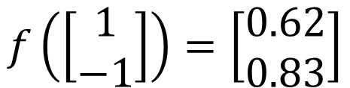

Simple Example Continued
1
4
0.98
2
0.86
3
0.62
1
-2
-1
-1
1
0
-2
-1
-2
0.12
-2
0.11
-1
0.83
-1
1
-1
4
0
0
2
$$f\left(\left[\begin{matrix}1 \\ −1\end{matrix}\right]\right)=\left[\begin{matrix}0.62 \\ 0.83\end{matrix}\right]$$
$$f:R^{2}→R^{2}$$

Slide 21

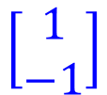
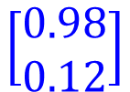



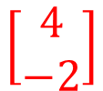
Matrix Form
1
4
0.98
1
W
x
b
a
+
-2
$σ\left( \right) =$
1
-1
-2
0.12
$$\left[\begin{matrix}1 & −2 \\ −1 & 1\end{matrix}\right]$$
$$\left[\begin{matrix}1 \\ −1\end{matrix}\right]$$
$$\left[\begin{matrix}1 \\ 0\end{matrix}\right]$$
$$=$$
$$\left[\begin{matrix}0.98 \\ 0.12\end{matrix}\right]$$
$$σ\left( \right)$$
$$+$$
-1
1
0
$$\left[\begin{matrix}4 \\ −2\end{matrix}\right]$$

Slide 22

Matrix Form Continued
……
y₁
W¹
……
y₂
b¹
……
……
……
……
……
x
a¹
……
y_{M}
a¹
W¹
x
b¹
+
$=σ\left( \right)$

Slide 23



……
y₁
W¹
W²
W^{L}
……
y₂
b¹
b²
b^{L}
……
……
……
……
……
x
a¹
a²
y
……
y_{M}
W¹
x
b¹
+
$$σ\left( \right)$$
a¹
b²
W²
+
$$σ\left( \right)$$
W^{L}
b^{L}
a^{L-1}
+
$$σ\left( \right)$$

Slide 24


……
y₁
W¹
W²
W^{L}
……
y₂
b¹
b²
b^{L}
……
……
……
……
……
x
a¹
a²
y
……
y_{M}
y
x
W^{L}
W²
W¹
x
b¹
b²
b^{L}
…
…
$$=f\left( \right)$$
+
+
$$=σ\left( \right)$$
$$σ\left( \right)$$
+
$$σ\left( \right)$$

Slide 25
Softmax Layer
In multi-class classification tasks, the output layer is typically a softmax layer
I.e., it employs a softmax activation function
A Layer with Sigmoid Activations
3
0.95
1
0.73
-3
0.05

Slide 26
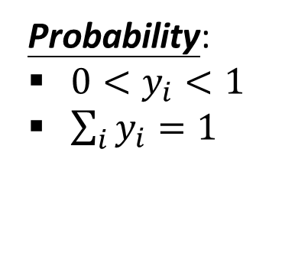
The softmax layer applies softmax activations to output a probability value in the range [0, 1]
The values z inputted to the softmax layer are referred to as logits
Probability:
$0<y_{i}<1$
$\sum_{i}{y_{i}=1}$
The Softmax Layer
3
20
0.88
1
2.7
0.12
-3
0.05
≈0

Slide 27
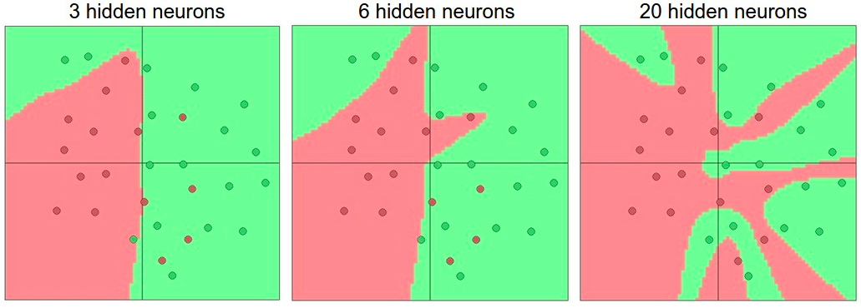
Non Linear Activations are Important
Non-linear activations are needed to learn complex (non-linear) data representations
Otherwise, NNs would be just a linear function (such as W_1 W_2 𝑥=𝑊𝑥)
NNs with large number of layers (and neurons) can approximate more complex functions.

Slide 28
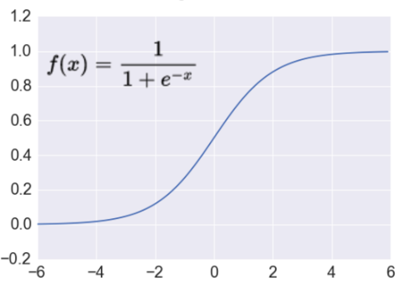



Activation: Sigmoid
Sigmoid function σ: takes a real-valued number and “squashes” it into the range between 0 and 1
Sigmoid activations are less common in modern NNs
$$f\left(x\right)$$
$$ℝ^{n}→\left[0,1\right]$$
$$x$$

Slide 29
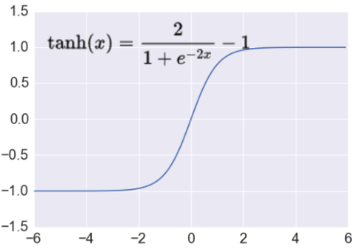

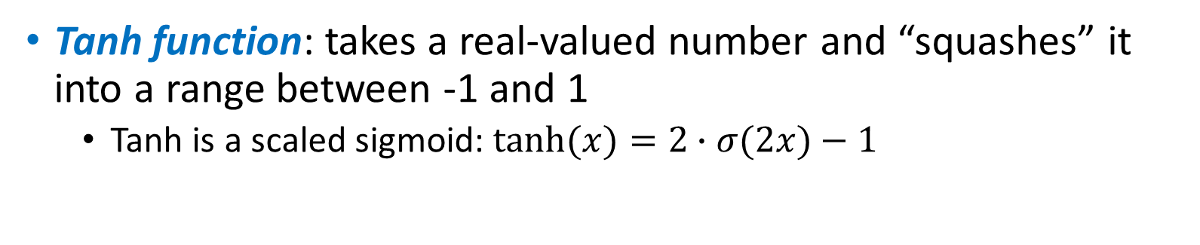


Activation: Tanh
Tanh function: takes a real-valued number and “squashes” it into a range between -1 and 1
Tanh is a scaled sigmoid: $tanh⁡(x)=2∙σ(2x)−1$
$$f\left(x\right)$$
$$ℝ^{n}→\left[−1,1\right]$$
$$x$$

Slide 30
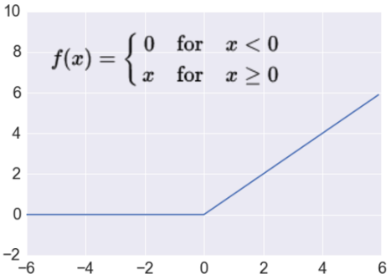




Activation: ReLU
ReLU (Rectified Linear Unit): takes a real-valued number and thresholds it at zero
$f\left(x\right)= max(0,x)$
$$ℝ^{n}→ℝ_{+}^{n}$$
Most modern deep NNs use ReLU activations
ReLU is fast to compute
Prevents the gradient vanishing problem
$$f\left(x\right)$$
$$x$$

Slide 31
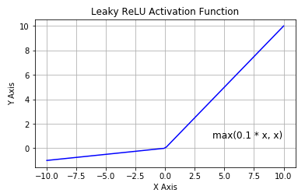

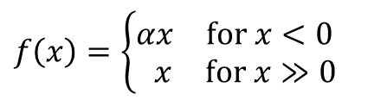
Activation: Leaky ReLU
Leaky ReLU activation function is a variant of ReLU
Instead of the function being 0 when $x<0$, a leaky ReLU has a small negative slope (e.g., α = 0.01, or similar)
$$f\left(x\right)=\left\{\begin{matrix}\begin{matrix}αx & for x<0 \end{matrix} \\ \begin{matrix}x & for x≫0\end{matrix}\end{matrix}\right.$$

Slide 32

Thank You

