Slide 1
Deep Learning
Tanveer Ahmed

Slide 2
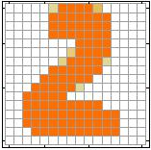
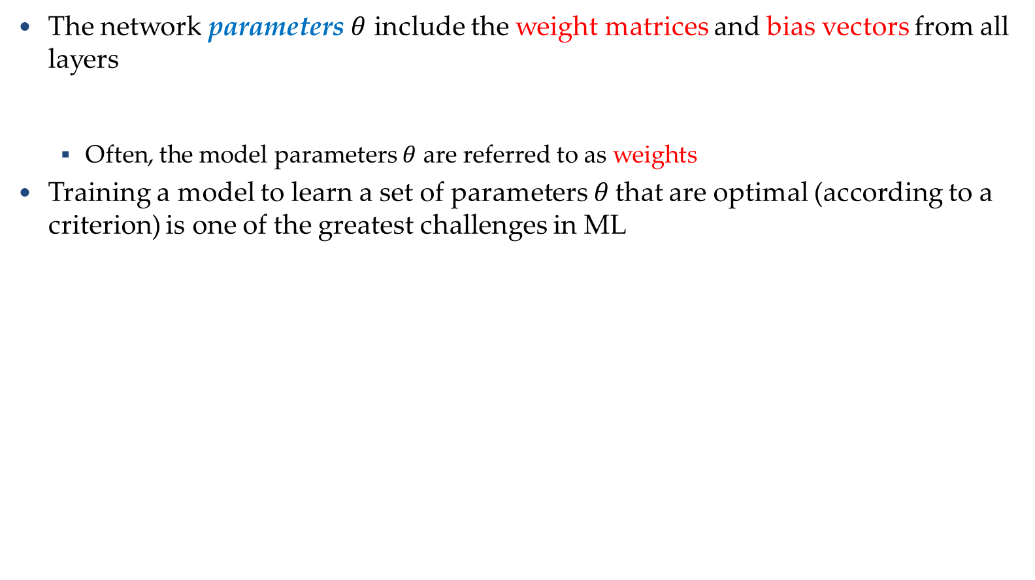
Training NNs
Training Neural Networks
The network parameters $θ$ include the weight matrices and bias vectors from all layers
Often, the model parameters $θ$ are referred to as weights
Training a model to learn a set of parameters$θ$ that are optimal (according to a criterion) is one of the greatest challenges in ML
$$θ=\left\{W^{1},b^{1},W^{2},b^{2},⋯W^{L},b^{L}\right\}$$
……
y₁
is 1
0.1
……
y₂
0.7
is 2
Softmax
……
……
……
……
y₁₀
is 0
0.2
16 x 16 = 256

Slide 3
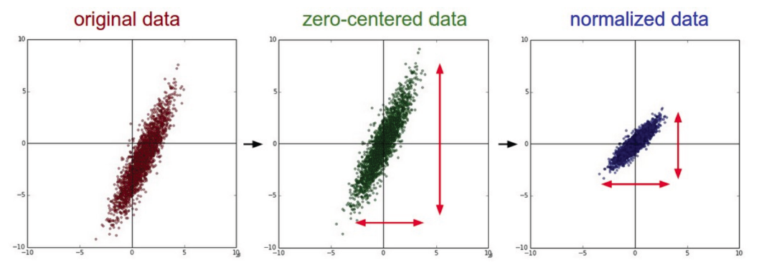
Training NNs
Training Neural Networks
Data preprocessing - helps convergence during training
Mean subtraction, to obtain zero-centered data
Subtract the mean for each individual data dimension (feature)
Normalization
Divide each feature by its standard deviation
To obtain standard deviation of 1 for each data dimension (feature)
Or, scale the data within the range [0,1] or [-1, 1]
E.g., image pixel intensities are divided by 255 to be scaled in the [0,1] range
Picture from: https://cs231n.github.io/neural-networks-2/

Slide 4




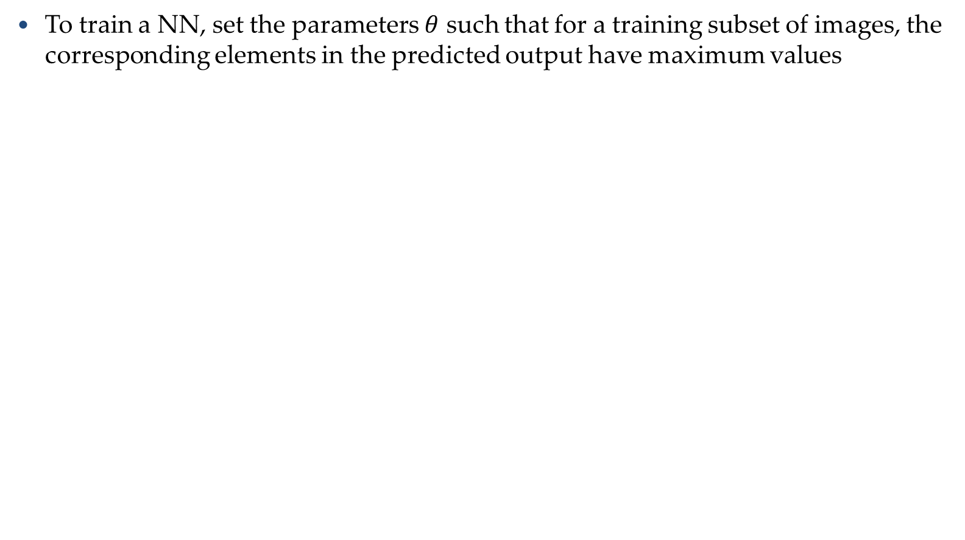
Training NNs
Training Neural Networks
To train a NN, set the parameters $θ$ such that for a training subset of images, the corresponding elements in the predicted output have maximum values
Input:
y₁ has the maximum value
Input:
y₂ has the maximum value
.
.
.
Input:
y₉ has the maximum value
Input:
y₁₀ has the maximum value

Slide 5

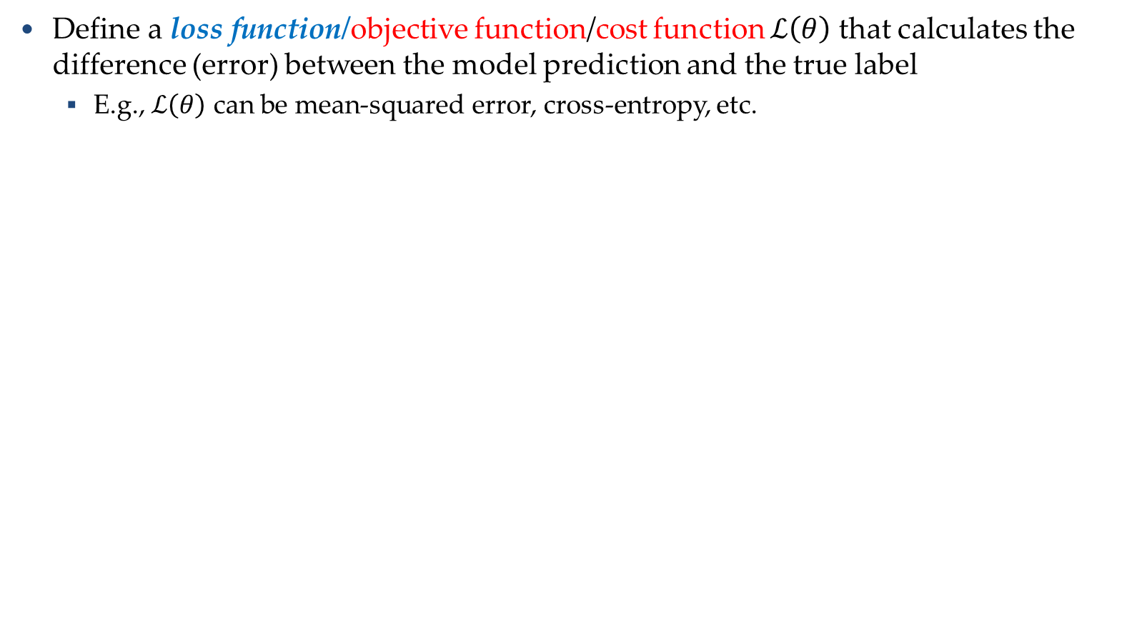

Training NNs
Training Neural Networks
Define a loss function/objective function/cost function $ℒ\left(θ\right)$ that calculates the difference (error) between the model prediction and the true label
E.g., $ℒ\left(θ\right)$ can be mean-squared error, cross-entropy, etc.
……
y₁
1
0.2
……
y₂
0
0.3
……
……
……
Cost
……
……
……
……
y₁₀
$$ℒ(θ)$$
0
0.5
True label “1”

Slide 6






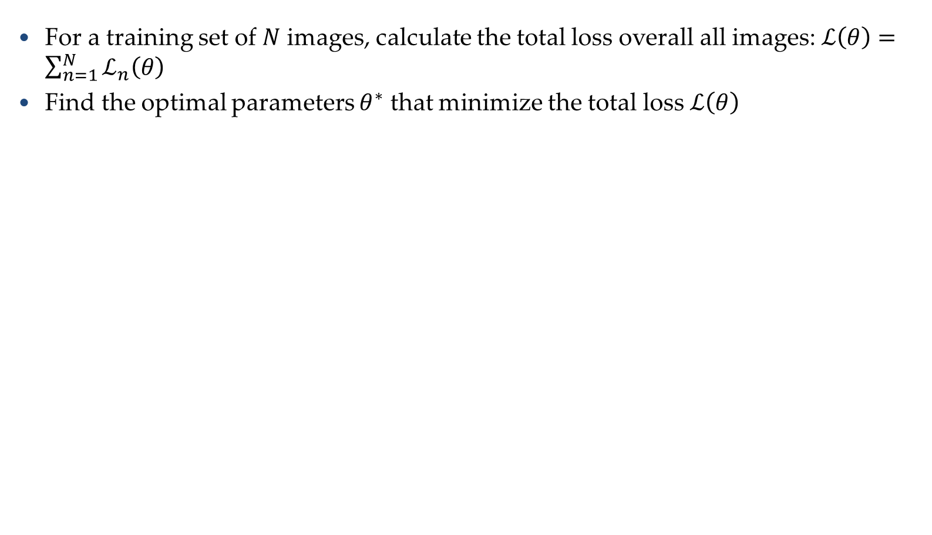




Training NNs
Training Neural Networks
For a training set of $N$ images, calculate the total loss overall all images: $ℒ\left(θ\right)=\sum_{n=1}^{N}{ℒ_{n}\left(θ\right)}$
Find the optimal parameters $θ^{∗}$ that minimize the total loss $ℒ\left(θ\right)$
$$ℒ_{1}\left(θ\right)$$
x¹
NN
y¹
$${\hat{y}}^{1}$$
NN
$$ℒ_{2}\left(θ\right)$$
x²
$${\hat{y}}^{2}$$
y²
NN
$$ℒ_{3}\left(θ\right)$$
x³
$${\hat{y}}^{3}$$
y³
……
……
……
……
NN
$$ℒ_{n}\left(θ\right)$$
x^{N}
$${\hat{y}}^{N}$$
y^{N}

Slide 7

Advantage of RELU

Slide 8




ReLU
$$a$$
$$a=z$$
$$a=0$$
$$z$$
0
0
0
0

Slide 9
ReLU
$$a$$
$$a=z$$
A Thinner linear network
$$a=0$$
$$z$$

Slide 10
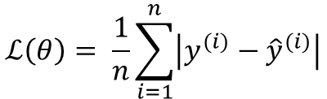
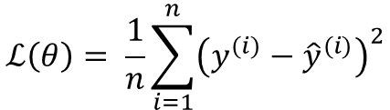
Loss Functions
Training Neural Networks
Regression tasks
Training
examples
Pairs of 𝑁 inputs $x_{i}$ and ground-truth output values$y_{i}$
Output
Layer
Linear (Identity) or Sigmoid Activation
$$ℒ\left(θ\right)= \frac{1}{n}\sum_{i=1}^{n}{{\left(y^{(i)}−{\hat{y}}^{(i)}\right)}^{2}}$$
Mean Squared Error
Loss function
$$ℒ\left(θ\right)= \frac{1}{n}\sum_{i=1}^{n}{\left|y^{(i)}−{\hat{y}}^{(i)}\right|}$$
Mean Absolute Error
Slide credit: Ismini Lourentzou – Introduction to Deep Learning

Slide 11

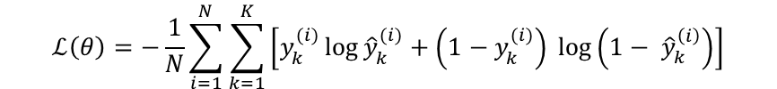
Loss Functions
Training Neural Networks
Classification tasks
Training
examples
Pairs of 𝑁 inputs $x_{i}$ and ground-truth class labels $y_{i}$
Output
Layer
Softmax Activations
[maps to a probability distribution]
Loss function
$$ℒ\left(θ\right)=−\frac{1}{N}\sum_{i=1}^{N}{\sum_{k=1}^{K}{\left[y_{k}^{(i)}\log{{\hat{y}}_{k}^{(i)}+\left(1−y_{k}^{(i)}\right) }\log\left(1− {\hat{y}}_{k}^{\left(i\right)}\right)\right]}}$$
Cross-entropy
Ground-truth class labels $y_{i}$ and model predicted class labels ${\hat{y}}_{i}$

Slide 12
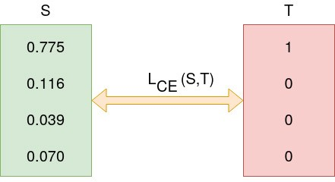
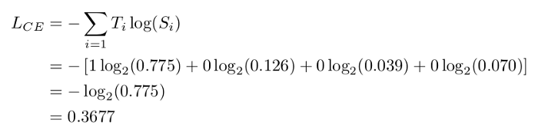
Binary Cross Entropy

Slide 13

Loss
A good function should make the loss of all examples as small as possible.
“1”
……
y₁
1
As close as possible
……
y₂
Given a set of parameters
0
Softmax
……
……
……
……
……
Loss
$$l$$
……
y₁₀
0
Loss can be square error or cross entropy between the network output and target
target
Notes:
With softmax, the summation of all the ouputs would be one.
Can be considered as probability if you want ……

Slide 14


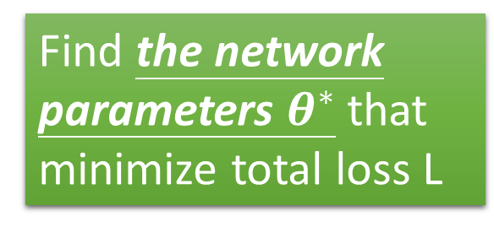









Total Loss
Total Loss:
$$L=\sum_{r=1}^{R}{l_{r}}$$
For all training data …
x¹
NN
y¹
$${\hat{y}}^{1}$$
$$l_{1}$$
As small as possible
x²
NN
y²
$${\hat{y}}^{2}$$
Find a function in function set that minimizes total loss L
$$l_{2}$$
x³
NN
y³
$${\hat{y}}^{3}$$
$$l_{3}$$
……
……
……
……
Find the network parameters $θ^{∗}$ that minimize total loss L
x^{R}
NN
y^{R}
$${\hat{y}}^{R}$$
$$l_{R}$$
Notes:
Randomly picked one
Two approaches update the parameters towards the same direction, but stochastic is faster!
Better!

Slide 15



Implementation
28x28
……
500
……
500
……
Softmax
y₁
y₂
y₁₀
……

Slide 16
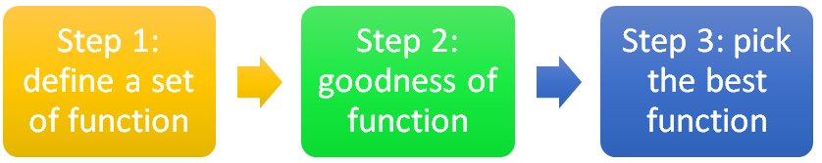
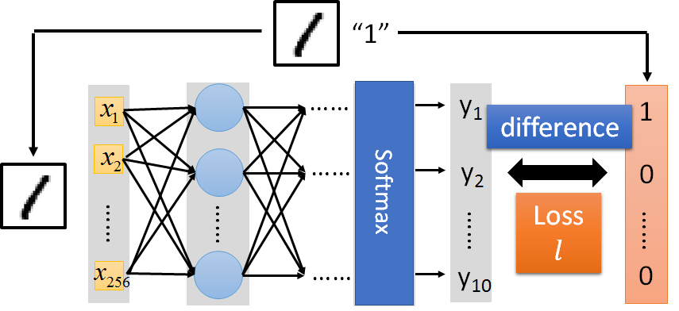


Slide 17


Example
Square Error
Cross Entropy
Several alternatives in Keras Library

Slide 18

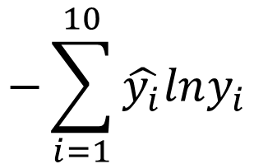
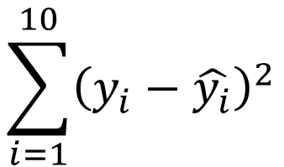


Choosing Proper Loss
“1”
……
y₁
1
$${\hat{y}}_{1}$$
1
……
y₂
0
$${\hat{y}}_{2}$$
0
Softmax
……
……
……
……
……
……
loss
……
y₁₀
0
0
$${\hat{y}}_{10}$$
Which one is better?
target
$$\sum_{i=1}^{10}{{\left(y_{i}−\hat{y_{i}}\right)}^{2}}$$
$$−\sum_{i=1}^{10}{\hat{y_{i}}lny_{i}}$$
Square
Error
Cross Entropy
=0
=0

Slide 19
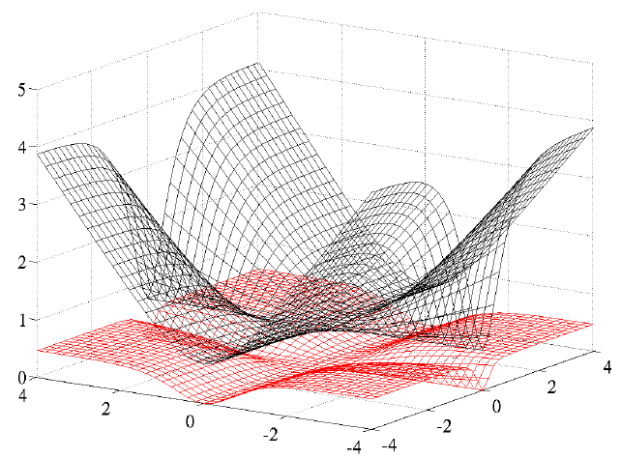
Choosing Proper Loss
When using softmax output layer, choose cross entropy
Cross Entropy
Total
Loss
Square
Error
w₁
w₂

Slide 20


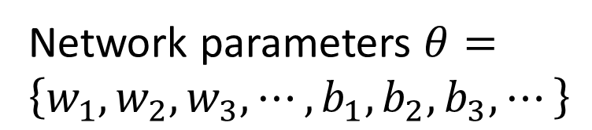
How to pick the best function
Find network parameters $θ^{∗}$ that minimize total loss L
Layer l
Layer l+1
Enumerate all possible values
Network parameters $θ=\left\{w_{1},w_{2},w_{3},⋯,b_{1},b_{2},b_{3},⋯\right\}$
10⁶
weights
……
……
Millions of parameters
E.g. Image Classification: 8 layers and 1000 neurons each layer
1000
neurons
1000
neurons
Notes:
百萬等級的
Solving this optimization problem by Calculus or something

Slide 21
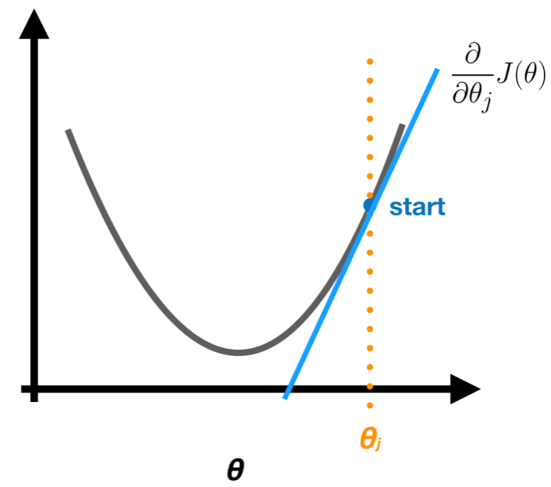
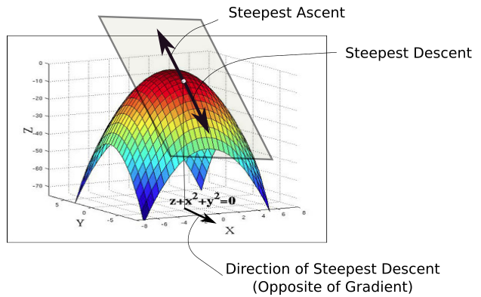
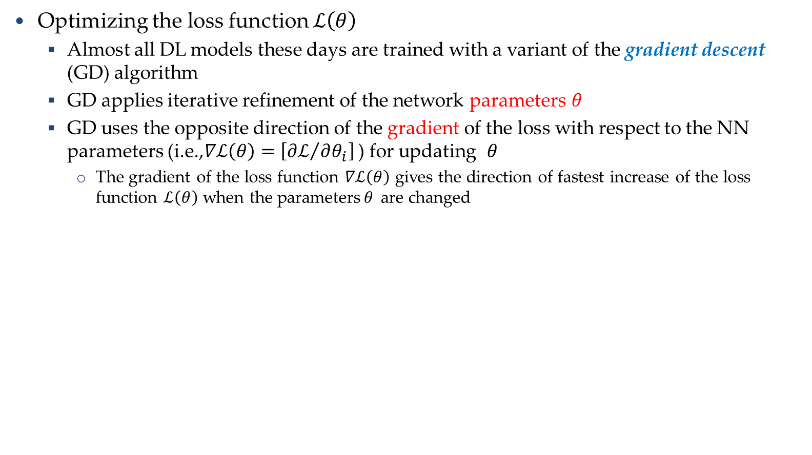



Training NNs
Training Neural Networks
Optimizing the loss function $ℒ\left(θ\right)$
Almost all DL models these days are trained with a variant of the gradient descent (GD) algorithm
GD applies iterative refinement of the network parameters$θ$
GD uses the opposite direction of the gradient of the loss with respect to the NN parameters (i.e.,$∇ℒ\left(θ\right)=\left[{∂ℒ}/{∂θ_{i}}\right]$ ) for updating $θ$
The gradient of the loss function $∇ℒ\left(θ\right)$ gives the direction of fastest increase of the loss function $ℒ\left(θ\right)$ when the parameters$θ$ are changed
$$ℒ\left(θ\right)$$
$$\frac{∂ℒ}{∂θ_{i}}$$
$$θ_{i}$$

Slide 22
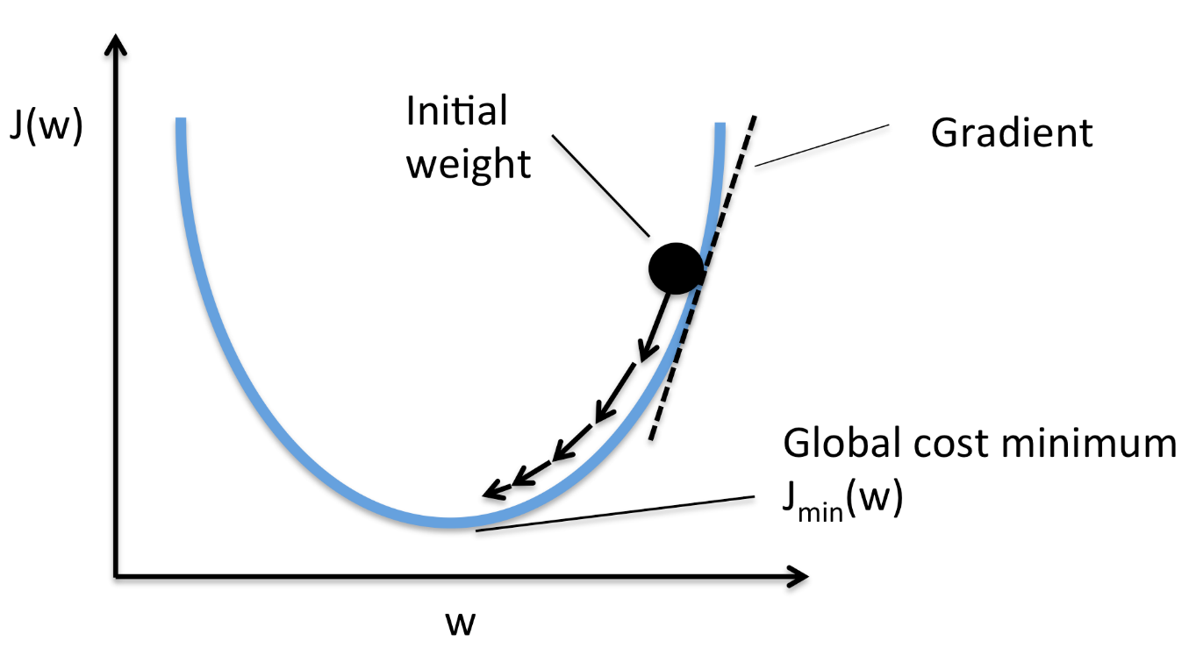
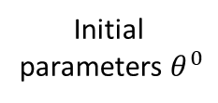

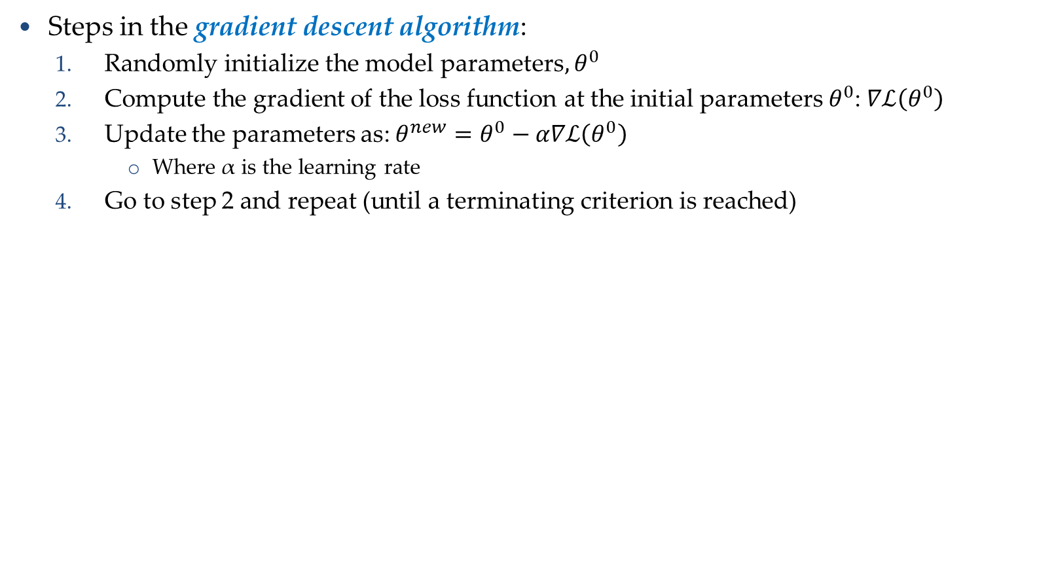
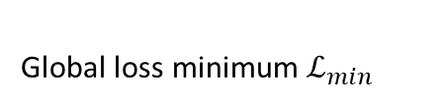
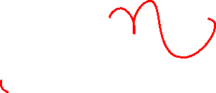



Gradient Descent Algorithm
Training Neural Networks
Steps in the gradient descent algorithm:
Randomly initialize the model parameters$,θ^{0}$
Compute the gradient of the loss function at the initial parameters $θ^{0}$: $∇ℒ\left(θ^{0}\right)$
Update the parameters as: $θ^{new}=θ^{0}−α∇ℒ\left(θ^{0}\right)$
Where α is the learning rate
Go to step 2 and repeat (until a terminating criterion is reached)
Loss $ℒ$
Initial
parameters $θ^{0}$
Gradient $∇ℒ=\frac{∂ℒ}{∂θ}$
Parameter update:${ θ}^{new}=θ−α∇ℒ\left(θ^{0}\right)$
Global loss minimum $ℒ_{min}$
Parameters $θ$

Slide 23
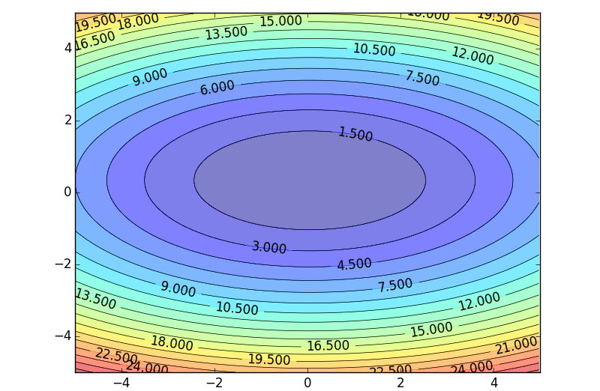


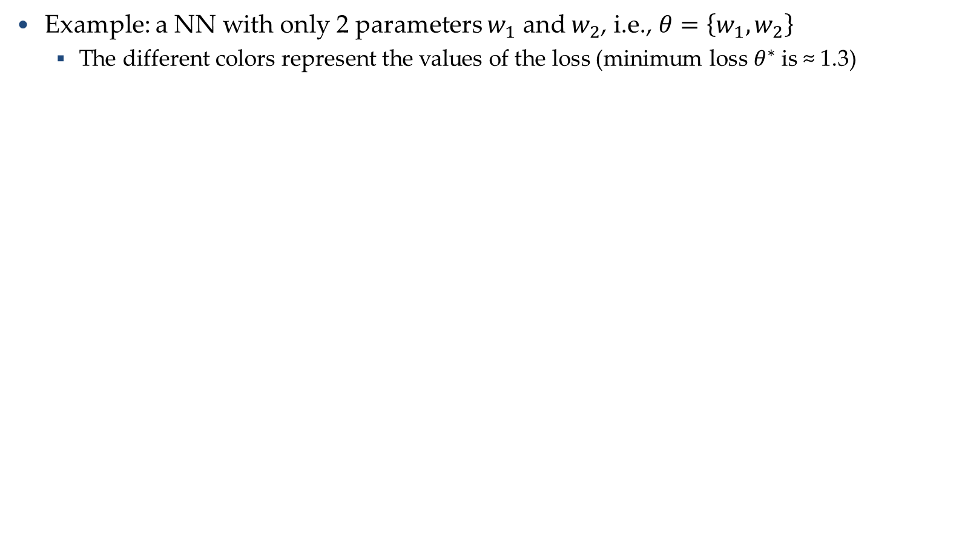
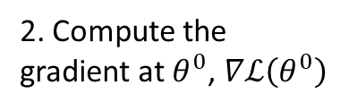


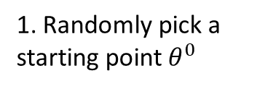

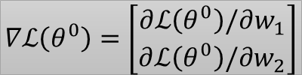



Gradient Descent Algorithm
Training Neural Networks
Example: a NN with only 2 parameters $w_{1}$ and $w_{2}$, i.e., $θ=\left\{w_{1},w_{2}\right\}$
The different colors represent the values of the loss (minimum loss$θ^{∗}$ is ≈ 1.3)
1. Randomly pick a starting point $θ^{0}$
2. Compute the gradient at $θ^{0}$, $∇ℒ\left(θ^{0}\right)$
$$θ^{∗}$$
$$w_{2}$$
3. Times the learning rate $η$, and update $θ,$
$$θ^{new}=θ^{0}−α∇ℒ\left(θ^{0}\right)$$
$$θ^{1}$$
$$θ^{1}=$$
$$θ^{0}−α∇ℒ\left(θ^{0}\right)$$
$$−∇ℒ\left(θ^{0}\right)$$
4. Go to step 2, repeat
$$θ^{0}$$
$$∇ℒ\left(θ^{0}\right)=\left[\begin{matrix}∂ℒ\left(θ^{0}\right)/∂w_{1} \\ ∂ℒ\left(θ^{0}\right)/∂w_{2}\end{matrix}\right]$$
$$w_{1}$$
Slide credit: Hung-yi Lee – Deep Learning Tutorial

Slide 24






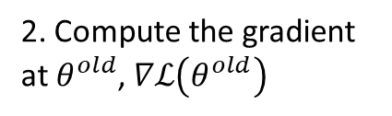


Gradient Descent Algorithm
Training Neural Networks
Example (contd.)
Eventually, we would reach a minimum …..
2. Compute the gradient at $θ^{old}$, $∇ℒ\left(θ^{old}\right)$
$$θ^{2}$$
$$θ^{1}−α∇ℒ\left(θ^{1}\right)$$
3. Times the learning rate $η$, and update $θ,$
$$θ^{new}=θ^{old}−α∇ℒ\left(θ^{old}\right)$$
$$w_{2}$$
$$θ^{2}−α∇ℒ\left(θ^{2}\right)$$
$$θ^{1}$$
4. Go to step 2, repeat
$$θ^{0}$$
$$w_{1}$$
Slide credit: Hung-yi Lee – Deep Learning Tutorial

Slide 25
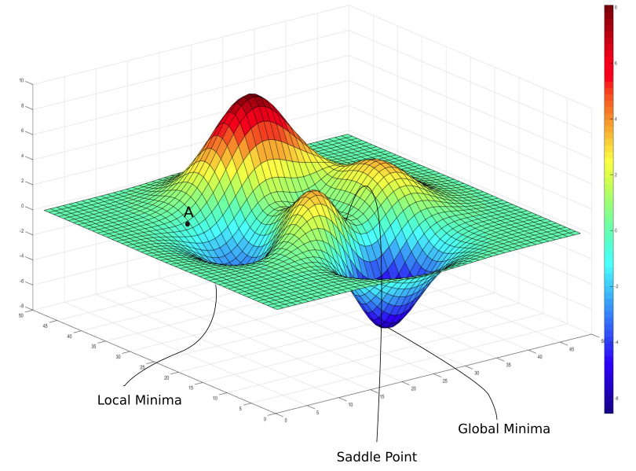
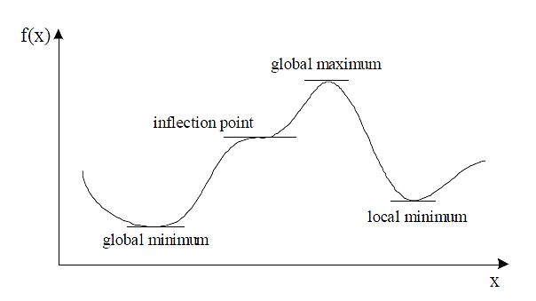


Gradient Descent Algorithm
Training Neural Networks
Gradient descent algorithm stops when a local minimum of the loss surface is reached
GD does not guarantee reaching a global minimum
However, empirical evidence suggests that GD works well for NNs
$ℒ\left(θ\right)$
$$θ$$
Picture from: https://blog.paperspace.com/intro-to-optimization-in-deep-learning-gradient-descent/

Slide 26
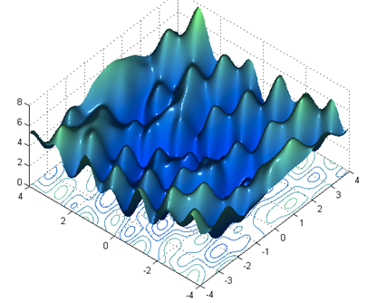

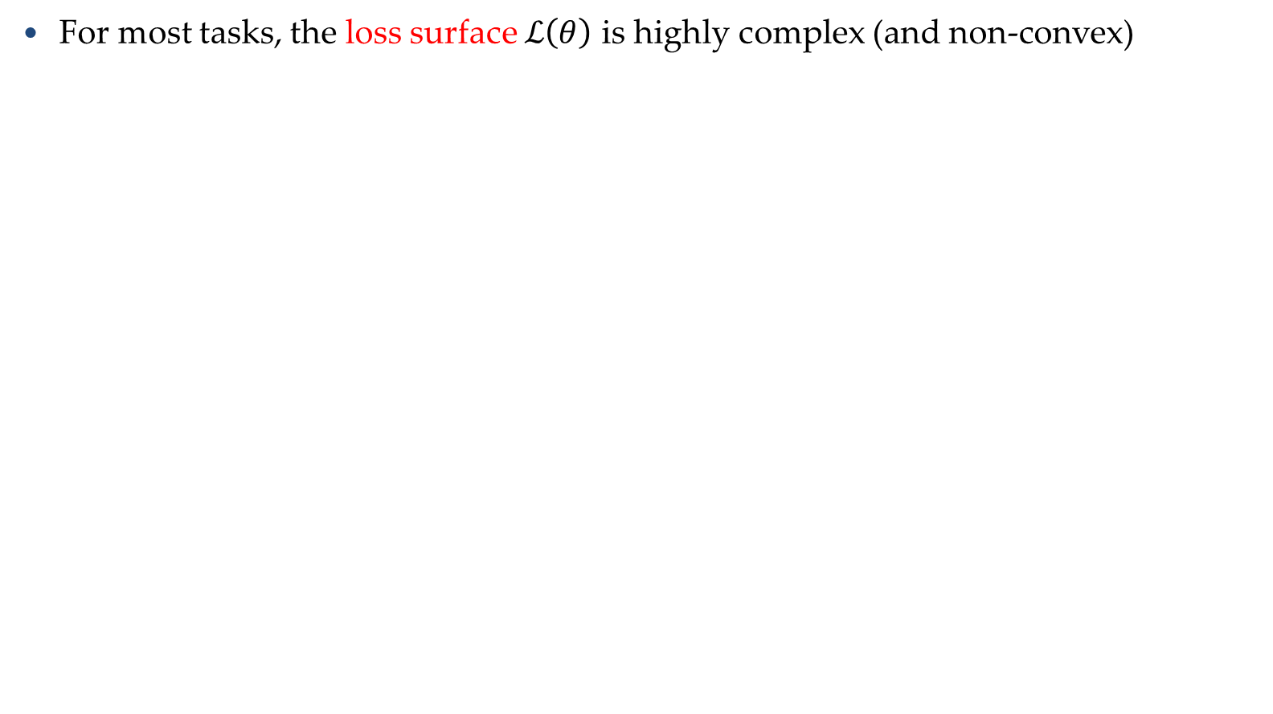



Gradient Descent Algorithm
Training Neural Networks
For most tasks, the loss surface $ℒ\left(θ\right)$ is highly complex (and non-convex)
Random initialization in NNs results in different initial parameters $θ^{0}$ every time the NN is trained
Gradient descent may reach different minima at every run
Therefore, NN will produce different predicted outputs
In addition, currently we don’t have algorithms that guarantee reaching a global minimum for an arbitrary loss function
$$ℒ$$
$$w_{1}$$
$$w_{2}$$
Slide credit: Hung-yi Lee – Deep Learning Tutorial

Slide 27
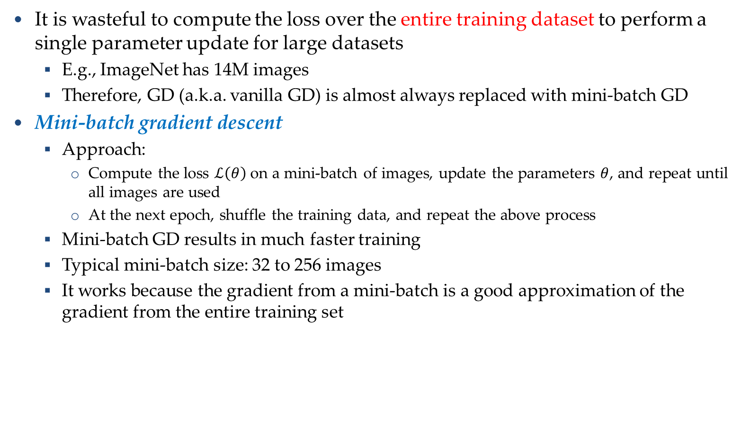
Mini-batch Gradient Descent
Training Neural Networks
It is wasteful to compute the loss over the entire training dataset to perform a single parameter update for large datasets
E.g., ImageNet has 14M images
Therefore, GD (a.k.a. vanilla GD) is almost always replaced with mini-batch GD
Mini-batch gradient descent
Approach:
Compute the loss $ℒ\left(θ\right)$ on a mini-batch of images, update the parameters $θ$, and repeat until all images are used
At the next epoch, shuffle the training data, and repeat the above process
Mini-batch GD results in much faster training
Typical mini-batch size: 32 to 256 images
It works because the gradient from a mini-batch is a good approximation of the gradient from the entire training set

Slide 28










Mini-batch
We do not really minimize total loss!
Randomly initialize network parameters
x¹
NN
y¹
Pick the 1st batch
$${\hat{y}}^{1}$$
$$l^{1}$$
$$L′=l^{1}+l^{31}+⋯$$
Mini-batch
NN
x³¹
y³¹
$${\hat{y}}^{31}$$
Update parameters once
$$l^{31}$$
Pick the 2nd batch
……
$$L′′=l^{2}+l^{16}+⋯$$
Update parameters once
x²
NN
y²
$${\hat{y}}^{2}$$
$$l^{2}$$
…
Until all mini-batches have been picked
Mini-batch
x¹⁶
NN
y¹⁶
$${\hat{y}}^{16}$$
$$l^{16}$$
one epoch
……
Repeat the above process

Slide 29
Mini-batch
Pick the 1st batch
x¹
NN
y¹
$${\hat{y}}^{1}$$
$$L′=l^{1}+l^{31}+⋯$$
$$l^{1}$$
Mini-batch
NN
Update parameters once
x³¹
y³¹
$${\hat{y}}^{31}$$
$$l^{31}$$
Pick the 2nd batch
……
$$L′′=l^{2}+l^{16}+⋯$$
Update parameters once
100 examples in a mini-batch
…
Until all mini-batches have been picked
Repeat 20 times
one epoch

Slide 30
















Shuffle the training examples for each epoch
Epoch 1
Epoch 2
x¹
NN
y¹
x¹
NN
y¹
$${\hat{y}}^{1}$$
$${\hat{y}}^{1}$$
$$l^{1}$$
$$l^{1}$$
Mini-batch
NN
Mini-batch
NN
x³¹
y³¹
$${\hat{y}}^{31}$$
x¹⁷
y¹⁷
$${\hat{y}}^{17}$$
$$l^{31}$$
$$l^{17}$$
……
……
x²
NN
y²
x²
NN
y²
$${\hat{y}}^{2}$$
$${\hat{y}}^{2}$$
$$l^{2}$$
$$l^{2}$$
Mini-batch
NN
Mini-batch
NN
x¹⁶
y¹⁶
$${\hat{y}}^{16}$$
x²⁶
y²⁶
$${\hat{y}}^{26}$$
$$l^{16}$$
$$l^{26}$$
……
……

Slide 31





Problems with Gradient Descent
Training Neural Networks
Besides the local minima problem, the GD algorithm can be very slow at plateaus, and it can get stuck at saddle points
cost $ℒ\left(θ\right)$
Very slow at the plateau
Stuck at a saddle point
Stuck at a local minimum
$$∇ℒ\left(θ\right)≈0$$
$$∇ℒ\left(θ\right)=0$$
$$∇ℒ\left(θ\right)=0$$
$$θ$$

Slide 32
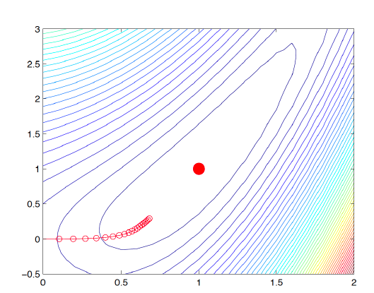
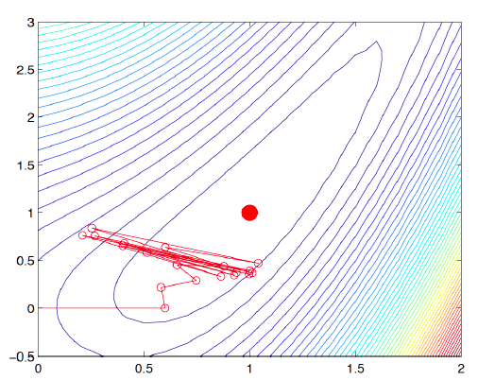
Learning Rate
Training Neural Networks
Learning rate
The gradient tells us the direction in which the loss has the steepest rate of increase, but it does not tell us how far along the opposite direction we should step
Choosing the learning rate (also called the step size) is one of the most important hyper-parameter settings for NN training
LR too small
LR too large

Slide 33
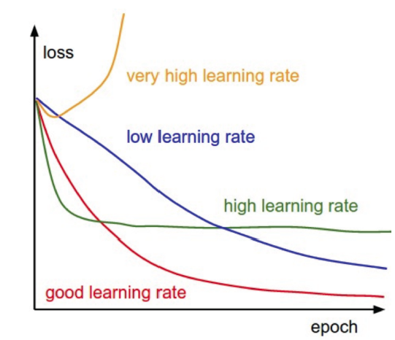
Learning Rate
Training Neural Networks
Training loss for different learning rates
High learning rate: the loss increases or plateaus too quickly
Low learning rate: the loss decreases too slowly (takes many epochs to reach a solution)
Picture from: https://cs231n.github.io/neural-networks-3/

Slide 34
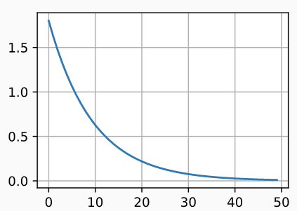
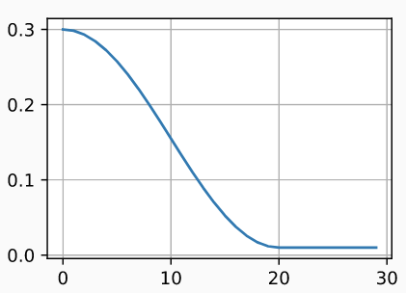
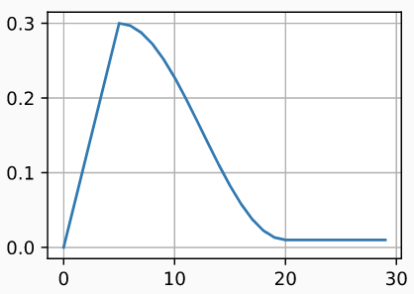
Learning Rate Scheduling
Training Neural Networks
Learning rate scheduling is applied to change the values of the learning rate during the training
Annealing is reducing the learning rate over time (a.k.a. learning rate decay)
Approach 1: reduce the learning rate by some factor every few epochs
Typical values: reduce the learning rate by a half every 5 epochs, or divide by 10 every 20 epochs
Approach 2: exponential or cosine decay gradually reduce the learning rate over time
Approach 3: reduce the learning rate by a constant (e.g., by half) whenever the validation loss stops improving
In TensorFlow: tf.keras.callbacks.ReduceLROnPleateau()
Monitor: validation loss, factor: 0.1 (i.e., divide by 10), patience: 10 (how many epochs to wait before applying it), Minimum learning rate: 1e-6 (when to stop)
Warmup is gradually increasing the learning rate initially, and afterward let it cool down until the end of the training
Exponential decay
Cosine decay
Warmup

Slide 35
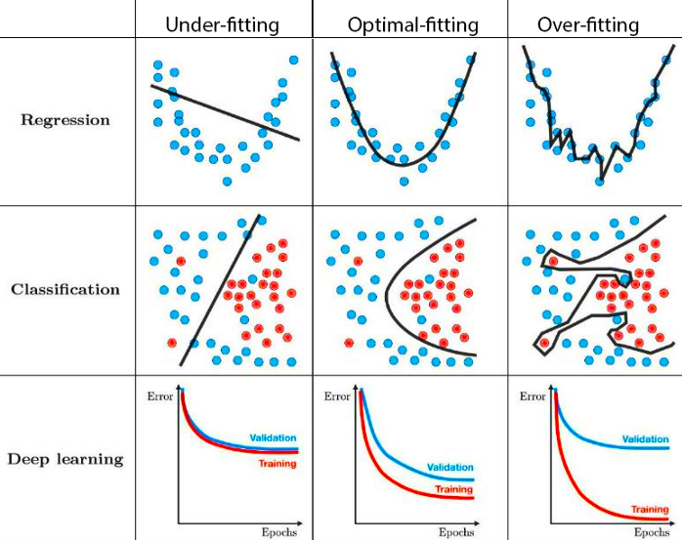
Generalization
Generalization
Underfitting
The model is too “simple” to represent all the relevant class characteristics
E.g., model with too few parameters
Produces high error on the training set and high error on the validation set
Overfitting
The model is too “complex” and fits irrelevant characteristics (noise) in the data
E.g., model with too many parameters
Produces low error on the training error and high error on the validation set

Slide 36

Overfitting
Generalization
Overfitting – a model with high capacity fits the noise in the data instead of the underlying relationship
The model may fit the training data very well, but fails to generalize to new examples (test or validation data)

Slide 37

How to Detect Overfitting vs Underfitting

Slide 38


Good vs Bad Models

