Slide 1
LINEAR REGRESSION
This PPT has been made via the use of AI Tools
PART 1
PART 2
PART 3
Foundations & Least Squares
Optimization, MLE & Norms
Evaluation → Logistic
Notes:
Title slide. Roadmap: we start from the intuition of fitting a line, build the full mathematical machinery (least squares, matrix algebra, gradient descent, MLE, regularization), then show how the same linear core extends into logistic regression for classification.

Slide 2
01
Foundations, Geometry
& the Least-Squares Idea
Why linear regression — the prediction problem
The linear model and its assumptions of form
Residuals: measuring how wrong a line is
The least-squares criterion and its geometry
Closed-form solution as an orthogonal projection
Notes:
Part 1 divider.

Slide 3
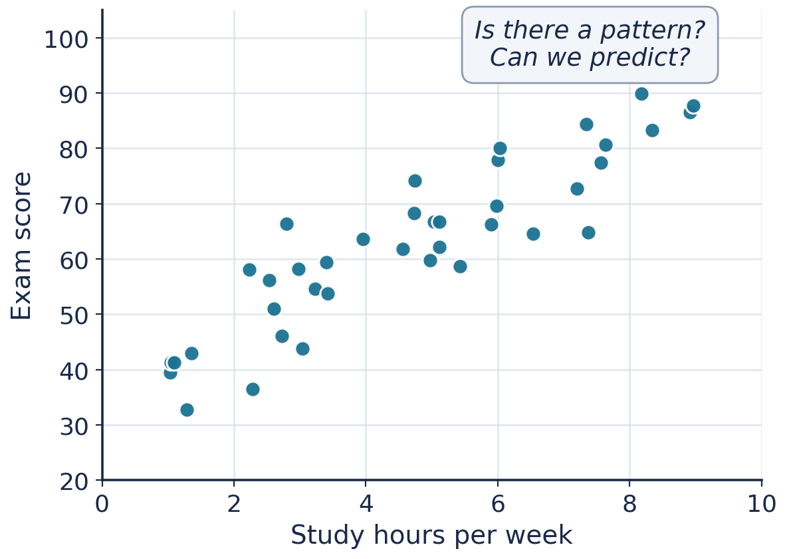
Why Linear Regression?
1 / 30
PART 1 · FOUNDATIONS & LEAST SQUARES
Regression answers a everyday question: given inputs, predict a continuous number.
Hours studied → exam score. Size → house price. Ad spend → sales.
It is the foundational model of statistics & machine learning:
interpretable — every coefficient has a clear meaning
fast — a closed-form exact solution exists
the base case for GLMs, neural nets, and logistic regression
Master this one model and most of supervised learning rhymes with it.
A cloud of points with an apparent linear trend
Notes:
Motivation: regression is prediction of a continuous target. Emphasize interpretability and that it is the conceptual base for everything later, including logistic regression.

Slide 4
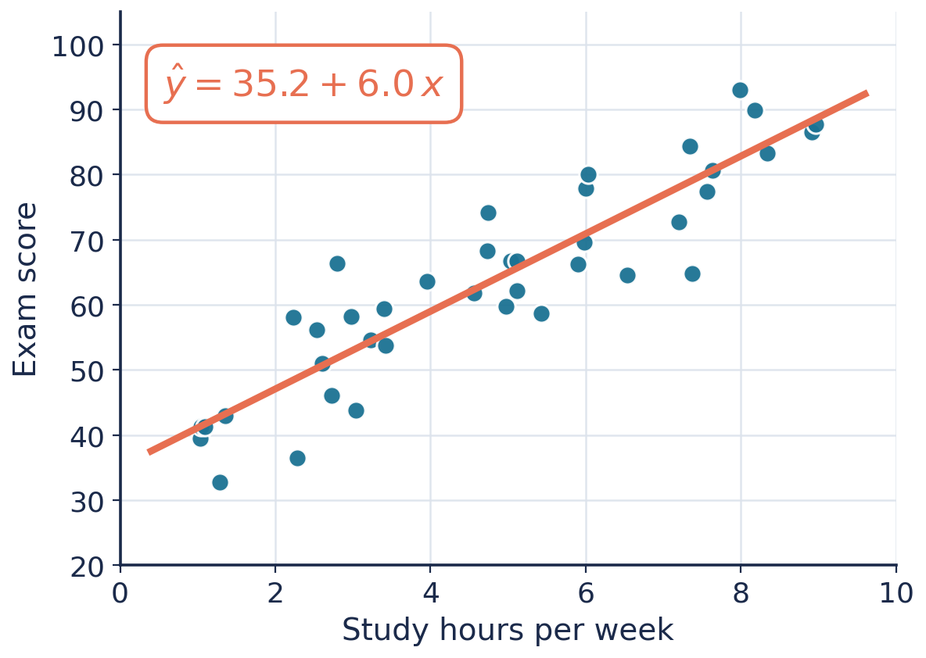
The Linear Model
2 / 30
PART 1 · FOUNDATIONS & LEAST SQUARES
y — the response (target) we want to predict
x₁ … xₚ — the features (predictors, covariates)
β₀ — intercept; βⱼ — slope / weight on feature j
ε — irreducible noise the model cannot explain
“Linear” means linear in the parameters β — not necessarily in x.
x², log x, x₁x₂ are all fine features; the model stays linear.
One feature: a line through the data
Notes:
Define each symbol. Stress 'linear in parameters' — the single most common misconception. Polynomial and interaction terms keep the model linear.

Slide 5
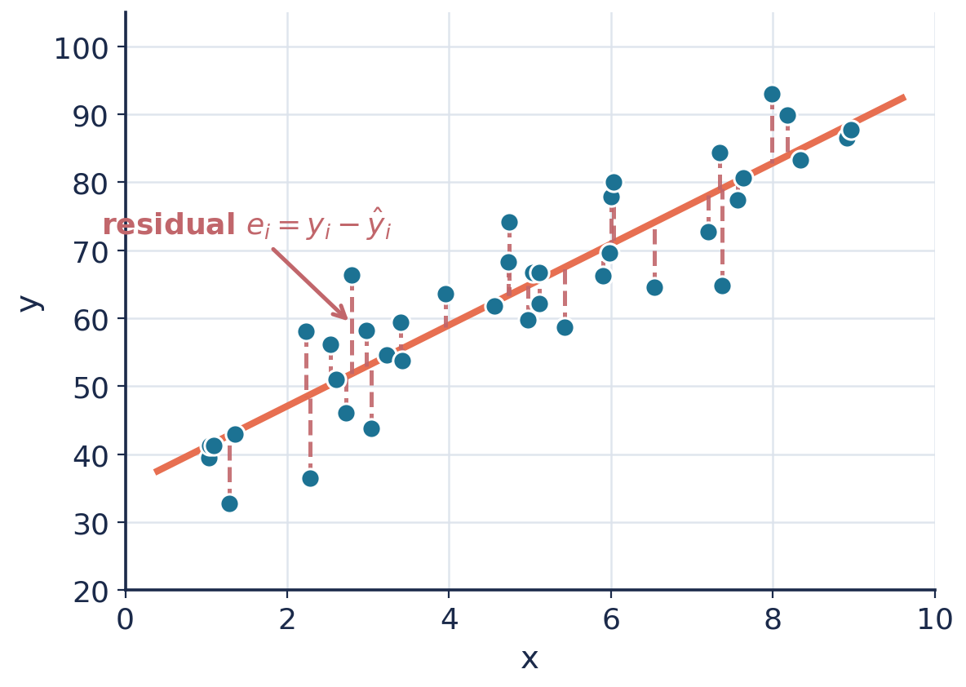
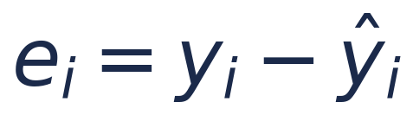
What Makes a Line “Good”?
3 / 30
PART 1 · FOUNDATIONS & LEAST SQUARES
For any candidate line, each point has a residual:
Positive residual → point sits above the line
Negative residual → point sits below the line
A good line makes residuals collectively small.
But small how? Sum of residuals can cancel to zero even for a terrible line — positives and negatives offset.
We need a measure that punishes every miss, regardless of sign.
Dashed segments = residuals (vertical misses)
Notes:
Residual = observed minus predicted. Key pedagogical trap: raw sum of residuals cancels, so it cannot measure fit. Motivates squaring next.

Slide 6
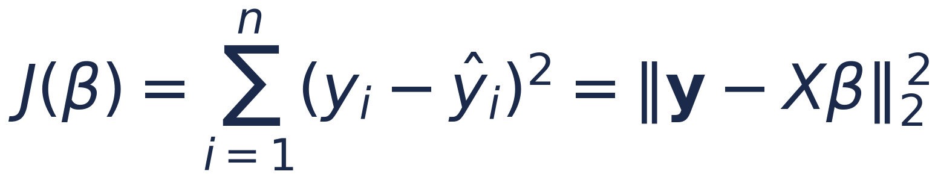
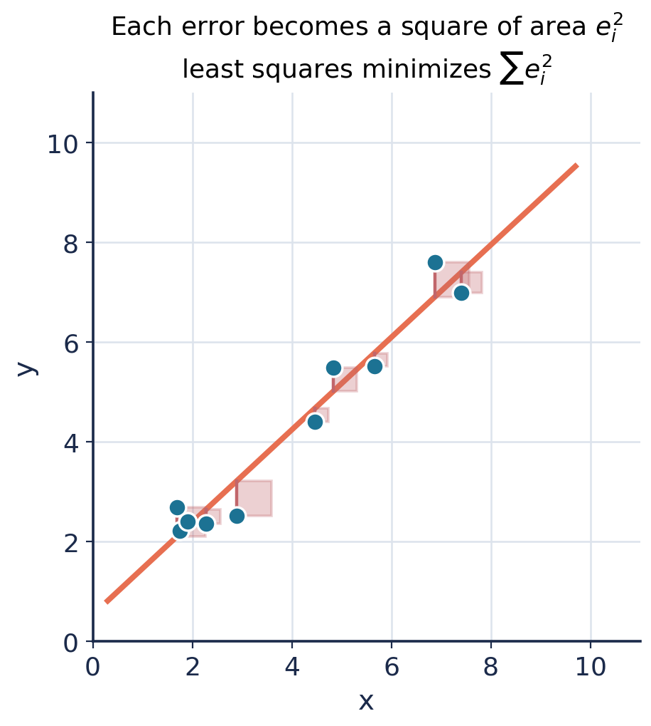
The Least-Squares Criterion
4 / 30
PART 1 · FOUNDATIONS & LEAST SQUARES
Square each residual, then add them up — the cost J(β).
Squaring removes sign, so misses never cancel out.
Squaring penalizes big errors far more than small ones.
J is smooth and convex → a single, findable minimum.
Least squares = choose β that minimizes this total squared error.
Each error is literally a square of area e²
Notes:
Three reasons for squaring: sign removal, heavy penalty on outliers, and smooth convex objective with closed form. The squares figure makes 'least squares' literal.

Slide 7
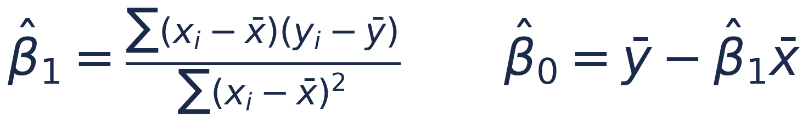
Solving Simple Regression
5 / 30
PART 1 · FOUNDATIONS & LEAST SQUARES
Set the derivatives of J with respect to β₀ and β₁ to zero.
Two equations, two unknowns → solve exactly. No search needed.
Slope β₁
Intercept β₀
Key fact
Covariance of x and y divided by the variance of x — how strongly y moves with x.
Forces the line through the mean point (x̄, ȳ).
The fitted line always passes through the centroid of the data.
Notes:
Differentiate, set to zero, solve. The slope is cov(x,y)/var(x); the intercept centers the line on the means. The line always passes through (x-bar, y-bar).

Slide 8
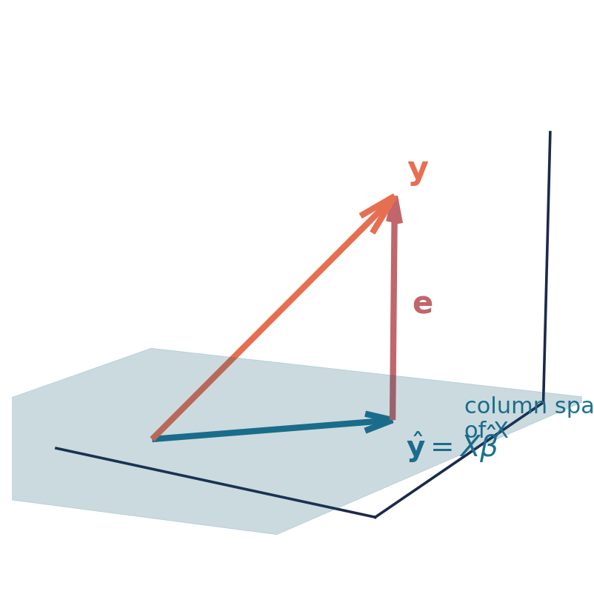
The Geometry of Least Squares
6 / 30
PART 1 · FOUNDATIONS & LEAST SQUARES
Stack the data: y is a vector in ℝⁿ.
Every possible Xβ sweeps out the column space of X — a flat subspace.
y usually does not lie in that subspace (noise pushes it off).
Least squares picks ŷ = Xβ̂ as the closest point in the subspace to y.
“Closest” = drop a perpendicular. The residual e = y − ŷ is orthogonal to the subspace.
y projected onto the column space of X
Notes:
Geometric view: fitting = orthogonal projection of y onto col(X). The residual is perpendicular to the fitted space — this is what 'best' means geometrically and it gives the normal equations.

Slide 9
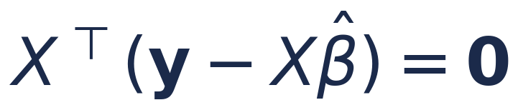
Orthogonality → Normal Equations
7 / 30
PART 1 · FOUNDATIONS & LEAST SQUARES
The residual being orthogonal to every column of X is the whole story.
expands directly into
These are the normal equations — the exact least-squares solution for any number of features.
(XᵀX)⁻¹ exists whenever the features are not perfectly collinear.
Notes:
Orthogonality condition X^T(y - X beta) = 0 rearranges into the normal equations. Bridge slide into Part 2's matrix derivation. Note collinearity breaks invertibility.

Slide 10
02
Optimization, Likelihood
& Regularization
Matrix formulation and the normal equations, derived
Gradient descent when n is large
Maximum likelihood — where least squares comes from
Parameter estimation: bias, variance, uncertainty
L₁ and L₂ norms → Lasso and Ridge
Notes:
Part 2 divider.

Slide 11
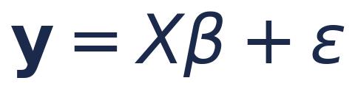
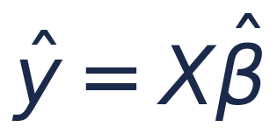
Matrix Formulation
8 / 30
PART 2 · OPTIMIZATION, MLE & NORMS
Multiple features get unwieldy in scalar form. Vectorize everything.
Design matrix X — one row per observation, one column per feature (plus a column of 1s for the intercept).
β — the vector of all coefficients. y — the vector of targets.
Predictions collapse to a single matrix product:
Notes:
Stack observations into the design matrix X (include a 1s column for intercept). The entire model is y = X beta + epsilon. Dimensions matter — walk through the shapes.

Slide 12
Deriving the Normal Equations
9 / 30
PART 2 · OPTIMIZATION, MLE & NORMS
Write the cost as a squared norm
The punchline
1
J(β) = ‖y − Xβ‖² = (y − Xβ)ᵀ(y − Xβ)
Calculus and geometry agree: the least-squares estimator is exact and closed-form.
Take the gradient with respect to β
2
∇J = −2Xᵀ(y − Xβ)
No iteration. No tuning. One matrix inverse.
Set the gradient to zero
3
XᵀXβ = Xᵀy
Solve for β (if XᵀX invertible)
So why ever iterate? → next slide.
4
β̂ = (XᵀX)⁻¹Xᵀy
Notes:
Four algebraic steps to the normal equations. Emphasize this is the same answer geometry gave. Sets up the question: if closed-form exists, why gradient descent?

Slide 13
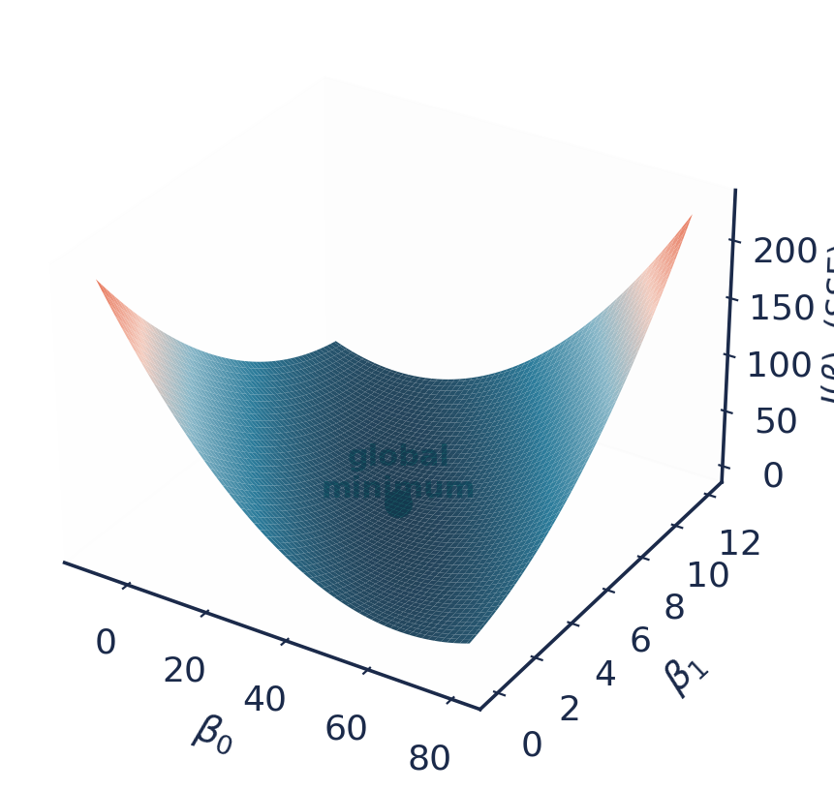
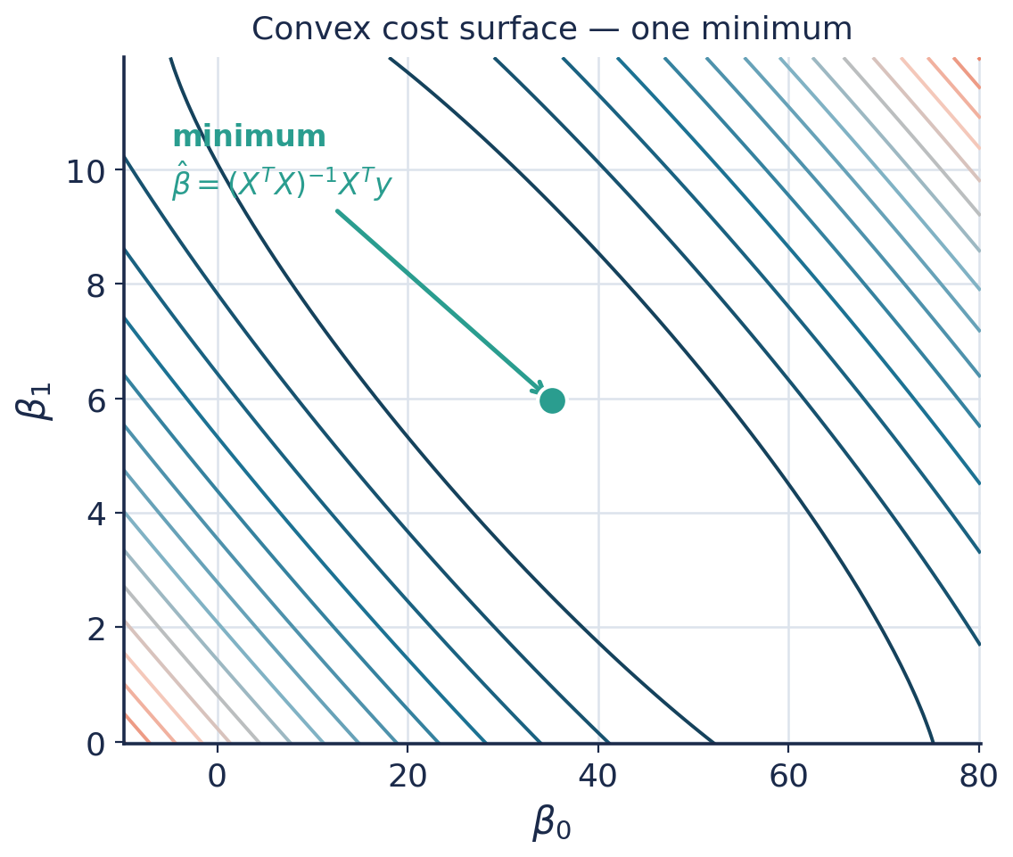
The Cost Surface
10 / 30
PART 2 · OPTIMIZATION, MLE & NORMS
J(β) is a bowl over parameter space — convex, one bottom.
The closed form jumps straight to the bottom.
But (XᵀX)⁻¹ costs ~O(p³) and needs all data in memory.
With millions of rows or thousands of features, that inverse is impractical.
Instead: start somewhere and walk downhill. That's gradient descent.
Convex bowl in (β₀, β₁)
Same surface, seen from above
Notes:
The convex bowl. Closed form is exact but O(p^3) and memory-heavy. For large-scale problems we iterate. Contour = top-down view we'll use for the descent path.

Slide 14
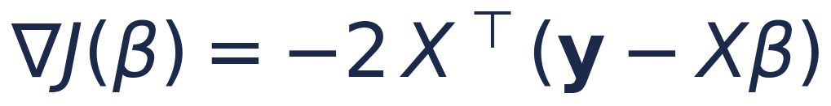
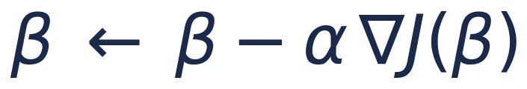
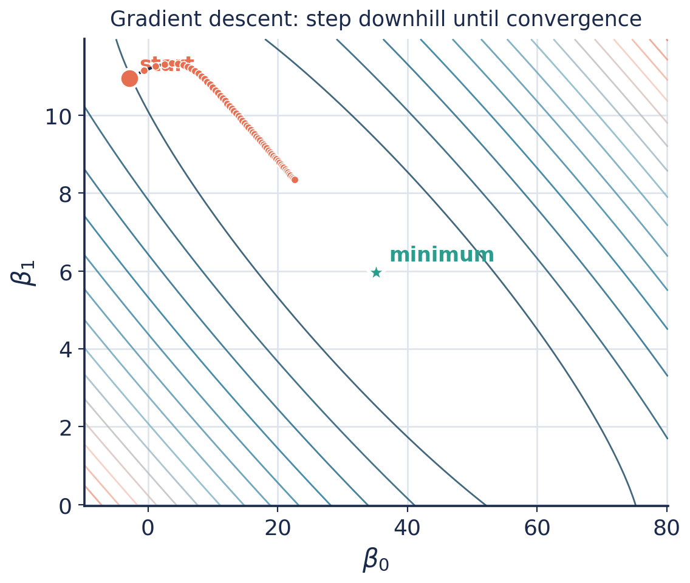
Gradient Descent
11 / 30
PART 2 · OPTIMIZATION, MLE & NORMS
The gradient points uphill. So step the opposite way.
α is the learning rate — the size of each downhill step.
Repeat until the gradient ≈ 0 (the bottom of the bowl).
Because J is convex, gradient descent is guaranteed to reach the global minimum.
Variants: batch (all data), stochastic (one point), mini-batch (a handful) — the engine behind modern ML.
Descending the contours to the minimum
Notes:
Update rule: beta <- beta - alpha * grad. Convexity guarantees convergence to global min. Mention SGD / mini-batch as the scalable variants used in deep learning.

Slide 15
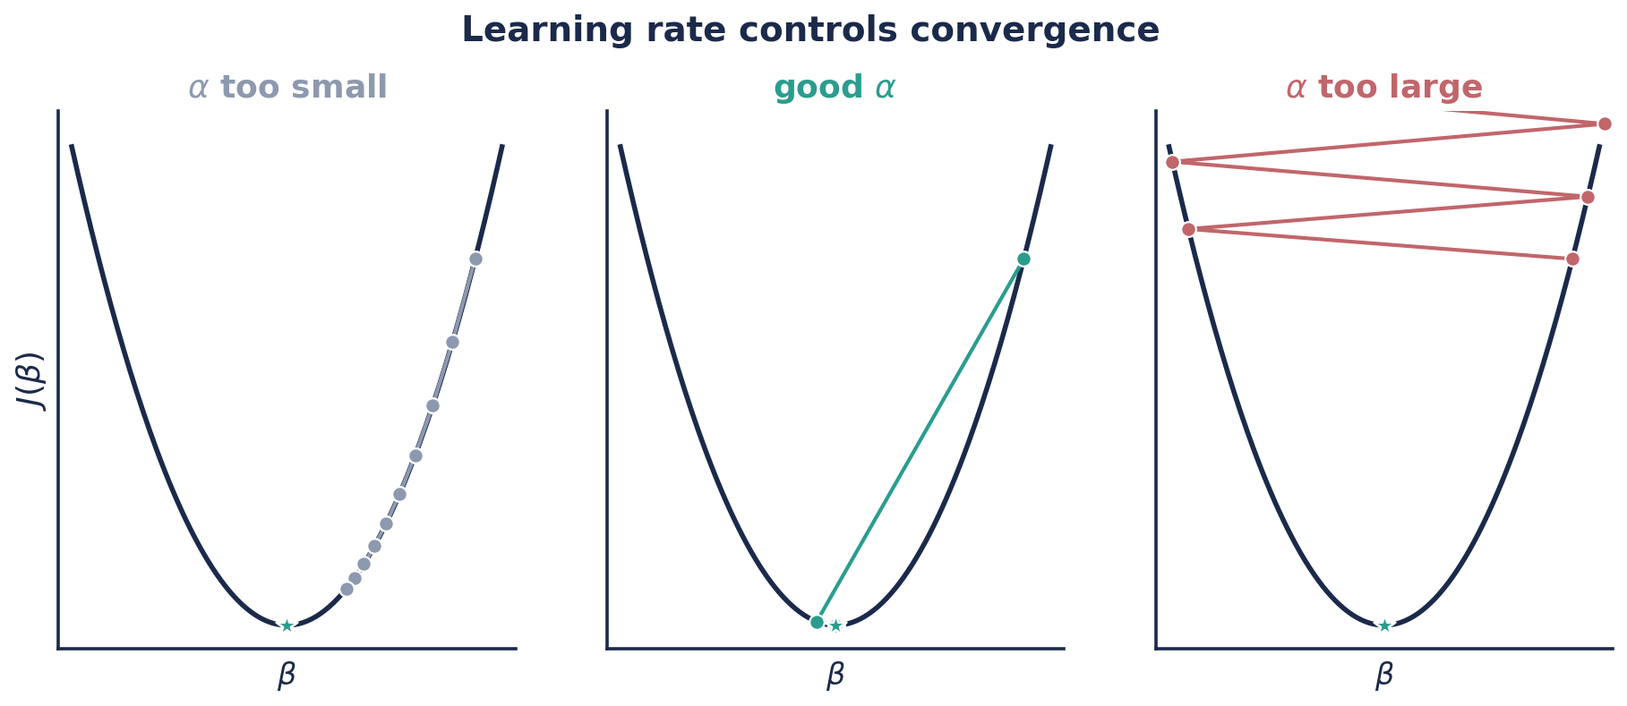
Choosing the Learning Rate
12 / 30
PART 2 · OPTIMIZATION, MLE & NORMS
Too small
Just right
Too large
Correct direction, but painfully slow — many wasted iterations.
Fast, smooth convergence to the minimum.
Overshoots, oscillates, can diverge entirely.
Notes:
Learning rate is the key hyperparameter. Too small = slow; too large = overshoot/diverge. In practice: try a few, or use adaptive methods (Adam, RMSProp).

Slide 16
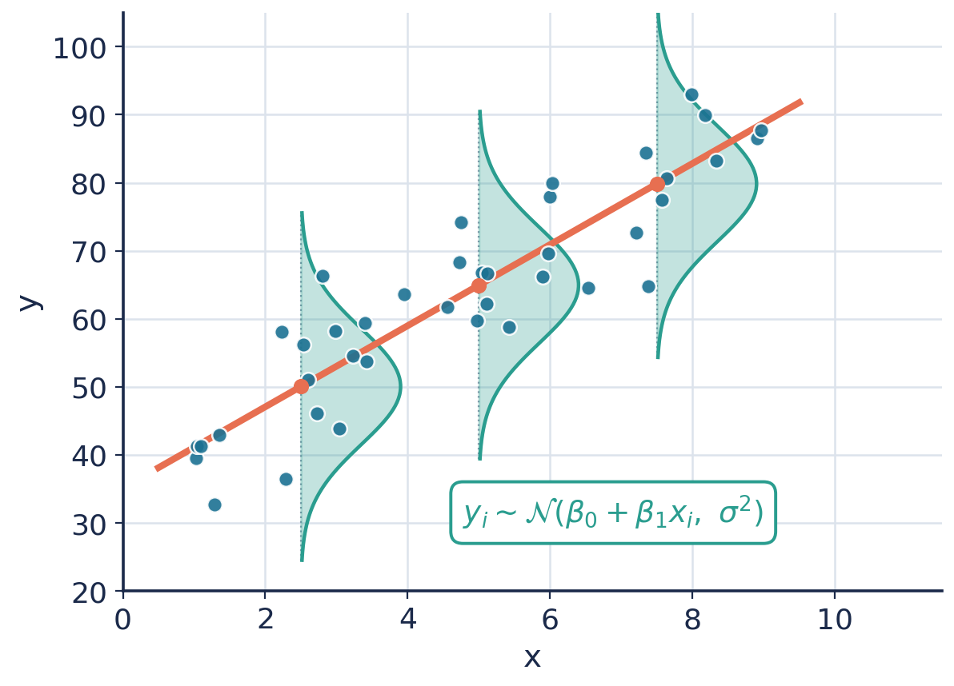
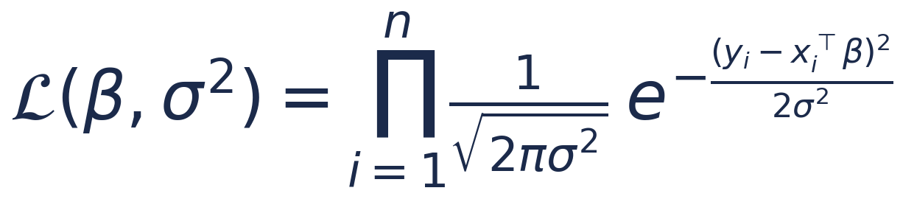
Maximum Likelihood Estimation
13 / 30
PART 2 · OPTIMIZATION, MLE & NORMS
So far least squares looked like an arbitrary choice. It isn't.
Assume the noise is Gaussian: ε ~ 𝒩(0, σ²).
Then each yᵢ is normally distributed around the line.
MLE asks: which β makes the observed data most probable?
Maximize the joint probability (likelihood) of all points.
Each yᵢ drawn from a Gaussian centered on the line
Notes:
MLE justifies least squares. Assume Gaussian noise; then y_i ~ N(x_i^T beta, sigma^2). Likelihood = product of Gaussians. Next slide: maximizing it = minimizing SSE.

Slide 17
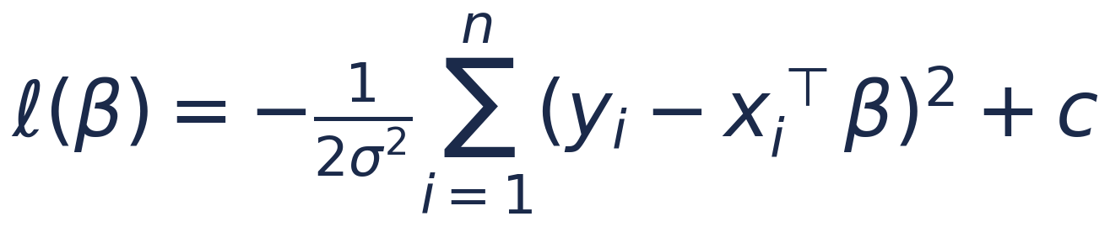
MLE Recovers Least Squares
14 / 30
PART 2 · OPTIMIZATION, MLE & NORMS
Products are hard to differentiate — take the log (monotonic, so the argmax is unchanged).
Only the sum-of-squares term depends on β. Maximizing the log-likelihood is exactly minimizing SSE:
Least squares is the maximum-likelihood estimator under Gaussian noise — a principled result, not a convenient guess.
Notes:
Log-likelihood: the -1/(2 sigma^2) * SSE term is the only beta-dependent piece. Hence argmax likelihood = argmin SSE. This is the deep justification for least squares.

Slide 18
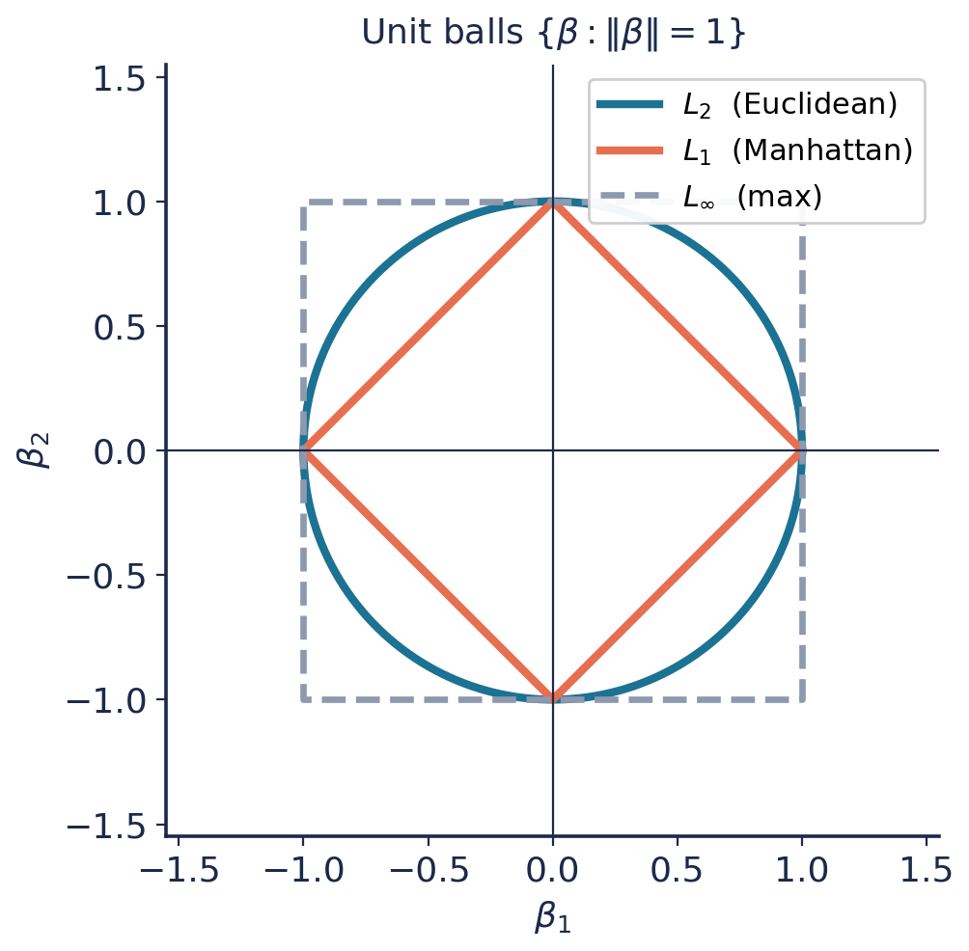
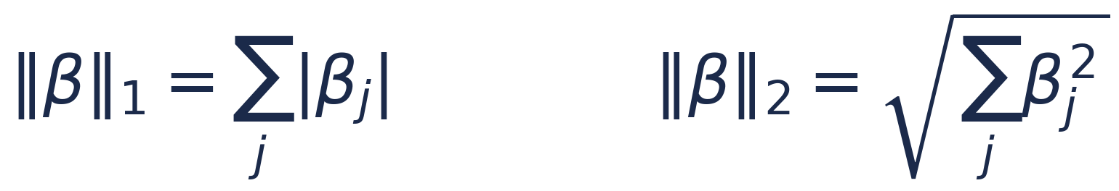
L₁ and L₂ Norms
16 / 30
PART 2 · OPTIMIZATION, MLE & NORMS
A norm measures the “size” of the coefficient vector β.
L₂ (Euclidean) — sum of squares. Smooth; shrinks coefficients.
L₁ (Manhattan) — sum of absolute values. Cornered; zeroes coefficients.
Unit balls: circle, diamond, square
Notes:
Norms quantify coefficient size. The GEOMETRY of the unit ball (round L2 vs pointed L1) is what produces shrinkage vs sparsity — set up for the next slide.

Slide 19
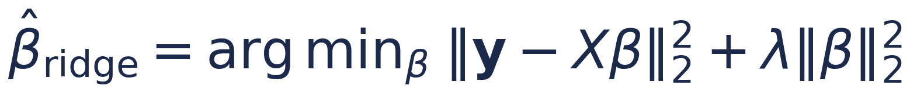

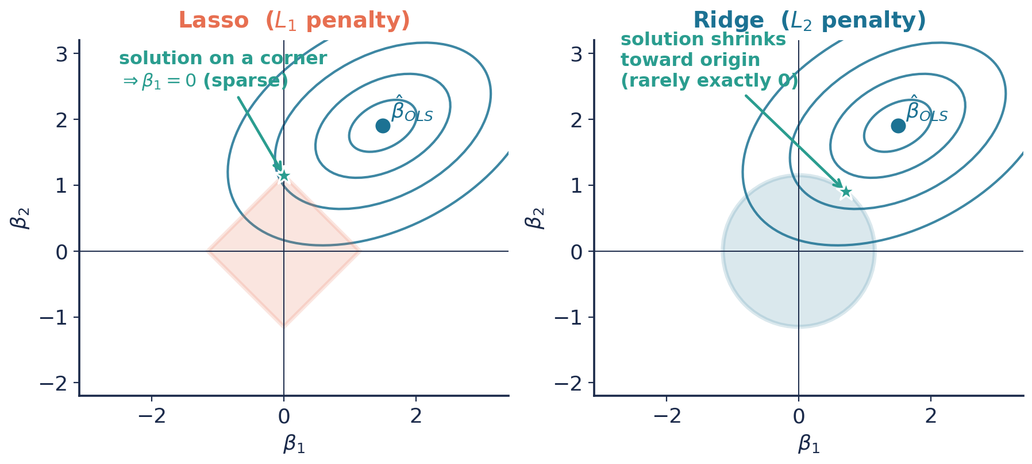
Ridge & Lasso: Penalized Regression
17 / 30
PART 2 · OPTIMIZATION, MLE & NORMS
Add a penalty on β to the cost. λ controls how hard we push coefficients toward zero — trading a little bias for much less variance.
Notes:
Add lambda * penalty. The SSE contours meet the constraint region: Lasso's diamond corners give exact zeros (feature selection); Ridge's circle shrinks smoothly. lambda tunes bias-variance.

Slide 20
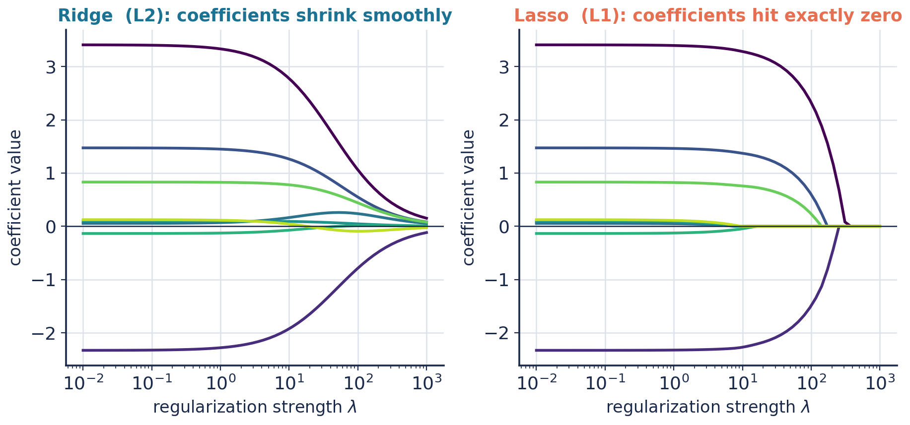
Ridge vs Lasso: What Each Does
18 / 30
PART 2 · OPTIMIZATION, MLE & NORMS
Ridge (L₂)
Lasso (L₁)
Shrinks all coefficients smoothly toward zero; keeps every feature. Best when many features each matter a little. Has a closed form: (XᵀX + λI)⁻¹Xᵀy.
Drives some coefficients to exactly zero — automatic feature selection. Best when only a few features truly matter. No closed form; solved numerically.
Notes:
Ridge shrinks and keeps all; Lasso selects. Ridge has closed form with lambda*I (also fixes non-invertibility). Elastic Net blends both. Choose by whether you expect a sparse truth.

Slide 21
03
Assumptions, Evaluation
& the Leap to Logistic
The assumptions behind valid inference
Diagnostics: reading the residuals
Evaluation: R², RMSE, and honest error
Bias–variance and why we regularize
From a line to a probability: logistic regression
Notes:
Part 3 divider.

Slide 22
Assumptions Behind the Model
19 / 30
PART 3 · EVALUATION → LOGISTIC
Least squares always gives an answer. These assumptions decide whether that answer is trustworthy.
L
I
N
E
Linearity
Independence
Normality
Equal variance
The relationship between X and the mean of y is linear.
Observations (and their errors) don't influence each other.
Errors are approximately normally distributed.
Error spread is constant across all x (homoscedasticity).
Mnemonic: L · I · N · E
Notes:
LINE: Linearity, Independence, Normality, Equal variance. Least squares runs regardless, but valid p-values and CIs depend on these holding. Check them — don't assume them.

Slide 23
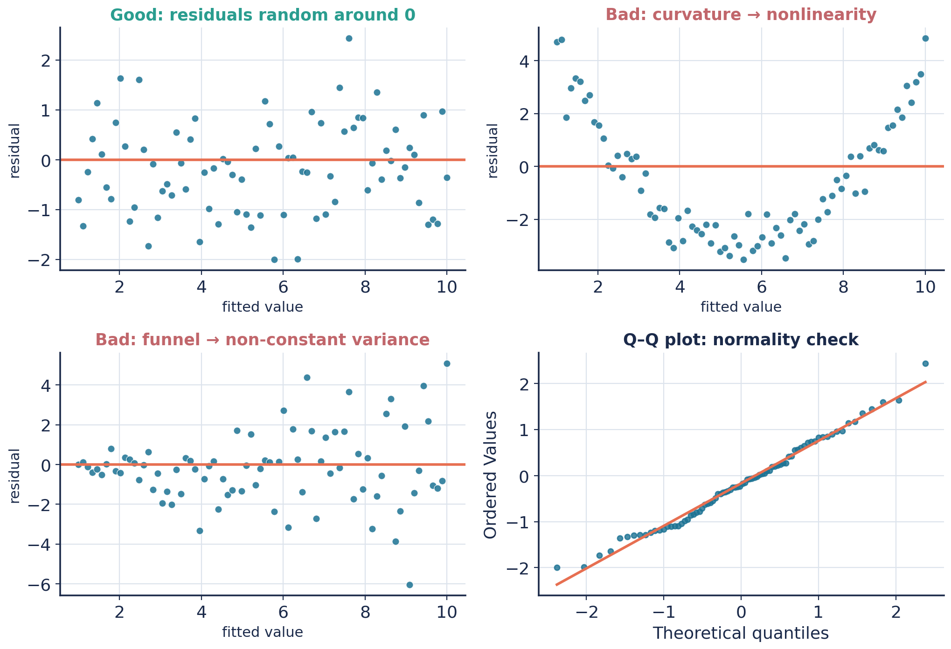
Diagnostics: Read the Residuals
20 / 30
PART 3 · EVALUATION → LOGISTIC
Residuals are the model's confession — plot them.
Random cloud around 0 → assumptions look fine.
Curvature → the true relationship isn't linear.
Funnel shape → variance grows with x (heteroscedasticity).
Q–Q plot off the line → non-normal errors.
Fixes: transform y, add features, or use robust / weighted methods.
Residual & Q–Q plots reveal assumption breaks
Notes:
Diagnostics are visual. Residuals vs fitted should be a structureless band. Patterns point to specific violations and specific fixes. This is where good modelling actually happens.

Slide 24
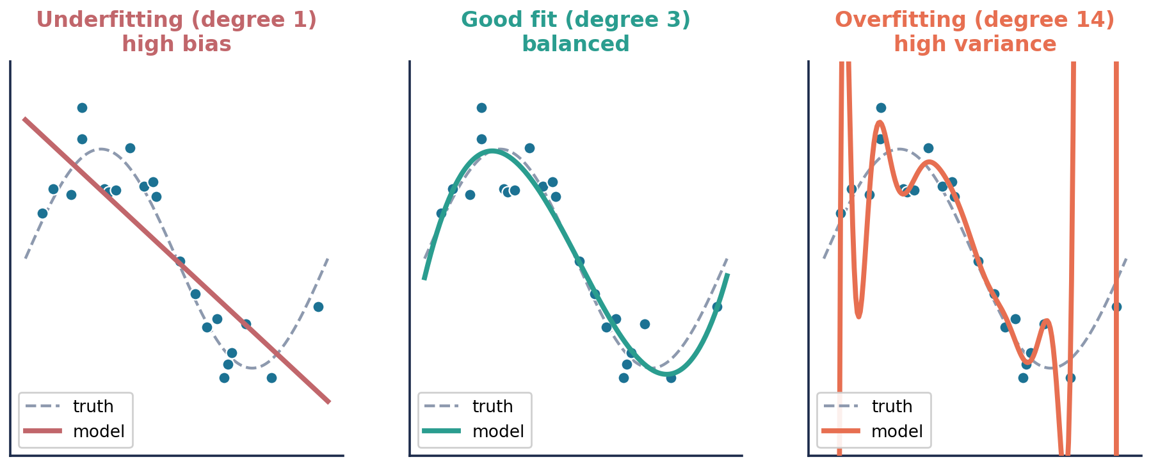
The Bias–Variance Trade-off
22 / 30
PART 3 · EVALUATION → LOGISTIC
Underfitting
Balanced
Overfitting
Model too simple — high bias. Misses real structure; poor on train and test.
Captures the signal, ignores the noise. The goal — regularization lives here.
Model too flexible — high variance. Memorizes noise; great on train, awful on test.
Notes:
The central tension of ML. Simple = biased; complex = high variance. Regularization (Part 2) deliberately adds a little bias to cut variance and generalize better. Test error is the judge.

Slide 25
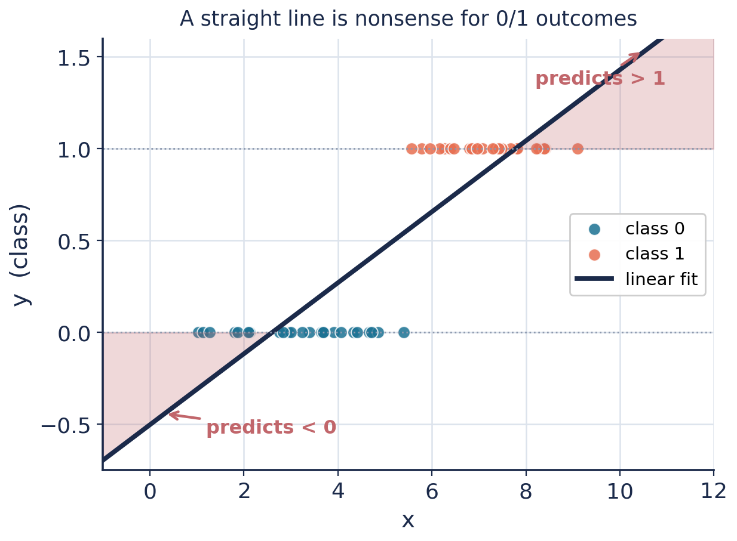
When the Target Is a Category
23 / 30
PART 3 · EVALUATION → LOGISTIC
Now suppose y is not a number but a class: spam / not-spam, pass / fail, 0 / 1.
Try to force a straight line through 0/1 labels and it breaks:
predictions run below 0 and above 1 — impossible as probabilities
the fit is dragged around by extreme points
“distance” from the line stops meaning anything sensible
We need an output bounded to [0, 1] that we can read as a probability.
A line escapes [0,1] — nonsense probabilities
Notes:
Transition slide. A linear fit on 0/1 labels predicts outside [0,1] and is outlier-sensitive. We need a bounded, probability-valued output. Enter the sigmoid.

Slide 26
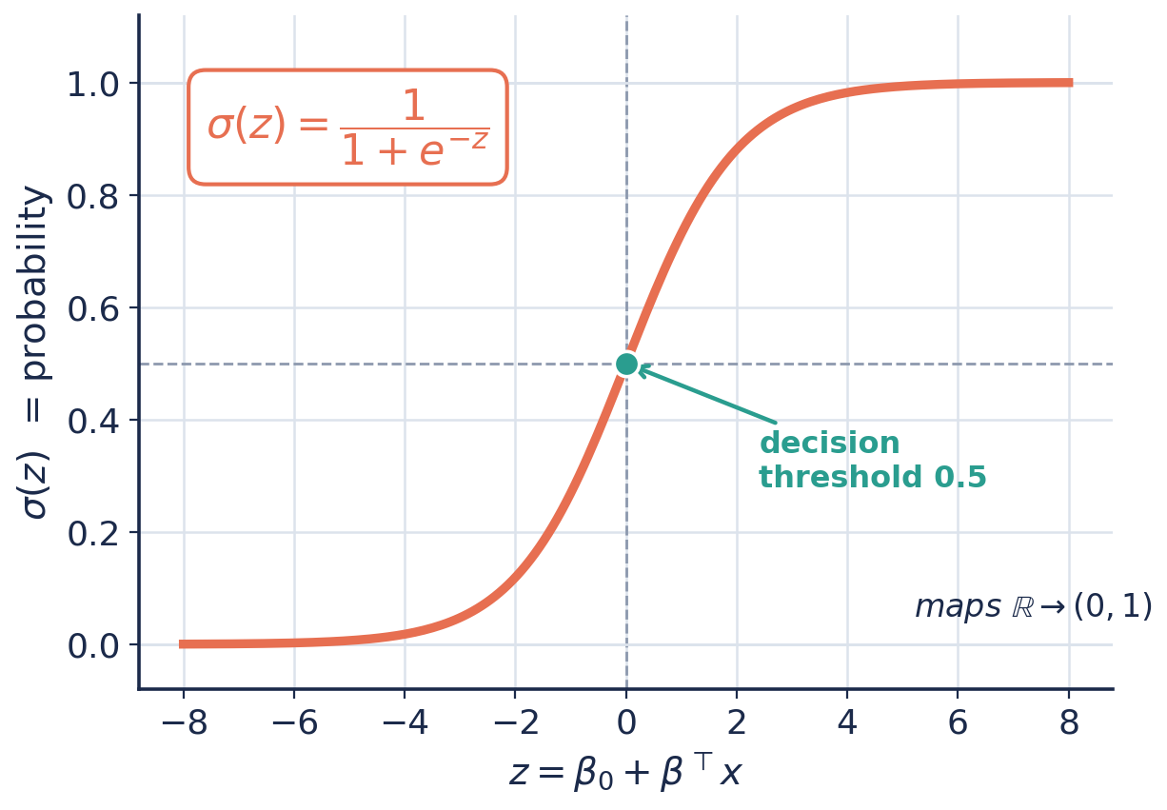
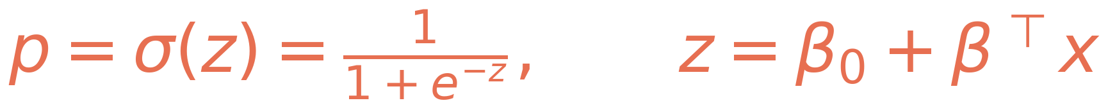
The Bridge: the Sigmoid
24 / 30
PART 3 · EVALUATION → LOGISTIC
Keep the familiar linear score z = β₀ + βᵀx.
Then squash it through the sigmoid σ(z) into (0, 1).
Large positive z → probability near 1
Large negative z → probability near 0
z = 0 → probability 0.5 (the decision threshold)
The linear model lives on inside; only the output is transformed.
The S-curve maps any real score to a probability
Notes:
The sigmoid is the single idea that turns regression into classification. z stays linear; sigma(z) bounds it to (0,1). z=0 is the 0.5 threshold. The linear core is untouched.

Slide 27
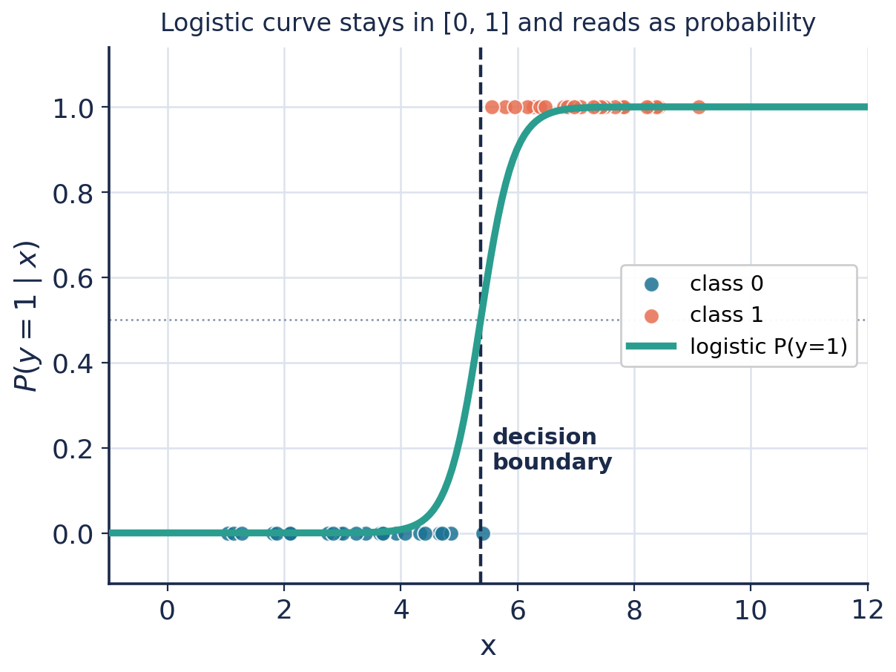
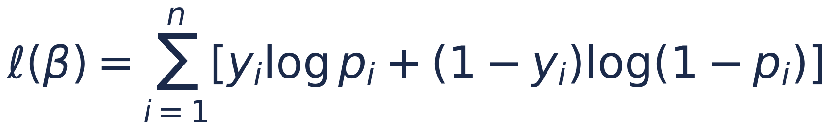
Fitting: MLE Returns
26 / 30
PART 3 · EVALUATION → LOGISTIC
No closed form here — but the logic of Part 2 carries straight over.
Write the likelihood of the 0/1 labels and maximize its log:
This is the log-loss / binary cross-entropy.
It's convex — gradient descent finds the global optimum.
Same recipe: model → likelihood → log → optimize.
Logistic curve fits the classes and stays in [0,1]
Notes:
Logistic MLE = maximize the Bernoulli log-likelihood = minimize cross-entropy. Convex, so gradient descent (Part 2) solves it. The whole MLE-then-optimize pattern repeats.

Slide 28
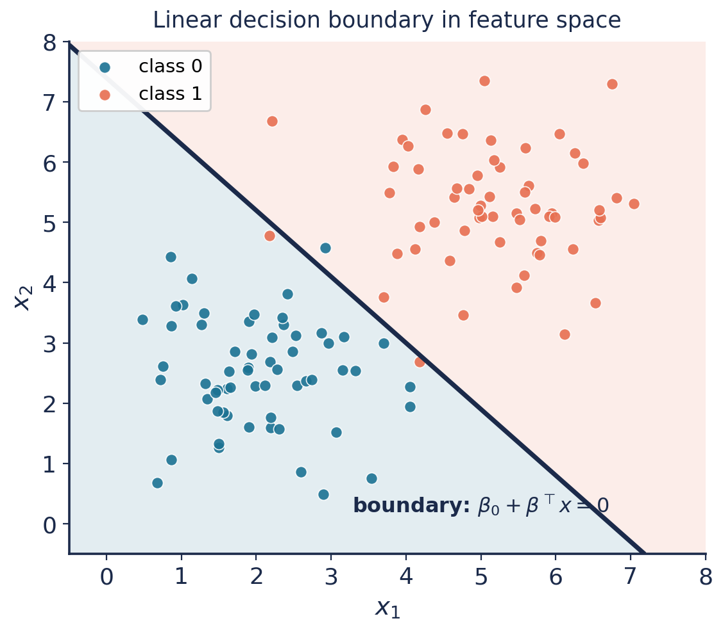
The Decision Boundary
27 / 30
PART 3 · EVALUATION → LOGISTIC
Predict class 1 when the probability exceeds 0.5.
That threshold is where z = 0 — a straight line (or hyperplane) in feature space.
So logistic regression is still a linear classifier: the boundary is linear, only the probability curve bends.
Move the threshold to trade precision against recall for your problem.
Curved boundaries? Add polynomial or interaction features — the model stays linear in β.
σ(z)=0.5 draws a straight line between classes
Notes:
Boundary is where z=0, i.e. a line/hyperplane — logistic regression is a LINEAR classifier. Threshold tuning trades precision vs recall. Feature engineering yields nonlinear boundaries.

Slide 29
Linear vs Logistic: One Family
28 / 30
PART 3 · EVALUATION → LOGISTIC
Linear Regression
Logistic Regression
Target
continuous number
class probability ∈ (0,1)
Model
β₀ + βᵀx
σ(β₀ + βᵀx)
Link
identity
logit (log-odds)
Loss
squared error (SSE)
cross-entropy (log-loss)
Fit by
normal equations / GD
gradient descent (MLE)
Boundary
—
linear in feature space
Different link, different loss — identical linear heart.
Notes:
Side-by-side: the two models differ only in link function and loss. Both are linear in the parameters. This table is the summary of the whole arc from line to classifier.

