Slide 1
1943 • THE FIRST NEURON MODEL
The McCulloch–Pitts Neuron
Mankind’s first mathematical model of a biological neuron
A simple, visual walkthrough

Slide 2
THE BIG PICTURE
Where deep learning began
1
2
3
1943
The idea
Why care
Warren McCulloch (neuroscientist) & Walter Pitts (logician) proposed the first computational model of a neuron.
Copy what a brain cell does — take inputs, add them up, and decide whether to “fire.”
Every artificial neuron and perceptron used in modern AI traces back to this one idea.
McCulloch–Pitts Neuron
2

Slide 3
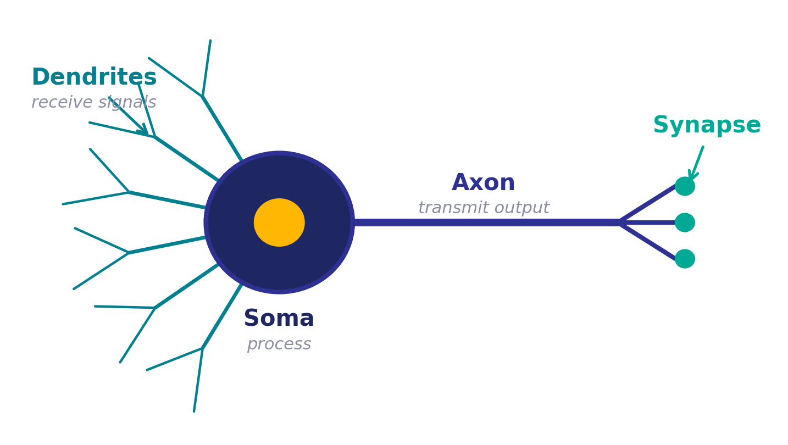
THE INSPIRATION
A biological neuron
Dendrite
receives signals from other neurons
Soma
processes the information
Axon
transmits this neuron’s output
Synapse
connection point to other neurons
McCulloch–Pitts Neuron
3

Slide 4
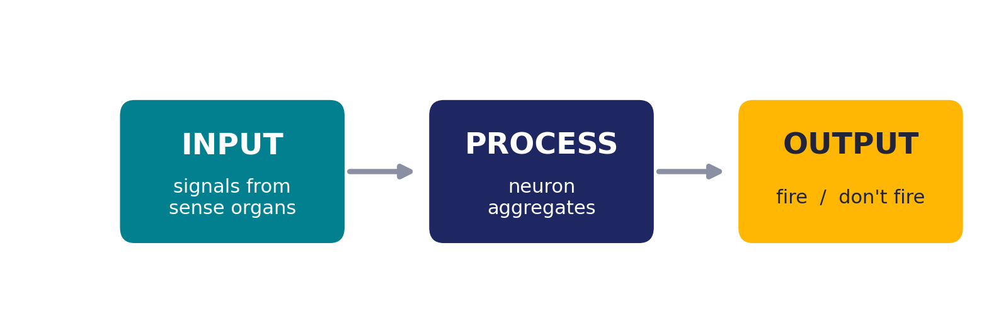
THE INSPIRATION
What a neuron really does
Strip away the biology and every neuron follows the same three-step rhythm:
Watching Friends? Your “laugh or not” neurons fire only when their criteria are met.
McCulloch–Pitts Neuron
4

Slide 5
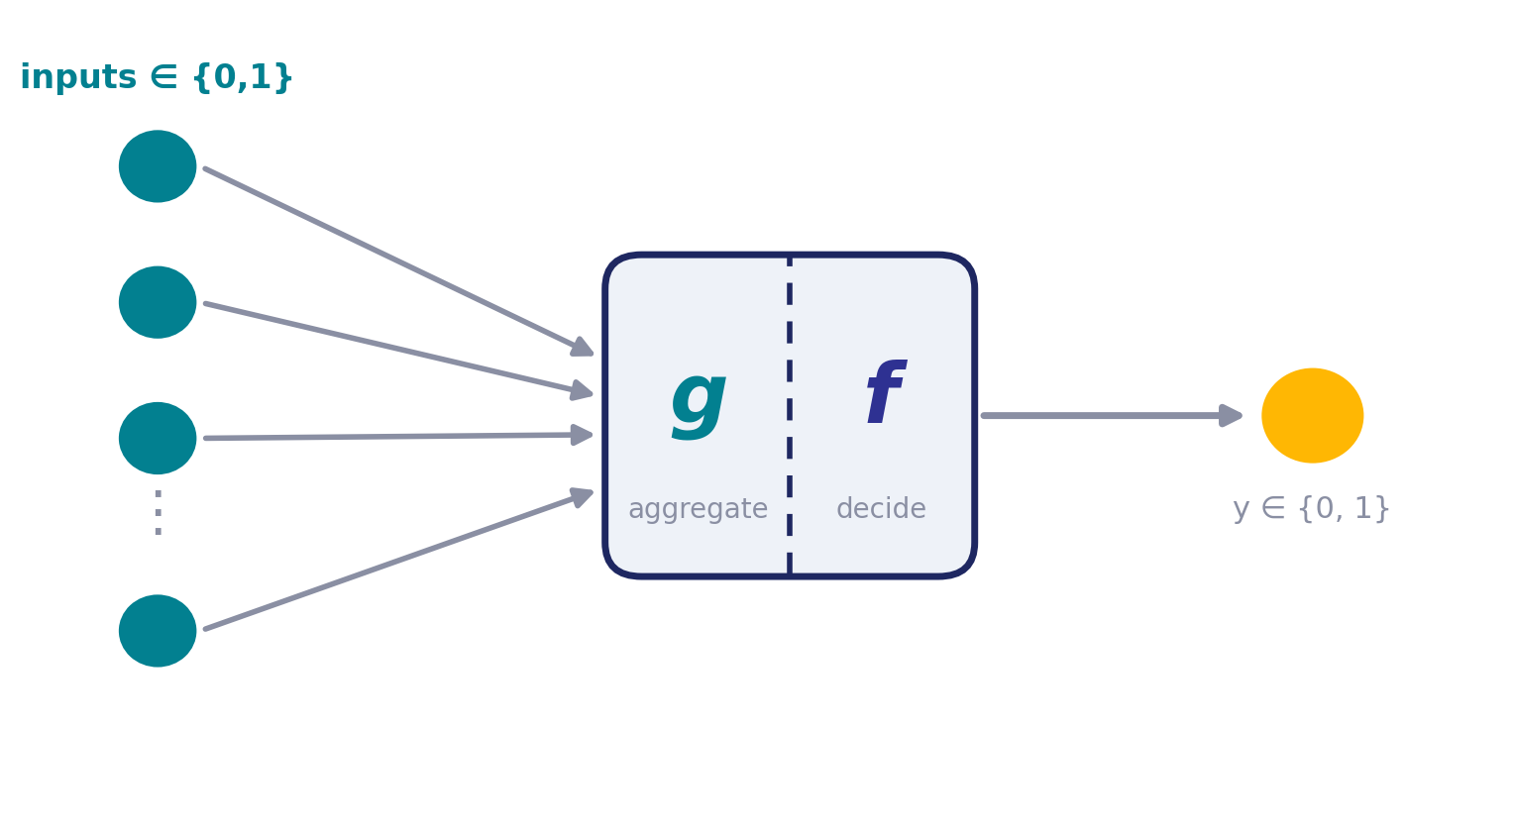
THE MODEL
The McCulloch–Pitts neuron
Two simple parts, one on/off decision

Slide 6
THE MODEL
Part g and Part f
g
f
Aggregation
Decision
Takes all the inputs (the “dendrites”) and simply adds them together into one value.
Looks at that total. If it clears a threshold, the neuron fires (1). If not, it stays silent (0).
McCulloch–Pitts Neuron
6

Slide 7
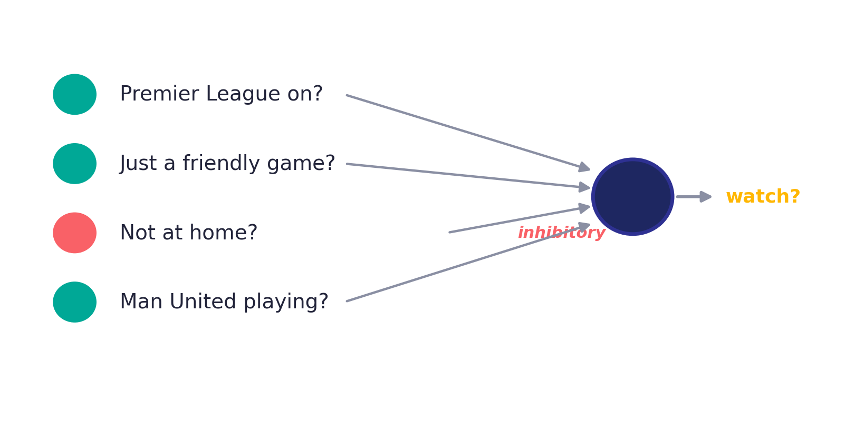
EXAMPLE
Will I watch this football game?
Each input is a yes/no question (0 or 1). The output is a single yes/no decision.
McCulloch–Pitts Neuron
7

Slide 8
EXAMPLE
Two kinds of input
Excitatory
Inhibitory
Push the neuron toward firing. None can fire it alone — but together they can push the sum past the threshold.
Have veto power. If an inhibitory input is 1, the neuron will NEVER fire — no matter what the others say.
Example: “Not at home?” is inhibitory — if you’re out, you can’t watch, period.
McCulloch–Pitts Neuron
8

Slide 9
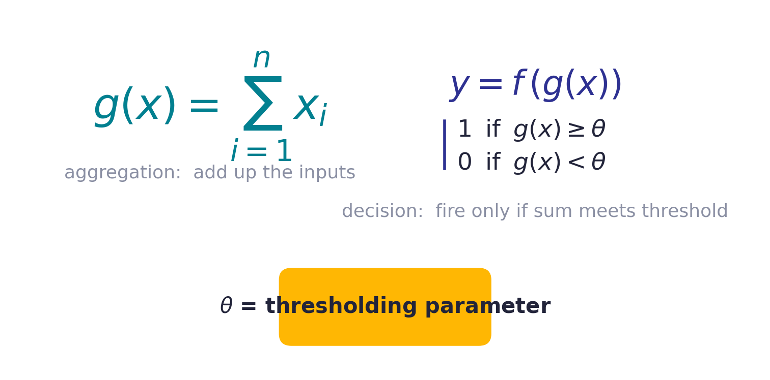
THE MODEL
Thresholding logic — the math
If you always watch when 2+ conditions are true, then θ = 2.
McCulloch–Pitts Neuron
9

Slide 10
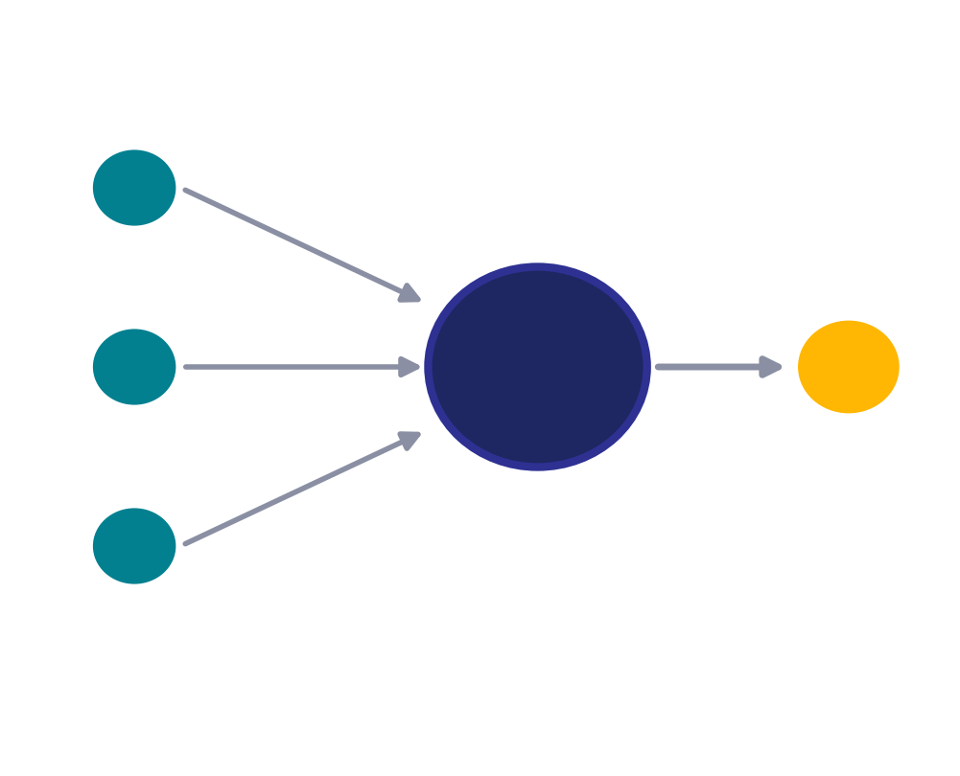
THE MODEL
A concise way to draw it
How to read it
Inputs x₁, x₂, x₃ are boolean — each is 0 or 1.
The number inside the neuron is the threshold θ.
If the sum of inputs ≥ θ, the neuron fires → y = 1.
Otherwise it stays silent → y = 0.
McCulloch–Pitts Neuron
10

Slide 11
BOOLEAN FUNCTIONS
One neuron, many logic gates
Because inputs and output are all boolean, the M-P neuron is really just learning a boolean function. By choosing the right threshold, a single neuron can act as AND, OR, NOT, NOR and more.
AND
OR
NOT
NOR
x₁ ∧ ¬x₂

Slide 12
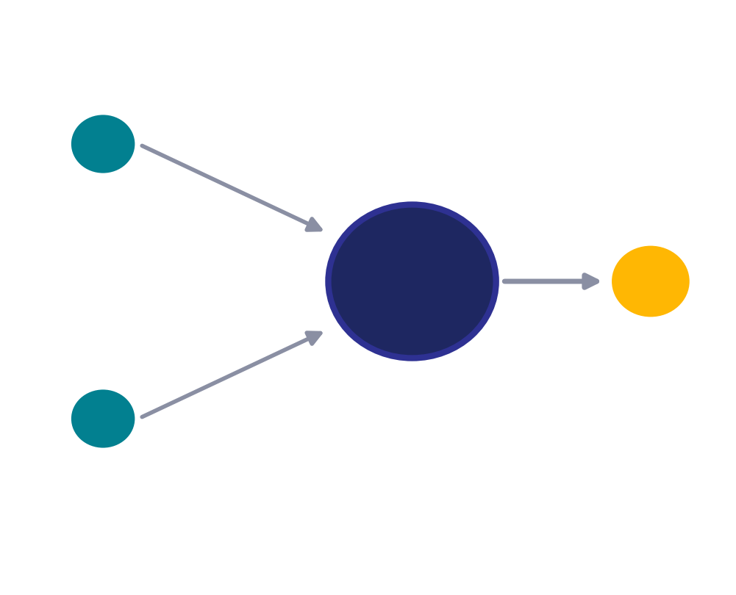
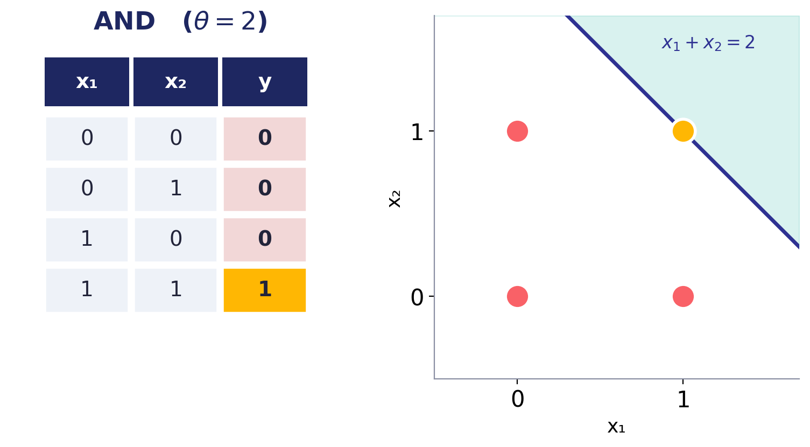
BOOLEAN FUNCTIONS
AND function
θ = 2 (fires only if both ON)
The neuron fires only when every input is 1 — the sum reaches the threshold of 2 in just one case.
McCulloch–Pitts Neuron
12

Slide 13
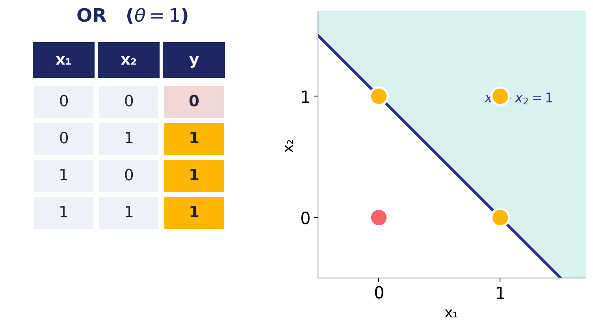
BOOLEAN FUNCTIONS
OR function
θ = 1 (fires if either ON)
With the threshold dropped to 1, a single active input is enough to make the neuron fire.
McCulloch–Pitts Neuron
13

Slide 14
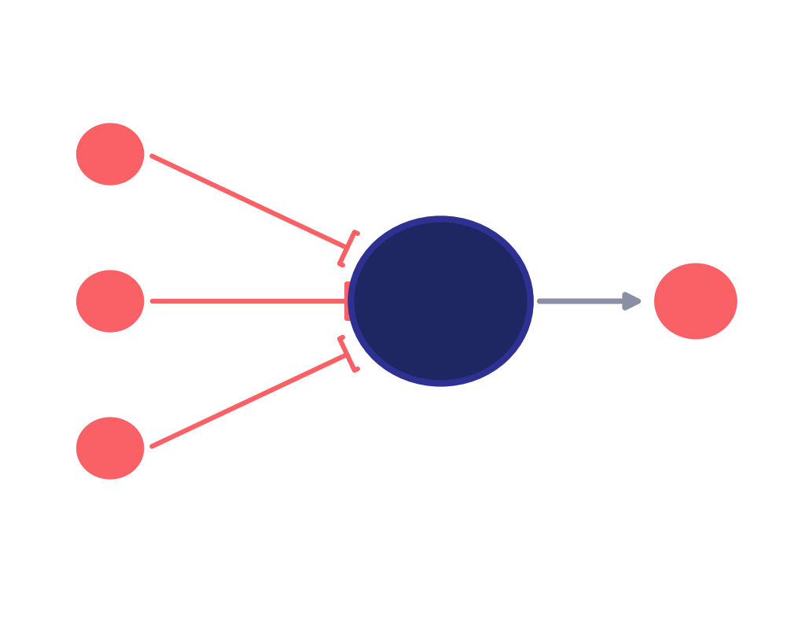
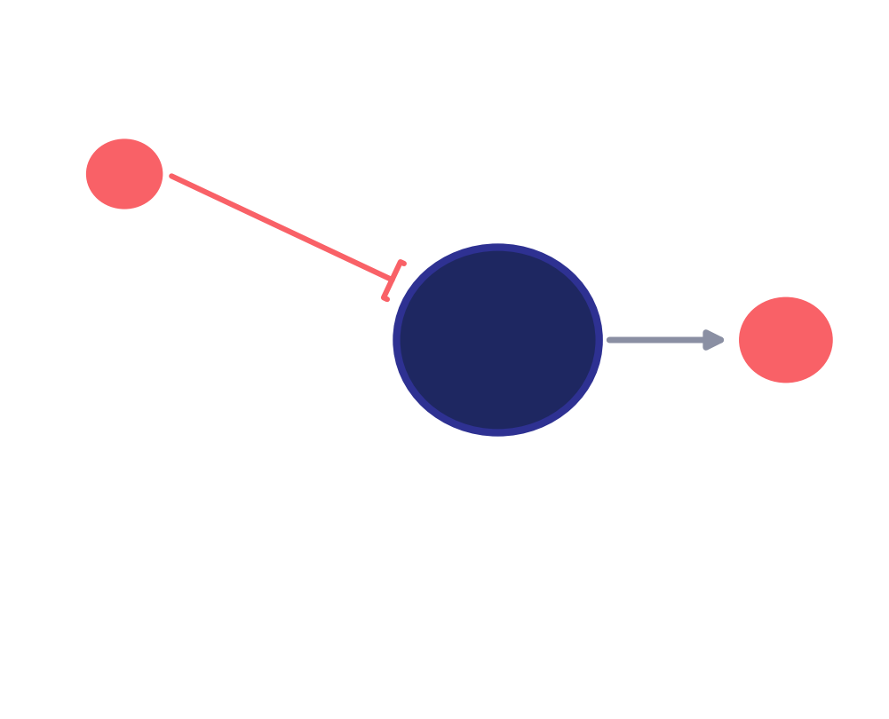
BOOLEAN FUNCTIONS
NOR and NOT
NOR
NOT
Fires only when ALL inputs are 0. All inputs inhibitory, θ = 0.
A single inhibitory input with θ = 0: 1 becomes 0, and 0 becomes 1.
McCulloch–Pitts Neuron
15

Slide 15
GEOMETRIC VIEW
What the neuron does, geometrically
Plot the possible inputs as points. The threshold rule draws a straight line (a “decision boundary”) that splits them into two groups:
On or above the line → output 1 (fires)
Below the line → output 0 (silent)

Slide 16
GEOMETRIC VIEW
A line splits the inputs in two
Same neuron, different threshold → the boundary line just shifts. Yellow points fire, red points stay silent — and one straight line always separates them.
McCulloch–Pitts Neuron
17

Slide 17
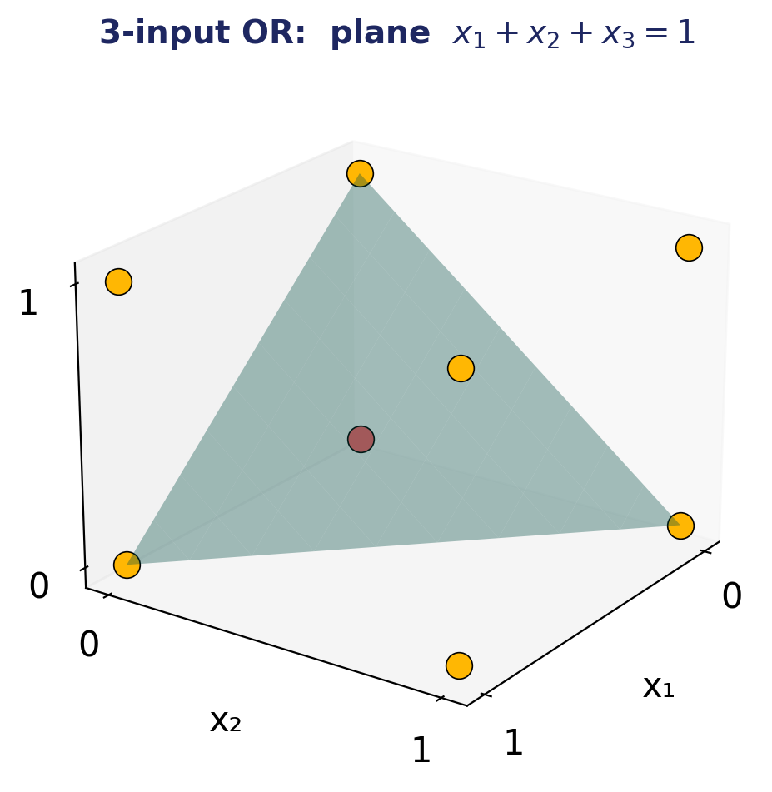
GEOMETRIC VIEW
More inputs? The line becomes a plane
Three inputs, three dimensions
A 3-input OR has 8 possible corner points.
The rule x₁ + x₂ + x₃ = 1 is now a flat plane.
Points on or above the plane fire (yellow).
Only the origin (0,0,0) stays below → silent.
McCulloch–Pitts Neuron
18

Slide 18
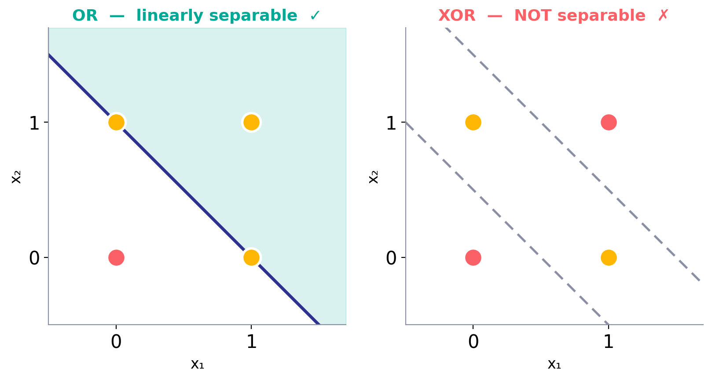
THE CATCH
Powerful — but only up to a point
Other limitations
✗
Inputs must be boolean — no real-valued data.
✗
The threshold has to be hand-coded, not learned.
✗
All inputs count equally — no way to weight some as more important.
The M-P neuron only works for linearly separable functions — ones a single straight line can split. XOR can’t be, so a single neuron can’t represent it.
✗
Can’t handle non-separable functions like XOR.
McCulloch–Pitts Neuron
19

Slide 19
TAKEAWAY
The seed of modern AI
In 1943, McCulloch & Pitts showed a simple threshold unit could compute logic — the first mathematical neuron.
1
2
3
Its idea
Its limit
What came next
Add up inputs, fire past a threshold — still the core of every neuron today.
Fixed thresholds, equal inputs, boolean-only, and no XOR.
In 1958 Rosenblatt’s perceptron added learnable weights & thresholds — the artificial neuron.
Source: A. L. Chandra, “McCulloch–Pitts Neuron” (TDS) • based on Prof. Mitesh Khapra’s NPTEL Deep Learning lectures

