Slide 1
OPTIMIZATION FOR MACHINE LEARNING
How Machines Learn to Descend
Gradient Descent · SGD · Momentum · Nesterov · Adagrad · RMSprop · Adam
contour simulations · learning-rate scheduling · numerical results
A two-lecture module · built on live optimizer simulations & a toy dataset
Notes:
Opening hook: every model you train — from logistic regression to a 100B-parameter transformer — is solved by one of the algorithms on this slide. Two lectures: Lecture 1 builds the first-order family from scratch (GD to Nesterov); Lecture 2 covers adaptive methods (Adagrad to Adam) and learning-rate scheduling. Every plot in this deck is a real simulation, not a cartoon.

Slide 2
TWO LECTURES, ONE IDEA: FOLLOW THE GRADIENT DOWNHILL
What we'll cover
First-order methods
Adaptive methods & scheduling
The optimization problem & loss landscapes
The toy dataset we simulate on
Gradient descent + the learning rate
Conditioning: why GD zig-zags
Batch vs. stochastic vs. mini-batch
Momentum & Nesterov acceleration
Per-parameter rates: Adagrad, RMSprop
Adam and its bias correction
Head-to-head on hard landscapes
Numerical results on the toy dataset
Learning-rate schedules (5 families)
A practical cheat-sheet + pitfalls
Optimization Algorithms for ML
Roadmap · 2
Notes:
Set expectations. Lecture 1 is the conceptual backbone — if they understand momentum they understand 80% of Adam. Lecture 2 is 'what people actually use in 2025'. Tell them the same toy dataset threads through the whole module so comparisons are apples-to-apples.

Slide 3
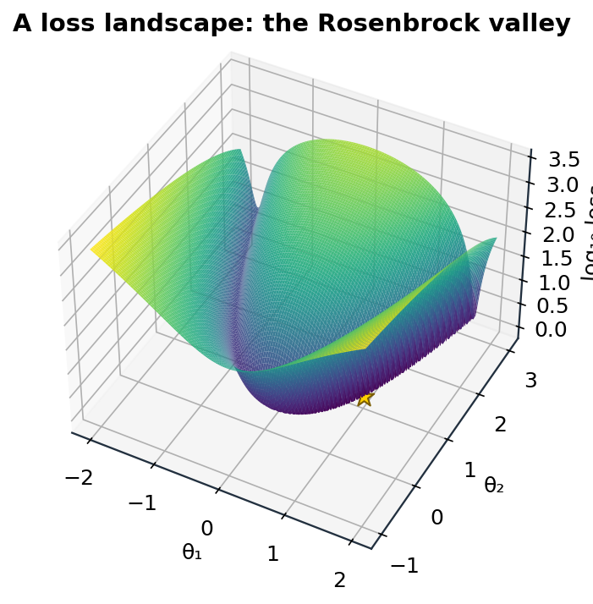
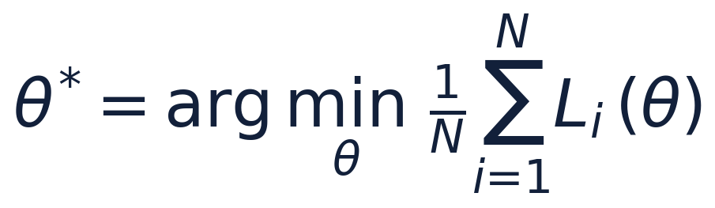
TRAINING = MINIMIZING A LOSS
The optimization problem
Learning is search. We pick parameters θ that make the average loss over the data as small as possible:
θ — the parameters (weights) we adjust
L — the loss: how wrong we are
∇L — the gradient: steepest-ascent direction
We can't solve it in closed form, so we descend iteratively.
A non-convex loss surface: valleys, ridges, and a single global minimum (★).
Optimization Algorithms for ML
Lecture 1 · 3
Notes:
The whole field is about navigating a surface like this efficiently, using only local gradient information — you never get to see the whole landscape. Emphasise: high dimensions make this hard; we visualise in 2-D but real θ has millions of entries. The Rosenbrock surface shown is a classic hard test case we'll return to.

Slide 4
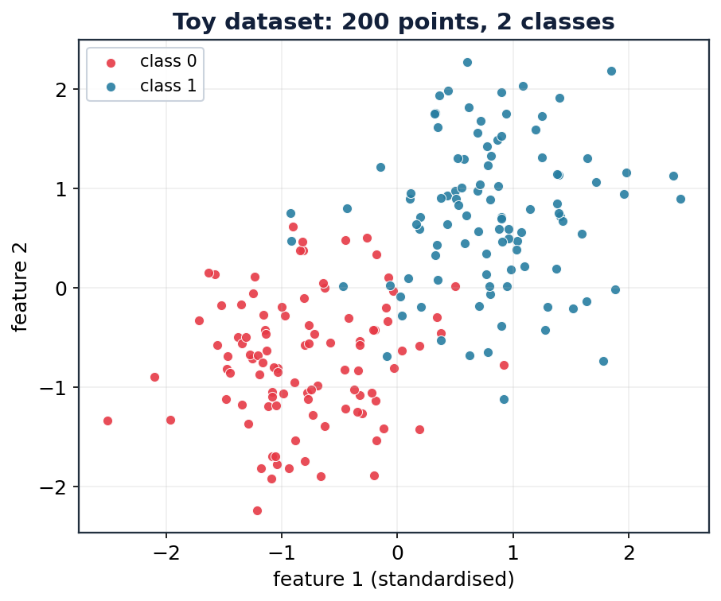
ONE DATASET, THREADED THROUGH EVERY EXPERIMENT
The toy dataset
Why a toy dataset?
Small enough that the loss surface is exactly computable and contour-plottable.
Two-feature logistic regression → the loss lives in 2-D (w₁, w₂), so we can watch optimizers move.
A larger 12-feature version (1,500 points) drives the numerical convergence results later.
Real data, real gradients — every trajectory in this deck is an actual run, not a sketch.
Toy setup: logistic regression · 2 classes · standardized features · convex loss
Optimization Algorithms for ML
Lecture 1 · 4
Notes:
Convexity matters here: logistic-regression loss is convex, so there is one global minimum and every optimizer should reach it — which means differences we see are about SPEED and PATH, not about getting stuck. That's the cleanest way to teach optimizer behaviour before introducing non-convex traps.

Slide 5
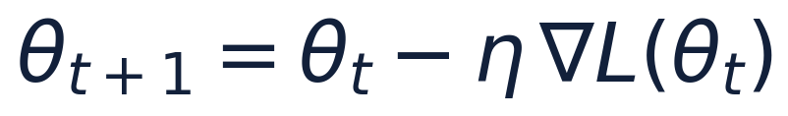
THE FOUNDATION OF EVERYTHING THAT FOLLOWS
Gradient descent
Repeatedly step in the direction of steepest descent — the negative gradient — scaled by a learning rate η:
The intuition
You're on a foggy hillside and can only feel the slope under your feet. Take a step downhill. Feel again. Repeat.
The gradient is that local slope. The learning rate is your stride length. Too timid and you crawl; too bold and you tumble past the valley floor.
η too small → painfully slow convergence
η too large → overshoot, oscillate, diverge
Uses the FULL dataset for each step (batch GD)
The single knob η dominates behaviour — so we study it first.
stride = η · slope = ∇L
Optimization Algorithms for ML
Lecture 1 · 5
Notes:
Anchor the fog metaphor hard — students reuse it for every later method. Momentum = you keep some of your previous velocity. Adam = you also remember how bumpy each direction has been. Everything is a modification of 'feel the slope, take a step'.

Slide 6
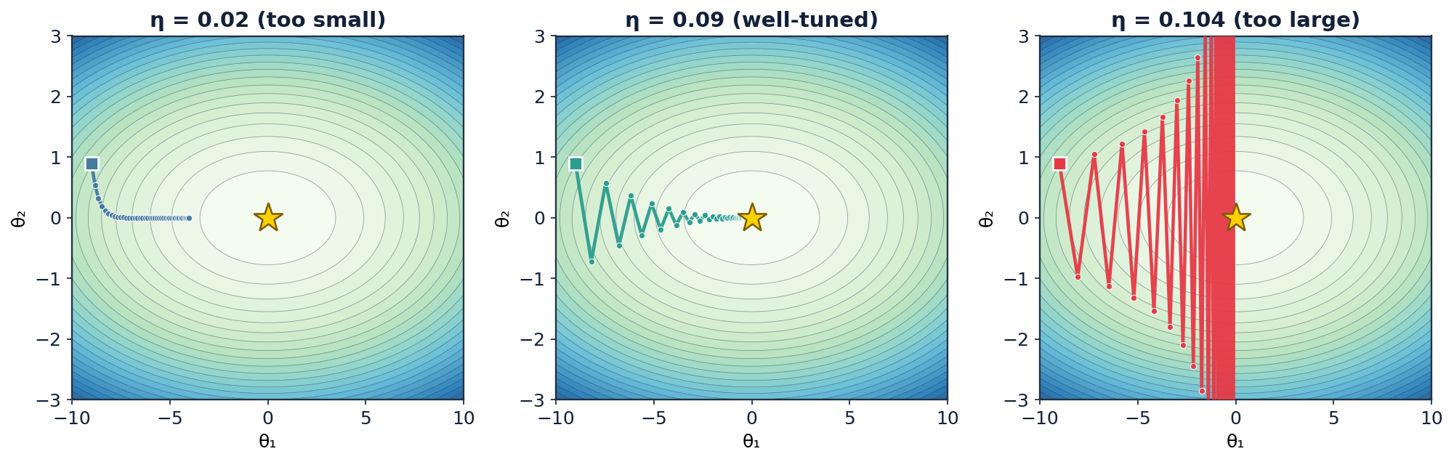
THE MOST IMPORTANT HYPERPARAMETER YOU WILL EVER TUNE
Gradient descent: the learning rate decides everything
Too small: safe but crawls. Well-tuned: brisk, controlled zig-zag into the minimum. Too large: overshoots and diverges.
Optimization Algorithms for ML
Lecture 1 · 6
Notes:
Same problem, same start, only η changes. Point at the right panel: the red fills the plot because each step lands further from the minimum than the last — classic divergence. There is a hard stability limit η < 2/L (L = largest curvature); beyond it GD provably diverges on a quadratic. This is why LR tuning and, later, LR scheduling matter so much.

Slide 7
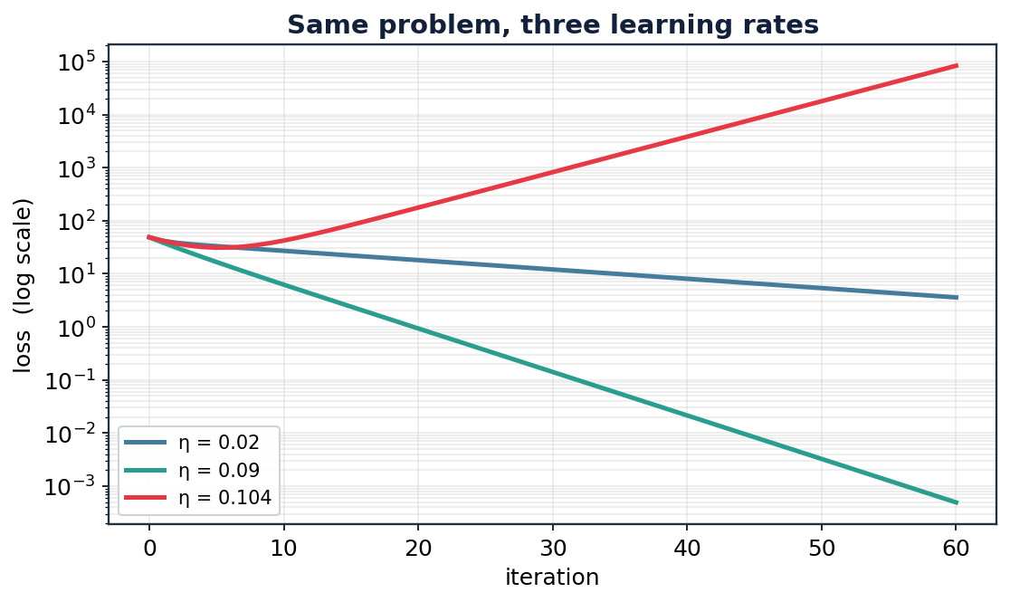
THE SAME THREE RUNS, AS LOSS CURVES
Reading convergence on a log scale
What the curves tell you
A straight line on a log-loss plot = geometric (linear) convergence.
Steeper slope = faster convergence per iteration.
The well-tuned rate reaches machine-precision loss; the tiny rate is still far from it.
The oversized rate curve turns upward — the tell-tale of divergence.
Optimization Algorithms for ML
Lecture 1 · 7
Notes:
Always plot loss on a log axis — linear-axis loss curves hide everything after the first few steps. Teach them to read the slope as a rate. This log-scale habit carries into every convergence plot in Lecture 2.

Slide 8
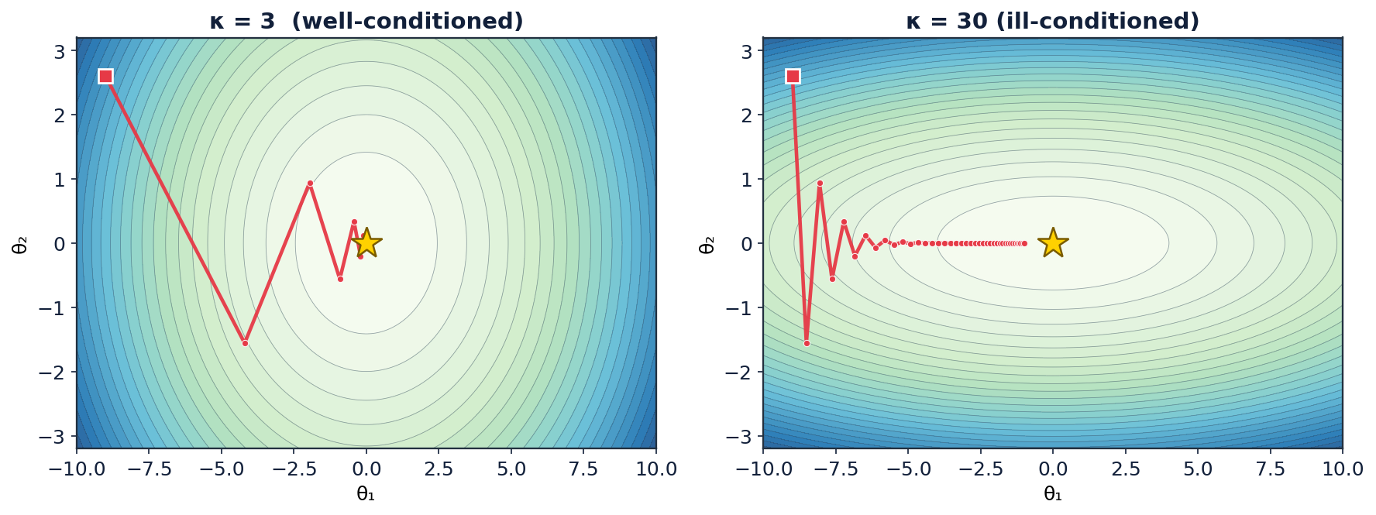
WHY PLAIN GRADIENT DESCENT STRUGGLES
Conditioning: the zig-zag problem
Condition number κ
κ = ratio of steepest to flattest curvature.
High κ → long narrow valley.
GD bounces across the steep walls while barely moving along the floor.
Steps that are safe across the valley are far too small along it.
Momentum & adaptive methods exist largely to fix this.
Optimization Algorithms for ML
Lecture 1 · 8
Notes:
This is THE motivating failure. GD's step direction is the gradient, which points across the valley, not toward the minimum. The higher the condition number, the worse the zig-zag, and real neural-network loss surfaces are extremely ill-conditioned (κ can be 1e6+). Every improvement in Lecture 1 and 2 is, at heart, an answer to this slide.

Slide 9
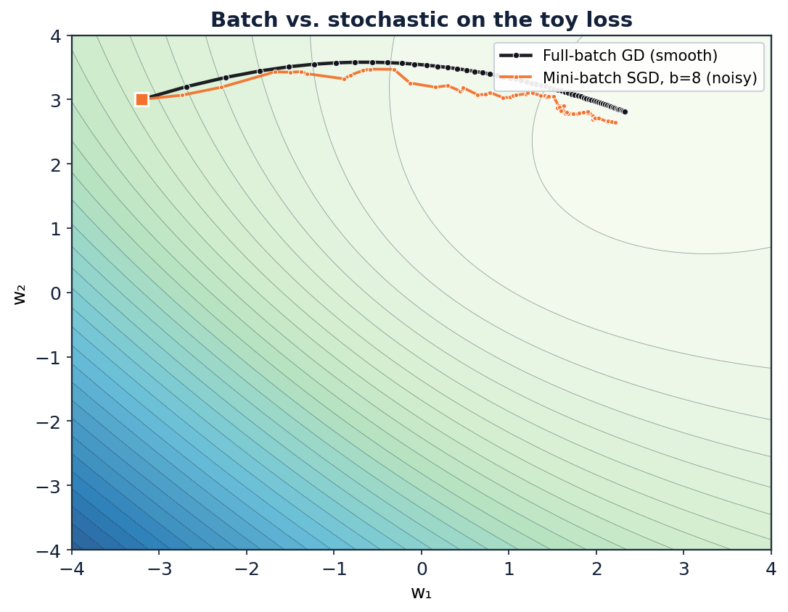
TRADING EXACTNESS FOR SPEED
Batch, mini-batch, and stochastic
How much data per step?
Full-batch: exact gradient from all N points. Smooth path, but every step is expensive.
Stochastic (SGD): one point per step. Cheap and noisy — the path jitters.
Mini-batch: b points per step (b = 32–512). The practical sweet spot everyone uses.
The noise isn't only a cost — it helps escape bad regions and generalize.
Optimization Algorithms for ML
Lecture 1 · 9
Notes:
Key reframe: the 'stochastic' in SGD is a feature, not just a bug. Noisy gradients let you take far more steps per unit compute, and the noise can kick you out of sharp minima toward flatter, better-generalizing ones. Modern training is essentially always mini-batch. Full batch is shown only as the smooth reference.

Slide 10
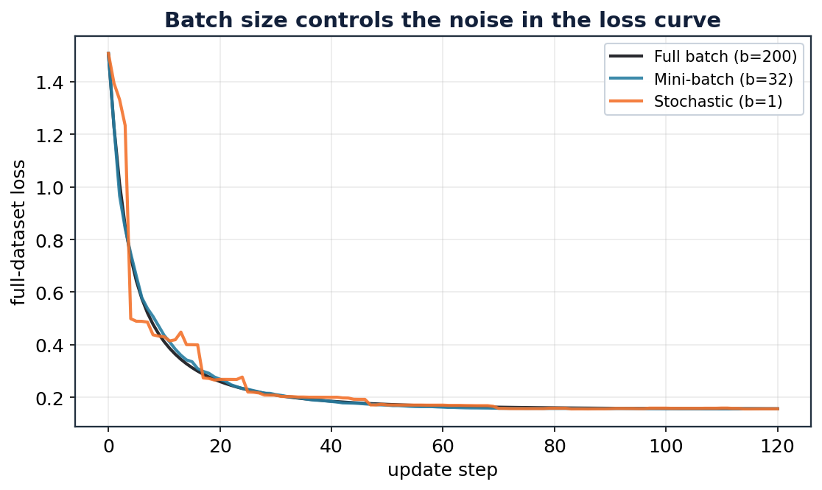
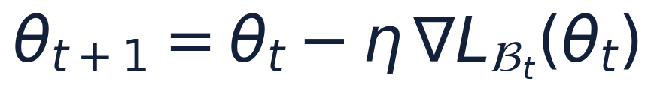
THE WORKHORSE OF DEEP LEARNING
Stochastic gradient descent (SGD)
Replace the full gradient with the gradient of a random mini-batch 𝓑ₜ:
Each step is an unbiased but noisy estimate of the true gradient.
Noise scale shrinks as batch size grows.
Constant η leaves a residual 'noise ball' around the minimum — motivating LR decay (Lecture 2).
Larger batches → smoother loss curves; b = 1 is the jittery extreme.
Optimization Algorithms for ML
Lecture 1 · 10
Notes:
Connect forward: because SGD never fully settles at a constant η (it orbits the minimum in a noise ball whose radius ∝ η), we later DECAY η so the ball shrinks to a point. That is the single most important reason learning-rate schedules exist. Foreshadow it here.

Slide 11
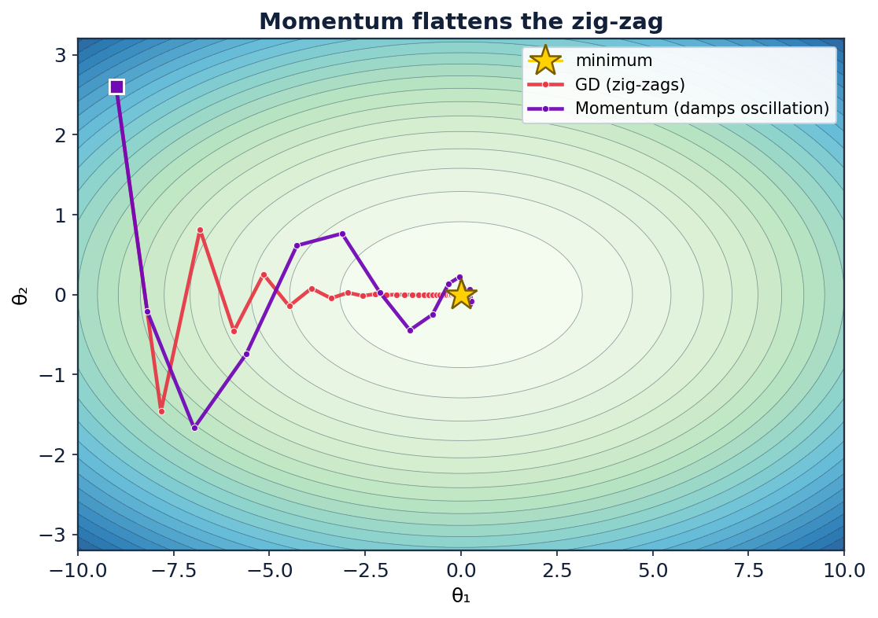
GIVE THE OPTIMIZER INERTIA
Momentum
Accumulate a velocity — an exponentially-decaying average of past gradients — and step with it:
Consistent directions build speed; oscillating ones cancel out.
β (typically 0.9) sets how much past velocity carries over.
A heavy ball rolling downhill — it powers through the zig-zag.
GD staircases across the valley; momentum damps the crossing and reaches the floor sooner.
Optimization Algorithms for ML
Lecture 1 · 11
Notes:
Note the figure uses a moderate β for a clean 2-D picture; in practice β ≈ 0.9. Physical picture: momentum is a ball with mass — it averages out the sideways bouncing and keeps the consistent downhill component. Mathematically it's an exponential moving average of gradients. This EMA idea returns in RMSprop and Adam.

Slide 12
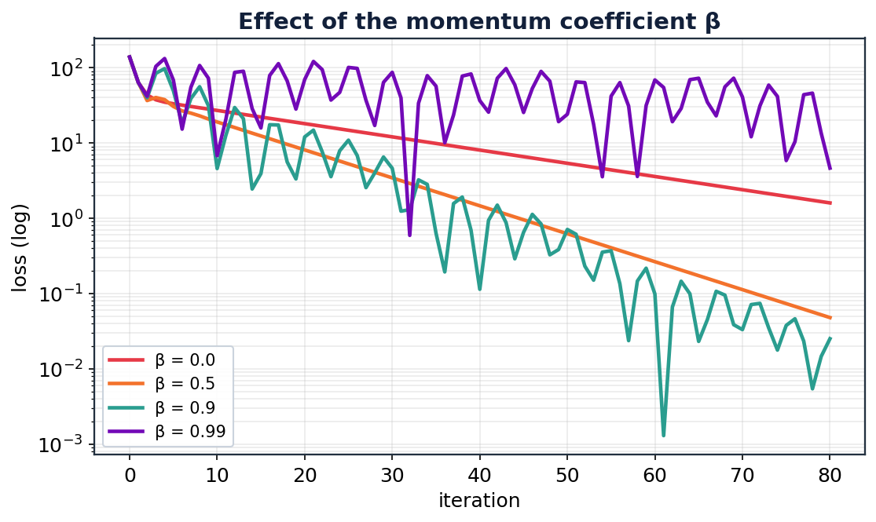
TUNING THE MEMORY OF THE VELOCITY
The momentum coefficient β
Choosing β
β = 0 → plain gradient descent.
β = 0.9 → ~10-step effective memory; the common default.
β → 0.99 → very long memory, faster on smooth valleys but risks overshoot.
Effective horizon ≈ 1 / (1 − β).
Optimization Algorithms for ML
Lecture 1 · 12
Notes:
The 1/(1−β) rule of thumb is worth memorising: β=0.9 → averages ~10 gradients, β=0.99 → ~100. Higher β accelerates but can overshoot and needs a smaller η. This is the classic speed-vs-stability trade you'll re-meet with Adam's β₁, β₂.

Slide 13
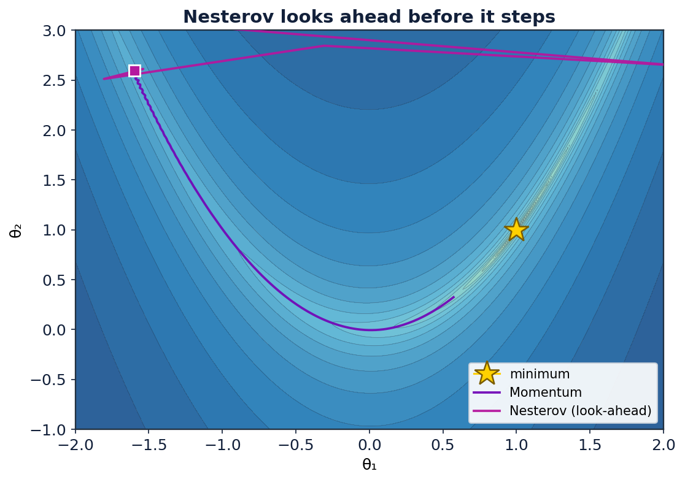
LOOK BEFORE YOU LEAP
Nesterov accelerated gradient (NAG)
Evaluate the gradient at the look-ahead point θ + βv, where momentum is about to carry you:
Momentum steps, then corrects; Nesterov peeks first, then steps.
That foresight lets it brake earlier before overshooting.
Better theoretical convergence rate on convex problems.
On the Rosenbrock valley, Nesterov's look-ahead tracks the curve more tightly.
Optimization Algorithms for ML
Lecture 1 · 13
Notes:
The one-line intuition students remember: 'momentum acts then looks; Nesterov looks then acts.' Because you evaluate the gradient where you're heading, you feel an approaching wall one step early and can brake — reducing overshoot. On the banana valley you can see the tighter tracking.

Slide 14
LECTURE 1 IN ONE PICTURE
First-order methods: the family so far
Method | Update idea | Fixes
Gradient descent | step along −∇L | — (the baseline)
SGD | −∇L on a mini-batch | cost per step
Momentum | EMA of gradients as velocity | zig-zag, slow valleys
Nesterov | gradient at the look-ahead point | overshoot
The through-line
Everything is 'feel the slope, take a step'.
Momentum adds memory of direction.
Still one global η for all parameters.
Next: give every parameter its own rate.
Optimization Algorithms for ML
Lecture 1 · recap · 14
Notes:
Close Lecture 1 by stressing the shared limitation: all four methods use a SINGLE learning rate applied to every parameter identically. If one direction is steep and another flat, one η can't serve both. That's the exact gap adaptive methods fill — the hook into Lecture 2.

Slide 15
Next Evolution in the Machinery
Adaptive Methods
& Learning-Rate Scheduling
One learning rate per parameter — and how to change it over time.
Notes:
Reset energy for lecture 2. Recap the one-sentence bridge: 'so far, one η for all parameters — now each parameter gets its own, and then we schedule η over time.'

Slide 16
DIFFERENT PARAMETERS NEED DIFFERENT STEPS
Why adapt the rate per parameter?
Some features are frequent, some rare; some directions steep, some flat.
A single η is a compromise that suits none of them.
Idea: scale each parameter's step by its own gradient history.
Big past gradients → take smaller steps (damp the steep directions).
Small past gradients → take larger steps (accelerate the flat directions).
The adaptive family
Adagrad — accumulate all squared gradients
RMSprop — use a decaying average instead
Adadelta — remove η with a ratio of averages
Adam — RMSprop + momentum + bias fix
Optimization Algorithms for ML
Lecture 2 · 16
Notes:
Frame the shared mechanism: every adaptive method divides the step by a running measure of that parameter's gradient magnitude. They differ only in HOW they accumulate that measure. If students grasp 'divide by sqrt of gradient-squared history', all four methods become variations on a theme.

Slide 17
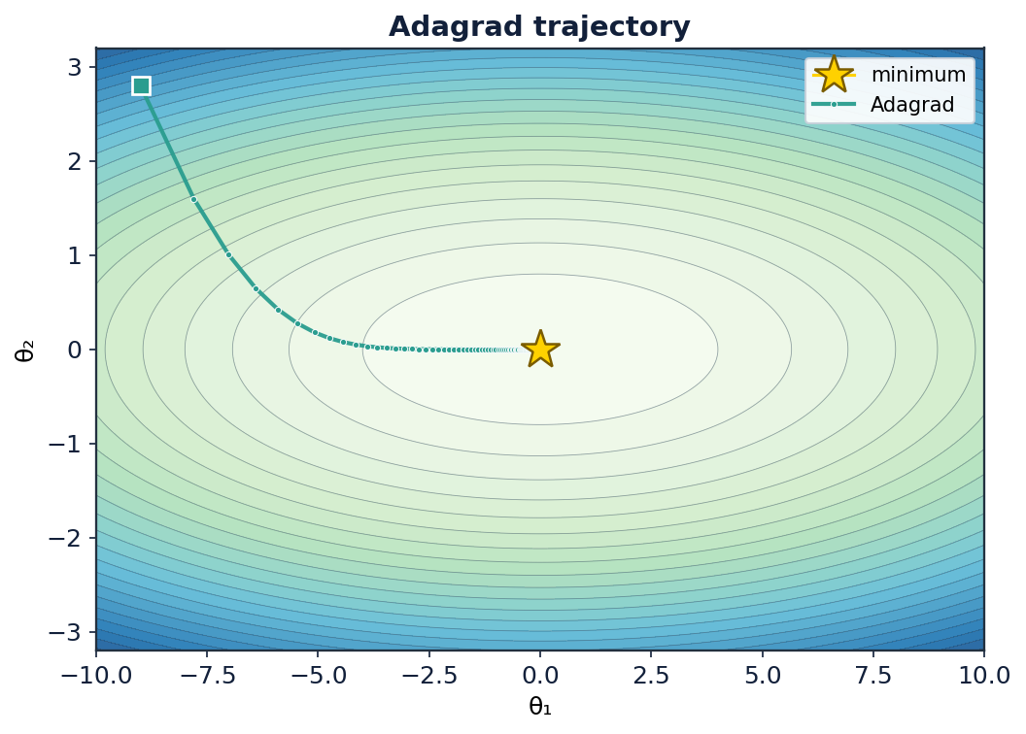
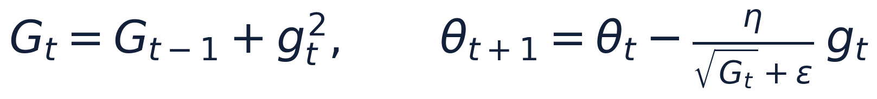
THE FIRST ADAPTIVE METHOD
Adagrad
Accumulate the sum of squared gradients per parameter, and divide the step by its square root:
Each parameter gets an individually-scaled learning rate.
Great for sparse features (rare features keep large steps).
ε (~1e-8) only prevents division by zero.
Weakness: Gₜ only grows → the rate can vanish.
Adagrad heads straight down the scaled directions on the toy quadratic.
Optimization Algorithms for ML
Lecture 2 · 17
Notes:
Adagrad's historic role: it made per-parameter rates practical and was a big deal for sparse NLP features. But flag the fatal flaw immediately (next slide): the accumulator never forgets, so the effective step size decays monotonically to zero and learning stalls on long runs.

Slide 18
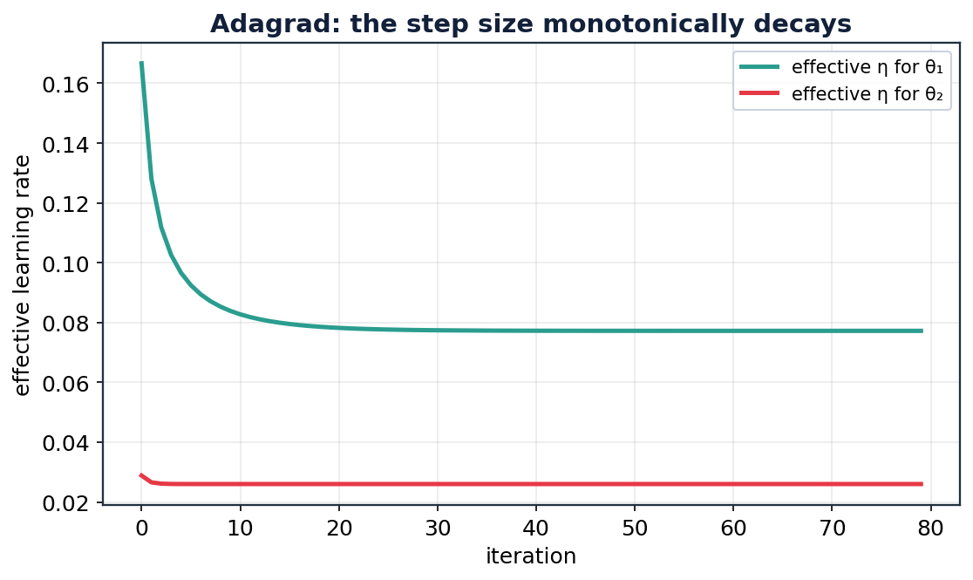
ADAGRAD'S ACHILLES HEEL
The vanishing learning rate
Why it stalls
Gₜ is a running sum that only ever increases.
So the effective step η/√Gₜ shrinks toward zero — permanently.
On long training runs the model effectively stops learning.
Fix: forget old gradients with a decaying average → RMSprop.
Optimization Algorithms for ML
Lecture 2 · 18
Notes:
This slide is the pivot to RMSprop. The effective rate for BOTH parameters marches monotonically down. On a convex toy problem that's tolerable; on a long deep-learning run it's fatal. The one-word fix is 'forget': replace the ever-growing sum with an exponentially-decaying average.

Slide 19

ADAGRAD, BUT IT FORGETS
RMSprop
Replace the growing sum with an exponentially-decaying average of squared gradients:
ρ (≈0.9) sets how fast old gradients are forgotten.
The effective rate stays healthy — no vanishing.
Handles non-stationary, noisy objectives well.
The de-facto standard before Adam arrived.
RMSprop keeps a steady, well-scaled step all the way in.
Optimization Algorithms for ML
Lecture 2 · 19
Notes:
RMSprop is literally Adagrad with the sum swapped for an EMA — same decaying-average trick as momentum, but applied to squared gradients (the magnitude) rather than gradients (the direction). Fun history: it was introduced in Hinton's Coursera lecture, never formally published. It's still a strong default for RNNs.

Slide 20
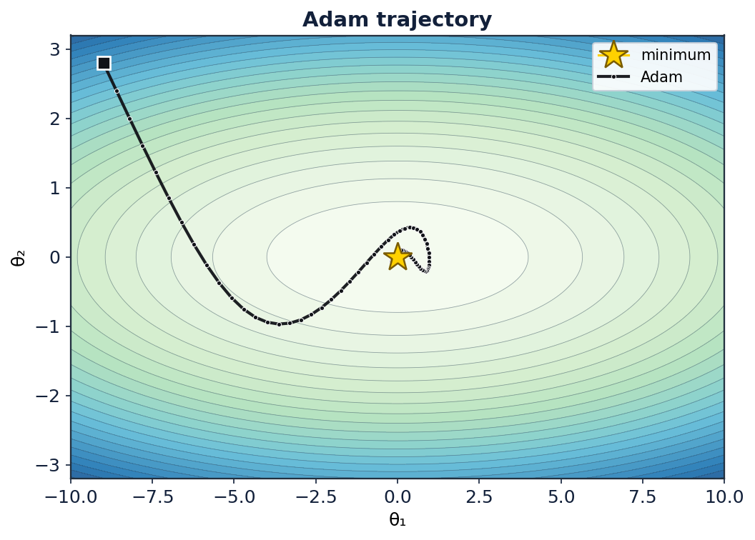
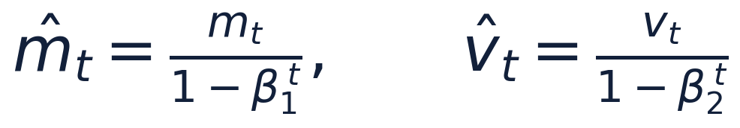
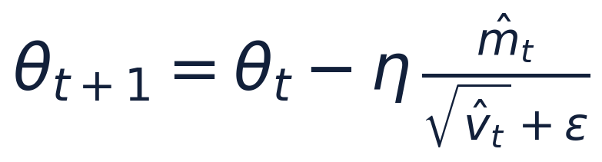
MOMENTUM MEETS RMSPROP — THE DEFAULT OPTIMIZER
Adam
1 · Track EMAs of the gradient (m) and its square (v):
2 · Bias-correct both (they start at zero):
3 · Step with the momentum, scaled by the magnitude:
Defaults that 'just work': β₁=0.9, β₂=0.999, ε=1e-8
Adam glides in with momentum, scaled per-direction like RMSprop.
Optimization Algorithms for ML
Lecture 2 · 21
Notes:
Adam = momentum (first moment m) + RMSprop (second moment v) + bias correction. Walk the three steps. The reason it's the default: it's robust to the choice of η across a huge range of problems, so people can train without heavy tuning. β₂=0.999 gives the magnitude estimate a ~1000-step memory.

Slide 21
THE MODERN LINEUP
Beyond Adam
AdamW
Nadam
AMSGrad
Lion / Sophia
Decouples weight decay from the gradient step. The current default for training transformers.
Adam with Nesterov-style look-ahead momentum. Slightly faster on some problems.
Uses a max of past v to guarantee non-increasing effective rates and fix a convergence gap.
Newer sign- and curvature-based optimizers aiming to beat AdamW at scale.
Optimization Algorithms for ML
Lecture 2 · 23
Notes:
Situate Adam historically: it's the 2015 default, but the field moved on. AdamW is what actually trains today's large models — the weight-decay decoupling matters a lot for generalization. Mention Lion/Sophia as active research so students know the story isn't finished. Don't go deep; this is orientation.

Slide 22
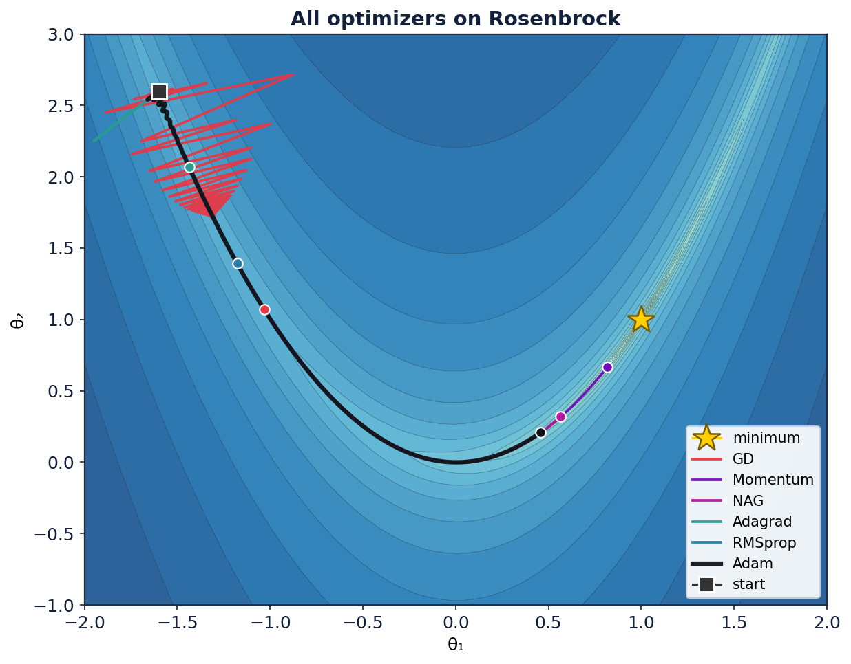
HEAD-TO-HEAD ON THE HARDEST CLASSIC TEST
Showdown: the Rosenbrock valley
Final loss after 400 steps
Adam
2.9e-1
Momentum
3.3e-2
NAG
1.9e-1
GD
4.1e+0
RMSprop
4.7e+0
Adagrad
5.9e+0
Adam & momentum ride the curved floor; GD thrashes across the walls.
Optimization Algorithms for ML
Lecture 2 · 24
Notes:
The money shot. Rosenbrock's banana valley is curved and ill-conditioned — GD's kryptonite. Watch Adam and momentum trace the floor while GD (red) bounces off the walls and barely descends. The numbers make it concrete: Adam ends ~0.3, GD still ~4. This is exactly the conditioning problem from Lecture 1, now solved.

Slide 23
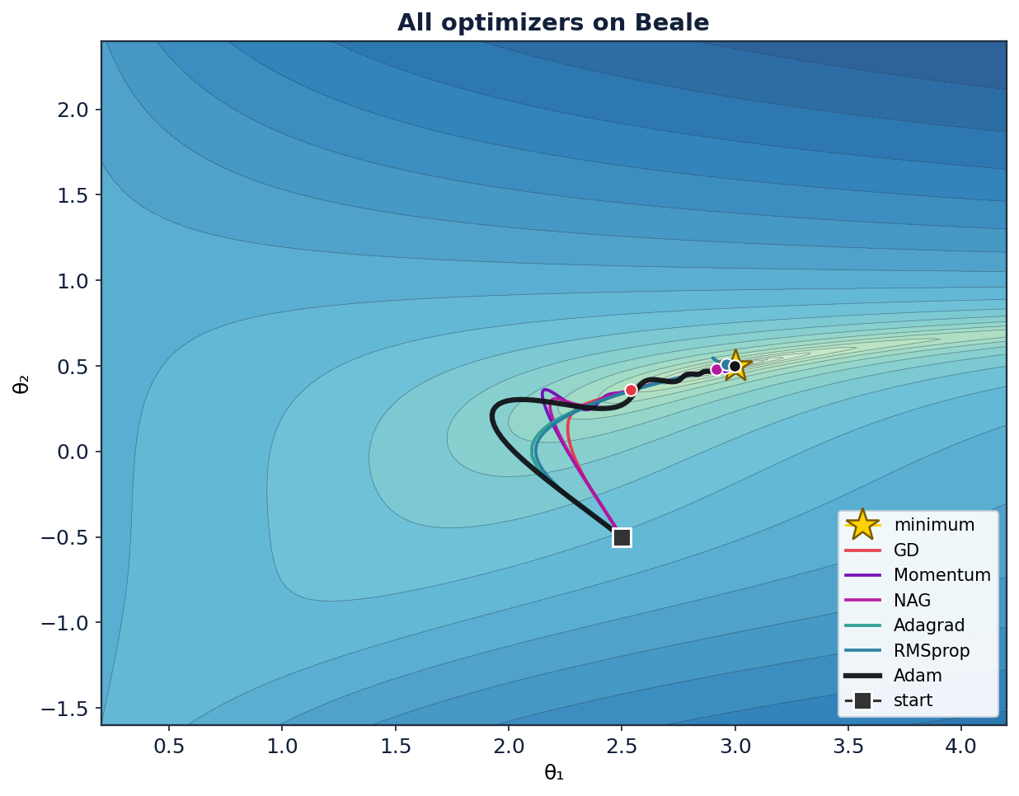
EVERYONE CONVERGES — BUT NOT EQUALLY FAST
Showdown: the Beale function
Final loss after 800 steps
Adam
3.6e-30
Adagrad
1.5e-10
Momentum
3.7e-4
NAG
1.2e-3
RMSprop
7.8e-3
GD
5.9e-2
From the same start, adaptive methods reach the minimum (3, 0.5) orders of magnitude closer.
Optimization Algorithms for ML
Lecture 2 · 25
Notes:
Beale has sharp diagonal valleys and a single minimum at (3, 0.5). All methods here converge (unlike some Rosenbrock runs), but final accuracy spans ~30 orders of magnitude: Adam ~1e-30, GD ~6e-2. This drives home that 'reaches the minimum' and 'reaches it precisely and quickly' are different bars.

Slide 24
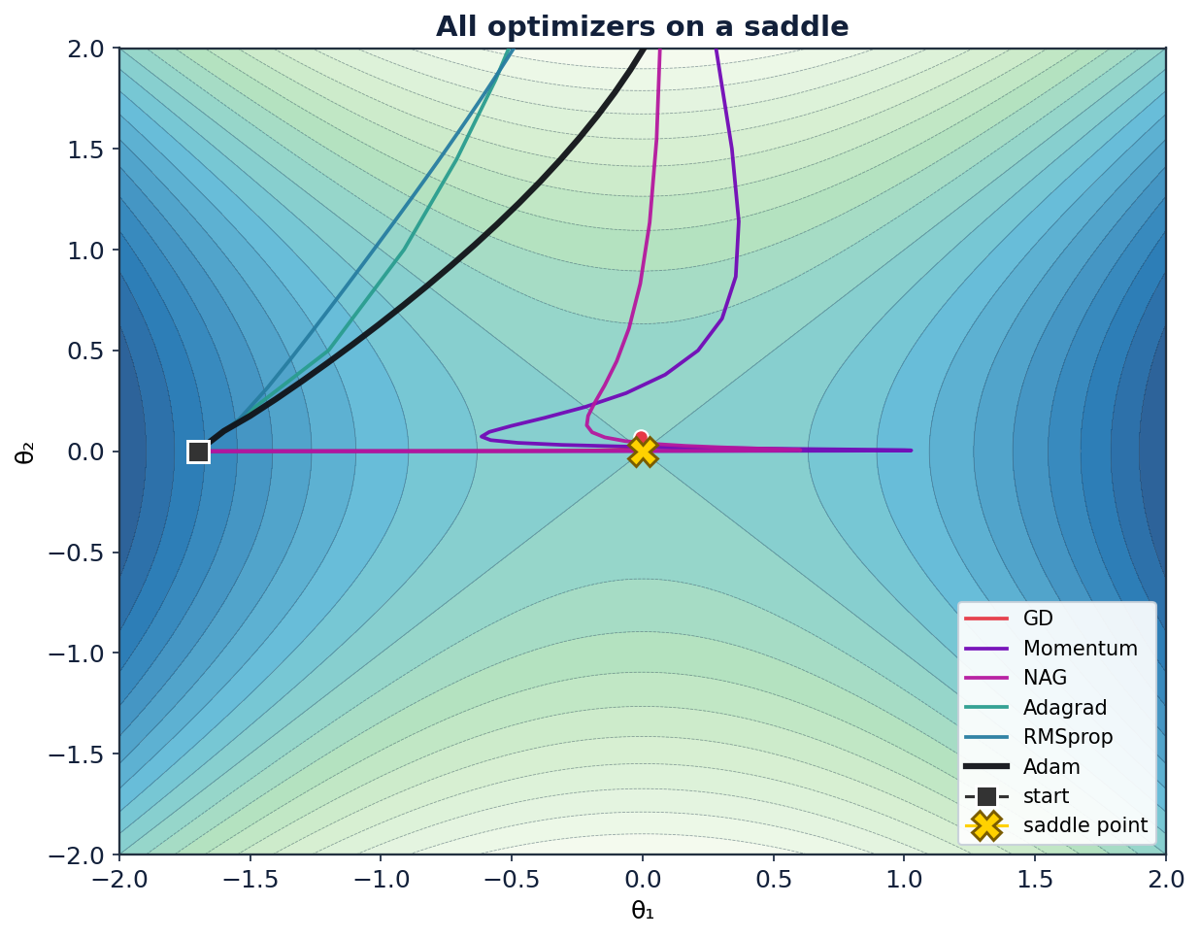
THE REAL ENEMY IN HIGH DIMENSIONS
Escaping saddle points
Why saddles matter
In high dimensions, saddle points vastly outnumber local minima.
Near a saddle the gradient is tiny — plain GD crawls and can stall.
Momentum carries speed through the flat region.
Adaptive scaling amplifies the small escape direction.
Optimization Algorithms for ML
Lecture 2 · 26
Notes:
Correct a common misconception: deep nets rarely get stuck in bad LOCAL MINIMA — the bigger obstacle is SADDLE POINTS, where some directions go up and some down, and the gradient nearly vanishes. GD limps; momentum and adaptive methods escape faster. This is a major reason vanilla SGD is rarely used bare.

Slide 25
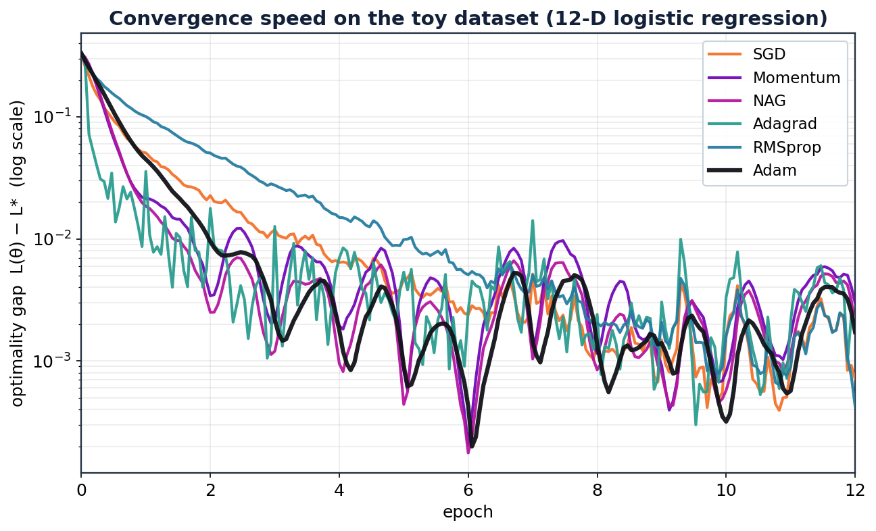
ON THE 12-FEATURE TOY DATASET — REAL TRAINING RUNS
Convergence speed, side by side
Reading the plot
Y-axis is the optimality gap L(θ) − L* on a log scale.
Lower and steeper = faster.
Adam descends smoothly to the lowest gap.
Mini-batch noise shows as the wiggle everyone shares.
All converge — this loss is convex — so it's a race, not a survival test.
Optimization Algorithms for ML
Lecture 2 · 27
Notes:
This is on the bigger toy dataset (1,500 points, 12 features), mini-batch training. Because logistic loss is convex, everyone reaches the minimum — the plot is about SPEED. The shared jitter is genuine mini-batch gradient noise. Adam's line is the smoothest and lowest. Next slide puts exact numbers to it.

Slide 26
THE NUMBERS BEHIND THE CURVES
Numerical results: optimizers
Optimizer | η | gap @ epoch 1 | epochs to gap<0.01 | final loss | test acc.
SGD | 0.5 | 0.0506 | 3.4 | 0.3633 | 87.1%
Momentum | 0.15 | 0.0213 | 1.8 | 0.3655 | 87.8%
NAG | 0.15 | 0.0185 | 1.5 | 0.3646 | 88.0%
Adagrad | 0.5 | 0.0357 | 0.9 | 0.3648 | 87.3%
RMSprop | 0.02 | 0.1005 | 4.8 | 0.3630 | 87.6%
Adam | 0.05 | 0.0448 | 2 | 0.3643 | 87.8%
Takeaways
Same minimum for all (convex).
Adam / NAG reach it fastest.
Accuracy ties — speed differs.
Toy dataset: 1,500 samples · 12 features · mini-batch = 64 · L* ≈ 0.362
Optimization Algorithms for ML
Lecture 2 · 28
Notes:
Real measured numbers, not illustrative. Note test accuracy is essentially tied (~88%) — on a convex problem the optimizer choice barely affects the final solution, only how fast you get there. The 'epochs to gap<0.01' column is the honest speed ranking. Caution students: on non-convex deep nets, optimizer choice CAN change the final solution and generalization.

Slide 27
Last Evolution
Learning-Rate Scheduling
Don't just pick η — change it over training.
Notes:
Transition: we've been assuming a fixed η. The last big lever is letting η change over time. This is where a lot of real-world training performance is won or lost.

Slide 28
BIG STEPS EARLY, SMALL STEPS LATE
Why schedule the learning rate?
Early training: you're far away — take big steps to make progress fast.
Late training: you're near the minimum — big steps overshoot and bounce.
Recall SGD's noise ball: its radius ∝ η. Shrinking η shrinks the ball to a point.
A schedule gives you the best of both: speed then precision.
The core trade-off
high η
fast progress, noisy, imprecise
low η
precise, stable, but slow
A schedule = start high, decay low. Get the fast progress first, then settle in precisely.
Optimization Algorithms for ML
Lecture 2 · 30
Notes:
Tie it back to the SGD noise-ball from Lecture 1: constant η leaves you orbiting the minimum at a radius set by η. Decaying η is how you actually land. This single insight motivates every schedule that follows.

Slide 29
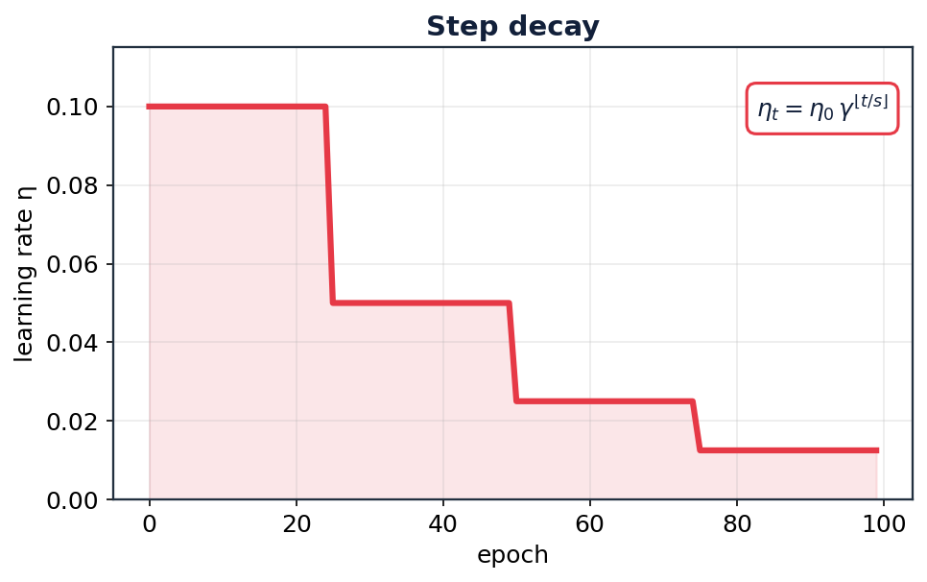
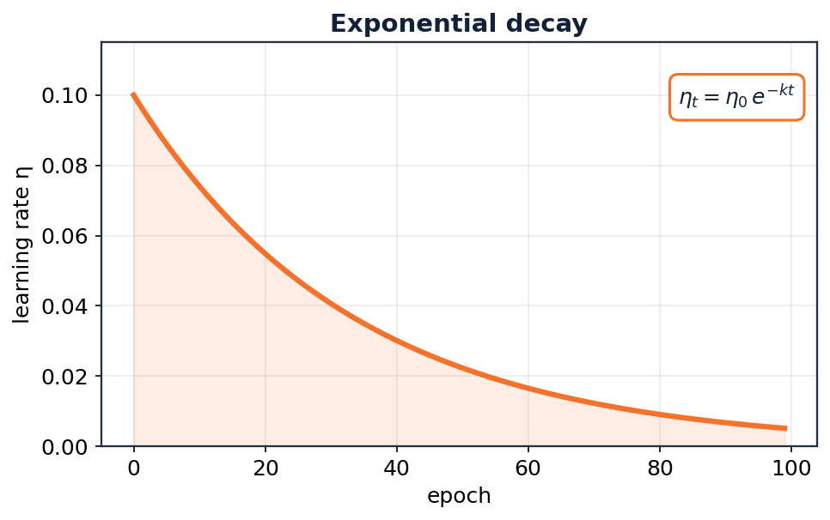
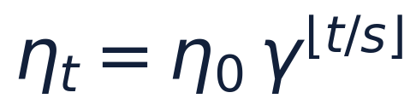
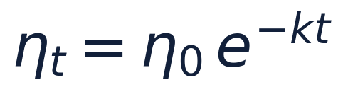
THE CLASSIC DECAYS
Step decay & exponential decay
Optimization Algorithms for ML
Lecture 2 · 31
Notes:
Step decay (drop η by a factor γ every s epochs) is still extremely common — the visible 'staircase' in loss curves is its signature, and each drop gives a sudden loss improvement. Exponential decay is the smooth continuous cousin. Both need you to pick a decay rate; step decay's drop points are often set by watching the validation curve plateau.

Slide 30
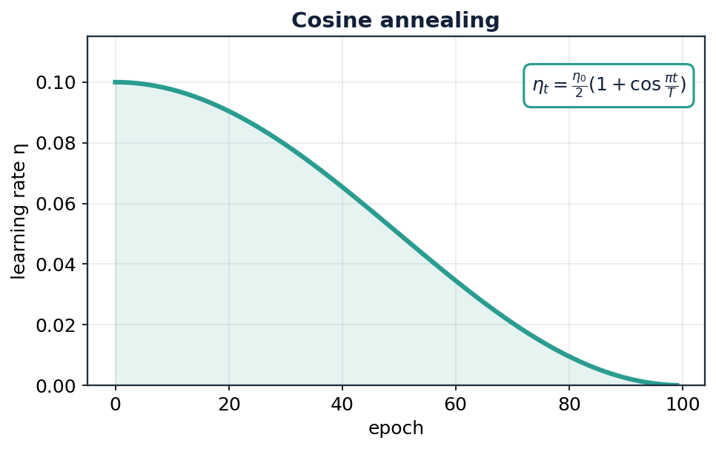
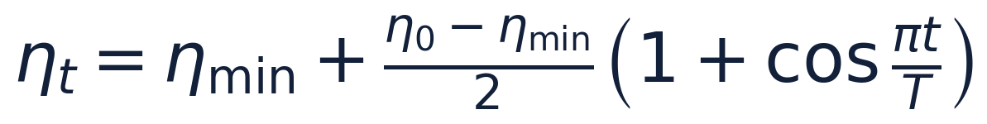
THE MODERN DEFAULT
Cosine annealing
Why it's popular
Smoothly eases η from η₀ down to ~0 following a half-cosine.
Gentle at the start and end, fastest decay in the middle.
No sharp drops to tune — just set the total length T.
With warm restarts (SGDR), η jumps back up periodically to escape and re-explore.
Optimization Algorithms for ML
Lecture 2 · 32
Notes:
Cosine annealing is the go-to schedule in modern vision and language training. Its smoothness avoids the abrupt behaviour of step decay, and the long low-η tail lets the model settle. Mention SGDR (warm restarts): periodically resetting η high can jump to a different basin and often improves results / gives cheap ensembles.

Slide 31
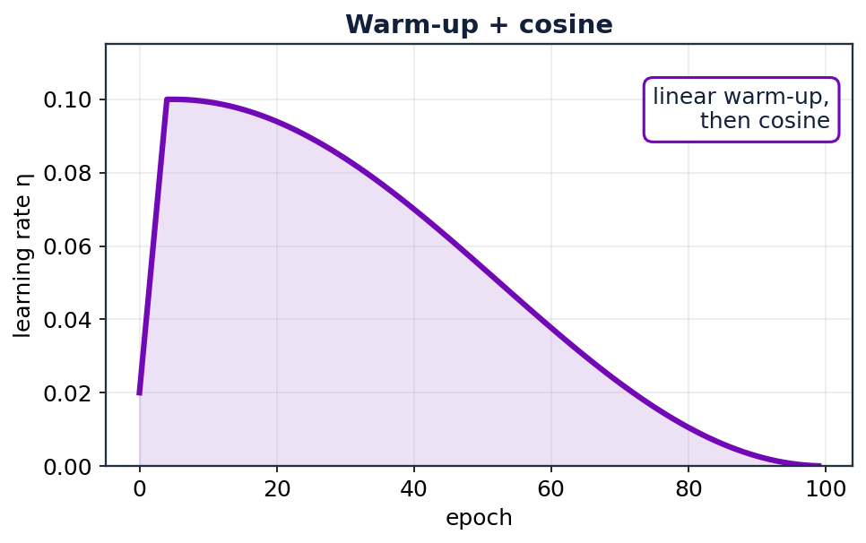
ESSENTIAL FOR LARGE-BATCH AND TRANSFORMER TRAINING
Warm-up + cosine
Why warm up?
At initialization the gradients are large and unreliable.
A big η immediately can blow the model up.
Linearly ramp η from ~0 to η₀ over the first few hundred steps.
Then hand off to cosine (or another) decay.
Standard in training BERT, GPT-style models, and any large-batch setup.
Optimization Algorithms for ML
Lecture 2 · 33
Notes:
Warm-up fixes an instability at step zero: fresh random weights produce huge, noisy gradients, and Adam's second-moment estimate hasn't stabilized, so a full η can diverge. Ramping η up over a few hundred/thousand steps lets the statistics settle. This is non-optional for transformer pre-training — leave it out and training often explodes.

Slide 32
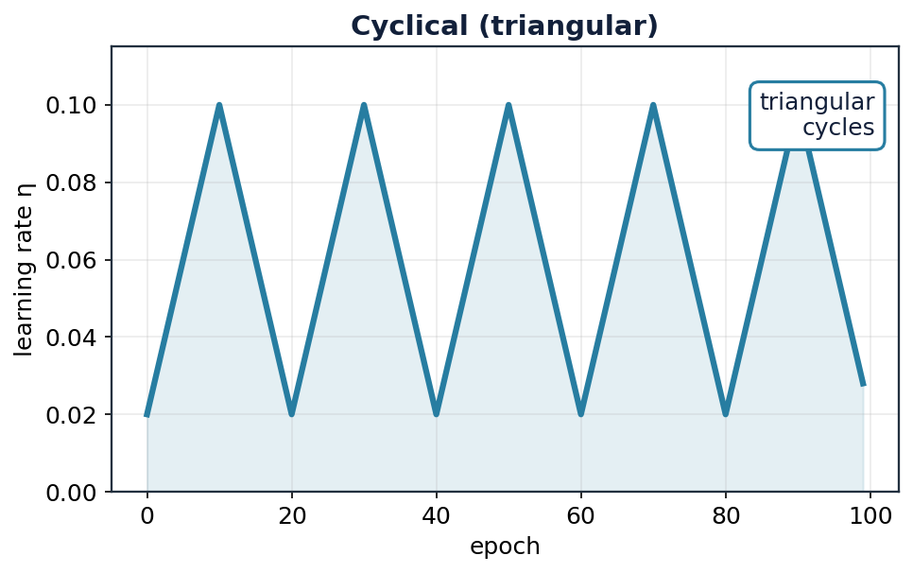
LET THE RATE OSCILLATE ON PURPOSE
Cyclical & one-cycle policies
The idea
Cycle η between a low and high bound instead of only decaying.
High phases power through saddles and flat regions.
Low phases let the model settle.
The LR-range test finds good bounds automatically.
One-cycle: a single up-then-down sweep — often trains faster ('super-convergence').
Optimization Algorithms for ML
Lecture 2 · 34
Notes:
Cyclical LR (Leslie Smith) challenges the assumption that η should only go down. The periodic highs help escape saddles; the lows consolidate. The one-cycle policy — ramp up once, then down well below the start — can give 'super-convergence', training in far fewer epochs. The LR-range test (sweep η and watch loss) is a practical way to pick the bounds.

Slide 33
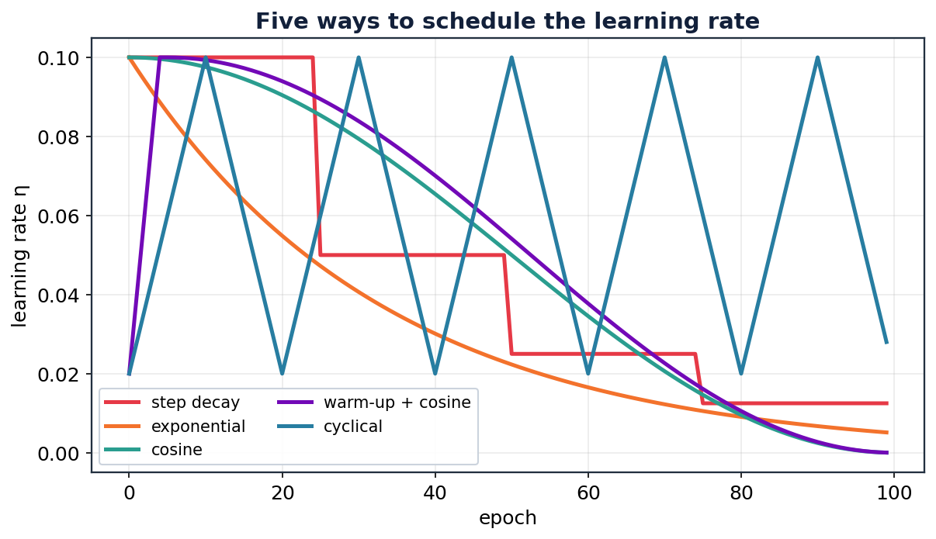
FIVE FAMILIES, ONE AXIS
The schedules at a glance
Pick by need
Step — simple, strong baseline.
Exponential — smooth decay.
Cosine — modern default.
Warm-up+cosine — large models.
Cyclical — escape + fast train.
Optimization Algorithms for ML
Lecture 2 · 35
Notes:
Use this as the summary reference. Note they all share the same η₀ ceiling here so the shapes are comparable. If a student remembers only one: cosine (or warm-up + cosine for big models) is a safe modern default.

Slide 34
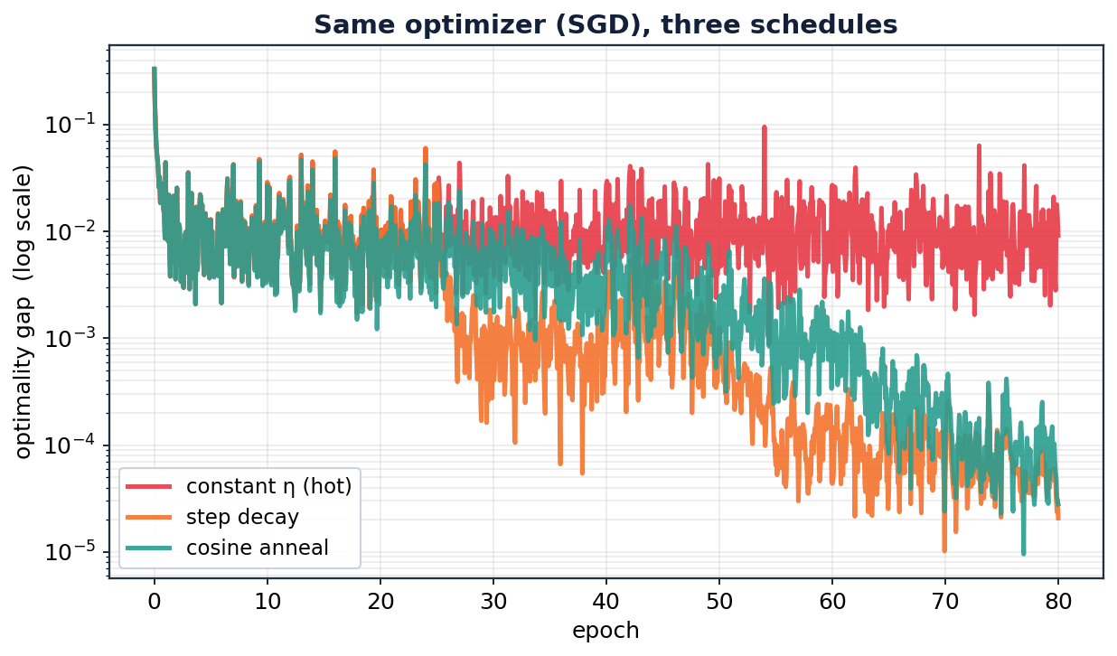
SAME OPTIMIZER, ONLY THE SCHEDULE CHANGES
Scheduling changes the result
Final optimality gap
constant η
0.0091
step decay
0.0000
cosine anneal
0.0000
A deliberately hot constant η bounces on the gradient noise and never settles. Decay drops it to the floor — a 10–100× smaller gap.
Optimization Algorithms for ML
Lecture 2 · 36
Notes:
This is the payoff experiment: identical SGD, identical starting η — only the schedule differs. The constant rate is stuck on the noise floor at ~1e-2; step and cosine decay push the optimality gap 1–2 orders of magnitude lower. Concrete proof that scheduling isn't cosmetic. Numbers are from actual runs on the toy dataset.

Slide 35
WHAT TO ACTUALLY USE
Practical cheat-sheet
Default starting point
Convex / classical ML
AdamW + cosine schedule with a short warm-up. Robust across most tasks.
SGD or L-BFGS; well-tuned SGD is hard to beat and generalizes well.
Training a transformer
Fine-tuning
AdamW, warm-up then cosine/linear decay — warm-up is non-negotiable.
Small η (1e-5–1e-4), short schedule, sometimes just constant + decay at the end.
If it diverges
If it's too slow
Lower η first; add/extend warm-up; clip gradients; check data scaling.
Raise η (do an LR-range test); add momentum; try a cyclical/one-cycle policy.
Optimization Algorithms for ML
Lecture 2 · 37
Notes:
The slide students will photograph. Emphasise the meta-rule: reach for AdamW + cosine + warm-up by default, and only deviate with a reason. The 'if it diverges / if it's too slow' rows are the debugging playbook — lower η and add warm-up cure most training explosions.

Slide 36
TRAPS AND THE BIG PICTURE
Common pitfalls & summary
Pitfalls to avoid
The one-slide summary
Not tuning η — it dominates everything else.
Forgetting to scale/standardize inputs (wrecks conditioning).
Comparing optimizers at one shared η — each has its own sweet spot.
Skipping warm-up on large models.
Reading loss on a linear axis — always use log.
Training = descend a loss surface with local gradients.
Momentum adds direction memory; adaptive methods add per-parameter scaling.
Adam(W) = momentum + RMSprop + bias fix — the default.
Then schedule η: high for speed, low for precision.
Optimization Algorithms for ML
Lecture 2 · 38
Notes:
Land the plane. The two-lecture arc in one breath: 'feel the slope and step' → add memory (momentum) → add per-parameter scaling (adaptive) → Adam combines both → then schedule the rate over time. The pitfalls list is the practical residue students will actually hit.

Slide 37
KEY TAKEAWAYS
Everything descends a gradient —
the art is how you take the step.
GD → SGD → Momentum → Nesterov: first-order foundations.
Adagrad → RMSprop → Adam(W): per-parameter adaptation.
Learning-rate schedules turn a good optimizer into a great training run.
Further reading: Ruder (2016), "An overview of gradient descent optimization algorithms" · Goodfellow, Bengio & Courville, Deep Learning, ch. 8 · Kingma & Ba (2015), "Adam" · Loshchilov & Hutter, "SGDR" and "AdamW"
Notes:
Leave the references up while taking questions. Suggested exercise: have students re-run the toy simulations and try to make SGD beat Adam by tuning η and a schedule — it's often possible, and teaches that optimizer choice and LR tuning are entangled.

