Slide 1

UNIT 2 · PART 2
Self-Consistency & Tree-of-Thought Reasoning
Advanced prompting strategies that help LLMs reason more reliably — by exploring, comparing, and selecting the best path forward.

Slide 2

SLIDE 11
What Is Self-Consistency Reasoning?
Generate multiple independent solutions to the same problem — then select the answer that appears most consistently across them.
Explore
Compare
Multiple solution paths
Candidate answers
Select
Most consistent result

Slide 3

SLIDE 12
How Self-Consistency Works
Receive Problem
Generate Candidates
Evaluate Answers
Find Most Consistent
Return Selected
By comparing outcomes across independent paths, the model reduces random errors and increases answer confidence.

Slide 4

SLIDE 13
Self-Consistency in Action
Problem: 125 engineers + 75 testers + 50 designers = ?
Solution 1
Solution 2
Solution 3
125 + 75 + 50 = 250 ✅
(125 + 75) + 50 = 250 ✅
125 + 75 = 190 → 240 ❌
Final answer: 250 — majority wins, even when one path fails.

Slide 5






SLIDE 14
Where Self-Consistency Shines
Mathematics
Programming
Reliable numerical calculations
Compare generated code solutions
Medical Diagnosis
Financial Planning
Evaluate diagnostic possibilities
Compare investment strategies
Scientific Research
AI Tutoring
Evaluate competing hypotheses
Verify explanations before presenting

Slide 6
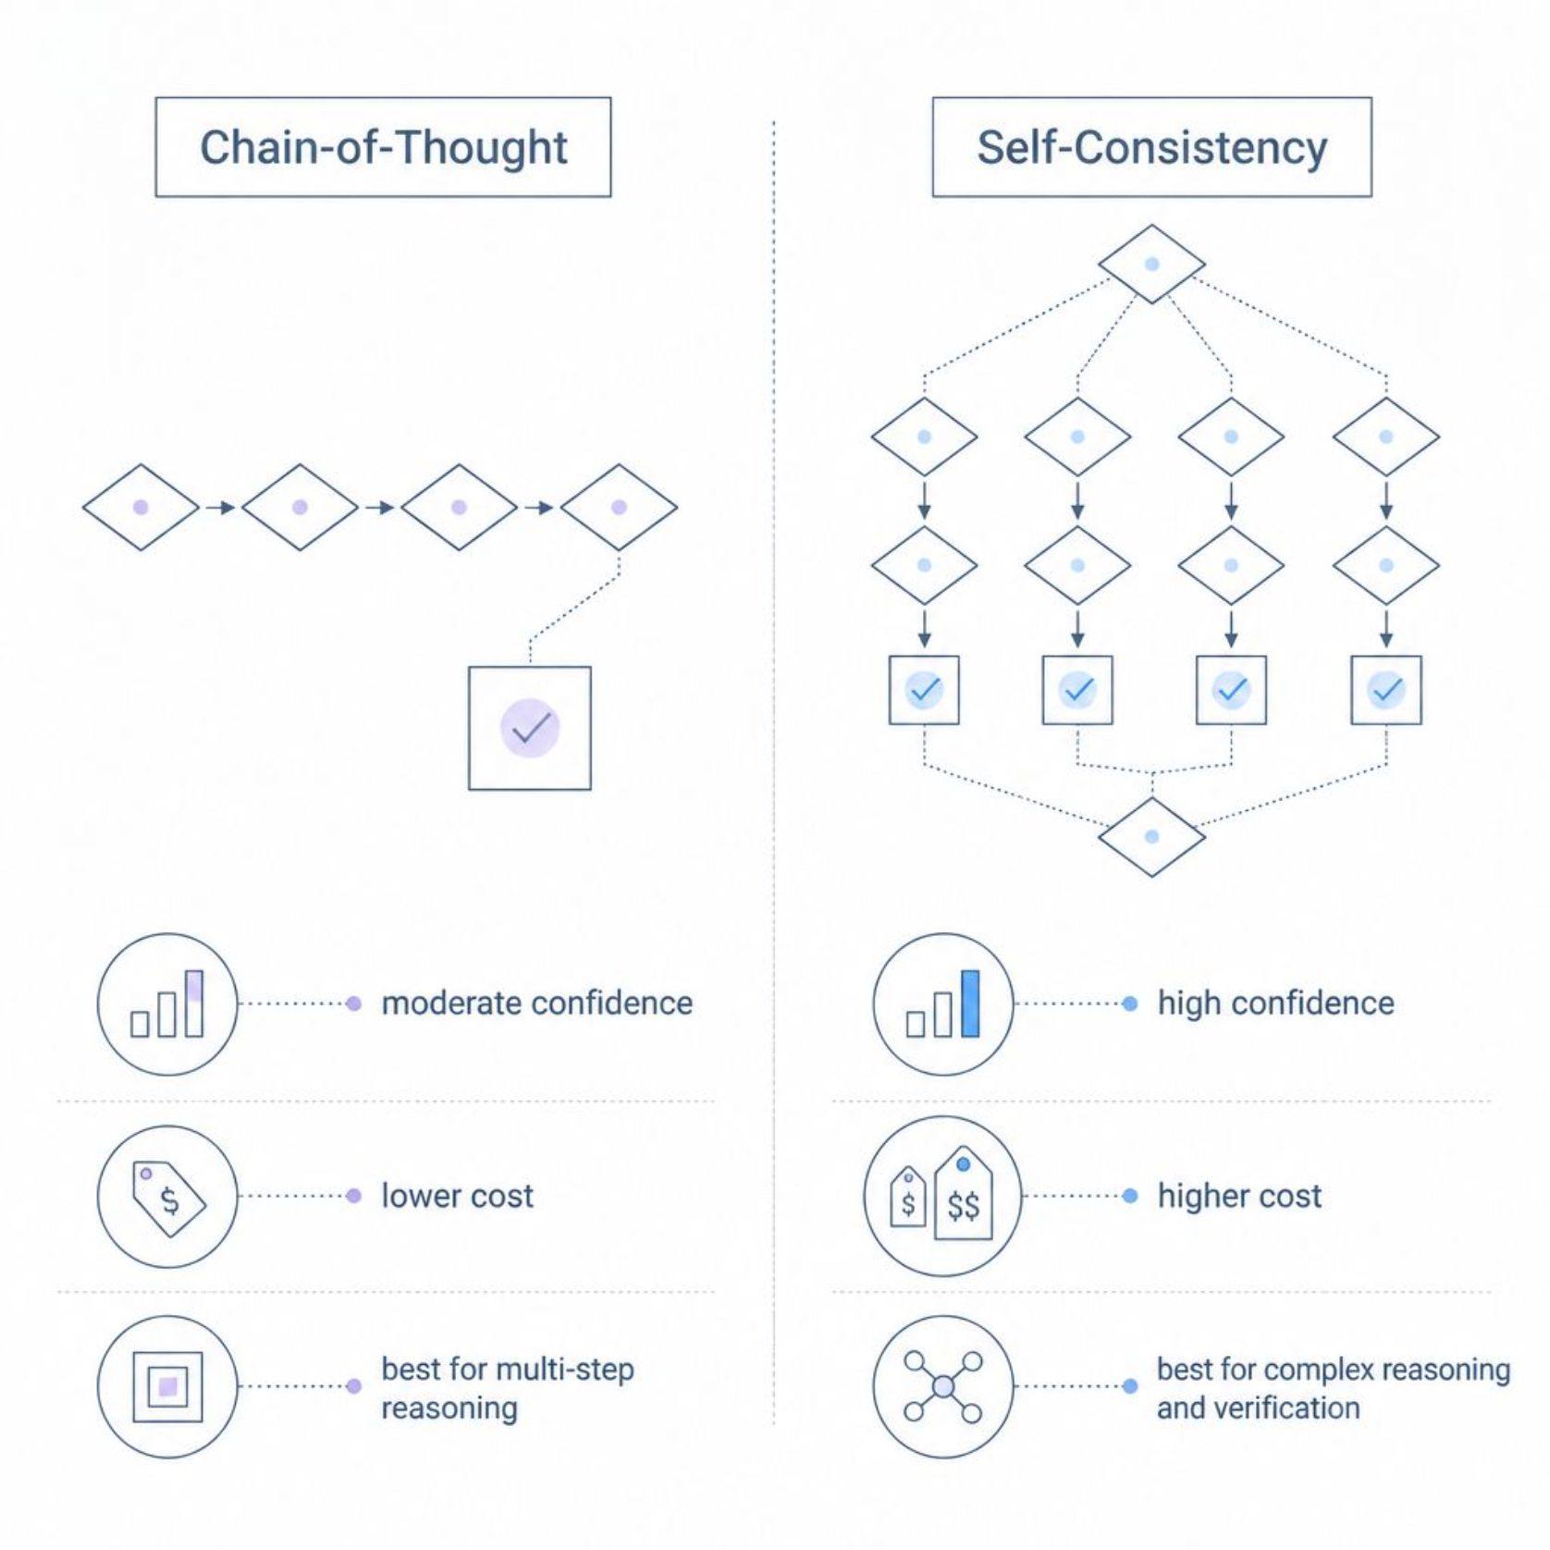
SLIDE 15
Chain-of-Thought vs. Self-Consistency
Key Distinction
CoT develops one solution path. Self-Consistency generates many and selects the most reliable.
CoT: single path → answer
Self-Consistency: multiple paths → compare → best answer

Slide 7

SLIDE 16
What Is Tree-of-Thought (ToT)?
ToT explores multiple solution branches, evaluates each, discards weaker paths, and advances the most promising one.
Branch
Evaluate
Explore alternatives in parallel
Score each branch
Select
Continue the strongest path

Slide 8

SLIDE 17
How Tree-of-Thought Works
Understand
Generate
Expand
Evaluate
Prune
ToT enables exploration and comparison of alternatives — rather than committing to the first solution found.

Slide 9

SLIDE 18
ToT Example: Planning a Tech Fest
Constraint: Budget = ₹5 lakh
Option A — Celebrity Speakers
Option B — Industry Experts
Option C — Student Workshops
High attraction · Budget exceeded ❌
Good value · Within budget ✅
High participation · Lowest cost ✅
Best decision: Combine B + C for maximum value within constraints.

Slide 10
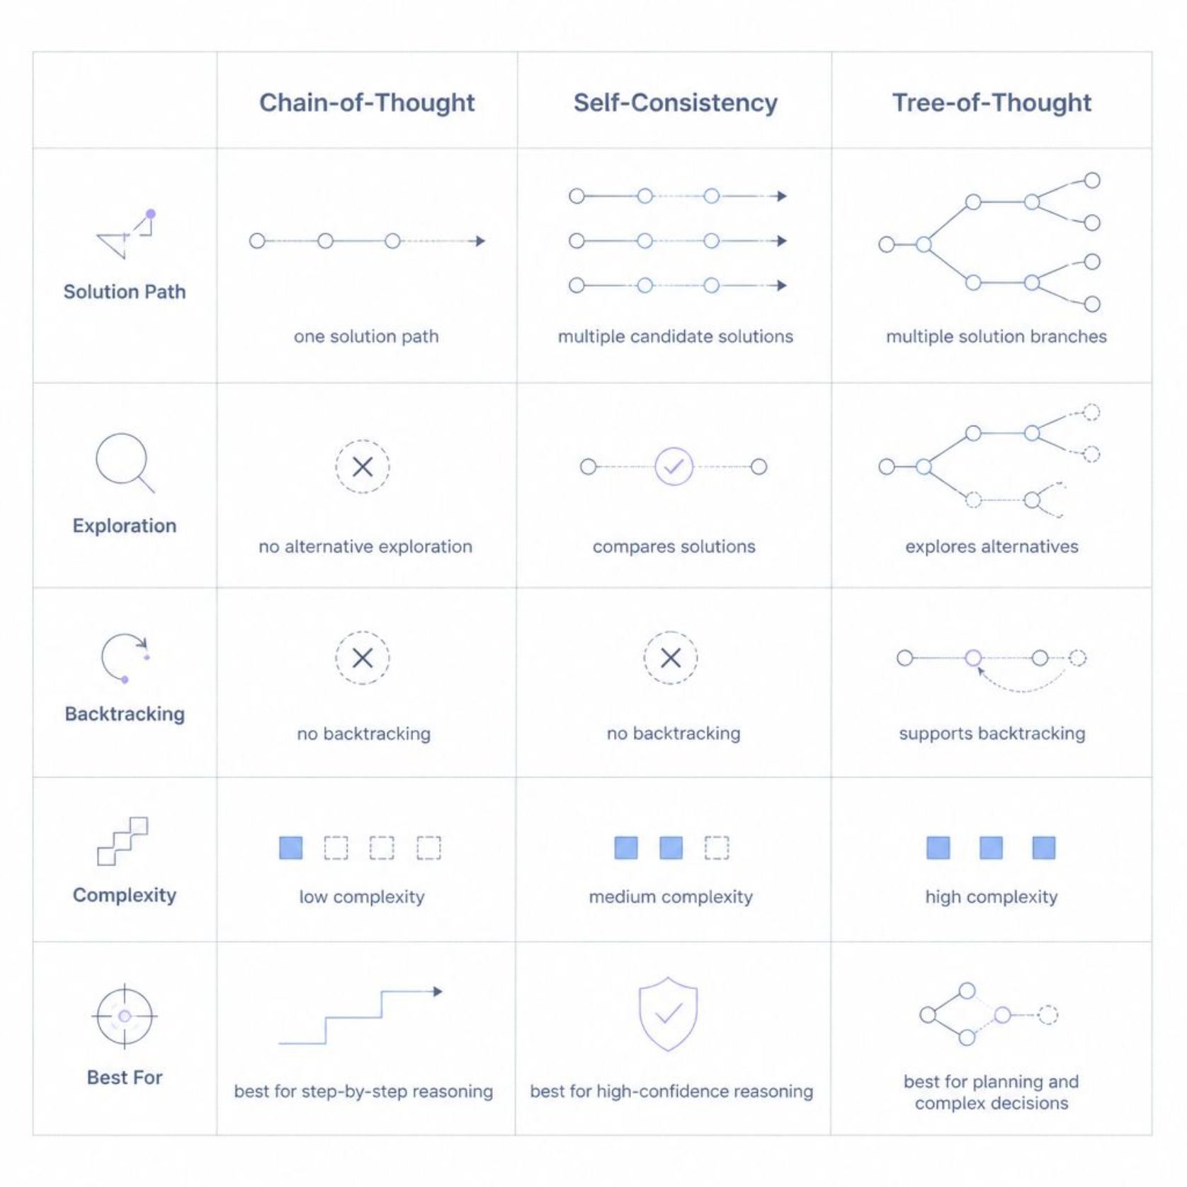
SLIDE 20
Reasoning Strategies Compared
Key Takeaways
CoT: Single path, step-by-step
Self-Consistency: Multiple paths, majority vote
ToT: Branching exploration with backtracking

