Slide 1

UNIT 2 · PART 7
SLIDES 76–90
Tool Integration & APIs as Agent Tools
How AI agents extend beyond their training data to interact with the real world — through APIs, databases, search engines, and code execution.

Slide 2


What Is Tool Integration?
Tool Integration enables an AI agent to interact with external systems — APIs, databases, search engines, and code environments — to accomplish tasks beyond its built-in knowledge. Unlike chatbots, agentic AI thinks, decides, and invokes tools when needed.
Knowledge Cutoff
LLMs can't access live or real-time data by default
No External Access
Cannot interact with software, hardware, or private databases
Unreliable Math
LLMs cannot perform precise calculations without a tool
No Autonomous Action
Cannot send emails, update records, or browse the web independently

Slide 3

LLMs Without Tools vs. AI Agents With Tools
❌ LLM Alone
✅ AI Agent With Tools
Answer conceptual questions
Write code and explain algorithms
Summarize and translate text
Search Google or Tavily
Execute Python programs
Query SQL and vector databases
Call REST APIs, send emails, book tickets
Cannot: fetch live weather, check flight prices, access databases, execute code, or send emails.
Example: "Find the cheapest flight from Pune to Delhi tomorrow" → Agent calls Flight API, compares prices, recommends best option.

Slide 4






Types of Tools Used by AI Agents
AI agents dynamically select from a toolbox of external capabilities based on the user's request.
Search Engine
APIs
Google Search, Tavily — retrieve latest web information
Weather, Maps, Flight — access external services
Databases
Vector DB
MySQL, PostgreSQL — retrieve stored records
FAISS, ChromaDB — semantic document search
Code Interpreter
Productivity Tools
Python Runtime — execute and evaluate code
Gmail API, Google Calendar — send emails, manage events

Slide 5
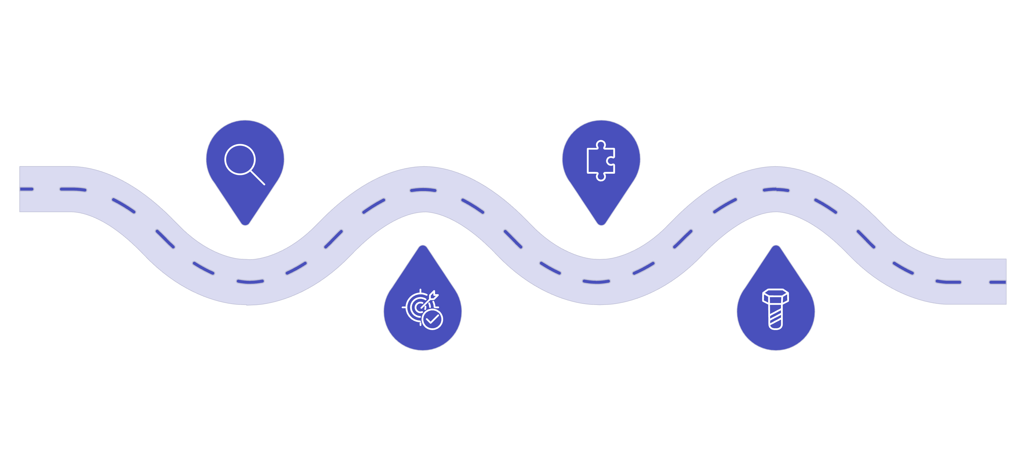
The Tool Selection Process
Before invoking any tool, the AI agent performs a structured reasoning loop — understanding intent, matching capability, and executing with precision.
Understand Intent
Match Tool
Select best-fit available tool
Clarify user goal and constraints
Identify Capability
Execute & Return
Run tool, receive results, respond
Determine required tool function
The agent does not randomly choose a tool. It reasons through the user's query and selects the most appropriate tool dynamically — for example, a weather query triggers the Weather API, while a math problem routes to the Python interpreter.

Slide 6
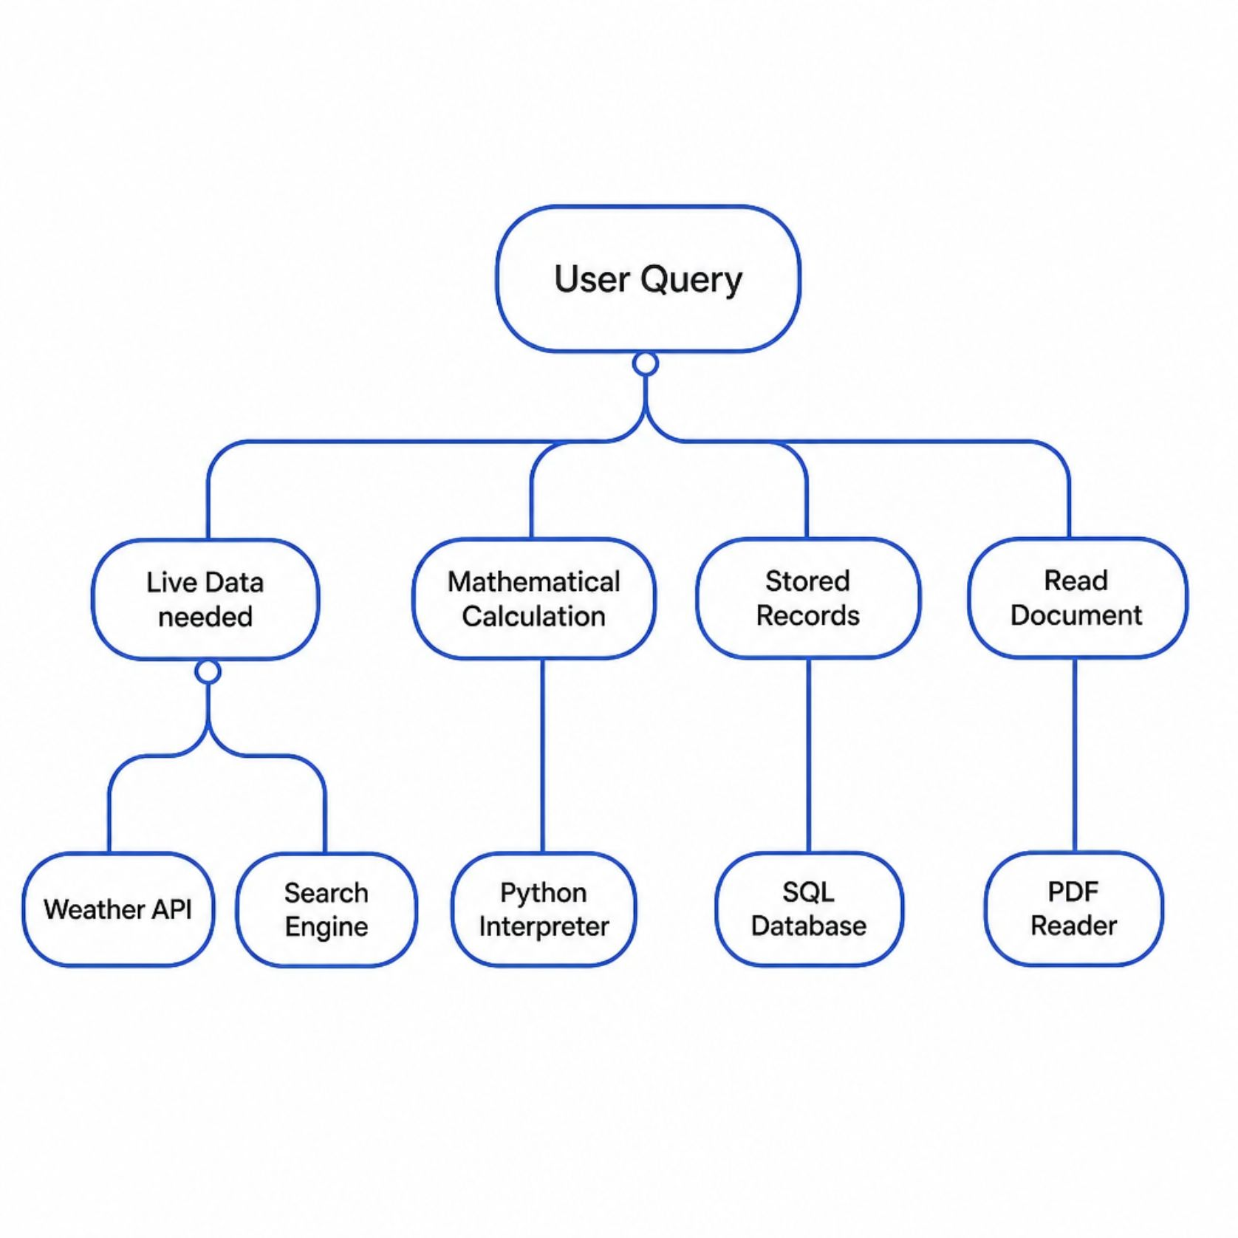

Tool Selection Decision Tree
The AI agent evaluates each query against a decision hierarchy before committing to a tool. This structured reasoning ensures the right tool is called at the right time.
Needs live data? → Weather API, Search Engine
Needs calculation? → Python Interpreter
Needs stored records? → SQL Database
Needs document reading? → PDF Reader
The agent reasons before acting — not after a failed attempt.

Slide 7
Hands-On: Building a Tool Router
Practical 1 — Rule-Based Router
Practical 2 — Keyword Mapping
query = input("Enter query: ").lower()
if "weather" in query:
print("Tool: Weather API")
elif "calculate" in query:
print("Tool: Python Calculator")
elif "pdf" in query:
print("Tool: PDF Reader")
else:
print("Tool: General LLM")
tools = {
"weather": "Weather API",
"news": "News API",
"email": "Gmail API",
"flight": "Flight Booking API"
}
for keyword, tool in tools.items():
if keyword in query:
print(f"Using {tool}")
These exercises simulate how an AI agent maps user intent → tool selection before generating a response.

Slide 8


Real-World Applications & Advantages
ChatGPT
Browsing, Code Interpreter, File Analysis
Microsoft Copilot
Office, Outlook, Teams integration
Perplexity AI
Web Search + LLM reasoning
Google Gemini
Google Workspace integration
Real-time information access
Improved factual accuracy & reduced hallucinations
Code execution & task automation
Enterprise system interaction

Slide 9
Limitations, Challenges & Review
⚠️ Challenges
🎯 Interview Questions
Incorrect tool selection by the agent
API failures, rate limiting, network latency
Authentication and security risks
Data privacy and operational costs
What is Tool Calling?
Explain the difference between an LLM and an AI Agent.
How do AI agents decide which tool to use?
What challenges arise when integrating external tools?
📋 Viva Questions
Classroom Activity: Match each user request to its appropriate tool — weather → Weather API, PDF → PDF Reader, graph → Python Interpreter.
What is Tool Integration?
Why do AI Agents need external tools?
How does Tool Integration reduce hallucinations?

Slide 10


Summary & Practical Assignment
01
Tool Integration
Extends AI capabilities beyond training data
02
Tool Types
APIs, databases, search engines, code interpreters
03
Tool Selection
Reasoning-driven, intent-based routing
04
Benefits & Limits
Real-time access vs. API risks and costs
Assignment — Build an AI Tool Router: Accept a user query, identify intent, select the appropriate tool (Weather API, Calculator, Search Engine, PDF Reader, Email Tool, etc.), display the selection, and explain the reasoning. Bonus: Support 10+ tools and handle unknown queries gracefully.

