Slide 1
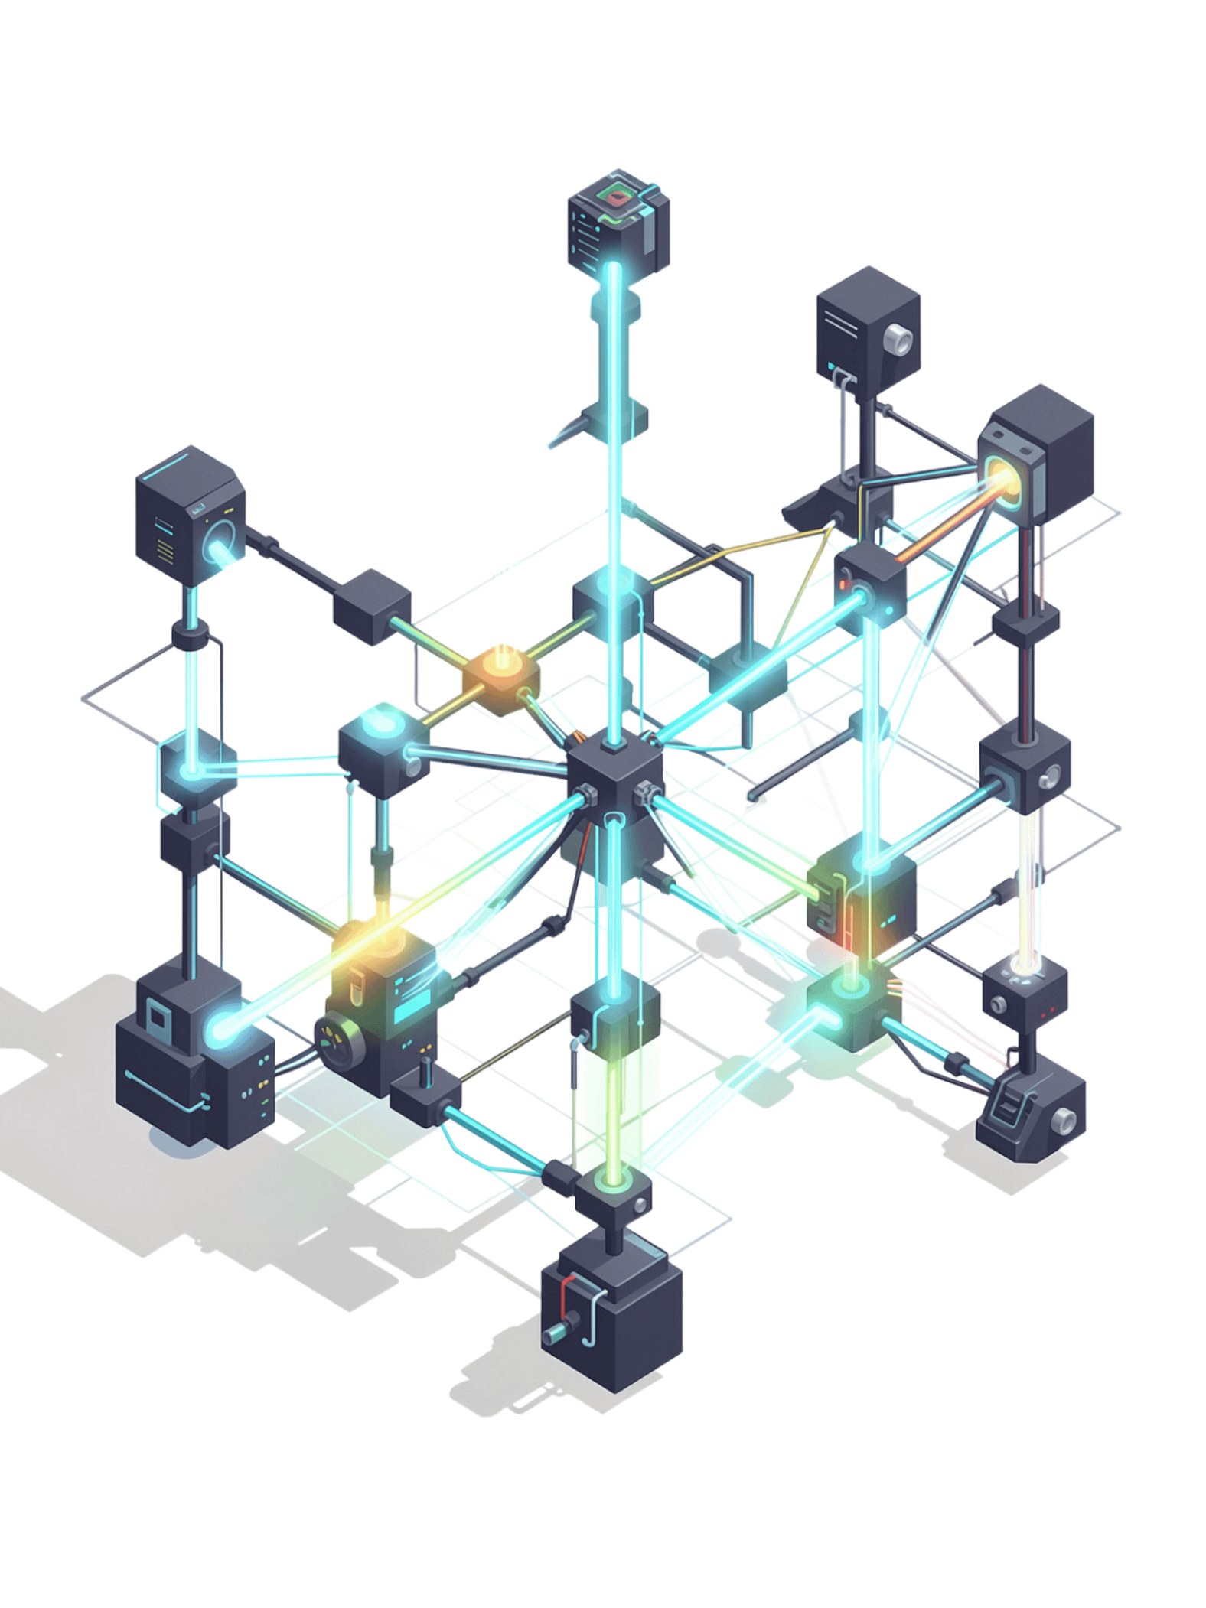
Retrieval-Augmented Generation (RAG) & Knowledge Grounding
Unit 3 — Part 2 · Advanced CS/ML

Slide 2


The Core Problem: LLM Knowledge Limitations
Static Knowledge
LLMs learn general patterns but have no access to private documents, real-time data, or domain-specific knowledge.
Confident Hallucinations
Models generate plausible-sounding but factually incorrect answers — with no uncertainty signal.
Concrete Example
"What is Symbiosis Institute's 2026 attendance policy?" — the LLM simply does not know.

Slide 3



What is RAG?
Retrieval
Augmented
Generation
Find relevant information from external knowledge sources in real time.
Enhance the LLM's prompt with that retrieved context before generation.
Produce a grounded, evidence-backed answer using the enriched input.

Slide 4
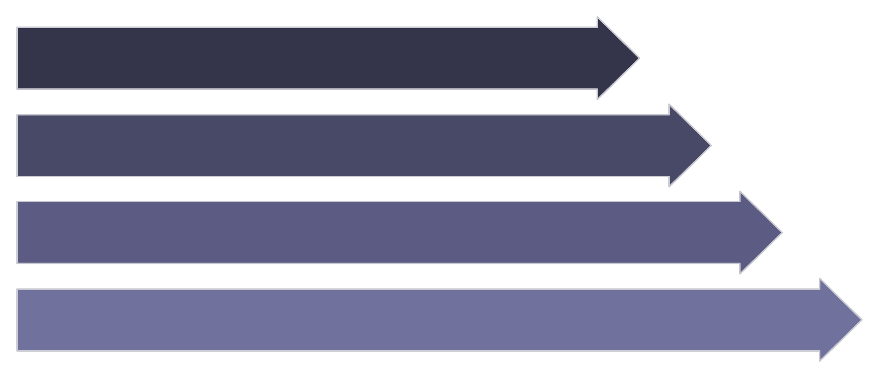
RAG Architecture: Two Phases
Offline — Ingestion
Documents are split into chunks, converted to vector embeddings, and stored in a vector database. This happens once (or on updates).
Ingest Docs
Chunk & Embed
Store Vectors
Online — Query
At inference time, the user's query is embedded, matched against stored vectors, and the top-k relevant chunks are injected into the LLM prompt.
Query & Answer

Slide 5
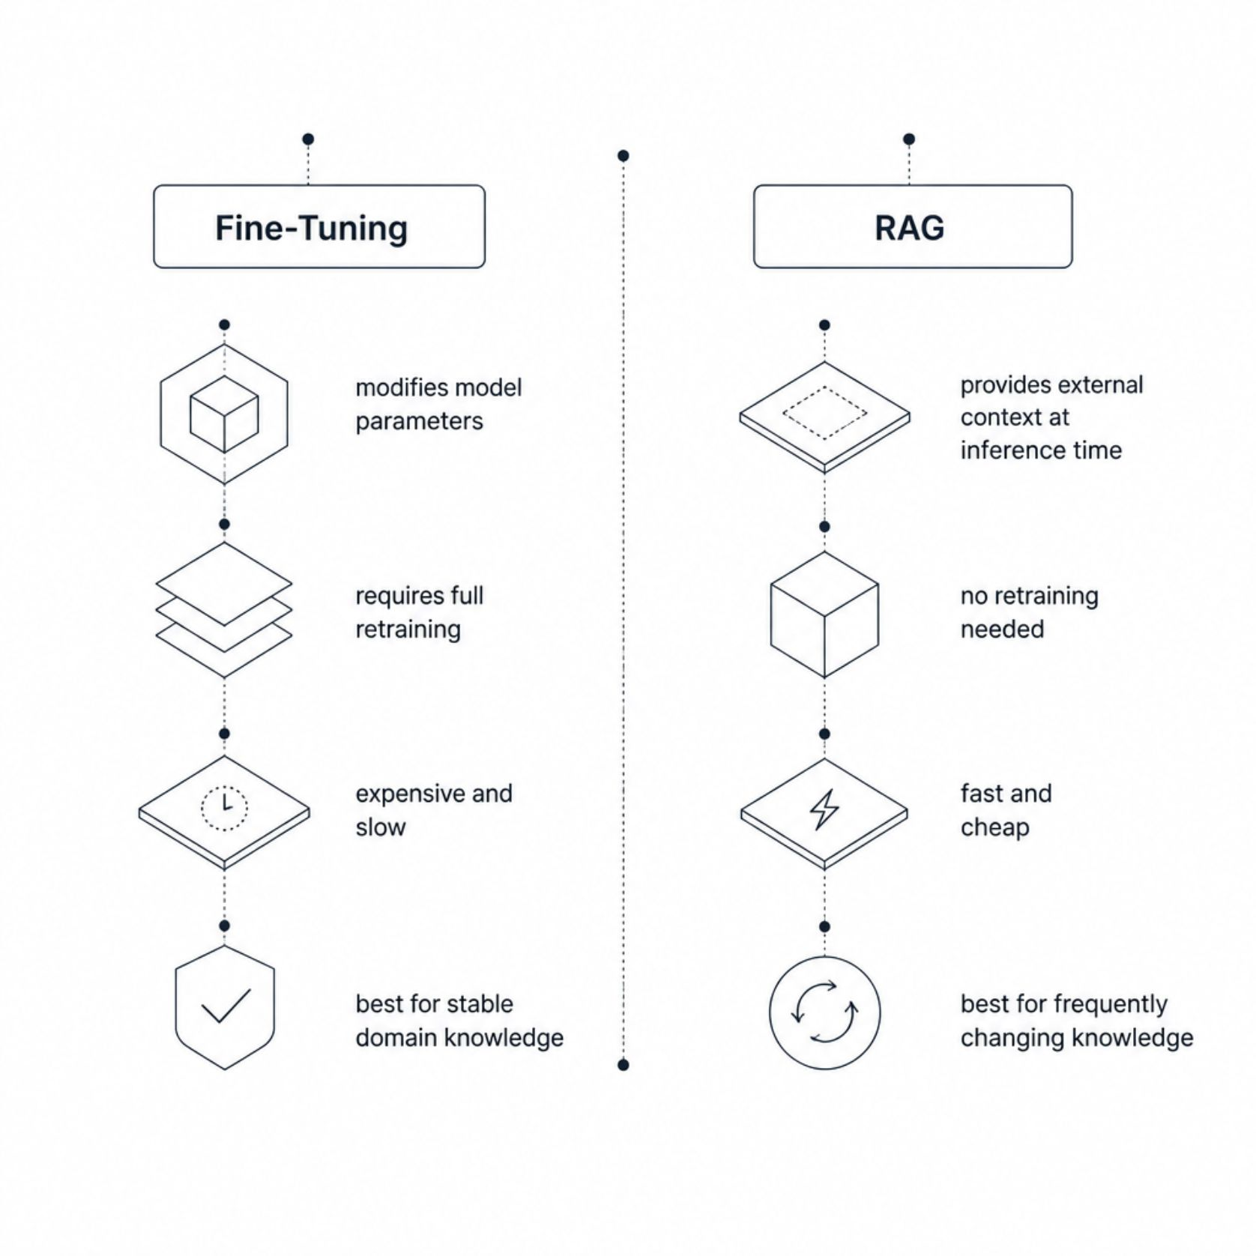

RAG vs. Fine-Tuning
The key insight: Fine-tuning bakes knowledge into model weights — a slow, costly process. RAG retrieves knowledge dynamically at inference time.
RAG is faster, cheaper, and far more practical when your knowledge base changes frequently.

Slide 6

Knowledge Grounding Defined
Generating answers using relevant, trusted external information rather than relying solely on the model's learned weights.
Without Grounding
"I think the deadline is the 15th..." — potential hallucination, no source.
With Grounding
"According to the policy document, the deadline is March 15th." — evidence-based, traceable.

Slide 7



Why Grounding Matters
Medical
Financial & Legal
Education & Corporate
Incorrect clinical information can directly harm patients. Grounding ensures answers trace to verified sources.
Regulatory compliance demands accuracy. Evidence-based generation replaces speculation with cited policy.
Institutional knowledge — from attendance rules to HR policy — must be grounded in official documents.
Retrieved information acts as the foundation for generation — transforming "I think..." into "According to the evidence..."

Slide 8
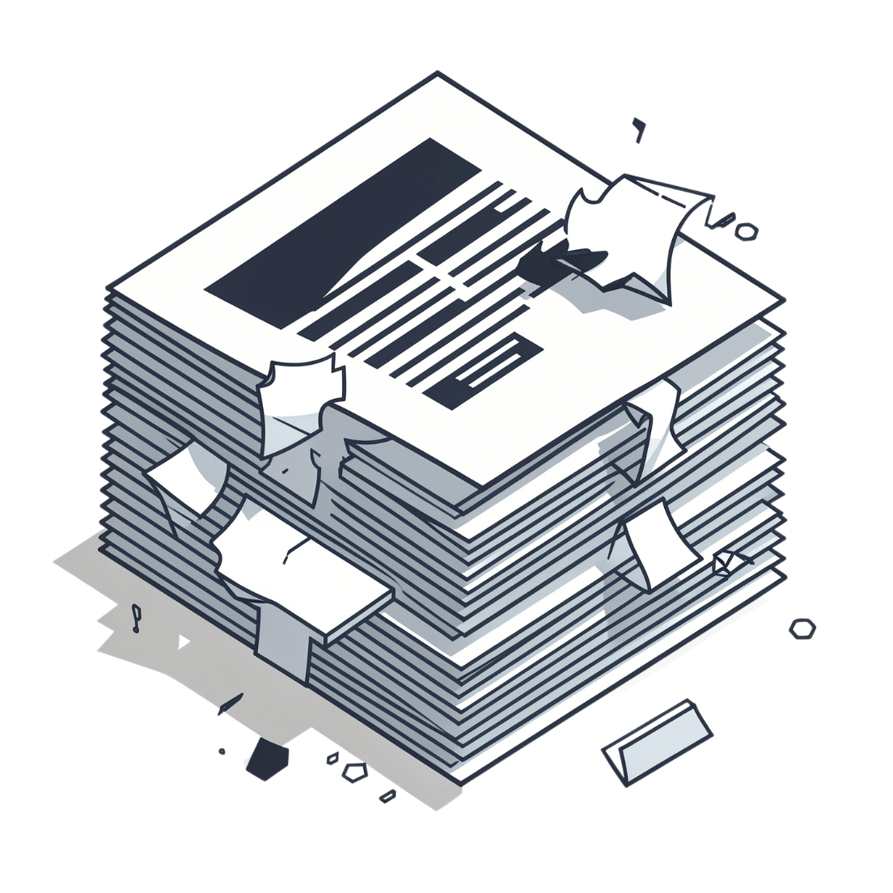
Document Chunking: Why It's Necessary
The Problem
A 500-page PDF cannot — and should not — be sent to the LLM for every query. Context windows have limits, and flooding them wastes tokens.
The Solution
Chunking breaks documents into smaller, semantically meaningful pieces. Only the relevant chunks are retrieved and passed to the model — enabling precision at scale.

Slide 9
What is a Chunk?
A chunk is a smaller section of a larger document, ideally scoped to a single topic or concept — making it independently useful for retrieval.
Chunk 1
Chunk 2
Chunk 3
Introduction & Course Overview
Attendance Policy & Requirements
Exam Rules & Grading Criteria
Query: "What attendance is required?" → retrieves Chunk 2 only, not the entire document.

Slide 10
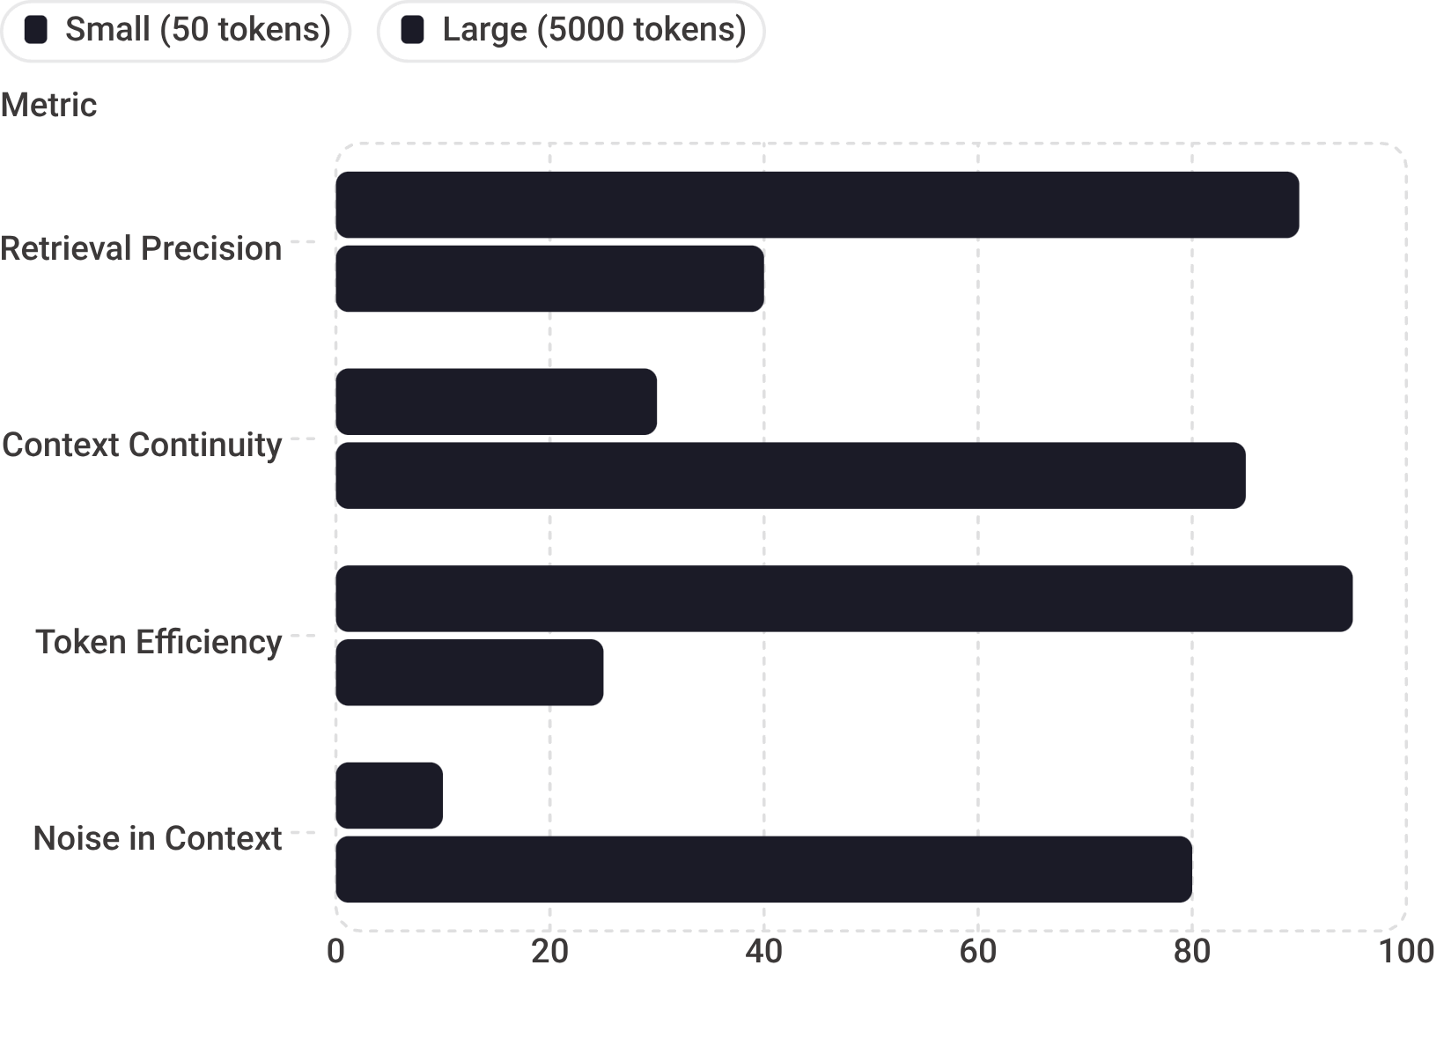

Chunk Size Trade-offs
Small Chunks (~50 tokens)
High precision retrieval — but context may be incomplete or missing surrounding meaning.
Large Chunks (~5000 tokens)
Better continuity — but introduces irrelevant content and significantly higher token costs.
Optimal chunk size depends on your domain and retrieval precision requirements. There is no universal answer.

Slide 11
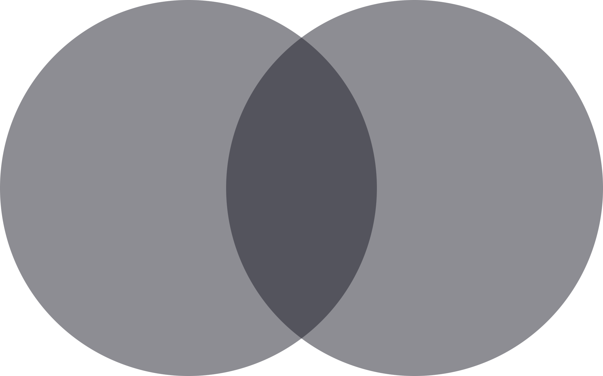

Chunk Overlap: Preserving Context
The Boundary Problem
Hard splits at fixed boundaries can sever meaning mid-sentence or mid-concept — breaking the semantic coherence a retriever depends on.
The Overlap Solution
Overlapping content is repeated across adjacent chunks, ensuring continuity is preserved across boundaries.
Example: Chunk 1 = A B C D E · Chunk 2 = D E F G H — tokens D and E bridge the gap.
Chunk 1: A B C D E
Overlap: D E
Chunk 2: D E F G H
More overlap = better context preservation, but higher storage and embedding costs. Design for your budget.

