Slide 1
Welcome

Slide 2
Car Showroom Management System
PRESENTED BY ( GROUP - 4 ) :
SONI HETVI M. (186040307054)
SHAH HARSH P. (186040307050)
PATEL JAY K. (186040307032)
GUIDED BY :
MR. JITEN PARMAR
B & B INSTITUTE OF TECHNOLOGY
COMPUTER DEPARTMENT
(GIA)

Slide 3
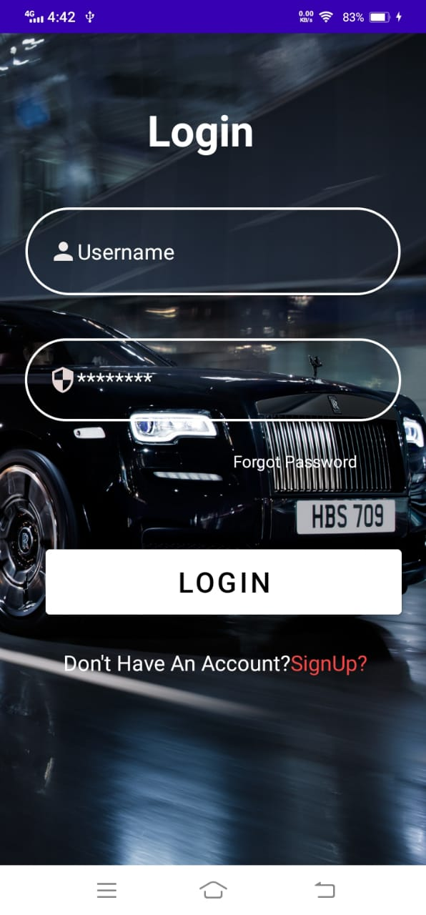
Screen layouts with description
Login Screen
The very first screen when we start our application is Login screen
In Login screen we collect username and password which is verified by registered data.
If you are new user then first you have to register your self.
If you forgot your password then you have to click on the forgot password and can easily change your password.

Slide 4
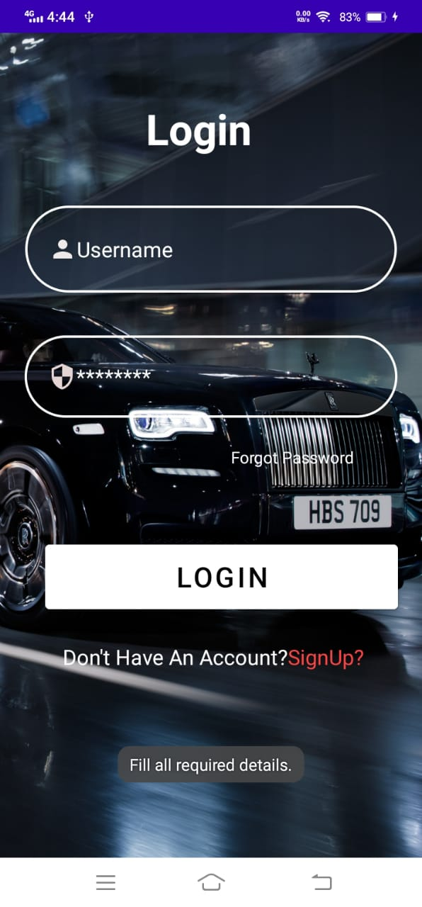
Login Screen
You’ll get message if you don’t fill any field and click on the Login Button
Message is “Fill all required details” as shown in red circle.
Login fields must contain your username and password.

Slide 5
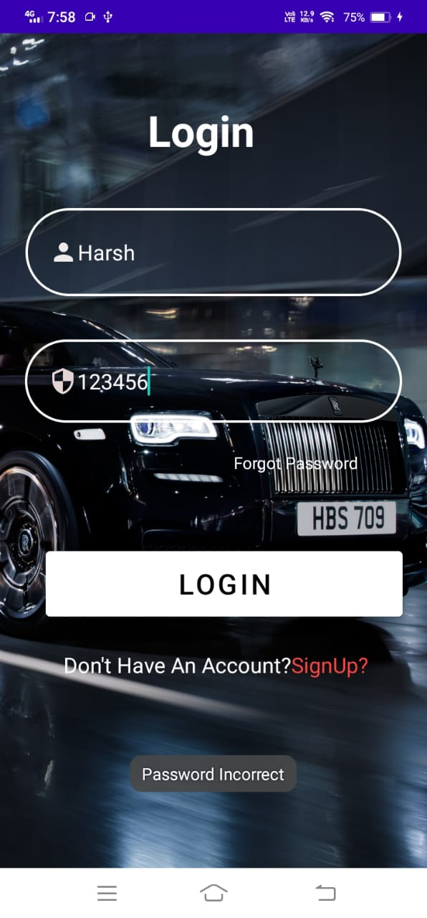
Login Screen
You’ll get message if your password is wrong while logging.
Message is “password Incorrect”

Slide 6
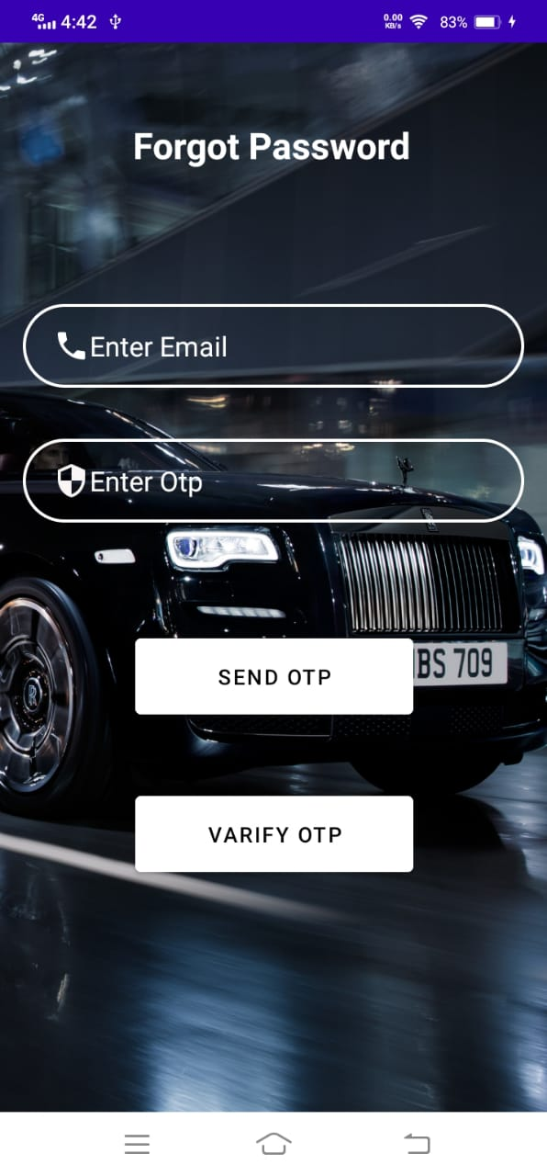
Forgot Password screen
After clicking on the forgot password from login screen, following screen will be shown.
In this screen user have to write his/her email and then the OTP will sent to their email.
After getting OTP user have to write OTP in “Enter OTP” field.
And then Click on the verify OTP button.

Slide 7
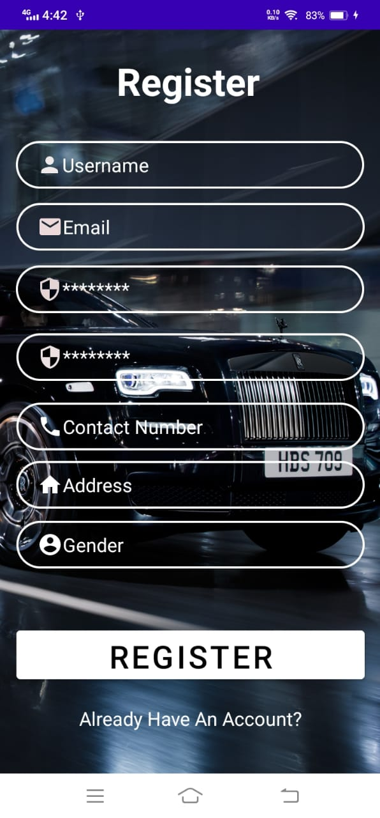
Register screen
In this screen we collect data of new users.
This screen contains following fields:
Username
Email
Password
Confirm password
Contact number
Address
Gender

Slide 8
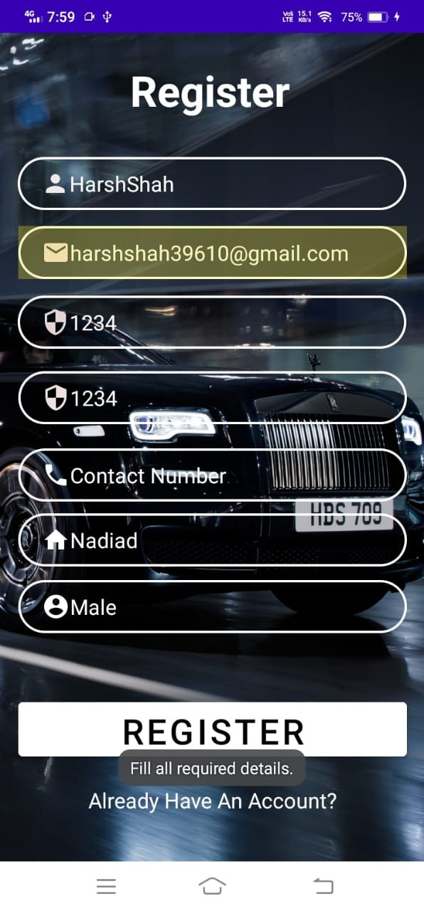
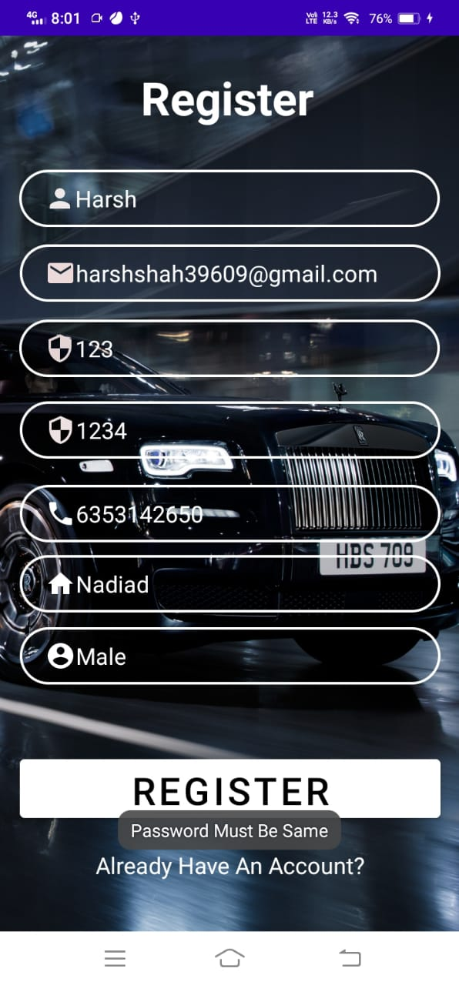
Register screen
You’ll get message if you don’t fill any field and click on the Register Button.
Message is “Fill all required details”.
If don’t enter the same password in confirm password field then it will give you message.
Message is “Password must be same”.

Slide 9
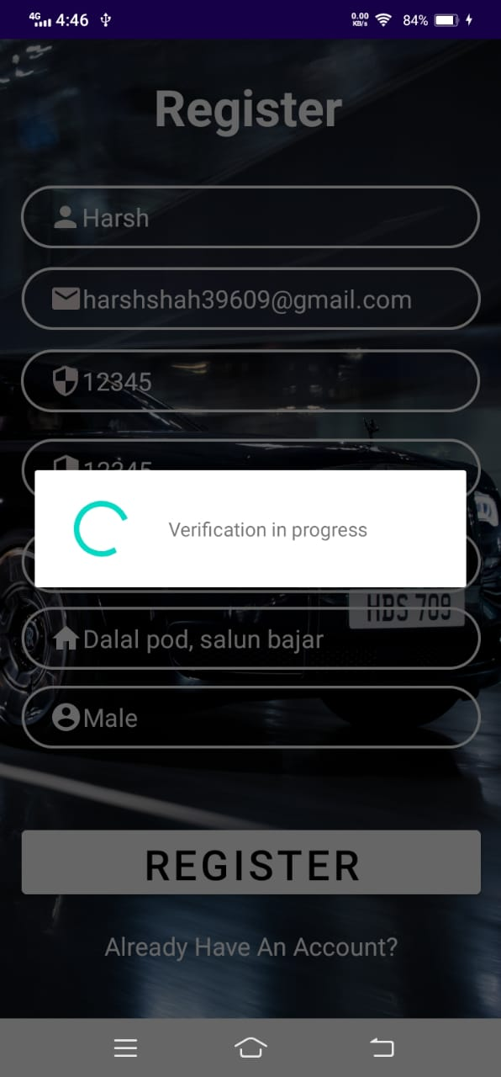
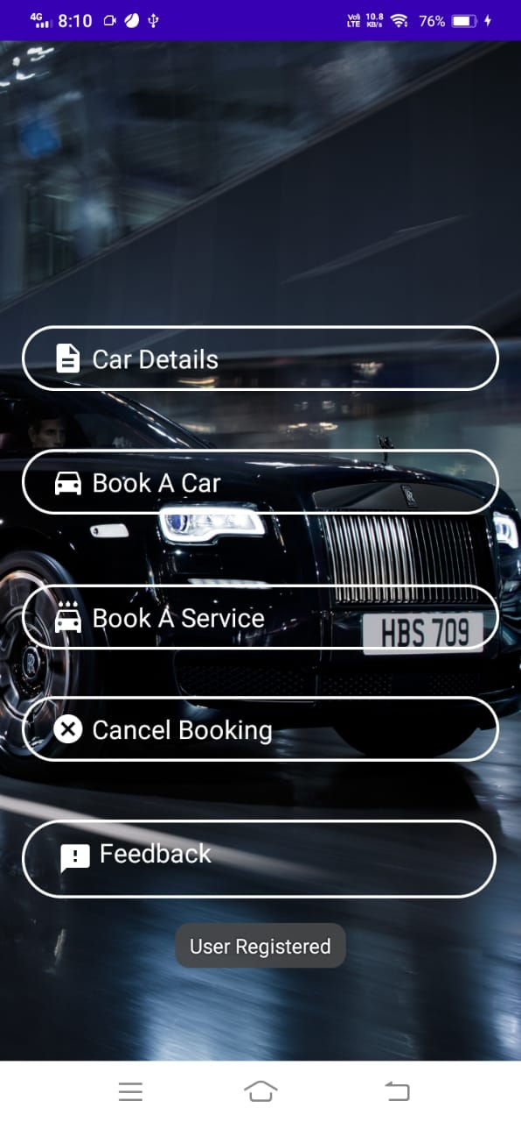
Register screen
After click on register button it will take while to processing.
As shown in this screen.
When all details are correct then user get message as shown in red circle.
Message is “User registered”

Slide 10

Main screen after login / Register screen
After Login / Register screen there is a main screen.
There are Five option.
Car details
Book a Car/Test drive
Book a Service
Cancel Booking
Feedback
All Five Options are Clickable.

Slide 11
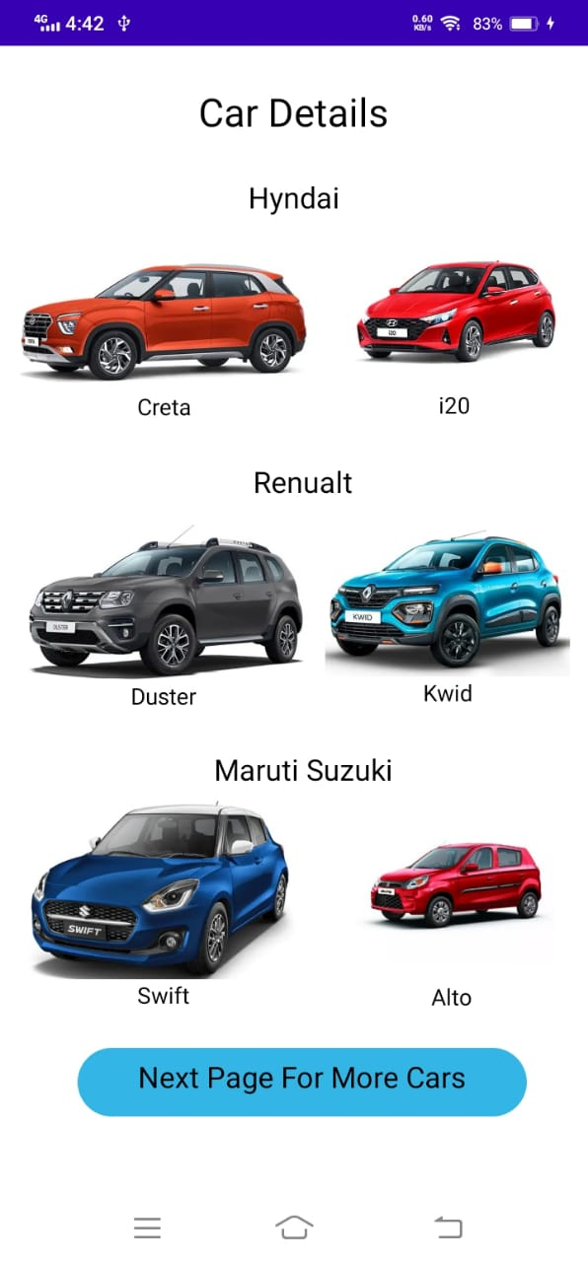
Car Details screen
When user click on Car details from Main screen, Given screen will be open.
There are all car models of particular company that available in showroom are displayed in this screen.
When User click on any of the car, The color Selector screen of that particular car will be open.
After clicking on “next page for more cars” you can move to the next page.

Slide 12
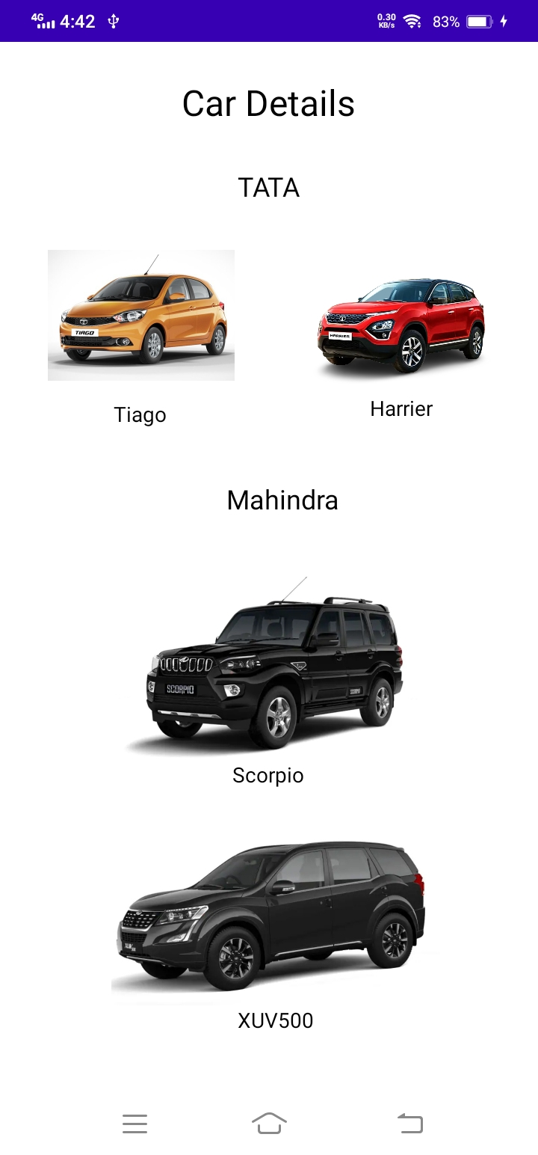
Car Details screen
When user click on the “Next page for more cars” from previous screen , Given screen will be open.
There are all car models of particular company that available in showroom are displayed in this screen.
When User click on any of the car, The color Selector screen of that particular car will be open.

Slide 13
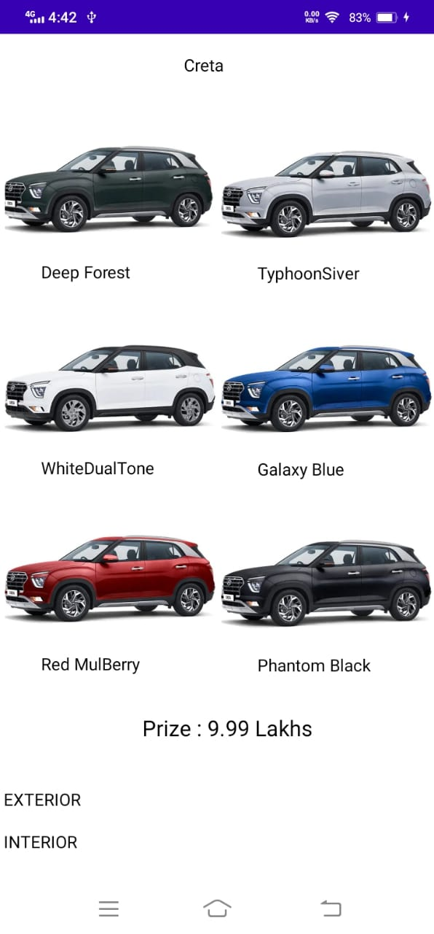
Color Selector Screen
In this screen User have a choice of colors.
User can select any color of his/her choice.
There is also a prize tag so that user can have a idea about price.
There are also options to have a look on car’s interior and exterior.

Slide 14
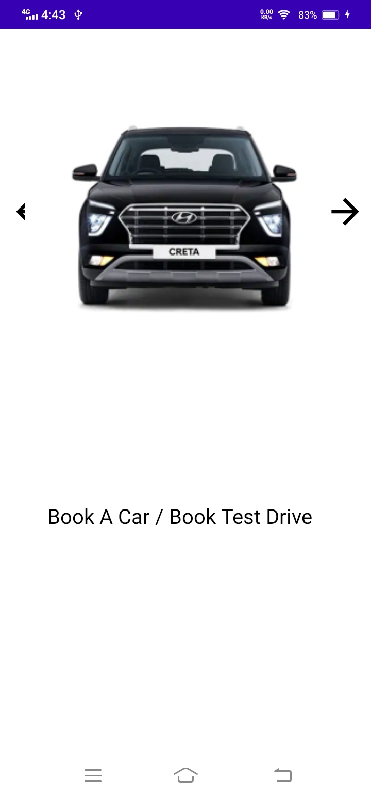
Car Details screen
In this screen User can show 4 views of car that are front, back and side views.
If User want to book a test drive or car ,user can directly navigated to book a test drive or car by choosing the options as shown in red circle.

Slide 15
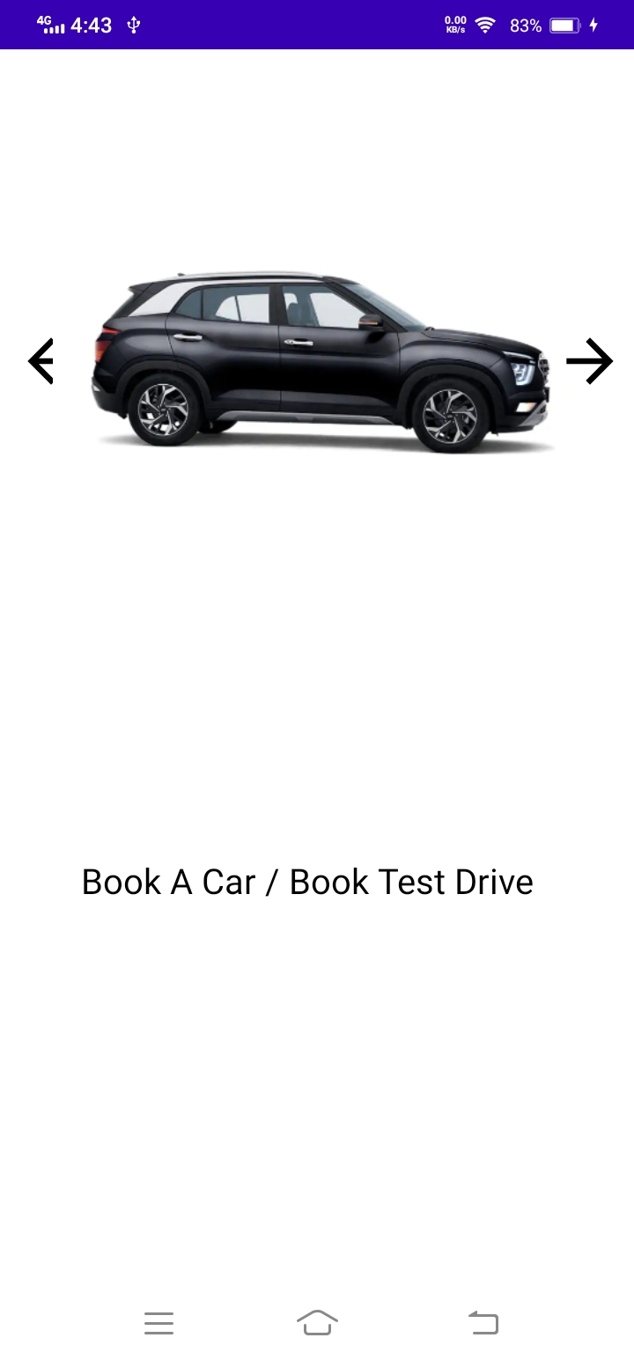
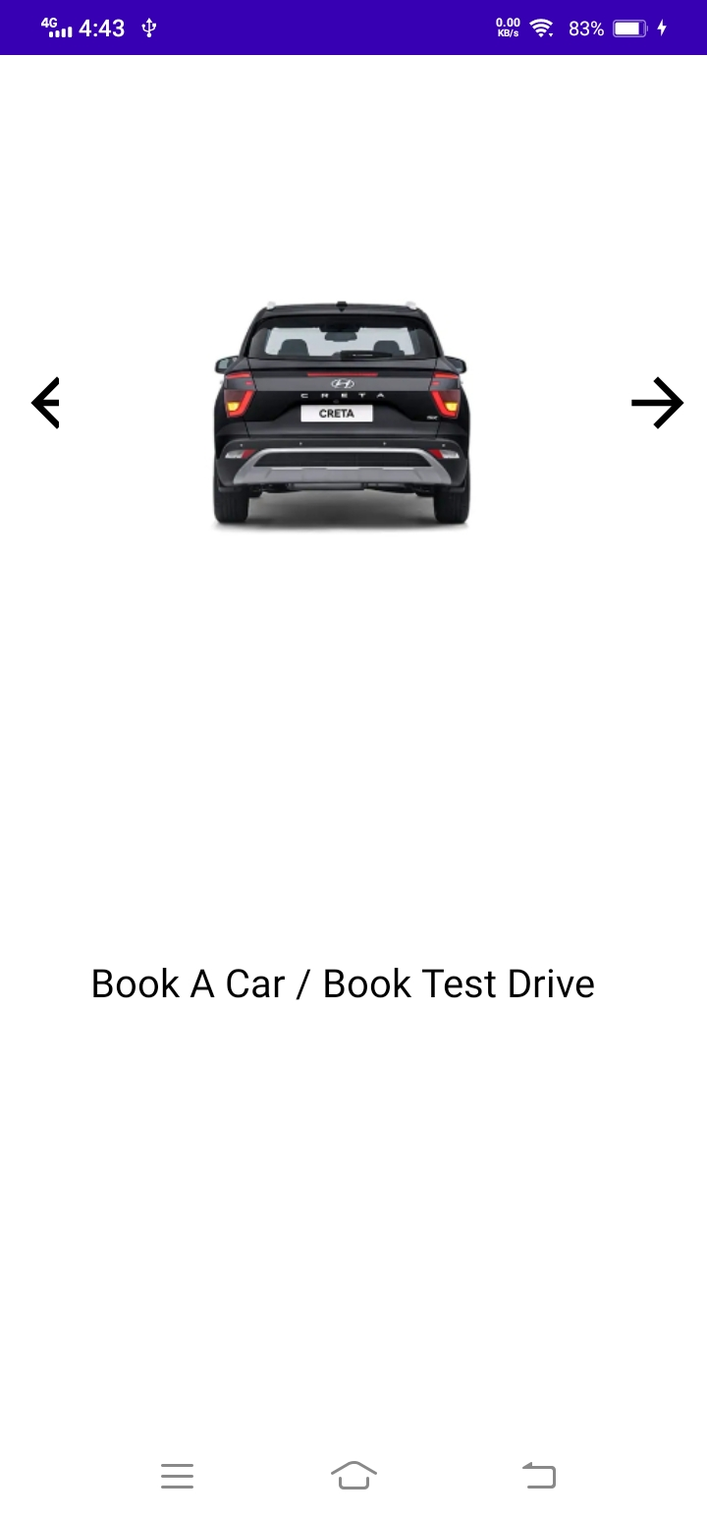
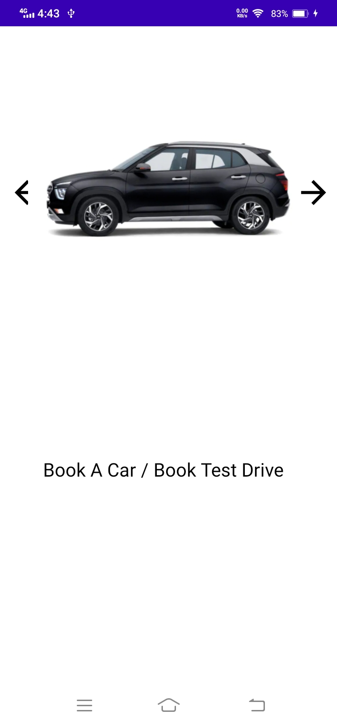
Car Details screen

Slide 16
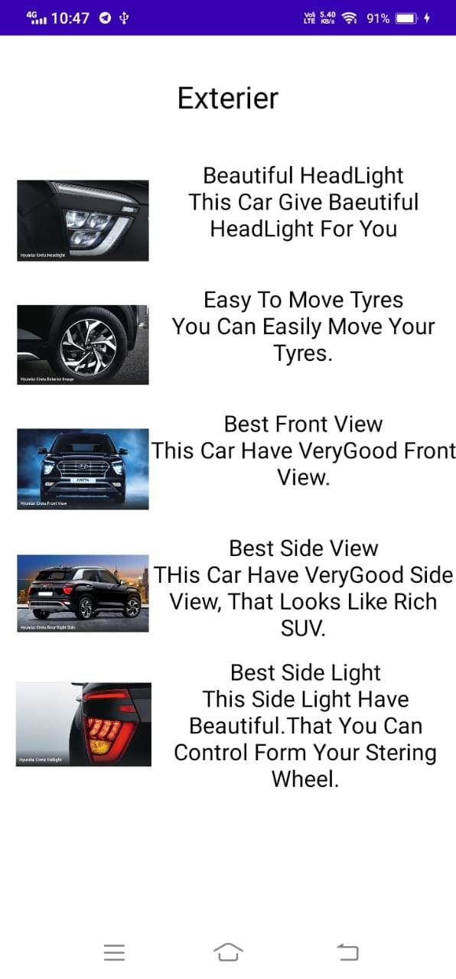
Exterior details screen
When User choose Exterior option from color selector screen, the given screen will be open which contains all information about the car exterior.
This screen also include the details of any new exterior feature if it there.

Slide 17
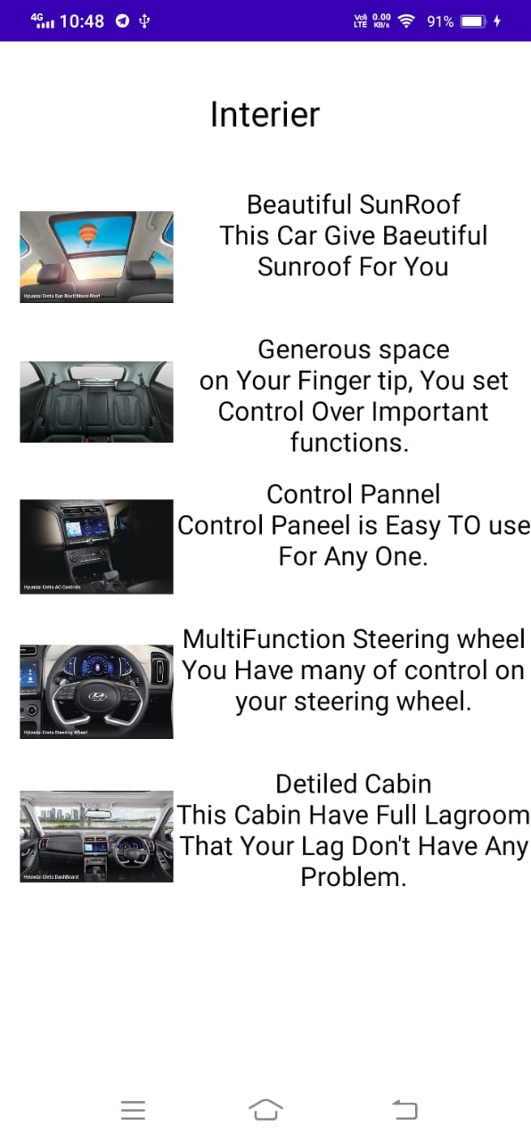
Interior details screen
When User choose Interior option from color selector screen, the given screen will be open which contains all information about the car Interior.
This screen also include the details of any new Interior feature if it there.

Slide 18
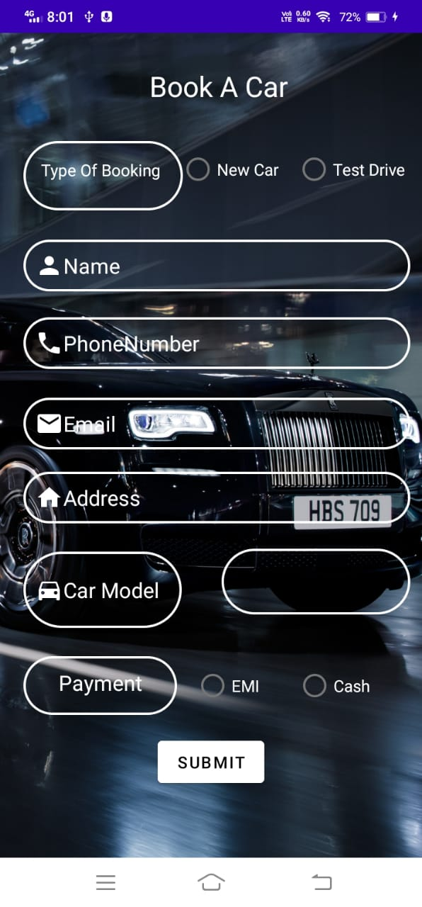
Book a car screen
When User click on Book a car from Main screen, Given screen will be open.
There is a form which get user’s information as well as information about the car for which he/she wants to request a test drive or book a car
On this screen there is two radio button available.
1. Test drive
2. Book Car
User have to select one option according to their requirement.

Slide 19
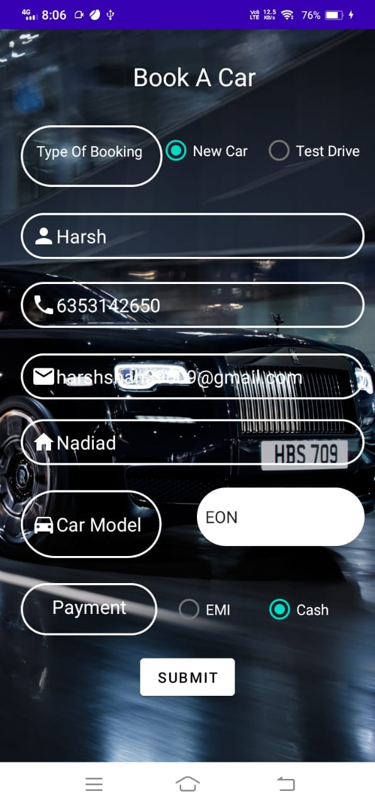
Book a car screen
When User enter data then we will verify phone number and email as entered at register screen.

Slide 20
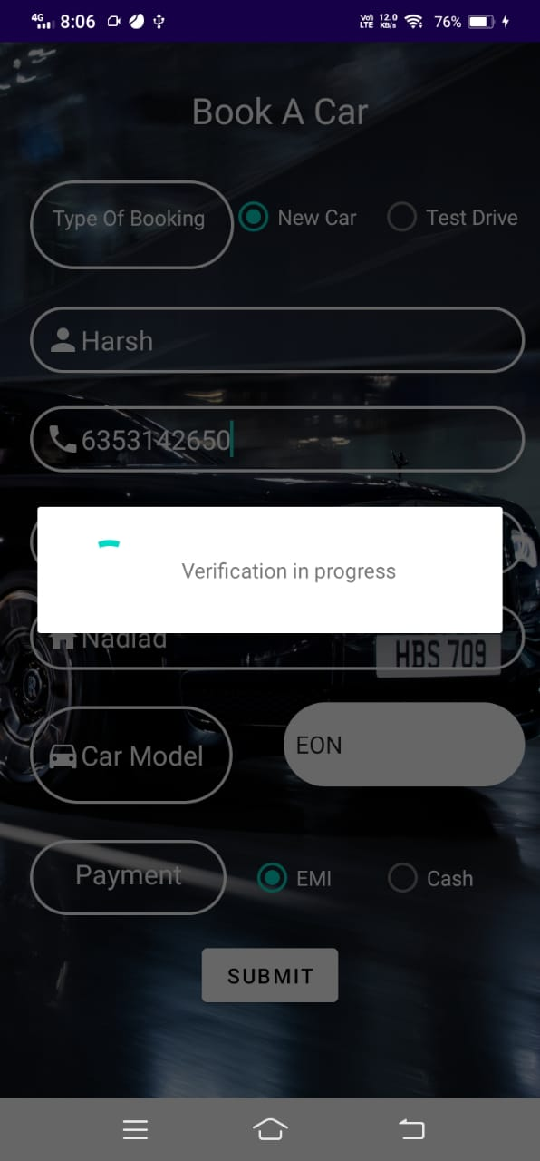

Book a car screen
After click on submit button it will take while to processing.
As shown in this screen.
When all details are correct then user get message as shown in red circle.
Message is “Booking Completed”

Slide 21
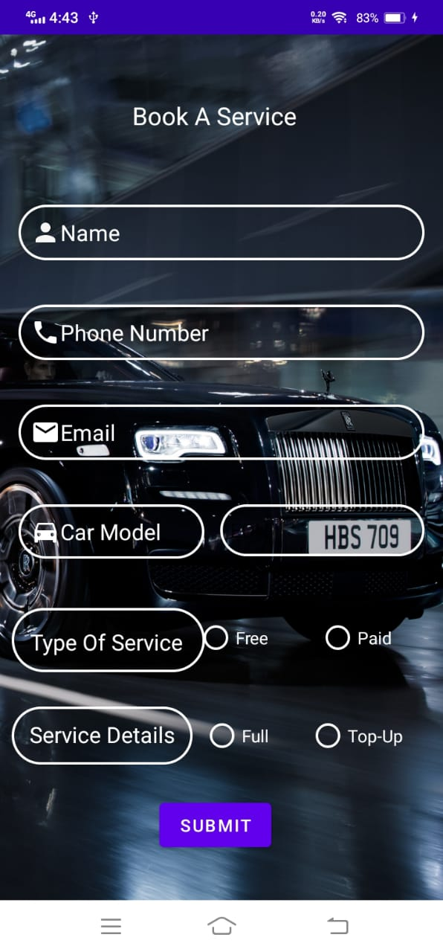
Book a Service screen
When User click on Book a Service from Main screen, Given screen will be open.
There is a form which get user’s information as well as information about the service of car.
On this screen there is two types of service available.
1. Paid
2. Free
Two more radio buttons are available that shows two types of service
1. Top up service
2. Full service
User have to select one option according to their requirement.

Slide 22
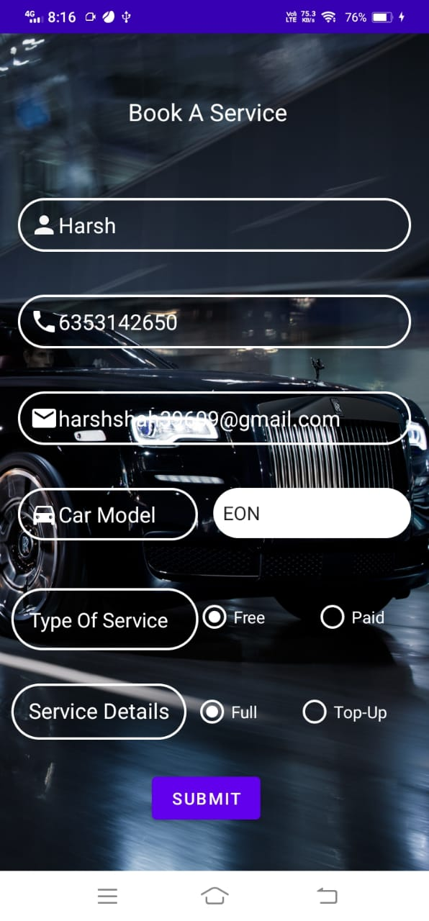
Book a Service screen
When User enter data then we will verify phone number and email as entered at register screen.
Here selected type of service is “Free” and service details is “Full”.

Slide 23
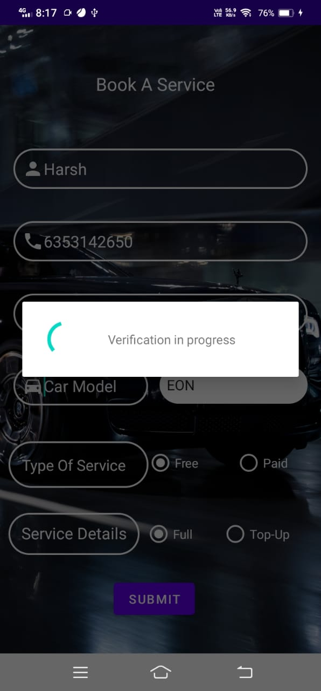

Book a Service screen
After click on submit button it will take while to processing.
As shown in this screen.
When all details are correct then user get message as shown in red circle.
Message is “Service Booked”

Slide 24
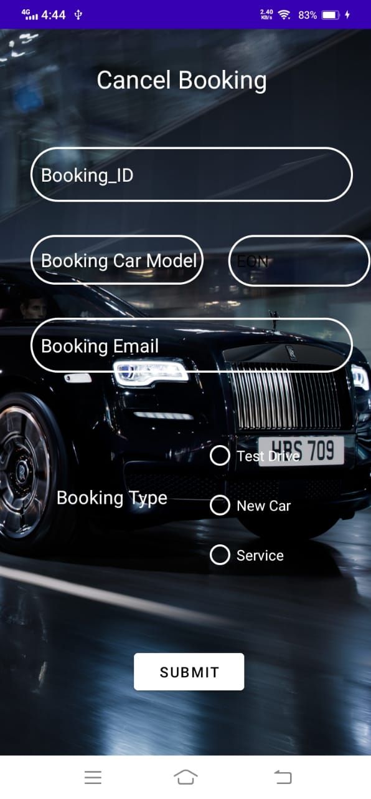
Cancel Booking screen
When User click on cancel booking from Main screen, Given screen will be open.
There is a form which get information as about the car for which he/she wants to cancel.
On this screen there is three radio button available.
1. Test drive
2. New Car
3. Service
User have to select one that he/she wants to cancel.
Booking id, Booked model and email is required for cancel booking.

Slide 25
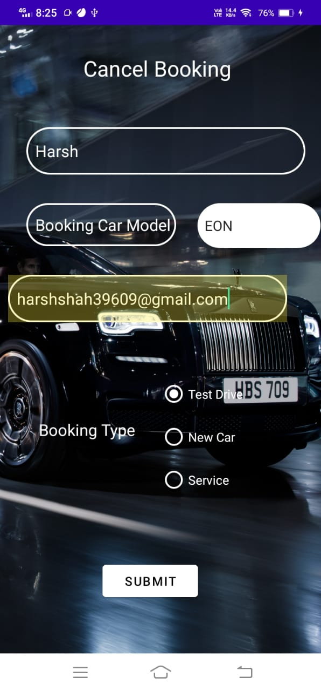
Cancel Booking screen
When User enter data then we will verify username, model and email as entered at book screen.
User have to select the type from shown three option.
1.Test drive
2.New car
3.service
Here selected type of cancel booking is “Test drive”.

Slide 26
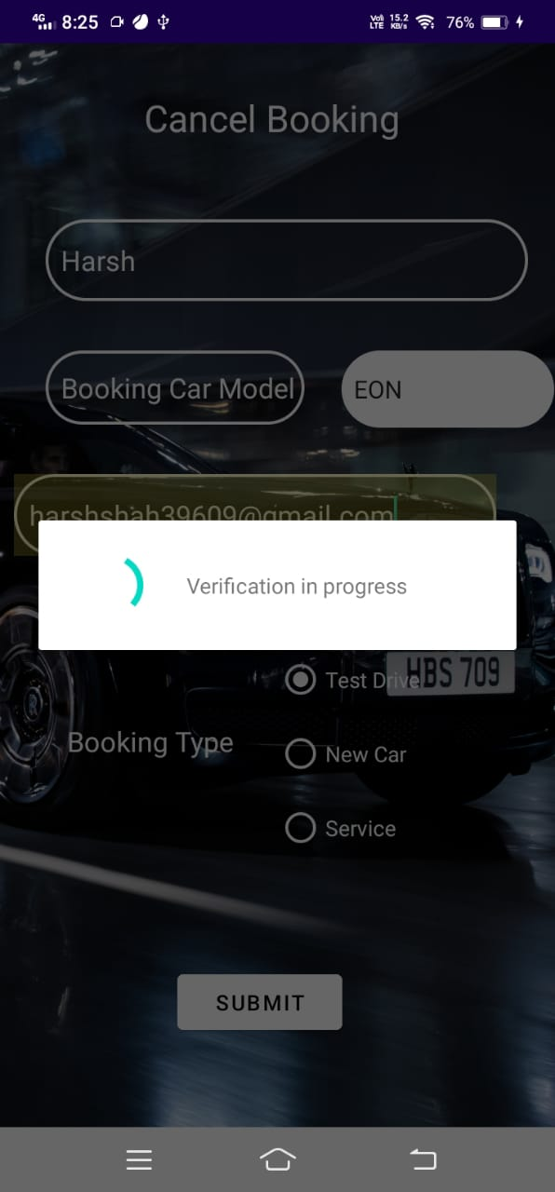

Cancel Booking screen
After click on submit button it will take while to processing.
As shown in this screen.
When all details are correct then user get message as shown in red circle.
Message is “Booking cancelled”

Slide 27
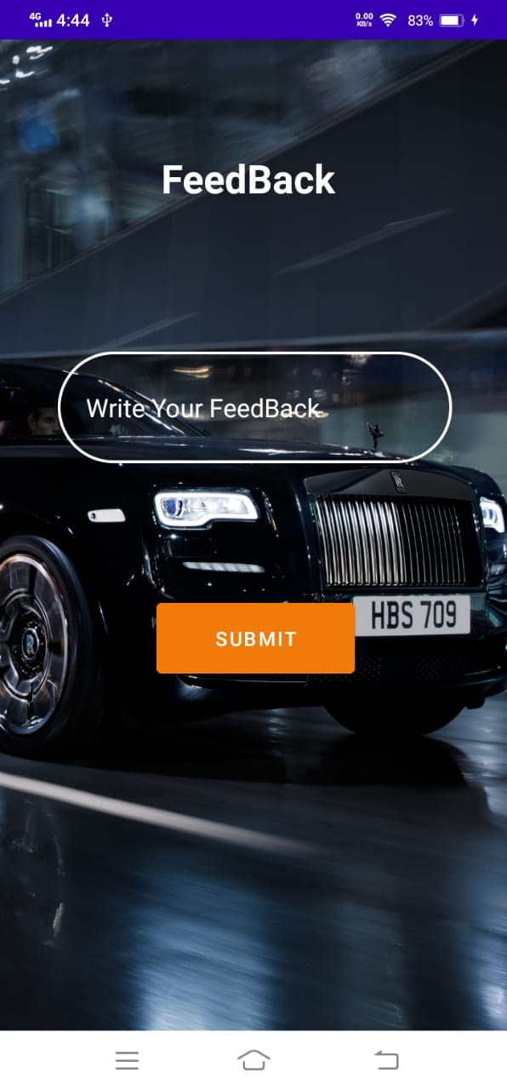
Feed Back screen
When User click on feedback from Main screen, Given screen will be open.
In This screen ,User can send feedback.
User can write feedback in given box and then click on the send button
Feedback will be stored in database.

Slide 28
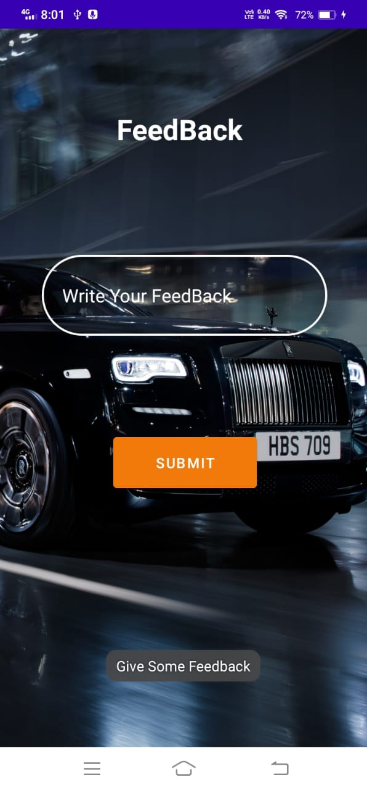
Feed Back screen
You’ll get message if you don’t write any thing and click on the Submit Button
Message is “Give some Feedback” as shown in red circle.

Slide 29
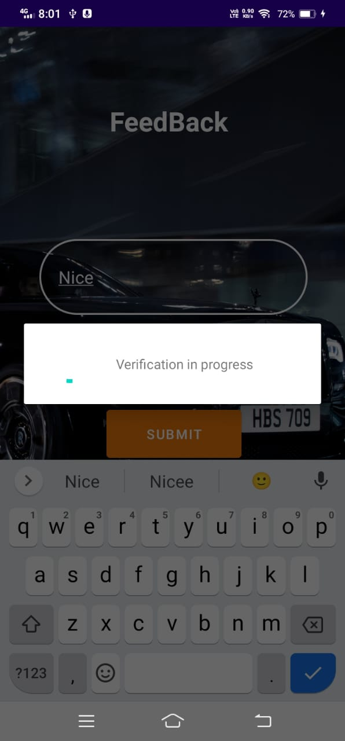
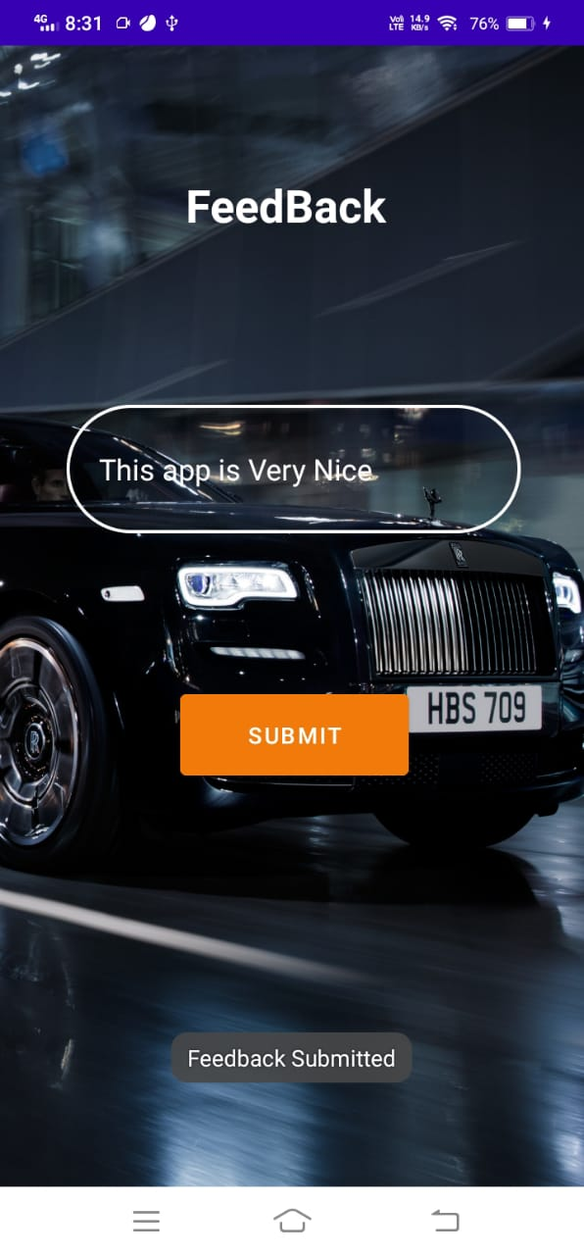
Feed Back screen
After click on submit button it will take while to processing.
As shown in this screen.
After feedback taken user will get message as shown in red circle.
Message is “Service Booked”

Slide 30
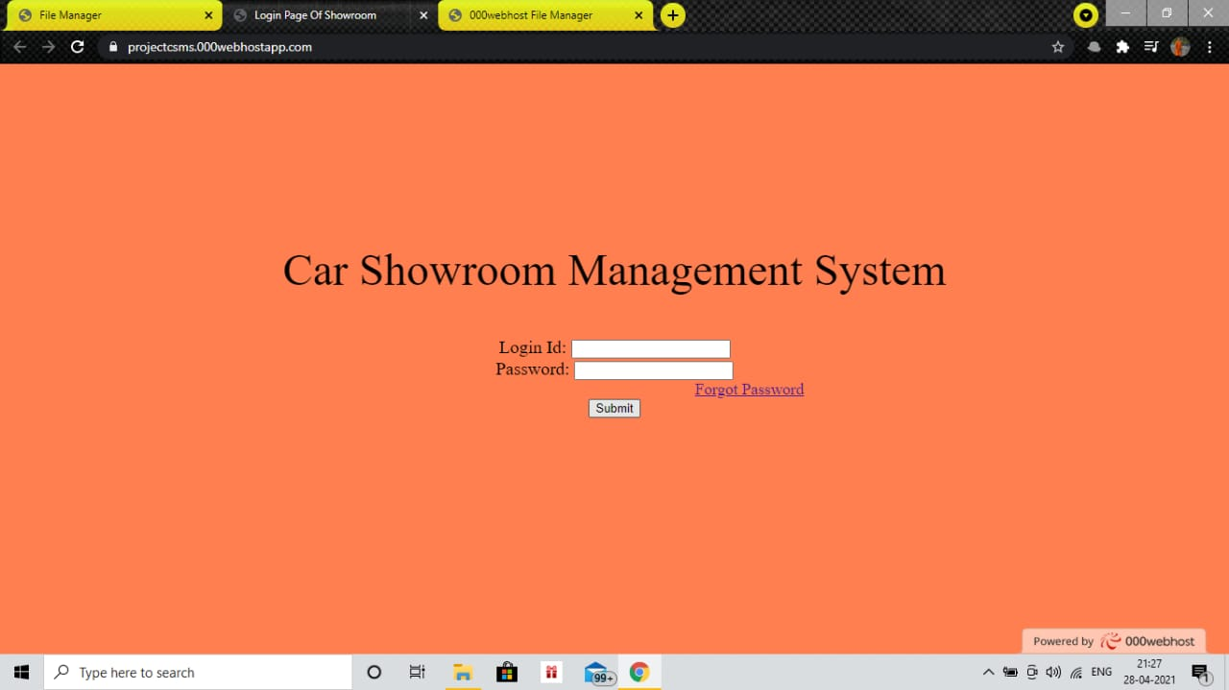
Admin Login screen
Here, Admin can log in to add new car to the application.
Also admin can see the reports like booked car Details, Booked service details, booked test drive details and feedback of users.

Slide 31
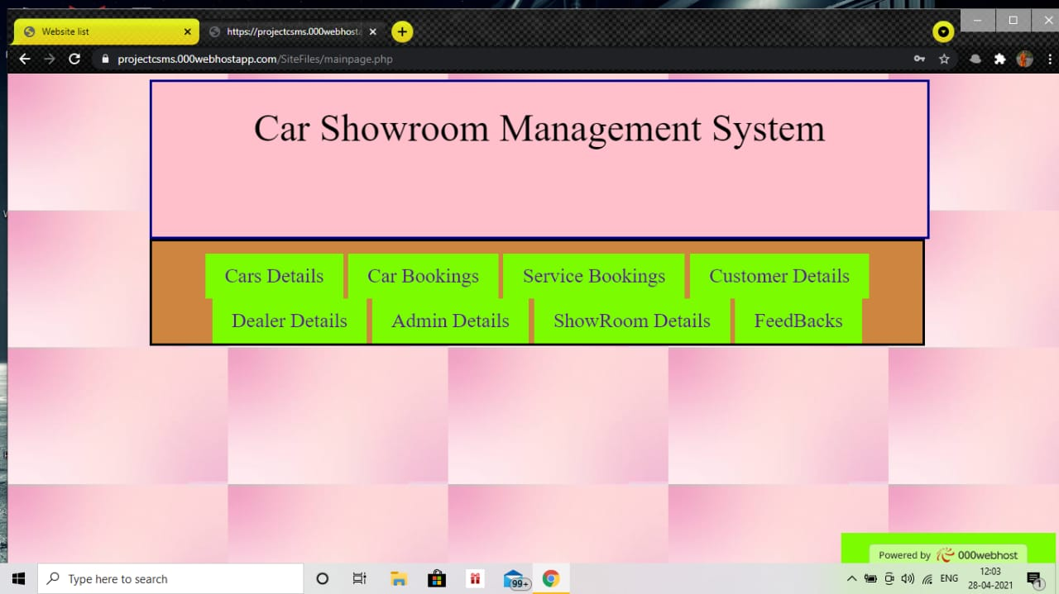
Option Selector
From this window, Admin can select option what he/she want to do.
If admin want to add new car to application, he/she will click add new car.
Same for other options.

Slide 32
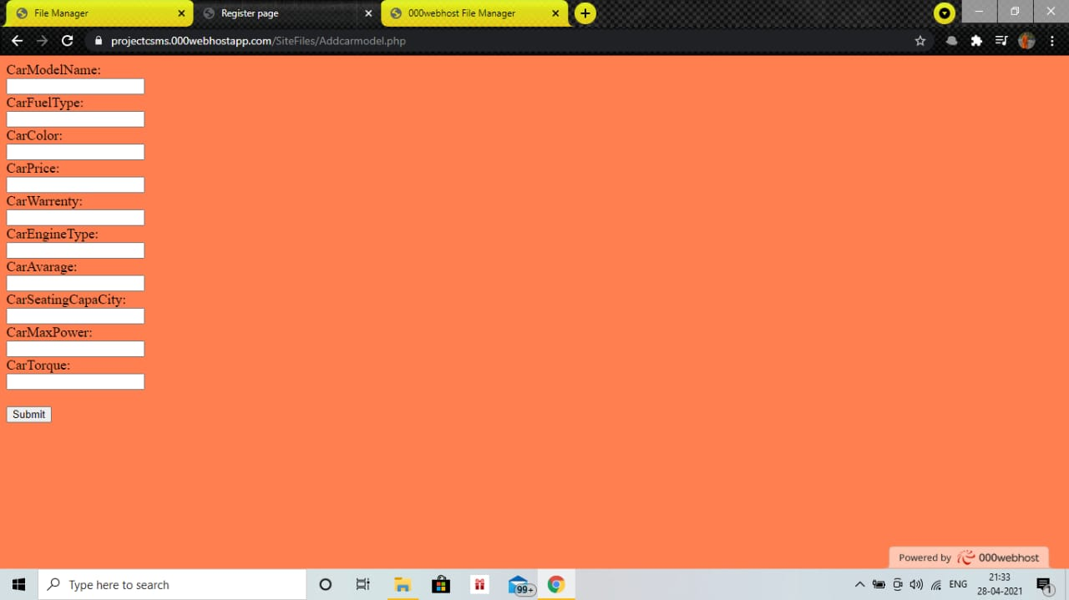
Add new car screen

Slide 33
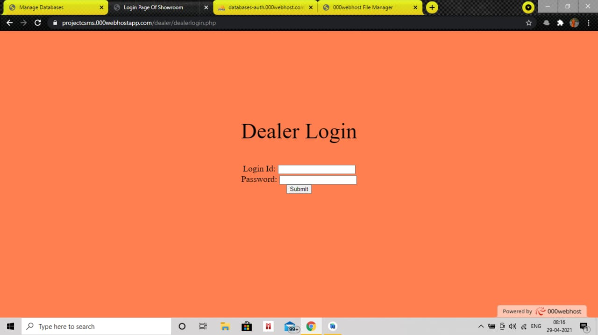
Dealer Login screen

Slide 34
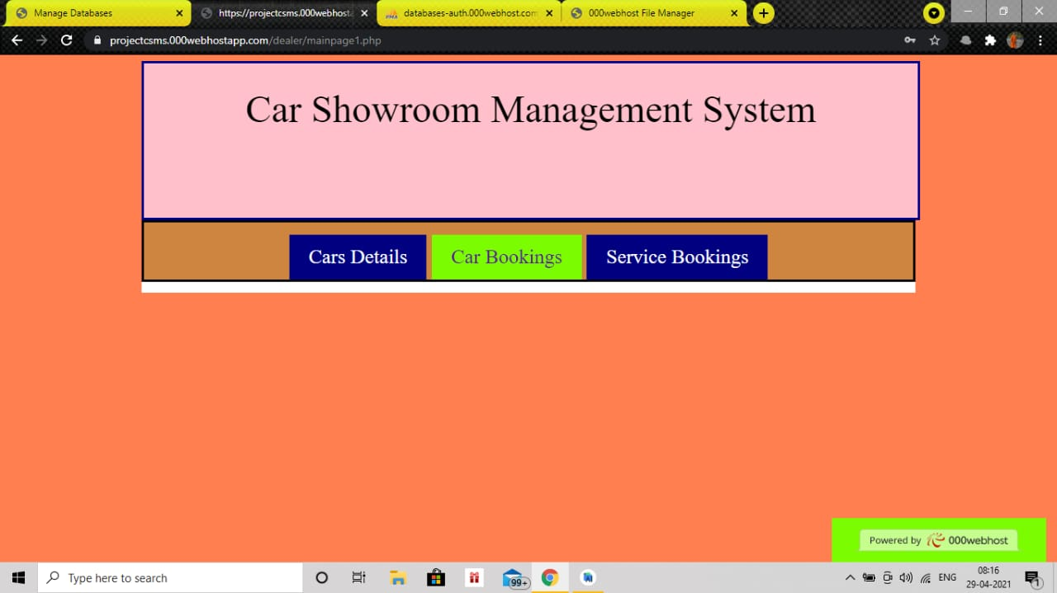
Dealer Login screen

Slide 35
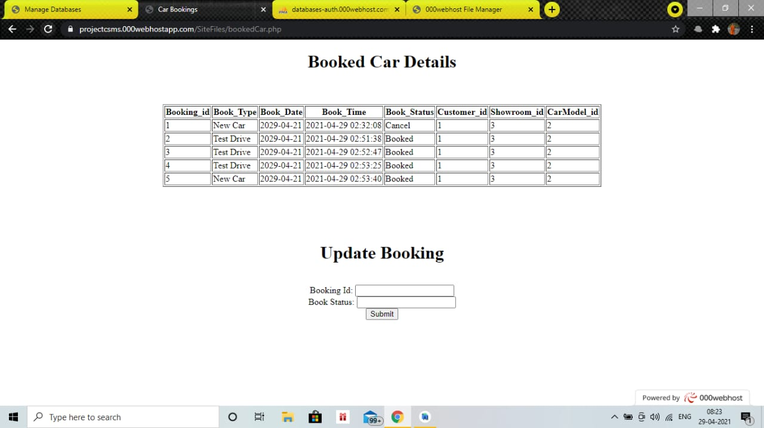
Reports Generated from system

Slide 36
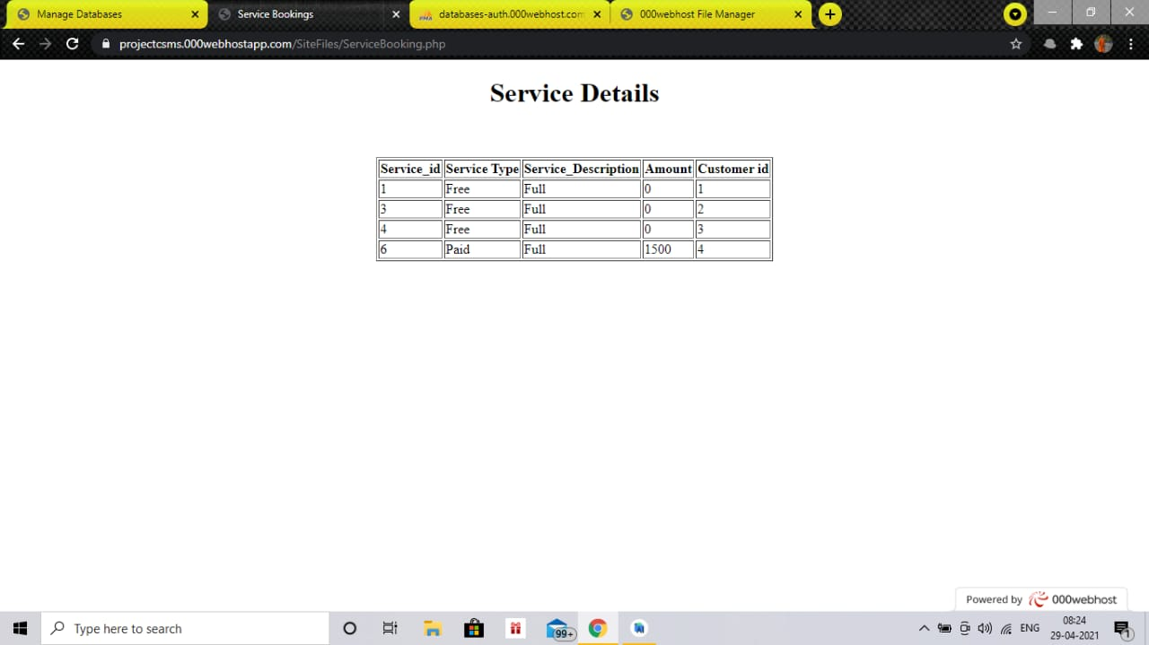
Reports Generated from system

Slide 37
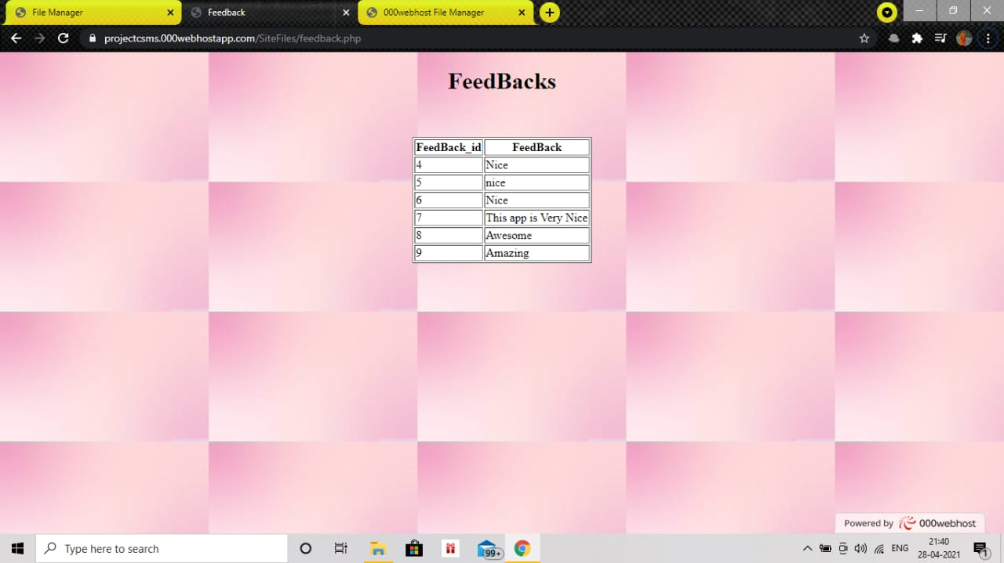
Reports Generated from system

Slide 38
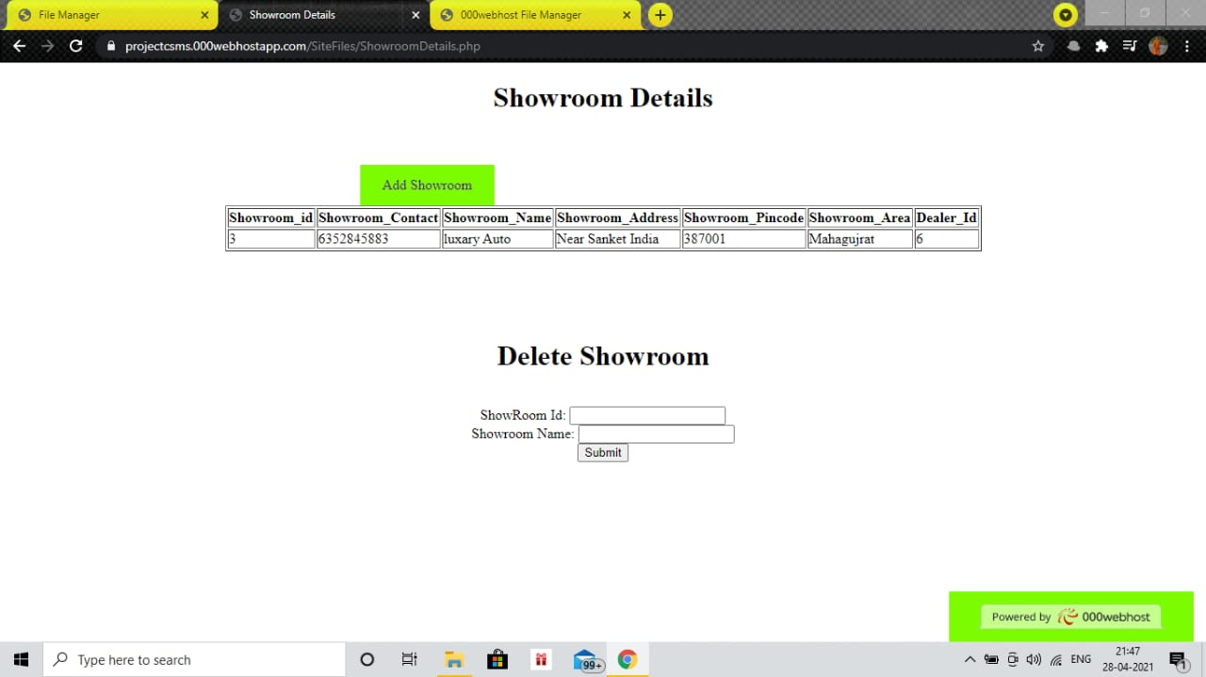
Showroom details screen
Same for car details and dealer

Slide 39
Reports generated from system screen
Positive – Negative testing
Test cases from main screen
Current Status | Input | Expected Output | Actual Output | Result
Main Screen | Click on car details | Open screen of Car details | Open screen of Car details | Correct
Main Screen | Click on Book A Car | Open screen of Book A Car | Open screen of Book A Car | Correct
Main Screen | Click on Book A Service | Open screen of Service Booking | Open screen of Service Booking | Correct
Main Screen | Click on cancel A Booking | Open screen of Cancel a Booking | Open screen of Cancel a Booking | Correct
Main Screen | Click on feedback | Open screen of feedback | Open screen of feedback | Correct

Slide 40
Test cases for my showroom
Current Status | Input | Expected Output | Actual Output | Result
Car details | Click On alto | Open Color selector of eon | Open Color selector of eon | Correct
Car details | Click On swift | Open Color selector of swift | Open Color selector of swift | Correct
Car details | Click On creta | Open Color selector of creta | Open Color selector of creta | Correct
Car details | Click On i20 | Open Color selector of i20 | Open Color selector of i20 | Correct
Car details | Click On harrier | Open Color selector of harrier | Open Color selector of harrier | Correct
Car details | Click On tiago | Open Color selector of tiago | Open Color selector of tiago | Correct
Car details | Click On scorpio | Open Color selector of scorpio | Open Color selector of scorpio | Correct
Car details | Click On xuv | Open Color selector of xuv | Open Color selector of xuv | Correct
Car details | Click On kwid | Open Color selector of kwid | Open Color selector of kwid | Correct
Car details | Click On duster | Open Color selector of duster | Open Color selector screen of duster | correct

Slide 41
Test cases for color selector screen
Current Status | Input | Expected Output | Actual Output | Result
Color Selector Screen | Select any Color | Selected Color is Open | Selected Color is not open | Incorrect (Fixed)
Color Selector Screen | Select Exterior Details | Exterior Details is Open | Exterior Details is Open | correct
Color Selector Screen | Select Interior Details | Interior Details is Open | Interior Details is Open | correct
Color Selector Screen | Click on Book a Car | Scree of Book a car is open | Scree of Book a car is not open | Incorrect (Fixed)

Slide 42
Test cases for Book a car
Current Status | Input | Expected Output | Actual Output | Result
Book A Car Screen | Insert First Name | The Data is inserted | The Data is inserted | Correct
Book A Car Screen | Insert Email i.e. abc@gmail.com | The Data is inserted | The Data is inserted if satisfy validation otherwise it will give an error | correct
Book A Car Screen | Insert Phone Number i.e.1234567890 | The Data is inserted | The Data is inserted if satisfy validation otherwise it will give an error | correct
Book A Car Screen | Insert Vehicle Name | The Data is inserted | The Data will be inserted | correct
Book A Car Screen | Select book type Book car/Test drive | The Data is inserted | The Data is inserted | correct
Book A Car Screen | Click on Book Button | The Data is stored in DB if all Field are filled up | The Data is not stored in DB if all Field are filled up | Incorrect (Fixed)
Book A Car Screen | Select payment type | The Data is inserted | The Data is inserted | correct

Slide 43
Test cases for Book a service
Current Status | Input | Expected Output | Actual Output | Result
Screen of Book A Service | Insert First Name | The Data is inserted | The Data is inserted | Correct
Screen of Book A Service | Insert Email i.e. abc@gmail.com | The Data is inserted | The Data is inserted if satisfy validation otherwise it will give an error | correct
Screen of Book A Service | Insert Phone Number i.e.1234567890 | The Data is inserted | The Data is inserted if satisfy validation otherwise it will give an error | correct
Screen of Book A Service | Insert Interested Model Name | The Data is inserted | The Data will be inserted | correct
Screen of Book A Service | Select service type | The Data is inserted | The Data is inserted | correct
Screen of Book A Service | Select payment type | The Data is inserted | The Data is inserted | correct
Screen of Book A Service | Click on Book Button | The Data is stored in DB if all Field are filled up | The Data is not stored in DB if all Field are filled up | Incorrect (Fixed)

Slide 44
Test cases for Feedback
Current Status | Input | Expected Output | Actual Output | Result
feedback Screen | Insert Feedback | The Data is inserted | The Data is inserted | Correct

Slide 45
Bibliography
• Database Management System, Bharat V.Chawda
• Advance Management System, Bharat V. Chawda
• Fundamental of software engineering, Rajib mall
• Advance Data base Management System
• Mobile computing and development, J. B. Patel
• Advance java programming
Website:
www.computerscienceknowledge.com
Android App Development Fundamentals for Beginners ...
Android Tutorial - Tutorialspoint Android Connect MySQL Database Programmatically ...

Slide 46
Future work in this application
Forgot password ( OTP Section )
About payment ( currently radio buttons are available but try to make it update and complete.

Slide 47
Learning during project
Team work
Divide work when you are confused.
Interaction with team member is needed.
Be helpful to each other
Motivate to each other when you can’t understand what to do.
Learning coding in android studio.
Never open your code in another version of android software instead of current working.
Always store your work in pen drive or keep another copy of it.

Slide 48
Thank you

