Slide 1
CSE 5330
Project Presentation
Team 03
Kushal Shah (1002117623)
Harsh Shah (1002057387)
Shivang Khatri(1002117821)
Alishbah Fahad (1001924185)

Slide 2
Project
Title
Food Wastage Management System
Problem
Large amounts of food are wasted in homes and restaurants, contributing to the unequal distribution of food.
Solution
Our system allows individuals and restaurants to donate their leftover food to nearby NGOs through a delivery person, reducing waste and helping those in need.
Features
Users (individuals and restaurants) can place orders to donate excess food to NGOs
Delivery persons pick up orders and deliver them to the nearest NGO based on zip code
Delivery persons rate the quality of the donated food
NGOs pay commission to system owner via cash or card
System tracks user information, food donations, orders, delivery persons, payments, ratings, and NGOs

Slide 3
Benefits
Promotes sustainable food consumption practices: The project encourages sustainable food consumption practices by offering an alternative to traditional food purchasing methods and providing affordable access to healthy food options.
Supports local communities: The project helps to support local communities by providing a platform for small businesses and local food providers to connect with consumers, creating a more sustainable and equitable food system.
Alleviates food insecurity: By providing affordable access to healthy food options, the project helps to alleviate food insecurity and improve food access for underserved communities.
Raises awareness and educates consumers: The project can help to raise awareness and educate consumers about the issue of food waste, inspiring them to make more sustainable choices in their everyday lives.

Slide 4
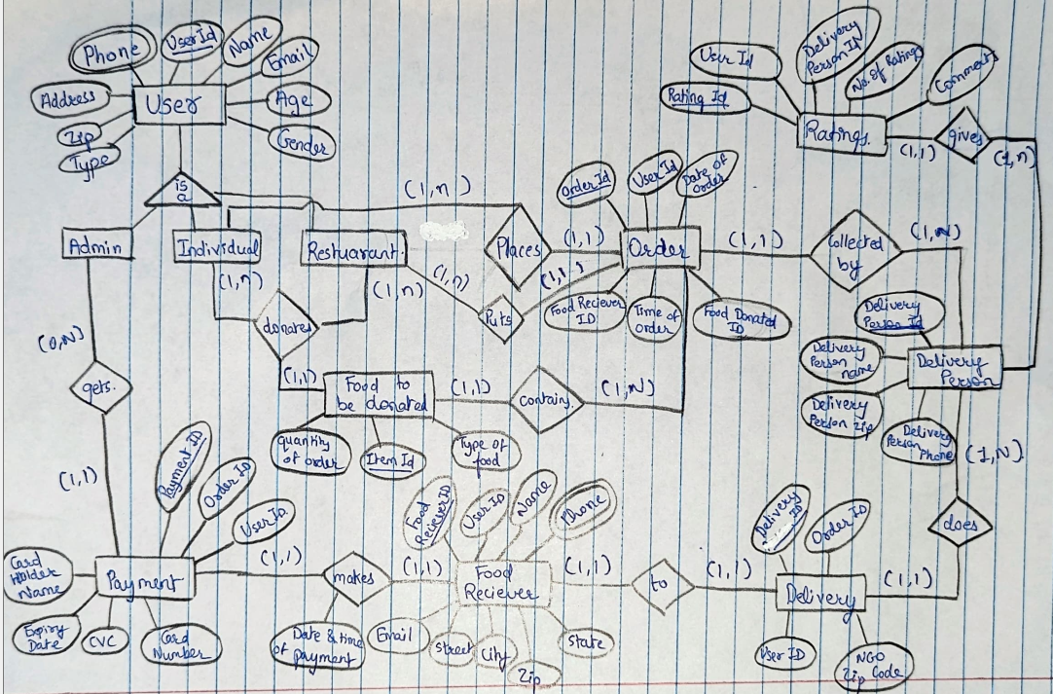
EER Diagram

Slide 5
EER Diagram
User: This entity represents the user of the system and stores their personal information such as name, email, address, age, gender, and type (individual or restaurant).
Admin: This entity represents the administrator of the system.
Individual: This entity represents individual users who are not associated with a restaurant.
Restaurant: This entity represents the restaurants that are registered with the system.
Order: This entity represents the order placed by a user and includes information such as order id, user id, date and time of order, food receiver id, food donated id, delivery person id, individual id, and restaurant id.
Ratings: This entity stores the ratings and comments given by delivery persons for users.
Delivery Person: This entity stores information about the delivery persons, including their name, phone number, zip code, and delivery person id.
Food to be Donated: This entity stores information about the food items that are available for donation, including the item id, quantity of order, type of order, and order id.
Payment: This entity stores the payment information for an order, including the payment id, order id, card number, CVC, expiry date, cardholder name, and food receiver id.
Food Receiver: This entity represents the receiver of the donated food items and stores their personal information, including name, email, address, zip code, and phone number.
Delivery: This entity represents the delivery of food items and includes information such as delivery id, delivery person id, order id, user id, NGO zip code, and food receiver id.

Slide 6
Description of Tables
USER_ADDRESS: ROWS: 50
USER: ROWS: 50
USER_PHONE: ROWS: 50
ADMIN: ROWS: 4
ADDRESS | ZIP
USER_ID | NAME | TYPE | ADDRESS | AGE | GENDER | CITY | EMAIL
USER_ID | PHONE
USER_ID

Slide 7
Description of Tables
INDIVIDUAL: ROWS: 29
RESTAURANT: ROWS: 17
CARD_DETAILS: ROWS: 44
FOOD_RECEIVER: ROWS: 50
USER_ID
USER_ID
CARD_NUMBER | CVC | EXPIRY_DATE | CARD_HOLDER_NAME
FOOD_RECEIVER_ID | USER_ID | EMAIL | NAME | STREET | ZIP
STATE | CITY

Slide 8
Description of Tables
FOOD_RECEIVER_PHONE: ROWS: 50
FOOD_RECEIVER_ZIP: ROWS: 50
DELIVERY_PERSON: ROWS: 50
RATINGS: ROWS: 50
FOOD _RECEIVER_ID | PHONE
NGO_ZIP | FOOD_RECEIVER_ID
DP_ID | DP_NAME | DP_ZIP | DP_PHONE
RATING_ID | USER_ID | DP_ID | NO_OF_RATINGS | COMMENTS

Slide 9
Description of Tables
ORDER: ROWS: 50
FOOD_TO_BE_DONATED: ROWS: 50
PAYMENT: ROWS: 50
DELIVERY: ROWS: 50
ORDER_ID | USER_ID | DATE_OF_ORDER | FOOD_RECEIVER_ID | TIME_OF_ORDER
DP_ID | INDIVIDUAL_ID | RESTAURANT_ID
FD_ID | QUANTITY | TYPE OF FOOD | ORDER_ID
PAYMENT_ID | ORDER_ID | USER_ID | CARD_NO | CVC | EXPIRY_DATE
DELIVERY_ID | DP_ID | ORDER_ID | USER_ID | FOOD_RECEIVER_ID
NGO_ZIP_CODE

Slide 10
Description of Tables
DONATES: ROWS: 50
USER_ID | FOOD_TO_BE_DONATED_ID

Slide 11
Project Goal
Did you meet all your business goals?
We tried our fullest to implement all the business goals and we almost achieved it.
Our few interesting business goals:
Goal 1: Find the average age of individual users who have placed at least 2 orders
Goal 2: Find the total number of orders made in each city

Slide 12
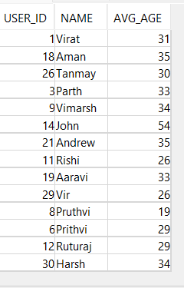
Project Goal
Find the average age of individual users who have placed at least 2 orders
SELECT i.USER_ID, u.NAME, AVG(u.AGE) as AVG_AGE
FROM Spring23_S003_3_USER u
JOIN Spring23_S003_3_INDIVIDUAL i ON u.USER_ID = i.USER_ID
JOIN Spring23_S003_3_ORDER o ON u.USER_ID = o.USER_ID
GROUP BY i.USER_ID, u.NAME
HAVING COUNT(*) >= 2;

Slide 13
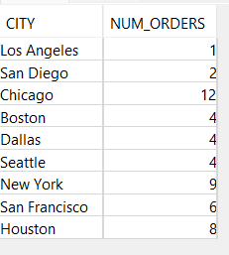
Project Goal
Find the total number of orders made in each city
SELECT u.CITY, COUNT(*) AS num_orders
FROM Spring23_S003_3_ORDER o
JOIN Spring23_S003_3_FOOD_RECEIVER f ON o.FOOD_RECEIVER_ID = f.FOOD_RECEIVER_ID
JOIN Spring23_S003_3_USER u ON f.USER_ID = u.USER_ID
GROUP BY u.CITY;

Slide 14
Project Takeaway
If done in a team, how did you manage the tasks and time?
All team members worked together and with each other’s co-operation.
Which phase(s) of the project was (were) difficult and why?
Phase 4 (ad-hoc queries, cube, roll up etc.)
Phase 1 (Requirement analysis, finding real world problem and its solution)
If you are asked to redo this project, what will you change in the approach you followed?
Change: We would like to add some time-based constraints that we had thought of, would like to optimize our query.

Slide 15
Project Takeaway
Are you happy with what you have developed?
Yes, of course. We tried our fullest to implement all the requirements that were given in all the phases.
Project showcasing our Database skills.
The goal of this project is to achieve the objective of creating a centralized database where we can store food which is donated to NGO.
This project will strengthen our resume.
Do you think this will add strength to your resume?
Definitely, We think this project will strengthen our resume. Project showcasing our Database skills.

Slide 16
Project Takeaway
What was your takeaway from the project that you think may help you in future?
We got one project to add on resume. Project showcasing our Database skills.
Building application from scratch. Built it from the phase of requirement gathering with business owner’s perspective to the delivery phase of project.
We understood how to do synchronized project development with other members of team.
We are content with what we have accomplished so far.

Slide 17
Discussion

