Slide 1

CA-3 | Agentic AI Proof of Concept
Model Drift Watchdog
An Agentic AI System That Detects, Decides, Validates & Acts When ML Models Go Stale
Domain: MLOps · Credit Risk in Digital Lending
Harsh Sharma
PRN 24070126067
Symbiosis Institute of Technology, Pune

Slide 2

Presenter: Harsh
ML Models Fail Silently
• Models trained on past data; real-world data changes
• Incomes rise, new customer types appear, pipelines break
• Model keeps running but makes worse decisions
• Risky loans approved; good customers rejected in lending
• Loan defaults known months later → losses discovered too late
Training Data
Today’s Data
Data Drift = the input data in production no longer looks like the training data
Model Drift Watchdog | CA-3 Agentic AI PoC
Harsh Sharma & Divyansh Agarwal
2

Slide 3
Presenter: Harsh
Why MLOps in Lending?
₹↓
◷
◇
High Financial Stakes
Label Delay
Regulatory Risk
Every wrong prediction is a bad loan or a lost customer
True outcomes arrive months later; input monitoring is the only early signal
Lenders must explain and audit automated credit decisions
Monitoring is a real, everyday pain point for ML teams in industry.
Model Drift Watchdog | CA-3 Agentic AI PoC
Harsh Sharma & Divyansh Agarwal
3

Slide 4
Presenter: Harsh
From Manual Checks to Agentic Monitoring
Today (Manual) ×
With Model Drift Watchdog ✓
Frequency
× Monthly / ad-hoc notebook checks
✓ Every new data batch, automatically
Detection
× Noticed after losses appear
✓ Caught early from input-data drift
Root cause
× Engineers investigate by hand
✓ Agents separate real drift from broken pipelines
Decision
× Gut feeling, inconsistent
✓ Policy-based, validated by a Critic agent
Retraining
× Manual and risky
✓ Old vs new model comparison + human approval
Reporting
× None or informal
✓ Auto-generated report and alert
Result: faster detection · consistent decisions · fewer false alarms · full audit trail
Model Drift Watchdog | CA-3 Agentic AI PoC
Harsh Sharma & Divyansh Agarwal
4

Slide 5
6 Agents + 1 Human, One Mission
Presenter: Harsh
▣
PLANNER AGENT
⌕
DATA PROFILER
⌁
DRIFT DETECTOR
Planner
Research
Executor
Builds a task plan from the data; re-plans if data is bad
Checks schema, missing values, sample size, statistics
Runs KS, Chi-square & PSI tests on every feature
⑂
DECISION AGENT
◇
CRITIC AGENT
▤
REPORTER / ACTION
Business Automation
Critic
Executor
Applies policy: No Action / Alert / Retrain / Fix Pipeline
Validates evidence and decision; triggers retries or escalation
Writes report & alert; retrains and compares models
HUMAN APPROVER ◉ Final sign-off before any new model is deployed
Model Drift Watchdog | CA-3 Agentic AI PoC
Harsh Sharma & Divyansh Agarwal
5

Slide 6
System Architecture
Presenter: Harsh
Streamlit UI
Pick scenario · Run watchdog · View trace · Approve
request + new data batch
DATA
reference.csv (training data)
production batch (per scenario)
champion model
Planner Agent — Labels present? Feature types? → Task plan
TOOLS
pandas · NumPy
SciPy (KS, Chi²) · PSI
scikit-learn · Plotly
LangGraph
Ollama / Mock LLM
Missing >10% / schema error
RE-PLAN → Fix Pipeline
Data Profiler — Schema · Missing values · Sample size
data OK
Drift Detector — KS · Chi² · PSI · Prediction drift · Accuracy (if labels)
Decision Agent
No Action · Alert · Retrain · Fix Pipeline
Critic Agent ◇ — Retry (max 2) · Still failing → Escalate to Human
Reporter / Action Agent — Report · Alert · Retrain challenger · Champion vs Challenger (AUC)
Human Approval — Deploy new model / Close incident
Orchestrated with LangGraph: shared state + conditional edges for re-planning, retries and escalation
Model Drift Watchdog | CA-3 Agentic AI PoC
Harsh Sharma & Divyansh Agarwal
6

Slide 7
How the Agents Decide — and Double-Check
Presenter: Divyansh
Decision Policy
Critic Checks
PSI < 0.10 Stable | 0.10–0.25 Moderate | > 0.25 Major | p-value < 0.05 = Drift
◇ Sample size < 500 → Profiler uses a larger window
◇ KS & PSI disagree → Detector re-checks with bootstrap
◇ Decision breaks policy → Decision agent revises
◇ Still failing after 2 retries → Escalate to human
◇ New model deployed only if AUC improves ≥ 0.01 AND human approves
FIX PIPELINE Missing values > 10% or schema mismatch
RETRAIN Major drift on a critical feature, prediction PSI > 0.25, or accuracy drop > 5 pts
ALERT Moderate drift, or major drift on a non-critical feature
NO ACTION Everything stable
Critical features: credit_score, monthly_income, loan_amount, employment_type
Design principle: Decisions come from statistics and rules (auditable & repeatable). The LLM only explains them in plain English.
Model Drift Watchdog | CA-3 Agentic AI PoC
Harsh Sharma & Divyansh Agarwal
7

Slide 8
4 Synthetic Scenarios We Test
Presenter: Divyansh
Synthetic loan data: 5,000 training rows + 1,000-row production batch · Features: age, monthly income, loan amount, credit score, employment type, city tier · Target: default
Normal Week
Gradual Drift
Sudden Drift
Pipeline Bug
Injected:
Nothing changed
Injected:
Incomes up ~20%, city tier shifts
Injected:
Influx of gig workers, lower credit scores
Injected:
40% credit scores missing
Expected:
✅ No Action
Expected:
⚠️ Alert
Expected:
🔁 Retrain → Human approves
Expected:
🛠️ Fix Pipeline (NOT retrain)
Scenario 4 is the key test: a naive system would retrain on broken data — our agents don't.
Model Drift Watchdog | CA-3 Agentic AI PoC
Harsh Sharma & Divyansh Agarwal
8

Slide 9
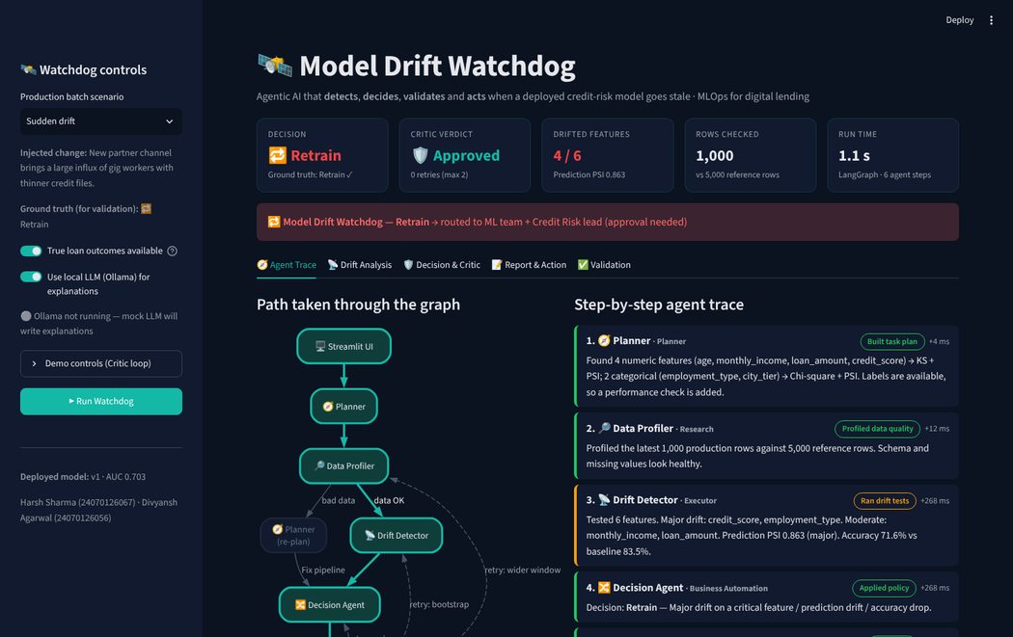
Live Demo — Streamlit PoC
Presenter: Divyansh
1 Sidebar
scenario picker · labels toggle · Ollama on/off · Run
3 Drift Analysis
reference vs production charts · PSI bars · drift table
4 Decision & Critic
triggered rule + pass/fail checklist
2 Agent Trace
step-by-step timeline of every agent, including retries
5 Report & Action
plain-English report · champion vs challenger · Approve / Reject
Demo flow: Normal Week → Sudden Drift → Pipeline Bug
Model Drift Watchdog | CA-3 Agentic AI PoC
Harsh Sharma & Divyansh Agarwal
9

Slide 10
How We Validate the Output
Presenter: Divyansh
5 Layers of Validation
Scenario | Expected | Agent Decision | Match
1 Ground truth: we know what drift was injected
2 Detection check: drifted features vs flagged features
3 Critic checks: sample size, test agreement, policy
4 Model check: challenger must beat champion on fresh data
5 Human check: nothing deploys without approval
Normal Week | No Action | No Action | ✅
Gradual Drift | Alert | Alert | ✅
Sudden Drift | Retrain | Retrain | ✅
Pipeline Bug | Fix Pipeline | Fix Pipeline | ✅
8/8 correct (incl. label delay) · Pipeline bug NOT retrained
Retrain: +0.026 AUC on fresh data · 7/7 robustness tests
Model Drift Watchdog | CA-3 Agentic AI PoC
Harsh Sharma & Divyansh Agarwal
10

Slide 11
Presenter: Divyansh
Limitations & What's Next
Limitations
Future Scope
◦ Synthetic data only
◦ Per-feature tests can miss combined (multivariate) drift
◦ Fixed thresholds, not learned
◦ Label delay not simulated
◦ Mock LLM explanations are template-based
↗ Scheduled / real-time streaming monitoring
↗ Multivariate drift detection (classifier-based)
↗ MLflow model registry integration
↗ Slack / email alerts via MCP
↗ Canary rollout of new models & adaptive thresholds
Model Drift Watchdog | CA-3 Agentic AI PoC
Harsh Sharma & Divyansh Agarwal
11

Slide 12
Thank You
Questions?
Model Drift Watchdog — Detect · Decide · Validate · Act
Harsh Sharma (24070126067) · Divyansh Agarwal (24070126056)
Symbiosis Institute of Technology, Pune

