Slide 1
Project 2: Markowitz portfolio optimization
Harsh Sharma (B20CS017)

Slide 2
Dataset
Description : Chosen 10 risky assets
Asset: Stocks
Time Period: 11-17-2023 to 2-17-2024

Slide 3
Assets Chosen
We have chosen the following 10 risky assets (stocks) :
● RELIANCE
● TCS
● HDFCBANK
● INFY
● ICICIBANK
● HINDUNILVR
● MRF
● TATAMOTORS
● SBIN
● IRCTC
As per the requirements of the assignment we have chosen a time period of 3 months (as per the instructions of the project).

Slide 4

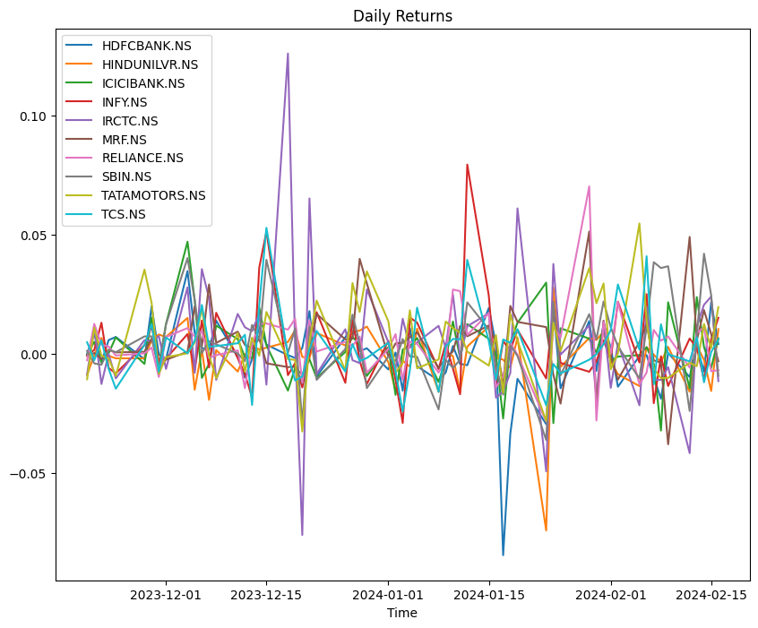
Calculating the simple returns for each asset
Return is calculated by using below formula :

Slide 5

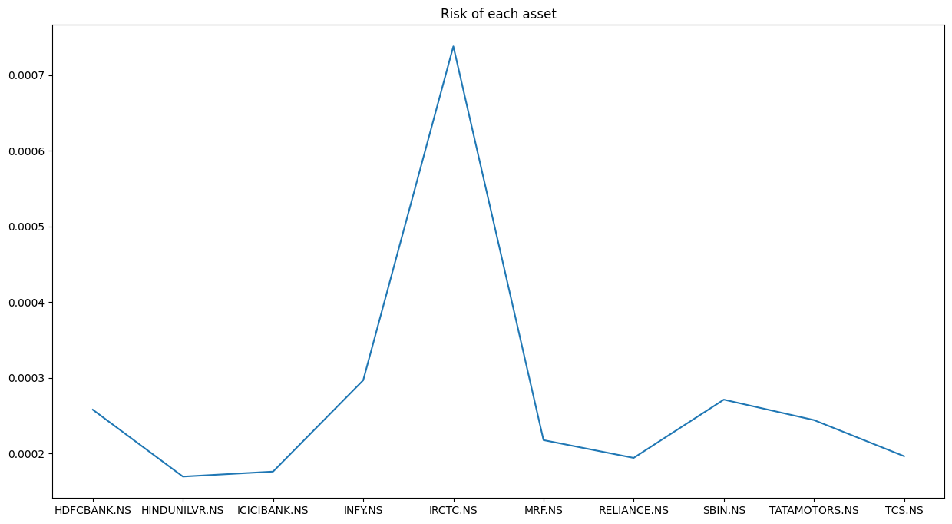
Calculating the risk for each asset
Risk is calculated by using below formula :

Slide 6
Markowitz's mean-variance optimization
Markowitz portfolio optimization is a method used to find the optimal allocation of assets in a portfolio to achieve a desired return with minimum risk (or maximum return for a given level of risk). The key idea behind Markowitz's approach is to consider both the expected return and the risk (typically measured as the variance or standard deviation of returns) of the portfolio when selecting the asset allocation.

Slide 7
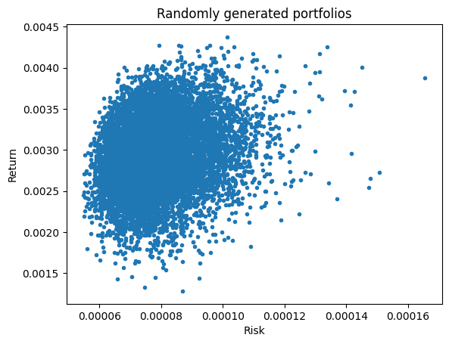
Visualisations 10000 Random Portfolio

Slide 8
Getting the Efficient Frontier
Initially, we obtain 10,000 randomly generated portfolios with random weights, risks, and returns. Next, we attempt to identify an optimal frontier for each of these risks. That is, there is no portfolio with less risk and the same return or the same risk and higher return if we choose any portfolio on the efficient frontier.To do this, we create an optimization problem with the constraint that the sum of the weights must equal one in order to maximize the returns associated with each sigma (risk). We are then left with a Markowitz efficient frontier.

Slide 9
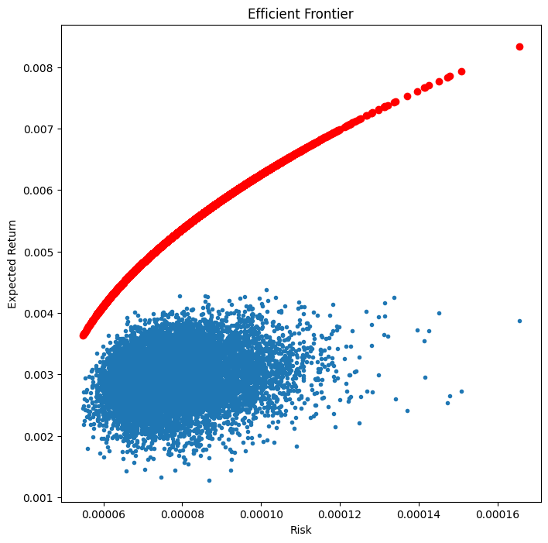
Visualisation of Efficient Frontier

Slide 10
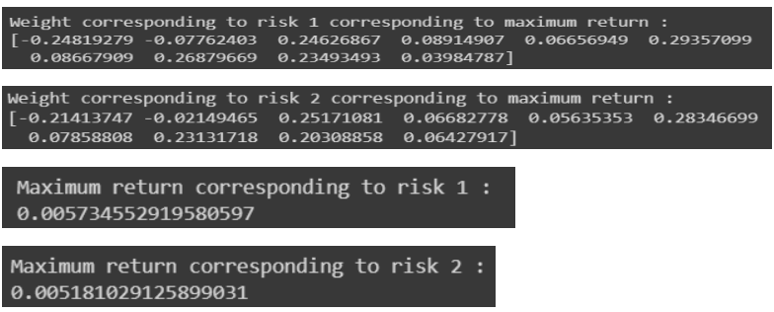
Choosing two random risk levels
We have chosen two random risk levels lying on the efficient frontier and calculated the weights corresponding to maximum returns using the optimization problem with constraints. After calculating the maximum returns we have plotted two points again on the graph and we can see that those points lie on the efficient frontier. Following are the weights corresponding to maximum returns :

Slide 11
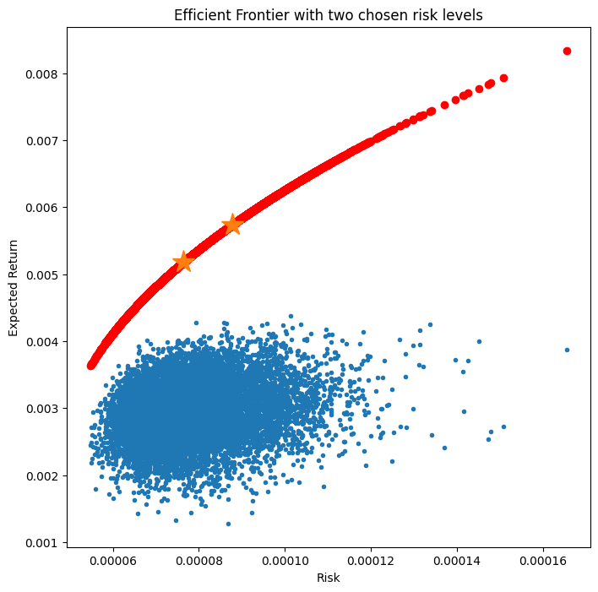
Visualisation of two chosen points

Slide 12
The trade-off between risk and return
The trade-off between risk and return is a fundamental concept in investing and portfolio management. It refers to the relationship where higher potential returns are typically associated with higher levels of risk, and lower risk investments tend to offer lower potential returns. This we can clearly see in the above graph of efficient frontier obtained as well. We can see that on increasing the risk there is a potential chance of increase in returns as well. The lower the risk the less is the return.

Slide 13
The limitations of Markowitz optimization
The Markowitz Model relies heavily on historical data, which may not reliably predict future market trends. Past performance is no guarantee of future results.
The model's assumptions are based on normally functioning markets. In highly volatile and unpredictable markets, the model may lose relevance.
Mean-variance theory assumes normally distributed returns. Assets that do not follow this distribution will not work well with the Markowitz Model.
The model assumes all portfolio assets are allocated to a single timeframe, which is rarely the case in reality.
Combining the Markowitz Model with a comprehensive understanding of market dynamics and trends is important.

Slide 14
Markowitz optimization real-world applications
Portfolio Construction: To create diversified portfolios with a goal of striking a balance between risk and return, investors and portfolio managers frequently employ Markowitz optimisation.
Asset Allocation: Based on the projected returns and risk characteristics of several asset classes, including cash, bonds, and stocks, this technique is used to find the best way to allocate assets.
Risk management: By spreading investments among uncorrelated assets, Markowitz optimization can assist in identifying and reducing risks in a portfolio.
Performance evaluation is the process of comparing a portfolio's actual performance to a benchmark and determining the effects of various investment methods.

Slide 15
Thanks
References
https://www.investopedia.com/
https://finance.yahoo.com/

