Slide 1
Project 1: Technical Analysis
Harsh Sharma (B20CS017)

Slide 2
Dataset
Company: Reliance
Asset: Stocks
Time Period: 1-24-2021 to 1-24-2024

Slide 3
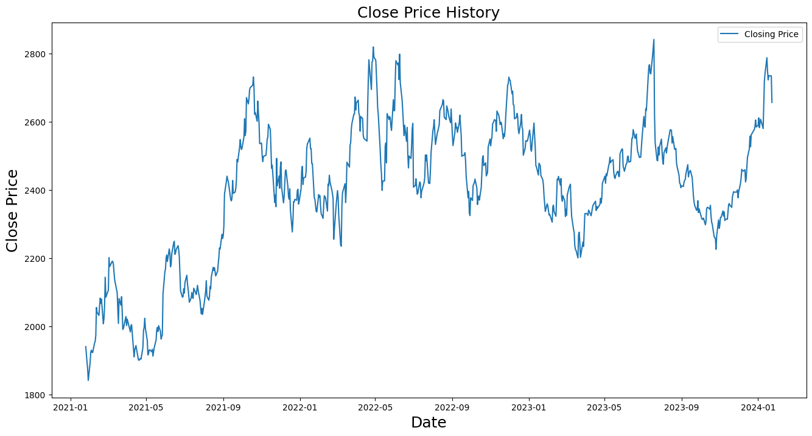
Data visualisation

Slide 4
Technical Indicators
Simple Moving Average
Relative Strength Index
Bollinger Bands
MACD
A simple moving average (SMA) is an arithmetic moving average calculated by adding recent prices and then dividing that figure by the number of time periods in the calculation average
The relative strength index (RSI) is a momentum indicator used in technical analysis. RSI measures the speed and magnitude of a security's recent price changes to evaluate overvalued or undervalued conditions in the price of that security.
Bollinger Bands are composed of three lines. One of the more common calculations uses a 20-day simple moving average (SMA) for the middle band. The upper band is calculated by taking the middle band and adding twice the daily standard deviation to that amount. The lower band is calculated by taking the middle band minus two times the daily standard deviation.
Moving average convergence/divergence (MACD, or MAC-D) is a trend-following momentum indicator that shows the relationship between two exponential moving averages (EMAs) of a security’s price. The MACD line is calculated by subtracting the 26-period EMA from the 12-period EMA.

Slide 5
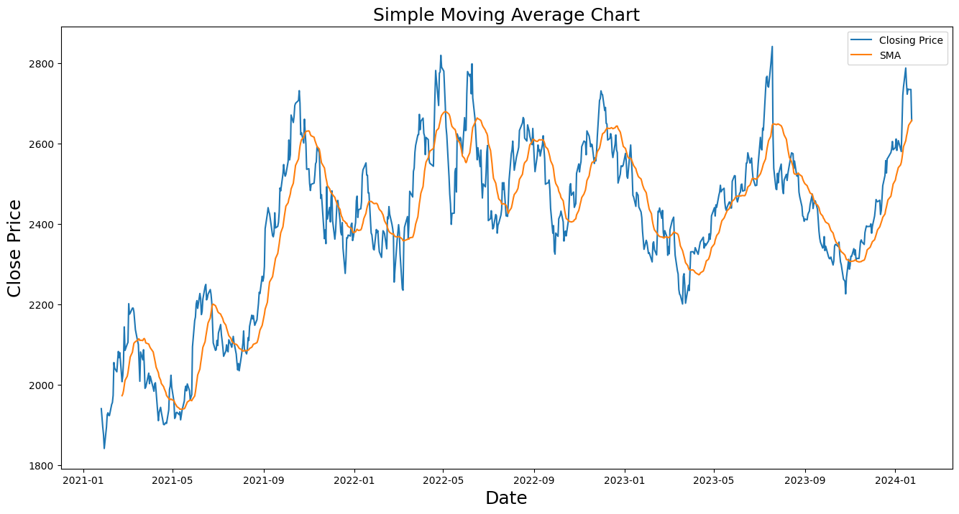
Visualisations of the Indicators
Simple Moving Average

Slide 6
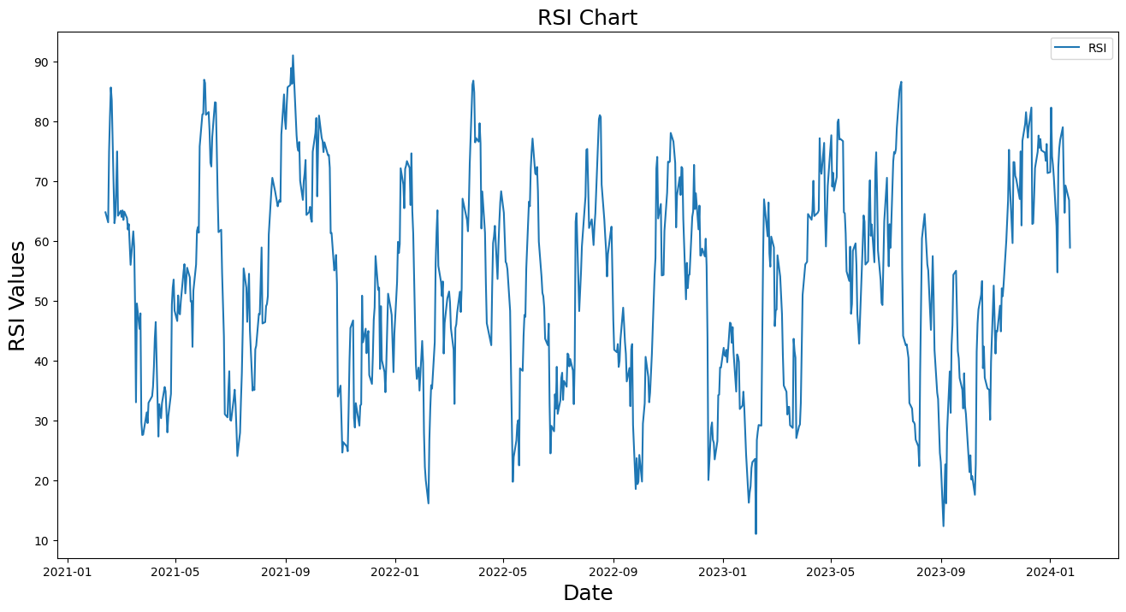
Visualisations of the Indicators
Relative Strength Index

Slide 7
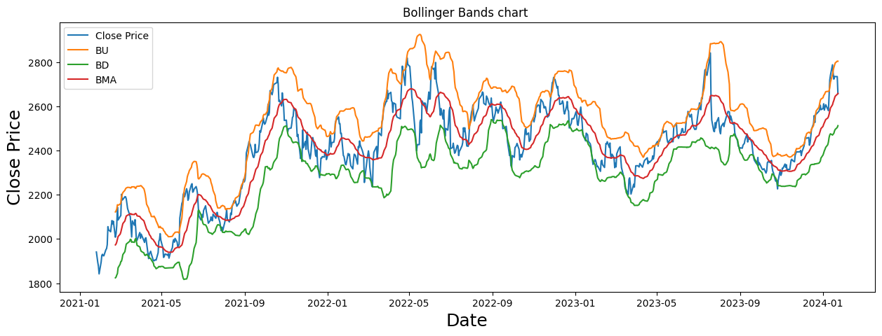
Visualisations of the Indicators
Bollinger Bands

Slide 8
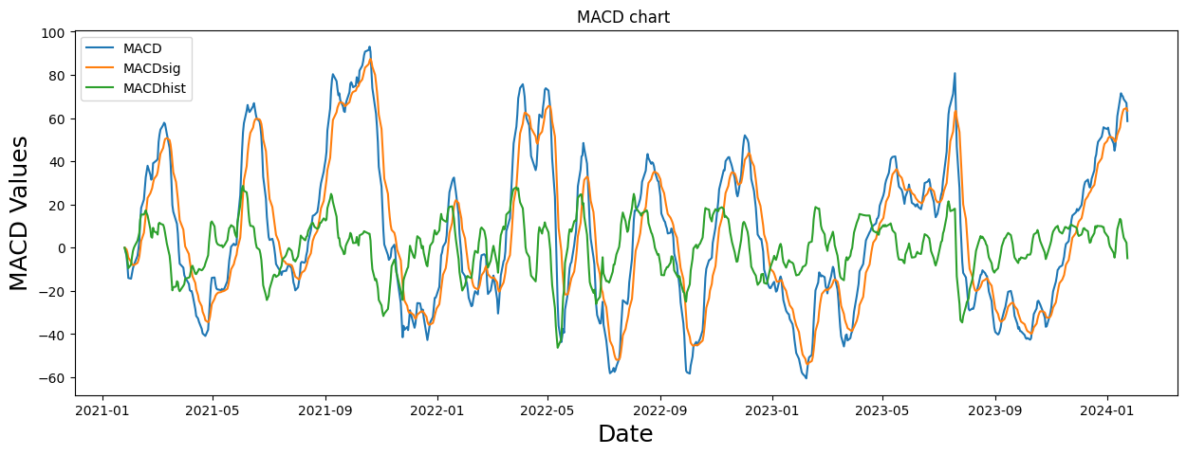
Visualisations of the Indicators
MACD (Moving Average Convergence Divergence)

Slide 9
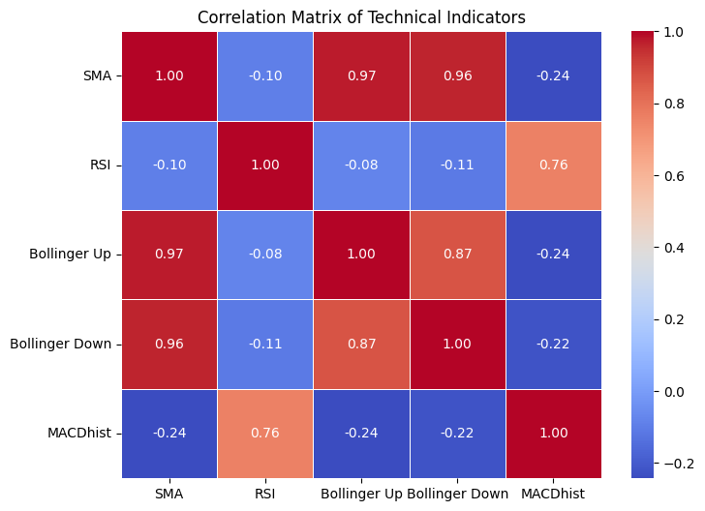
Correlation Analysis
First all the indicators are scaled using min max scaler so that they can come at equal level
Now covariance matrix is calculated and visualised using heatmap.

Slide 10
Combined Indicator
Combined Indicator is weighted sum of the used four indicators.
Weights are calculated using the correlation matrix calculated in the previous step.
For every indicator all covariance values with another indicators are added.
Weights are nothing but the sum calculated in the previous step divided by sum of all covariance values.
Now every indicator is multiplied by its corresponding weight and added to get the combined indicator or new indicator.

Slide 11
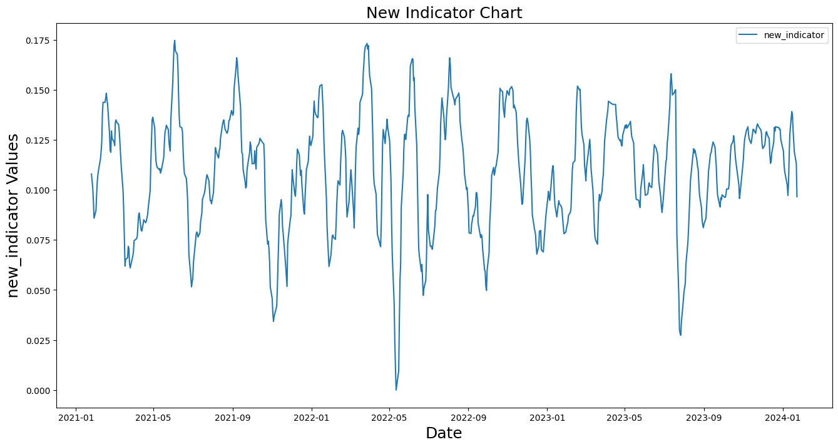
Visualisation of the New Indicator

Slide 12

Predictions
First true outcomes are calculated using the formula
If rj >0 then we will long the stock or bull the stock , else short or bear the stock.
After this predicted outcomes are calculated on the basis of combined indicator.
We have used simple moving average over a period of 10 days to predict the outcomes.
If the current new indicator value is greater than the average new indicator value then we will long/bull the stock else short/bear the stock.
From this method we achieved the accuracy of 59.84 percentage.

Slide 13
Thanks
References
https://www.investopedia.com/
https://finance.yahoo.com/

