Slide 1

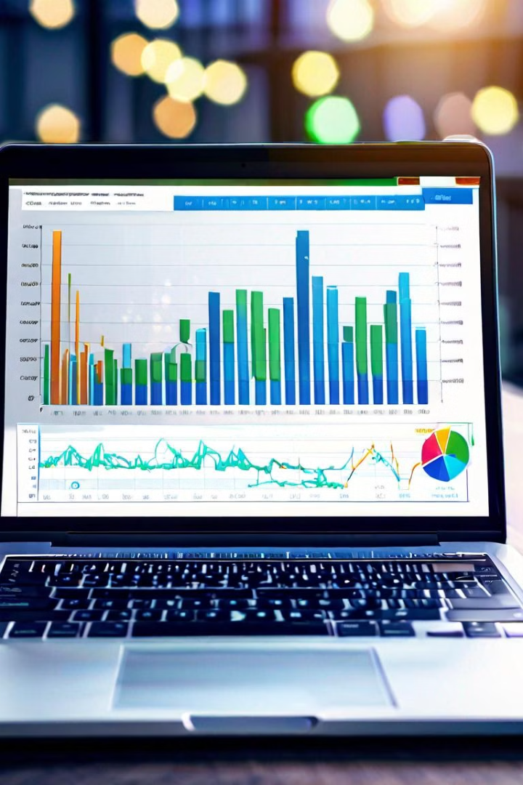
RED ALERT
Leverage machine learning and deep learning models to build a predictive system that uses real-time news headlines and social media data to provide users with timely alerts about potential stock price movements.

Slide 2
Leveraging News and Social Media Data to Predict Stock Price Movements
Uncover Market Insights
News headlines and social media discussions can reveal valuable insights into investor sentiment, industry trends, and potential stock price drivers.
Identify Early Signals
By analyzing real-time data, the Stock Notifier can detect early signals of impending stock price changes, allowing users to make informed decisions.

Slide 3

Data Collection
Gathering Real-Time News
1
Gathering real-time news headlines from various online sources such as CNBC is crucial for the Stock Notifier. This data provides valuable insights into market sentiment and potential stock price movements.
2
Advanced Web Scraping
Using advanced web scraping techniques and APIs, the system collects a constant stream of up-to-date news, ensuring timely and accurate information for the predictive model.

Slide 4
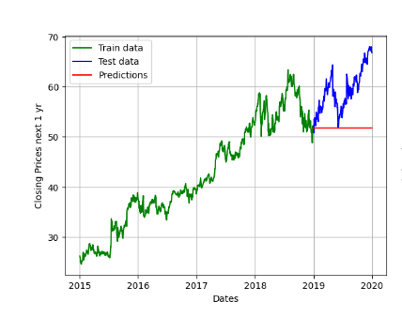
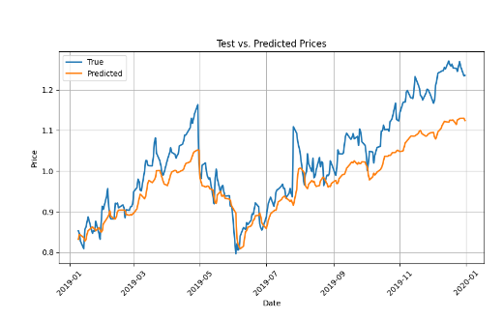
Feature Engineering
1
Sentiment Analysis
2
Numerical Features
Extract meaningful features from the news headlines to feed into the prediction model. Analyze sentiment, keywords such as company name associated with the headline, to uncover signals of potential stock movements.
Engineer numerical features like sentiment scores, topic relevance, and entity associations to capture the nuances of the real-time data.

Slide 5
Model Selection and Training
Exploring AI Techniques
Model Training
Leveraging the latest advancements in artificial intelligence, we have evaluated a range of machine learning and deep learning models such as DeBERTa-v3-base and DistilBERT-base-uncased (for tokenization of news articles), and BLOOM-560M (for multi-label classification of news to get priority).
Training of the above models will be done on the dataset, and further the model will be evaluated on metrics like Accuracy, Precision, Recall, and F1-score.

Slide 6



Alert Generation
Timely Alerts
Predictive Insights
Seamless Integration
The Stock Notifier will provide user-friendly alerts for predicted stock price movements.
Leveraging machine learning models, the system will analyze real-time news and social media data to identify potential opportunities and risks.
Clear, concise notifications will be delivered to users' mobile devices and integrated into a web-based dashboard.

Slide 7
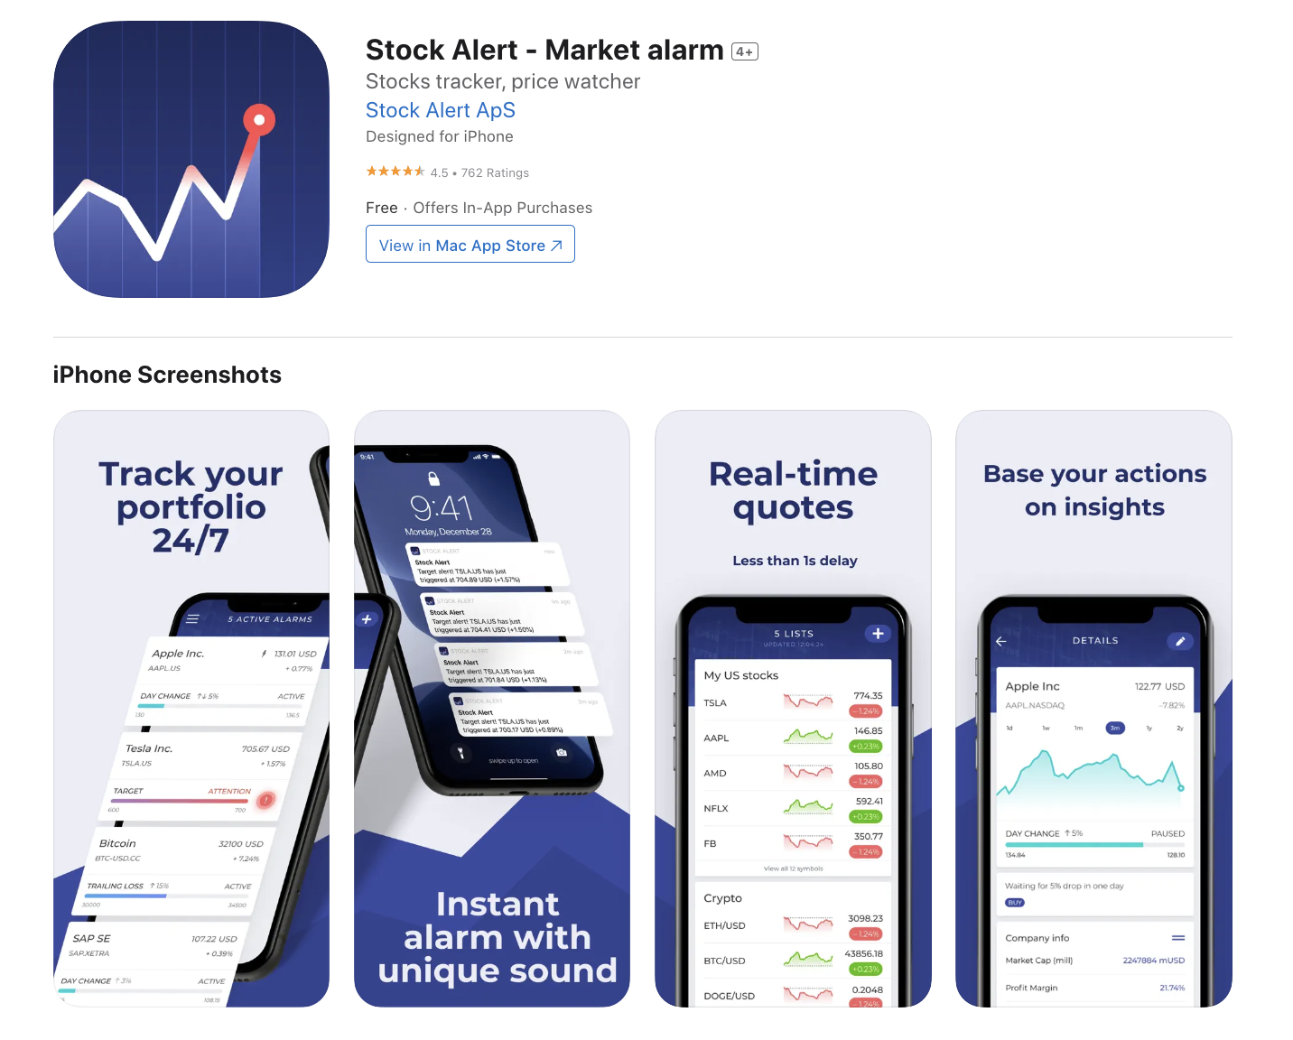
User Interface: Designing an Intuitive Platform
Intuitive Dashboards
The Stock Notifier features a clean, modern user interface that puts real-time stock data and predictive insights at your fingertips. Intuitive dashboards and visualizations make it easy to monitor portfolios and receive timely alerts on potential price movements.
Mobile Connectivity
Seamless integration with mobile devices ensures you stay connected to your investments anywhere, anytime. The platform's user-centric design prioritizes simplicity and ease of use, empowering both novice and experienced investors to make informed decisions.

Slide 8
Business Model
Subscription Model
Freemium Model: Offer basic news alerts for free and charge a subscription fee for premium features like real-time alerts, personalized news curation, advanced analytics, etc.
Tiered Subscription : Offer multiple subscription tiers (e.g., Basic, Premium, Pro) with varying levels of features and benefits.
Partnerships and Collaborations
Media Partnerships: Collaborate with media outlets or financial news providers to offer exclusive content or features to your users.
Educational Partnerships: Partner with educational institutions or organizations to offer financial literacy courses, workshops, or webinars through your platform.

Slide 9




Highlighting the Competitive Advantage
Data-Driven Insights
Personalized Experience
User-Centric Approach
Real-Time Responsiveness
Leveraging advanced data analytics to provide users with unparalleled market intelligence and investment guidance.
Delivering a tailored experience that caters to the unique needs and preferences of each individual user.
Prioritizing the user's needs and continuously incorporating their feedback to enhance the overall product experience.
Ensuring users receive the most up-to-date information and alerts, enabling them to make timely investment decisions.

Slide 10
The Future of Informed Investing
Empowering Investors
Knowledge Base: Access educational resources and expert insights to enhance your investment skills.
Community Engagement: Connect with a vibrant investor community to share ideas and learn collaboratively.
Transparent & Trustworthy: Benefit from our commitment to data integrity, user privacy, and transparent reporting.

Slide 11



Conclusion and Future Improvements
Predictive Power
The Red Alert has demonstrated the power of leveraging news to predict stock price movements.
Continuous Refinement
By continually refining the machine learning models and incorporating new data sources, the system can provide even more accurate and timely alerts for users.

Slide 12

Q/A

