Slide 1
Control System Design for Mechanical systems using Contraction theory
Harshal Shirsath, 119247419

Slide 2
AGENDA
Introduction
Primary goals
Areas of growth
Timeline
Summary

Slide 3
INTRODUCTION
The presentation will tale you over all the basic concepts which are required to achieve the generalized systemic ways to solve multiple problems. Considering the tools of physics, Continuum mechanics and differential geometry. We are going to learn some controls depicted by Lyapunov, Barbalat Lemma, with adaptive controls and also Hyperstability by V.M. Popov.

Slide 4
Contraction analysis
Generalized solution to all the stability problems in a exact differential format.

Slide 5
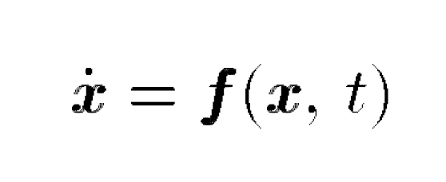
Differential Analysis can help a lot of many stability issues but the problem is these are not very accurate and are very concise to one particular problem of stability.
When considered Contraction theory it helps to find the exact differential equation for all the general problems related to stability and forms a generalized equation for the same.
The above equation represents the closed loop dynamics of a controlled system
The state feedback is u(x,t)

Slide 6
Displacement-real & virtual
The displacement can be of two types in which one is virtual displacement and the other is virtual displacement which we are going to use in the further slides.

Slide 7


Real Displacement: The real displacement is the distance final distance moved from the initial point to the final point in a given time interval(time interval is very important)
Virtual Displacement: The change in position for an infinitesimal time.
The is the virtual displacement at a fixed time.

Slide 8
Definition for contraction region
Given the system equations x_ = f(x; t), a region of
the state space is called a contraction region with respect to a uniformly
positive definite metric M(x; t) = T if F is uniformly
negative definite in that region

Slide 9
Theorem for virtual displacement
Given the system equations ̇x = f(x,t), any trajectory, which starts in a ball of constant radius centered about a given trajectory and contained at all times in a contraction region, remains in that ball and converges exponentially to this trajectory.

Slide 10

The above mentioned equation is the convergence equation.
This sufficient exponential convergence result may be viewed as a strengthened, an analogy we shall generalize . Note that its proof is very straightforward, even in the non-autonomous case, and even in the non-global case, where it guarantees explicit regions of convergence. Also, note that the ball in the above theorem may not be replaced by an arbitrary convex region - while radial distances would still decrease, tangential velocities could let trajectories.

Slide 11

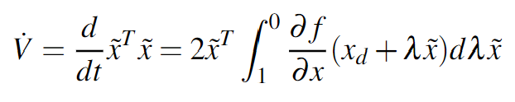
The below mentioned equation is something we got from Lyapunov analysis which shows for the uniformly negative definite region depicted by

Slide 12
Combination of contracting systems

Slide 13
Lyapunov definition
Definition : A real valued function φ (ρ) belongs to class K if it is defined, continuous and strictly increasing for all ρ, 0 ≥ ρ ≥ p1 where ρ1 is arbitrary and φ (0) = 0.

Slide 14
Lyapunov theorem
Theorem 1: If a function V(x,t) that is defined for all x and t satisfies: i: V(x,t) is continuous with respect to x and t for all t. ii: V(x,t) is positive definite. i.e. αε K exists such that 0 ≥ α(||x||) ≥ V (x,t) iii : V(x,t) is radially unbounded. i.e. α in (ii) is such that lim ρ→∞ α(ρ) = ∞ iv : V(x,t) is descresent. i.e. there exists β ε K such that V (x,t) ≥ β (||x||) for all x ε R n
Positive definiteness of V and negative semi-definiteness of result in stability.

Slide 15
The multivariable nonlinear autonomous system has a wide scope in stability approach using Lyapunov's method and Popov's hyperstability.
Lyapunov method requires to recast the feedback loop consisting the linear time-invariant operator in the feedback path which can be resolved by using an alternative path of hyperstability.
In nonautonomous equations this theory is less decisive as compared to the autonomous systems which leads to the difficulty to yeild a negative semidefinite time derivative V(x,t).

Slide 16
Positive definiteness of V and negative semi-definiteness of result in stability.
Quite often it is found that V(x,t) is only negative semi-definite and in such cases only uniform stability is achieved rather than uniform asymptotic stability can be used.

Slide 17
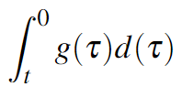
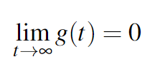
LEMMA’s Theory
If ’g’ is a real function of the real variable ’t’ defined and uniformly continuous for t > 0 and if the limit of the integral
as t tends to infinity exists and is a finite number, then

Slide 18


If is uniformly continuous, then every solution of the below mentioned
differential equation would be on the same form :

Slide 19


Hyperstability (V.M.Popov)
In stability theory, hyperstability is a property of a system that requires the state vector to remain bounded if the inputs are restricted to belonging to a subset of the set of all possible inputs.
A system is hyperstable if there are two constants such that any state trajectory of the system satisfies the inequality:

Slide 20

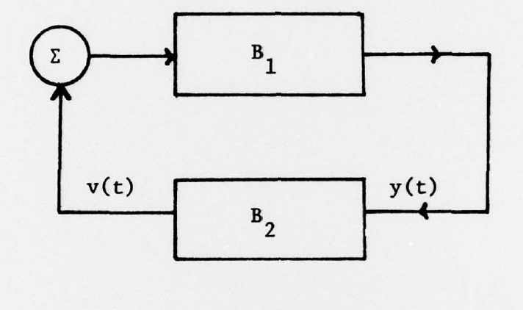
Consider a feedback system with two blocks B1 and B2 . Let B2 have input y(t) and output v(t) and let
for all t ≥ 0
The block B1 is said to be hyper stable if every system of the type

Slide 21
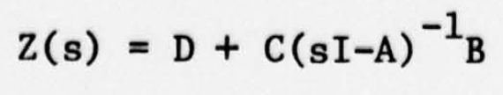
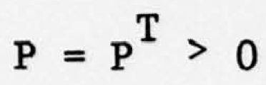
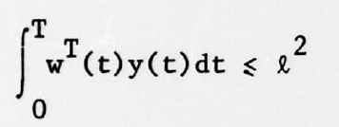

So, the theorem of hyperstability says that for a system to be hyper stable, the transfer matrix be positive real.
For some and all T.
l is an arbitrary constant independent of T
W(t) satisfy the following equation 1:
------------------------------------(1)
It stays together if the inequality for the below equation 2 holds
------------------------------------(2)

Slide 22
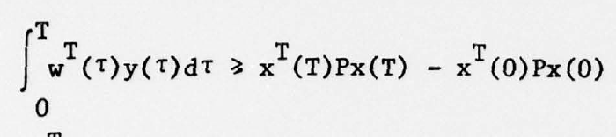
The below equation satisfies hyper stability if and only of the equations 1
and 2 satisfy itself
And for

Slide 23
Passivity theory
The Passivity theory formalizes that the Lyapunov functions are combinations of systems which are derived simply by addition of the Lyapunov functions of subsystems.

Slide 24
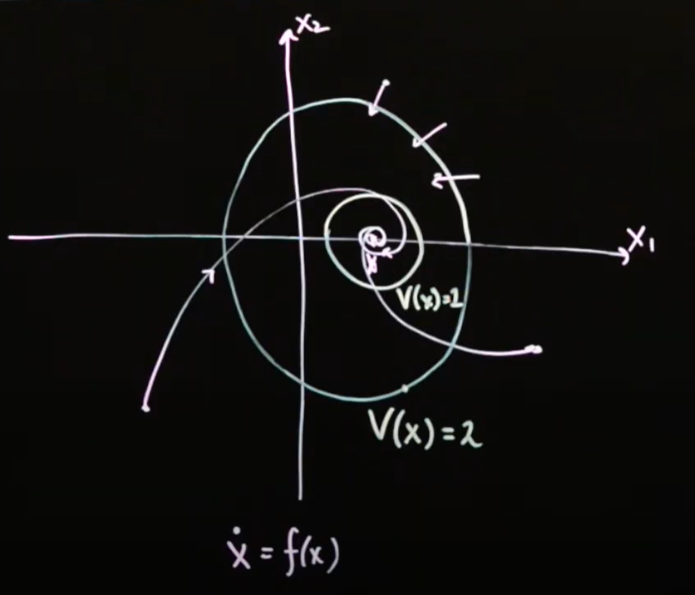
Basically, Lyapunov functions are the energy levels in the systems which
converges in order to reach equilibrium.

Slide 25

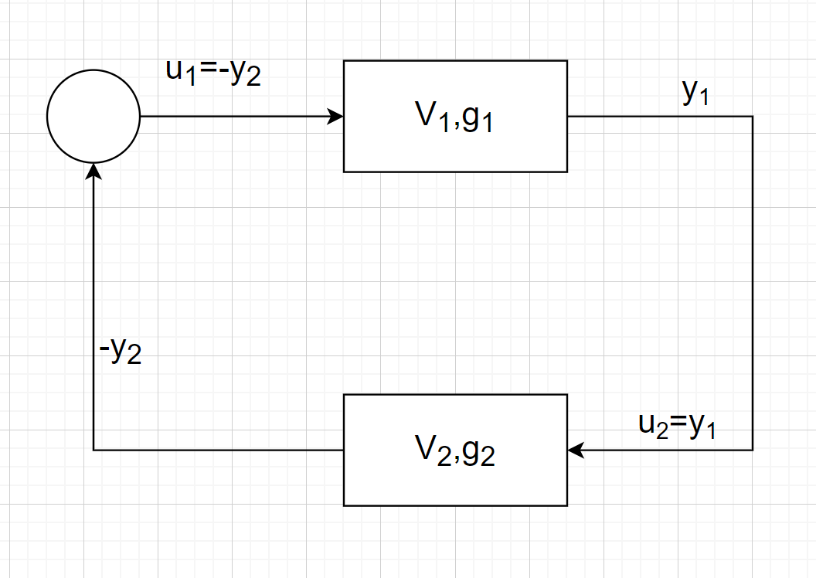
where V_1(t) and g1(t) are scalar functions of time, y_t is its output and U_1 is the system input.

Slide 26
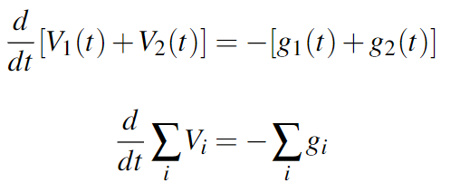
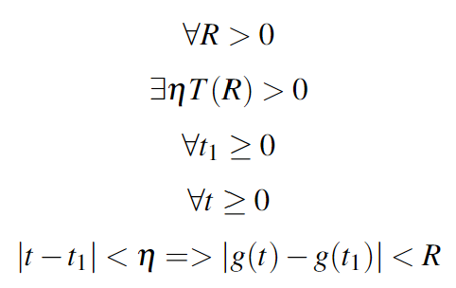
In the feedback configuration in which u_2=y_1 and u_1=-y_2
This equation indirectly helps us to find the total length by addition
of all the individual lengths

Slide 27
Basic combination
Parallel or Feedback combinations lead to an augmented Lyapunov dynamics.
Basically these combinations provide differential closure properties of contracting systems.

Slide 28
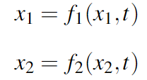
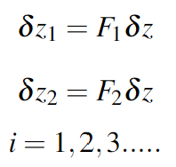
Parallel combination
Two systems of same dimensions.
The below are the virtual dynamics of the system

Slide 29



Parallel combination
Superposition of both the virtual dynamics
Where,
While, when the contracting system is not time variant then the equation becomes:

Slide 30
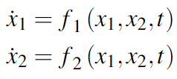
Feedback combination
The two systems with different dimensions:

Slide 31
Barbalat’s Lemma
We do not know will the derivative actually converge to zero.
Therefore, Barbalat Lemma proposed that the derivative should itself be smooth in order for it to converge to zero.

Slide 32

Barbalat’s Lemma definition
If the differentiable function f(t) has a finite limit as t → ∞, and if f is uniformly continuous, then f(t)→ 0 as t→ ∞.
Function g(t) is continuous on [0,$∞$) if

Slide 33

Barbalat’s Lemma definition
If the differentiable function f(t) has a finite limit as t → ∞, and if f is uniformly continuous, then f(t)→ 0 as t→ ∞.
Function g(t) is continuous on [0,$∞$) if

Slide 34
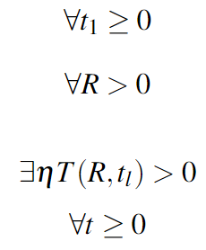


If the function g(t) is continuous on [0,$∞)$ for the conditions of
If the function g(t) is uniformly continuous on [0, $∞$)

Slide 35
If one finds an η which does not depends on a specific point t₁ only then g is uniformly continuous.
Also, considering the condition in which η does not shrink as t₁ → ∞.
It should be noted that t and t₁ play a symmetric role in defining uniform contiunity.
The function’s derivative is determined by the sufficient condition for
differential function to be uniformly continuous is derivative be bounded.

Slide 36
Adaptation
Adaptive control is an approach to dealing with uncertain systems or time-varying systems.

Slide 37
Systematic theories exist for the adaptive control of linear systems.
Existing adaptive control techniques can also treat important classes of nonlinear systems, with measurable states and linearly parametrizable dynamics.
For these nonlinear systems, adaptive control can be viewed as an alternative and complementary approach to robust nonlinear control techniques, with which it can be combined effectively.
Although most adaptive control results are for single-input single-output systems, some important nonlinear physical systems with multiple-inputs have also been studied successfully.

Slide 38
Time delay
In systems which have transmission delays or computation delays there comes a time delay feedback connections when multiple systems are involved.

Slide 39
Let’s consider there are two systems which are contracting, probably different dimensions. ̇z₁ = f ₁ (z₁,t) + G₁τ₂
z₂ = f ₂ (z_{i},t) + G2τ2 u_{i} = GT_{i} zi + Kτ_{i} , i = 1, 2 y_{i} = GT_{i} z_{i} − Kτ_{i,} i = 1, 2
to choose which variables are actually transmitted.
Directly inspired by the use of wave variables in force-reflecting teleoperation, define intermediate variables.

Slide 40
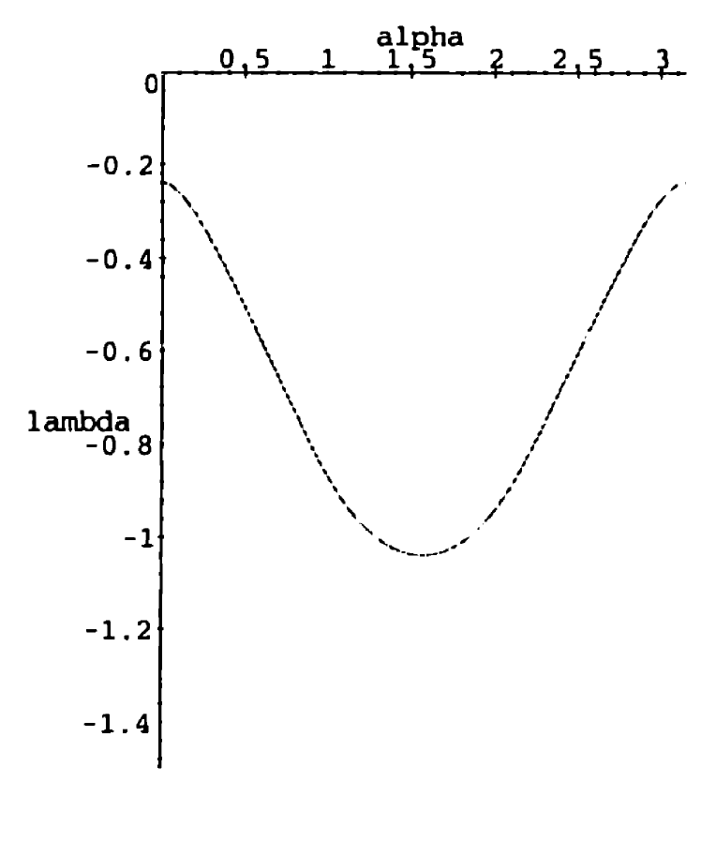
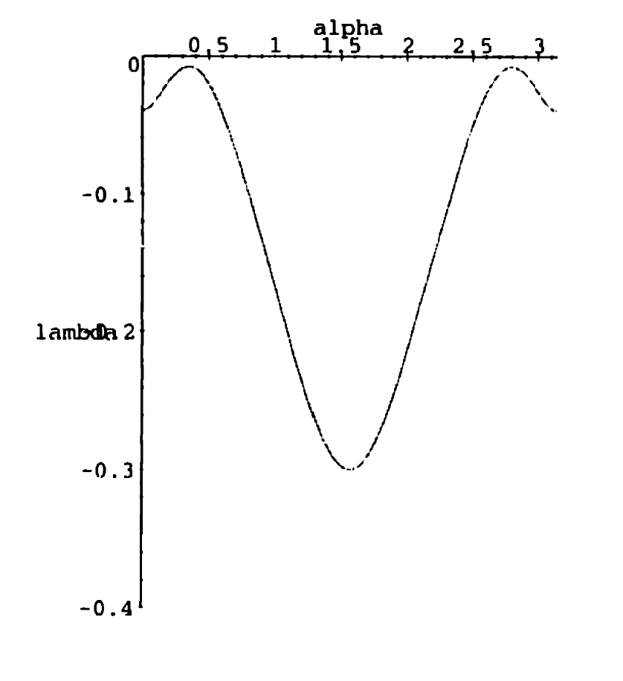
Results
Aircraft Rotation Controller

Slide 41
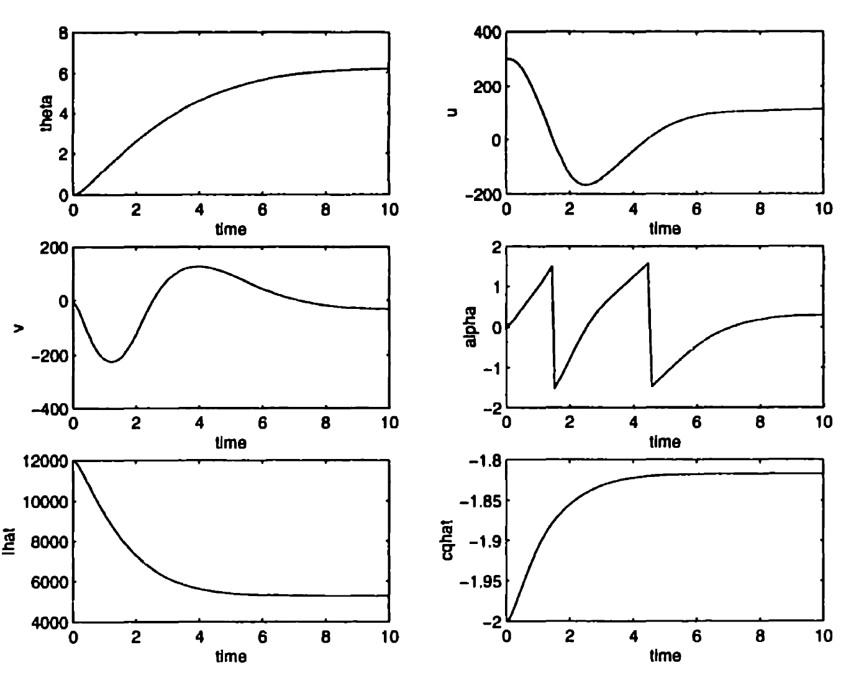
Results
Aircraft Rotation Controller

Slide 42
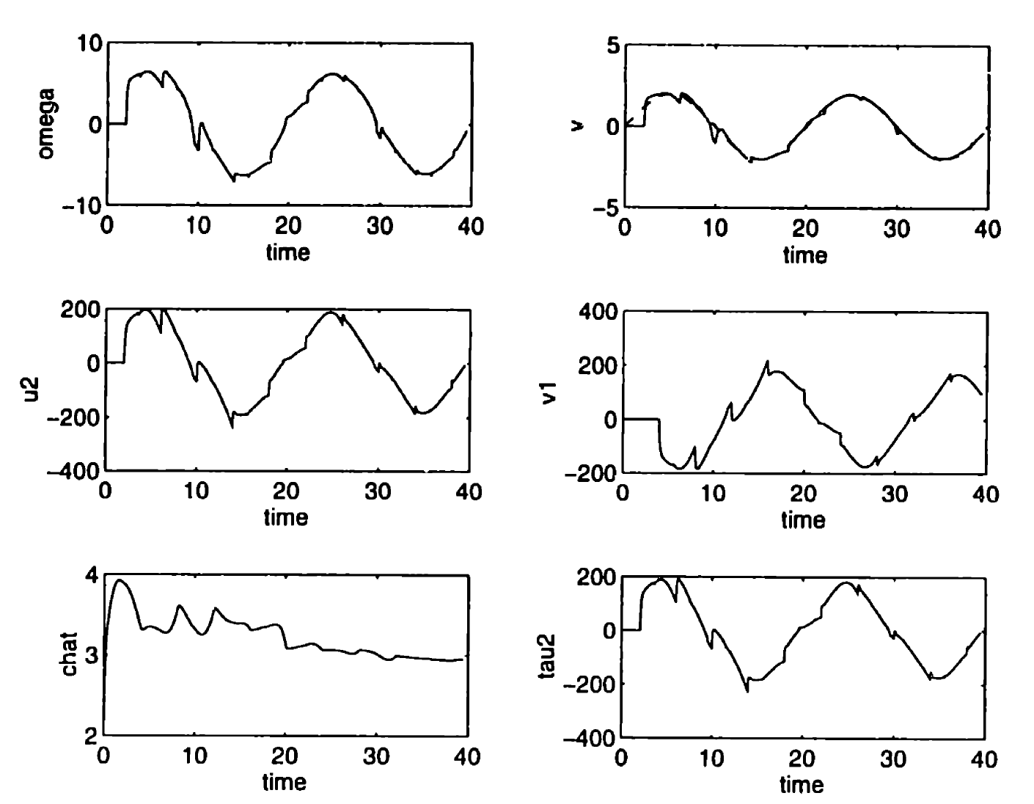
Results
Time-delayed underwater vehicle controller

Slide 43
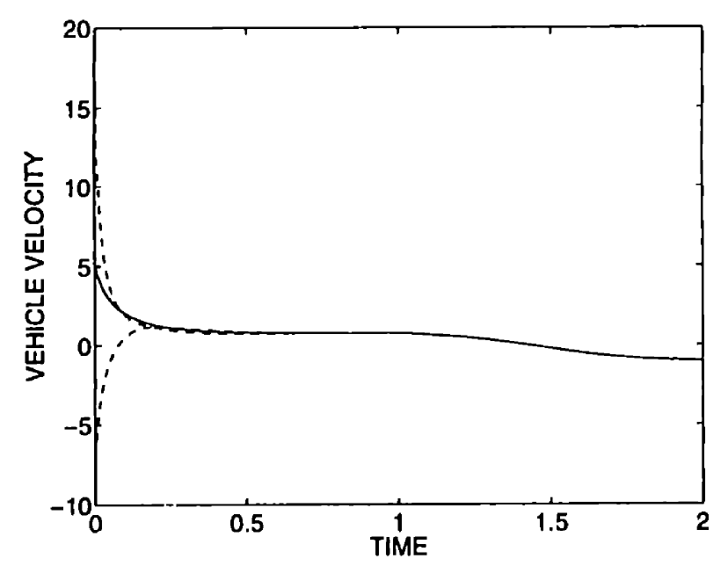
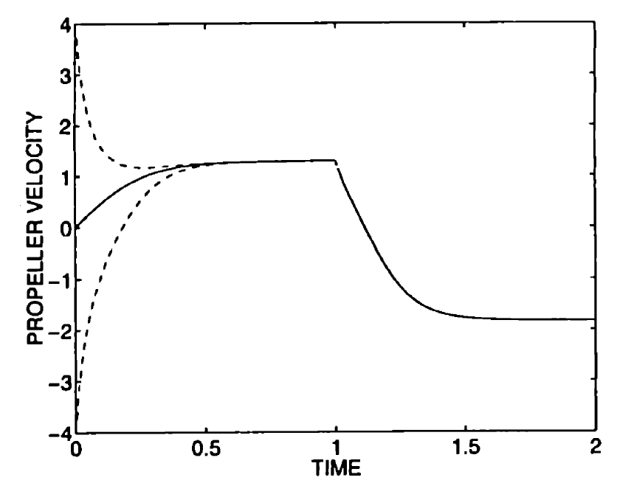
Results
Underwater Vehicle Observer

Slide 44
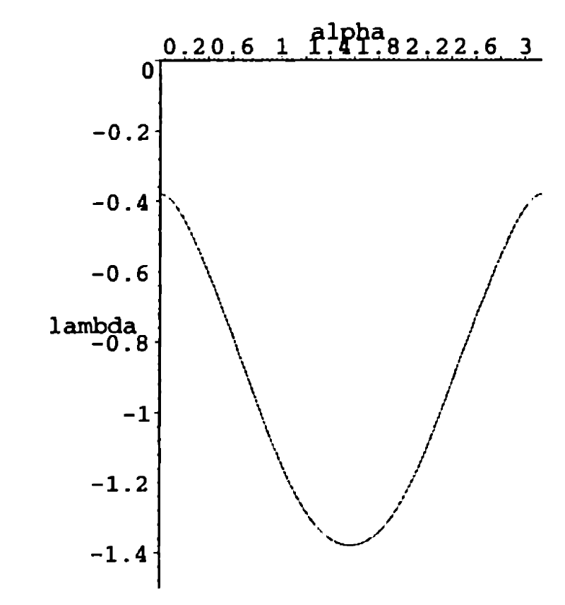
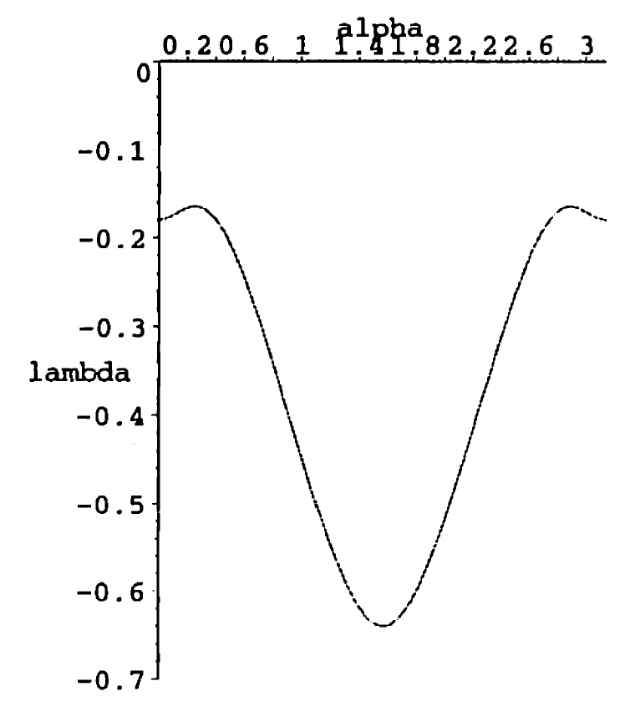
Results
Advanced Underwater Vehicle Observer

Slide 45
THANK YOU
Harshal Shirsath
shirsath@umd.edu

