Slide 1
Airbnb Lense
Capturing Your Style
Harsh Shroff | harshroff@umbc.edu
DATA 606 - Dr Chaojie (Jay) Wang

Slide 2
Introduction
The project is about the development of an Airbnb Photo & Text-Based Recommendation System. This system aims to provide Airbnb users with personalized recommendations for accommodations based on the photos of their previous stays and/or by inputing a couple of sentences. It utilizes computer vision and machine learning techniques to analyze images and match them with similar Airbnb listings. It also uses an OpenAi API to understand the text input and get the recommendations. The system benefits both travelers looking for unique and stylish accommodations and hosts seeking insights into their competition.

Slide 3

Data Description
CSV Files: 160 MB
Images per state:
New York (NYC): 80.5 GB
North Carolina (Asheville): 9.44 GB
Rhode Island (Rhode Island): 11.5 GB
District of Columbia (Washington): 14.3 GB
New Jersey (Newark + Jersey City): 5.36 GB
Massachusetts (Boston + Cambridge): 9.48 GB
The data source for this project is the InsideAirbnb dataset, which is published by Airbnb and contains comprehensive information about Airbnb listings worldwide, including property details, host information, and photos.

Slide 4

Project Methodology
Data Preprocessing & EDA
ML Model Training & Testing
Model Deployment on a Streamlit Webapp

Slide 5
Data Preprocessing & EDA

Slide 6
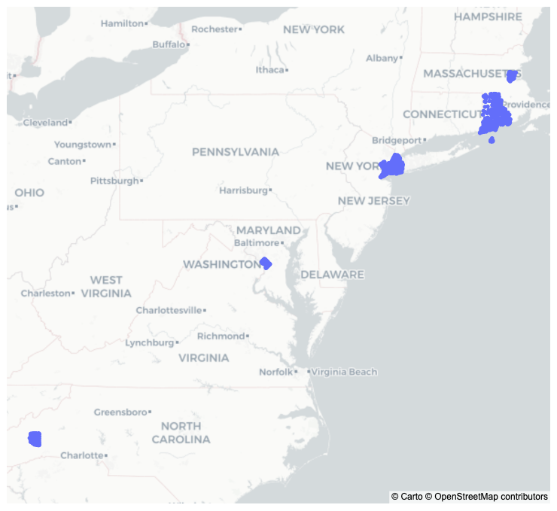
Map of Listings
The map generated using the latitude and longitude data available in the .csv file shows listings in all cities and states.

Slide 7
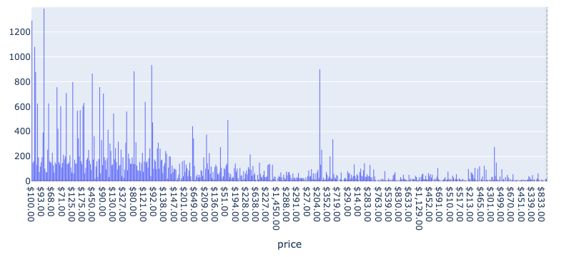
Price Distribution

Slide 8
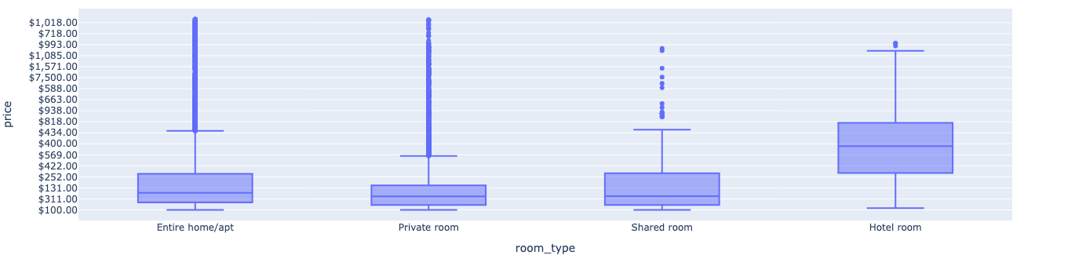
Price Distribution by Room Type

Slide 9
ML Model

Slide 10
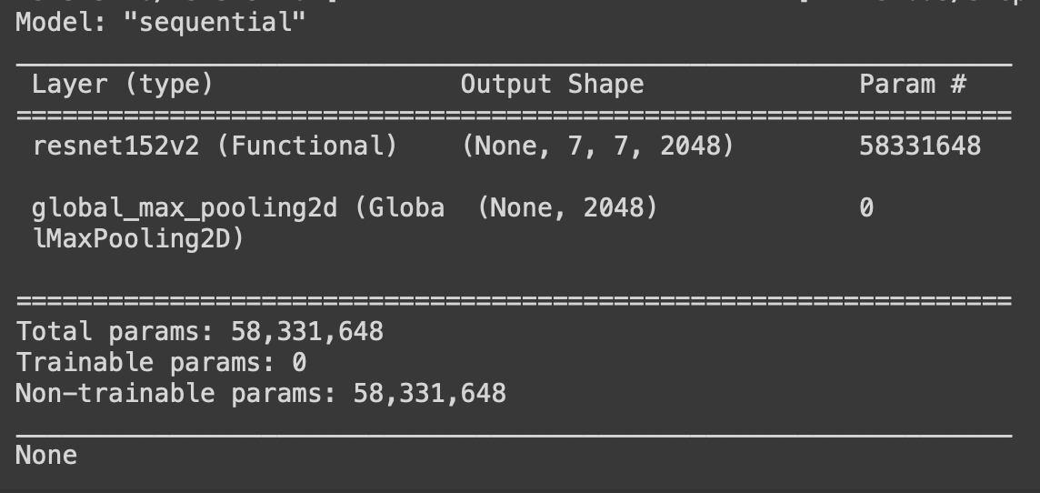
Model Summary
As seen, the model is not trainable and is used for transfer learning.

Slide 11
Deployment

Slide 12
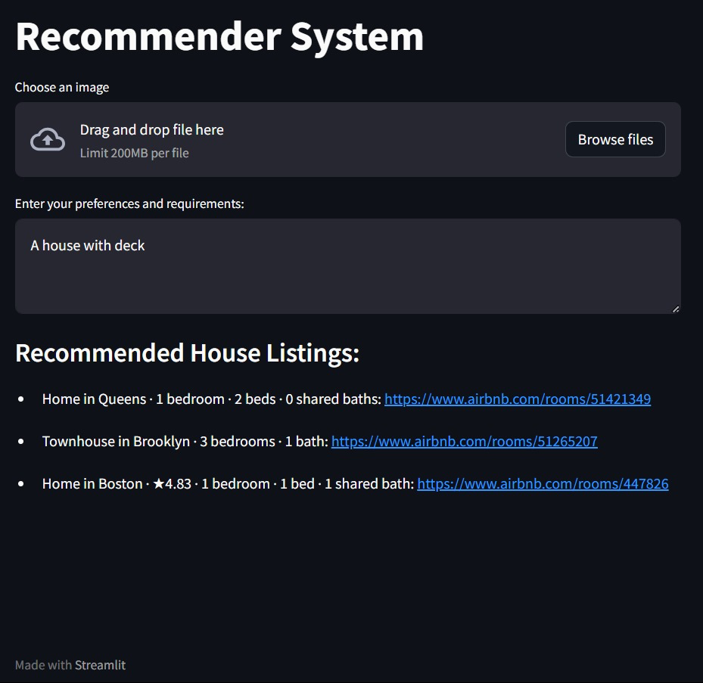
Text Based Recommender
Gives three recommendations with respect to given text.

Slide 13
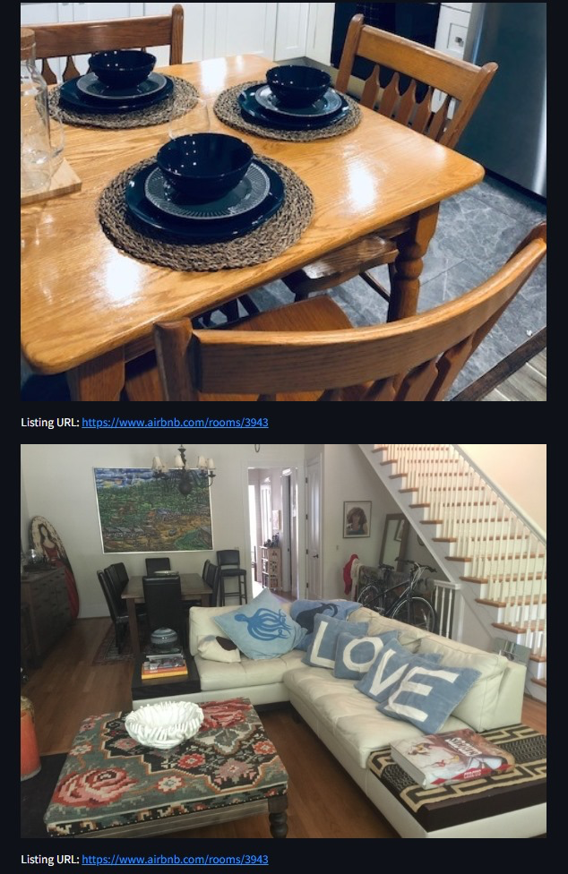
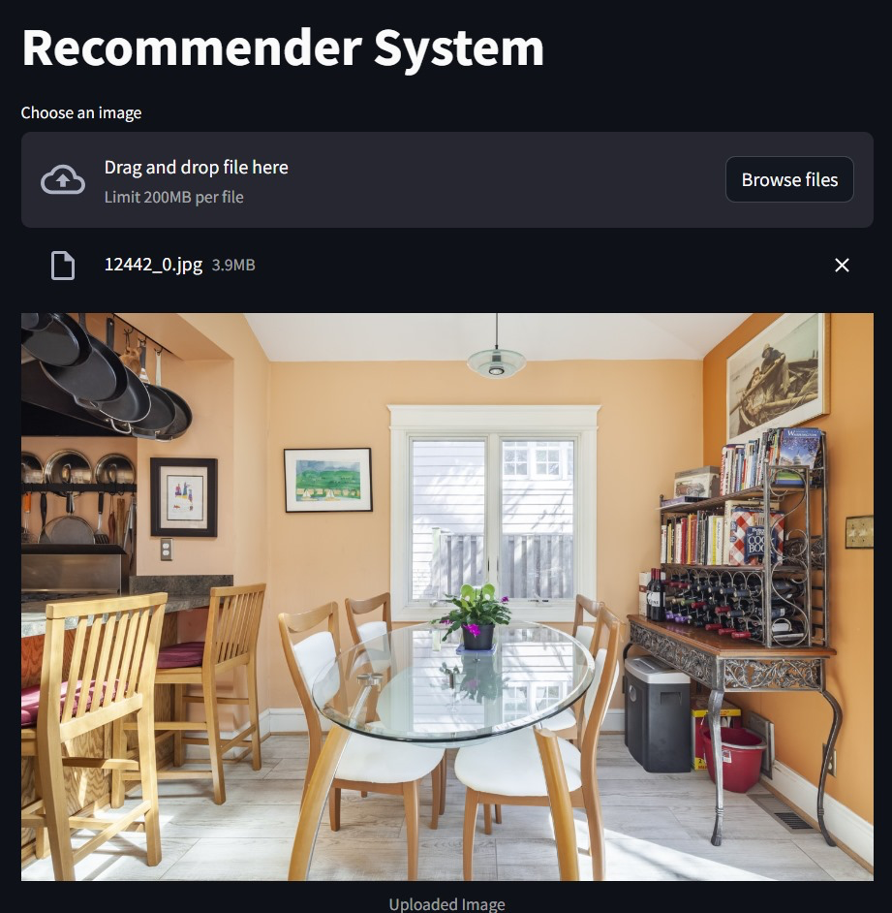
Image Based Recommender
Gives three recommendations with respect to uploaded image.

Slide 14
Thank You!
Harsh Shroff | harshroff@umbc.edu
DATA 606 - Dr Chaojie (Jay) Wang

