Slide 1

Revolutionizing Oral Cancer Detection
Exploring the impact of CNN and Transfer Learning on oral cancer detection.
Made By:-
Harsh Singh (22BAI1372)
Garvit Agarwal (22BAI1288)
Course:- BCSE332L – Deep Learning
Slot:- F2 + TF2
Faculty:- Rajalakshmi R

Slide 2
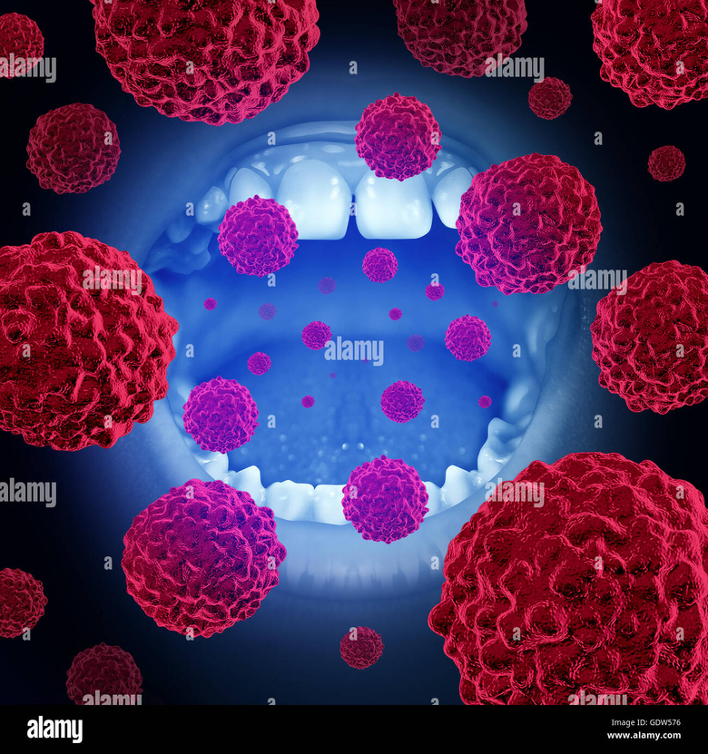
Introduction
Oral cancer is a global health challenge, with millions affected annually. Early detection is crucial for improving survival rates, yet conventional methods of diagnosis, such as visual inspections and biopsies, are often subjective, time-consuming, and costly. Recent advancements in deep learning, particularly Convolutional Neural Networks (CNNs) and transfer learning, have shown great potential in revolutionizing the field of medical image analysis. By leveraging these technologies, we can develop automated, accurate, and efficient systems to detect oral cancer from medical images. This approach not only accelerates the diagnostic process but also provides consistent and precise results, improving patient outcomes and reducing the burden on healthcare systems.

Slide 3

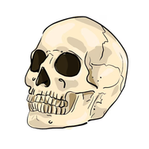
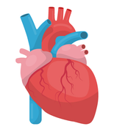
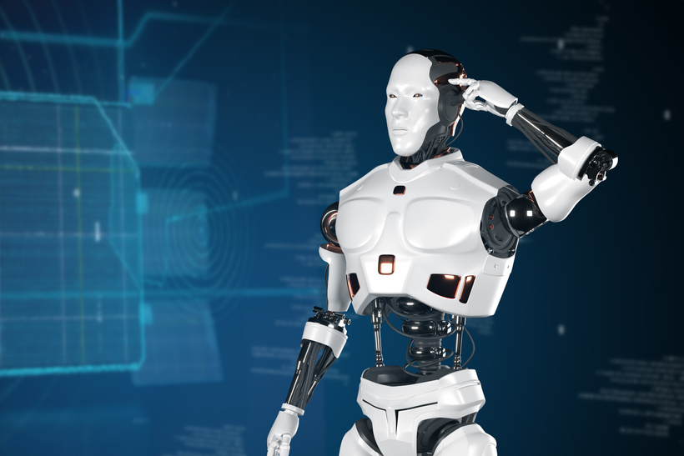
Understanding Oral Cancer
Oral Cancer Overview
Cancers affecting the mouth and throat are classified as oral cancer
.High Mortality Rate
Late diagnosis contributes to a significantly high mortality rate in oral cancer cases.
Importance of Early Detection
Early detection plays a vital role in enhancing treatment effectiveness and survival rates.
Technology in Detection
Utilizing CNN and transfer learning can revolutionize the detection
process of oral cancer.

Slide 4
Traditional Methods of Oral Cancer Detection
PROS
CONS
Early detection potential
Cost-effective screening
Established clinical protocols
Familiarity among practitioners
Accessibility in rural areas
Non-invasive techniques available
Limited sensitivity and specificity
Subjective interpretation by clinicians
Time-consuming procedures
High false-negative rates
Invasive follow-up required
Dependence on patient compliance

Slide 5


The Need for Innovative Solutions
ADVANCEMENTS IN DETECTION TECHNOLOGY
ADDRESSING HEALTHCARE DISPARITIES
The integration of innovative solutions, such as Convolutional Neural Networks (CNNs) and transfer learning, is essential to overcome the limitations of traditional oral cancer detection methods, enhancing diagnostic accuracy and enabling earlier intervention for improved patient outcomes.
Innovative detection solutions can help bridge the gap in healthcare access by providing efficient, cost-effective screening tools that can be deployed in diverse settings, ultimately leading to more equitable healthcare outcomes for populations at risk of oral cancer.

Slide 6
CNN and Transfer Learning: A Brief Overview
CNN in Image Classification: Convolutional Neural Networks excel in classifying images, making them crucial for medical diagnostics.
Pattern Detection in Medical Images: CNNs efficiently identify patterns, enhancing the accuracy of medical image analysis.
Transfer Learning Benefits: Transfer Learning allows leveraging existing models to accelerate new task learning, optimizing performance.
Reduced Training Time: Utilizing pre-trained models significantly cuts down the time required to train new models.
Lower Data Requirements: Transfer Learning diminishes the amount of data needed, making it easier to implement in resource-limited settings.

Slide 7
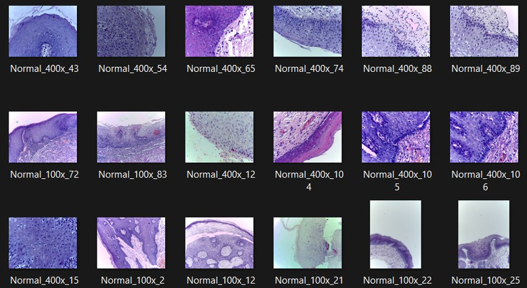
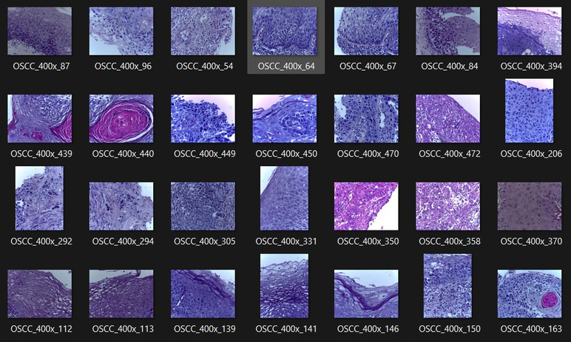
About Dataset
The oral cancer dataset typically used for AI and deep learning tasks contains medical images, such as histopathological slides, radiographs, or intraoral images, aimed at detecting and classifying oral cancer. A common format for such datasets includes:
Images: These are labeled images of oral lesions, either malignant (cancerous) or benign, categorized based on their diagnostic class (e.g., healthy, precancerous, cancerous). The images might include high-resolution scans of tissues or radiographs.
Annotations: The dataset usually contains annotations for each image, which specify details such as the region of interest (ROI), class of the lesion, and potentially the bounding box coordinates (for object detection tasks).
Link: https://www.kaggle.com/datasets/ashenafifasilkebede/dataset/code

Slide 8
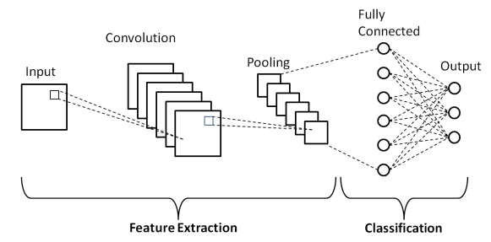
Advantages of Using CNNs for Oral Cancer Detection
Improved Diagnostic Precision: CNNs enhance diagnostic precision by automatically identifying intricate patterns in oral images, reducing human error and increasing the likelihood of early cancer detection, which is critical for effective treatment.
Efficiency in Image Analysis: The use of CNNs allows for rapid processing of large datasets, enabling healthcare professionals to analyze numerous images quickly, thus streamlining the diagnostic workflow and improving patient throughput in clinical settings.
Adaptability through Transfer Learning: CNNs can leverage transfer learning to adapt pre-trained models on diverse datasets, significantly improving performance in oral cancer detection tasks with limited labeled data, making them highly effective in various clinical environments.

Slide 9
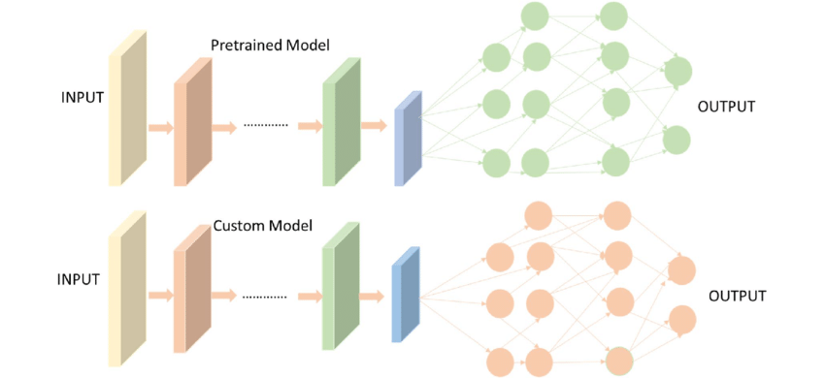
Benefits of Transfer Learning for Medical Applications
Enhanced Model Performance:
Transfer learning allows models to leverage knowledge from pre-trained networks, significantly improving performance in medical applications, especially when labeled data is limited, leading to more accurate diagnoses in oral cancer detection.
Reduced Training Time:
By utilizing existing models, transfer learning drastically reduces the time required for training deep learning algorithms, enabling quicker deployment of effective diagnostic tools in clinical settings and facilitating timely patient care.
Improved Generalization:
Transfer learning enhances the model's ability to generalize across diverse datasets, making it particularly valuable in medical applications where variability in patient demographics and imaging conditions can affect diagnostic accuracy.

Slide 10
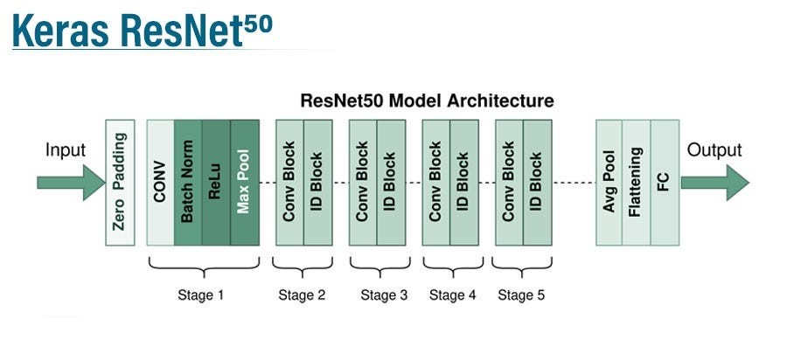
ResNet: Revolutionizing Deep Learning with Residual Networks
ResNet has revolutionized various fields, including image classification, object detection, and medical image analysis, due to its ability to capture deep hierarchical features and improve accuracy significantly. It is also widely used in transfer learning tasks, where pre-trained ResNet models can be fine-tuned on specific datasets, like those used for medical diagnosis, including oral cancer detection. This makes ResNet a powerful tool for developing robust, efficient, and accurate AI-driven diagnostic systems.

Slide 11
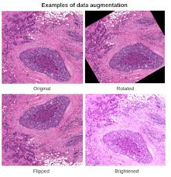
Data Augmentation
Data augmentation in oral cancer detection helps expand the dataset by applying various transformations to the existing images, improving model performance and generalization. Common techniques include:
Flipping: Horizontal/vertical flip to vary orientations.
Rotation: Rotating images by small angles.
Scaling (Zooming): Zooming in or out to alter image focus.
Translation (Shifting): Shifting images in different directions.
Brightness/Contrast Adjustment: Modifying lighting conditions.
Gaussian Noise: Adding pixel-level noise to simulate image imperfections.
Shearing: Skewing the image for diversity.
Elastic Deformation: Subtle distortions mimicking tissue movement.
Cutout/Occlusion: Masking parts of the image to challenge the model.
These techniques help prevent overfitting, increase dataset diversity, and improve the accuracy of detecting oral cancer.

Slide 12
Summary of Accuracy Comparison:
CNN: ~65%-75%
Transfer Learning: ~80%-85%
ResNet-50 (with Transfer Learning): ~90%-95%
By leveraging the deeper architecture and pre-trained features in ResNet-50, significant accuracy improvements are realized compared to a standard CNN. Transfer learning further enhances accuracy, especially for smaller datasets, by reducing overfitting and enabling the model to generalize better across new data.

Slide 13

Ethical Considerations
Patient Privacy and Data Security: AI systems require vast amounts of patient data, raising concerns about data privacy and security. Ensuring that sensitive health data is stored, processed, and shared securely is critical to prevent breaches and unauthorized access. Strong encryption, data anonymization, and compliance with privacy regulations (like HIPAA, GDPR) are essential safeguards.
Bias and Fairness: AI models are often trained on datasets that may not be fully representative of diverse populations. This can lead to biased outcomes, where certain groups (e.g., based on race, gender, or socioeconomic status) may receive unequal treatment. Addressing data bias, ensuring diversity in training data, and conducting fairness audits are necessary to prevent disparities in healthcare delivery.
Transparency and Explainability: AI algorithms, particularly deep learning models, can function as "black boxes" with decisions that are difficult to interpret. In healthcare, where trust and accountability are paramount, it is important to develop models that are explainable, allowing clinicians and patients to understand how decisions are made. This fosters trust and ensures that AI-driven recommendations are used responsibly.
Accountability and Responsibility: Determining who is accountable when AI systems make errors or result in adverse outcomes is a critical ethical issue. Clear guidelines must be established for accountability, whether it lies with the developers, healthcare providers, or regulatory bodies. Legal frameworks need to evolve to address liability in AI-driven healthcare systems.
Informed Consent: Patients should have the right to know when AI is being used in their healthcare and understand how their data will be used. Informed consent must go beyond traditional models, ensuring patients are fully aware of AI's role in their diagnosis and treatment, as well as any potential risks involved.

Slide 14
Future Direction and Improvements
Multimodal Data Integration: Combining clinical, genomic, and image data for a comprehensive diagnosis.
Real-Time AI Tools: AI integrated into diagnostic devices for immediate results during patient exams.
AI-Powered Telemedicine: Bringing AI detection tools to underserved areas through mobile and remote platforms.
Explainable AI: Making AI models more transparent to build trust among clinicians.
Domain-Specific Models: Using pretrained models fine-tuned for medical images to improve accuracy.
AI-Guided Biopsies: Assisting in targeting biopsy sites for better diagnosis.
Enhanced Pathology: AI aiding pathologists in analyzing slides more efficiently.
Continuous Learning: AI models that improve over time based on real-world feedback.
Bias Reduction: Ensuring datasets are diverse for fair and accurate diagnosis across populations.
Regulatory Approvals: Streamlining AI deployment in healthcare with safety and efficacy standards.
These improvements will make oral cancer detection faster, more accurate, and widely accessible.

Slide 15
Thank You!

