Slide 1

Problem Statement
Sales: Our goal is to get atleast 4-5 deals or events.
Marketing: To improve the market presence using social media
and events.
Increase sales through marketing and PR of Utsav Hub- Your Event Buddy.
Harsh Kumar Swami(2021149)
Harshvardhan Chourasia(2021151)

Slide 2

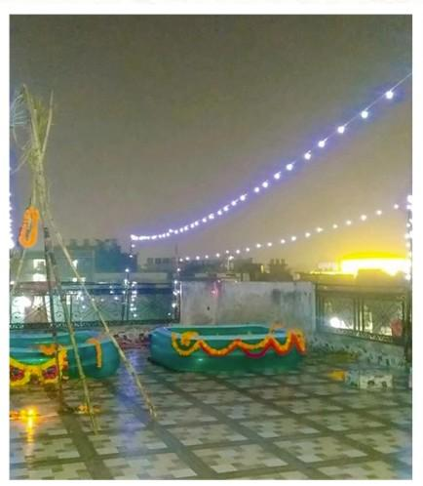
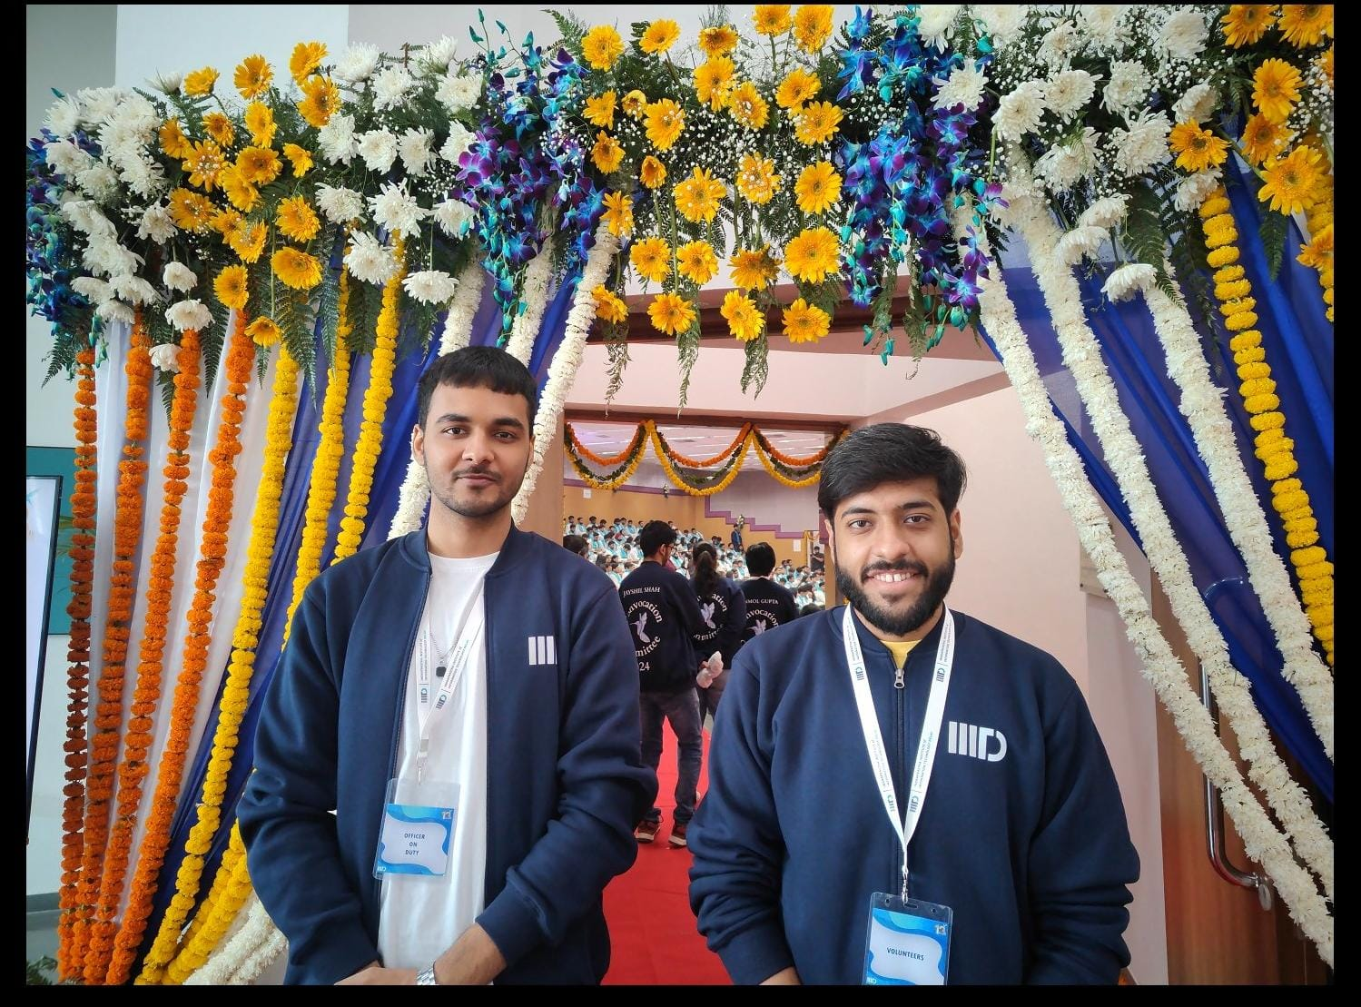
What we have done-1
I have developed a contact network and organized social & personal events.
I have contact 120+ college clubs.
Offline College campus visit.

Slide 3
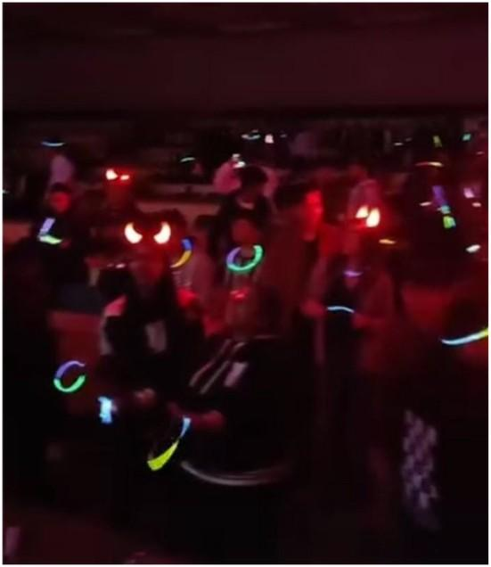
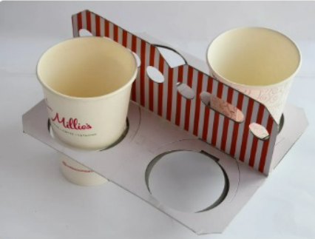
What we have done-2
Bring on new Vendors for different customer events and types.
Created an Instagram post for our startup’s outreach.
Vendors offering eco-friendly event supplies, such as
paper cup bags and trays.

Slide 4
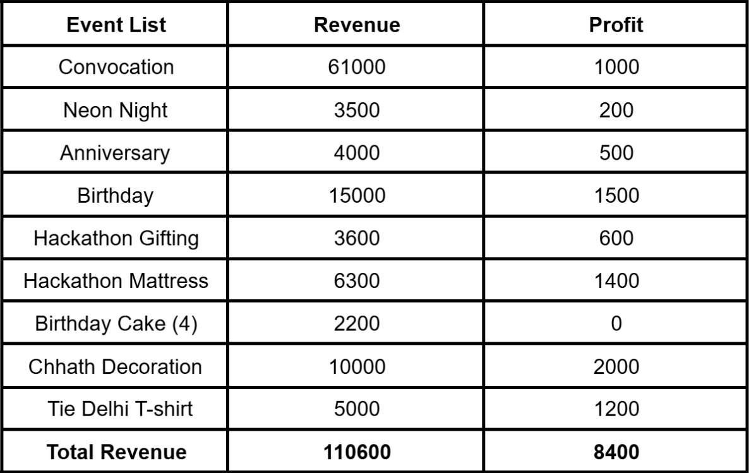
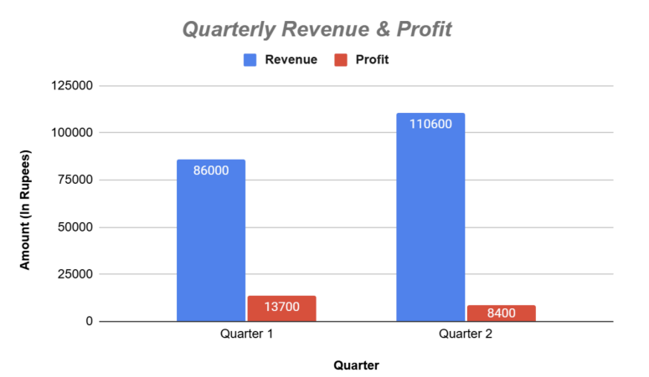
Result and Outcome

Slide 5
Forward-Looking Strategy
Technological Advancements
Eco-Friendly Practices
Service Diversification
---Thank You---

