Slide 1
Detecting Readmission Risk for Diabetic patients.
Team name: Code Syrup
Aarshi Shaikh
Prashant Srivastava
Harsh Tantak
Github link: https://github.com/HarshTantak/J-and-J-hackathon

Slide 2
Why is detecting readmission risk important?
Detecting readmission risk is important for hospitals because it helps ensure better patient care and prevents unnecessary hospital stays. When hospitals can identify patients at risk of being readmitted, they can take early actions to improve their health, reduce complications, and provide the right follow-up care. This helps patients avoid going back to the hospital soon after being discharged. It also helps hospitals make better use of their resources, like staff and hospital beds, since they can focus on high-risk patients and prevent overcrowding. By lowering readmission rates, hospitals can also save on costs and improve their overall performance.

Slide 3
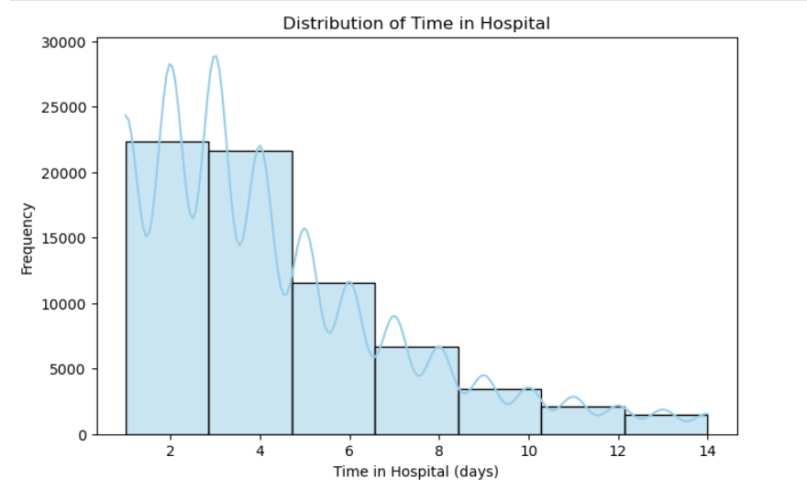
Exploratory Analysis of the Features.
About distribution of time in hospital
The graph shows how long people stay in the hospital. Most people stay for a short time, with two groups being common: one around 2-3 days and another around 6-7 days. As the time in the hospital gets longer, fewer people stay that long. It's like a hill that's longer on one side - this is called a "right-skewed" shape. This means there are a few people who stay in the hospital for a very long time.

Slide 4
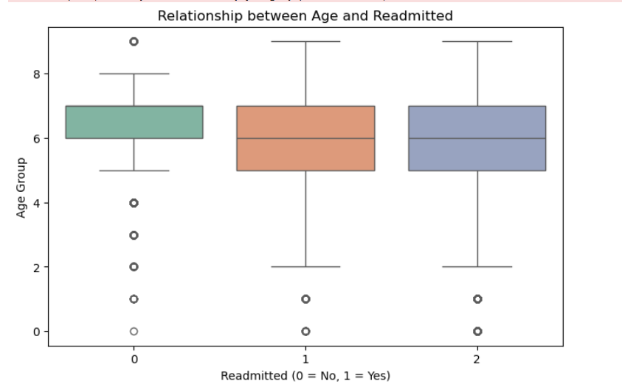
Exploratory Analysis of the Features.
About relationship between age and readmitted
The box plots reveal that the age distribution varies significantly across the readmission categories. In the "No Readmission" group (0), the age range is concentrated in the lower end with a few outliers in the higher age range. For the "Readmitted" groups (1 and 2), the age distribution is more spread out, with a wider range of ages represented. This suggests a potential association between age and the likelihood of readmission.

Slide 5
Assumption
For handling missing data, we made the decision to remove the weight column from the dataset during the data cleaning process. The reason for this was that nearly 95% of the values in this feature were missing, which made it impractical to retain. We assumed that weight does not have a significant impact on predicting the outcomes in our model, and thus, removing it would not affect the overall performance.

Slide 6
Handling missing value
A1Cresult: The A1Cresult feature had some missing values, which we imputed using the mode (the most frequent value). This method was chosen because it helps retain the distribution of values while minimizing the impact of missing data.
medical_specialty: Some rows had the medical_specialty labeled as ?, which represented missing or unknown information. Instead of removing these rows, we stored them in a separate dataframe called unknown_Specialty for further analysis or prediction later. This ensures we don't lose any valuable data and can handle it in a different context where necessary.

Slide 7
Analyzing the Impact of HbA1c on Readmission Title: Impact of HbA1c (A1Cresult) on Readmission
Exploring the relationship between A1Cresult and readmission rates is crucial for our project because it helps us identify a key indicator that could significantly affect the likelihood of early readmission for diabetic patients. A1C levels provide insights into how well a patient’s diabetes is being managed. Since poor diabetes control (indicated by higher A1C levels) often leads to complications, understanding this relationship allows us to better predict which patients are at risk of being readmitted within 30 days of discharge. By focusing on early readmission, we can provide actionable insights to healthcare providers, enabling them to intervene and manage high-risk patients more effectively, thereby improving patient outcomes, reducing readmission rates, and optimizing hospital resources.
Additionally, using Logistic Regression as our model for binary classification ensures that we can effectively assess the likelihood of early readmission based on critical factors like A1Cresult, number of diagnoses, and primary diagnosis. This allows us to build a predictive model that is both interpretable and actionable, providing valuable insights that can directly inform healthcare decision-making.

Slide 8
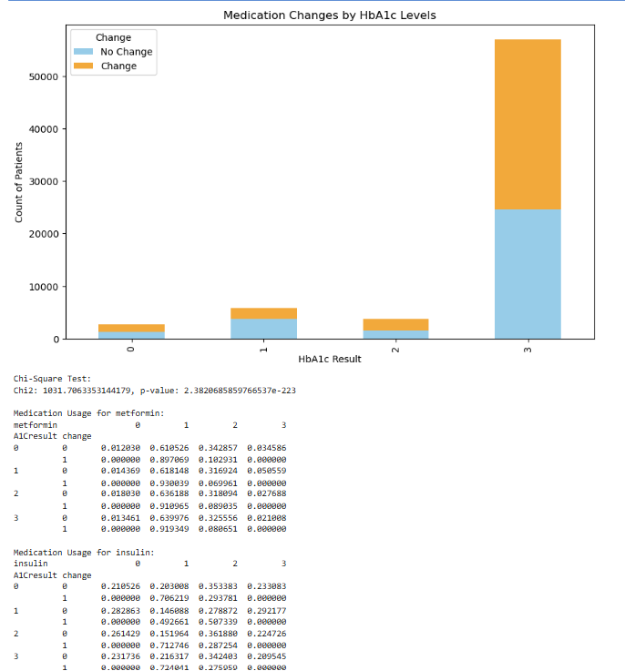
Increase in Medication Changes with Higher HbA1c: As the HbA1c level increases, there is a noticeable rise in the number of patients whose medication was changed. This suggests that doctors are more likely to adjust treatment plans for patients with higher HbA1c levels, indicating a potential association between HbA1c and the need for medication modification. Dominance of "No Change" in Lower HbA1c Groups: In the lower HbA1c groups (0 and 1), the majority of patients experienced no medication changes. This suggests that for patients with well-controlled blood sugar levels, maintaining the current medication regimen is often sufficient. Chi-Square Test Result: The Chi-Square test, with a p-value of 2.38206858597665372-223, indicates a statistically significant association between HbA1c levels and medication changes. This provides further evidence that the observed pattern in the graph is not due to random chance.
For change = 1 (medication changed):
A significantly larger proportion of patients are prescribed metformin = 1. Example: For A1Cresult = 0 and change = 1, 89.71% of patients had metformin = 1.
Dosages 2 and 3 are extremely rare or absent when a medication change occurs.

Slide 9
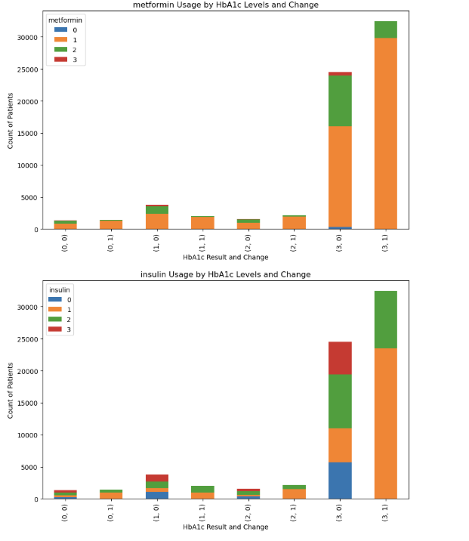
These graphs provide valuable insights into the clinical decision-making process regarding diabetes medication. They demonstrate that:
HbA1c levels play a crucial role in determining the use of both metformin and insulin.
Medication changes are often associated with higher HbA1c levels and are frequently accompanied by the introduction or intensification of insulin therapy.

Slide 10
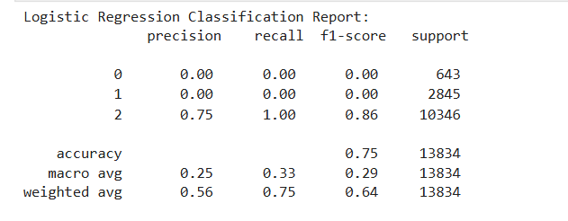
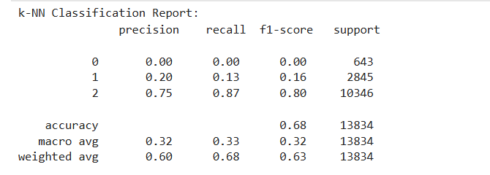
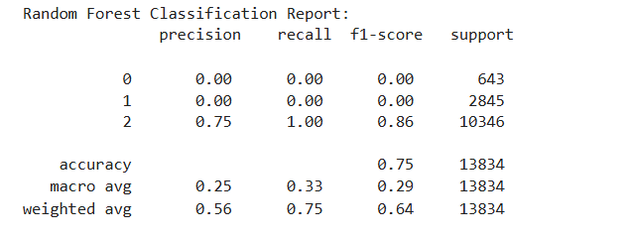
After fitting Logistic Regression, KNN, and Random Forest models, we recommend using Logistic Regression. Although both Logistic Regression and Random Forest have the same accuracy of 75%, we choose Logistic Regression because the target variable is binary (early readmission: Yes or No). Logistic Regression is simpler, easier to interpret, and works well with binary outcomes, making it the best fit for our project.

Slide 11
Multi-Collinearity Detection Title: Detecting Multi-Collinearity in the Dataset
To address multicollinearity, a correlation matrix was used to assess the relationships between predictors and the target variable (early readmission). The analysis revealed no significant evidence of multicollinearity, as correlation coefficients between features were not greater than 0.7. Most variables showed weak correlations with the target variable, and features like number_inpatient, weight, number_diagnoses, and time_in_hospital exhibited weak negative correlations, while payer_code and medical_specialty had weak positive correlations.
If multicollinearity had been present, we could have used Principal Component Analysis (PCA) to reduce dimensionality and transform correlated features into uncorrelated principal components while preserving data variance. However, since no substantial multicollinearity was detected, PCA was deemed unnecessary. Instead, we proceeded with training the model directly on the selected features. This absence of multicollinearity ensures the stability of the model’s coefficients, maintaining both interpretability and predictive power, thereby strengthening our confidence in the performance of logistic regression without the need for feature transformation.

Slide 12
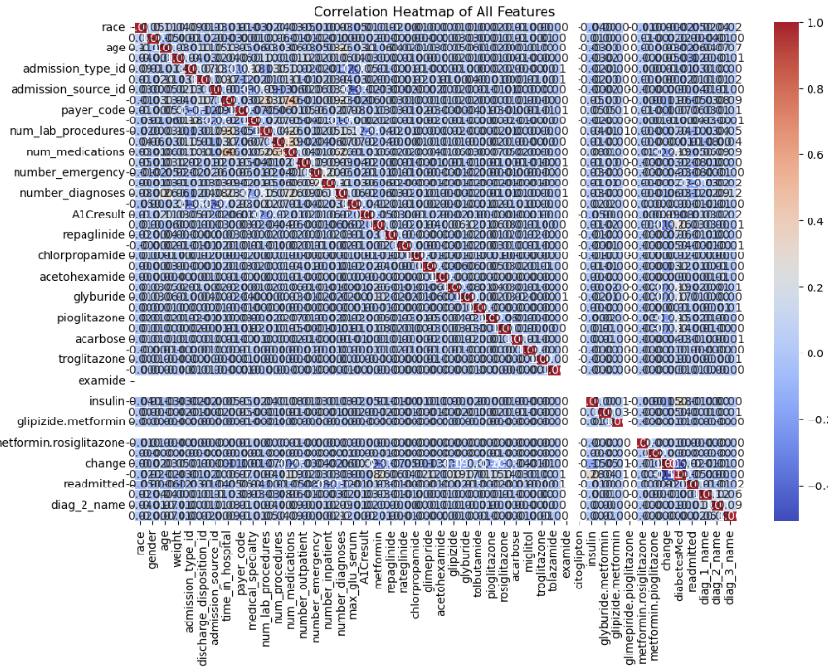
Correlation heatmap

Slide 13
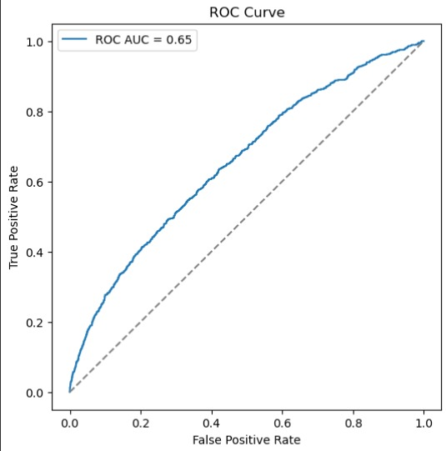
Model validation
Model Validation and Performance Evaluation:
ROC Curve and AUC: The ROC curve illustrates the tradeoff between the true positive rate (sensitivity) and the false positive rate (1-specificity). The AUC (Area Under the Curve) is 0.65, indicating that while the model performs better than random guessing (AUC = 0.5), its overall performance remains modest and could benefit from further optimization.

Slide 14
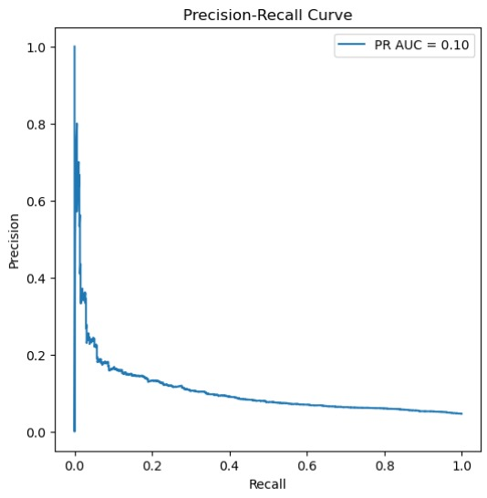
Model validation
2. Precision-Recall Curve and PR AUC:
The Precision-Recall curve shows the balance between precision (positive predictive value) and recall (sensitivity). The PR AUC is 0.10, which is low. This suggests the model struggles with identifying true positives, especially in a heavily imbalanced dataset where the minority class (early readmission) is underrepresented.

Slide 15
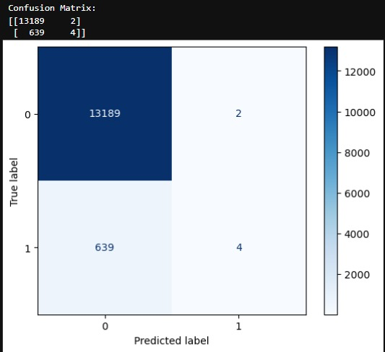
Model validation
3.Confusion Matrix:
True Negatives: 13,189
False Positives: 2
False Negatives: 639
True Positives: 4
The model shows a heavy bias towards predicting the majority class (no early readmission), as indicated by the high true negatives and very low true positives.

Slide 16
Conclusion
Early Readmission Analysis: The logistic regression model identified key factors like time in hospital, number of diagnoses, and changes in medications that affect early readmission. Despite imbalances in the dataset, the model showed moderate performance.
Data Preparation and Model Performance: Effective data preprocessing and feature selection helped build a robust model. While advanced models like Random Forest and KNN improved accuracy, logistic regression was chosen for its interpretability.
Exploratory Insights: Demographic trends showed higher readmission rates in Caucasian males. Longer hospital stays and more medical procedures also increased the likelihood of early readmission. Changes in HbA1c levels were linked to medication adjustments.
Predictive Power of A1C and Medication Changes: Changes in A1C levels and adjustments in diabetes medications showed a strong correlation with readmission, emphasizing the importance of regular monitoring of these parameters in diabetes management.

