Slide 1
Reading CSV Data and Plotting Candlestick Patterns
Date: 02/08/23
Name: Harsh Kumar

Slide 2



Story Time

Slide 3
Introduction
Today, we will see our project on developing a Stock Screener Application in Python. Our focus will be on reading CSV data and plotting candlestick patterns using the “mplfinance” library.
The ability to analyze stock data efficiently is essential for traders and investors to make informed decisions. Our application aims to provide a user-friendly interface to visualize and identify candlestick patterns, a popular tool for technical analysis in the financial world.

Slide 4
Contents
Theory
Demonstration
Technical Stacks
Challenges
References
Conclusion

Slide 5
Theory
Candlestick Patterns: An introduction to candlestick charts and how they represent the price movements of a financial instrument over time.
Basic Candlestick Patterns: Explanation of commonly used candlestick patterns like Doji, Hammer, Shooting Star, Bullish Engulfing, and Bearish Engulfing, among others.
Importance of Candlestick Patterns: Understanding how traders use these patterns to identify potential trend reversals and continuation signals.

Slide 6
Candlestick Patterns
Candlestick patterns are a popular form of technical analysis used by traders to interpret price movements and make predictions about future price movements in financial markets, such as stocks, forex, cryptocurrencies, and commodities. These patterns are formed by the price action over a specific period, typically represented by a single candlestick or a combination of multiple candlesticks.
Each candlestick typically represents one trading session (e.g., one day for daily charts) and contains four data points: the opening price, closing price, highest price (high), and lowest price (low) during that session. The body of the candlestick represents the price range between the opening and closing prices, while the "wicks" or "shadows" represent the highest and lowest prices during that session.

Slide 7
Basic Candlestick Patterns
Here are some common candlestick patterns:
Doji:
Hammer and Hanging Man:
Shooting Star and Inverted Hammer:
Bullish and Bearish Engulfing
Morning Star and Evening Star:
Piercing Pattern and Dark Cloud Cover:
Three White Soldiers and Three Black Crows:

Slide 8
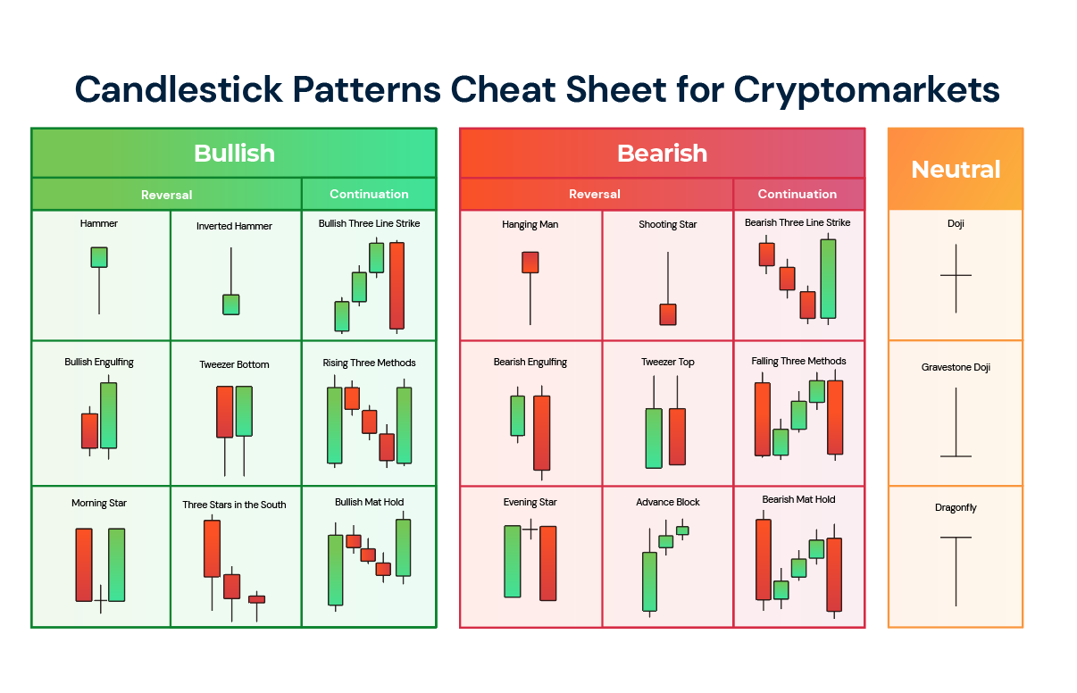

Slide 9
Importance of Candlestick Patterns
It's important to note that while candlestick patterns can provide valuable insights into potential market movements, they are not infallible and should be used in conjunction with other technical analysis tools and indicators to make well-informed trading decisions. Additionally, market conditions can change rapidly, so traders should exercise caution and use risk management strategies when trading based on candlestick patterns.

Slide 10
Demonstration
Walkthrough of the Stock Screener Application: A live demonstration of our Python-based Stock Screener Application.
Loading CSV Data: How the application reads and processes CSV data containing historical stock price information.
Plotting Candlestick Patterns: Step-by-step explanation of the code provided, where we utilize the mplfinance library to plot candlestick charts with volume bars.

Slide 11
Technical Stacks
Python: The programming language used for the development of the Stock Screener Application.
pandas: A powerful library for data manipulation and analysis.
mplfinance: A Python library for plotting financial charts, including candlestick charts.
Jupyter Notebook: The environment used for development and demonstration purposes.

Slide 12
Challenges and Scope of Improvement
Consistent Datasets
Recognition of patterns
Proficiency increase

Slide 13
References
Candlestick Patterns: https://en.wikipedia.org/wiki/Candlestick_pattern
Candlestick Recognition: https://blog.elearnmarkets.com/35-candlestick-patterns-in-stock-market/
mplfinance: https://pypi.org/project/mplfinance/
Plotting in Python: https://www.w3schools.com/python/matplotlib_plotting.asp

Slide 14
Question & Answers
GitHub Link: https://github.com/HarshUmpoxy/PythonProjects
You all may drop any questions in the repo.

Slide 15
Conclusion
Recap of the project's objectives and key takeaways.
Importance of Technical Analysis.
Future Scope.

Slide 16
Thank You
I appreciate your time and attention during this presentation. If you have any questions or feedback, please feel free to ask. Happy trading!

