Slide 1


Noida Institute of Engineering and Technology, Greater Noida
RECENT TRENDS
Unit: 5
ACSAI0622N Social Media Analytics (ACSAI0622N)
Atul Pratap Singh
Assistant Professor
B.Tech CSE[AI]
B Tech 6th Sem

Slide 2


Faculty Introduction
Name | Atul Pratap Singh
Qualification | B.Tech, M.Tech, Ph.D (P)
Designation | Assistant Professor
Department | B.Tech CSE[AI]
Total Experience (NIET Experience) | 15.5 Years (4 Months in NIET)
Subject Taught | Introduction to Artificial Intelligence, Web Technology, Parallel Algorithms, Data Structures…

Slide 3

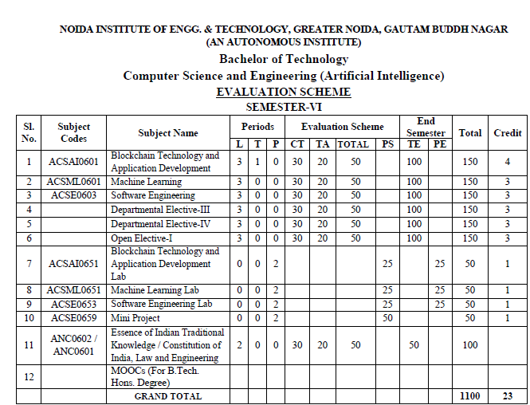
EVALUATION SCHEME

Slide 4
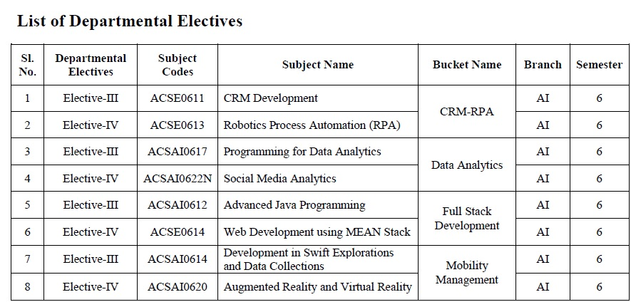
EVALUATION SCHEME

Slide 5

Syllabus
UNIT-I:SENTIMENT MINING
Overview: Text and Sentiment Mining, Semantic Analysis Applications, Sentiment Analysis Process, Speech Analytics, Text Representation- tokenization, stemming, stop words, TF-IDF, Feature Vector Representation, Named Entity Recognition (NER), N-gram modelling, Text Clustering, Text Classification, Topic Modelling-LDA, HDP. Sentiment Classification, feature based opinion mining, comparative sentence, and relational mining, Opinion Summarization, Opinion spam detection.

Slide 6

Syllabus
UNIT-II:WEB MINING
Web Mining Overview, Web Structure Mining, Search Engine, Web Analytics, Machine Learning for extracting knowledge from the web, Inverted indices and Boolean queries. PLSI, Query optimization, SEO, page ranking, social graphs (Interaction, Latent and Following Graphs), Ethics of Scraping, Static data extraction and Web Scraping using Python.

Slide 7
Syllabus
UNIT-III: MINING SOCIAL MEDIA
Introduction to Social Media Mining, Challenges in Social Media Mining, Process of Social media mining, Essentials of social graphs and its types, Social Networks Measures, Network Models, Information Diffusion in social media, Behavioral Analytics, Influence and Homophily, Recommendation in social media.

Slide 8
Syllabus
UNIT-IV: TEXT SUMMARIZATION
Introduction to Text Summarization, Text extraction, classification and clustering, Anomaly and Trend Detection, Text Processing, N-gram Frequency Count and Phrase Mining, Page Rank and Text Rank Algorithm, LDA Topic Modelling, Machine-Learned Classification and Semantic Topic Tagging, Python libraries for Text Summarization. (NumPy, Pandas, Ntlk, Matplotlib).

Slide 9
Syllabus
UNIT-V: RECENT TRENDS
Trend Analysis, Types of trend analysis, Recent Trends in Text, Data Localization Role of Web Mining in E-Commerce, Social Media Analytics, Social media analytics tools.
Case Studies: Facebook Insights Using Python, Sentiment and Text Mining of Twitter data and Google analytics.

Slide 10
Branch Wise Application
1.Security
2. Digital Advertising
3. E-Commerce
4. Publishing
5. Massively Multiplayer Online Games
6. Backend Services and Messaging
7. Project Management & Collaboration
8. Real time Monitoring Services
9.Live Charting and Graphing
10. Group and Private Chat

Slide 11
Course Objective
To understand text mining and social media data analytic activities and apply the complexities of processing text and network data from different data sources.

Slide 12
Course Outcomes (COs)
At the end of course, the student will be able to:
Design new solutions to opinion extraction, sentiment classification and data summarization problems.
Apply a wide range of classification ,clustering ,estimation and prediction algorithms on web data.
Perform social network analysis to identify important social actors, subgroups and network properties in social media sites.
Interpret the terminologies ,metaphors of text summarization.
Apply state of the art mining tools and libraries on realistic data sets as a basic for business decisions and applications.

Slide 13
Program Outcomes (POs)
Engineering Graduates will be able to:
PO1 : Engineering Knowledge
PO2 : Problem Analysis
PO3 : Design/Development of solutions
PO4 : Conduct Investigations of complex problems
PO5 : Modern tool usage
PO6 : The Engineer and Society

Slide 14
Program Outcomes (POs)
Engineering Graduates will be able to:
PO7 : Environment and sustainability
PO8 : Ethics
PO9 : Individual and teamwork
PO10 : Communication
PO11 : Project management and finance
PO12 : Life-long learning

Slide 15

COs - POs Mapping
CO.K | PO1 | PO2 | PO3 | PO4 | PO5 | PO6 | PO7 | PO8 | PO9 | PO10 | PO11 | PO12
CO1 | 2 | 2 | 2 | 3 | 3 | - | - | - | - | - | - | -
CO2 | 3 | 2 | 3 | 2 | 3 | - | - | - | - | - | - | -
CO3 | 3 | 2 | 3 | 2 | 3 | - | - | - | - | - | - | -
CO4 | 3 | 2 | 3 | 2 | 3 | - | - | - | - | - | - | -
CO5 | 3 | 2 | 3 | 3 | 3 | - | - | - | - | - | - | -
AVG | 2.8 | 2.0 | 2.8 | 2.4 | 3.0 | - | - | - | - | - | - | -

Slide 16
Program Specific Outcomes(PSOs)
S. No. | Program Specific Outcomes (PSO) | PSO Description
1 | PSO1 | Apply Artificial Intelligence and its applications to design intelligent systems for the betterment of society.
2 | PSO2 | Develop AI-based innovative solutions demonstrating research, entrepreneurship, professional ethics, and communication skills.
3 | PSO3 | Demonstrate competency in AI by working in a team and engaging in life-long learning.

Slide 17
COs - PSOs Mapping
CO.K | PSO1 | PSO2 | PSO3 | PSO4
CO1 | 3 | - | - | -
CO2 | 3 | 2 | - | -
CO3 | 3 | 3 | - | -
CO4 | 3 | 3 | - | -
CO5 | 3 | 3 | - | -

Slide 18
Program Educational Objectives (PEOs)
Program Educational Objectives (PEOs) | PEOs Description
PEOs | Engage in successful professional practices in the area of Artificial Intelligence and pursue higher education and research.
PEOs | Demonstrate effective leadership and communicate as an individual and as a team in the workspace and society.
PEOs | Pursue life-long learning in developing AI-based innovative solutions for the betterment of society.

Slide 19

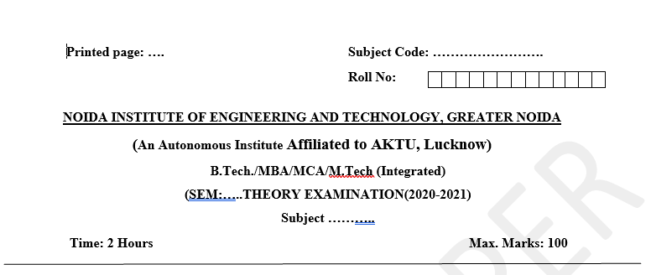
Pattern of External Exam Question Paper (100 marks)

Slide 20
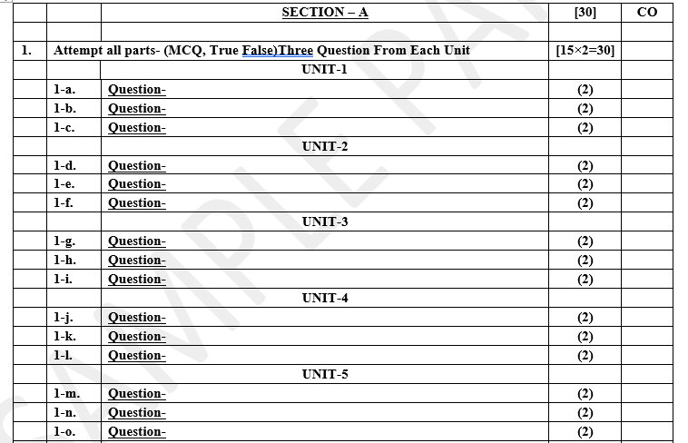
Pattern of External Exam Question Paper (100 marks)

Slide 21
Pattern of External Exam Question Paper (100 marks)

Slide 22
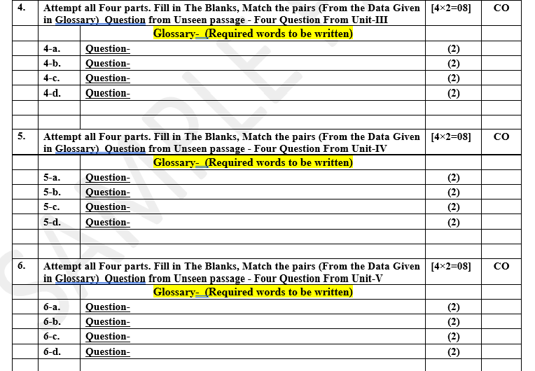
Pattern of External Exam Question Paper (100 marks)

Slide 23
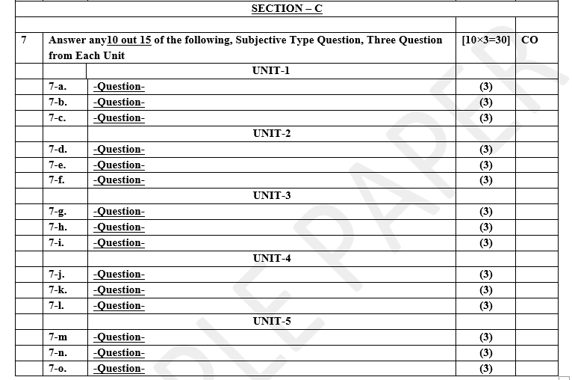
Pattern of Online External Exam Question Paper (100 marks)

Slide 24
Prerequisite / Recap
Student should have knowledge of Knowledge of Data Analysis Tools and Web Technology.
Students should have good knowledge of Python Programming and Python coding experience.
knowledge of Computer and basic skill.
Good problem solving Skill .

Slide 25
Brief Introduction about the Subject with videos
YouTube /other Video Links
https://www.youtube.com/watch?v=Uqs0GewlMkQ
https://www.youtube.com/watch?v=tUNwSH7671Y&t=2s
https://www.youtube.com/watch?v=zz1CFBS4NaY
https://slideplayer.com/slide/14222744/
https://www.youtube.com/watch?v=KjWu1-dZn00
https://www.youtube.com/watch?v=ntOaoW0T604
https://www.youtube.com/watch?v=otoXeVPhT7Q&list=PL34t5iLfZddt0tt5GdDy3ny6X5RQvwrp6&index=2

Slide 26

Unit 5 Content
Trend Analysis
Types of Trend Analysis
Recent Trends in Text
Data Localization
Role of Web Mining in E-Commerce
Social Media Analytics
Social Media Analytics tools
Case Study:- Facebook Insights using Python
Case Study:- Sentiment and Text Mining of Twitter Data
Case Study:- Google Analytics

Slide 27
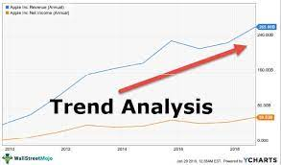
Trend Analysis
Trend analysis involves collecting the information from multiple periods and plotting the collected information on a horizontal line to find actionable patterns from the given information.
Trend analysis is a technique used in technical analysis that attempts to predict future stock price movements based on recently observed trend data. Trend analysis uses historical data, such as price movements and trade volume, to forecast the long-term direction of market sentiment. It include Consumer Insight, Product Development, Brand Perception, Real Time Adaptation etc.

Slide 28
Trend Analysis
Understanding Trend Analysis:
Trend analysis tries to predict a trend, such as a bull market run, and ride that trend until data suggests a trend reversal, such as a bull-to-bear market. Data Analysis, Time Frame Selection, Sentiment Analysis, Visualization etc in Trend analysis is helpful because moving with trends, and not against them, will lead to profit for an investor. It is based on the idea that what has happened in the past gives traders an idea of what will happen in the future. There are three main types of trends: short-, intermediate- and long-term.
Trend analysis, which is a type of comparative analysis, is the process of examining present patterns in order to forecast future ones. This may involve trying to ascertain the likelihood of a present market trend—such as gains in a certain market sector—continuing as well as the possibility that a trend in one market area could lead to a trend in another. Even if a trend analysis could require a lot of data, the accuracy of the findings cannot be guaranteed.

Slide 29
Trend Analysis
What Is a Trend?
A trend is the overall direction of a market during a specified period of time. Trends can be both upward and downward, relating to bullish and bearish markets, respectively. While there is no specified minimum amount of time required for a direction to be considered a trend, the longer the direction is maintained, the more notable the trend. Trends are identified by drawing lines, known as trendlines, that connect price action making higher highs and higher lows for an uptrend, or lower lows and lower highs for a downtrend.

Slide 30
Trend Analysis
What is the Use of Trend Analysis?
It is used by both – Accounting analysis and technical analysis.
Use in Accounting:
Sales and cost information of the organization’s profit and loss statement can be arranged on a horizontal line for multiple periods and examine trends and data inconsistencies. For instance, take the example of a sudden spike in the expenses in a particular quarter followed by a sharp decline in the next period, which is an indicator of expenses booked twice in the first quarter. Thus, the trend analysis in accounting is essential for examining the financial statements for inaccuracies to see whether certain heads should be adjusted before the conclusion is drawn from the financial statements.

Slide 31
Trend Analysis
Use in Technical Analysis:
An investor can create his trend line from the historical stock prices, and he can use this information to predict the future movement of the stock price. The trend can be associated with the given information. Cause and effect relationships must be studied before concluding the trend analysis.

Slide 32
Trend Analysis
Examples of Trend Analysis:
Examining sales patterns to see if sales are declining because of specific customers or products or sales regions.
Examining expenses report claims for proof of fraudulent claims.
Examining expense line items to find out if there are any unusual expenditures in a reporting period that require further investigation.
Forecast revenue and expense line items into the future for budgeting
for estimating future results.
Social Media Engagement Trends use to complete task and sales target on
time.
Patient outcomes in Healthcare is used to complete health delivery.

Slide 33
Trend Analysis
What is the Importance of Trend Analysis?
The trend is the best friend of the traders is a well-known quote in the market. Trend analysis tries to find a trend like a bull market run and profit from that trend unless and until data shows a trend reversal can happen, such as a bull to bear market. It is most helpful for the traders because moving with trends and not going against them will make a profit for an investor.
Trends can be both growing and decreasing, relating to bearish
and bullish market.
While no specified minimum amount of time is required for a direction to be considered a trend, the longer the direction is maintained, the more notable the trend.

Slide 34
Questions
How do you analyse trend analysis?
Explain two examples of trend analysis.
Which graph is used for trend analysis?
Which is the best tool for trend analysis?
How we can analyze trend in terms of Social Media and Market?

Slide 35
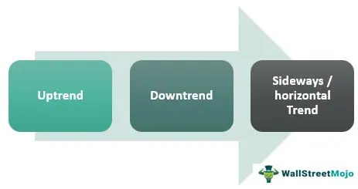
Types of Trend Analysis

Slide 36
Types of Trend Analysis
1) Uptrend
An uptrend or bull market is when financial markets and assets – as with the broader economy-level – move upward and keep increasing prices of the stock or the assets or even the size of the economy over the period. It is a booming time where jobs get created, the economy moves into a positive market, sentiments in the markets are favorable, and the investment cycle has started.
2) Downtrend
Companies shut down their operation or shrank the production due to a slump in sales. A downtrend or bear market is when financial markets and asset prices – as with the broader economy-level – move downward, and prices of the stock or the assets or even the size of the economy keep decreasing over time. Jobs are lost, asset prices start declining, sentiment in the market is not favorable for further investment, and investors run for the haven of the investment.

Slide 37
Types of Trend Analysis
3) Sideways / horizontal Trend
A sideways/horizontal trend means asset prices or share prices – as with the broader economy level – are not moving in any direction; they are moving sideways, up for some time, then down for some time. The direction of the trend cannot be decided. It is the trend where investors are worried about their investment, and the government is trying to push the economy in an uptrend. Generally, the sideways or horizontal trend is considered risky because when sentiments will be turned against cannot be predicted; hence investors try to keep away in such a situation.

Slide 38
Questions
What are the three categories of trends?
Explain role of trend analysis in Finance.
What should a trend analysis include?

Slide 39
Recent Trends in Text
Fusion of text (unstructured) data with structured data:
To achieve results that cannot be achieved by either data set alone. "A good example of this are cell phones that interpret ambiguous sounding names by referencing the structured contacts list".
Increase in interest in multilingual text analytics:
"Vendors from outside the US are slowly making headway in text analytics for languages other than English, and their clients are our international competitors”.
3) Finding trends and trending events in news streams:
"Uncovering new trends - historical data is good for helping to predict future things - as long as the environment is consistent”.

Slide 40
Recent Trends in Text
4) Algorithmic understanding of social media comments:
"In recent years, text analytics has made a significant footing in Social Media Analytics impacting brand management and viral marketing promotions".
5) Use of text analytics for getting insights from unstructured Big Data: "Everyone is talking about Big Data. The real issue is how you can extract relationships between textual information and disparate objectives”.
6) Advances in machine learning:
"The advent of high-performance machine learning algorithms that enable rapid training over very large, high-dimensional vector spaces".
7) Integration of different capabilities:
"Today we can see the integration of categorization/coding/rule building, predictive modeling and sentiment analysis, visualization."

Slide 41
Data Localization
Data Localization
The process of keeping and handling data inside the boundaries of a certain nation or area as opposed to enabling its worldwide transmission and processing is known as data localization. Due to worries about data security, privacy, and local law compliance, this idea has become more popular. Ensuring that specific data types stay inside the bounds of a given geographic area—whether physically or legally—is the goal of data localization.
Key Points of Data Localization is:-
Compliance with Law and Regulation:- A number of nations have passed laws and rules requiring the processing and storage of specific kinds of data inside their borders. This is frequently carried out to safeguard private information, respond to privacy issues, and guarantee adherence to regional data protection laws.
Data Sovereignty:- The idea of data sovereignty, in which a nation claims ownership over the data created and gathered under its borders, is frequently linked to data localization.
Protection against Unauthorized Access:- Countries try to lower the possibility of illegal access by foreign entities by localizing data.

Slide 42
Data Localization (Cont.)
Privacy and Security:- Maintaining data inside a designated geographic region is thought to improve data security and privacy. It can lessen the dangers connected to international data transfers.
Challenges for Global Business:- While certain concerns may be addressed by data localization techniques, they can provide difficulties for multinational corporations that conduct cross-border operations. It can be difficult to comply with many sets of data localization requirements, which could impede data flow.

Slide 43
Role of Web Mining in E-Commerce
Web mining is a vital tool in the E-Commerce industry because it can extract useful facts and insights from vast amounts of publicly available data. Web mining techniques are applied in e-commerce to improve customer experiences, decision-making processes, and corporate competitiveness. Web mining plays the following important roles in E-Commerce:
Market Basket Analysis:-
Function: Web mining, in particular market basket analysis, facilitates the discovery of correlations and trends in the purchasing habits of clients. b). Application: Product placement is optimized, personalized product recommendations are made, and successful cross-selling and upselling tactics are created by e-commerce companies using this data.
2. Customer Behavior Analysis:-
Function: Web mining examines user activity on e-commerce websites, such as clickstream data, browsing trends, and time spent on pages.
Application: By comprehending consumer behaviour, companies may better target their marketing efforts to the interests and demands of their target audience and optimise the design and navigation of their websites.

Slide 44
Role of Web Mining in E-Commerce (Cont.)
3. Customization:
Role: By evaluating past data and forecasting user preferences, web mining makes it possible to create individualized user experiences.
Application: To improve customer engagement and happiness, e-commerce platforms employ personalization to display targeted adverts, suggest goods, and customize content.
4. Systems of Recommendations:
Function: Recommendation systems that make product or service recommendations based on user behavior and preferences are constructed using web mining algorithms.
Application: Recommendation systems are used by e-commerce companies to improve user experience, boost revenue, and cultivate client loyalty.
5. Optimization of Price:
Function: Web mining aids in the analysis of market trends and rivals' pricing strategies.
Application: To maintain competitive pricing, maximize revenue, and optimize profit margins, e-commerce companies modify their pricing models in response to information gleaned from web mining.

Slide 45
Role of Web Mining in E-Commerce (Cont.)
6 . Fraud Protection and Identification:
Function: Web mining, in particular anomaly detection, helps find odd trends that can point to fraud.
Application: Web mining is used by e-commerce platforms to identify and stop fraudulent transactions, safeguarding the company and its clients.
7. Analysis of Customer Sentiment:
Role: To determine sentiment, web mining techniques examine feedback, social media comments, and consumer reviews.
Application: Sentiment analysis is used by e-commerce companies to learn about consumer satisfaction levels, pinpoint areas for development, and modify marketing plans as necessary.
8. Management of Inventory:
Function: Demand forecasting and inventory management optimization are made easier by web mining.
Application: To maintain ideal stock levels, lower overstock and stockouts, and improve overall supply chain efficiency, e-commerce platforms make use of data-driven insights.

Slide 46
Role of Web Mining in E-Commerce (Cont.)
9 . Adaptive Web Design:
Function: Web mining aids in comprehending user preferences for the layout and content of websites.
Application: Based on data mining, e-commerce websites modify their navigation, content, and layout to make their site more user-friendly and boost engagement and conversion rates.

Slide 47
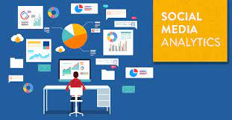
Social Media Analytics
Social Media Analytics
Social Media Analytics is the process of collecting and analyzing audience data shared on social networks to improve an organization's strategic business decisions.
Social media can benefit businesses by enabling marketers to spot trends in consumer behavior that are relevant to a business's industry and can influence the success of marketing efforts.

Slide 48
Social Media Analytics (Cont.)
What are the use cases of Social Media Analytics?
1) Measure the ROI of social media marketing efforts:
The main goal for any social media post, like, retweet or share is ROI.
To determine social media ROI, marketers must first determine an initial benchmark and then have a way to measure key performance indicators (KPIs) against that benchmark over time.
2) Track the efficiency of marketing teams:
Most organizations strive to streamline workflows and enable team members to be more productive. A lesser known, but still important, feature of Social Media Analytics is its ability to improve efficiency with your marketing team.

Slide 49
Social Media Analytics (Cont.)
Improve strategic decision-making:
Social Media Analytics can improve a marketing team's ability to understand what social media strategies are working and which ones aren't as effective.
However, the analytical results can also provide insight that can be useful for making business decisions about other important aspects of the business not necessarily directly related to the marketing campaigns.
It may include:-
Objectives and Key Metrics.
Integrated Data Source.
Implement Social Listening.
Benchmark Strategies for Competitors.

Slide 50
Social Media Analytics (Cont.)
What metrics should be tracked with Social Media Analytics?
There are six general types of social media metrics that should be tracked.
1) Performance metrics
Measuring the performance of social media marketing efforts is critical to understanding where strategic efforts are working and where improvement is needed.
Key performance metrics to track include the following:
• interactions across platforms and over time to determine if the posted content is properly engaging the audience;
• whether the number of followers is increasing over time to verify consistent progress across platforms; and
• click-through rate for link clicks on posts to see if they're properly driving traffic from social media channels.

Slide 51
Social Media Analytics (Cont.)
2) Audience analytics
It's important to clearly understand and define the target audience, as it is the most important element of a social media strategy. Understanding the audience will help create a favorable customer experience with content targeted at what customers want and what they're looking for.
In the past, audience data was difficult to measure as it was scattered across multiple social media platforms. But with analytics tools, marketers can analyze data across platforms to better understand audience demographics, interests and behaviors. AI-enabled tools can even help predict customer behavior. They can also study how an audience changes over time.
The better targeted the content is, the less advertising will cost and the cost-per-click of ads can be optimized.

Slide 52
Social Media Analytics (Cont.)
3) Competitor analytics
To obtain a full understanding of performance metrics, it's necessary to look at the metrics through a competitive lens. In other words, how do they stack up to competitors' performance?
With Social Media Analytics tools, social media performance can be compared to competitors' performance with a head-to-head analysis to gauge relative effectiveness and to determine what can be improved.
Most modern tools that include AI capabilities can benchmark competitor performance by industry to determine a good starting point for social media efforts.

Slide 53
Social Media Analytics (Cont.)
4) Paid social analytics
Ad spending is serious business. If targeting and content isn't right, it can end up an expensive proposition for unsuccessful content. More advanced analytics tools can often predict which content is most likely to perform well and be a less risky investment for a marketing budget.
For best results, an all-in-one platform is the preferred choice to track performance across all social media accounts such as Twitter analytics, paid Facebook posts or LinkedIn ads. Important metrics to track include the following:

Slide 54
Social Media Analytics (Cont.)
• Total number of active ads
• Total ad spend
• Total clicks
• Click-through rate
• Cost per click
• Cost per engagement
• Cost per action
• Cost per purchase
Cost per Acquisition
These metrics will indicate exactly where each dollar spent is going and how much return is being generated for social media efforts. They can also be compared against competitor spending to ensure that spending is at an appropriate level and to reveal strategic opportunities where an increased share of voice may be attainable.

Slide 55
Social Media Analytics (Cont.)
Influencer analytics
To gain a leg up on competition in a competitive space, many social media marketers will collaborate with social influencers as part of their marketing campaigns. To make the most of partnerships, it's necessary to measure key metrics to ensure that the Influencer marketing is achieving desired goals.
Social Media Analytics can provide insights into the right metrics to ensure that influencer campaigns are successful. Some influencer metrics that should be tracked include the following:

Slide 56
Social Media Analytics (Cont.)
• Total interactions per 1,000 followers to understand if they're properly generating engagement;
• Audience size and most frequently used hashtags, to help determine the maximum reach of your campaign;
• The number of posts influencers create on a regular basis, to help determine how active they are and how powerful engagement can be; and
• Past collaborations, which can be a great indicator of the potential for success with an influencer.
Conversion Tracking need to be measure the tangible impact on revenue.
Influencer network analysis need to be check.
Influencer tactics that are tailored to new trends guarantee that target audiences are reached with relevance and efficacy.

Slide 57
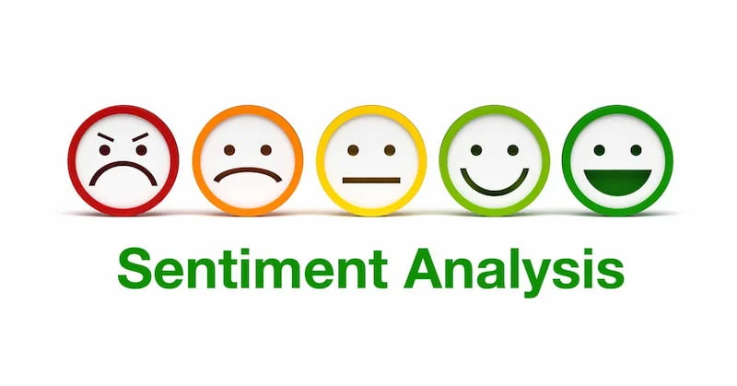
Social Media Analytics (Cont.)
Sentiment analysis
Sentiment analysis is an important metric to measure as it can indicate whether a campaign is gaining favorability with an audience or losing it. And for customer service oriented businesses, sentiment analysis can reveal potential customer care issues.
To ensure that a campaign is in sync with the target audience and maintains a strong rate of growth, interactions and engagement rate should be tracked over time. A decline could indicate that a change of course is needed.

Slide 58
Questions
What do you understand by social media analytics?
How is sentiment analysis performed when analyzing the results of a survey or poll?
Can you give me some examples of how social media analytics is used in real-world applications?
What are some common techniques that can be used to perform sentiment analysis on text data?

Slide 59
Social Media Analytics tools
While many businesses use some sort of social media management tool, most of these baseline scheduling tools don't go far enough to provide the in-depth metrics and data points that Social Media Analytics tools can deliver.
Not only can this deeper level of insight go a long way to inform a successful campaign, it can also be shared with stakeholders to show high-level ROI across disparate social media channels.
An effective analytics tool will have an intuitive, easy-to-use interface that enables transparency in a campaign; it should also streamline the social media marketing processes and workflows.
Examples of Social Media Analytics tools include Sprout Social, Google Analytics, Hootsuite, Social Blade, Bitly and Buffer Analyze.

Slide 60
Social Media Analytics tools (Cont.)
1) Followerwonk
Followerwonk helps you explore and grow your social graph. You can dig into your Twitter analytics to learn who your followers are, where they’re located, and when they tweet. The app creates actionable visualizations that enable you to compare your social graph to others, as well as find and connect with influencers.
2) Buffer
Buffer is a great tool that will help you in two main ways. You can write a few of posts at a time and choose which social profiles to send them to, and then Buffer will spread them throughout the day or week so that you don’t have to be at a computer all the time in order to have a social media presence. It also shortens your links and tracks engagement so you can see how many people clicked on them.

Slide 61
Social Media Analytics tools (Cont.)
3) SumAll
SumAll helps guide your decision making by connecting all your key online marketing and e-commerce data in one interactive chart. Features include real-time data monitoring, goal tracking, viewing new vs. returning customers, and trendlines that project future performance.
4) Quintly
Quintly is a social media benchmarking and analytics solution that tracks and compares the performance of your social media marketing activities. Whether you are using Facebook, Twitter, YouTube, Google+, or all of them, their tool visualizes and checks your social marketing success, benchmarking your numbers against your competitors or best practices.

Slide 62
Social Media Analytics tools (Cont.)
5) Cyfe
Cyfe is an all-in-one dashboard that helps you monitor and analyze data found across all your online services, including Google Analytics, Salesforce, AdSense, MailChimp, Amazon, Facebook, WordPress, Zendesk, and Twitter from one single location in real time. No more wasting countless hours tracking down your data from all over the Web every day!
6) Keyhole
Keyhole provides real-time social conversation tracking for Twitter, Facebook, and Instagram. It helps you measure and amplify conversations around your brand and campaigns, enables you identify prospective clients and influencers talking about (or looking for) your services, and aids in driving engagement by finding and re-sharing relevant content.

Slide 63
Social Media Analytics tools (Cont.)
7) Klout
Klout measures influence based on your ability to drive action across the social Web. When you connect your social media accounts, it generates a score on a scale of 1-100 that represents your ability to engage other people and inspire social actions. The platform helps you gain insights that allow you better understand how you influence others.
8) ViralWoot
ViralWoot enables you to get more exposure for your Pinterest profile and your pins. You earn “seeds” (points) by following other users and re-pinning. It also helps with scheduling so your visibility is increased, and you can create alerts that let you know when other users are pinning your content.

Slide 64
Social Media Analytics tools (Cont.)
9) Addictomatic
Addictomatic is straightforward tool that can be used to monitor your brand’s influence and reputation. Its discovery platform searches Google, Bing, Twitter, WordPress, YouTube, and Flickr to find the most recent blog posts, news, images, or videos based on your keywords. It breaks the search results into headers, making them easier to navigate.
10). Social Blade
A tool called Social Blade offers statistics and analytics for Twitter, Instagram, Twitch, YouTube, and Facebook. It provides information on engagement rates, follower growth, and historical data.
11). Bitly
Although its main function is link shortening, Bitly also provides some simple link tracking metrics. For their shortened links, users can see click-through rates, geographical data, and referral sources.

Slide 65
Questions
What type of software tools does one need to perform social media analytics?
What are some popular platforms for performing social media analytics?
What factors should we consider before choosing a tool or platform for performing social media analytics?

Slide 66
Case Study:- Facebook Insights using Python
Facebook Insights is an analytics tool provided to Facebook page owners or platform administrators. Facebook Insights generates metrics that allow administrators to analyze trends about the activity on a given page. It provides comprehensive statistics and metrics that can assist page managers in comprehending the performance of their content and gaining knowledge about the behaviour of their audience.This includes information about page users' (fans') growth and demographics, and their consumption of provided content. The information is gathered on a daily basis and is designed to help page operators better understand their users, allowing them to better manage their content to appeal to the target audience.

Slide 67
Case Study:- Facebook Insights using Python (Cont.)
Facebook Insights provides data on a number of areas. These include:
User Activity: Information on the page views and tab views that occur on a Facebook page. Information about external referrers to the page and users' consumption of content (such as links and video) is also provided.
Interactions: Data on how a page's users comment, share or like content on a given Facebook page. This includes information on daily page activity, views and user feedback.

Slide 68
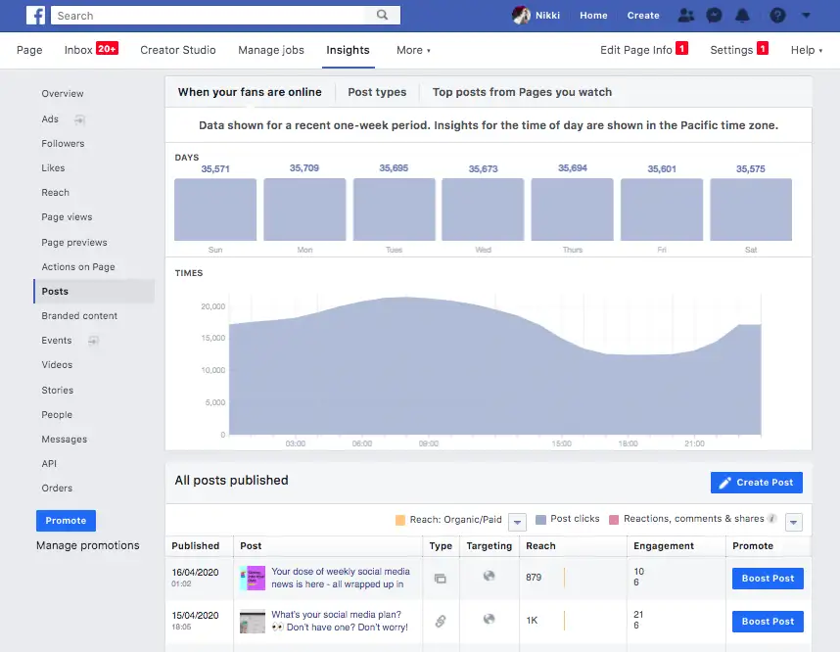
Case Study:- Facebook Insights using Python (Cont.)

Slide 69
Case Study:- Facebook Insights using Python (Cont.)
Where is Facebook Insights?
To access Facebook Insights, you'll need to have a business page. Then, follow the steps below:
Once you log into Facebook, head to your business page. Then, click on "Insights," located on the sidebar to the left of the page.
You'll land on the "Overview" page which features a dashboard with three main categories. The first is your page summary, which shows key metrics from the last seven days. However, you can also view data from today, yesterday, and the last 28 days.
Once you scroll down, you'll see insights on your most recent posts.
You'll find a number of tabs and sections offering details on Page Summary, Posts, Stories, Videos, People, and more within the Insights area.

Slide 70
Case Study:- Facebook Insights using Python (Cont.)
4) The last section features insights from your competitors. In this section, Facebook can recommend pages to watch, but you can also customize which brands' performance you track by clicking "Add Pages”.
5) To dive deeper into these metrics, you can click each category listed on the sidebar to the left of the dashboard.

Slide 71
Case Study:- Facebook Insights using Python (Cont.)
How to Use the Facebook Insights API?
The Facebook Insights API, also known as the Ads Insights API, allows you to fetch ad data to track your ad performance. The API is particularly useful because it allows marketers to pull the exact data they want to track, no matter how granular.
To fetch the data from the API, you must determine what data you want to pull and create an access token for that ad, so that only your team can access that information. You'll then need to determine where to import that data, like Google Sheets or HubSpot's ads software within the Marketing Hub.

Slide 72
Case Study:- Facebook Insights using Python (Cont.)
How to Export Facebook Insights Data?
Start on your dashboard overview. On the top right corner of your "Page Summary," you'll see "Export Data”.
A window will pop up. From there, you'll narrow down what data to export, the data range, file format and layout.
Click "Export Data" and you're all set.

Slide 73
Case Study:- Facebook Insights using Python (Cont.)
Analyzing Facebook Page Insight using Python
There are multiple processes involved in creating a thorough case study for Facebook Insights using Python. These include gaining access to the Facebook Graph API, obtaining data, and conducting analysis. An outline of a case study that covers the fundamental steps is provided below.
Goal: Utilizing Python and the Facebook Graph API, examine important Facebook Page metrics.
Tools and Technologies:
Python (programming language)
Facebook Graph API
Python libraries: requests, matplotlib, pandas, etc.

Slide 74
Case Study:- Facebook Insights using Python (Cont.)
Steps:-
Set Up Facebook App
a. Register as a developer on Facebook.
b. To get an App ID and App Secret, create a new Facebook application.
c. Assign the rights required to view the Facebook Page Insights.
2. Use pip to install the necessary Python libraries.
3. Access Facebook Graph API
a. To get an access token for your Facebook Page, use the App ID and App Secret that were generated.
b. To send queries to the Facebook Graph API, use the access token.
4. Get insights from your Facebook page:
Use the Facebook Page's API to request insights data.
Endpoint: /vX.X/{page-id}/insights (Insert your actual Page ID here, and replace X.X with the API version).

Slide 75
Case Study:- Facebook Insights using Python (Cont.)
5. Parse and Store Data:
a. Parse the JSON response obtained from the API.
b. Store the relevant metrics (e.g., page likes, post reach, engagement) in a structured format, such as a Pandas DataFrame.
6. Data Analysis and Visualization:
a. Use Pandas for data manipulation and analysis.
b. Create visualizations (e.g., line charts, bar charts) using Matplotlib to illustrate trends in metrics over time.
7. Interpretation and Insights:
a. Analyze the visualizations to derive insights about the performance of the Facebook Page.
b. Identify patterns, peaks, and troughs in metrics.
c. Assess the impact of specific posts, campaigns, or events on engagement and reach.
8. Automate Data Retrieval (Optional):
a. Create a script to automate the process of retrieving Facebook Insights regularly.
b. Implement error handling and logging to ensure the reliability of the data extraction process..

Slide 76
Case Study:- Facebook Insights using Python (Cont.)
Python Code for Example:-
import requests
import pandas as pd
import matplotlib.pyplot as plt
# Replace with your actual values
access_token = 'your_access_token'
page_id = 'your_page_id'
api_version = 'v12.0'
# Construct API endpoint
endpoint = f'https://graph.facebook.com/{api_version}/{page_id}/insights'
params = {'access_token': access_token}
# Make API request
response = requests.get(endpoint, params=params)
data = response.json()
# Parse and store relevant data in a Pandas DataFrame
insights_data = pd.DataFrame(data['data'])
# Data analysis and visualization (example: line chart of page likes over time)
plt.plot(insights_data['time'], insights_data['values'])
plt.title('Page Likes Over Time')
plt.xlabel('Date')
plt.ylabel('Page Likes')
plt.show()

Slide 77
Case Study:- Twitter Analytics
What is Twitter Analytics?
Twitter analytics allows you to track and view key metrics, like follower gain/loss, Top Tweet, Audience Insight, impressions, engagement rate, retweets and more. The tool has been around since 2014 and is available to all Twitter users, including both personal and business accounts.
Using Twitter Analytics for business helps you make data-driven decisions about your social media strategy. Armed with data, you can optimize your Twitter campaigns to get better results and more followers without guessing whether your plan will work or not.

Slide 78
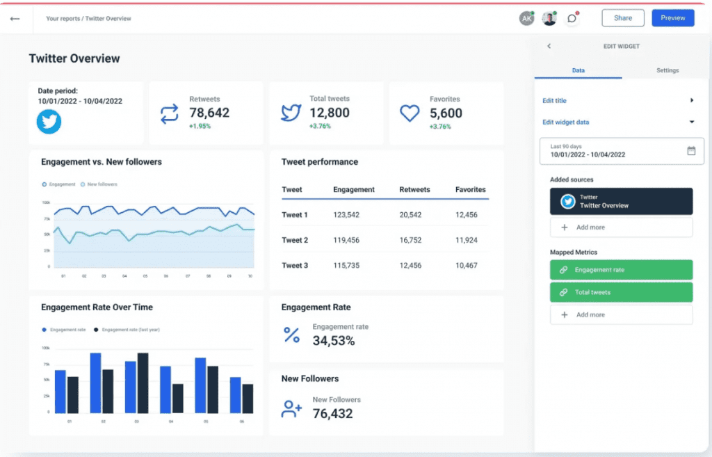
Case Study:- Twitter Analytics

Slide 79
Case Study:- Twitter Analytics (Cont.)
Benefits of tracking Twitter analytics
Learning what your audience really wants:
Through Twitter analytics, you’ll find valuable audience insights that will tell you what your followers respond to the most. Text posts? Photos? Video? Polls? Cat GIFs? All of the above, but only on Sundays?
Without data, you’ll never know for sure what type of content will be a hit and what will miss the mark.

Slide 80
Case Study:- Twitter Analytics (Cont.)
Tracking your growth
Ditch your spreadsheets and leave the math to Twitter analytics. Track your follower gain or loss per month and see growth trends over time.
Having analytics data lets you see what types of content are getting you new followers (or turning people away).

Slide 81
Case Study:- Twitter Analytics (Cont.)
Figuring out the best time to post
With Twitter analytics, you can tell when your Tweets are getting the most engagement. You’ll be able to see patterns for what times of day work best. Don’t stress too much about it, though: 42% of American users check Twitter once a day, and 25% check it several times a day.

Slide 82
Case Study:- Twitter Analytics (Cont.)
What can you track with Twitter analytics?
Here’s what you can find out with Twitter analytics.
The dashboard page
This is what you see when you first navigate to Twitter analytics. It shows you a monthly overview of your top stats, including your:
Top Tweet (by number of impressions)
Top mention (by engagements)
Top media Tweet (ones that include an image or video)
Top follower (the person with the most followers who started following you in the current month)
It also includes a short summary of your activity that month.

Slide 83
Case Study:- Twitter Analytics (Cont.)
The Tweets page
You can see all your Tweets’ impressions and engagement rates in the chosen time period, which defaults to the past 28 days. This is also where you view stats on your Promoted Tweets (paid advertising).
Along the right side, you can also view your average:
Engagement rate
Link clicks
Retweets
Likes
Replies

Slide 84
Case Study:- Twitter Analytics (Cont.)
The Video page
Under the “More” tab at the top, you’ll find the video page. However, this page only shows stats for video content uploaded via Twitter’s Media Studio or for Promoted video ads.
Like the Tweets page, you can view similar video engagement stats here:
Views
Completion rate (how many people watched until the end)
Total video minutes viewed
Retention rate

Slide 85
Case Study:- Twitter Analytics (Cont.)
The conversion tracking page
Also under the “More” tab is the conversion tracking page. To use it, you first need to set up Twitter conversion tracking on your website. After it’s set up, you’ll see conversion data for Twitter Ads here and can export it as a .CSV file.

Slide 86
Case Study:- Sentiment and Text Mining of Twitter Data
Understanding the sentiment expressed in tweets and drawing conclusions from them are the goals of sentiment analysis and text mining of Twitter data. Businesses, researchers, and organizations can monitor brand perception, ascertain trends, and ascertain public opinion with the use of this procedure.
Tools & Technologies:-
1. Twitter API: To retrieve tweets historically or in real time, you must have access to the Twitter API.
2. Python: Because of its extensive library ecosystem, Python is a popular language for text mining and sentiment analysis.
3. Tweepy: To access the Twitter API, use the Python module Tweepy. It makes the process of getting tweets easier.
4. TextBlob or NLTK: These Python libraries—TextBlob and NLTK, or Natural Language Toolkit—offer textual data processing capabilities, such as sentiment analysis.
5. Pandas: For managing and evaluating structured data, Pandas is an effective Python data manipulation toolkit.

Slide 87
Case Study:- Sentiment and Text Mining of Twitter Data (Cont.)
Steps:-
1. Set Up Twitter API Access:
Create a Twitter Developer account and create an application to obtain API keys and tokens.
2. Install Required Python Libraries:
pip install tweepy textblob pandas matplotlib
3. Get Twitter Information:
To obtain tweets based on search searches, user timelines, or streaming, use Tweepy to connect to the Twitter API.
import tweepy
# Set up Tweepy with API keys and tokens
auth = tweepy.OAuthHandler('consumer_key', 'consumer_secret')
auth.set_access_token('access_token', 'access_token_secret')
api = tweepy.API(auth)

Slide 88
Case Study:- Sentiment and Text Mining of Twitter Data (Cont.)
4. Text Cleaning: Remove stop words, special characters, URLs, and other information from the text data before processing it.
5. Sentiment Analysis: To analyze sentiment, use NLTK or TextBlob. For example, TextBlob offers an easy-to-use API for tackling typical natural language processing (NLP) problems.
from textblob import TextBlob
# Analyze sentiment of a tweet
def analyze_sentiment(tweet):
analysis = TextBlob(tweet)
return analysis.sentiment.polarity
6. Apply Sentiment Analysis to Twitter Data: Assign a sentiment score to each tweet by iteratively going through the obtained tweets and using the sentiment analysis tool.
7. Aggregate and Visualize Results: Utilize Pandas for combining sentiment scores, and Matplotlib or Seaborn for generating word clouds or sentiment trends over time as visual representations.

Slide 89
Case Study:- Sentiment and Text Mining of Twitter Data (Cont.)
import pandas as pd
import matplotlib.pyplot as plt
# Create a DataFrame from the tweets
df = pd.DataFrame({'Tweets': tweets, 'Sentiment': sentiment_scores})
# Plot sentiment distribution
df['Sentiment'].plot(kind='hist', bins=3, rwidth=0.8)
plt.xlabel('Sentiment')
plt.title('Sentiment Distribution')
plt.show()
8. Analysis and Interpretation: Examine the patterns and trends in the sentiment. Determine the sentiment's highs and lows and link them to certain occasions or subjects.
This will provide a fundamental framework for using Python to mine text and sentiment from Twitter data. You might want to investigate more sophisticated methods, sentiment lexicons, or machine learning models for sentiment analysis, depending on your particular objectives.

Slide 90
Case Study:- Google Analytics
Google Analytics is a website traffic analysis application that provides real-time statistics and analysis of user interaction with the website. Google analytics enables website owners to analyze their visitors, with the objective of interpreting and optimizing website’s performance. Google analytics can track all forms of digital media and referring upstream web destinations, banner and contextual advertisements, e-mail and integrates with other Google products.

Slide 91
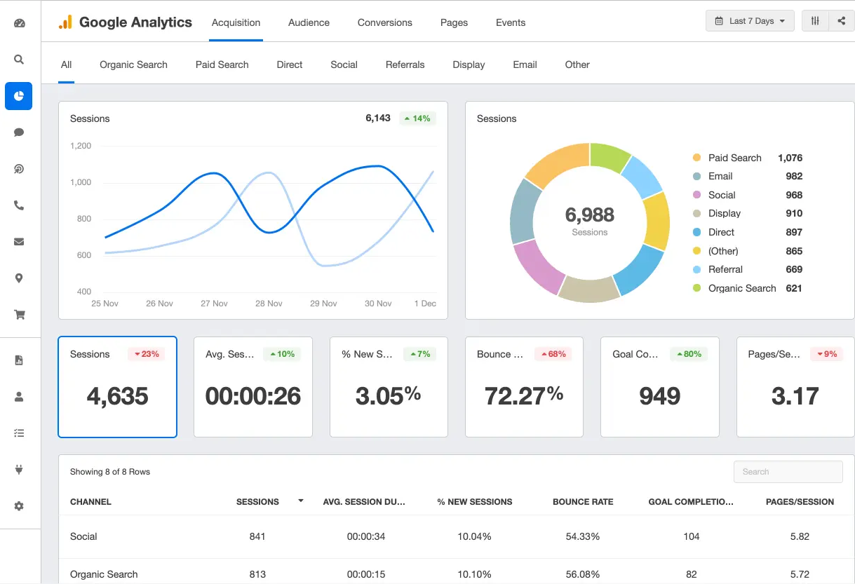
Case Study:- Google Analytics

Slide 92
Case Study:- Google Analytics
The data provided by Google analytics is designed especially for marketing and webmasters alike in gauging the quality of traffic they are receiving and the effectiveness of their marketing efforts.
Google analytics can provide the response of a marketing campaign by tracking visitors from all the referring sites and the number of visitors converted to customers or members from each. Google analytics works by via a snippet of Javascript on the website to be monitored. There is no hardware or software to install as the application is entirely cloud based.

Slide 93
Questions
What are the different categories of information that can be extracted from social media sources like Twitter?
What do you think is the best way to deal with missing values in datasets collected from social media sources?
What methodologies do you follow when presenting insights from social media analytics to stakeholders?

Slide 94
Glossary Questions
Is it possible to use machine learning methods for sentiment analysis? If yes, then what types of algorithms would you recommend using for this purpose?
What’s the difference between positive and negative sentiment? Can you explain with an example?
What are the main steps involved in performing social media analytics?
What factors should we consider before choosing a tool or platform for performing social media analytics?
How can the findings of social media analytics be presented effectively to management?
What do you think is the best way to deal with missing values in datasets collected from social media sources?

Slide 95
Glossary Questions
Trend analysis is a ________.
………….. social network is considered the most popular for social media marketing.
What is another term for "social media“…………..?
In ___________problems nodes in Social n/w associated with labels.
………………….refers to the process of deriving high-quality information from text.

