Slide 1

Agro retail management system
Harsh Velani - 202319025
Parth Patel - 202319007

Slide 2
Objective of project
Optimize Inventory Management
Customer Management
User Authentication and Security

Slide 3
Functionalities Available
Worker
View Products
View Stock
Place Order
View Orders
Manager
Add New Products
Update Stock
Delete Product
View Orders
Delete Order
Edit Order
Personal Information
Return Unused Products

Slide 4
Assumptions
Data Quality : Product Data is downloaded from official website gbpuat.ac.in .
Assuming that all the products are included which are used generally in agriculture.
Assuming authenticity and security of user and customer information.

Slide 5
Out-of-scope Functionalities
Sales Analysis : Add analysis function on monthly/yearly sales based on different categories.
Database : Use Database.
OOP : Use Classes and Objects.
Data Visualization : Visualize the sales based on seasons, categories, brands, etc.
Payment Mode : Add mode of payment.
Billing : Add billing system including GST.
Purchase Price : Update Purchase Price of products.

Slide 6
List of Topics covered in the project from the course
Lists
Dictionaries
Loops (for [enumerate, range] and while)
Functions
Inbuilt Functions (.find, .lower(), .get(), .append(), etc.)
Conditional Statements (if, elif, else)
Libraries (Datetime)
Combined Data Structure (List of Dictionary where each dictionary is row of table)
File Handling (Reading and Writing CSV and Text files)

Slide 7

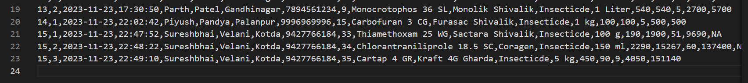
Top 5 functionalities of the project with code snippets and screenshots of output
1. Place Order :
Before Placing Order
Product csv file
Order csv file
After Placing Order
Product csv file
Order csv file

Slide 8


2. Edit Order :
Personal Information
Return Unused Products
1. Editing Personal Information
Order csv file
2. Return Unused Products
Order csv file
Product csv file

Slide 9
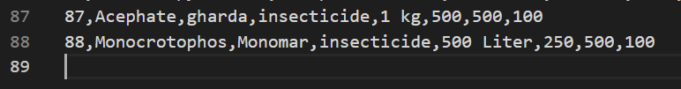
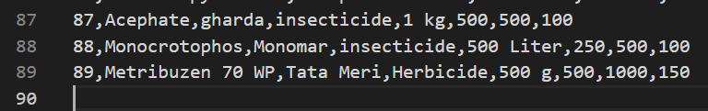
3. Add New Products
Product csv Before adding new product
Product csv After adding new product

Slide 10
4. Update Stock Of Existing Products
Product csv Before Updating existing product
Product csv After Updating existing product

Slide 11
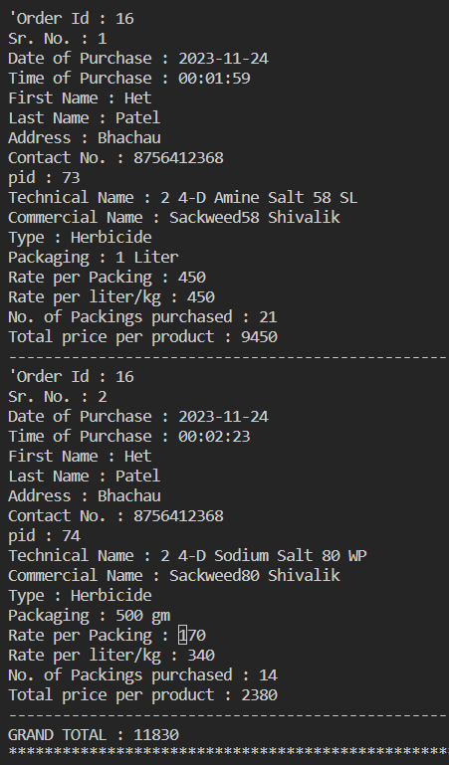
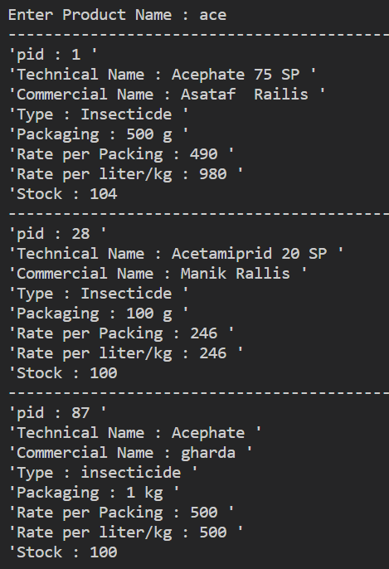
5. View Orders View Products
Click here to get Python code

Slide 12
Future work
Sales Reporting and Analytics:
Generate detailed reports on sales performance, revenue, and product trends.
Utilize analytics to identify top-selling products, peak sales periods, and other insights.
Backup and Recovery:
Implement a robust backup and recovery system to prevent data loss in case of system failures.
Use of Database

Slide 13
Conclusion and Future work
The Offline Retail Management System project in Python seeks to revolutionize traditional retail operations by providing a comprehensive, user-friendly software solution.
The system aims to enhance the overall efficiency and accuracy of offline retail businesses.

Slide 14
Lessons learned from the project
File Handling with hard code.
Use Combined Data Structure for CRUD(Create, Read, Update, Delete) Functions.
Here, we used List of Dictionary where each dictionary is row of table.

Slide 15
Thank You!

