Slide 1
32606-Database HD Assignment Movie Database
Harsha Varthini Maniraj
25379328

Slide 2

Real world example
IMDb- Internet Movie Database.
Database that provides information about films, television series, podcasts.
It includes details such as cast and crew biographies, plot summaries, award nominations, ratings, reviews.
Link: https://www.imdb.com/?ref_=nv_home

Slide 3
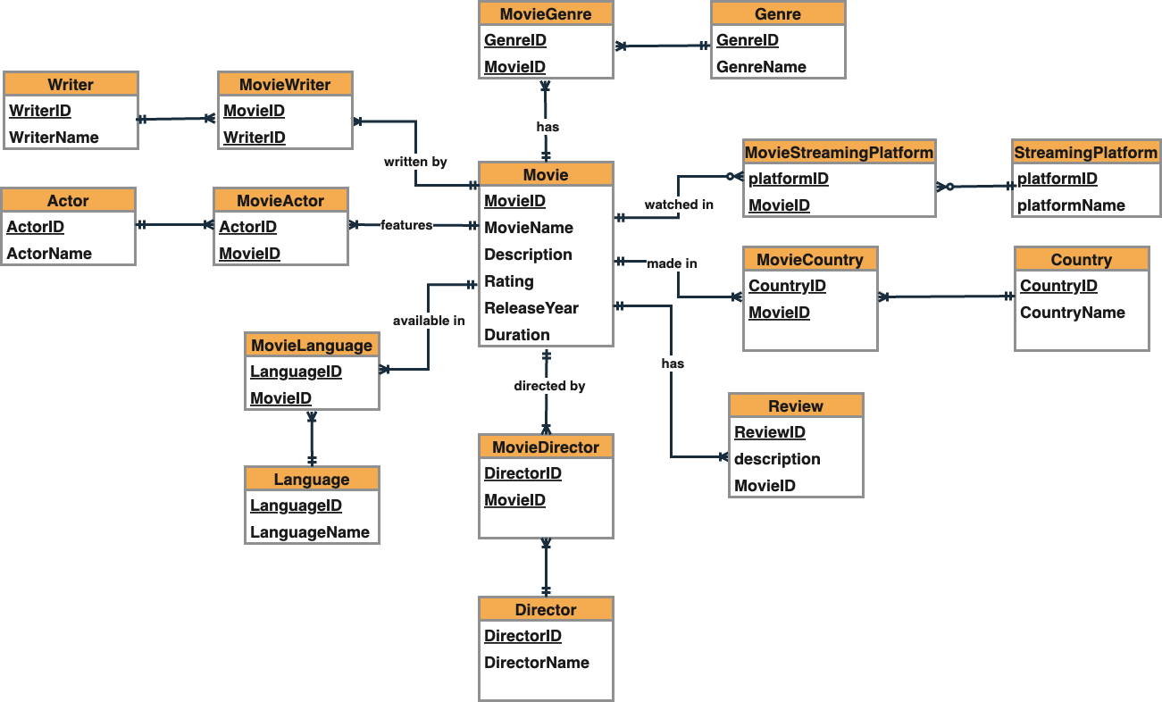
ERD

Slide 4
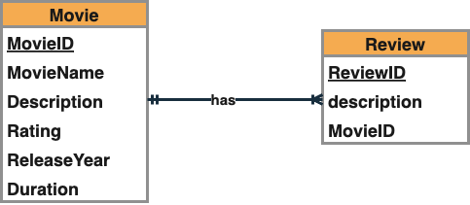
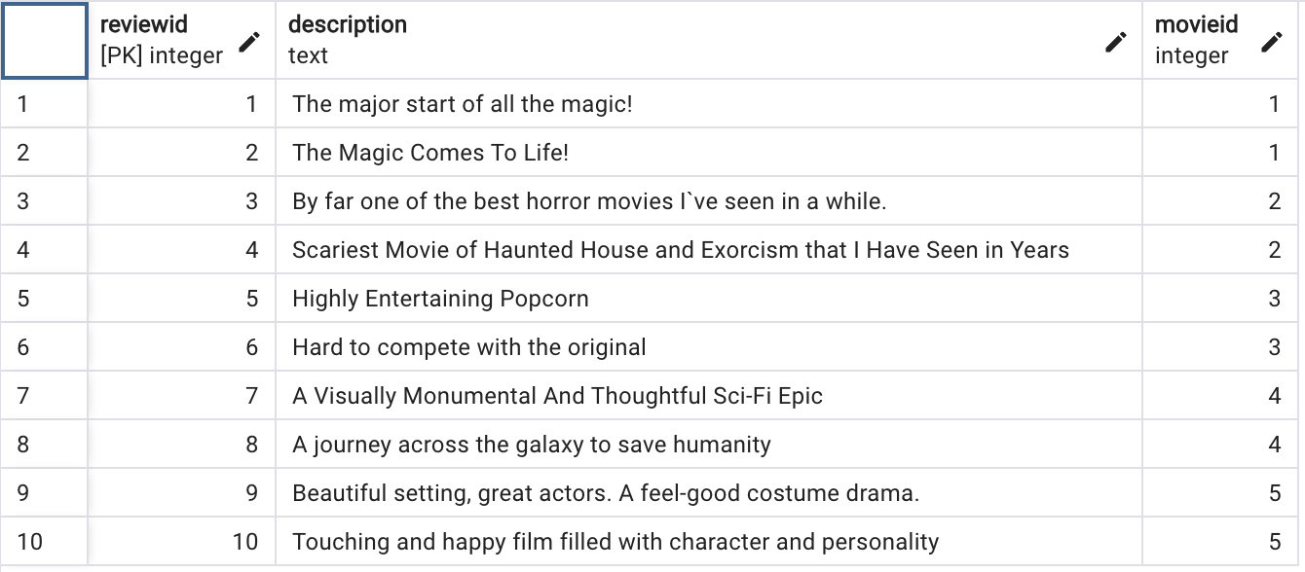
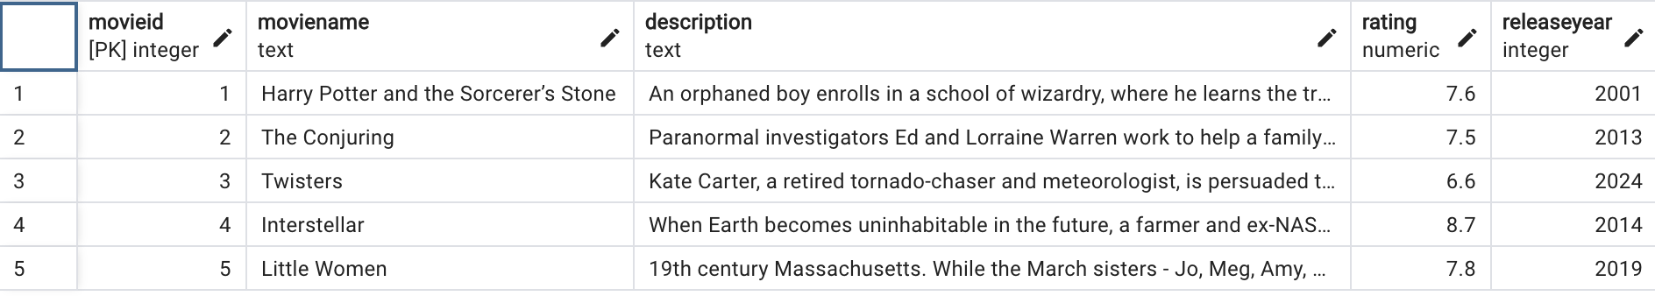
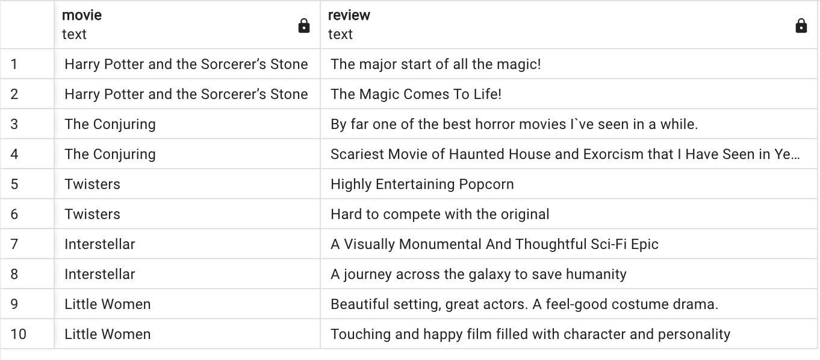
One to many relationship
Movie and Review
One movie has many reviews. In other way, many reviews are given to one movie.
select moviename as movie, review.description as review from movie, review where movie.movieID = review.movieID;

Slide 5
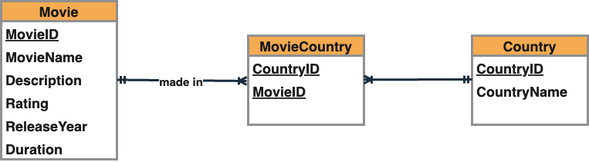
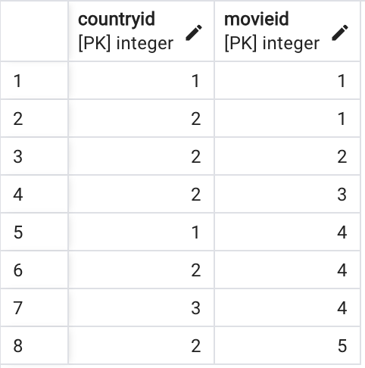
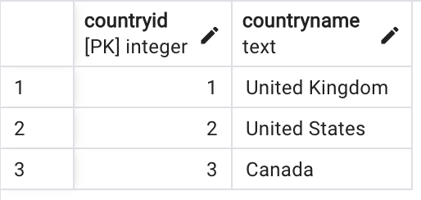
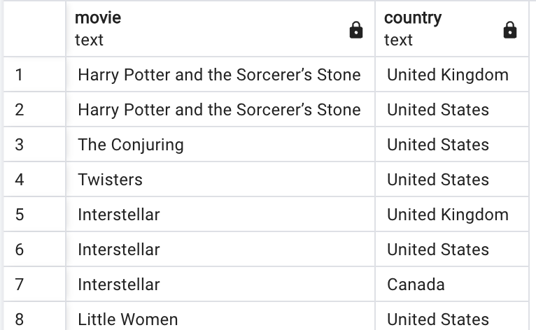
Many to many relationship
Movie and Country
One Movie can be made in one or more countries. While, many movies can be made from one country.
select moviename as movie, countryname as country from movie natural join moviecountry natural join country;

Slide 6
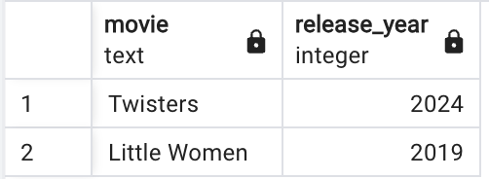
Simple query
Find the movies released after 2015
select moviename as Movie, releaseyear as Release_Year from movie where releaseyear > 2015;

Slide 7
Natural join
Find the movies in which Emma Watson starred
select moviename as movie, description, actorname as actor from movie natural join actor natural join movieactor where actorname = 'Emma Watson';

Slide 8
Cross product
Find the movies in which Emma Watson starred
select moviename as movie, description, actorname as actor from movie m, actor a, movieactor i where m.movieID = i.movieID and a.actorID = i.actorID and actorname = 'Emma Watson';

Slide 9
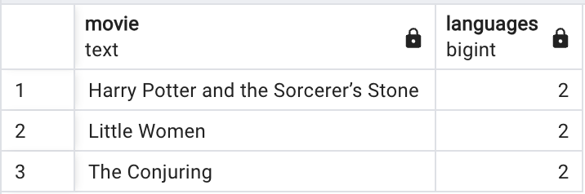
Group by and having
Find the movies with more than one language
SELECT MovieName as Movie, count(LanguageName) as Languages FROM Movie NATURAL JOIN Language NATURAL JOIN MovieLanguage
GROUP BY MovieName HAVING count(LanguageName) > 1 ORDER BY MovieName;

Slide 10
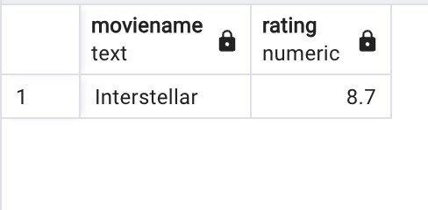
Sub query
Find the movie with the highest rating
SELECT MovieName, rating FROM Movie WHERE rating = (SELECT max(rating) FROM Movie);

Slide 11
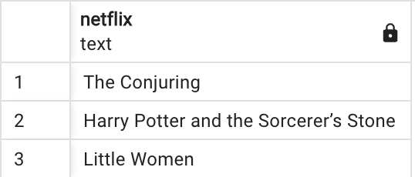
Self join
Find all the movies that are available to stream on Netflix
SELECT m1.moviename as Netflix FROM Movie m1
INNER JOIN MovieStreamingPlatform i1 ON m1.movieID = i1.movieID
INNER JOIN StreamingPlatform s1 ON s1.platformname = 'Netflix' and s1.platformID = i1.platformID;

Slide 12
CHECK Statements
Create table Movie
(
movieID integer NOT NULL,
movieName text,
description text,
rating numeric,
releaseYear integer,
duration varchar(30),
CONSTRAINT Movie_PK PRIMARY KEY (movieID),
CONSTRAINT rating_check CHECK (rating >= 0 AND rating <= 10)
);
rating_check is a CHECK constraint which only allows values from 0 to 10 for rating column

Slide 13
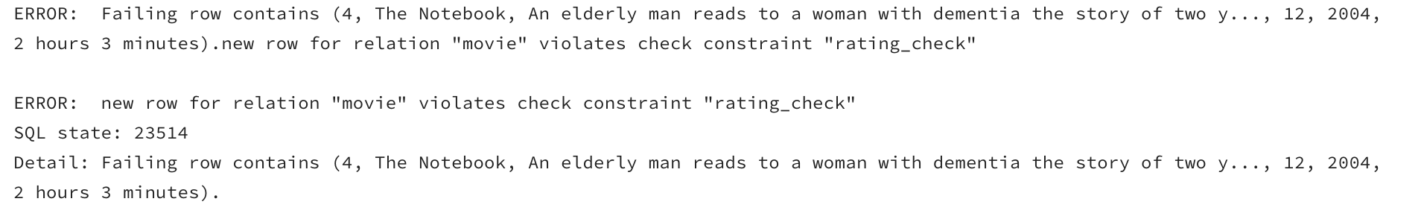
Example and Result: Check constraint
Insert into Movie values(4,'The Notebook', 'An elderly man reads to a woman with dementia the story of two young lovers whose romance is threatened by the difference in their respective social classes.',12, 2004, '
2 hours 3 minutes' );

Slide 14
ON DELETE CASCADE
Create table MovieStreamingPlatform
(
platformID integer NOT NULL,
movieID integer,
CONSTRAINT MovieStreamingPlatform_movieID_FK FOREIGN KEY (movieID) REFERENCES Movie ON DELETE CASCADE,
CONSTRAINT MovieStreamingPlatform_platformID_FK FOREIGN KEY (platformID) REFERENCES StreamingPlatform ON DELETE CASCADE,
CONSTRAINT MovieStreamingPlatform_PK PRIMARY KEY (platformID, movieID)
);
Create table MovieCountry
(
countryID integer NOT NULL,
movieID integer NOT NULL,
CONSTRAINT MovieCountry_movieID_FK FOREIGN KEY (movieID) REFERENCES Movie ON DELETE CASCADE,
CONSTRAINT MovieCountry_countryID_FK FOREIGN KEY (countryID) REFERENCES Country ON DELETE CASCADE,
CONSTRAINT MovieCountry_PK PRIMARY KEY (countryID, movieID)
);
When you try to delete a row from Movie table, the referenced rows in MovieStreamingPlatform table is deleted too.
When you try to delete a row from Movie table, the referenced rows in MovieCountry table is deleted too.

Slide 15
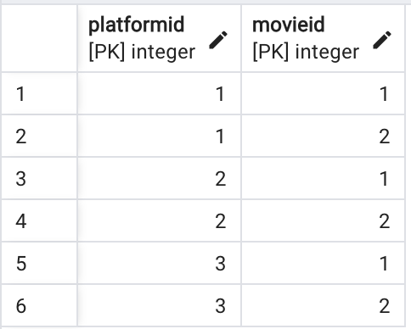
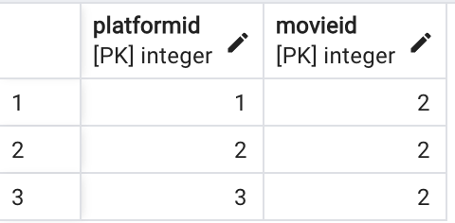
Example and Result: Deleting a row
Delete from movie where movieID = 1;
Movie Table
MovieStreamingPlatform Table

Slide 16
View
Find all the Thriller movies
CREATE VIEW Thriller_Movies AS
select m.moviename from movie m natural join moviegenre i natural join genre g where m.movieid = i.movieid and g.genreid = i.genreid and
g.genrename = 'Thriller';

Slide 17
Thank You

