Slide 1

PILLS NOTIFY
HARSHA S PILLAI
ROLL NO : 56
S4 MCA

Slide 2
Contents
Relevance
Description
Objective
Existing system
Proposed system
Modules
Front end and backend
Screenshots

Slide 3
Relevance
Health is the only thing that we should care the most. COVID-19 made all the people aware about the importance of health. In such a situation, forgetting about the medicine timings can severely affect the health of an individual. Notify pill is an android application for all your medical needs.
It reminds you whenever you need to take a certain pill. It is especially aimed for those, who have trouble remembering the same or are too busy with their own schedule that they do not keep track of time.

Slide 4
Description
Pills Notify is an android application meant to aid the forgetful and busy with remembering to take their daily medications. It is designed for users who need a little help keeping track of their medication schedule and who are dedicated to keeping the schedule.
The application allows the user to store pill objects and multiple alarms for those pills. The user can view their pills in a today view and can select date to view medicines. In addition, the application stores the history of when each medication was taken. This will aid the user in keeping track of their medication usage.

Slide 5
Objective
To remind users of their daily intake of medicines and is mostly targeted at an elderly audience with a focus on accessibility and usability.
This application is to serve as a medication administration reminder which act as a scheduler and a reminder app at the same time and the users will not need to track times for taking regularly scheduled medicines.

Slide 6
Existing system
The existing system allows the user to store pill objects and alarms for those pills. The user can view their pills in a today view, a tomorrow view, a weekly view, and an editable view that shows every pill and every alarm.
It allows the user to add an alarm, edit the alarm and delete the alarm.

Slide 7
Proposed system
The proposed system is more efficient as it allows to store the quantities of medicine so that one can know, how many tablets or medicines he/she must take.
The app would use the different ringtones to notify the user about the medication. The app is also implemented with a splash light feature, so that the user will notified at the time of his/her medications.

Slide 8
Modules
Profile creation
Medicine Activity
Home Page Activity
Settings Activity
Database Creation
Flash Light Activity

Slide 9
Front end and backend
FRONT END
XML
BACKEND
Android Studio IDE
Java
SQLite database

Slide 10
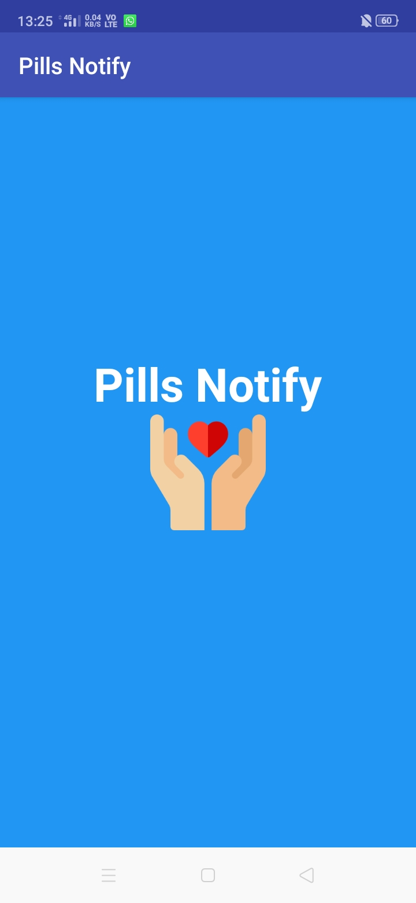
Screenshots

Slide 11
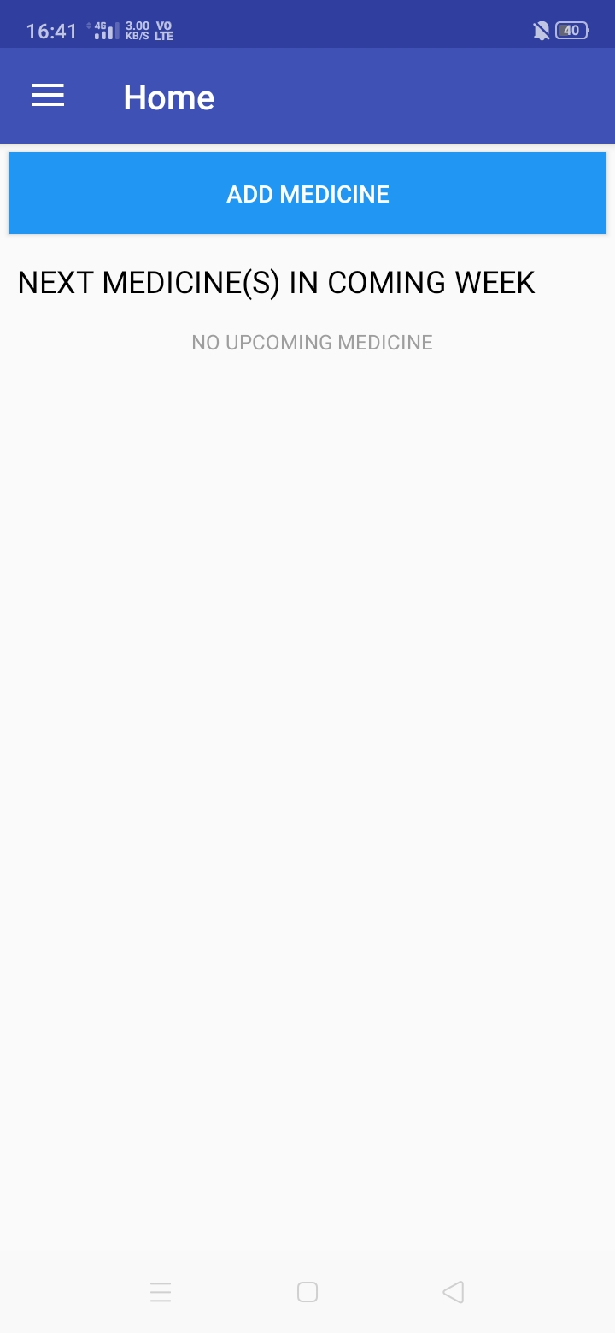

Slide 12
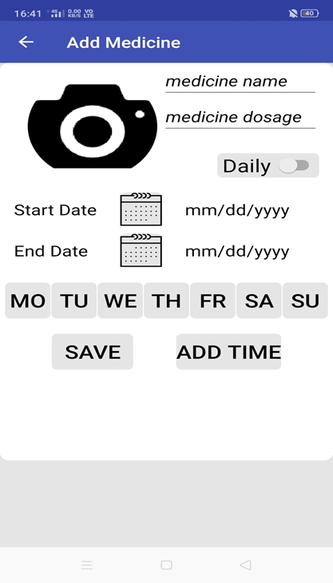

Slide 13
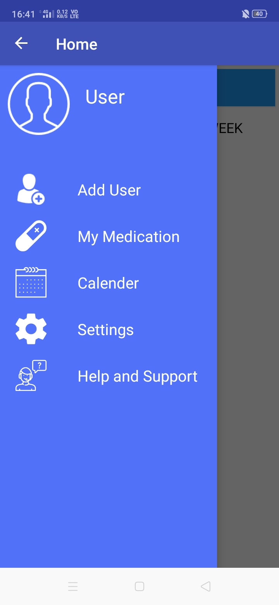

Slide 14
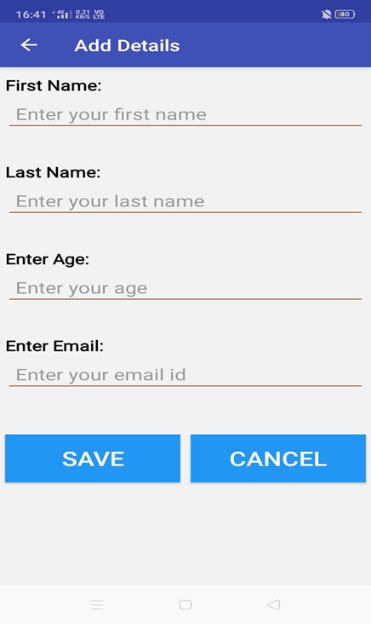

Slide 15
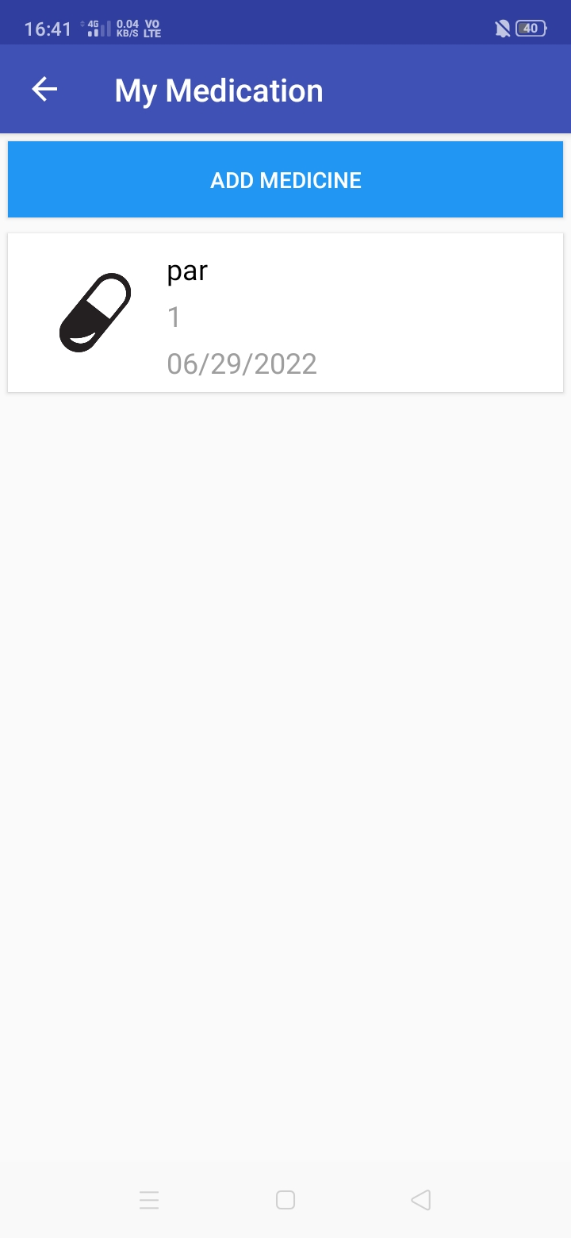

Slide 16
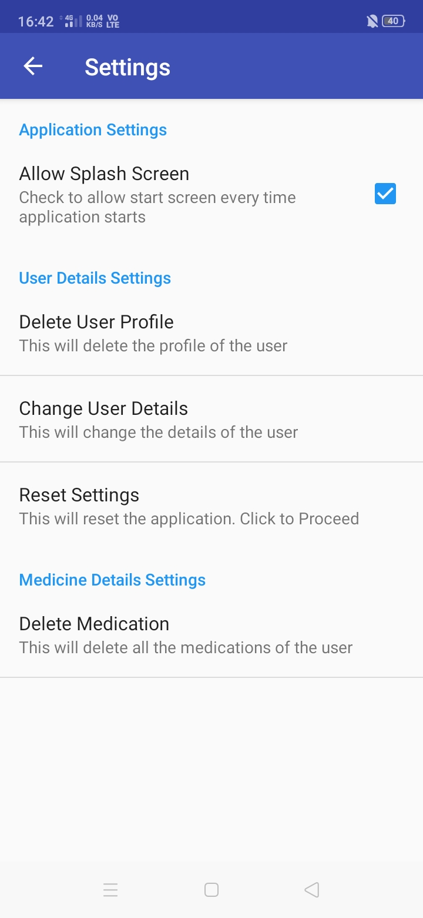

Slide 17
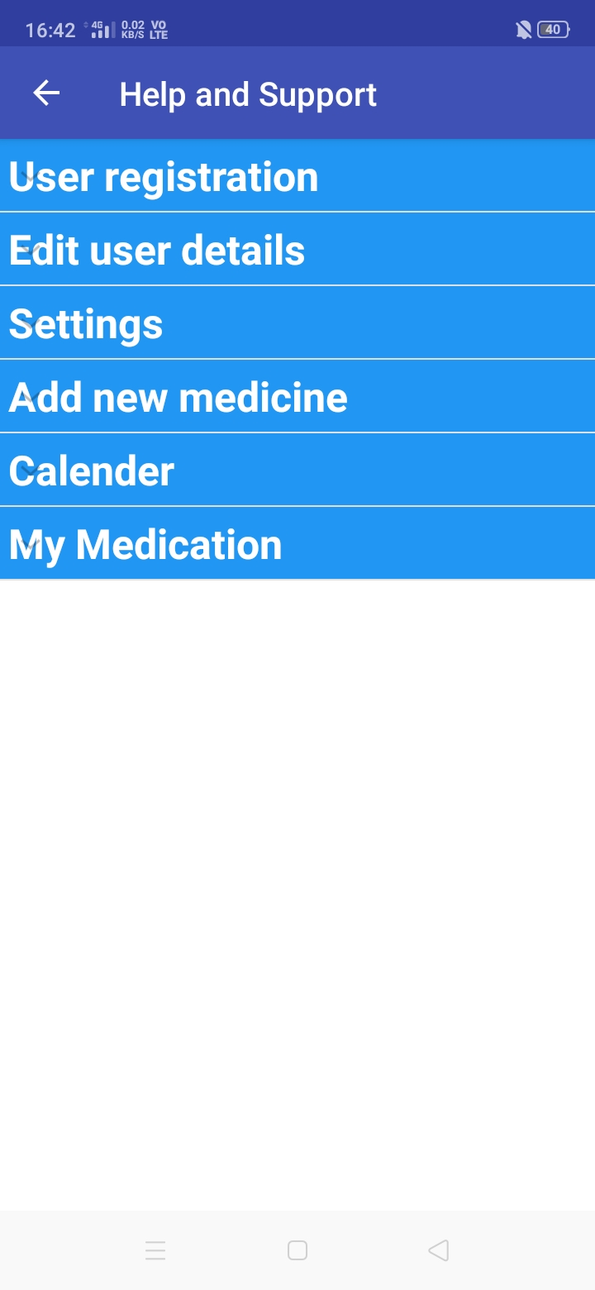

Slide 18





THANK YOU

