Slide 1

Simple Alarm Clock (Console-Based)
Using C and DS
Team details :
P. Harsha Vardhan - 24KB1A05CX - Team lead
P. Deekshith Reddy – 24KB1A05EN
P. Mukesh - 24KB1A05CS

Slide 2
Introduction
Demonstrates a simple alarm clock system built using C.
Focuses on real-time applications.
Enhances coding practice using DS.

Slide 3
Objective
Design a console-based alarm clock.
Enhance C and DS skills.
Understand real-time clock operations.

Slide 4

Why C and DSA?
**Why C?**
- Fast, close to hardware.
- Strong library support (Time.h).
**Why DS?**
- Efficient logic and data handling.
- Fundamental for real-world problem-solving.

Slide 5
Algorithm
Start
Input: Prompt the user to enter the alarm time in the format HH MM SS.
Store the input values in variables alarm_hour, alarm_minute, and alarm_second.
Display: Print the alarm time (for user confirmation).
Loop: Enter an infinite loop that checks the current time.
Get the current system time using time() and localtime().
Extract the current hour, minute, and second from the system time.
Display: Print the current system time.
Compare: Check if the current time is greater than or equal to the alarm time.
If yes, proceed to step 6.
If no, continue checking the time in the loop.
Trigger Alarm:
Print "⏰ ALARM! Time's up!" to notify the user.
Use the Beep() function to play a beep sound for a set number of times (15 times, 1 second each).
End: Once the alarm has triggered, end the program.

Slide 6
Lesson Learnt
- >Improved C programming skills.
- >Learned to use (time.h).
- >Understood real-time systems.
-> Applied DSA concepts effectively.

Slide 7
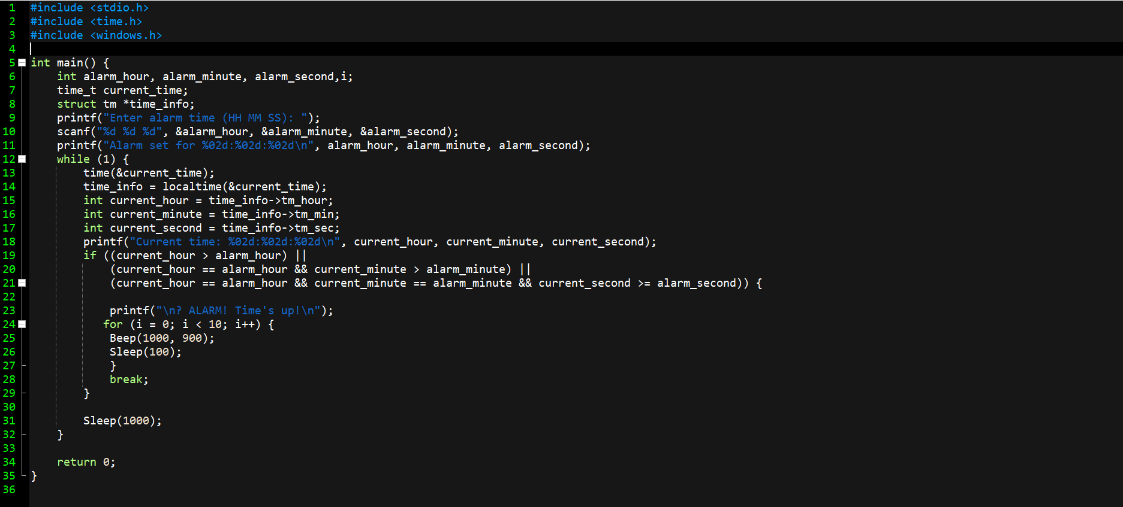
Image
Source code :

Slide 8
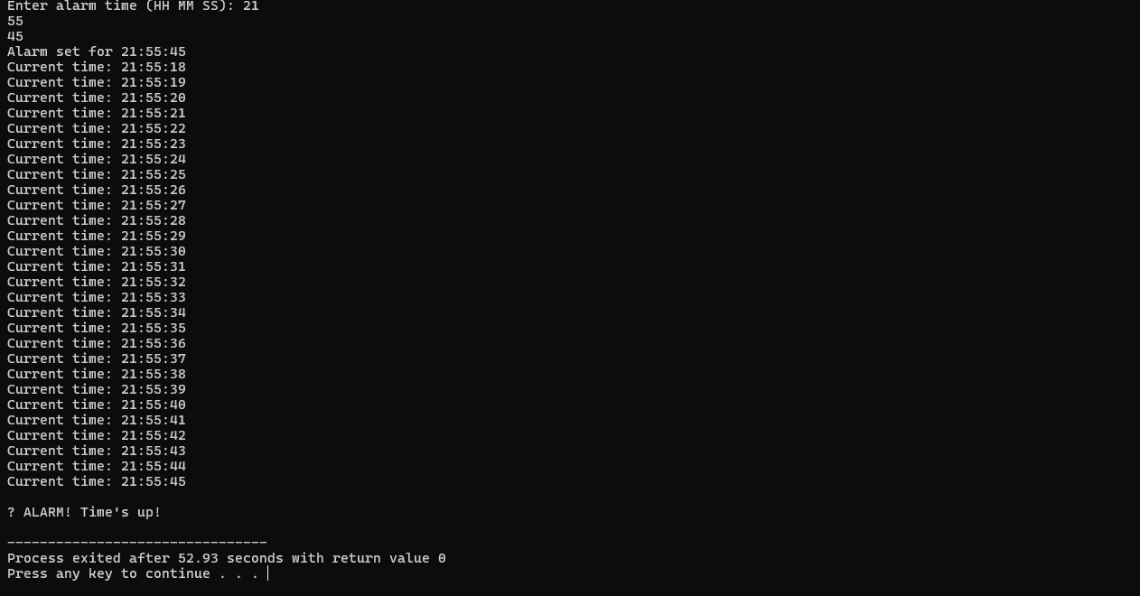
Image
Output :

Slide 9

Output
When alarm time matches:
"⏰ Alarm! Wake up! Time is 06:30:00".

Slide 10
Thank You

