Slide 1
ECONOMIC TIMES AI CHALLENGE · SMART CITIES / PUBLIC SAFETY / DIGITAL TRUST
FRAUD SHIELD
AI-powered Digital Public Safety Intelligence — detecting digital-arrest scams,
counterfeit currency and organised fraud networks before mass victimisation occurs.
Rs 1,776 Cr
1.14 Million
6 modules
lost to digital-arrest scams · Jan–Sep 2024 (MHA)
cybercrime complaints in 2023 · up 60% YoY
one platform · live at fraud-shield-et.streamlit.app
Harsha Boddu · 2026

Slide 2
Industrialised fraud, reactive defence
Rs 1,776 Cr
defrauded via 'digital arrest' scams in just nine months of 2024 — fraudsters impersonating CBI, ED and Customs trap victims in psychological hostage situations over video call (MHA).
+60%
year-on-year growth in cybercrime complaints — 1.14 million registered in 2023, run by fraud compounds using spoofed numbers, AI voices and fake government portals.
Rs 500
high-quality FICN fakes now defeat manual detection in routine banking operations — RBI Annual Report 2025 flagged record seizures.
What law enforcement lacks is not evidence after the fact — it is intelligence before mass victimisation.
FRAUD SHIELD · AI for Digital Public Safety
2

Slide 3
From point of complaint to point of contact
TODAY — REACTIVE
FRAUD SHIELD — PREDICTIVE
Victim transfers money, then complains
Case-by-case investigation, evidence after the fact
Scam scripts spread faster than advisories
Counterfeits detected only at expert examination
Complaints stay isolated across jurisdictions
Verdict in seconds, before the transfer happens
Every verdict explained — evidence citizens can see
Advisories in the citizen's own language + helpline 1930
Note screening at tellers, counting machines, PoS
Complaints fused into ring-level intelligence packages
FRAUD SHIELD · AI for Digital Public Safety
3

Slide 4
One platform, six converged modules
1
Citizen Fraud Shield
2
Counterfeit Check
3
Network Intelligence
Message/transcript verdict in seconds — hybrid rule engine + NVIDIA NIM LLM, evidence view, EN/HI/TE advisories.
CV screening of banknotes: geometry, security thread, microprint density, serial panel — with RBI escalation policy.
Graph AI clusters victims, scammer numbers, mules and devices into rings with priority takedown targets.
4
Geo Intelligence
5
Command Center
6
Evaluation
India hotspot map of complaints and FICN seizures with ranked patrol prioritisation.
Live NCRP-style feed, rupees at risk, city and scam-type exposure — the operational picture.
120-message multilingual benchmark, adjustable threshold, confusion matrix — we measure ourselves.
FRAUD SHIELD · AI for Digital Public Safety
4

Slide 5
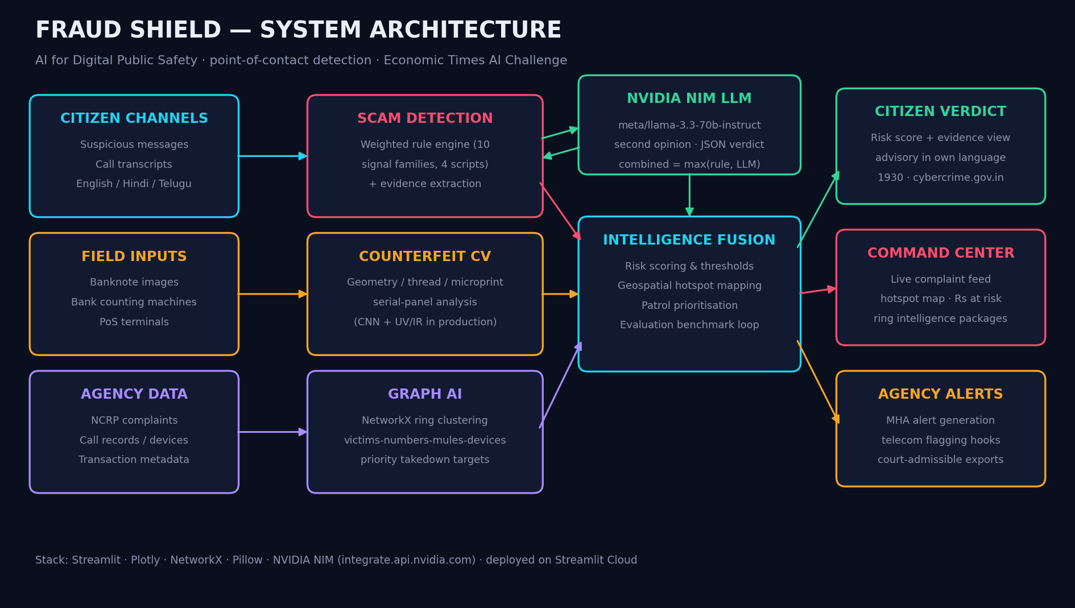
Architecture
FRAUD SHIELD · AI for Digital Public Safety
5

Slide 6
Citizen Fraud Shield — the wow moment
Hybrid detection. A transparent weighted rule engine (10 signal families across English, Hindi, Telugu and romanized text) fused with an LLM second opinion — combined verdict takes the higher score.
Explainable by design. The transcript is re-rendered with every trigger phrase highlighted, plus weighted signal codes (DIGITAL_ARREST +25, SECRECY +15) — evidence a citizen, an ops team or a court can read.
Actionable. Advisory in the citizen's own language with direct routing to helpline 1930 and cybercrime.gov.in.
Suspicious message / call transcript
v
Rule engine · 10 signal families · 4 scripts
v
NVIDIA NIM LLM · meta/llama-3.3-70b-instruct
v
Combined verdict · 0–100 + evidence
v
Advisory in EN / HI / TE · report via 1930
FRAUD SHIELD · AI for Digital Public Safety
6

Slide 7
Physical + geospatial layers
C
Counterfeit Check (FICN)
G
Geo Intelligence
Photo of any note - five visible-feature checks: geometry, resolution, security-thread band, microprint density, serial-panel contrast
Verdict tiers: consistent with genuine / escalate to manual check / withhold and report
Deployable where notes change hands: tellers, counting machines, PoS
Production path: CNN on RBI security features + UV/IR sensor input
India hotspot map: complaint clusters sized by volume, coloured by rupees at risk
FICN seizure points overlaid - financial and physical threat on one map
Ranked patrol prioritisation: CRITICAL / HIGH / ELEVATED per district
Feeds inter-district intelligence sharing in near real time
FRAUD SHIELD · AI for Digital Public Safety
7

Slide 8
Fraud rings, not isolated cases
Complaints, phone numbers, mule accounts and device fingerprints are fused into a graph — coordinated campaigns emerge as connected rings.
Each ring ships as an intelligence package: footprint, cities, total defrauded — and a priority takedown target: the highest-degree infrastructure node, whose removal disrupts the most victim connections at once.
Designed to link across jurisdictions and export as court-admissible evidence.
PRIORITY TARGET
scammer number · victims · mule account · device
FRAUD SHIELD · AI for Digital Public Safety
8

Slide 9
We measure ourselves
Rule engine alone, on a 120-message benchmark (EN/HI/TE + romanized, incl. adversarial soft-worded cases), threshold 40:
0 false positives
62 genuine messages — bank credits, deliveries, personal chats — none flagged. Citizens are never punished for normal life.
6 misses, by design
Every false negative is a soft-worded script with no hard keywords — exactly the residual the NVIDIA NIM LLM second-opinion layer targets.
FRAUD SHIELD · AI for Digital Public Safety
9

Slide 10
Roadmap
NOW
NEXT
SCALE
Working prototype live on Streamlit Cloud — six modules, NIM LLM verdicts, multilingual advisories, measured benchmark.
WhatsApp + IVR citizen channels, 12 regional languages, CNN counterfeit model with UV/IR input, NCRP API integration.
Telecom-level live call flagging, automated MHA alert generation, cross-jurisdiction ring exports as court-admissible evidence.
Fraud Shield — from reactive investigation to predictive neutralisation. Point of contact, not point of complaint.
FRAUD SHIELD · AI for Digital Public Safety
10

