Slide 1



A CENTER FOR INTER-DISCIPLINARY RESEARCH
2021-22
TITLE
“YOUTUBE TRANSCRIPT SUMMARIZER”
GOKARAJU RANGARAJU
INSTITUTE OF ENGINEERING AND TECHNOLOGY
AUTONOMOUS

Slide 2
Advanced Academic Center
( A Center For Inter-Disciplinary Research )
This is to certify that the project titled
“YOUTUBE TRANSCRIPT SUMMARIZER”
is a bonafide work carried out by the following students in partial fulfilment of the requirements for Advanced Academic Center intern, submitted to the chair, AAC during the academic year 2021-22.
NAME | ROLL NO. | BRANCH
SASHANK DESU | 20241A05H0 | CSE
KARTHIK ALLADI | 20241A05C3 | CSE
GUMMADI HARIKA | 20241A05E8 | CSE
This work was not submitted or published earlier for any study
Dr/Ms./Mr.
Dr.B.R.K.Reddy
Dr. G. Ramesh
Project Supervisor
Program Coordinator
Dean, AAC

Slide 3
ACKNOWLEDGEMENTS
We express our deep sense of gratitude to our respected Director, Gokaraju Rangaraju Institute of Engineering and Technology, for the valuable guidance and for permitting us to carry out this project.
With immense pleasure, we extend our appreciation to our respected Principal, for permitting us to carry out this project.
We are thankful to the Associate Dean, Advanced Academic Centre, for providing us an appropriate environment required for the project completion.
We are grateful to our project supervisor who spared valuable time to influence us with their novel insights.
We are indebted to all the above mentioned people without whom we would not have concluded the project.

Slide 4
ABSTRACT
In recent times, YouTube has increasingly become the preferred platform to consume educational content. In order to learn complex and intricate concepts, a student has to sit through many of hours of YouTube videos where an average video length is about 20 minutes. To solve this issue, YouTube Transcript Summarizer was conceptualized.YouTube Transcript Summarizer is a Chrome Extension which can be used in YouTube videos to quickly generate the summary of the video. This allows for a seamless transfer of information without spending hours watching the content.

Slide 5
INTRODUCTION
YouTube is an online video sharing and social media platform, founded by Chad Hurley in 2005. It is the second most visited website, right behind Google search. Since its inception, it has been frequently used as an educational platform with a goal of teaching millions of students across the globe.All YouTube users can upload videos up to 15 minutes each in duration. Users can verify their account, normally through a mobile phone, to gain the ability to upload videos up to 12 hours in length, as well as produce live streams.Each video is identified by an eleven-character case sensitive alphanumeric Base64 string in the Uniform Resource Locator (URL) which can contain letters, digits, an underscore (_), and a dash (-).Most videos enable users to leave comments, and these have attracted attention for the negative aspects of both their form and content.YouTube offers users the ability to view its videos on web pages outside their website. Each YouTube video is accompanied by a piece of HTML that can be used to embed it on any page on the Web.This functionality is often used to embed YouTube videos in social networking pages and blogs.YouTube Transcript Summarizer generates the summary of a YouTube video by extracting chunks of information and piecing it together through NLP models using the automatically-generated English-language transcript provided with the video.

Slide 6
PROJECT WORKFLOW
1) Get transcript data
2) Convert to json file
3) Extract data from json file
4) Summarize text using HuggingFace Library Models
5) Create Flask API with above functions and handle HTTP requests
6) Make chrome extension
7) Design chrome extension UI
Gathering of data:
Gathering of data includes collecting the transcript of a selected YouTube video. The transcript must be in english and be automatically generated by YouTube.
Data preprocessing:
Here we extract important sentences in a transcript for summarization. NLP models are used for this task.
Brain part:
Here we summarize the text using the T5 model in the Hugging Face Library and then display the output through a chrome extension.

Slide 7
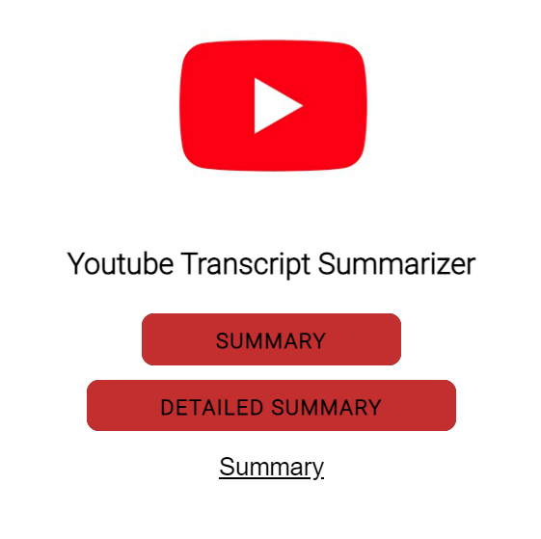
Output:
Expected output is in the form of a summary which gives a gist of the content spoken in the video.
Users can also generate a detailed summary.

Slide 8
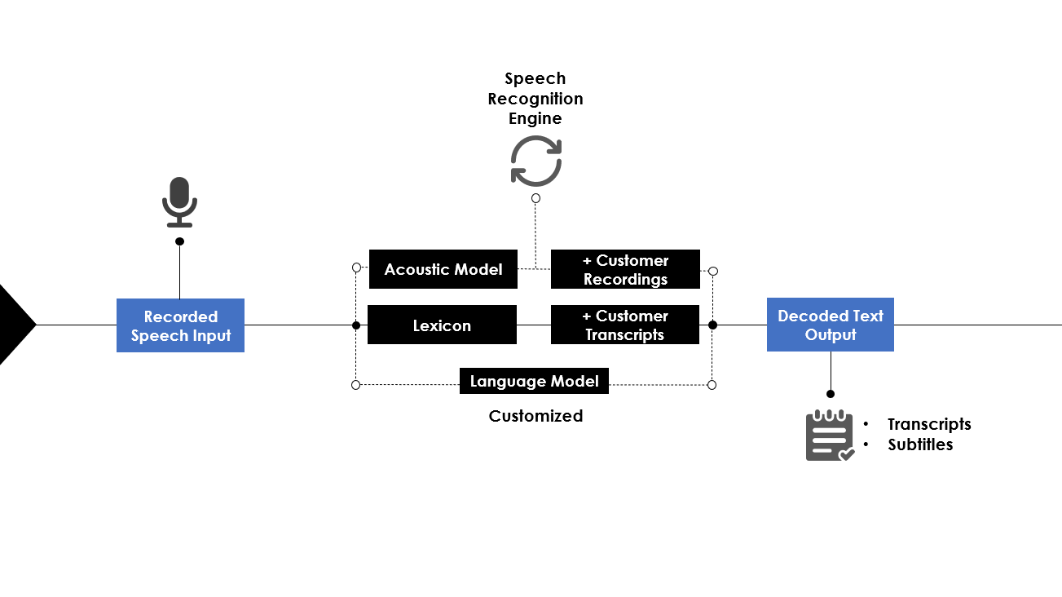

FUTURE DEVELOPMENTS
1. Automatic Subtitle Generation using Speech-To-Text NLP Models
Generates subtitles in real-time for any YouTube video that lacks subtitles. Initial implementation would be for English-language videos.
2. Multilingual Support For Summary Generation
Can extend support for summary in multiple languages like German, Spanish
etc.
.

Slide 9
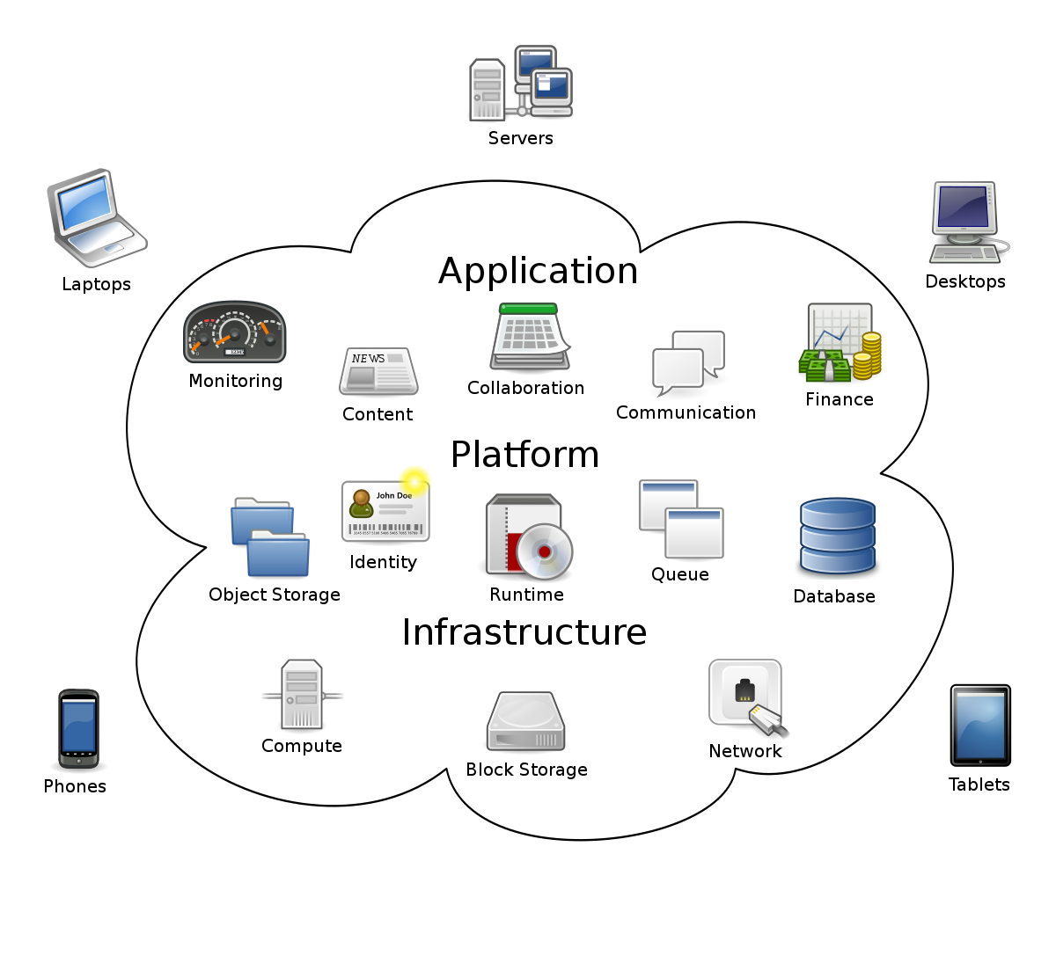
3. Deploying The Project On A Cloud Database​
In its current state, the project can be uploaded to a Cloud Database so that it can be readily deployed and used from anywhere.
4. Displaying Additional Content In The Chrome Extension
Additional stats like Video Transcript, Transcript Length etc. can be displayed in the Chrome Extension.

Slide 10
CODE​ :
​
Steps Involved ​
Get transcript for a given video
Perform text summarization
Create REST API endpoint
Getting started with Chrome Extension
Build a User Interface for Extension Popup
Display summarized transcript

Slide 11
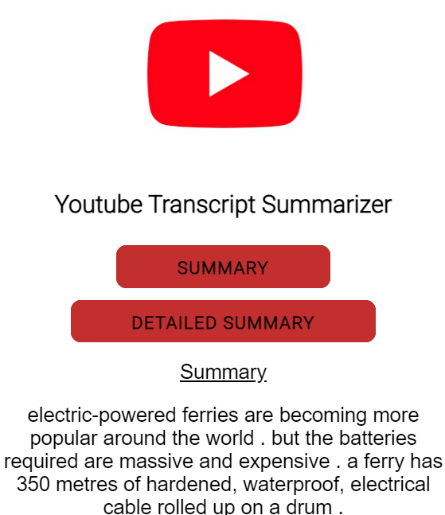
Keys and their controls :
Press on the youtube summarizer extension and click on the ‘summarize’ button.
Results :

Slide 12
REFERENCES :
https://realpython.com/lessons/creating-virtual-environment/
https://atmamani.github.io/blog/building-restful-apis-with-flask-in-python/
https://huggingface.co/docs/transformers/installation
https://pypi.org/project/youtube-transcript-api/
https://www.geeksforgeeks.org/read-write-and-parse-json-using-python/
https://www.thepythoncode.com/article/text-summarization-using-huggingface-transformers-python
https://huggingface.co/docs/transformers/task_summary
https://blog.miguelgrinberg.com/post/designing-a-restful-api-with-python-and-flask
https://medium.com/swlh/parsing-rest-api-payload-and-query-parameters-with-flask-better-than-marshmallow-aa79c889e3ca
https://betterprogramming.pub/the-ultimate-guide-to-building-a-chrome-extension-4c01834c63ec
https://medium.com/coding-in-simple-english/how-to-create-chrome-extension-7dd396e884ef
https://developer.chrome.com/docs/extensions/mv2/user_interface/
https://developer.mozilla.org/en-US/docs/Mozilla/Add-ons/WebExtensions/manifest.json/page_action

