Slide 1


Blockchain
Sri Harsha Chayanulu Varahabhatla
ENPM693 (0301)

Slide 2

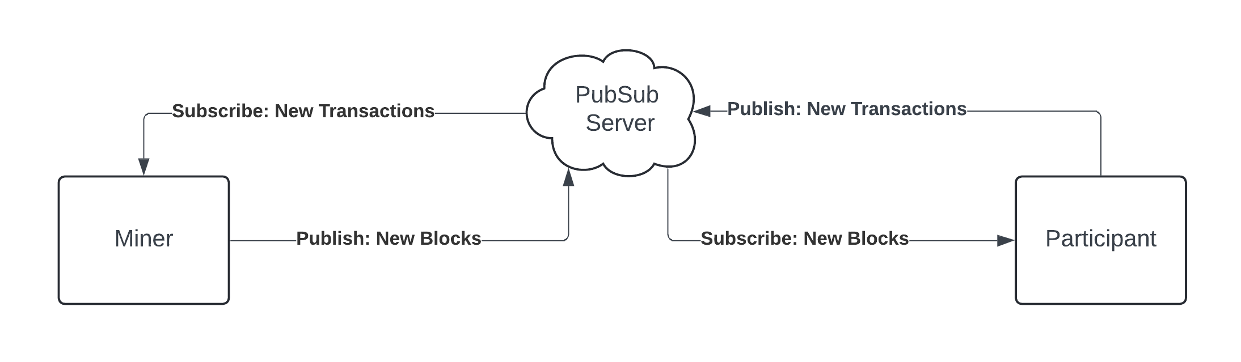
Architecture

Slide 3
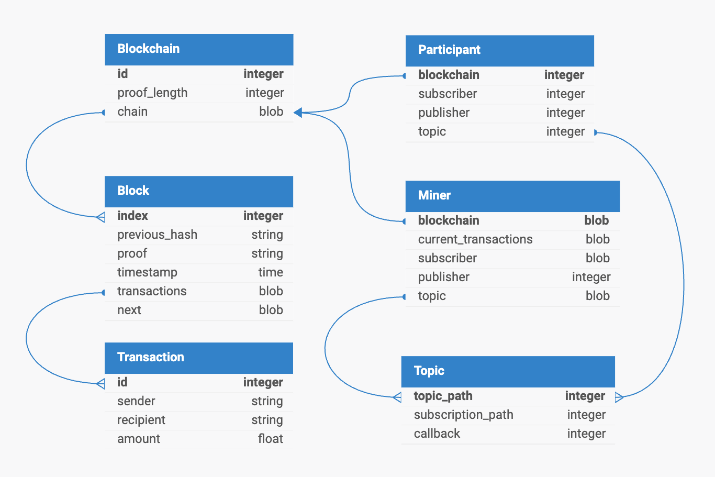
Schema

Slide 4
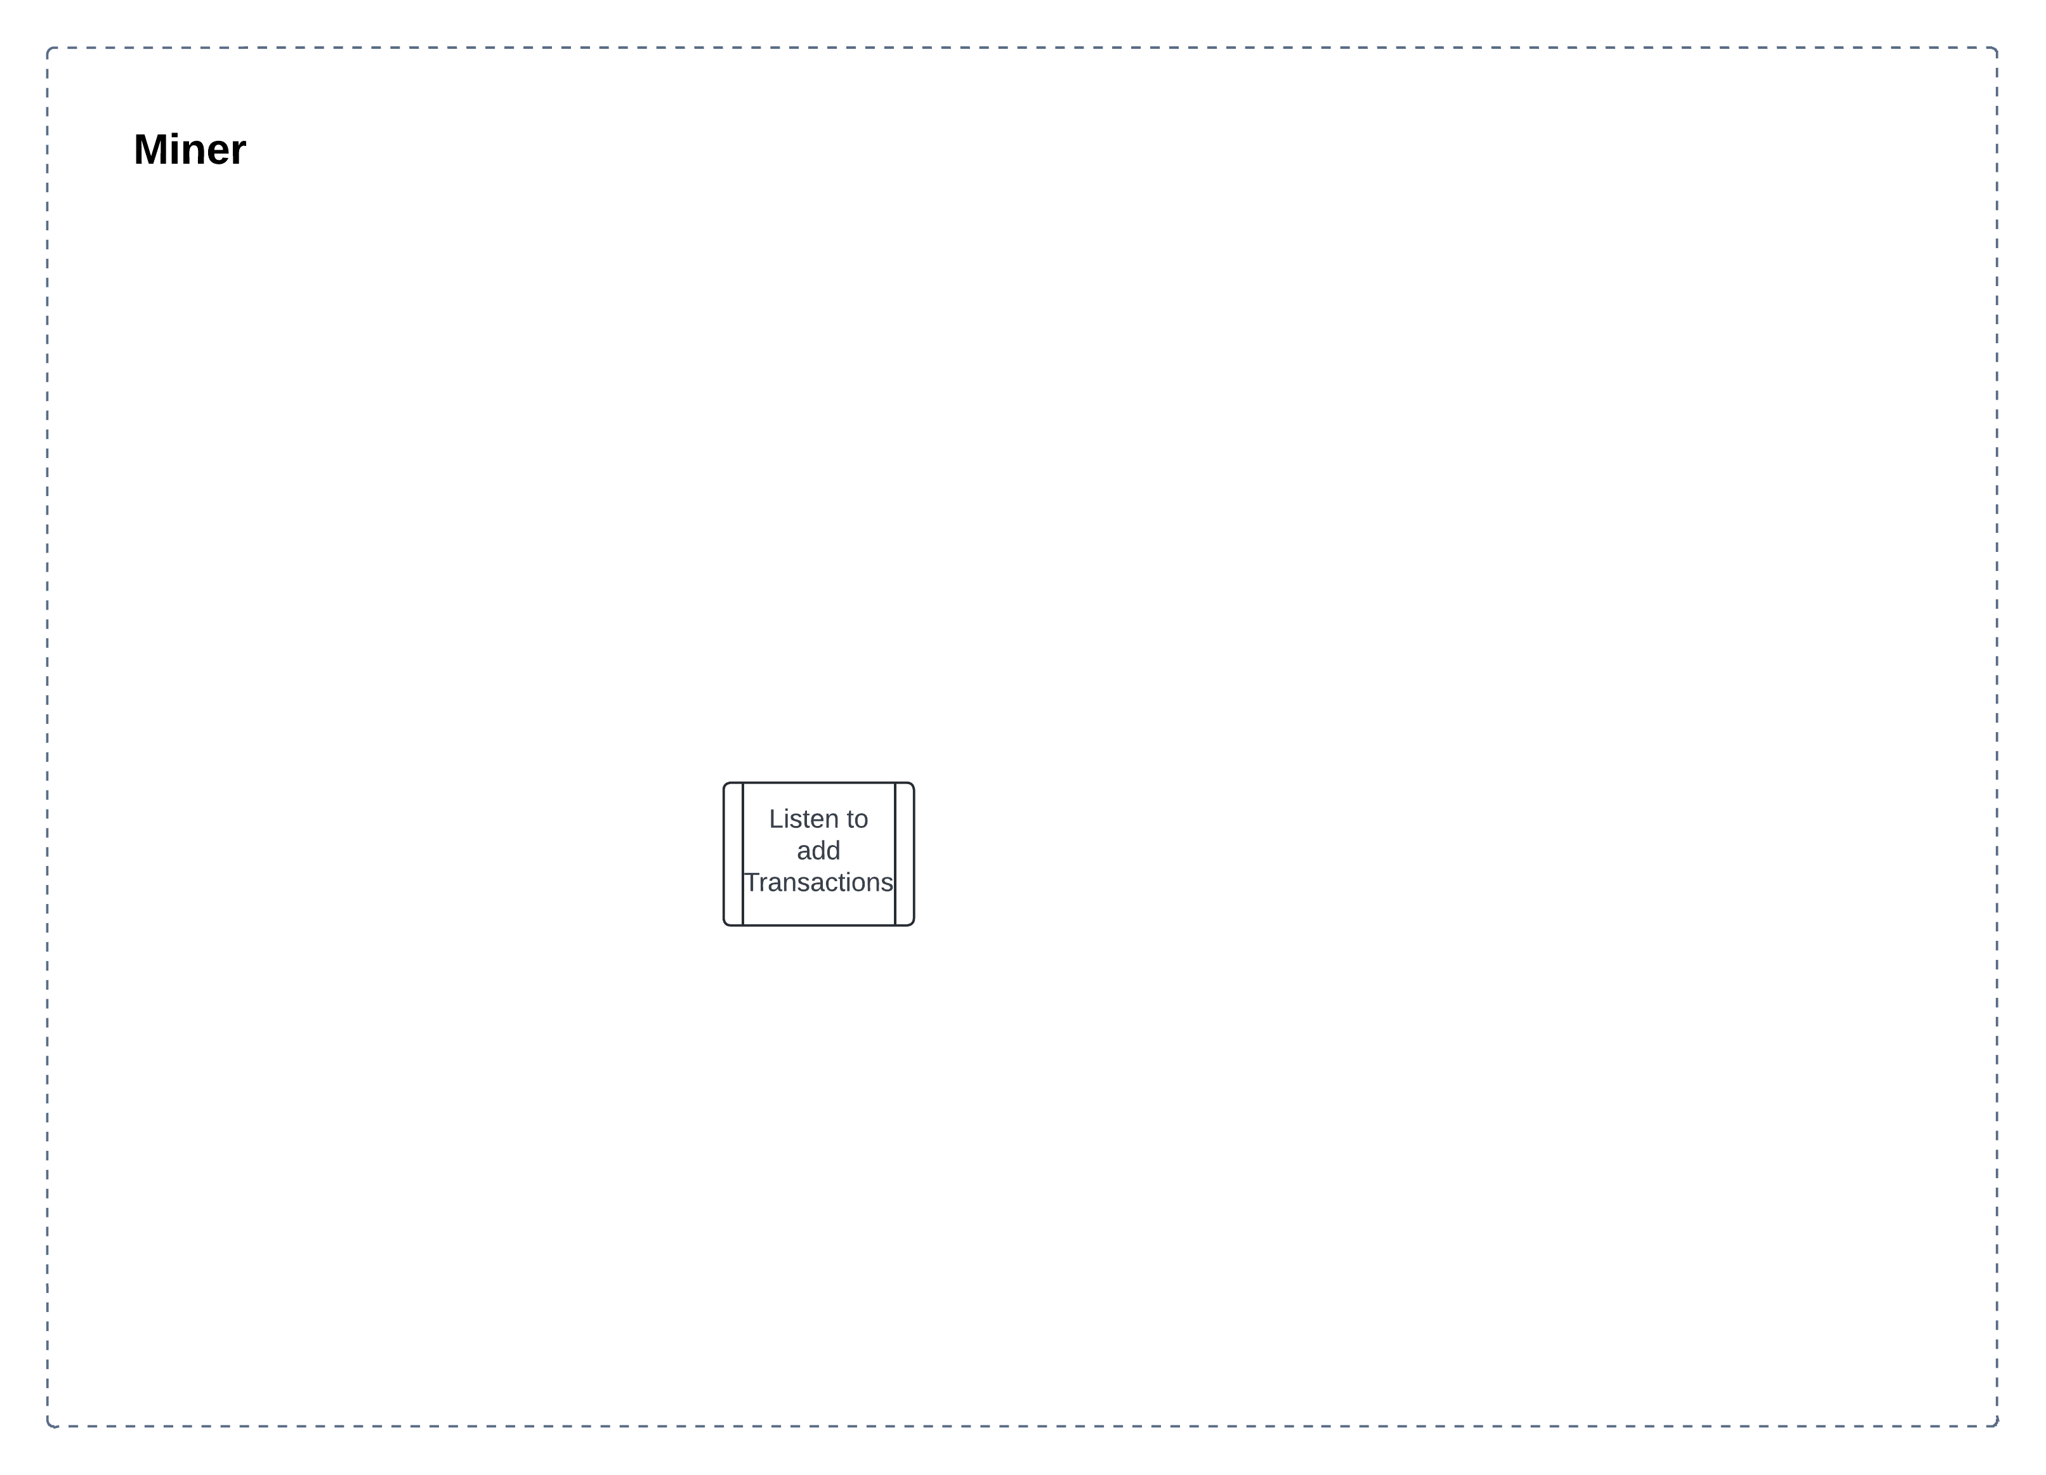
Process
flow

Slide 5
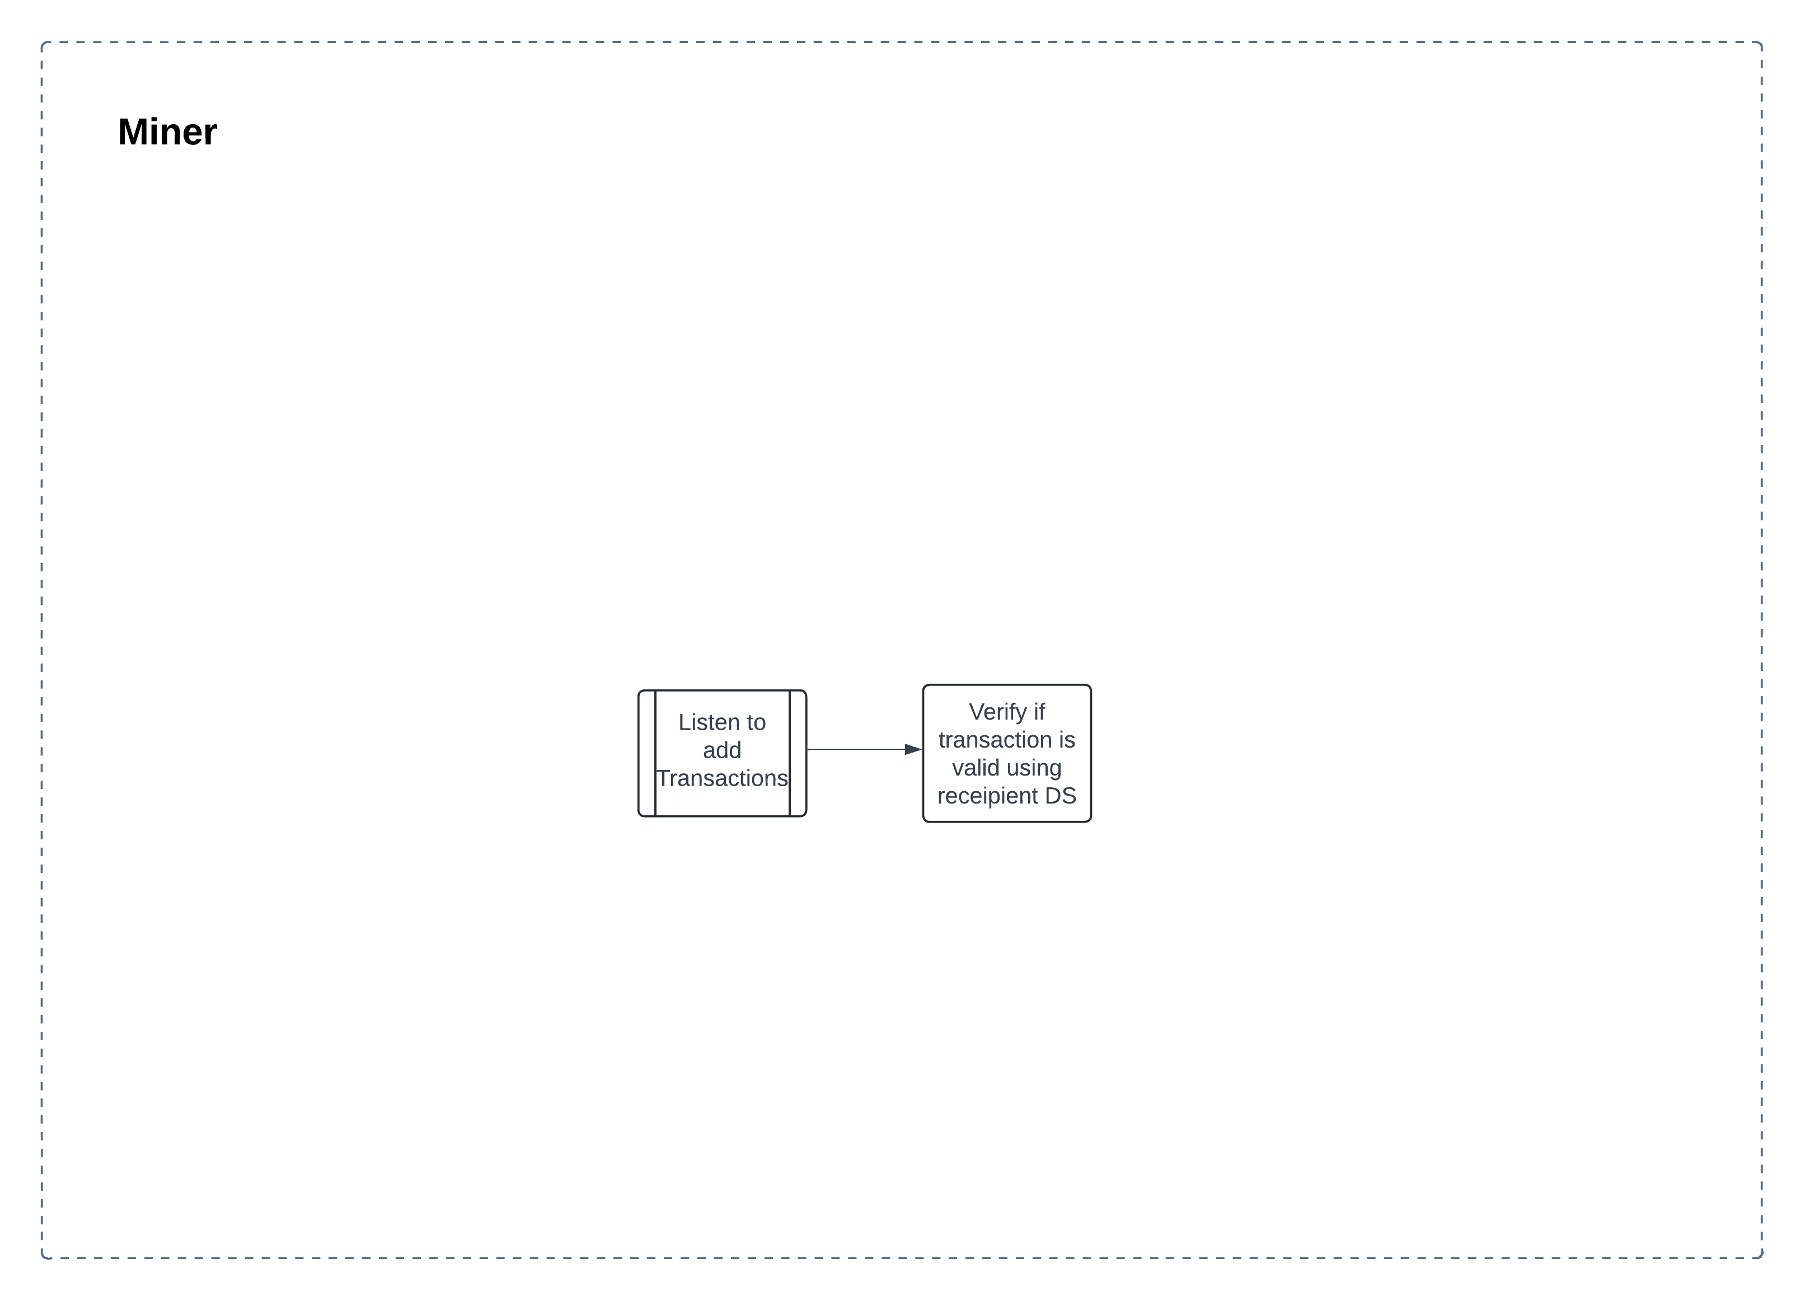
Process
flow

Slide 6
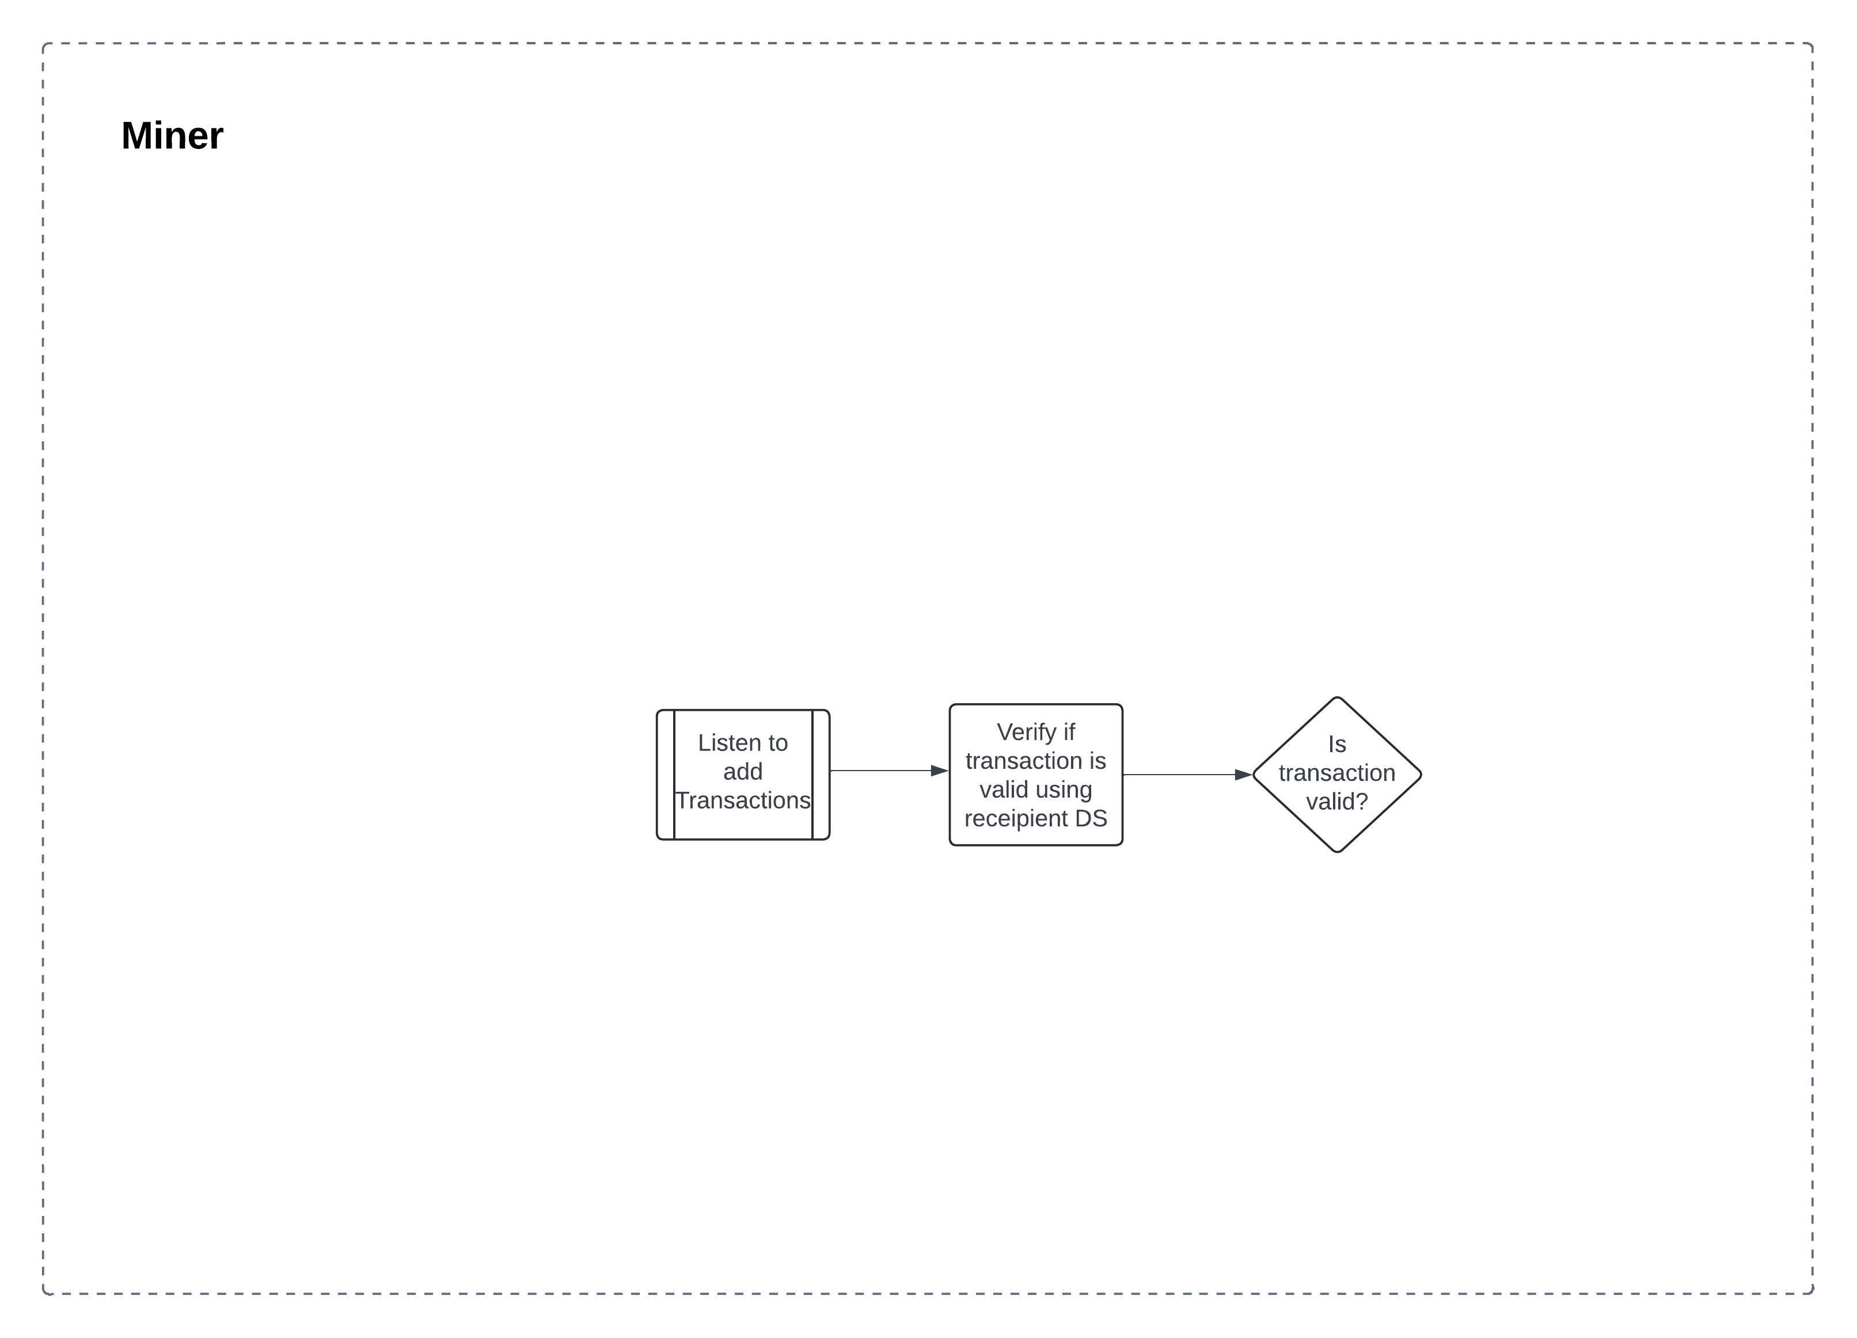
Process
flow

Slide 7
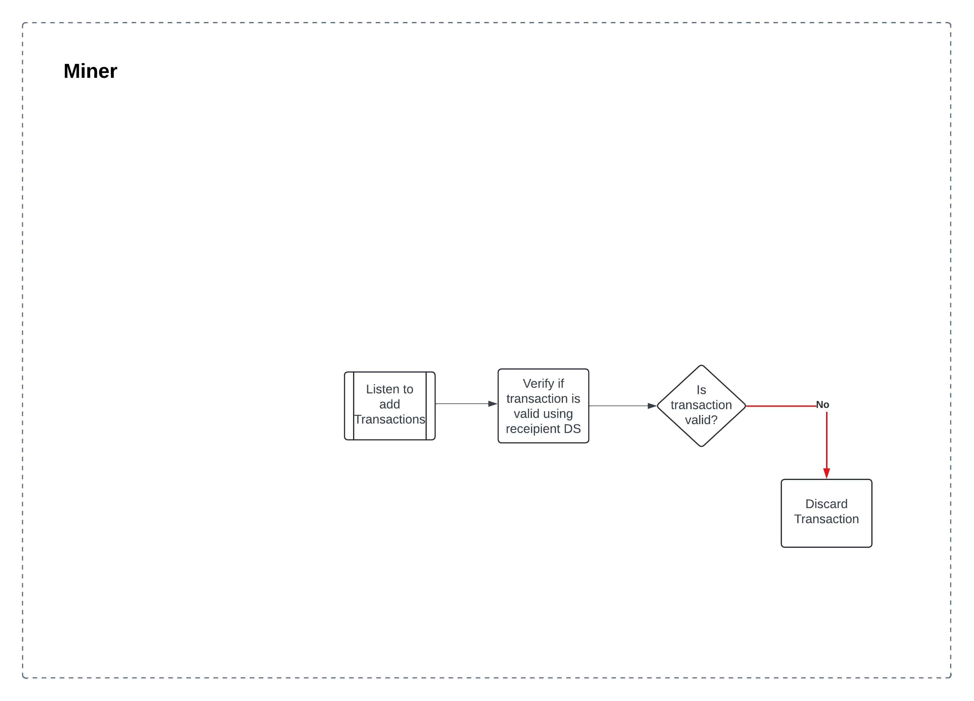
Process
flow

Slide 8
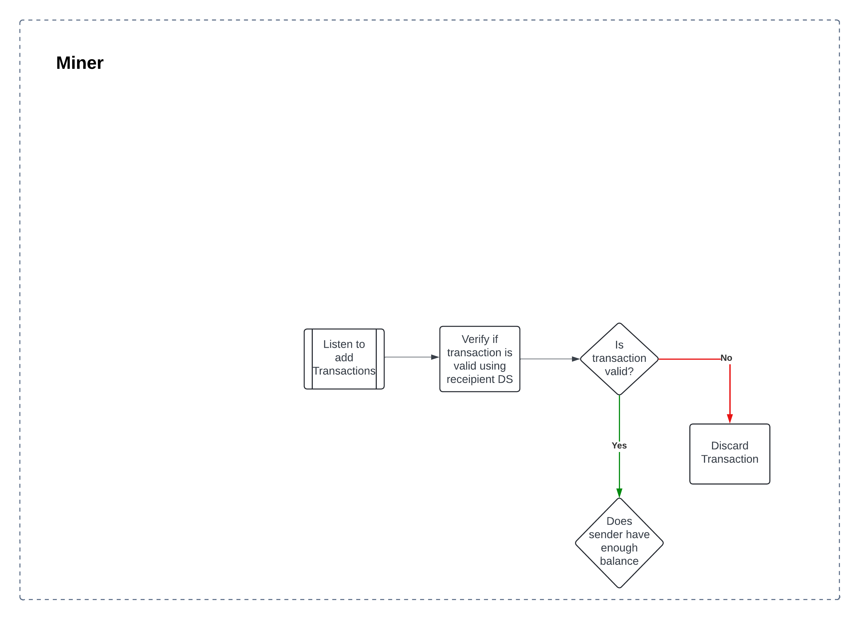
Process
flow

Slide 9
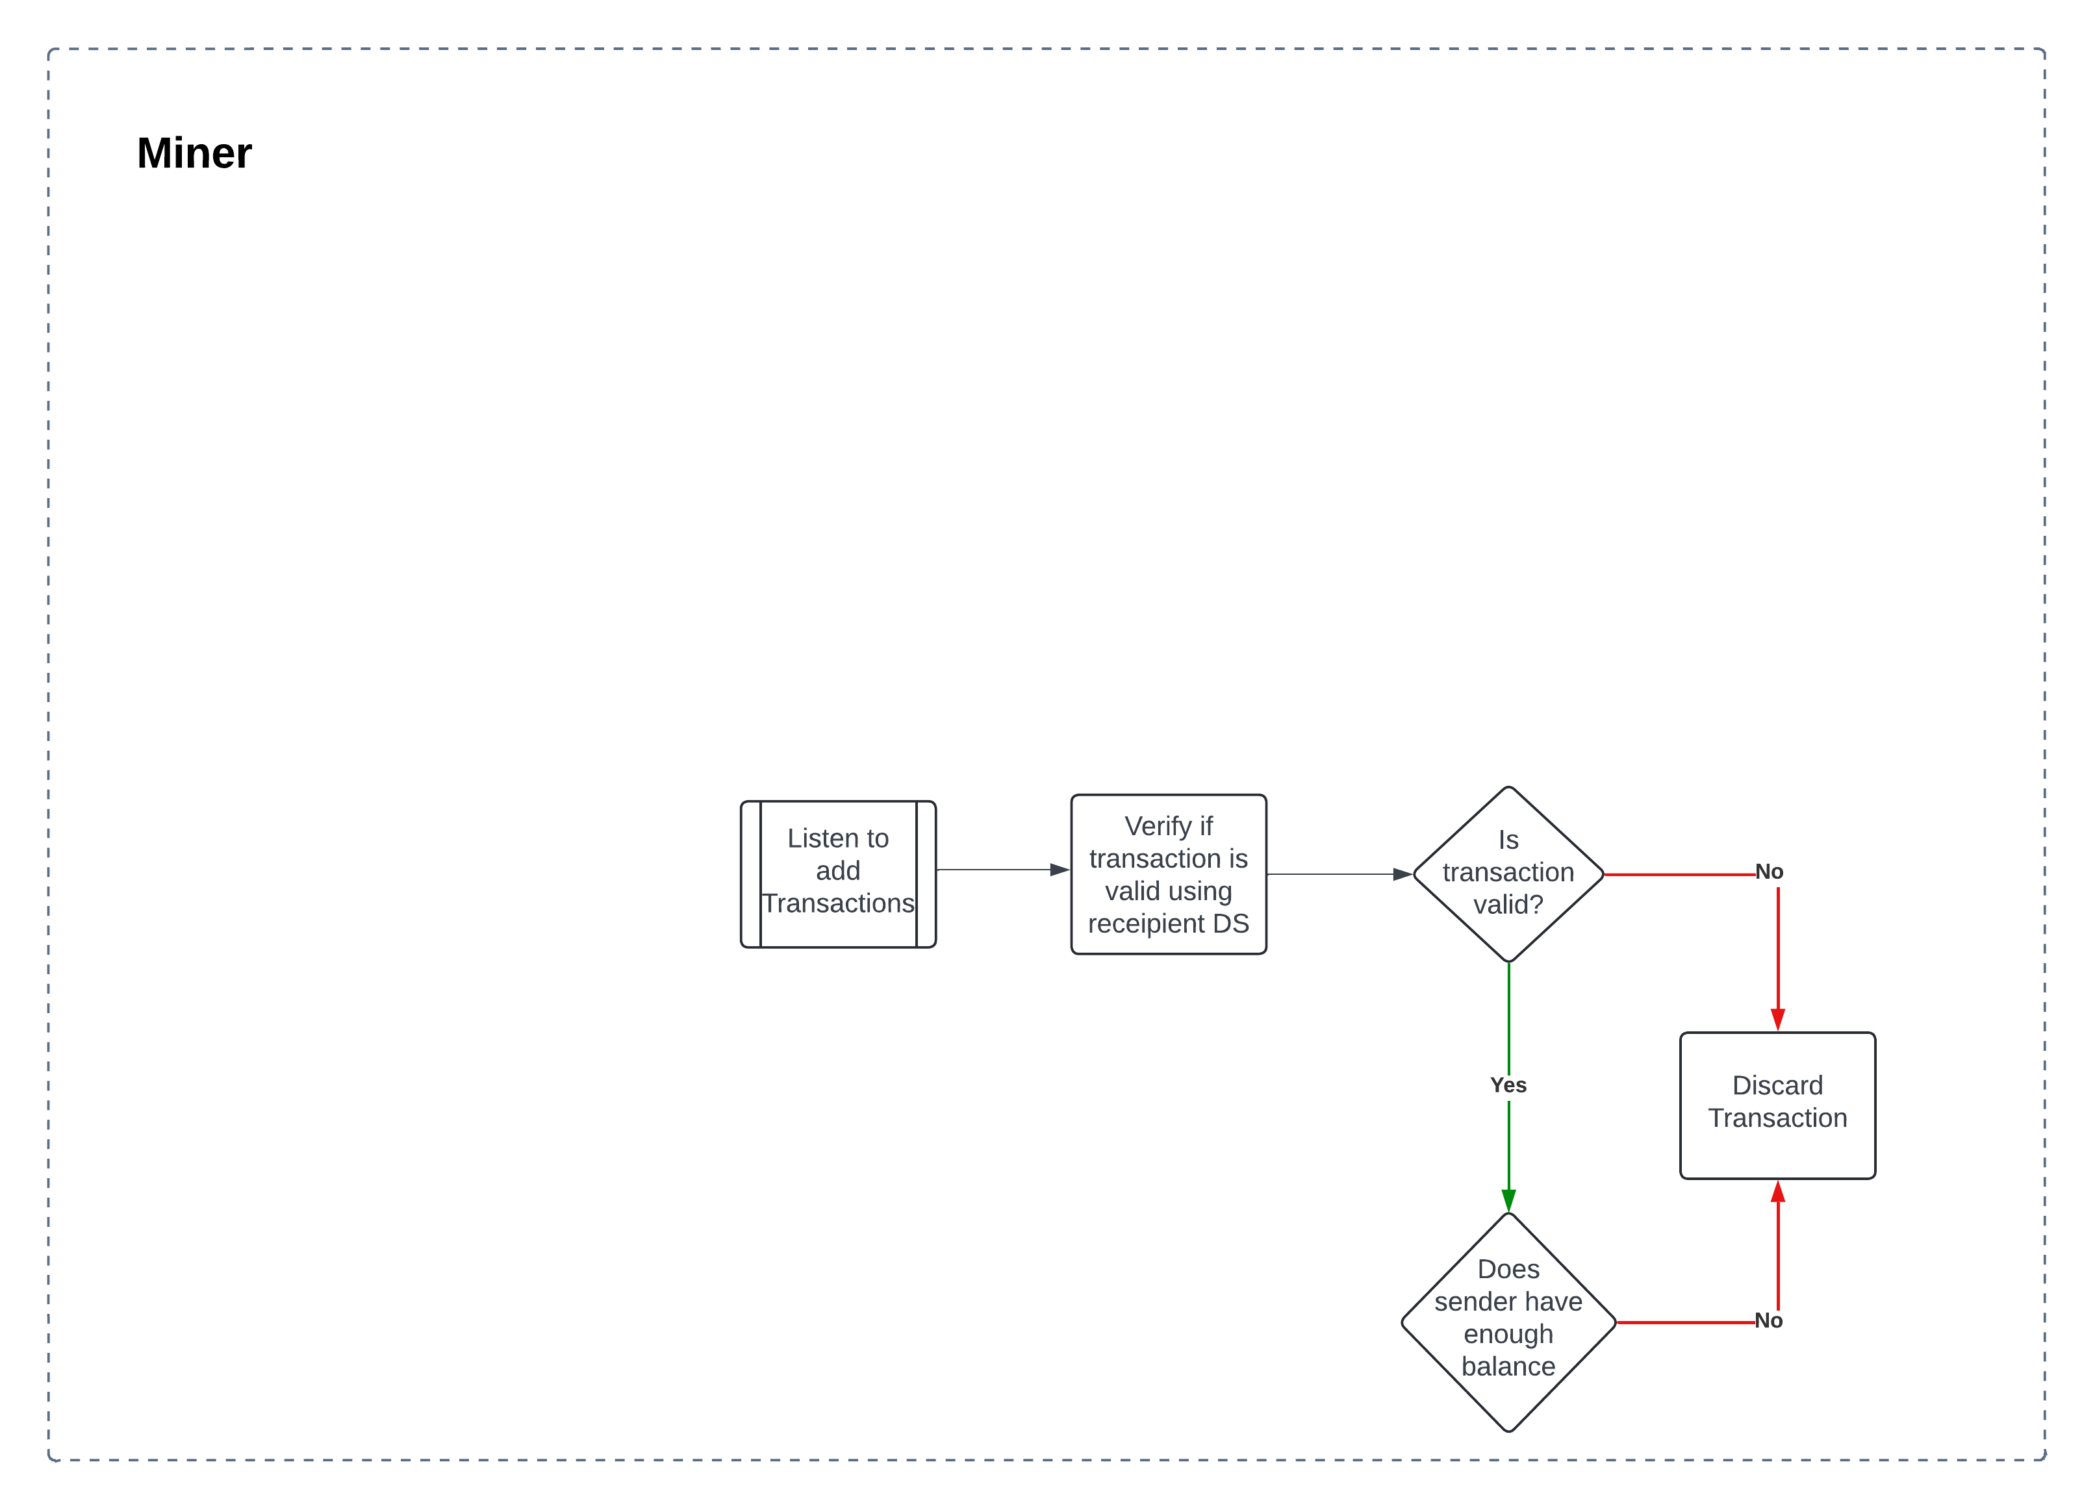
Process
flow

Slide 10
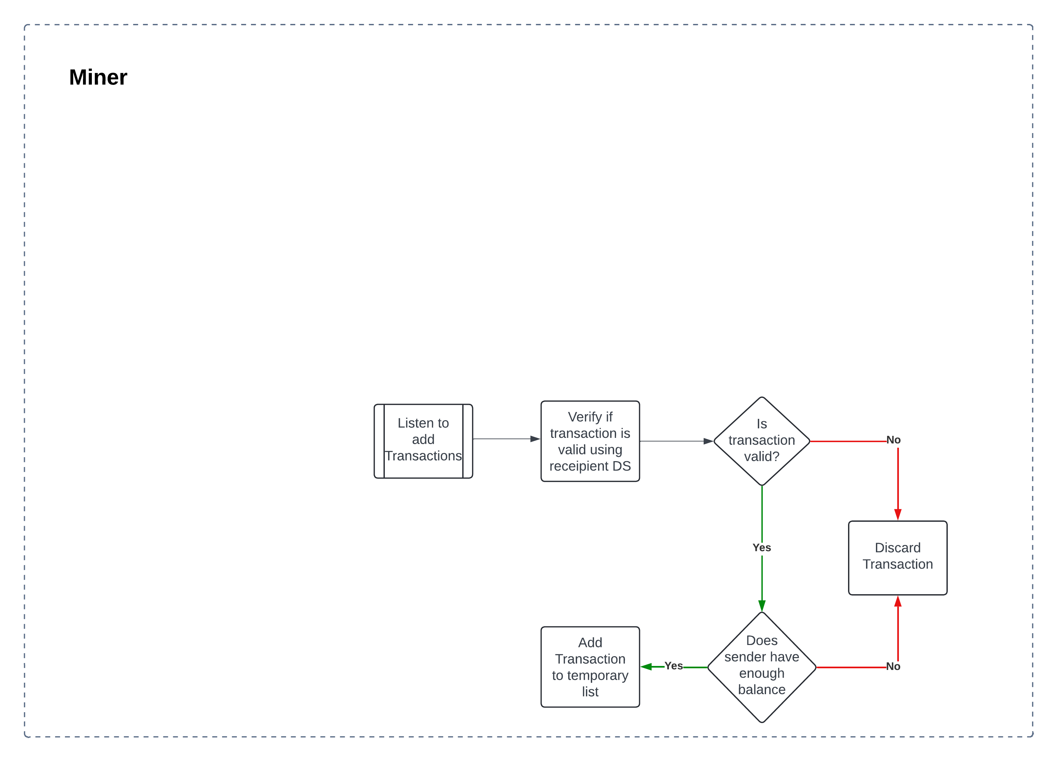
Process
flow

Slide 11
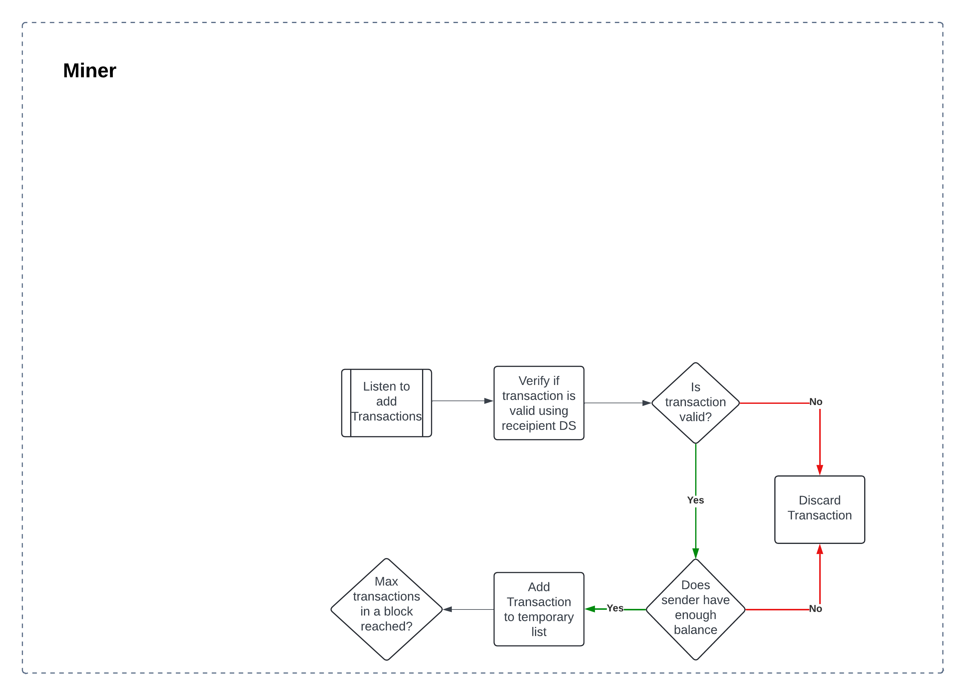
Process
flow

Slide 12
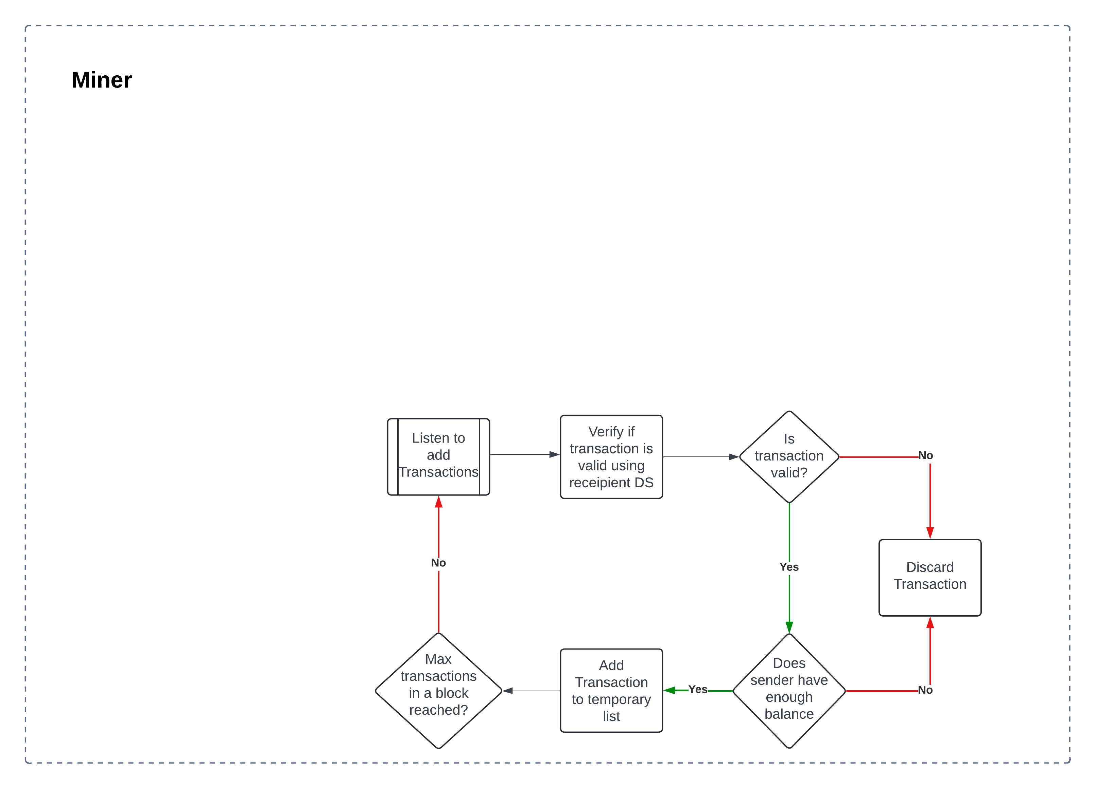
Process
flow

Slide 13
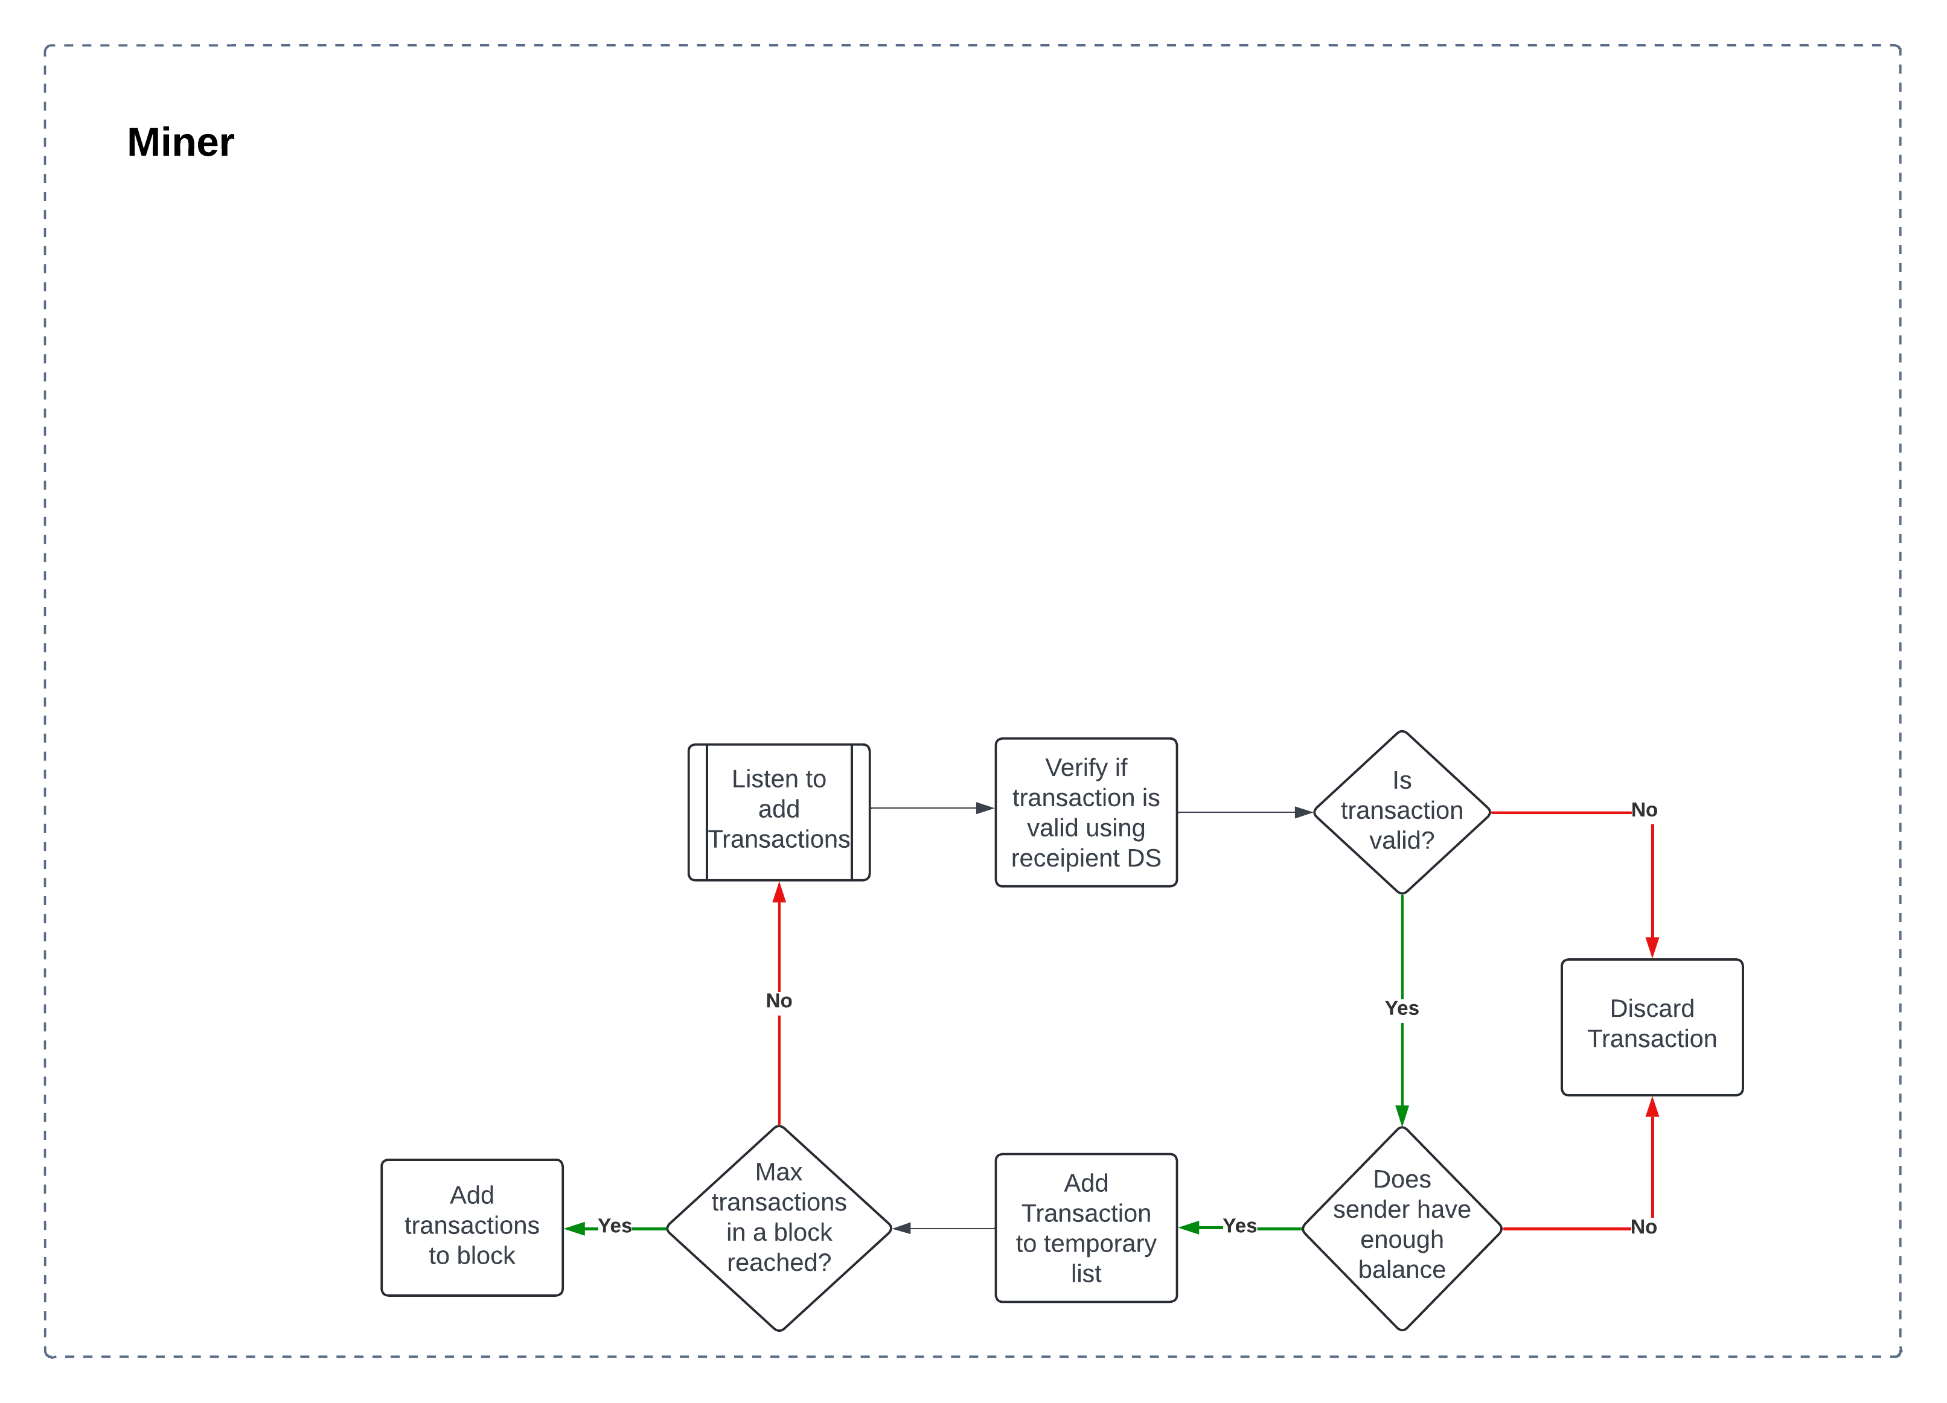
Process
flow

Slide 14
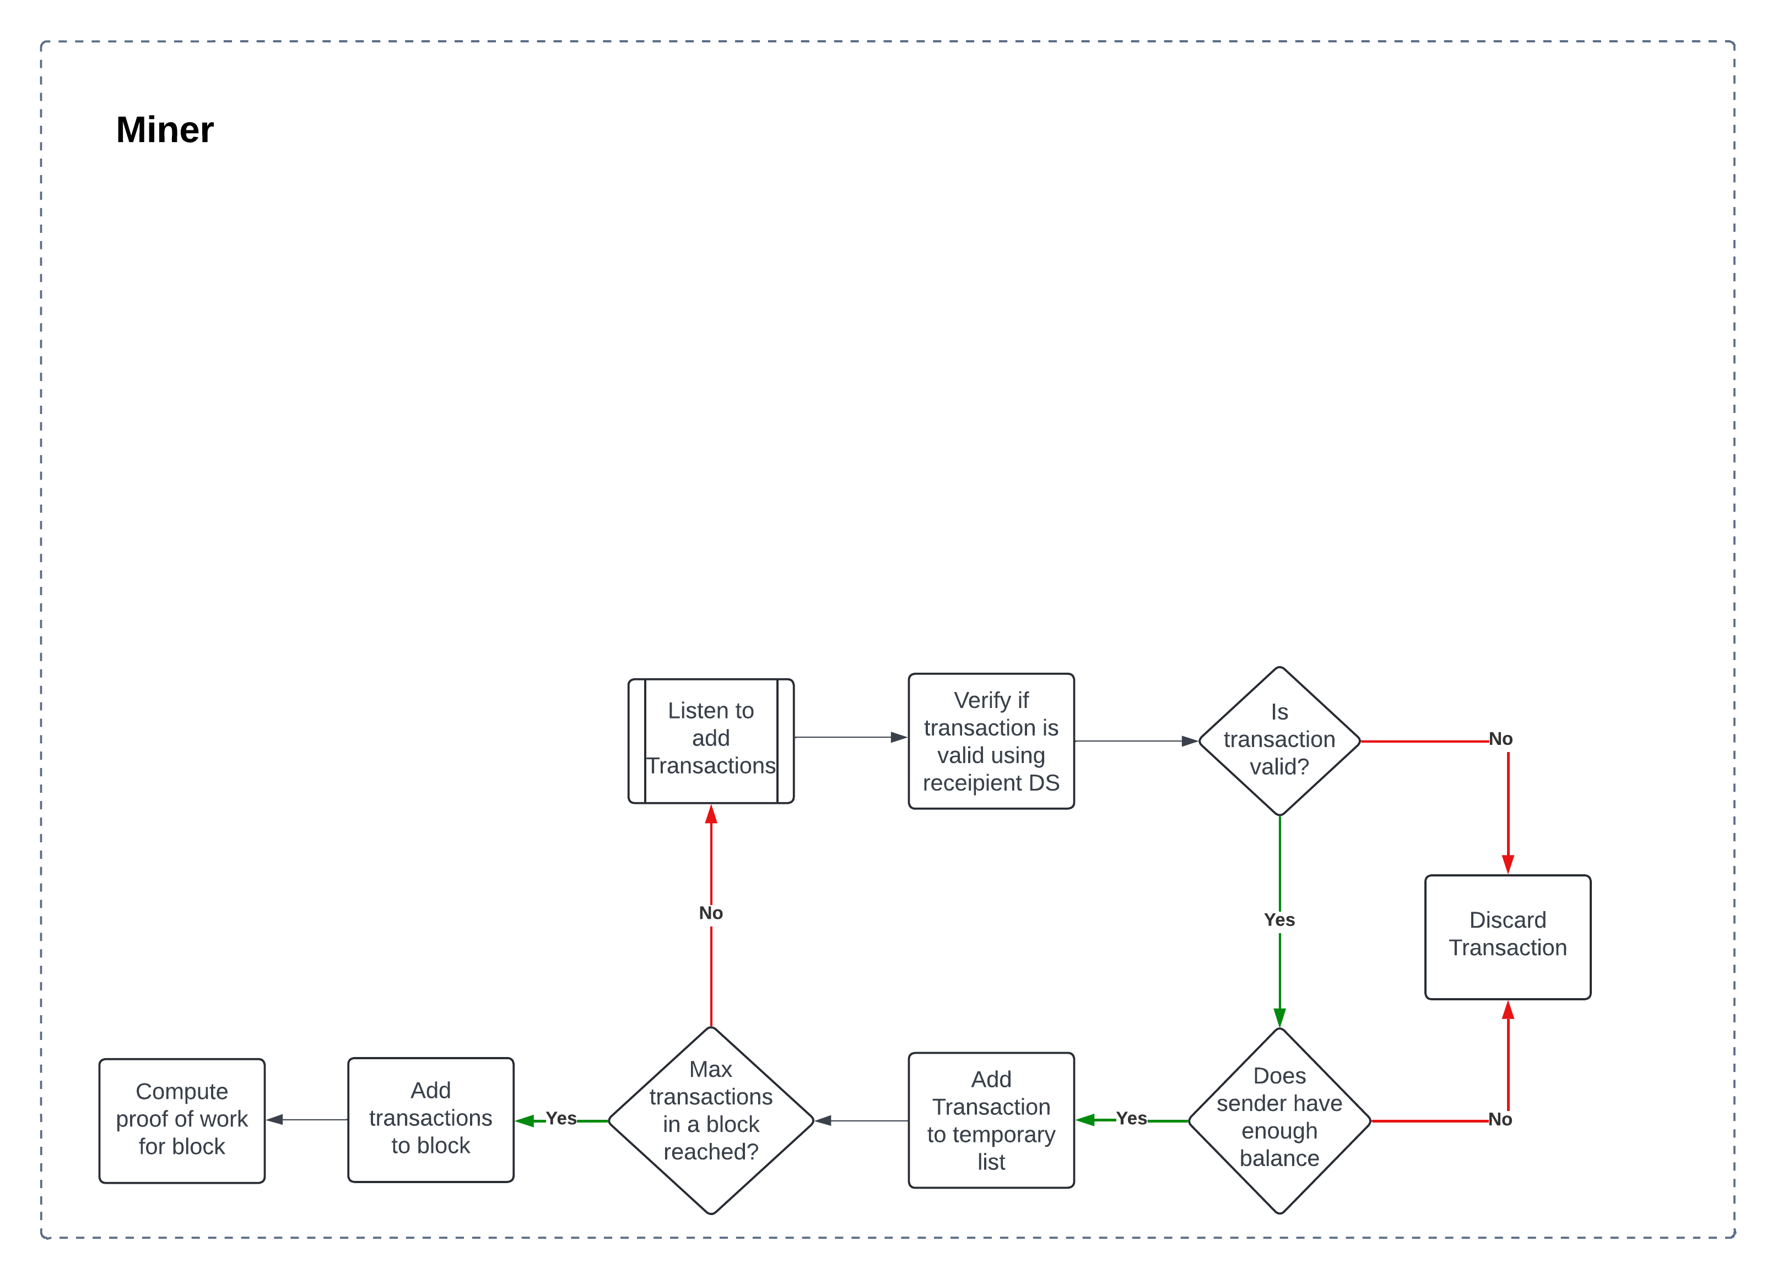
Process
flow

Slide 15
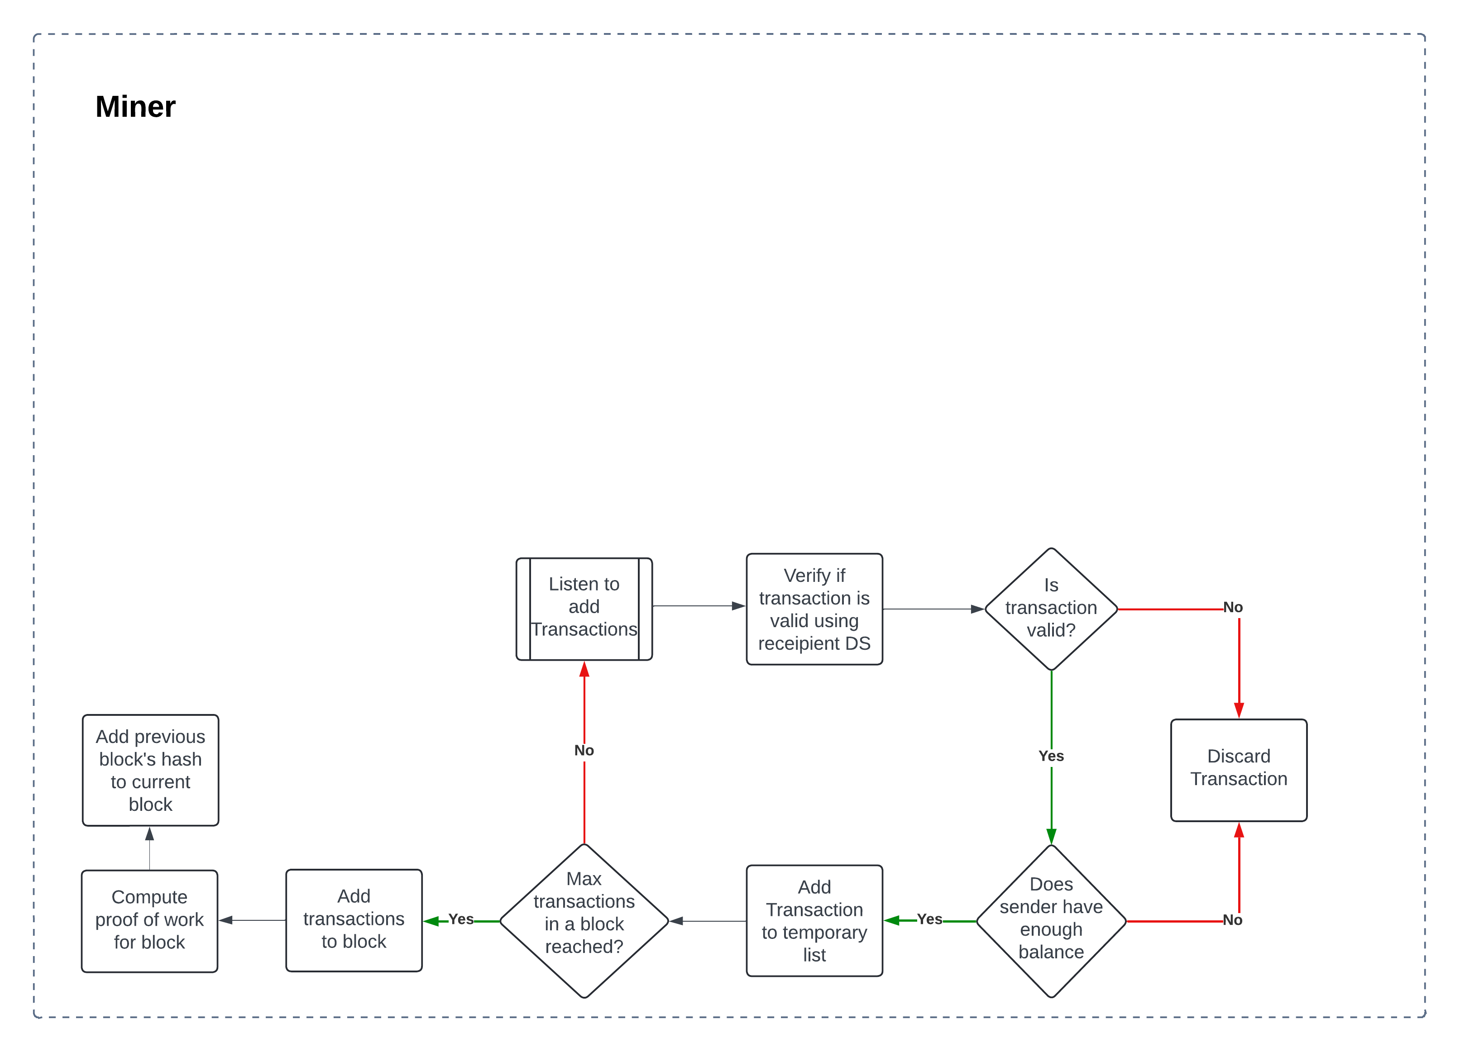
Process
flow

Slide 16
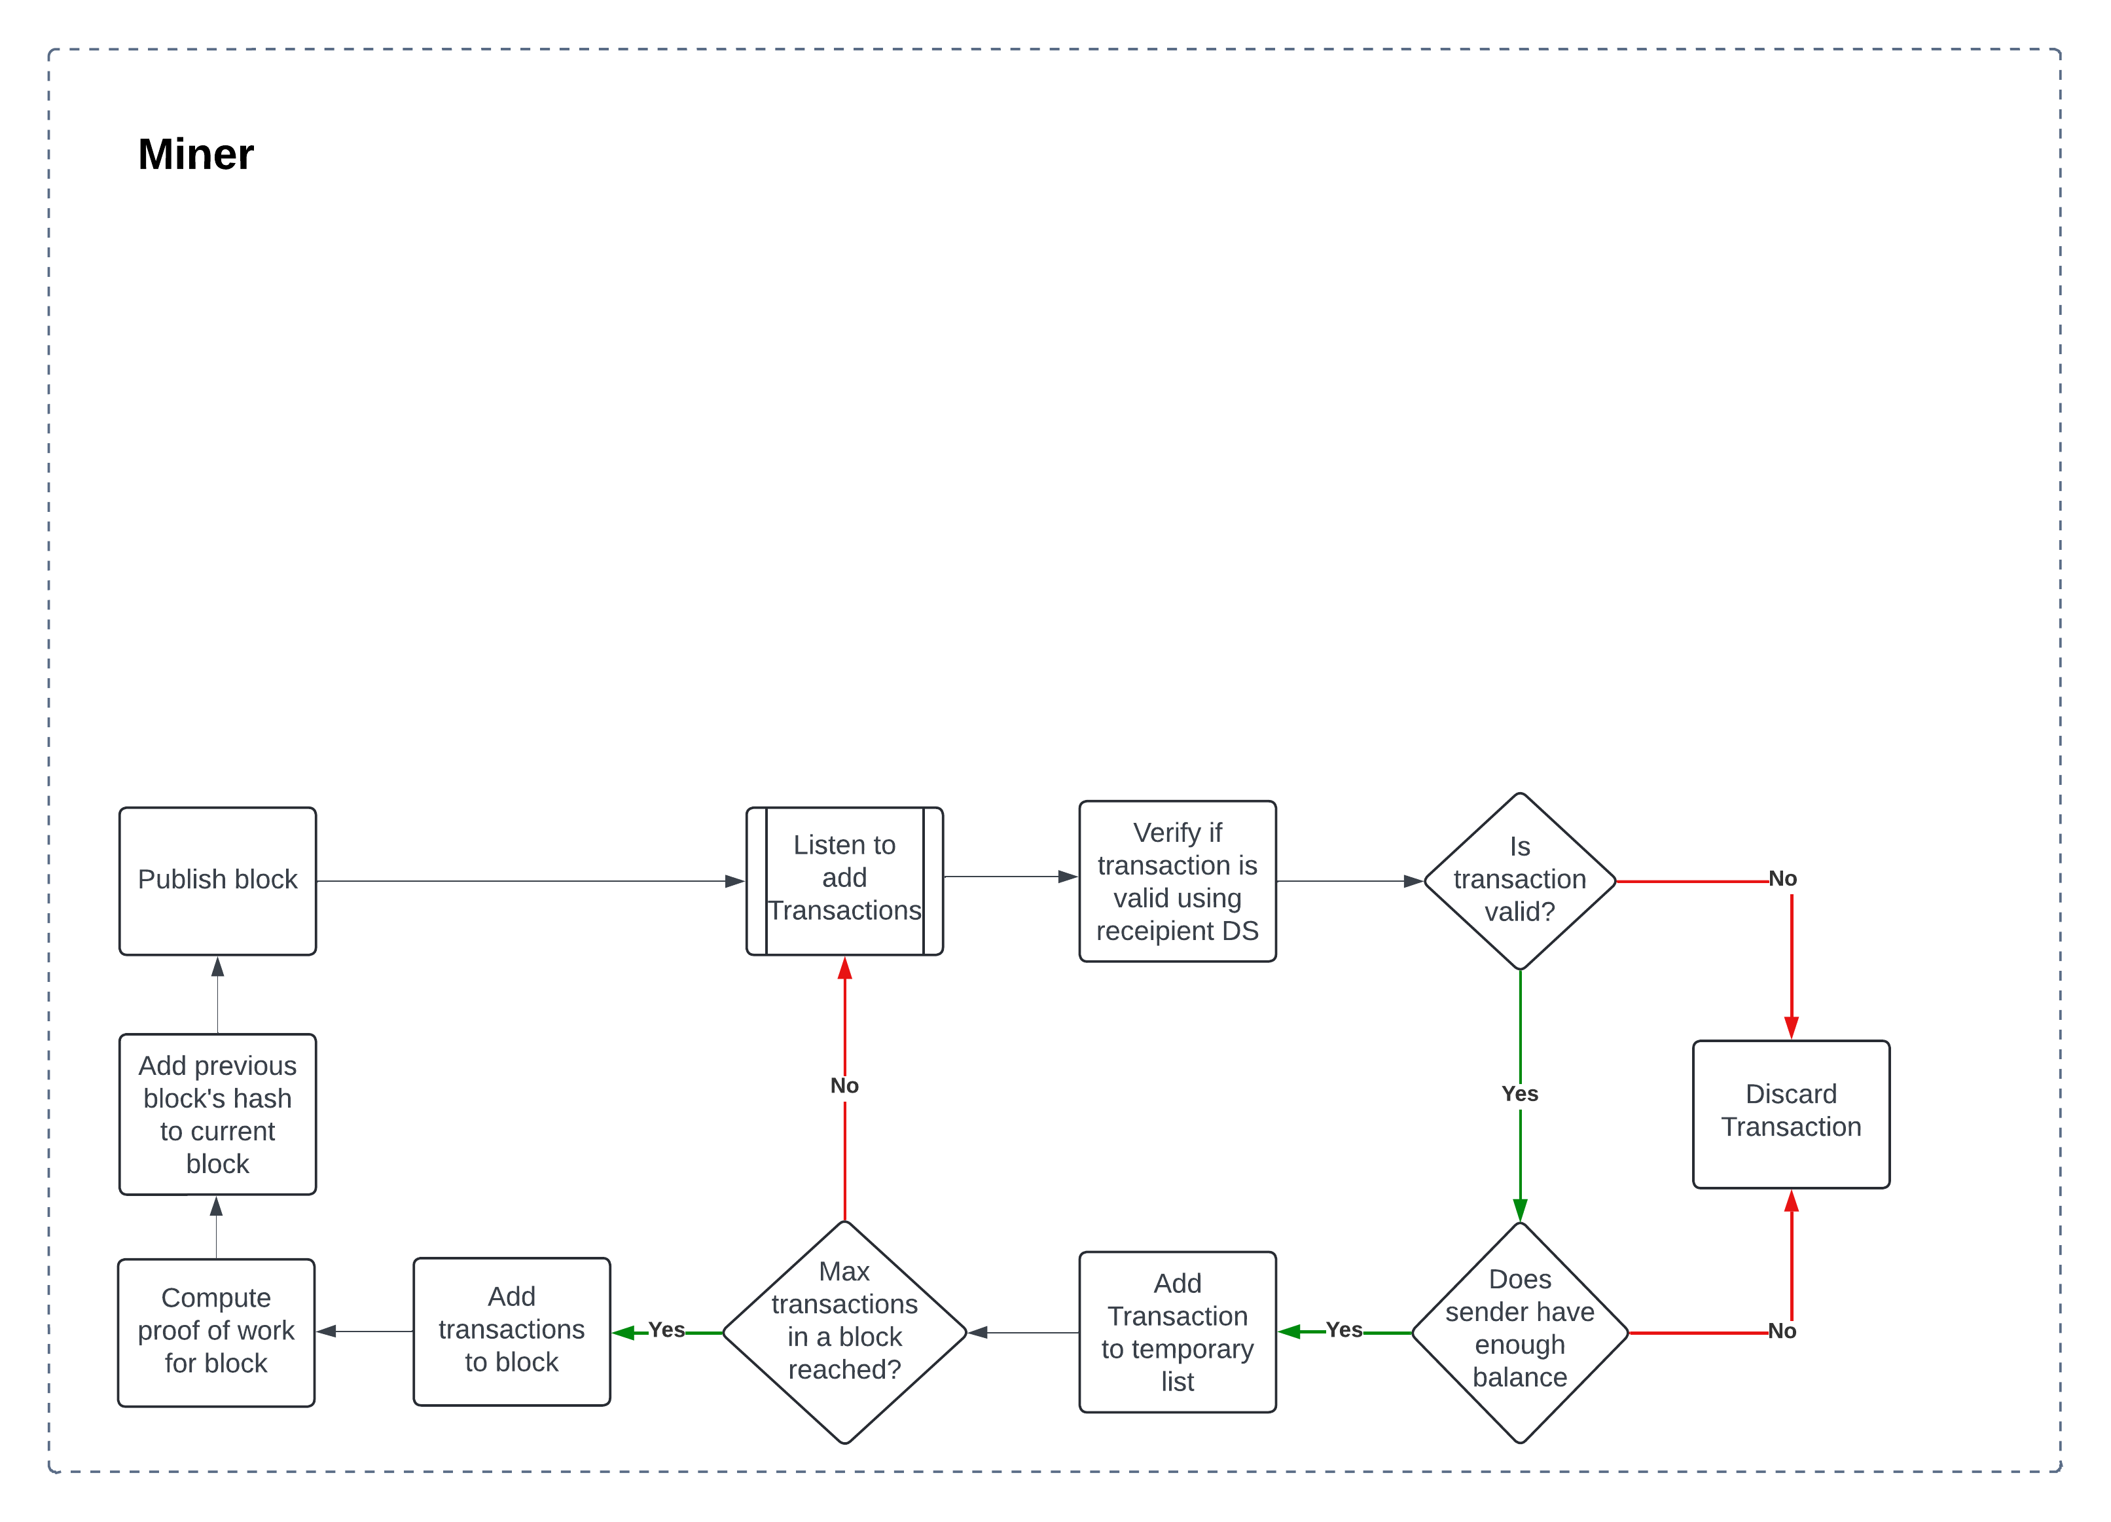
Process
flow

Slide 17
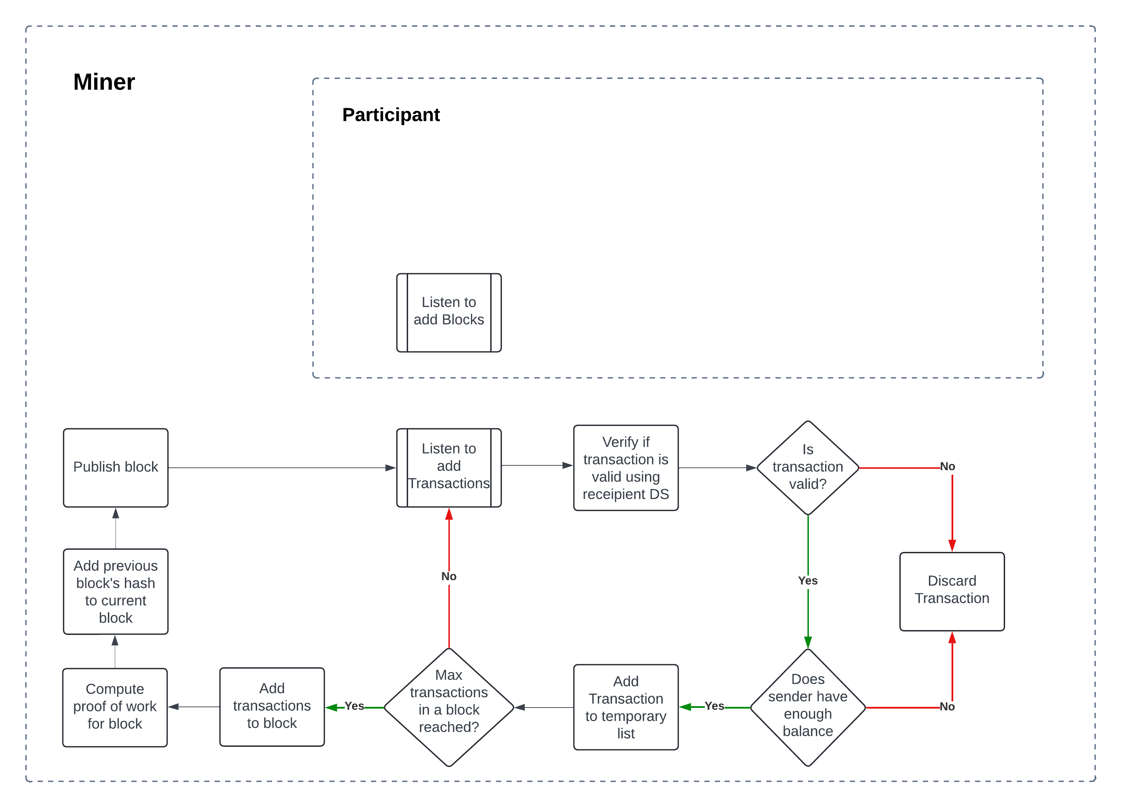
Process
flow

Slide 18
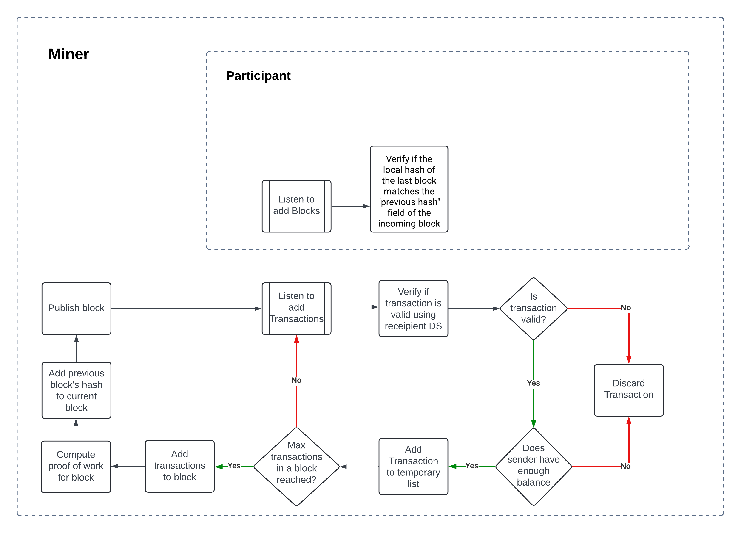
Process
flow

Slide 19
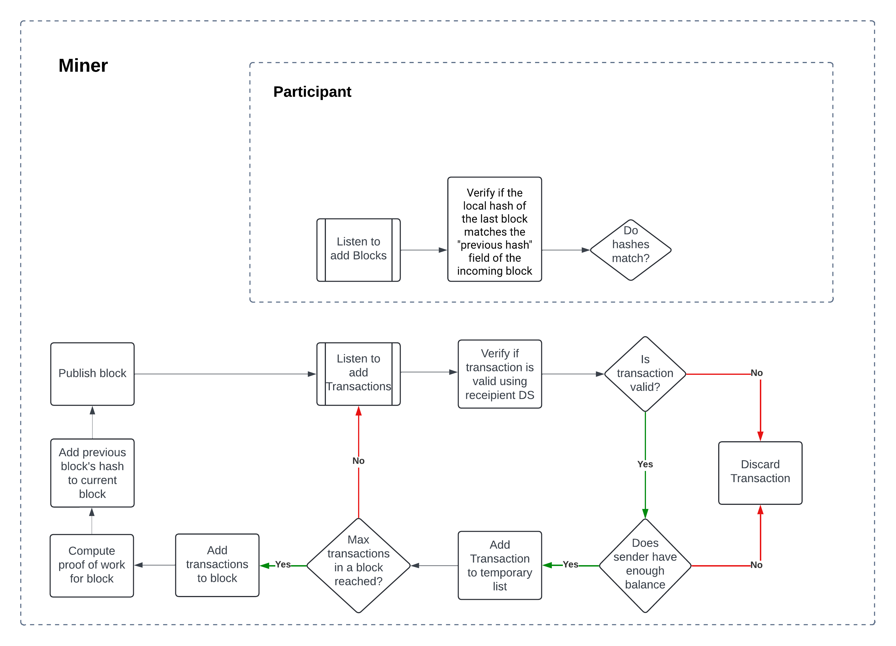
Process
flow

Slide 20
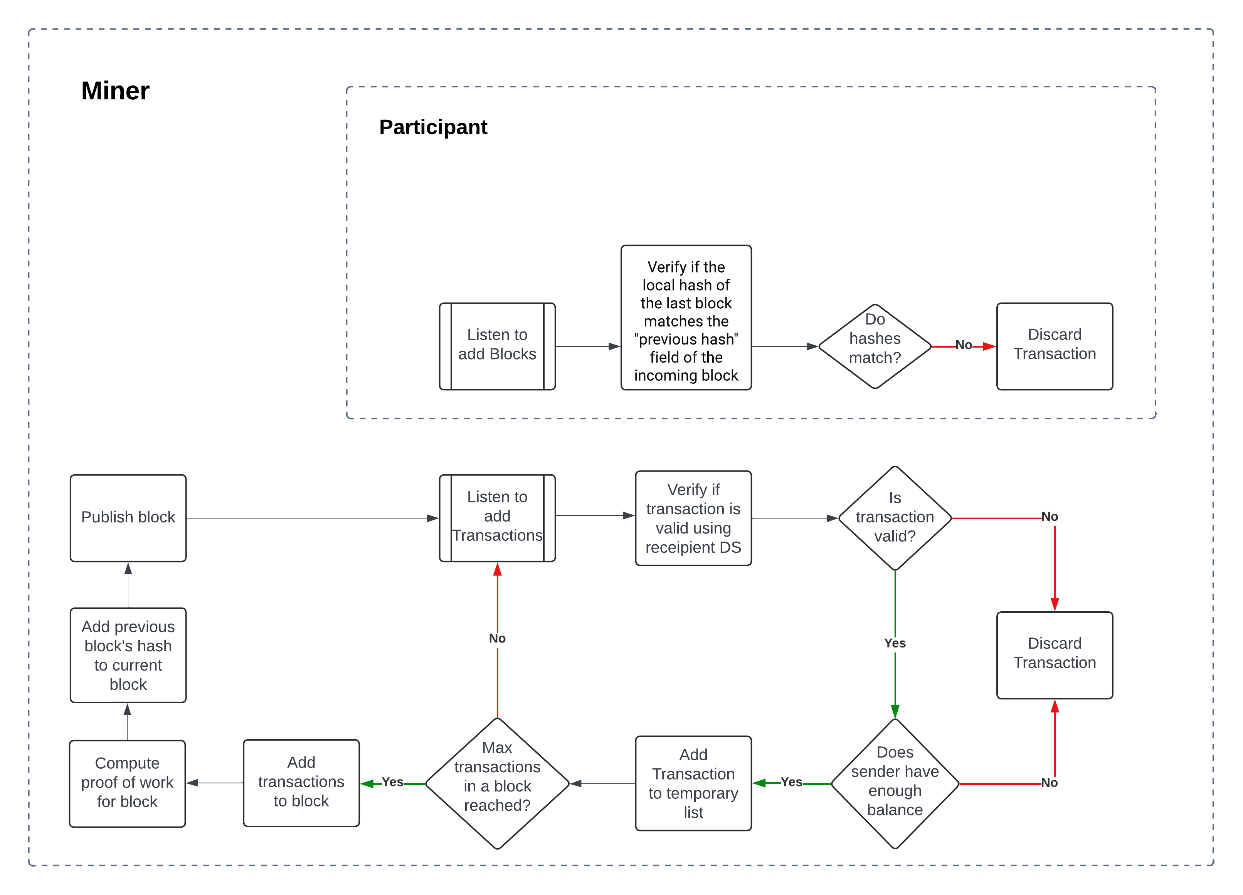
Process
flow

Slide 21
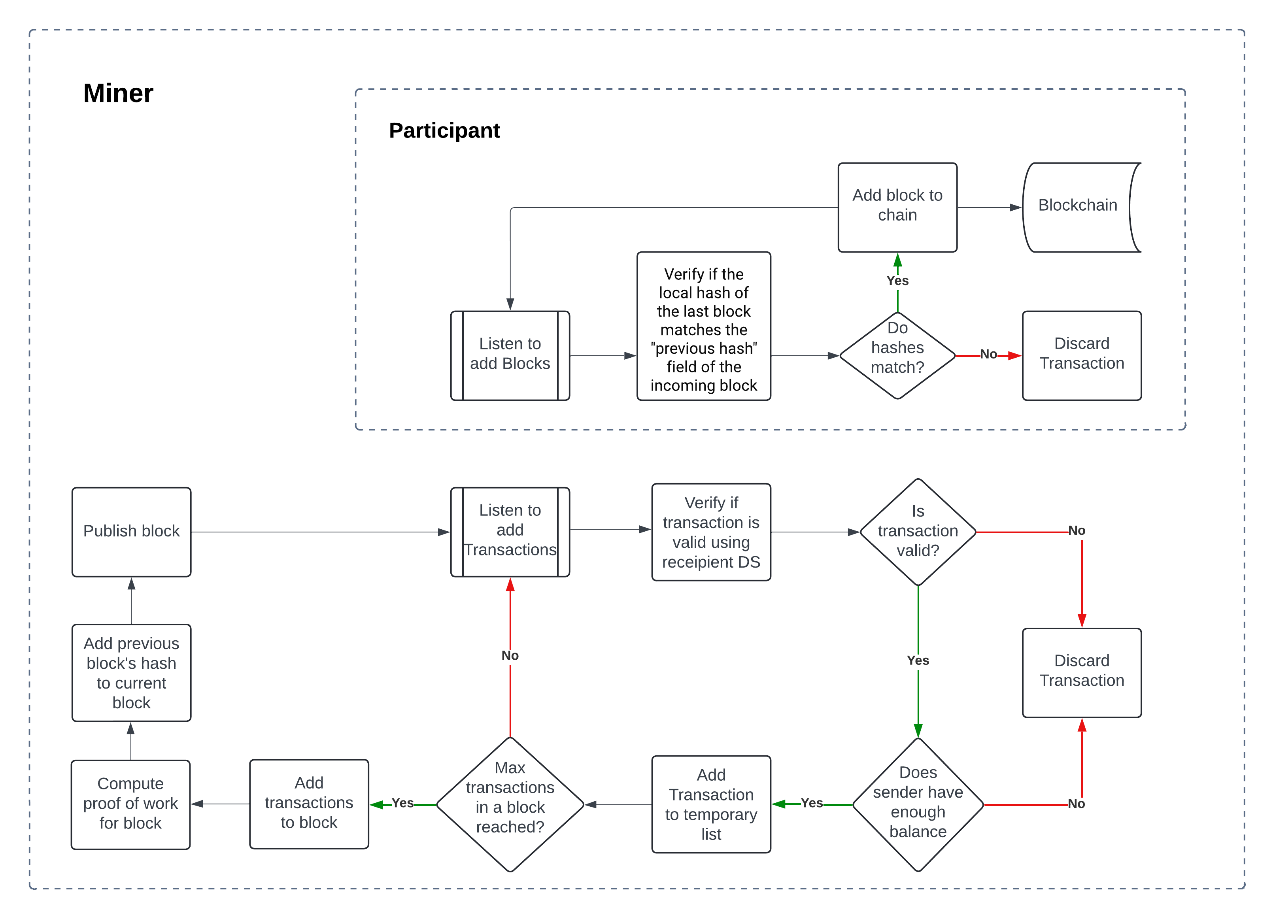
Process
flow

Slide 22
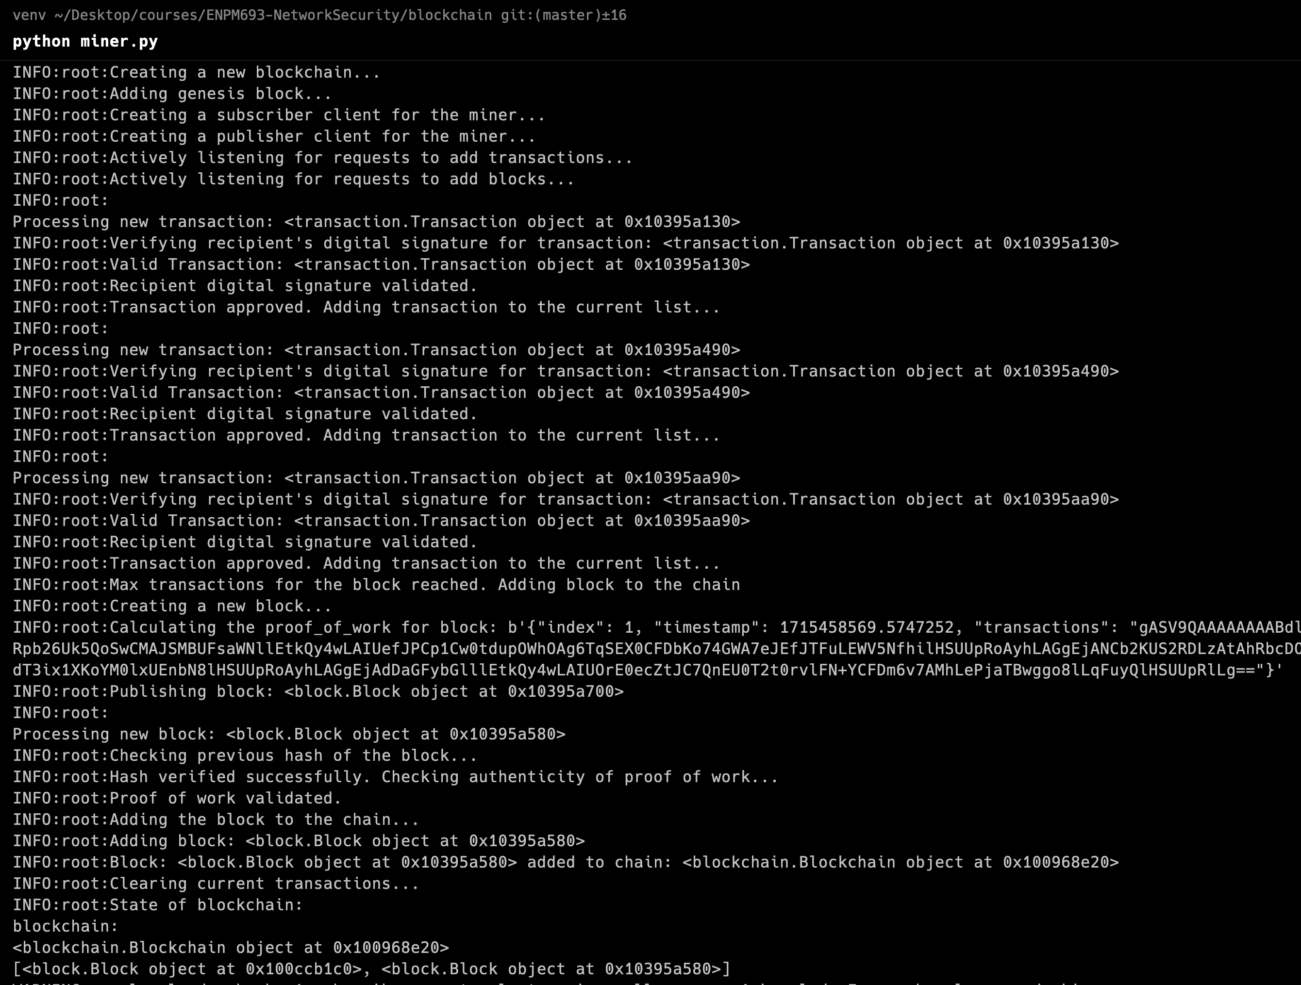

Miner

Slide 23
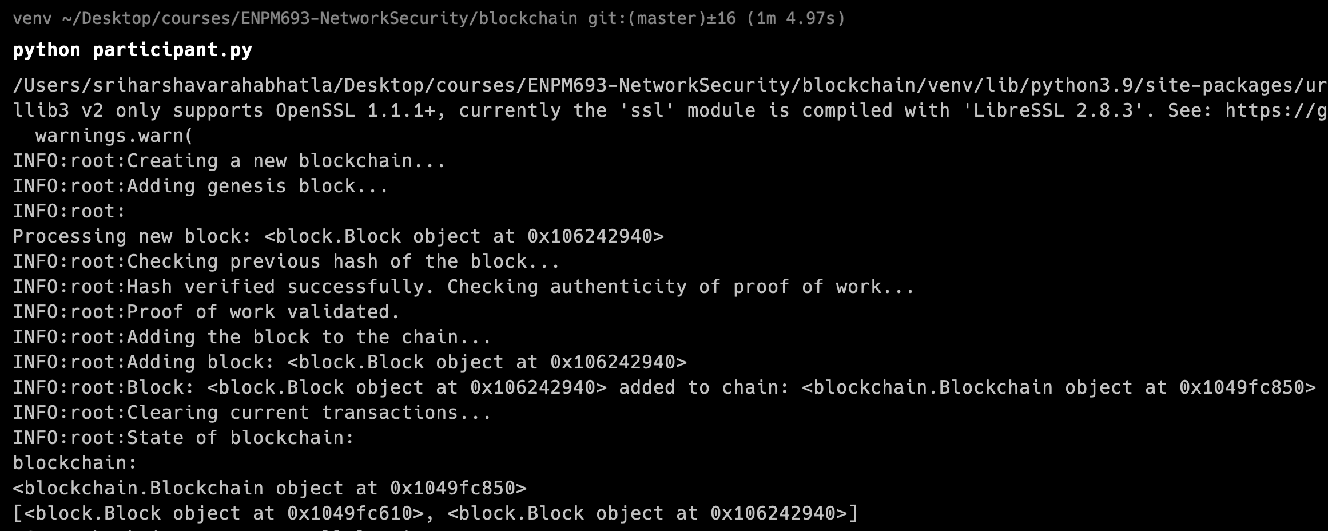
Participant

Slide 24
Thank You
github repository: https://github.com/Harsha-IAGB/blockchain.git

