Slide 1
Criminal Record Management System
Project by:-
Nandita Mahesh 20BCE1595
Sri HarshaVardhan Palla 20BCE1308
Varun Verma 20BCE1506
Video link:- https://youtu.be/fI07Cutpdac

Slide 2
Table of Content
01
04
02
05
03
06
Introduction
Use Cases
Objectives
Dfd and State diagram
Components
Demo

Slide 3
01
Introduction

Slide 4
In modern days crime is increasing day by day.
To combat such crimes and to provide safety to citizens, police department plays a vital role.
The correct information provided by the people to police helps a lot in arresting criminals.
In order to increase efficiency and save time, our project implements a CRMS (criminal record management system).
This is an online web application with database system in which police will keep the record of criminals who have been arrested.

Slide 5
Objectives

Slide 6



What We Are Working On
Reduce Manual Documentation
Interconnections and fast networking
Security and Control

Slide 7
To keep record of the criminals
To keep record of criminal’s details for future investigation
To keep record of crime activity
Reduce manual and redundant records keeping
Facilitate interaction and sharing of information between police departments of different districts
Building security
Monitoring control to ensure only authorized personally have access to the criminal information

Slide 8
Components

Slide 9



Traffic Section
Criminal Section
Search And View

Slide 10
Use Cases

Slide 11
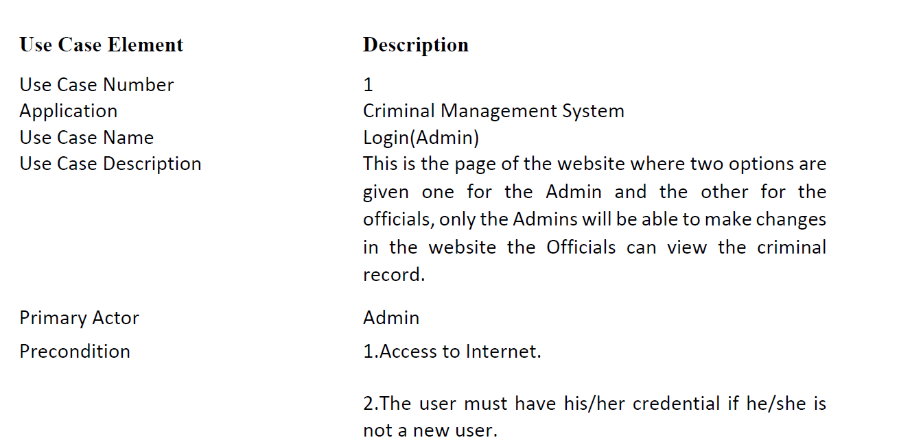

Slide 12
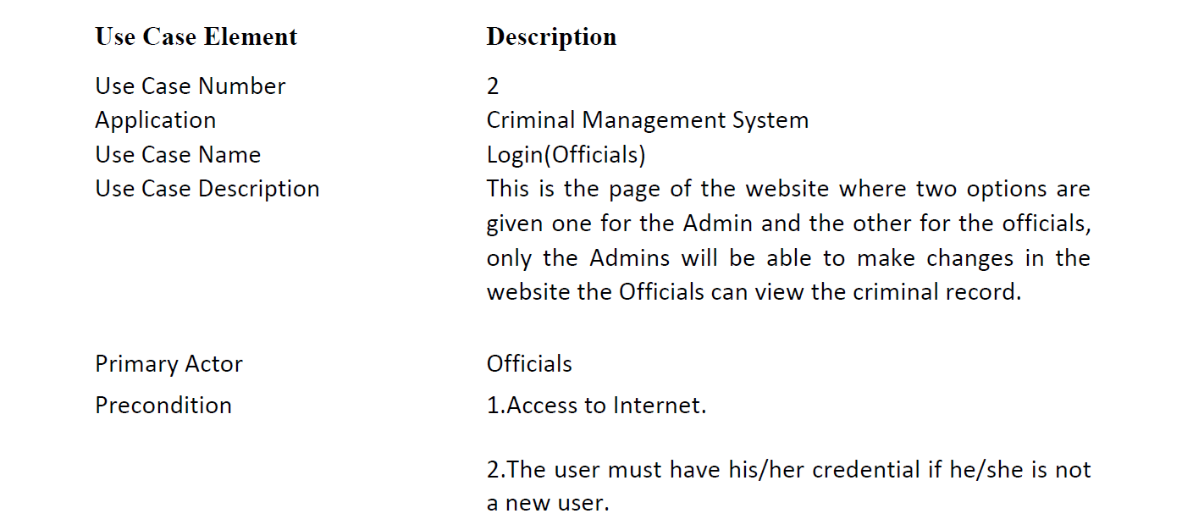

Slide 13
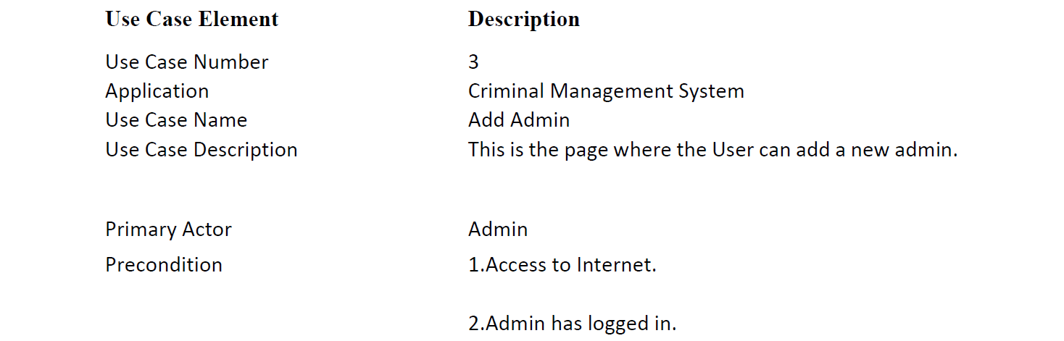

Slide 14
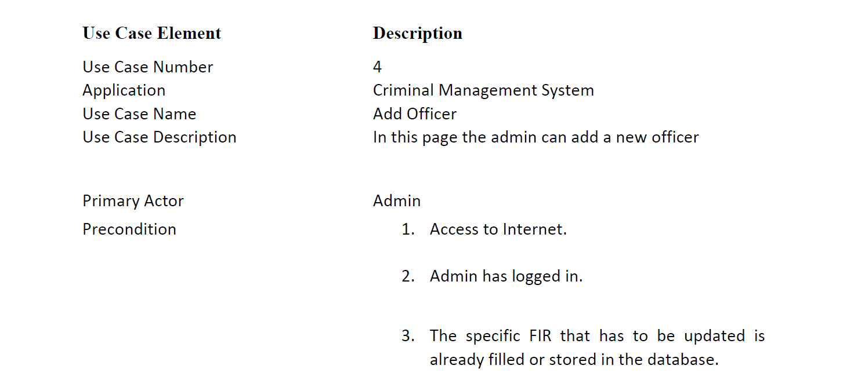

Slide 15
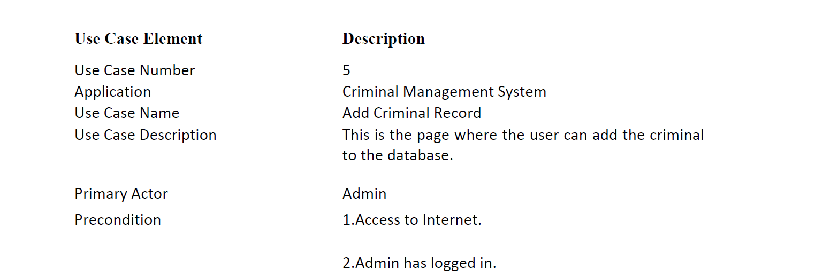

Slide 16
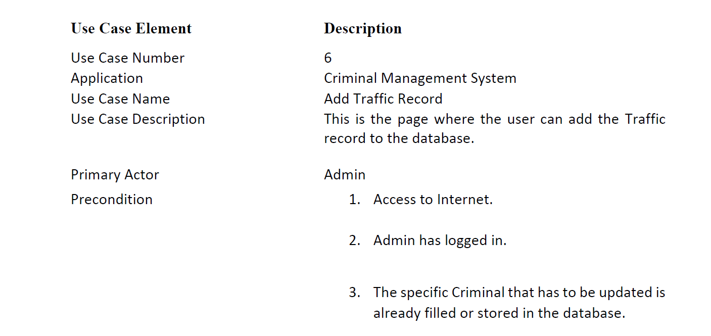

Slide 17
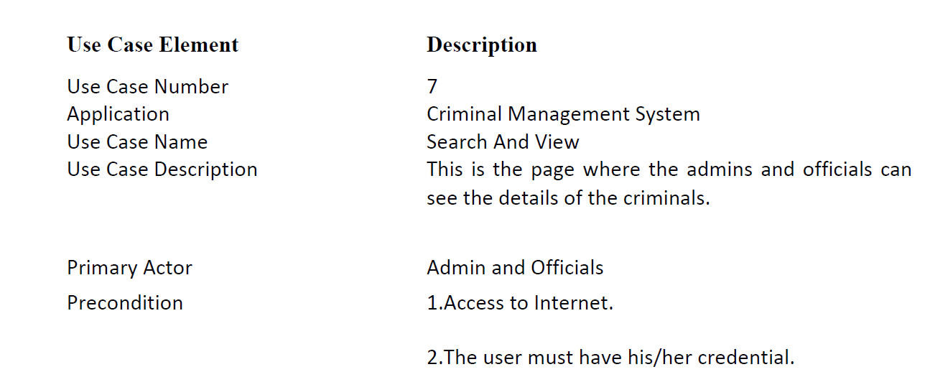

Slide 18
State Diagram

Slide 19
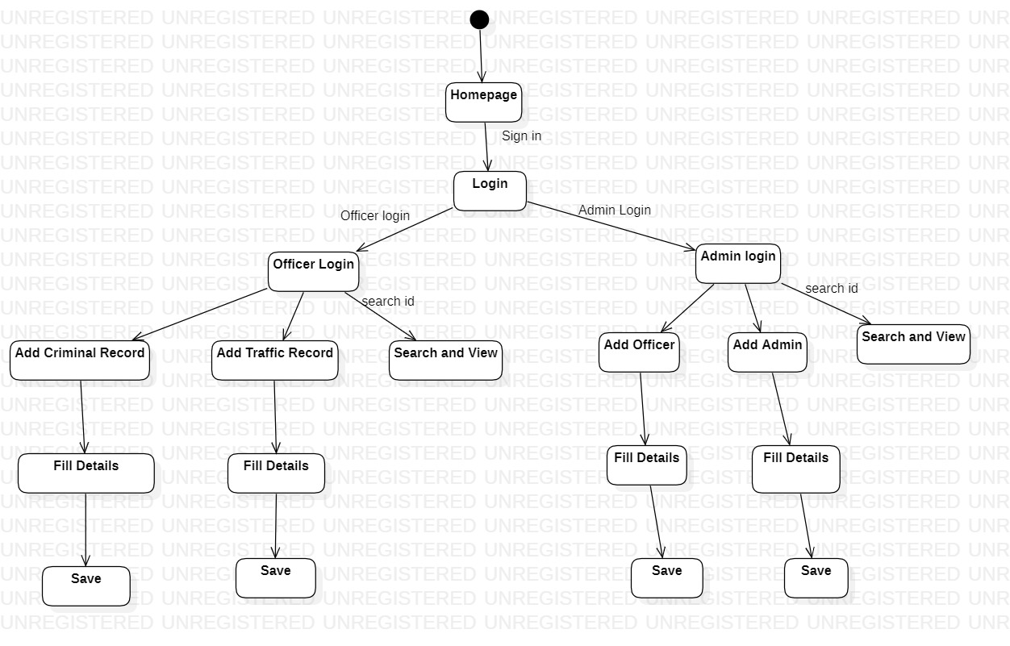

Slide 20
Data Flow Diagrams

Slide 21
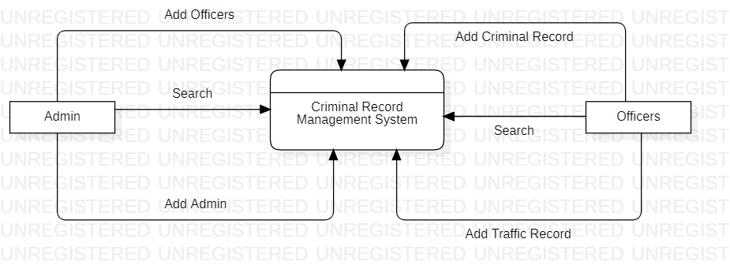
LEVEL 0 DFD(CONTEXT DIAGRAM)

Slide 22
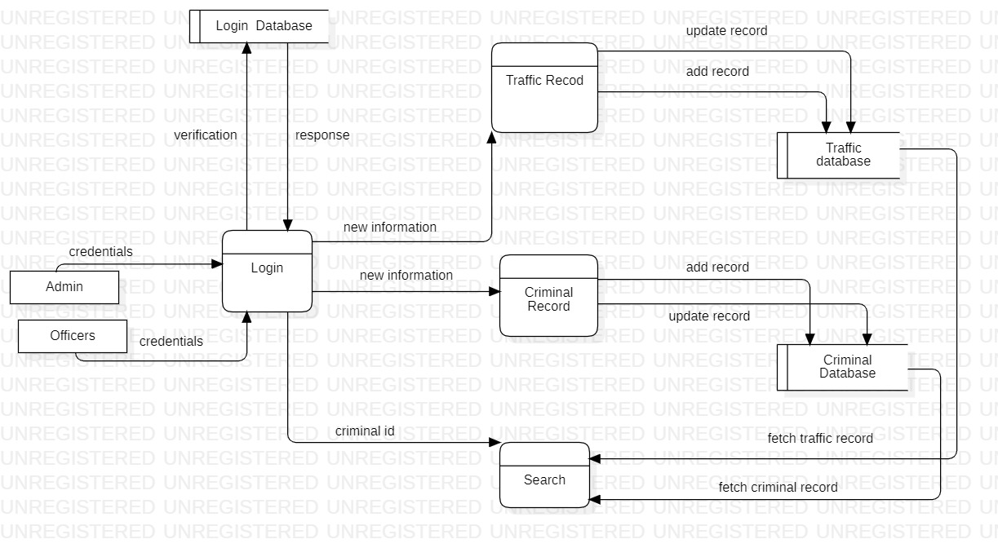
LEVEL 1

Slide 23
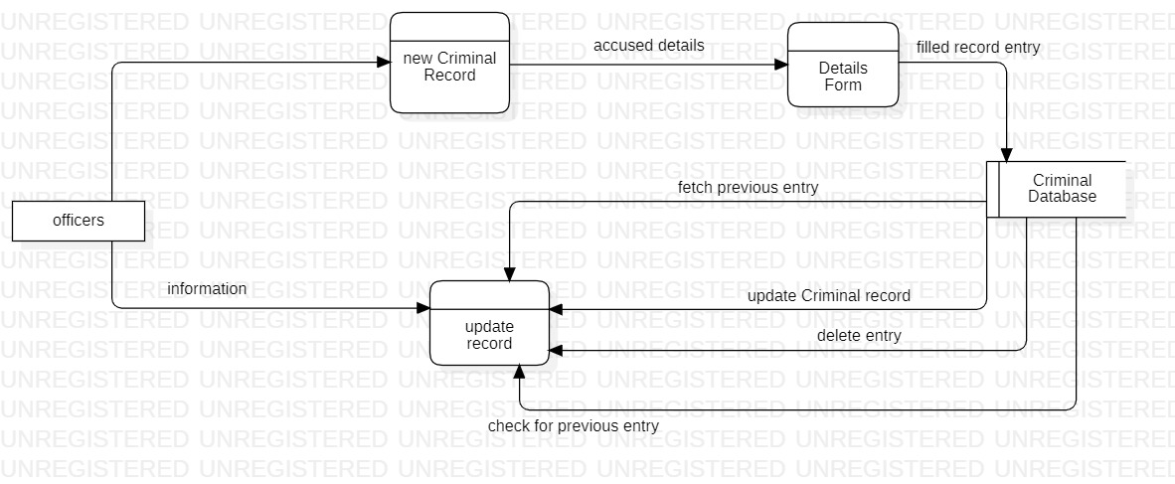
LEVEL 2:-CRIMINAL SECTION

Slide 24

LEVEL 2:-TRAFFIC SECTION

Slide 25
Demo

Slide 26
Our Team Contributions
Varun Verma
Demo
Login Modules
Admin Module
Nandita Mahesh
Introduction
Idea of project
Homepage Module
HarshaVardhan Palla
Use cases
Diagrams
Officers Module

Slide 27
Thankyou
Does anyone have any questions?

