Slide 1

CRIMINAL RECORD MANAGEMENT SYSTEM
Software Engineering Project By:
Nandita Mahesh 20BCE1595
Sri HarshaVardhan Palla 20BCE1308
Varun Verma 20CBE1506
Video link : https://drive.google.com/drive/folders/1k2Rpq4QPAmVFXwSi2EJpRm81iw98dJom?usp=sharing

Slide 2
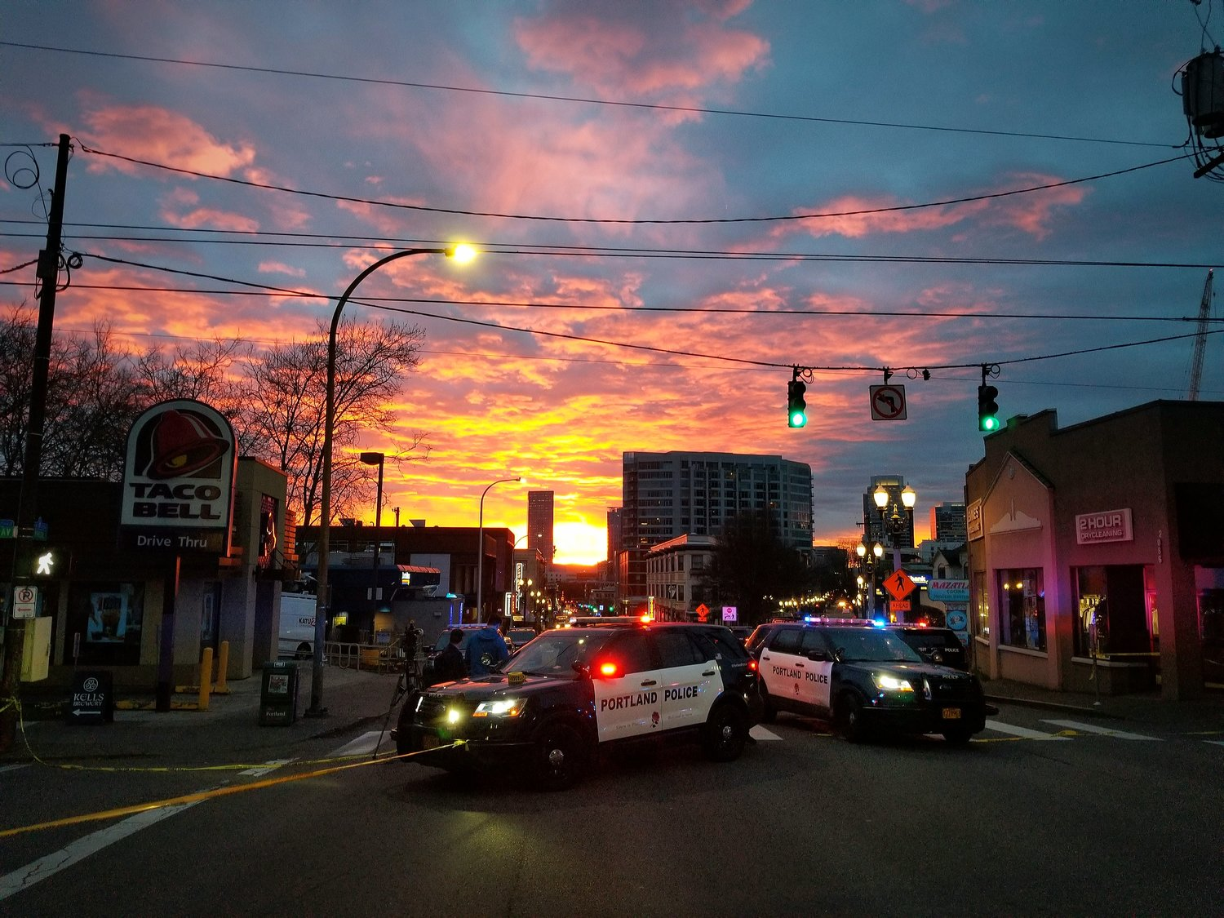
INTRODUCTION
In modern days crime is increasing day by day.
To combat such crimes and to provide safety to citizens, police department plays a vital role.
The correct information provided by the people to police helps a lot in arresting criminals.
In order to increase efficiency and save time, our project implements a CRMS (criminal record management system).
This is an online web application with database system in which police will keep the record of criminals who have been arrested.

Slide 3



OBJECTIVES
- To keep record of the criminals
To keep record of criminal’s details for future investigation
To keep record of crime activity
Reduce manual and redundant records keeping
Facilitate interaction and sharing of information between police departments of different districts
Building security
monitoring control to ensure only authorized personally have access to the criminal information
Reduce manual
Documentations
Interconnections & fast sharing
Security & control

Slide 4



PROJECT COMPONENTS :
The major modules of the project include :
Login (administrators & Officers)
FIR Section
Criminal Record Section
Search and View records
FIR section
Criminal Record Section
Search Records

Slide 5

USE CASE DESCRIPTIONS
The use cases of the project are listed below

Slide 6
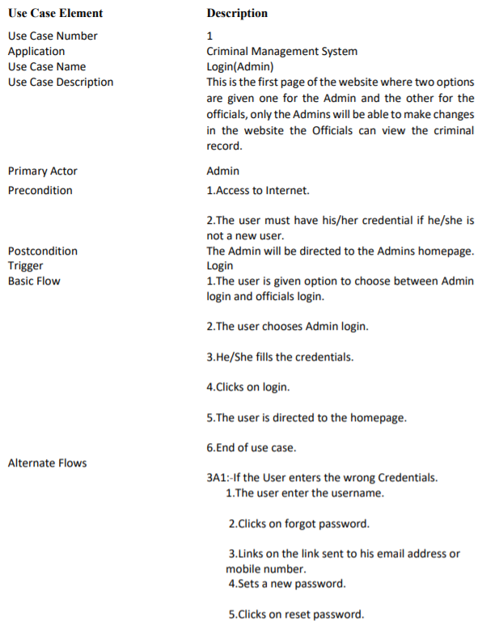

Slide 8
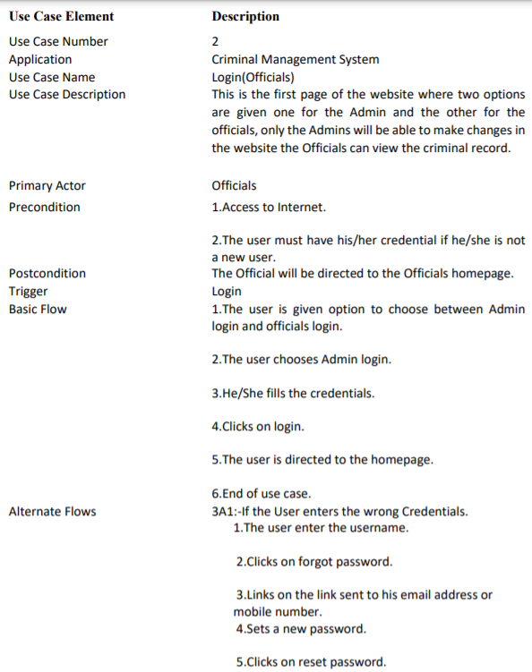

Slide 10
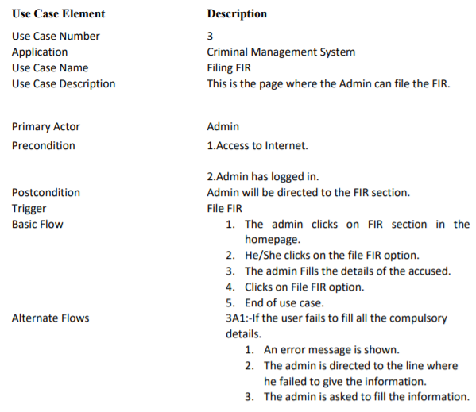

Slide 12
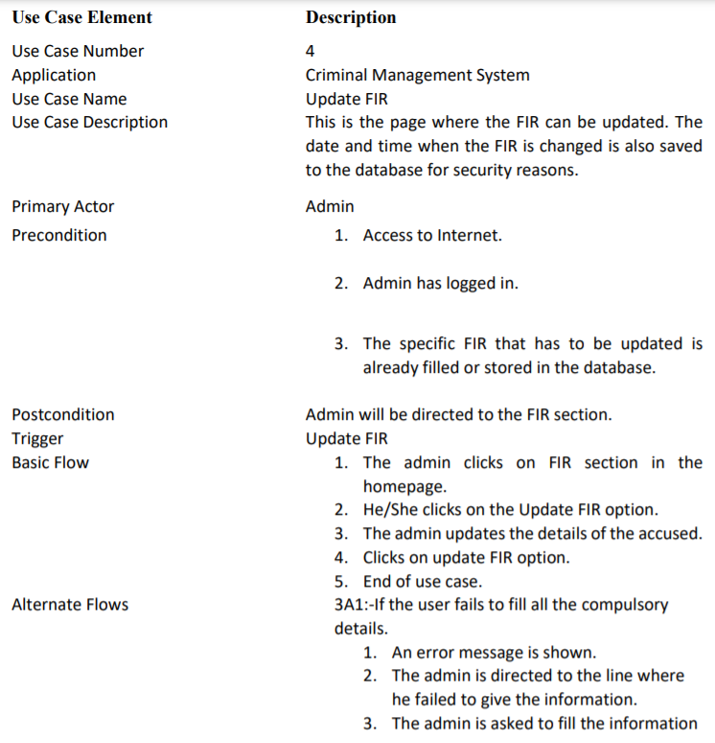

Slide 14
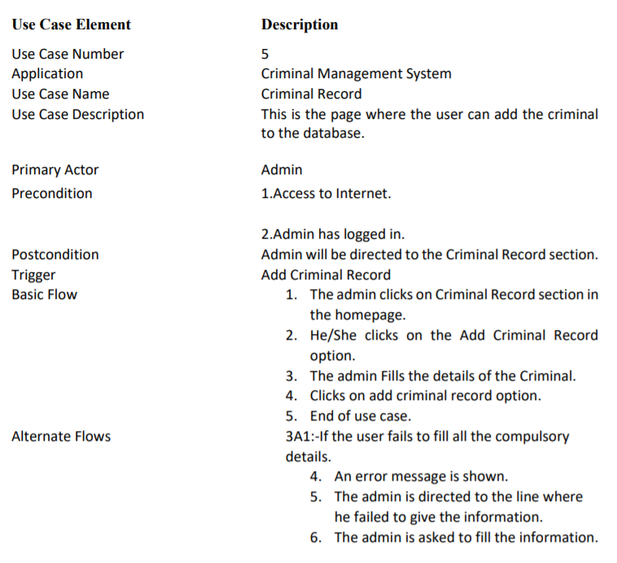

Slide 16
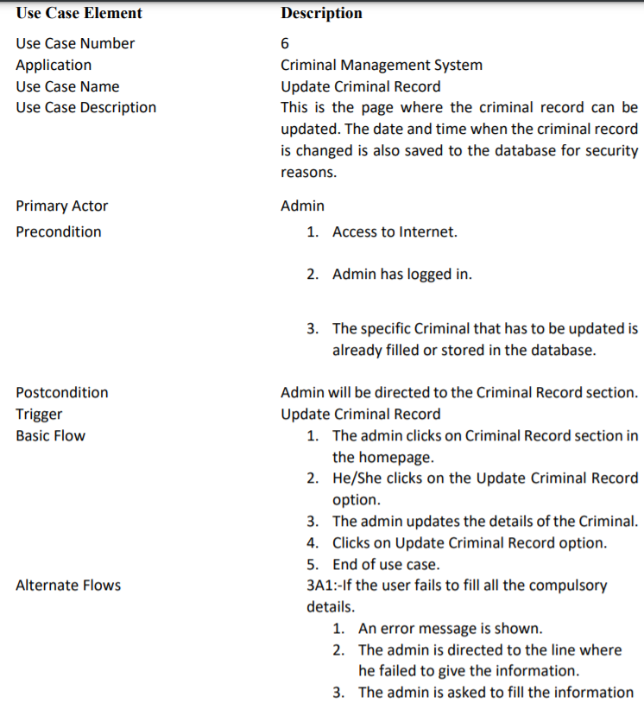

Slide 18
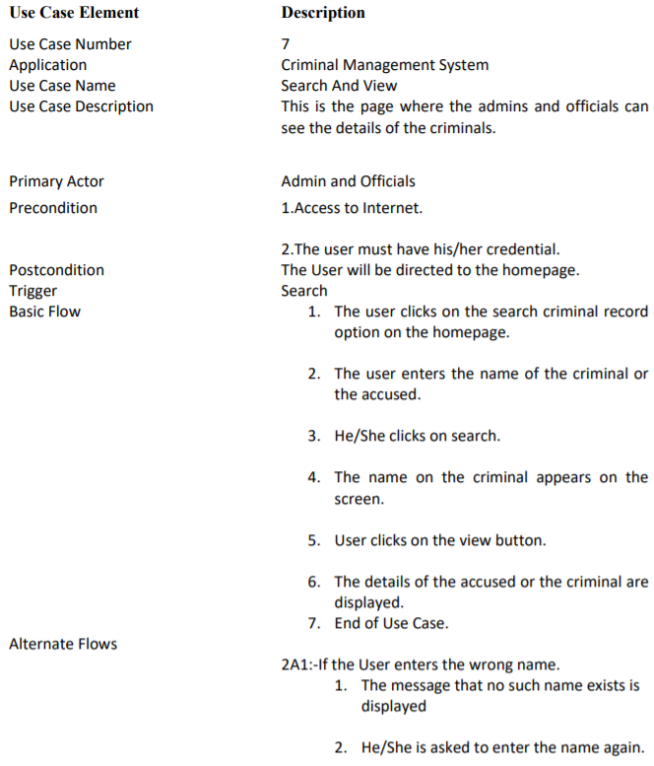

Slide 20
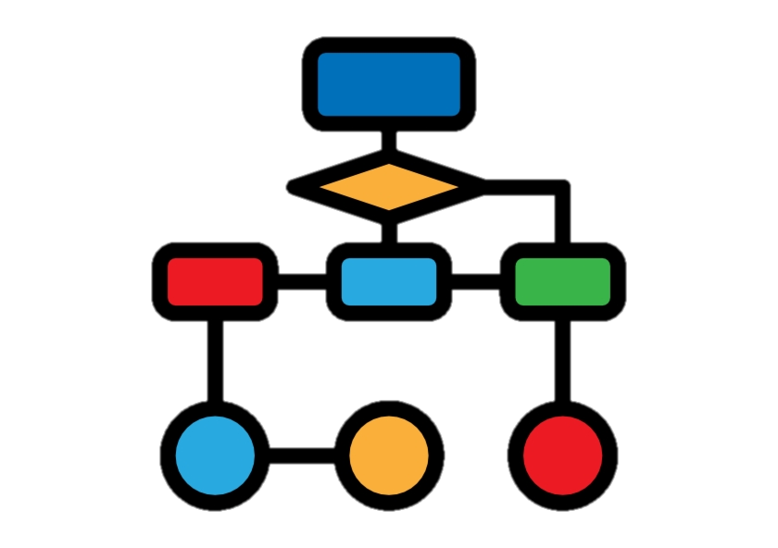
DATA FLOW DIAGRAMS
The flow diagrams for the project are given below in increasing order of detail

Slide 21
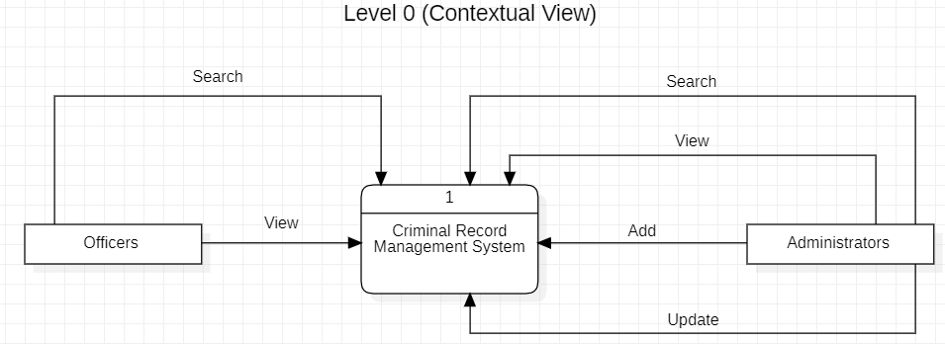
LEVEL 0 DFD (CONTEXTUAL VIEW)

Slide 22
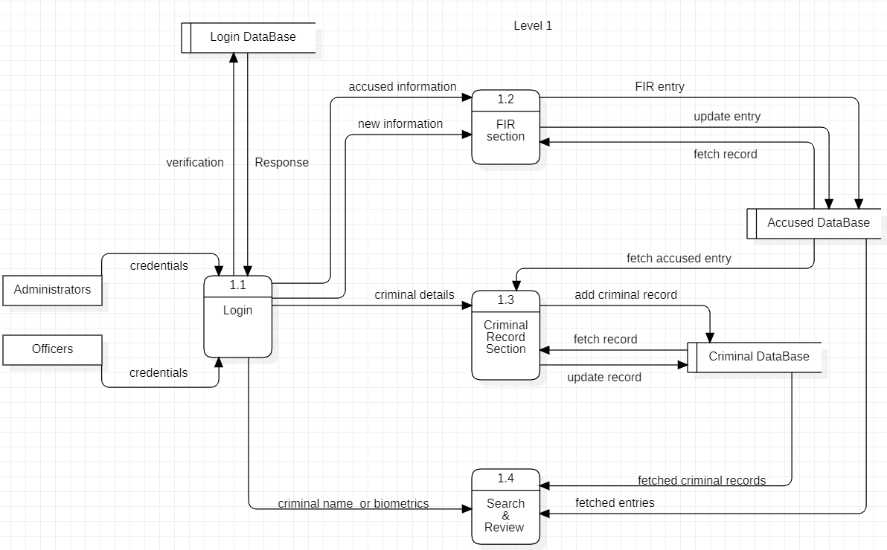
LEVEL 1 DFD

Slide 23
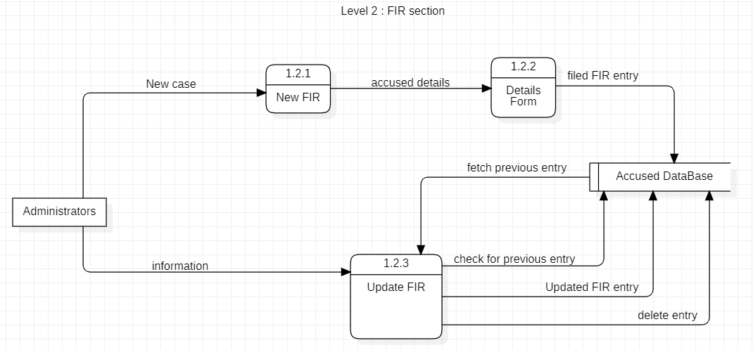
LEVEL 2 DFD : FIR SECTION

Slide 24
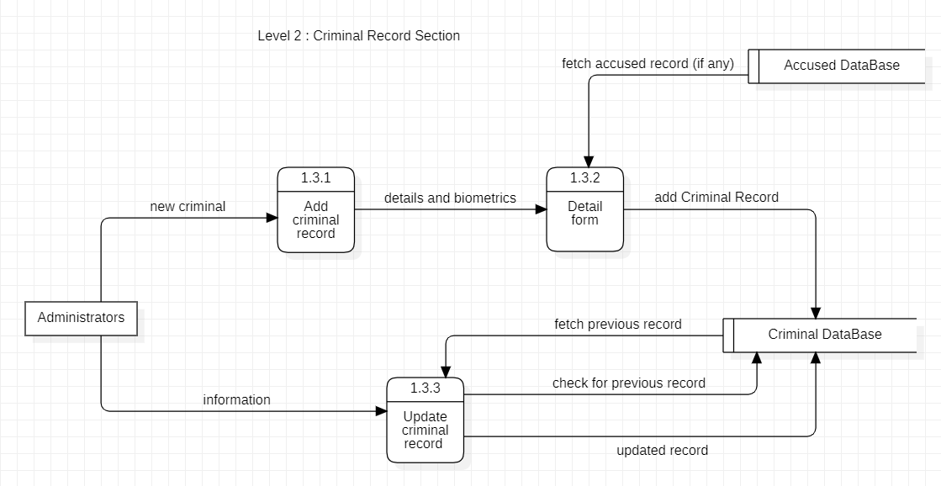
LEVEL 2 DFD : CRIMINAL RECORD SECTION

