Slide 1
Create A Presentation On Artificial Intelligence
Research-backed presentation
Sources: 5

Slide 2
Title
1. Introduction to Artificial Intelligence and its Evolution
2. Exploring the Concept of Rubric Enabled Generative Artificial Intelligence (REGAI)
3. Development and Evaluation of REGAI
4. Key Aspects of Retrieval Augmented Generation (RAG) and Large Language Models (LLM)
5. Understanding Artificial Agents and Their Increasing Importance
6. A Systematic Approach to Artificial Agents: Exploring Their Role in Ubiquitous Computing and Autonomous Systems
7. The Intersection of AI and Robotics: An In...

Slide 3
Introduction
Welcome to our exciting presentation about the fascinating world of Artificial Intelligence (AI). Today, we delve into the highly advanced realm of AI and explore its various facets, from the development of Rubric Enabled Generative Artificial Intelligence (REGAI) to the systematic approach of Artificial Agents.
We kick off with an intriguing discussion about REGAI, a state-of-the-art AI technique that uses rubrics to enhance retrieval augmented generation (RAG) and large language model (LLM)....

Slide 4
Main Points
1. Introduction to Artificial Intelligence (AI): Understanding the Basics
- Definition of AI and its evolution over the years.
- Differentiating between AI, Machine Learning, and Deep Learning.
2. Development and Evaluation of REGAI: An Innovative Approach in AI
- Unveiling the concept of Rubric Enabled Generative Artificial Intelligence (REGAI).
- Discussing the use of rubrics in REGAI: manual and automatic creation.
- Evaluating the efficiency and benefits of REGAI in AI tec...

Slide 5
Data/Statistics
Slide 1: Introduction
- Discuss the rise of artificial intelligence (AI) and its impact on various sectors.
- Emphasize the focus of the presentation on REGAI, AI Agents and AI Presentation Maker.
Slide 2: Overview of REGAI (Rubric Enabled Generative Artificial Intelligence)
- Definition and explanation of REGAI.
- Discuss the use of rubrics in REGAI, both manually and automatically created by the system.
Slide 3: Advantages of REGAI
- Highlight the benefits of using REGAI in AI development.
-...

Slide 6
Conclusion
In conclusion, the evolution of artificial intelligence has led to significant advancements in various fields, including the development of autonomous computing, intelligent systems, and robotics. The creation of REGAI, a Rubric Enabled Generative Artificial Intelligence, marks a significant breakthrough in retrieval augmented generation and large language modelling. This AI technique utilizes rubrics for a more systematic and improved output. Agent systems are also becoming more integral in the...

Slide 7
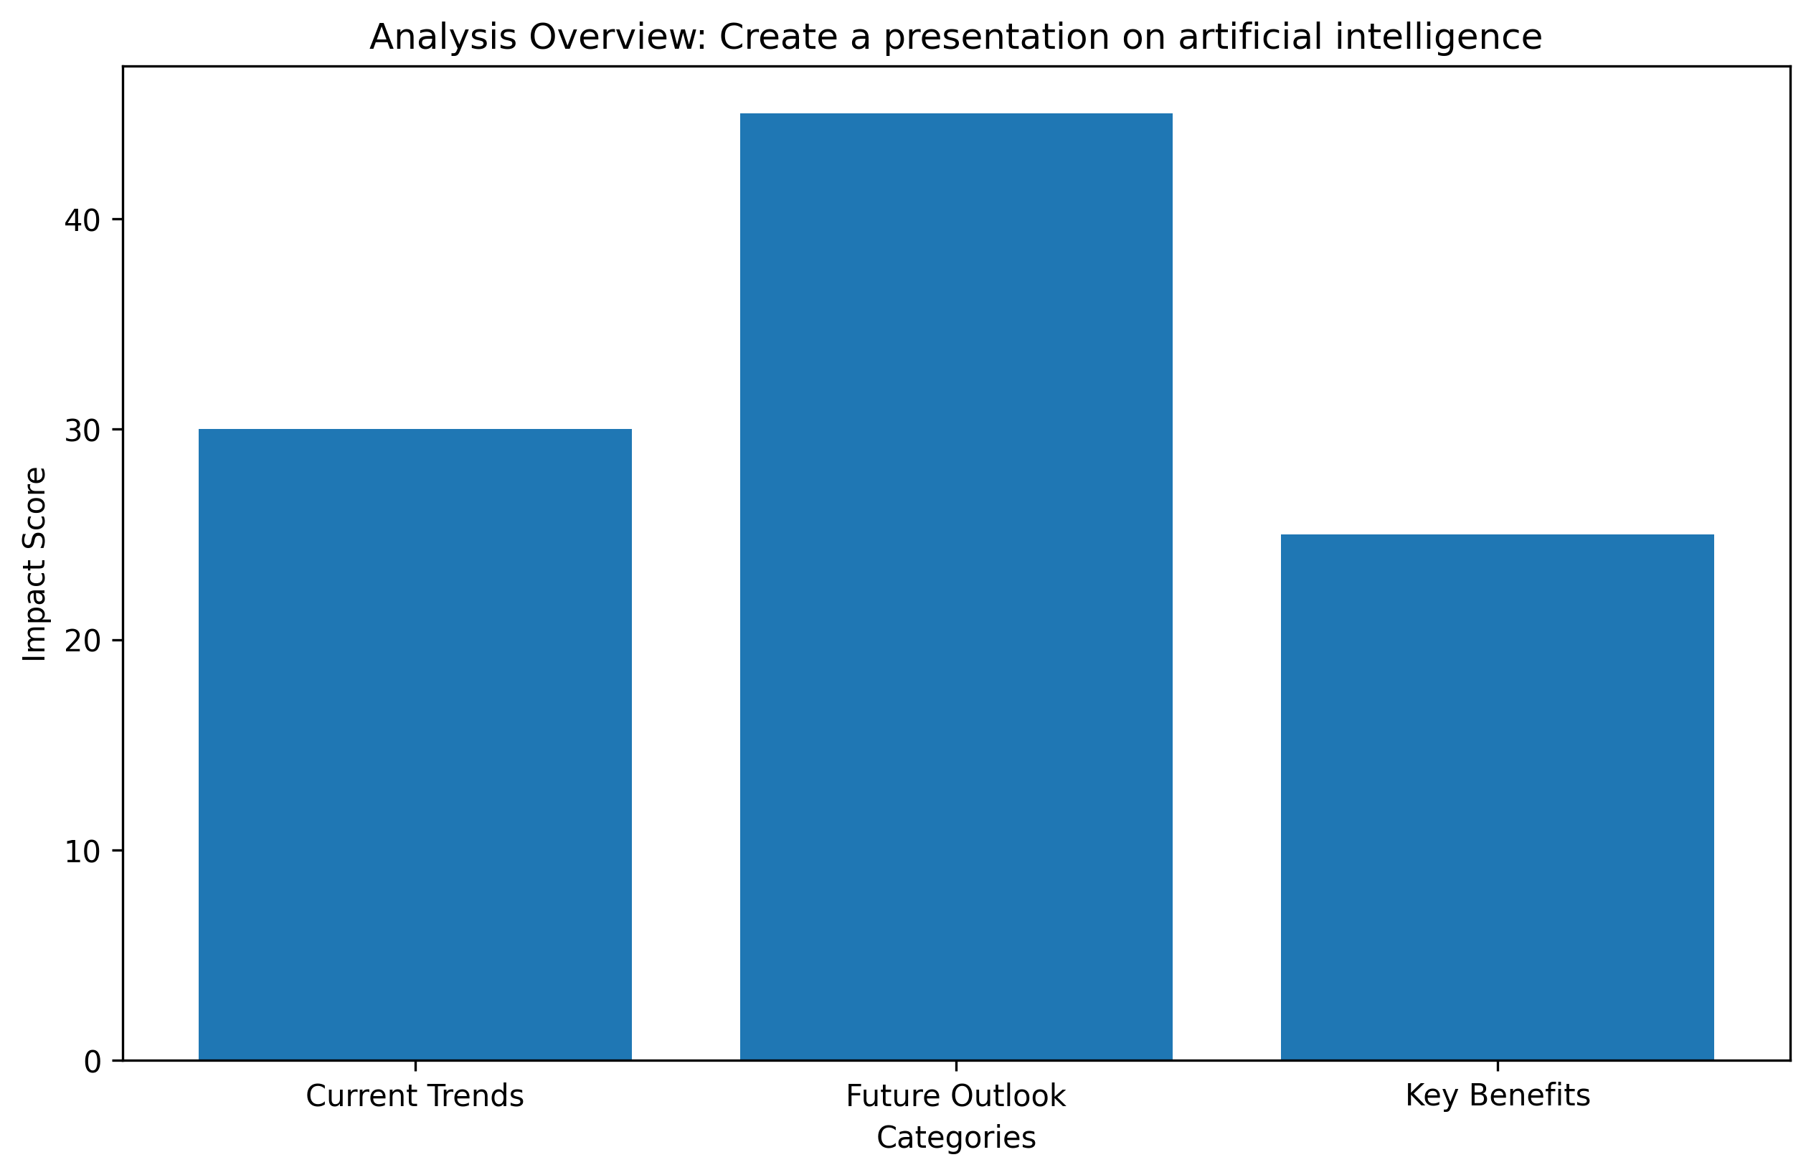
Data Analysis

Slide 8
Sources
• Development of REGAI: Rubric Enabled Generative Artificial Intelligence: http://arxiv.org/abs/2408.02811v1
• A Systematic Approach to Artificial Agents: http://arxiv.org/abs/0902.3513v1
• AI Presentation Maker: Create presentations with AI | Canva: https://www.canva.com/create/ai-presentations/
• Free AI Presentation Maker | Slidesgo: https://slidesgo.com/ai/presentation-maker
• Gamma: Instant Presentations, Websites, and More with AI: https://gamma.app/

