Slide 1
Artificial Intelligence Presentation
Research-backed presentation
Sources: 6

Slide 2
Title
1. "Exploring the World of Artificial Intelligence: From Basics to Advanced Applications"
2. "Understanding Artificial Intelligence: Deciphering Its Role in Our Daily Lives"
3. "A Deep Dive into Machine Learning Methods on Knowledge Graphs"
4. "The Emergence and Evolution of Artificial Intelligence in the 21st Century"
5. "Artificial Intelligence and Astronomy: A Revolutionary Collaboration"
6. "The Application of Artificial Intelligence in Astronomical Optical Telescopes"
7. "Artificial Intelli...

Slide 3
Introduction
Good day everyone, thank you for joining us for this insightful presentation on Artificial Intelligence. Artificial Intelligence, or AI, is a revolutionary field in computer science that incorporates elements of human intelligence into computational systems. Tasks such as learning, reasoning, problem-solving, perception, and decision-making, which were once thought to be the exclusive domain of humans, are now being replicated by AI.
Our discussion today will delve into the fascinating world o...

Slide 4
Main Points
1. Introduction to Artificial Intelligence (AI): Definition and overview of AI as a capability of computational systems to perform tasks typically linked to human intelligence including learning, reasoning, and decision-making.
2. Exploring the Field of AI: Discussing the development and studies in the field of computer science that focus on the methods and systems of AI.
3. Comprehensible Artificial Intelligence on Knowledge Graphs: A discussion on how AI applications are moving beyond resear...

Slide 5
Data/Statistics
Slide 1: Introduction to Artificial Intelligence
- AI is an area in computer science that emphasizes the creation of intelligent systems that work and react like humans.
- Key functions include learning, reasoning, problem-solving, perception, and decision-making.
Slide 2: Artificial Intelligence Growth
- By 2025, the global AI market is projected to reach $60 billion, up from $1.4 billion in 2016 (Statista, 2019).
- There is an estimated 14X increase in the number of active AI startups since 2...

Slide 6
Conclusion
In conclusion, artificial intelligence is increasingly becoming a significant part of our daily lives. It is a powerful tool that has the capability to perform tasks typically associated with human intelligence, such as learning, reasoning, problem-solving, and decision-making. As it continues to develop and evolve, we see AI moving out of research labs and being widely integrated into various fields, including astronomy. Machine Learning methods on Knowledge Graphs are becoming more prevalent, ...

Slide 7
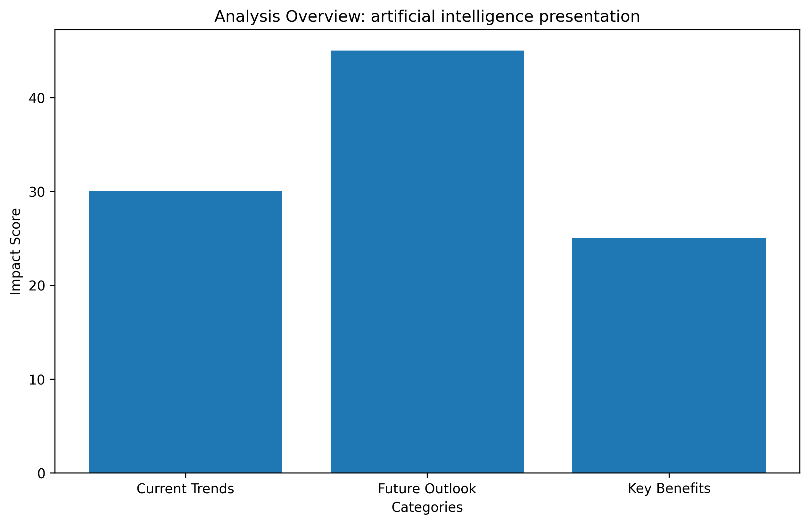
Data Analysis

Slide 8
Sources
• Artificial intelligence: https://en.wikipedia.org/wiki/Artificial_intelligence
• Comprehensible Artificial Intelligence on Knowledge Graphs: A survey: http://arxiv.org/abs/2404.03499v1
• Intelligence of Astronomical Optical Telescope: Present Status and Future Perspectives: http://arxiv.org/abs/2306.16834v2
• Artificial intelligence powerpoint presentation | PPTX: https://www.slideshare.net/slideshow/artificial-intelligence-powerpoint-presentation/265169851
• AI Presentation Maker: Create presentations with AI | Canva: https://www.canva.com/create/ai-presentations/

