Slide 1
Taxonomy-driven security assessment for KVM virtualization
Cloud Security & Vulnerabilities | Submitted to Malay Kumar | November 2026
vsec: a framework that turns a survey's threat taxonomy into testable controls
Built with an AI coding assistant (Claude); AI-agent reviews only, no human review. Real measurements on one host (WSL2 + KVM) for M1 and M2; M3 and M4 not run.
A. Doni Aditya, B. Harsha Vardan, E. Hariteja, L. Sahith Akash Manikanta | four students, with an AI coding assistant (Claude)
Remaining work, NOT part of this submission: native Linux (E1) and the M4 timing study; Volatility (M3) on real dumps; more than one real host.
Notes:
If short on time, say only: this is a design and implementation project built with an AI assistant, and its real measurements come from one host (WSL2 + KVM).
We are A. Doni Aditya, B. Harsha Vardan, E. Hariteja, L. Sahith Akash Manikanta. This is a four-student project, built with an AI coding assistant (Claude) that wrote most of the code, tests and first drafts. Reviews were done by AI agents only, in three waves; no human reviewed the work. Today we present the framework and the experiment design, plus an implementation that passes its own tests. Our real measurements come from one host: WSL2 with KVM on a laptop. The native PC booted from an external SSD, called E1, was never built, so there are no native-versus-VM results and no Volatility results.

Slide 2
Problem and research question
Research question
Centrepiece (M4)
Can the survey's threats and controls become testable controls on a modern KVM stack? Which hold, fail, or cannot be tested?
Do several behaviour signals together detect a hypervisor that hides its static indicators better than the best single signal? (A stand-in for a VMBR, a hypervisor-based rootkit.)
Survey Sierra-Arriaga et al., ACM Computing Surveys 2020 (53:2, 1-37)
Mapping 31 controls, 9 classes: our own judgement, each traced to a survey section
vsec | four students with an AI assistant | A. Doni Aditya, B. Harsha Vardan, E. Hariteja, L. Sahith Akash Manikanta
2
Notes:
If short on time, say only: a survey names threats but not what is testable; we turn them into testable controls and ask whether several behaviour signals beat one.
A 2020 virtualization-security survey (Sierra-Arriaga et al., ACM CSUR 2020) lists many threats and controls but does not say which can be tested on a modern KVM stack. The 31 controls and 9 threat classes are this project's own mapping; each control cites the survey section it derives from. Question: which hold, which fail, which cannot be tested; 'cannot be tested' is a valid answer, reported as N/A. Centrepiece, module M4: a VMBR is a hypervisor-based rootkit; our stand-in only hides static indicators and is not a real one.

Slide 3
From survey taxonomy to a result matrix
Survey taxonomy
4 modules
One finding format
Result matrix
→
→
→
9 classes, 31 controls
M1 to M4
PASS, FAIL or NA
one row per VM
Honesty rules
PASS passed its defined test; it does not mean 'secure'
NA never counted as PASS; on a seeded fault it is a miss
Simulated data never a result
M1 fixtures self-consistency only
vsec | four students with an AI assistant | A. Doni Aditya, B. Harsha Vardan, E. Hariteja, L. Sahith Akash Manikanta
3
Notes:
If short on time, say only: one pipeline from taxonomy to matrix, and PASS only means 'passed its test'.
The taxonomy of 9 threat classes and 31 controls is split across 4 modules: M1 configuration auditor, M2 snapshot privacy, M3 offline forensics, M4 multi-signal hypervisor detection. Each writes the same finding format, and one report command builds the result matrix. Honesty rules: PASS means the control passed its defined test, never that the system is secure. NA is never PASS; on a seeded fault it counts as a miss. Simulated data is never a result.

Slide 4
Taxonomy to modules: what is actually tested
Threat class | Label | Module | Controls
Guest->Host | Tested | M1 | 12
Host->VMM | Config-proxy | M1 | 6
Guest->Guest | Config-proxy | M1 | 3
VMM vulnerabilities | Config-proxy | M1 | 2
Side channels | Config-proxy | M1 | 3
DMA/IOMMU | Tested on E1 | M1 | 2
Snapshot privacy | Tested | M2 | 1
VMI / hidden processes | Tested | M3 | 1
Hypervisor/VMBR presence | Tested | M4 | 1
Label = how a class is tested, not a result. E1 = planned PC booted from an external SSD (not built).
vsec | four students with an AI assistant | A. Doni Aditya, B. Harsha Vardan, E. Hariteja, L. Sahith Akash Manikanta
4
Notes:
If short on time, say only: nine threat classes, and only some are tested directly; the rest are Config-proxy, meaning configuration or version checks.
31 controls in 9 threat classes, the project's own mapping. The label says how a class is tested, not the result. Config-proxy means only configuration or a version is checked, not an attack: Host->VMM, VMM vulnerabilities, side channels and Guest->Guest. Guest->Guest gets its PASS from a host-side check of the network definition; a guest scan can only add a FAIL. DMA/IOMMU needs E1, not built. C23 and C24 use a fixture CVE list; the real list gives NA.

Slide 5
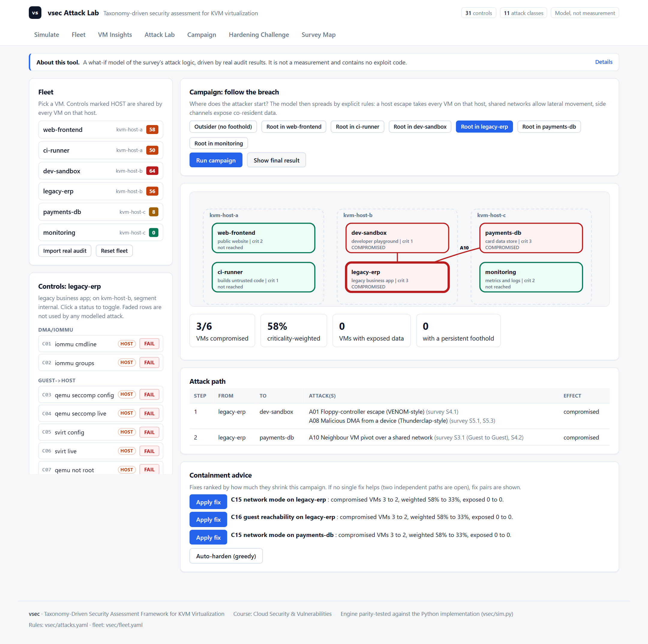
Attack Lab: a fleet what-if simulator
Fleet 6 VMs on 3 hosts; states from the real auditor
Attack 11 survey attacks, stage by stage, fix and replay
Campaign breach path across VMs and hosts
Insights risk, exact smallest fix plan, runbook export
Import load your own vsec audit
Model not a measurement, no exploit code
vsec | four students with an AI assistant | A. Doni Aditya, B. Harsha Vardan, E. Hariteja, L. Sahith Akash Manikanta
5
Notes:
If short on time, say only: a fleet what-if simulator: launch survey attacks, follow a breach from VM to VM, get ranked fixes; a model, not a measurement.
simulator.html models 6 VMs on 3 KVM hosts. Every control state comes from running our real auditor on generated example hosts and VMs, and the page can import a real audit. You launch one of 11 survey attacks against a VM, or start a campaign from the outside or from a foothold in one VM, and watch the breach spread: a host escape takes every VM on that host, shared networks allow lateral movement, side channels expose co-resident data. In the example, an outsider reaches 5 of 6 VMs, including payments-db on the hardened host, because it shares a network with a weak VM. The page then ranks the fixes that shrink the blast radius and exports a runbook. It is a model of the survey's logic, not a measurement: no exploit code, no timing or accuracy claim. A test checks that the JavaScript and Python engines agree.

Slide 6
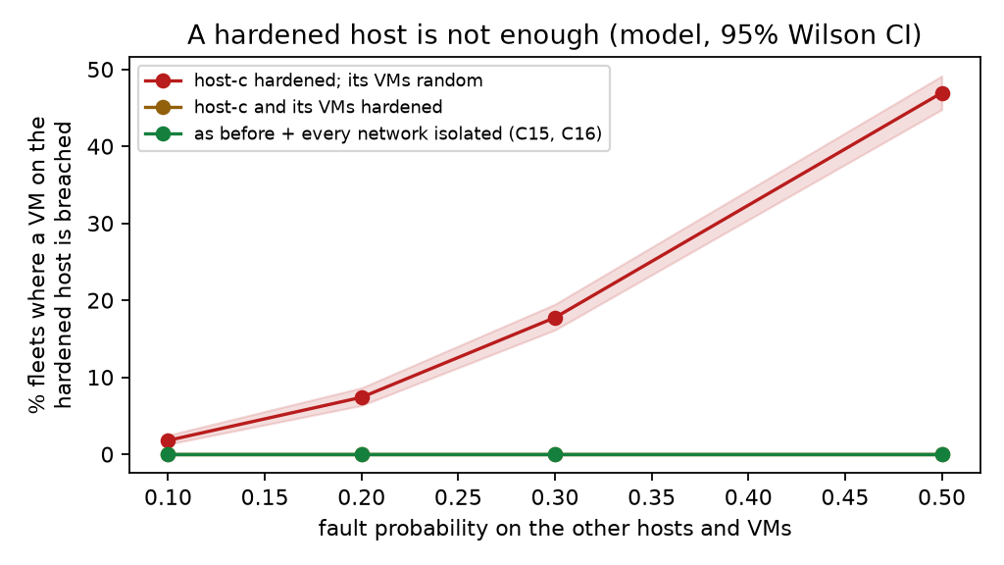
Results we can run today (no KVM hardware)
M1 10,400 decisions, P = R = 100% (fault injection)
Cost about 40 ms per audit
M2 encoded secrets 0/120, then 80/120 after fix
Leverage KSM off (C09) blocks the most attacks
Hardened host VMs still breached up to 47%
Honest known ground truth, not real hosts
vsec | four students with an AI assistant | A. Doni Aditya, B. Harsha Vardan, E. Hariteja, L. Sahith Akash Manikanta
6
Notes:
If short on time, say only: six reproducible experiments: auditor exact on its fault model, scanner blind to encoded secrets, a hardened host is not enough.
Six reproducible experiments, one command: python scripts/run_experiments.py. E1 and E2: fault injection into constructed case folders. The auditor reported exactly the seeded faults: 78 of 78 single faults, and in 400 folders with up to 70 percent of controls broken, 10,400 decisions with precision and recall 100 percent (lower CI bound 99.9). About 40 ms per audit. Same team wrote checker and faults, so this is self-consistency. E3: the snapshot scanner finds 120 of 120 plainly stored secrets with zero false positives but 0 of 120 encoded ones (base64, UTF-16, split): an honest blind spot. A second version with decoding passes, tested on fresh dumps, finds 80 of 120 (all UTF-16 and base64); page-split secrets stay hidden. E4 to E6 use the Attack Lab model: KSM off is the single most valuable control; two fixes stop the outsider campaign; a VM on a fully hardened host is still breached in up to 47 percent of random fleets unless the VM itself is hardened, then 0 percent.

Slide 7
Real KVM host: audit, fix, snapshot
Host WSL2 + KVM, QEMU 8.2.2, libvirt 10, real CirrOS guest
Audit default 8 FAIL, weakened 11, after fixes 2 (platform limits)
Caught us our 'isolated' network still exposed the host
Lynis 247 tests, no QEMU/VM checks: the gap we fill
Snapshot v1 found 4/11 planted secrets, v2 11/11, redaction clean
Leak path typed secrets return after reboot via shell history
vsec | four students with an AI assistant | A. Doni Aditya, B. Harsha Vardan, E. Hariteja, L. Sahith Akash Manikanta
7
Notes:
If short on time, say only: a real KVM host: stock install fails 8 controls, 2 after our fixes; Lynis misses them; a real snapshot leaks secrets that v2 finds.
We turned the laptop's WSL2 into a real KVM host: Ubuntu 24.04, QEMU 8.2.2, libvirt 10, hardware-accelerated KVM, one CirrOS guest. A stock virt-install guest fails 8 of 28 controls: VNC without password, NAT network, world-readable image and save dirs, nested on. We added a floppy controller, VNC on all interfaces and unsafe cache: 11 FAIL, all seeded weaknesses caught. After vsec's printed fixes: 2 FAIL, both platform limits (no IOMMU and no AppArmor inside WSL2). vsec even caught our own mistake: our isolated network still had a host IP. Lynis on the same host: 247 tests, hardening index 64, but no check of QEMU or VM configuration. Real snapshot: we planted fake secrets in the running guest and took virsh dump. Scanner v1 found the 4 plain ones, v2 found all 11, redaction removed them. 13 extra hits are public crypto constants in the kernel. Also, typed secrets survive reboots through shell history.

Slide 8
M1: configuration auditor
84/84 seeded faults found in 50 fixtures; 0 false alarms in 1,310 clean checks.
28 checks: 15 config, 11 live (e.g. sVirt = per-VM security labels), 2 version (fixture CVE list; the real list gives NA).
What 84/84 shows
What it does not show
- Checker matches its own specification
- Missing input gives NA, never PASS
- Real-world correctness
- Independent evidence: same author, tests written by the same AI
vsec | four students with an AI assistant | A. Doni Aditya, B. Harsha Vardan, E. Hariteja, L. Sahith Akash Manikanta
8
Notes:
If short on time, say only: 84/84 on my own fixtures shows self-consistency, not real-world correctness.
M1 has 28 controls: 15 config checks that read files, 11 live checks that prove a control is active (for example the Seccomp field, or sVirt, libvirt's per-VM security labels), and 2 version checks. The 84/84: 50 fixtures with 84 seeded faults, 28 controls times 3, all found; 0 false alarms in 1,310 clean checks; 6 NA predictions. But the checker's author wrote the fixtures and the same AI wrote the tests, so this is self-consistency, not correctness. Lynis and OpenSCAP would give independent evidence; planned, never run.

Slide 9
M1 to M3 in brief
M1 Config auditor
M2 Snapshot privacy
M3 Offline forensics
28 checks on a host's configuration; each gives PASS, FAIL or NA.
Scans VM memory snapshots for planted fake secrets.
Compares pslist and psscan (two ways of listing processes in a memory dump) to find hidden ones.
M2 and M3: scanner and scoring code tested on synthetic input only. Volatility has not run on real dumps.
vsec | four students with an AI assistant | A. Doni Aditya, B. Harsha Vardan, E. Hariteja, L. Sahith Akash Manikanta
9
Notes:
If short on time, say only: three small modules; only M1 has been run on its own fixtures, M2 and M3 only on synthetic input.
M1 audits a host's configuration: 28 checks, each PASS, FAIL or NA. M2 scans VM memory snapshots for planted fake secrets; tested on synthetic dumps only. M3 uses Volatility 3, a memory-forensics tool, offline. pslist walks the kernel's own process list, psscan scans raw memory for process structures; a process only the scan finds is a hidden candidate. Volatility has not run on real dumps. Details are in the backup.

Slide 10
M4: multi-signal hypervisor detection (design)
Same PC, same image, 15 boot sessions per class (planned)
native
kvm-plain
kvm-masked
Ubuntu
PC hardware
Guest OS
QEMU/KVM
PC hardware
Guest OS, static indicators hidden
QEMU/KVM
PC hardware
Not a real VMBR
E1 the planned PC booted from an external SSD; not built
Signals timing, memory, scheduler jitter
bench.c one functional run in WSL2 (a VM), never native or in a guest
vsec | four students with an AI assistant | A. Doni Aditya, B. Harsha Vardan, E. Hariteja, L. Sahith Akash Manikanta
10
Notes:
If short on time, say only: three machine classes to compare; the experiment needs a PC I have not built.
M4 is the centrepiece, and it is a design with three machine classes: native (Ubuntu on the PC), kvm-plain (a QEMU/KVM guest, default settings) and kvm-masked (static indicators hidden with standard libvirt options; no time faking; not a real VMBR). It needs E1, the planned PC booted from an external SSD; not built. bench.c, the C benchmark, compiled with gcc 13.3 and zig. One functional run in WSL2 (a VM under Hyper-V) on 2026-10-04: the CSV loads, quality checks pass, no number is a finding. Never run natively or in a KVM guest.

Slide 11
Pre-specified analysis plan: hypotheses H1 to H4
Hypothesis | Supported if
H1 Combined signals beat best single signal | AUROC higher at T_short; p < 0.05
H2 Fewer false alarms on native | FPR difference CI excludes 0; Holm p < 0.05
H3 Robust to unseen workloads | Upper 95% bootstrap bound of AUROC drop < 0.05; Holm p < 0.05
H4 Practical cost | Under 10 s per decision, under 5% overhead
AUROC 0.5 = chance, 1 = perfect
Holm multiple-test correction
Status draft plan, not yet committed
vsec | four students with an AI assistant | A. Doni Aditya, B. Harsha Vardan, E. Hariteja, L. Sahith Akash Manikanta
11
Notes:
If short on time, say only: four hypotheses with fixed pass rules, written down before any data; the plan is a draft.
This is a pre-specified analysis plan: a draft in prereg.md, not yet committed or tagged, so it is not a registration. AUROC: how well a detector separates two classes; 0.5 is chance, 1 is perfect. Holm: a correction for testing several hypotheses at once. H1: combined signals beat the best single signal at the shortest useful time. H3: the drop in session AUROC on unseen workloads; upper 95% bootstrap bound under 0.05 and Holm p under 0.05; F1 drop is secondary. With 15 against 15 sessions a null result proves nothing.

Slide 12
Safety and lab rules
Preflight gate
Isolation
No other VM running; target offline and reverted before any dump.
Target VM has no network; snapshot revert before every run.
Rootkit guard
Data safety
Optional test, only inside the isolated target. No real malware.
Synthetic secrets only. All files stay in the project folder.
vsec | four students with an AI assistant | A. Doni Aditya, B. Harsha Vardan, E. Hariteja, L. Sahith Akash Manikanta
12
Notes:
If short on time, say only: everything runs in an isolated, reverted target VM; no real malware or credentials.
Defensive research on my own hardware. Before any dump, a preflight script checks that no other VM runs, the target is offline and the target was reverted; the revert marker is single-use and expires in 15 minutes. The target VM has no network and is reverted before every experiment. The optional rootkit test runs only inside the isolated target, never on the host. No real malware, no VMBR, no real credentials. For E1: BitLocker key on paper first, internal disk disconnected during install.

Slide 13
Status and limitations
Part | Built | Real data
Framework | yes | n/a
M1 | yes | fixtures only
M2 | yes | none
M3 | yes | none
M4 | yes | none
One PC one CPU model
Not a real VMBR kvm-masked is full QEMU/KVM
M1 truth self-written fixtures
Config-proxy four classes
1028 tests: Windows 1009 passed, 19 skipped (about 4 min). Linux under WSL2 once: 985 passed, 2 failed (fixed), 1 skipped; not re-run. Tested on a real KVM host under WSL2 (paper Section 7.8); not tested on native bare-metal Linux.
vsec | four students with an AI assistant | A. Doni Aditya, B. Harsha Vardan, E. Hariteja, L. Sahith Akash Manikanta
13
Notes:
If short on time, say only: built and tested on Windows and Linux (WSL2); real measurements from one host.
Built and tested; measured on one real host (WSL2 + KVM) and on constructed inputs. Last full Windows run: 1028 tests collected, 1009 passed, 19 skipped, about 4 minutes. Linux once under WSL2: 985 passed, 2 failed, 1 skipped; the 2 failures were fixed but the suite was not re-run. Tested on a real KVM host under WSL2 (paper Section 7.8); not tested on native bare-metal Linux. The tests were written by the same AI as the code. Limits: one machine and CPU model; kvm-masked is full QEMU/KVM, not a real VMBR; M1 truth is self-written; four classes are Config-proxy. M4 code ran only on simulated data.

Slide 14
Remaining work, NOT part of this submission
Remaining work, NOT part of this submission: native Linux (E1) and the M4 timing study; Volatility (M3) on real dumps; more than one real host.
Week | Planned work
W1-W2 | Build E1; pilot; commit and tag prereg.md
W3-W5 | Collect 45 boots; M1 and M2 evaluation
W6-W7 | Analyse H1 to H4; M3 clean dumps
W8 | Paper, slides, demo video
Also not done
Lynis and OpenSCAP (independent config scanners): planned, never run.
vsec | four students with an AI assistant | A. Doni Aditya, B. Harsha Vardan, E. Hariteja, L. Sahith Akash Manikanta
14
Notes:
If short on time, say only: none of this is done; it is the plan for what comes after this submission.
Planned work, not done work. E1 is not built, so there are no native-versus-VM, M2-dump or Volatility results. The eight-week plan can be compressed. Before any real data, prereg.md must be committed and tagged. Lynis and OpenSCAP, two independent configuration scanners, are planned for M1 but never run. Never cut: plan committed before data, randomised sessions, the masked class, the result matrix, the preflight gate.

Slide 15
How this was made, and questions
Who four students with an AI assistant (Claude) that produced most code, tests, documents and first drafts
Reviews AI agents only; no human review
Tests show internal consistency, not correctness
Results one real host (WSL2); constructed inputs are not findings
Plan prereg.md is a draft, not yet committed
Thank you. Questions?
vsec | four students with an AI assistant | A. Doni Aditya, B. Harsha Vardan, E. Hariteja, L. Sahith Akash Manikanta
15
Notes:
If short on time, say only: four students with an AI assistant, one real host measured, analysis plan still a draft.
Please state this plainly. Four students worked with an AI assistant (Claude) that produced most of the code, tests, documents and first drafts. The tests show internal consistency, not real-world correctness. Real measurements exist for one host only (WSL2 + KVM); simulated numbers are not results. The analysis plan (prereg.md) is a draft, not yet committed. Reviews were by AI agents only, in three waves, with no human review. If asked whether 84/84 is proof: no, it is self-consistency. Backup slides follow with the finding format, M2, M3, engineering detail, empty results tables and likely questions.

Slide 16
Backup: finding format and result matrix
Matrix 1: per threat class (layout only)
{"id":"C07","module":"M1",
"taxonomy":"Guest->Host",
"control":"qemu_not_root",
"status":"PASS|FAIL|NA",
"severity":1..4,
"evidence":"...","fix":"...",
"env":"E0|E1","vm":"weak"}
Threat class | Label | Controls | Tested | N/A
... | ... | n | n | n
Matrix 2: per VM (layout only)
VM | Class 1 | Class 2 | ...
weak | status | ... | ...
hardened | status | ... | ...
real-world | status | ... | ...
Severity 1 to 4. M4 status: PASS if detected environment equals declared environment. Counts are never summed across different VMs.
Class status: PASS only if every control was tested and passed; otherwise PARTIAL (some tested) or NA (none tested). Any FAIL gives FAIL.
vsec | four students with an AI assistant | A. Doni Aditya, B. Harsha Vardan, E. Hariteja, L. Sahith Akash Manikanta
16
Notes:
Every module emits the same JSON finding: id, module, taxonomy class, control, status PASS, FAIL or NA, severity 1 to 4, evidence, fix, env and vm. For M4, PASS means the detected environment equals the declared one. report.py turns findings into the matrix. Matrix rule: a class shows PASS only if every control in the class was tested and passed; otherwise PARTIAL (some tested) or NA (none tested); any FAIL gives FAIL. Counts are never summed across different VMs. The tables are layout only, with no values.

Slide 17
Backup: M2 snapshot privacy
12 cells 4 secret types x 3 memory states
Held-out variants page-split, UTF-16, base64 (rules written blind)
Real programs ssh-agent and openssl s_server, throwaway keys
Host-side manifest guest-written manifest is not trusted
Negative controls empty and high-entropy-padded dumps
Synthetic secrets only never real credentials
 | live | freed | exited
ssh_key | cell | cell | cell
aws | cell | cell | cell
jwt | cell | cell | cell
hex32 | cell | cell | cell
Layout of the 12 cells. No real dumps; synthetic dumps cannot tell the three states apart.
vsec | four students with an AI assistant | A. Doni Aditya, B. Harsha Vardan, E. Hariteja, L. Sahith Akash Manikanta
17
Notes:
Question: do VM memory snapshots leak secrets. Four synthetic secret types in three memory states give 12 cells, at least 10 dumps per cell planned. Held-out variants (secrets split across page boundaries, UTF-16, base64) are a separate column, and the scanner rules are written without seeing them. Ground truth: a secret counts as present only if an exact search of the dump finds the planted bytes. The guest writes its own manifest, which cannot be trusted, so a host-side generator exists. Negative controls: empty and random high-entropy dumps. Synthetic dumps cannot tell live, freed and exited memory apart; only real VM dumps can. There is no real M2 data.

Slide 18
Backup: M3 offline memory forensics
Compare pslist vs psscan, lsmod vs module scan
Symbols one pinned kernel, sha256-pinned build, hash required
Sandbox Volatility with no network, memory cap, unprivileged
Truth public images with documented hidden processes
False positives clean dumps under process churn
Limit only unlinked processes and modules, only at dump time
Process view
pslist: kernel's own list
psscan: raw memory scan
in scan, not in list = hidden candidate
Module view
lsmod vs scan for kernel modules
Reported as
Exact counts (k of n) with Clopper-Pearson 95% CIs, plus a failure-case table
vsec | four students with an AI assistant | A. Doni Aditya, B. Harsha Vardan, E. Hariteja, L. Sahith Akash Manikanta
18
Notes:
M3 runs Volatility 3 on virsh dump output, offline. It compares pslist (the kernel's own process list) against psscan (a raw-memory scan for process structures), and lsmod against a scan for kernel modules; an item in the scan but not in the list is 'unlinked'. The claim is limited to unlinked processes and modules at dump time; it is not live introspection. Symbols: one pinned guest kernel, symbol file built on the host with pinned sha256; unverified symbols give C30 = NA. Volatility runs in a sandbox script with no network and a memory cap. Ground truth would be public Linux forensic images with documented hidden processes. Scoring code is tested; Volatility has not run on real dumps and there is no M3 data.

Slide 19
Backup: engineering detail
Tests 1028 collected; Windows 1009 passed, 19 skipped
Linux WSL2 once: 985 passed, 2 failed (fixed), 1 skipped; not re-run
Reviews AI-agent reviews, 3 waves; no human review; tests written by the same AI
bench.c gcc 13.3 and zig; one functional run in WSL2 (a VM)
Shell scripts bash -n syntax check only
Contract test bench.c columns vs feature loader
Verified
Python logic and scoring (unit tests), report and CLI on synthetic input.
NOT verified
Native Linux, a KVM host, Volatility, libvirt, any real measurement.
vsec | four students with an AI assistant | A. Doni Aditya, B. Harsha Vardan, E. Hariteja, L. Sahith Akash Manikanta
19
Notes:
Be precise and claim no more. Windows: 1028 tests collected, 1009 passed, 19 skipped (symlinks, POSIX permissions, bash and sandbox tests), about 4 minutes. Linux once under WSL2: 985 passed, 2 failed (since fixed), 1 skipped; not re-run after the fixes. Reviews: AI agents only, 3 waves, no human review, and the tests were written by the same AI that wrote the code. bench.c compiled with gcc 13.3 and zig; one functional run in WSL2 (a VM) on 2026-10-04; never native or in a KVM guest. The shell scripts pass bash -n only. A contract test pins the bench.c CSV columns to the feature loader.

Slide 20
Backup: results tables (empty by design)
Remaining work, NOT part of this submission: native Linux (E1) and the M4 timing study; Volatility (M3) on real dumps; more than one real host.
M4 | Result | Threshold
H1 (AUROC) | not done | p < 0.05
H2 (FPR) | not done | CI excl. 0, Holm
H3 (AUROC drop) | not done | < 0.05, Holm
H4 (cost) | not done | < 10 s, < 5%
Module | Ground truth | Result
M1 fixtures | 50 fixtures | 84/84 (self-check)
M1 real | ~10 configs | none
M2 | 12 cells | none
M3 | public images | none
Also not done: indicator-leak table, F1-vs-measurement-time curve, per-VM result matrix.
vsec | four students with an AI assistant | A. Doni Aditya, B. Harsha Vardan, E. Hariteja, L. Sahith Akash Manikanta
20
Notes:
These tables are intentionally empty. No real measurement exists, and nothing from the simulated runs is shown. Simulated numbers must never be copied here. The only entry with a number is M1 on its own fixtures, which is self-consistency. Left: the M4 H1 to H4 table with the thresholds from the draft analysis plan. Right: module evaluation tables with ground truth, metric and interval columns.

Slide 21
Backup: likely questions
Is 84/84 proof? no, self-consistency: the checker's author wrote the fixtures, tests by the same AI
Why E1? the laptop's Windows already runs on Hyper-V
If no E1? M4 compares 1 vs 2 virtualization layers (WSL)
H1 untestable? ceiling rule: timing alone near AUROC 1.0
Is kvm-masked a VMBR? no, a non-adaptive stand-in
Where are the numbers? none yet; E1 not built
Files
FINAL_PROJECT_PLAN.md
README.md
prereg.md (draft)
docs/YOUR_TASKS.md
vsec/taxonomy.yaml
Built with an AI coding assistant (Claude); AI-agent reviews only, no human review. Real measurements on one host (WSL2 + KVM) for M1 and M2; M3 and M4 not run.
vsec | four students with an AI assistant | A. Doni Aditya, B. Harsha Vardan, E. Hariteja, L. Sahith Akash Manikanta
21
Notes:
Why is 84/84 not proof: the checker's author wrote the fixtures and the same AI wrote the tests; independent evidence needs Lynis, OpenSCAP and real configurations. Why E1 and not the laptop: Windows already runs on Hyper-V, so the laptop has no bare-metal setup. If E1 is impossible, M4 would compare 1 against 2 virtualization layers and the claim would be renamed. Why might H1 be untestable: timing alone may reach AUROC near 1.0, and then the ceiling rule reports untestable. Is kvm-masked a real stealth hypervisor: no. Does PASS mean secure: no. Where is the data: nothing real yet.

