Slide 1
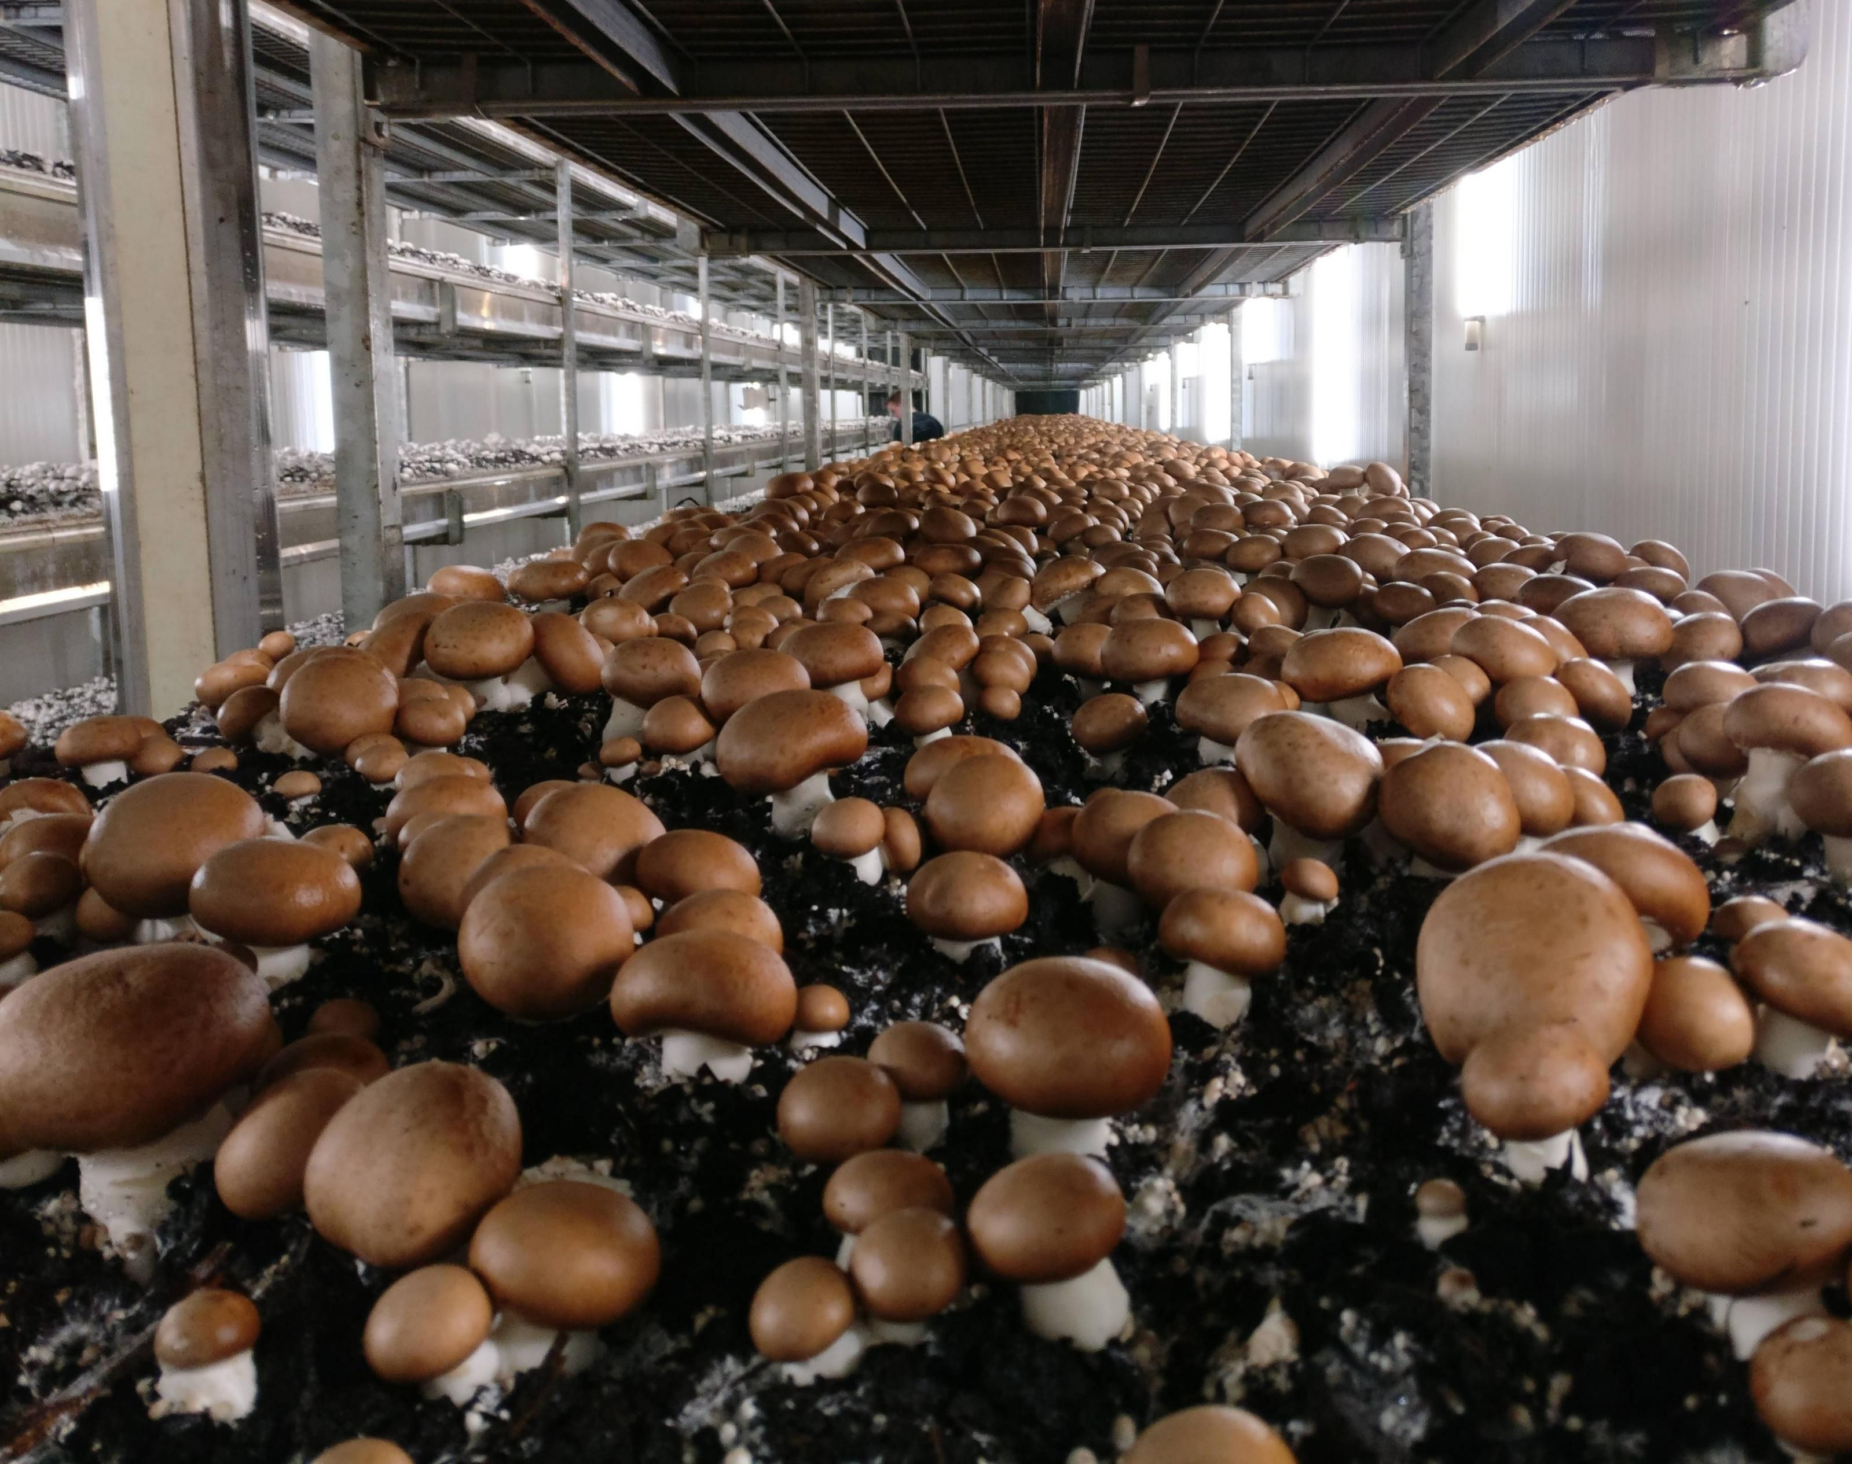
Smart Environmental Regulation for Oyster Mushroom Farming in Warm Climates
19CSE446-Internet of Things
Course Faculty : Dr Anantha Narayanan V Sir
Mentor : Dr Amit Agarwal Sir

Slide 2
Team Details
1.N.Geetha Krishna CB.EN.U4CSE21040
Nirupam Abhijith CB.EN.U4CSE21243
T.Harsha Vardhan CB.EN.U4CSE21062

Slide 3

Table of contents
Supervisory control and data acquisition
Sensor placement model
Control unit design – using Fritzig software
Communication technologies & Transmission protocols
Selection of Hardware components
Deployment level Diagram
Flowchart of the software process
Data analytics in edge or cloud
Application design with UI (web-pages)

Slide 4
Model Overview:
This project brings exciting for mushroom lovers and farmers alike! It's like having a tiny, super-smart helper in your mushroom farm, constantly checking on the temperature, humidity, and even the amount of carbon dioxide in the air. By using sensors and clever computer programs, this project can automatically adjust things to create the perfect environment for your mushrooms to grow big, strong, and delicious. This not only helps you grow more mushrooms, but also saves on resources and makes the whole process less work! So, instead of constantly running around checking on things, you can focus on other aspects of your farm or simply enjoy the satisfaction of watching your mushrooms thrive.

Slide 5
Sensor Placement Model:
We are carefully placing sensors throughout the mushroom growing area to make sure the environment is consistent everywhere. Sensors are placed every 10 feet to track changes across the room, and we are even adding CO2 sensors at different heights to check on the carbon dioxide levels. This extra care ensures that all the mushrooms get the perfect conditions they need to grow healthy and strong!

Slide 6
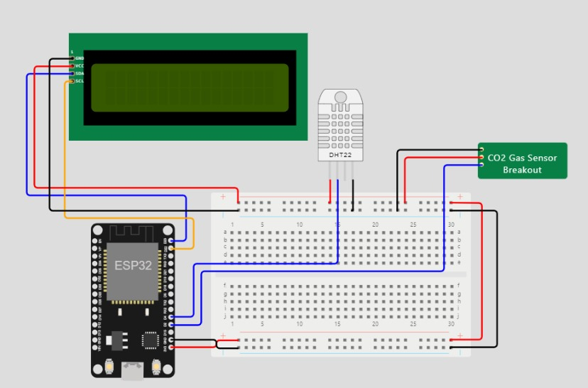
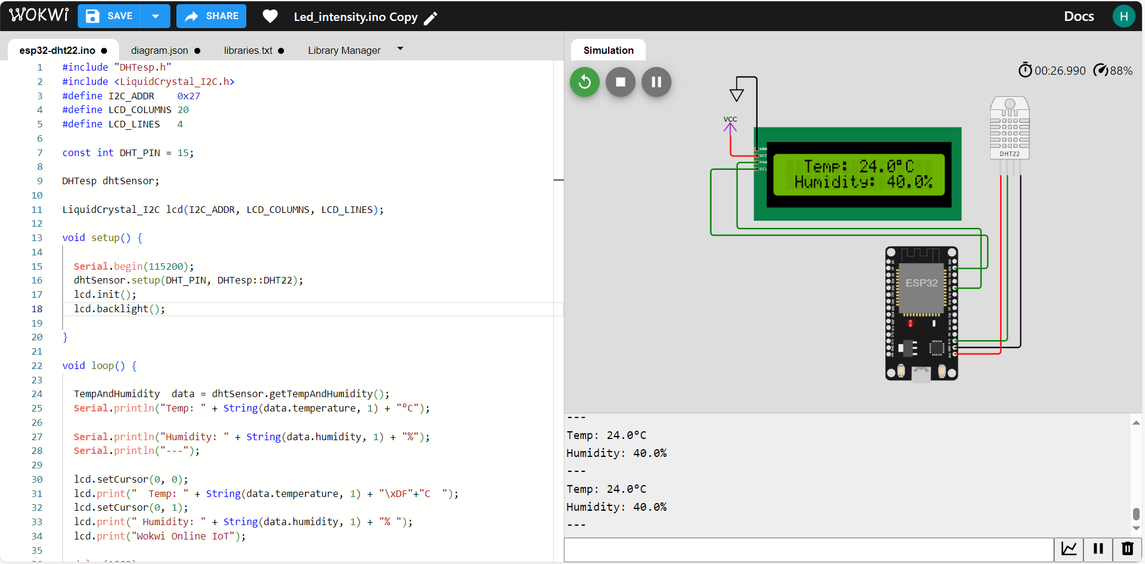
Control Unit Design:

Slide 7
Communication Technologies used in the project
ESP32 S3 Microcontroller:
Overview
Features
Role in the IoT System
Wi-Fi Router:
Connectivity in Cultivation Facility
Wireless Network Establishment
Integration with ESP32 S3
User Interface Devices (Smartphone / Web Design):
Smartphone Application
Web Design for Monitoring
Control and Alert Features
Cloud-Based Server:
Infrastructure Overview
Data Handling and Processing
Integration with IoT Endpoints

Slide 8
Communication Protocols:
Wi-Fi
Role in Wireless Connectivity
Facilitating Real-time Adjustments
MQTT Protocol
Lightweight Nature
Publish-Subscribe Architecture
HTTP
Communication Interface
JSON Format for Data Interchange

Slide 9
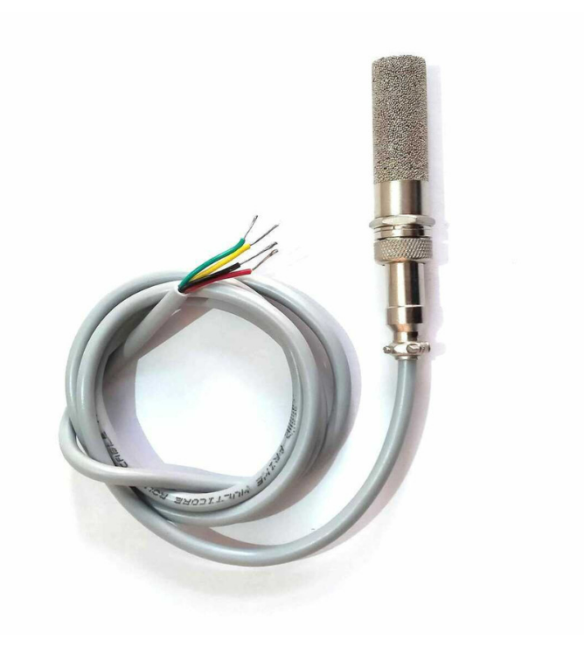
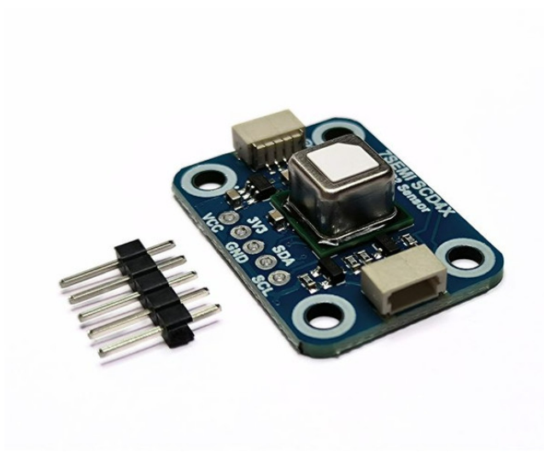
Selection of hardware components in the solution.
CO2 Sensor (Sensirion SCD41):
Temperature and Humidity Sensor (Sensirion SHT25):

Slide 10
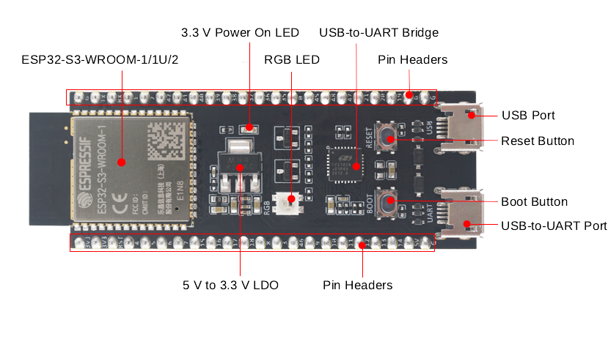
Control Unit (ESP32 S3)

Slide 11
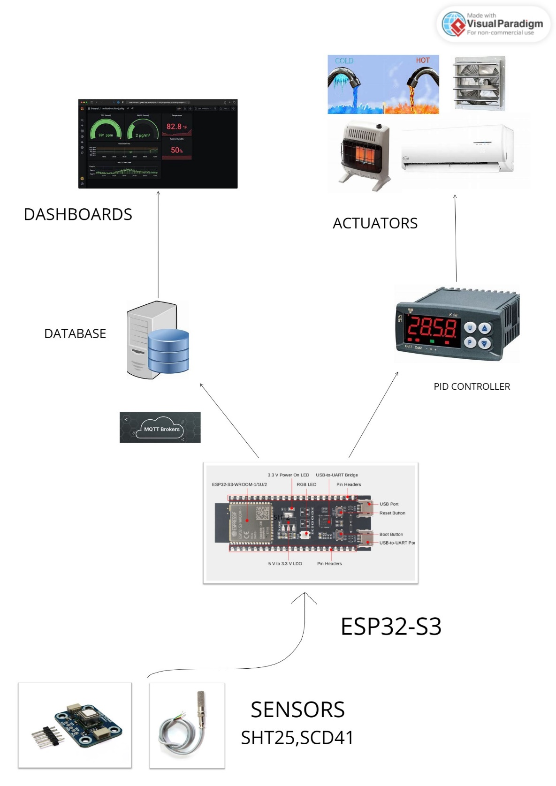
Deployment Level Diagram

Slide 12
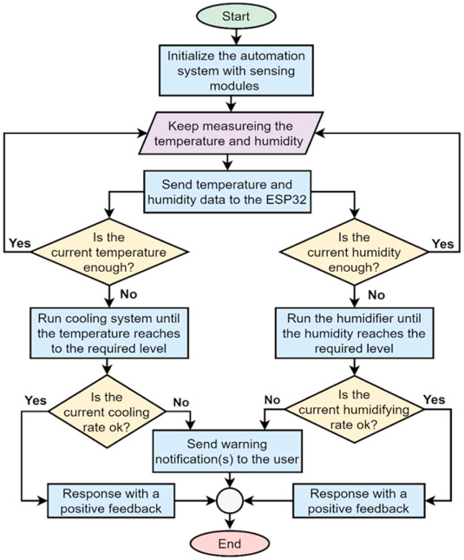
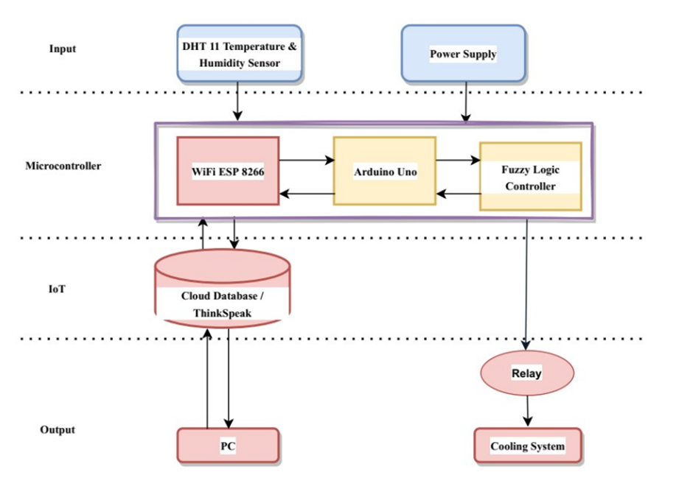
Flowchart of Software Process

Slide 13
Data Analytics in edge and cloud
Data Collection and Storage:
Real-time Sensor Data Collection
Secure Transmission to Cloud Storage
Data Cleansing and Pre-processing:
Identification of Raw Data Issues
Application of Pre-processing Techniques
Data Analysis:
Pattern Identification in Processed Data
Algorithmic Detection of Deviations
Historical Analysis for Trends
Data Visualization:
Utilization of Line Charts, Heatmaps, and Histograms
Visualization of Daily, Weekly, and Monthly Trends
Interactive Dashboards for Comparative Analysis

Slide 14
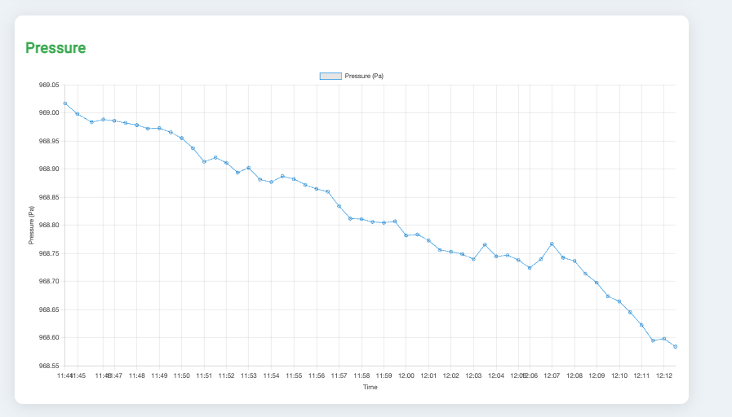
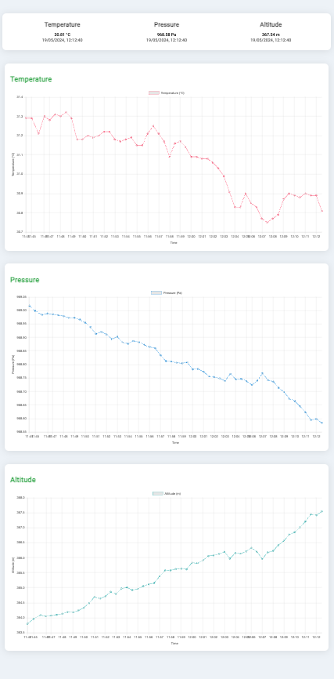
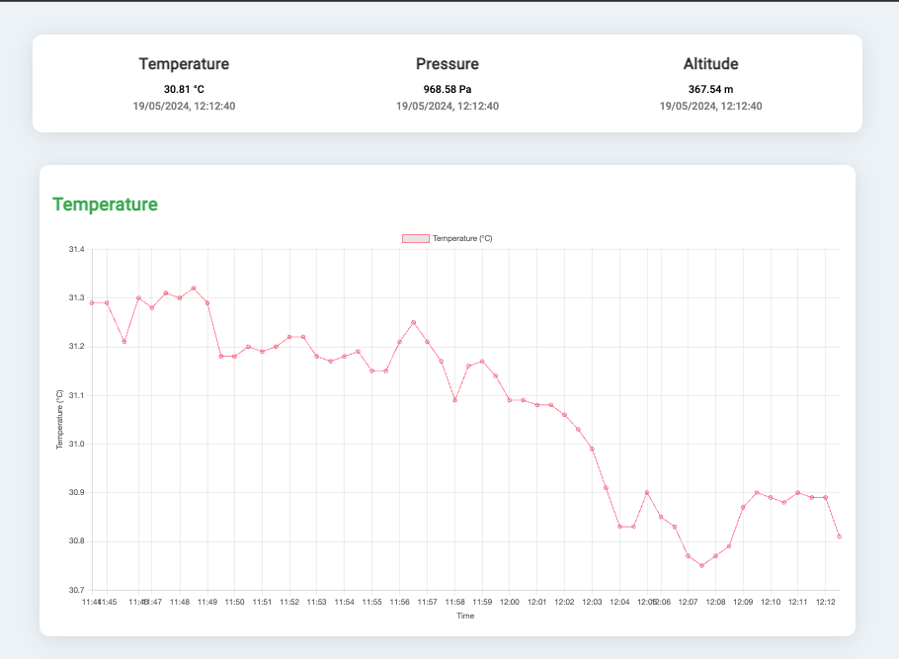
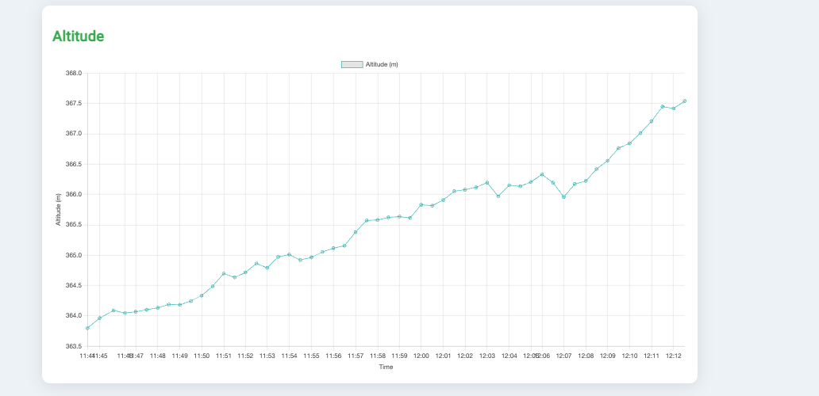

Slide 15
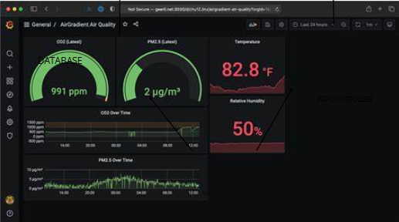
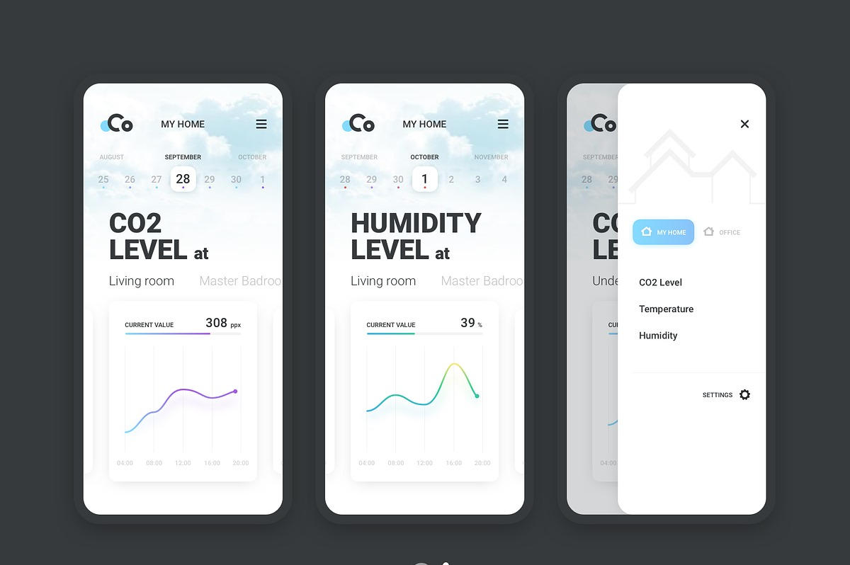
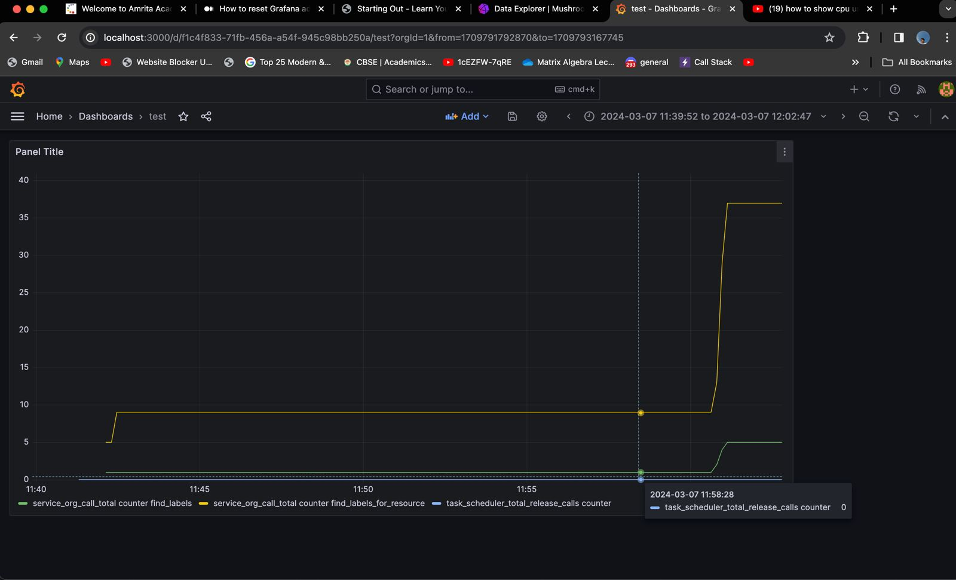
Application design with UI (web-pages)

Slide 16
Budget for Case Study Prototype Building
Hardware Components and Sensors:
Sensirion SCD41 CO2 Sensor: INR 3000
Sensirion SHT25 Humidity/Temperature Sensor: INR 1500
ESP32 S3 Microcontroller: INR 1500
Relay Modules (for actuator control): INR 1000
Connecting Wires and Cables: INR 500
Power Supply Units: INR 1000
Cloud Services:
Utilization of free hosting services like Render or Heroku: No additional cost
Alternatively, utilizing $100 free credits provided by AWS: No additional cost (assuming the project falls within the usage limits)
Total Estimated Budget: INR 8500

Slide 17
THANK YOU …..!!!

