Slide 1
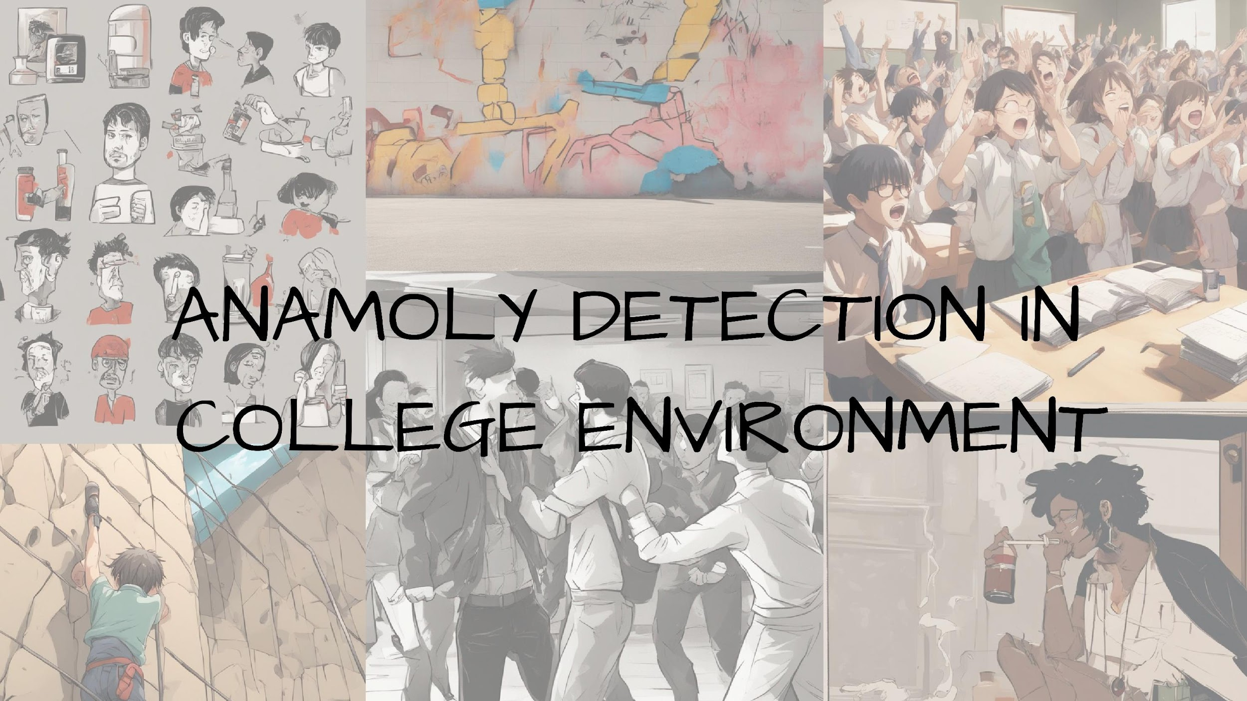

Slide 2
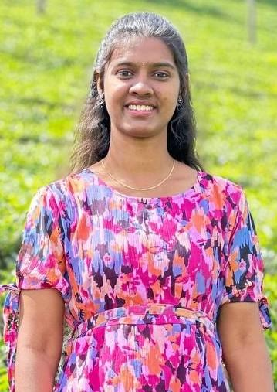
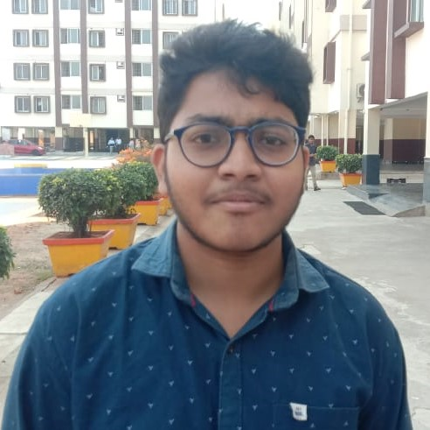

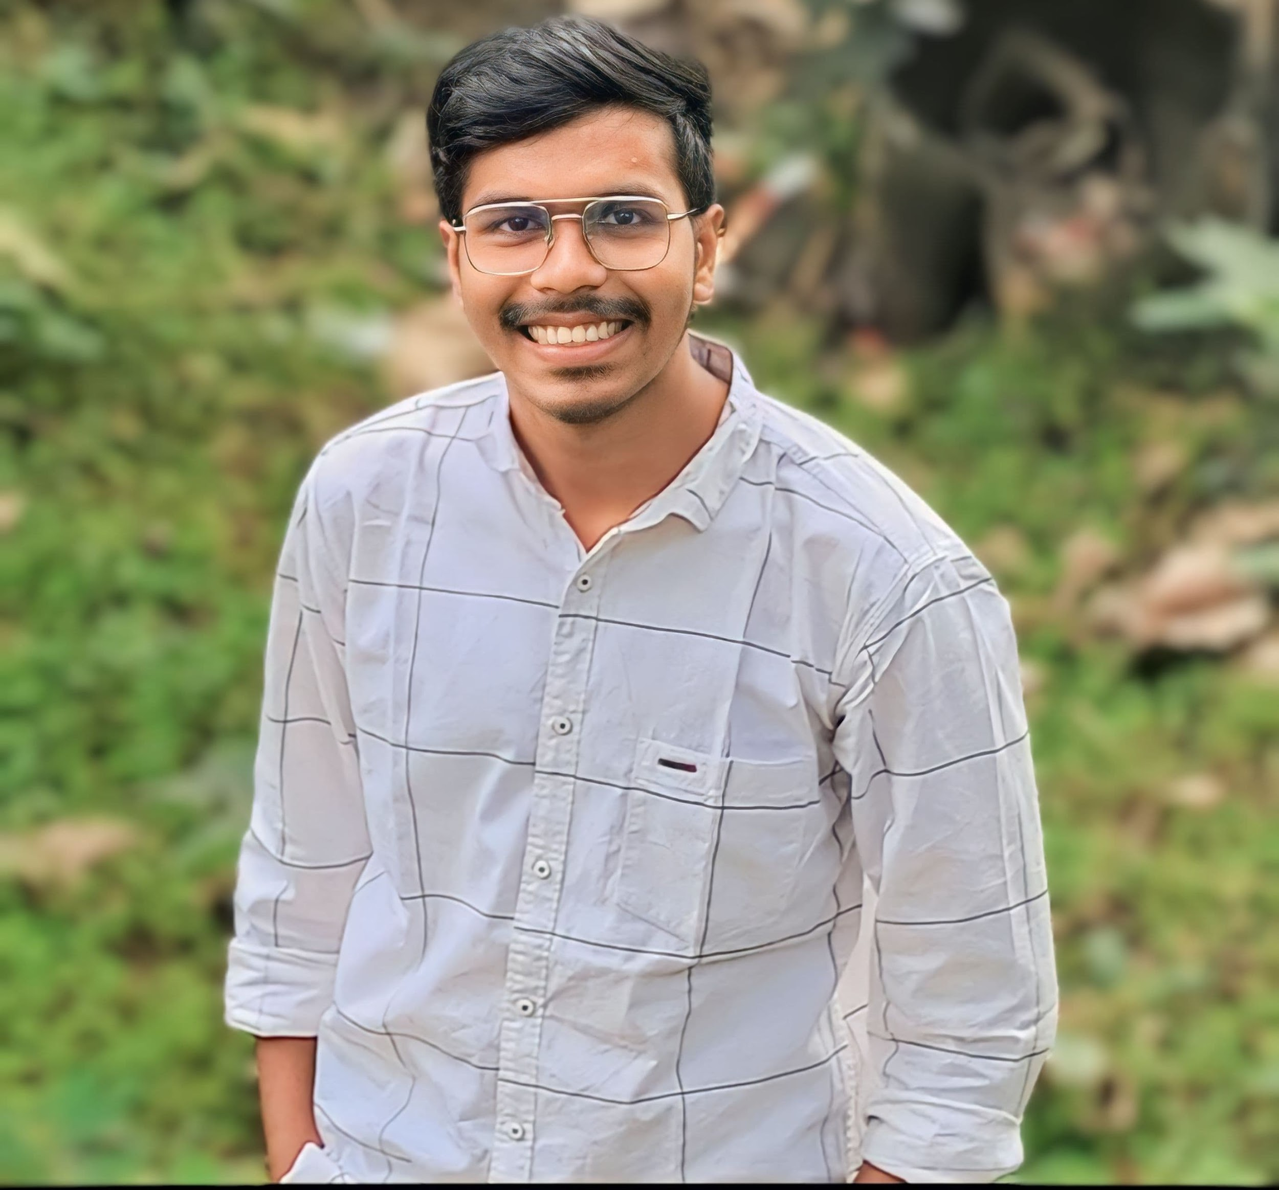
GROUP DETAILS
Student Name | Student Roll Number | Student Photo
JAHNAVI ANALA | CB.EN.U4CSE21024
MANTHINI MEHER VARDHAN | CB.EN.U4CSE21034
NERELLA GEETHA KRISHNA | CB.EN.U4CSE21040
TANGUDU HARSHA VARDHAN | CB.EN.U4CSE21062
GitHub URL: https://github.com/Harsha-Vardhan-Tangudu/Anomaly-Detection-in-college-environment-Using-Computer-Vision

Slide 3
ROLES ASSIGNED FOR THE PROJECT
STUDENT NAME | ASSIGNED ROLE | FEAUTRE DESCRIPTOR
JAHNAVI ANALA | Tracking - Monitoring objects or elements as they move across frames in images or videos, utilizing algorithms like snake algorithm or optical flow algorithm. | SURF
MANTHINI MEHER VARDHAN | Dataset (Images and Videos) - Describing scenes in images and videos to provide context. | HARRIS CORNER
NERELLA GEETHA KRISHNA | Matching - Enhancing images, converting color modules, identifying key frames, and utilizing computer vision algorithms for tasks like denoising. | GOLF
TANGUDU HARSHA VARDHAN | Detection - Identifying elements within the images/videos, including feature detection and algorithm implementation. | SIFT

Slide 4
CONTRIBUTION
ROLL NUMBER | NAME | Contribution
CB.EN.U4CSE21024 | ANALA JAHNAVI | Literature survey, Tracking, Feature detection (OLB), Corner Detection, Optical Flow algorithm (DenseNet Optical Flow), SVM, Documentation.
CB.EN.U4CSE21034 | MANTHINI MEHER VARDHAN | Dataset Generation, Literature survey, initial preprocessing techniques, Feature detection (Harris corner), Edge detection, Optical Flow algorithm (PyrLK Optical Flow), PPT.
CB.EN.U4CSE21040 | NERELLA GEETHA KRISHNA | Matching, Literature survey, Optical Flow Algorithm (Farneback Optical Flow), Dataset Alignment, Image Processing Techniques, Feature detection (GOLF), Filters, Testing, PPT.
CB.EN.U4CSE21062 | TANGUDU HARSHA VARDHAN | Feature detection (SIFT), Literature survey, Preprocessing, Projection methods and colour spaces, CNN models Training, Optical Flow algorithm (Lucas-Kanade Optical Flow), Documentation.

Slide 5
Motivation for the Project
Safety and Security
🡪 Ensure safety of students, faculty, and staff.
🡪Detect and prevent violent or harmful behavior.
Maintaining Order
🡪Identify and address disruptive behaviors like vandalism (E.g. Drawing sketches on walls in college or school)
🡪 Promptly deal with unauthorized activities
Protecting Property
🡪Preserve college infrastructure and resources.
🡪Identify individuals engaged in damaging property
Promoting Health and Well-being
🡪Identify instances of smoking or excessive drinking.
🡪Enable interventions for healthier behaviors among students.
Compliance and Enforcement
🡪 Enforce campus policies and regulations.
🡪Create a culture of accountability and respect for guidelines.

Slide 6
Challenges faced!
Here are a few challenges that we may encounter while working on this project:
Noise and errors: Real-world data can be noisy or contain errors.
Anomaly Detection Accuracy: identify and differentiate between normal and abnormal behaviors in real-time scenarios can be complex.
Integrating the anomaly detection system: Integrating with current campus security infrastructure, surveillance systems, and policies may encounter compatibility issues.
Data Collection: Gathering a comprehensive dataset with various scenarios of smoking, drinking, fighting, reckless driving, exam cheating, etc., may be challenging due to privacy concerns, ethical considerations, and access limitations.
Resource Constraints: Dealing with resource constraints such as limited computational power, storage capacity, and budget for implementing the anomaly detection system

Slide 7
Problem Statement
Colleges face ongoing difficulties in maintaining safety, order, property integrity, health standards, and college policy. While Anomaly detection systems offer promise in addressing these issues, there's a need for a clear plan to effectively implement these systems.
This plan should prioritize the safety and well-being of everyone on campus while also supporting an environment conducive to learning.“
In this project, we will utilize multiple images and videos captured in various scenarios involving smoking, drinking, fighting, reckless driving, exam cheating, hanging out of moving buses, chasing after buses, engaging in ragging, shouting, disrupting the college environment, vandalism, and other related activities.
In addition, we will develop a system that concurrently provides solutions when detecting the aforementioned scenarios.

Slide 8
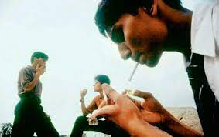
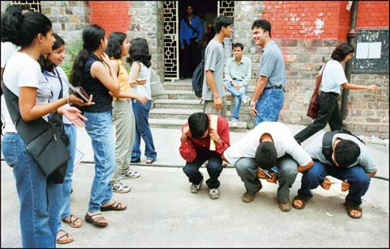
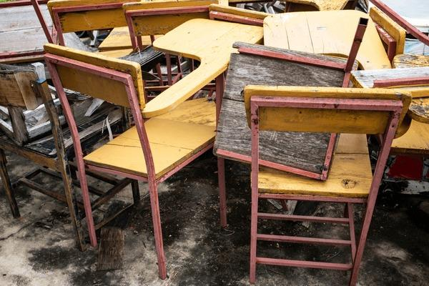
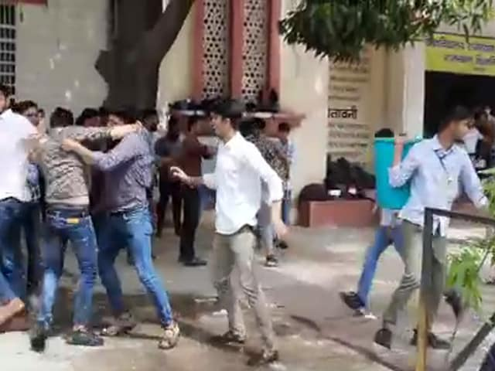
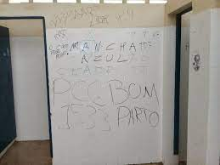
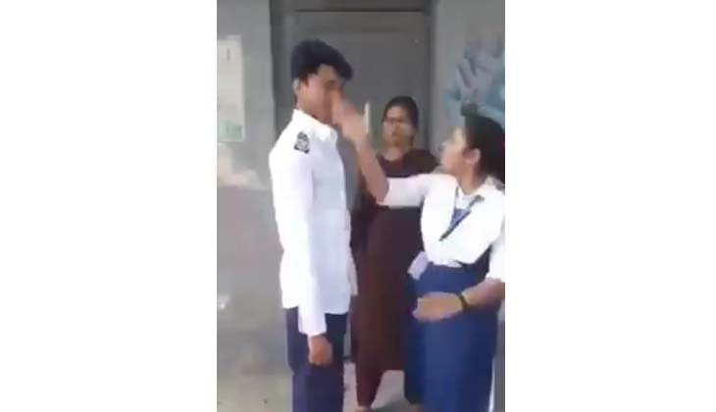
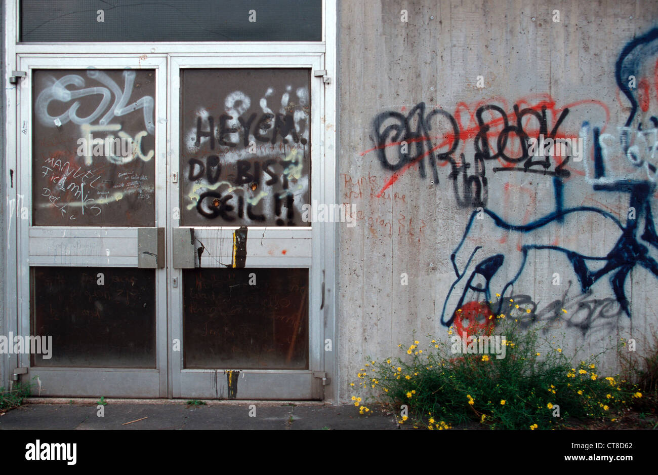
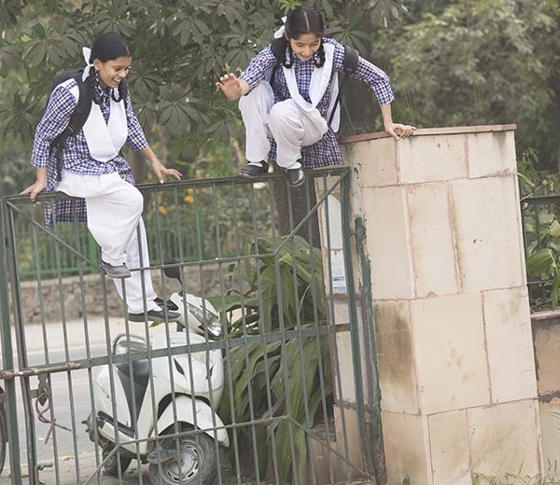
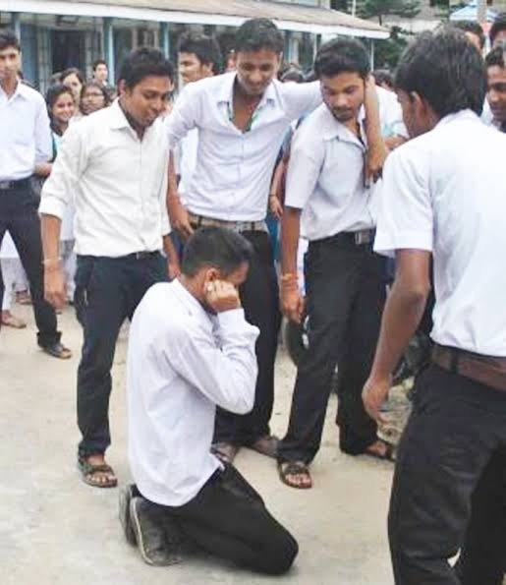
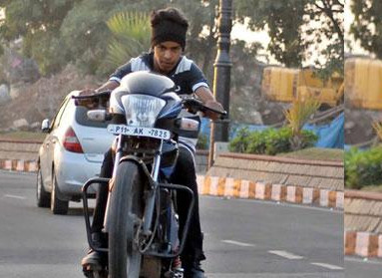
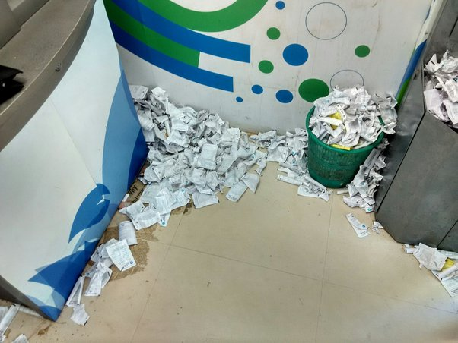

Slide 9
Dataset Detail – Kaggle Dataset
These datasets includes videos in .mp4 format, There are many scenarios showing about untrimmed real-world surveillance videos, with 13 realistic anomalies including Abuse, Arrest, Arson, Assault, Road Accident, Burglary, Explosion, Fighting, Robbery, Shooting, Stealing, Shoplifting, and Vandalism.
S.no | Data-set name | No. of Files | Resolution | Environment | Color | Image/Video Format
1 | Anomaly-Detection-Dataset-UCF | 8369 | 320 X 240 | Indoor and Outdoor | All Colors | .mp4

Slide 10
Dataset Detail
Custom Dataset
Present Scope :
This dataset consists of Images of 60 in .jpg format and Videos of 200 in .mp4 format in below mentioned Drive link.
This dataset is purely collected from our college environment which consist of maximum anomaly behaviors of students.
As we planned for this phase update - collected only anomaly consisting Dataset.
S.no | Data-set name | No. of Files | Resolution | Environment | Color | Image/Video Format
1 | Anomaly detection in college environment | 260 | Multiple Resolutions | Indoor and Outdoor | All Colors | .mp4 & .jpg
Future Scope :
We will try to collect dataset as much as we can which helps for training in all ways and also for testing .
We are planning to collect all anomaly and non-anomaly behavior consisting dataset
https://drive.google.com/drive/folders/1vdsMuTLC2OxboYeuE5oZ45UsZKYsG-EM

Slide 11
Extra Information on Dataset :
Camera Front 16MP / Rear 64MP+2MP+2MP Aperture Front f/2.0(16MP), Rear f/1.79(64MP) + f/2.4 (2MP) + f/2.4 (2MP) Flash Rear flash Scene Mode Night (front & rear), Portrait, Photo, Video, Pano, Live Photo, Slo-Mo, Time-Lapse, Pro, DOC, AI 64MP | Ultra wide 50 MP Samsung JN1 sensor ƒ/2.2 aperture 1/2.76” sensor size EIS image stabilisation 114° field of view Night Mode Macro (4 cm) HDR | Front Camera 16 MP Sony IMX471 sensor ƒ/2.45 aperture 1/3.1” sensor size Live Photo HD Portrait Google Filter Beauty Mode Night Mode 1080p video recording at 30 fps | Video 4K recording at 30 fps 1080p recording at 30 or 60 fps Live HDR at 30 fps Slo-mo (120 fps) Night Mode (720p/1080p at 30 fps) OIS and EIS image stabilisation | Main Camera 50 MP Sony IMX766 sensor ƒ/1.88 aperture 1/1.56” sensor size 1 µm pixel size Focal length: 24 mm

Slide 12
Literature Survey - Dataset Detail
This paper proposes a novel approach for anomaly detection in surveillance videos without annotating anomalous segments. The method utilizes a deep multiple instance ranking framework with weakly labeled training videos, treating normal and anomalous videos as bags and video segments as instances. Sparsity and temporal smoothness constraints are introduced in the ranking loss function for improved anomaly localization during training. A new dataset comprising 128 hours of real-world surveillance videos with 13 anomalies is introduced, serving two tasks: general anomaly detection and recognizing specific anomalous activities. Experimental results demonstrate significant improvement over state-of-the-art approaches, and the challenging nature of the dataset highlights opportunities for future research.
Real-World Anomaly Detection in Surveillance Videos | IEEE Conference Publication | IEEE Xplore
DATA FORMAT : .MP4
TITLE : Real-World Anomaly Detection in Surveillance Videos

Slide 13
Methodology :
Describes the CNN-BiLSTM model architecture for violence detection.
Explains the three components: CNN, Bidirectional LSTM Cells, and Dense Layers.
Outlines the experimental setup, including data preprocessing, model training, and testing.
Lists software, hardware, and resources used in the project.
Describes the datasets used for training and testing, including Hockey Fight, Movies, and Violent Flows datasets.
Summary of Findings:
The researchers developed a real-time violent activity monitoring system using computer vision and neural networks. The system aims to detect violence in public spaces quickly and efficiently by analyzing the speed and movements of individuals through cameras. The proposed model, CNN-BiLSTM, was trained and tested on datasets related to hockey fights, movies, and crowd violence.
Dataset Accuracy:
For the Hockey Fight dataset, the model achieved a maximum accuracy of 94.9% for training and 96.94% for validation. When trained on the Movies dataset, the model reached a maximum accuracy of 92.92% for training and 96.94% for validation. Training on the Violent Flows dataset resulted in a maximum accuracy of 77.31% for training and 80% for validation.

Slide 14
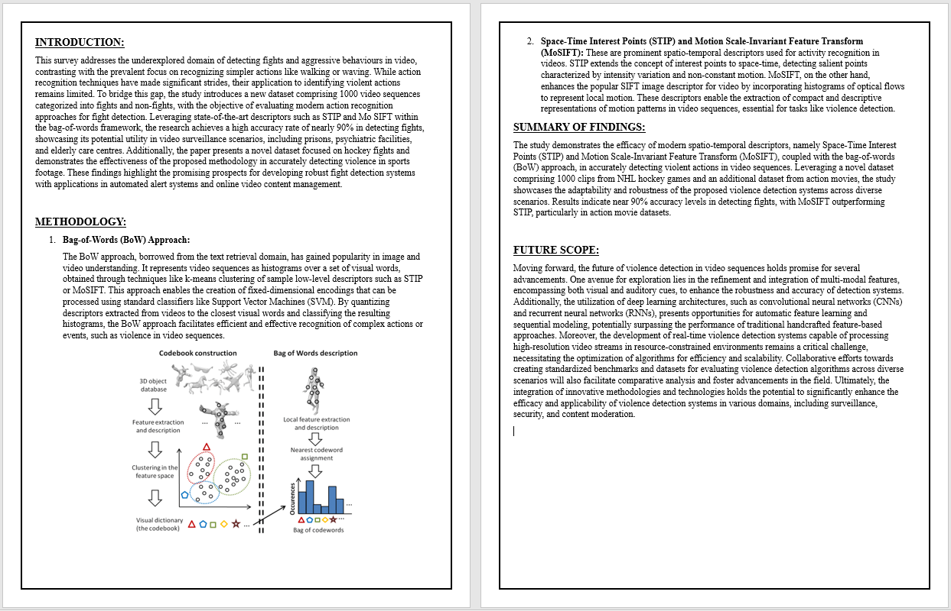
Literature Survey 1 – Algorithm Detail
Violence Detection in Video Using Computer Vision Techniques
Violence Detection in Video Using Computer Vision Techniques | SpringerLink

Slide 15
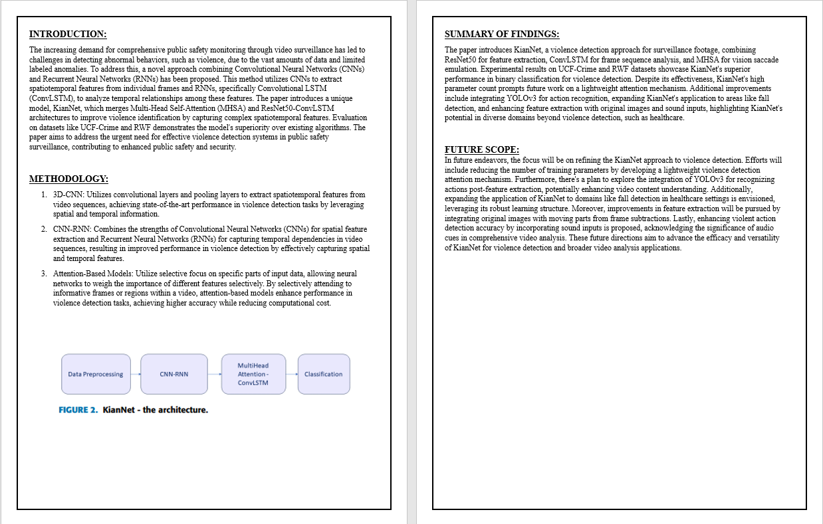
Literature Survey 2 – Algorithm Detail
KianNet: A Violence Detection Model Using an Attention-Based CNN-LSTM Structure
KianNet: A Violence Detection Model Using an Attention-Based CNN-LSTM Structure | IEEE Journals & Magazine | IEEE Xplore

Slide 16
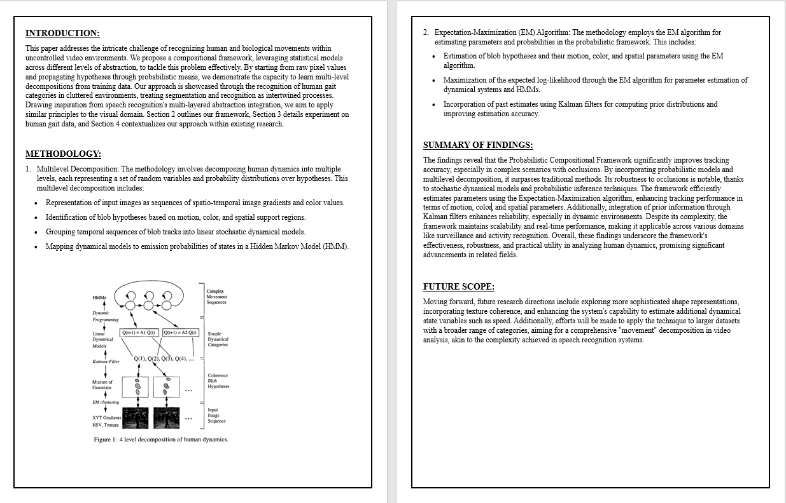
Literature Survey 3 – Algorithm Detail
Learning and Recognizing Human Dynamics in Video Sequences
Learning and recognizing human dynamics in video sequences | IEEE Conference Publication | IEEE Xplore

Slide 17
Preprocessing Methods Contribution
S.NO | NAME | EDGE DETECTION | FILTERS | CORNER DETECTION | PROJECTION METHODS | HISTOGRAM EQUILLIZATION | COLOUR SPACES
1 | JAHNAVI ANALA | Canny Edge Detector | Gaussian Filter | Harris Corner Detector | Perspective projection | Histogram Equillization | HSV
2 | MANTHINI MEHER VARDHAN | Sobel Operator | Median Filter | Shi-Tomasi Corner Detector | Orthographic projection | Histogram Equillization | RGB
3 | NERELLA GEETHA KRISHNA | Prewitt Operator | Bilateral Filter | FAST (Features from Accelerated Segment Test) | Parallel projection | Histogram Equillization | CMYK
4 | TANGUDU HARSHA VARDHAN | Laplacian of Gaussian (LoG) | Anisotropic Diffusion | KLT Corner Detector | Affine projection | Histogram Equillization | HSL

Slide 18
Final preprocessing methods using for our Project
METHOD | TYPE
Corner detection | Shi-Tomasi Corner Detection
Edge detection | Canny edge detection for overall edge detection and Laplacian of Gaussian
Filters | Anisotropic diffusion
Projection Methods | perspective projection
Color Spaces | HSV and LAB
Histogram Equalization
Detection:
Frame-by-Frame Detection: You can extract frames from the video using the frame rate information you have. Then, you can perform detection on each individual frame using object detection algorithms like YOLO, SSD, or Faster R-CNN. This approach allows for fine-grained detection but might be computationally intensive
Algorithm: CNN

Slide 19
Future Scope:
The study identifies potential areas for future enhancements and research:
Extended Validation: Further validation with additional standard datasets is recommended to test the model's generalizability.
Enhanced Model Architecture: Improving the model architecture could lead to increased accuracy. The researchers plan to maintain and refine the architecture for better results.
Combined Violence and Weapon Detection: Integrating weapon detection capabilities into the system to address a broader range of security concerns.
Night Vision and Thermal Imaging: Implementing technologies such as night vision and thermal imaging to enhance the system's capabilities in detecting violent activities.

Slide 20
Plan of work from Team forward
Data Acquisition and Preparation: Upon collecting images and videos from relevant sources while addressing privacy concerns and obtaining necessary permissions.
Algorithm Development and Optimization: this algorithm needs to achieve high accuracy and efficiency in identifying abnormal behaviors
Integration and Testing: integrating with college security system and testing the dataset and also checking for the improvements.
Pilot Deployment and Evaluation: Deployment of the system and execution with in the college for monitoring performance.

Slide 21
Thank You…!!!

