Slide 1

Agentic GraphRAG for Financial Question Answering
Student Details:
1. C Vishnuvardhan Chowdary – CB.SC.U4AIE23219
2. CB Harsha Vardhan – CB.SC.U4AIE23220
3. I Charuhas Reddy – CB.SC.U4AIE23233
4. Y Bhasith Sai Reddy – CB.SC.U4AIE23264
Team Number: C09
Supervisor: Dr. Ardra P.S

Slide 2
Introduction & Motivation
SEC 10-K filings are dense, numerically precise disclosures; manual cross-company, cross-year reasoning is slow and error-prone
Plain LLMs hallucinate on financial facts, standard RAG retrieves flat, disconnected passages that can't support multi-hop reasoning
Graph-augmented RAG enables structured, auditable retrieval, but efficient, query-aware agent usage remains an open problem
Growing LLM-assistant adoption in finance makes accuracy and traceability non-negotiable and not optional
Motivates a system that's graph-aware, reasoning-aware, and efficiency-aware, not just retrieval-aware

Slide 3
Literature Review
Paper | Methodology | Dataset Used | Key Results | Limitations
GraphRAG: From Local to Global (Edge et al., 2024) | Builds an LLM-generated knowledge graph, applies Leiden community detection, answers queries via map-reduce over community summaries. | Large private document corpora | Improved comprehensiveness and diversity over vanilla RAG, with lower token cost than map-reduce summarization. | Designed for summarization, not financial QA; graph construction is expensive.
Think-on-Graph (Sun et al., 2023) | Treats the LLM as a graph-traversal agent, iteratively exploring entities and relations via beam search to build explicit multi-hop reasoning paths. | General-domain knowledge graph (WebQSP, CWQ, GrailQA) | Higher multi-hop reasoning accuracy than conventional KGQA and RAG baselines, with interpretable reasoning paths. | Not evaluated on financial documents; traversal becomes computationally expensive on very large graphs.
HybridRAG (Sarmah et al., 2024) | Combines semantic vector retrieval with knowledge graph retrieval, fusing both contexts before answer generation. | Nifty-50 earnings call transcripts | Outperformed standalone VectorRAG and GraphRAG in retrieval quality and answer generation for financial QA. | Fixed retrieval pipeline with no adaptive routing; limited to earnings call transcripts.

Slide 4
Literature Review
Paper | Methodology | Dataset Used | Key Results | Limitations
Adaptive-RAG (Jeong et al., 2024) | Trains a lightweight classifier to predict query complexity, then routes each query to no-retrieval / single-step / multi-step strategies instead of one fixed pipeline | TriviaQA, HotpotQA, MuSiQue, 2WikiMultiHopQA | Matches accuracy of always-expensive multi-step retrieval while cutting average retrieval/generation steps to 1.03 | General open-domain QA only — no graph-structured evidence, no financial domain, complexity signal is purely query-based
FinReflectKG-MultiHop (Arun et al., 2025) | Builds a multi-hop financial QA benchmark by mining 2–3 hop subgraphs from FinReflectKG, comparing KG-path retrieval against page-window retrieval. | FinReflectKG | KG-guided retrieval improved accuracy by ~24% while cutting token usage by ~84.5% vs. page-window retrieval. | Introduces a benchmark, not a QA system; evaluates retrieval strategies rather than adaptive agents.

Slide 5
Research Gap
No adaptive retrieval strategy:- HybridRAG and GraphRAG apply one fixed retrieval pipeline to every query; Think-on-Graph does adaptive traversal but only on general-domain KGs, never financial. No reviewed work routes queries by complexity in the financial domain.
Retrieval quality and reasoning accuracy are conflated:- FinReflectKG-MultiHop shows KG-guided retrieval improves correctness by ~24%, but this measures retrieval, not whether the LLM reasons correctly over evidence once retrieved.
No end-to-end evaluated QA system on this KG:- FinReflectKG builds the KG; FinReflectKG-MultiHop is benchmark-only; HybridRAG evaluates on earnings calls, not this KG. No reviewed work builds and evaluates an agentic system on FinReflectKG with traceable, claim-level scoring.

Slide 6
Problem Statement
Corporate financial reports contain interconnected textual and numerical information spread across multiple sections and fiscal years. Existing RAG systems struggle with multi-hop financial reasoning, treat all queries with the same retrieval strategy, and provide limited evidence traceability. This project addresses these challenges through an adaptive agentic GraphRAG framework that combines graph-based retrieval, symbolic financial reasoning, and claim-level provenance verification.
In Scope | Out of Scope
Agentic GraphRAG for financial question answering using FinReflectKG | Building the knowledge graph (pre-existing dataset)
Adaptive query routing based on query complexity | Building or modifying the benchmark dataset
Hybrid retrieval (knowledge graph + vector search) | Live/real-time financial market data
Symbolic financial computation (e.g., ratios, growth rates) | Financial forecasting or investment recommendations
Claim-level provenance and evidence verification | Large-scale coverage of all companies

Slide 7
Objectives
Develop an agentic retrieval system over FinReflectKG, combining graph traversal, hybrid passage search, and symbolic computation for multi-hop financial QA
Design a query-adaptive retrieval controller: lightweight or comprehensive retrieval based on estimated question complexity, not one uniform strategy
Evaluate the system across staged configurations to quantify how retrieval, graph enrichment, and adaptive routing each contribute to accuracy
Identify and mitigate the gap between retrieval quality and reasoning accuracy through structured evidence formatting
Measure efficiency and traceability: latency/compute savings from routing, and how well answers trace back to retrieved evidence

Slide 8
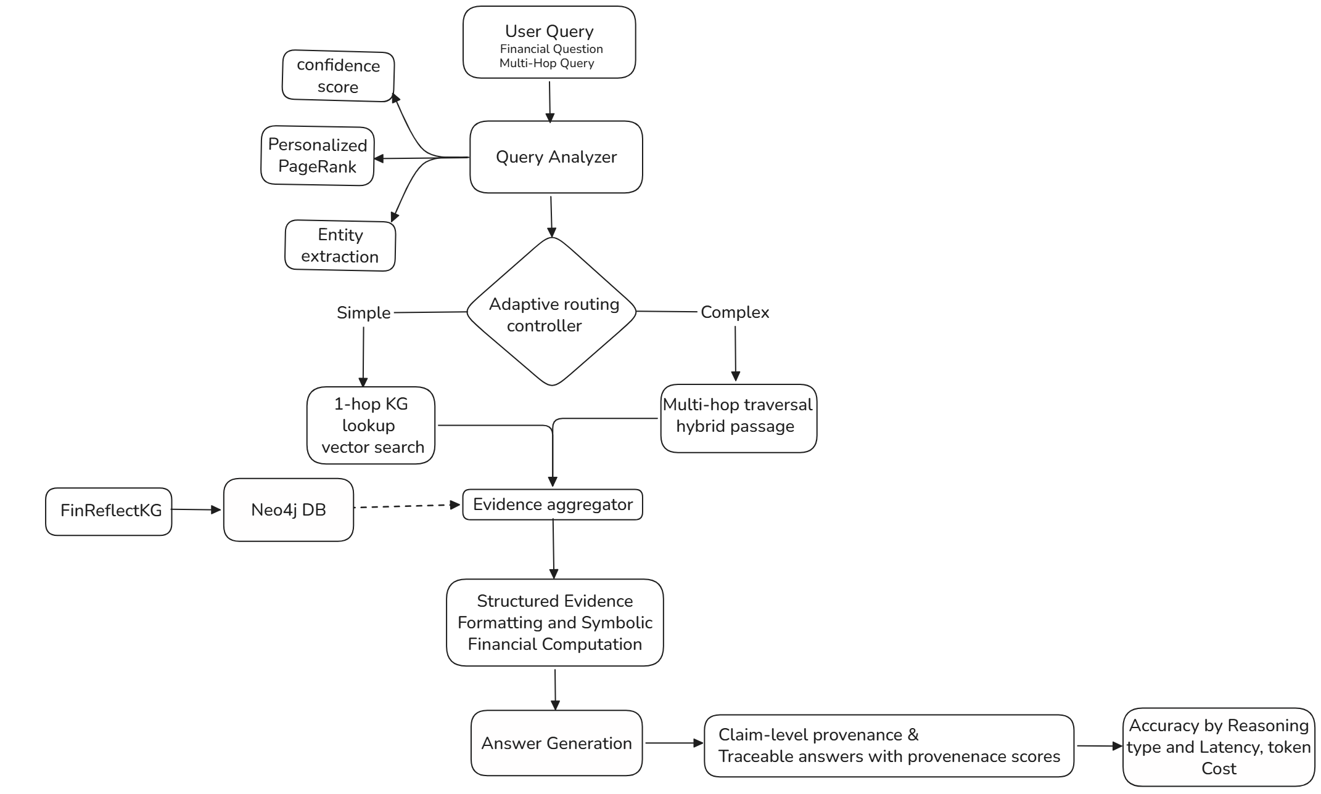
Proposed Methodology

Slide 9
Techniques & Tools
Component | Technique/Tool Chosen | Alternatives Considered | Why Chosen?
Embedding model | bge-base-en-v1.5 | nomic-embed-text | Stronger retrieval quality with query-instruction prefixing
Graph database | Neo4j AuraDB | Self-hosted graph DB | Easier team collaboration
Agent orchestration | LangGraph agent | Custom tool-calling loop | Mature multi-tool routing framework
LLM | Llama 3.3 70B | Other hosted LLMs (Qwen3) | Low-latency inference & cost-effective
Complexity signal for routing | Personalized PageRank (Neo4j GDS) | Manual heuristic rules | Built-in graph algorithm
Provenance scoring | Claim-level KG verification | Answer-level verification | Finer-grained traceability

Slide 10
Expected Outcomes
A working agentic GraphRAG prototype: graph traversal, hybrid retrieval, and symbolic computation over the FinReflectKG knowledge graph
A functioning adaptive routing layer with quantified latency/compute savings vs always running full retrieval
An evaluated improvement for the retrieval-vs-reasoning gap (evidence retrieved correctly but underused) shown via before/after accuracy with structured evidence formatting
Accuracy by question type (temporal / cross-company / intra-document) + claim-level provenance scores, consolidated into a final comparison report

Slide 11
Industry Relevance
Sector alignment: Financial services / fintech, specifically equity research, credit analysis, and regulatory/compliance review, where analysts manually cross-reference across companies and years
Real use-case: AI analyst copilot for multi-hop financial question answering with traceable, auditable evidence to support due diligence, investment research, and compliance workflows.
Commercial Relevance: Explainable, traceable outputs help build trust in AI-assisted financial analysis and support regulatory compliance.

Slide 12
Timeline
 |  |  | ‘26 |  |  |  |  | ‘27
 | July | Aug | Sep | Oct | Nov | Dec | Jan | Feb | Mar
Literature review & dataset exploration
KG & Neo4j setup
Baseline retrieval (Vector RAG)
Adaptive Routing (PPR, Confidence Signal) and Entity extraction
Hybrid Retrieval
Mid Project Review and Retrieval refinement
Structured Evidence Formatting
Symbolic Financial Computation
Claim Level provenance Scoring
Evaluation
Results consolidation
Final report + paper writing

Slide 13
Team Roles
Member | Role
I Charuhas | Data & Knowledge Graph — FinReflectKG ingestion, Neo4j setup, graph pattern mining
CB Harsha Vardhan | Agentic Retrieval Core — vector search, graph traversal, symbolic computation tools, agent orchestration
C Vishnuvardhan | Adaptive Routing & Evidence Formatting — complexity estimator, routing controller, structured formatting fix
Y Bhasith Sai | Evaluation & Provenance — claim-level verification, accuracy analysis, latency/cost benchmarking

Slide 14
References
[1] D. Edge et al., "From Local to Global: A Graph RAG Approach to Query-Focused Summarization," arXiv preprint arXiv:2404.16130, Apr. 2024.
[2] J. Sun et al., "Think-on-Graph: Deep and Responsible Reasoning of Large Language Model on Knowledge Graph," in Proc. International Conference on Learning Representations (ICLR), 2024.
[3] B. Sarmah, B. Hall, R. Rao, S. Patel, S. Pasquali, and D. Mehta, "HybridRAG: Integrating Knowledge Graphs and Vector Retrieval Augmented Generation for Efficient Information Extraction," in Proc. International Conference on AI in Finance (ICAIF), 2024.
[4] S. Jeong, J. Baek, S. Cho, S. J. Hwang, and J. C. Park, "Adaptive-RAG: Learning to Adapt Retrieval-Augmented Large Language Models through Question Complexity," in Proc. Conference of the North American Chapter of the Association for Computational Linguistics: Human Language Technologies (NAACL-HLT), 2024.
[5] A. Arun, R. R. Harsh, B. Sarmah, and S. Pasquali, "FinReflectKG-MultiHop: Financial QA Benchmark for Reasoning with Knowledge Graph Evidence," arXiv preprint arXiv:2510.02906, 2025.

