Slide 1

Agentic GrahRAG for Financial Question Answering
FIRST REVIEW – B.TECH PROJECT
Student Details:
1. C Vishnuvardhan Chowdary – CB.SC.U4AIE23219
2. CB Harsha Vardhan – CB.SC.U4AIE23220
3. I Charuhas Reddy – CB.SC.U4AIE23233
4. Y Bhasith Sai Reddy – CB.SC.U4AIE23264
Team Number: C09
Supervisor: Dr. Ardra P.S

Slide 2
01 | Project Progress Since Zeroth Review
Oracle Reasoning Experiment: Tested FinQA benchmark with 100% gold retrieval, proving that LLM reasoning accuracy sharply drops from 100% (3-step) to 20% (4-step) across 5 distinct failure modes
Hybrid Adaptive Query Router Built: Implemented a 4-route controller (Vector, Graph, Symbolic, Hybrid) combining entity extraction, topology density and PPR ranking with 100% routing accuracy
Structured Evidence Formatter Developed: Typed Markdown table formatting improving distractor resistance from 66.7% → 100% on complex entity classification queries
Parallel Hybrid Retrieval: Concurrent ThreadPool retrieval merging vector text passages with PPR-ranked graph triples for multi-faceted financial queries

Slide 3
02 | Motivation & Problem Statement
Problem: Corporate financial reports contain interconnected textual and numerical information spread across multiple sections and fiscal years. Existing RAG systems struggle with multi-hop financial reasoning, treat all queries with identical retrieval strategies, and provide limited evidence traceability.
Objective 1: Develop an agentic retrieval system combining graph traversal, hybrid passage search, and symbolic computation for multi-hop financial question answering over FinReflectKG.
Objective 2: Design a query-adaptive routing controller that dispatches queries to lightweight or comprehensive retrieval paths based on estimated complexity — not one uniform strategy
Objective 3:Identify and mitigate the retrieval-vs-reasoning gap through structured evidence formatting, and measure answer traceability via claim-level provenance

Slide 4
03 | Consolidated Literature Review & Research Gap
Paper | Core Approach | Key Result | Gap
GraphRAG (Edge et al., 2024) | LLM-generated KG + community summarization | Better comprehensiveness than vanilla RAG | No financial QA; expensive graph construction
Think-on-Graph (Sun et al., 2023) | LLM as graph-traversal agent via beam search | Higher multi-hop accuracy with interpretable paths | Not evaluated on financial documents
HybridRAG (Sarmah et al., 2024) | Vector + KG retrieval fused before generation | Outperforms standalone Vector/Graph RAG in financial QA | Fixed pipeline, no adaptive routing
Adaptive-RAG (Jeong et al., 2024) | Lightweight classifier routes by query complexity | Matches expensive multi-step at 1.03 avg steps | General QA only, no graph evidence or financial domain
FinReflectKG-MultiHop (Arun et al., 2025) | Multi-hop subgraph mining from FinReflectKG | KG retrieval +24% accuracy, -84.5% token cost | Benchmark only — no agentic QA system built

Slide 5
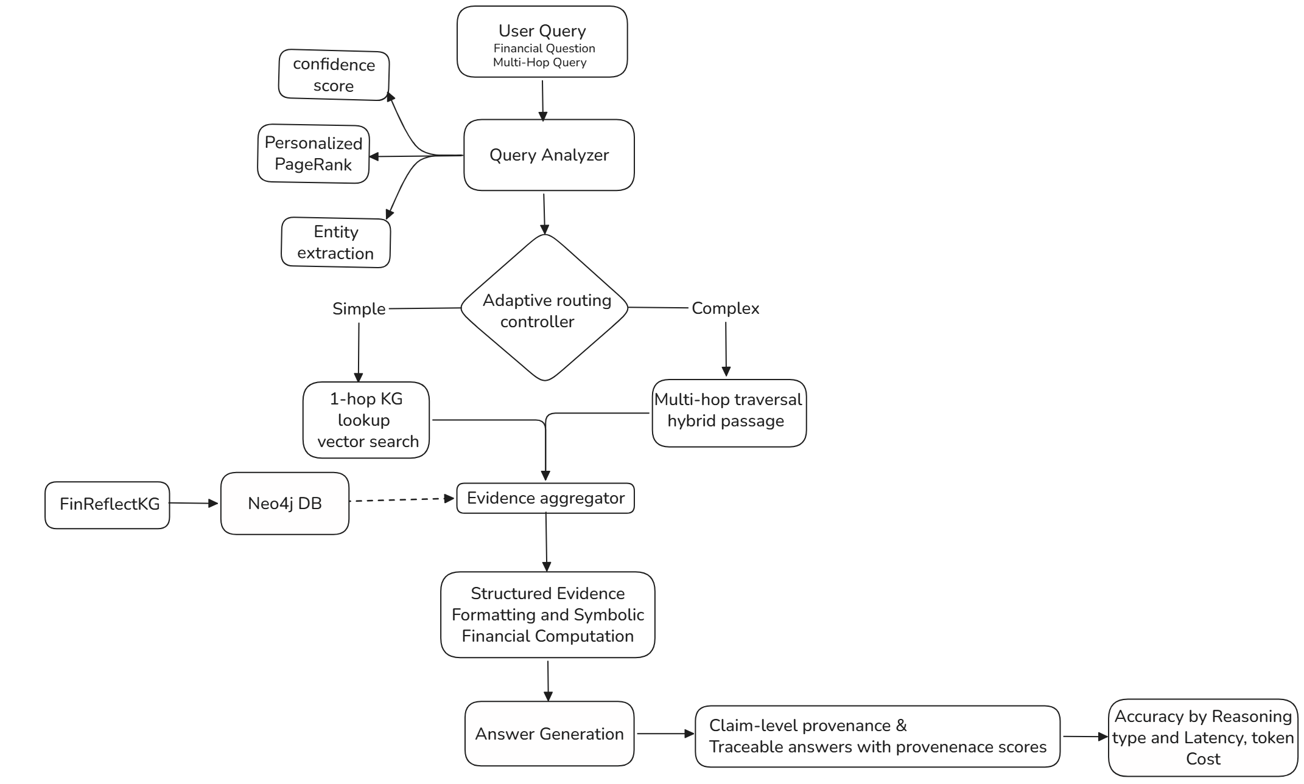


04 | Finalized System Architecture & Methodology

Slide 6
05 | Implementation Status – Prototype / Proof-of-Concept
Tier 0–3 Multi-Tier Pipeline: Fully implemented and benchmarked, progressing from zero-context parametric baseline to full Agentic GraphRAG
Adaptive Query Router: Fast-path regex + LLM fallback with topology density scoring and sub-0.4s routing decision
Structured Evidence Formatter: Dynamic Markdown table generator grouping metrics, risks, and market conditions with 0% fact-dropping guarantee
Parallel Hybrid & Symbolic Engines: Concurrent retrieval merging vector text with graph triples, alongside deterministic Python arithmetic for multi-year YoY growth

Slide 7
06 | Experimental Setup & Test Cases
Dataset Scope: 51,927 triplets from SEC 10-K filings dataset + 20 stratified FinQA benchmark questions
Inference Stack: BAAI/bge-small-en-v1.5 embeddings (384-dim), Neo4j AuraDB + NetworkX graph snapshot, Qwen 3.8-27B LLM.
Evaluation Scenarios: Oracle Reasoning Test (isolating reasoning from retrieval), Adaptive Routing Ablation (A1–A6), Formatting Ablation, and 3-Way Hybrid Retrieval Evaluation
Key Metrics: Routing Accuracy (%), Distractor Resistance (%), Latency Reduction (%), YoY Math Exact Match (%), End-to-End Latency (s)

Slide 8
07 | Results – Quantitative Performance
Oracle Reasoning Degradation: 100% accuracy on 3-step reasoning drops to 20% on 4-step reasoning (60% overall), validating the necessity of structured evidence formatting
Adaptive Routing Efficiency: 6/6 (100%) routing accuracy, achieving 64% – 83% latency reduction on descriptive queries by avoiding heavy graph traversals
Distractor Resistance: Structured Markdown tables improved factual focus from 66.7% (raw triples) → 100% on complex entity classification queries
Symbolic Math Precision: 100% exact numerical match on multi-year financial growth queries, eliminating arithmetic hallucinations.

Slide 9
08 | Results Analysis & Interpretation
The Retrieval-vs-Reasoning Gap Confirmed: High retrieval recall alone does not guarantee correct answers, raw triple dumps overload LLMs, leading to goal substitution and dropped terms
Why Formatting Solves Entity-Type Blindness: Flat triples cause models to confuse risk factors with financial metrics; categorized tables with PRIMARY MATCH anchors restore semantic focus
Why Vector RAG Fails in Finance: Dense embeddings capture broad topical keywords but cannot resolve 2-hop regulatory or litigation relationships across corporate entities
Compute Optimization via Routing: Running full graph traversal on every query wastes 50–80% of compute; adaptive routing preserves accuracy with speed on simple queries

Slide 10
09 | Prototype / Demonstration

Slide 11
10 | Current Limitations & Technical Challenges
Neo4j AuraDB Free-Tier Constraints: Instance restricts heavy in-memory GDS projections, requiring local NetworkX graph snapshot fallback
FinReflectKG Dataset Coverage Gaps: Cross-entity ownership queries return empty subgraphs, has_stake_in relationship is sparse for MSFT in the dataset
Complex Multi-Step Table Traversal: Deeply nested tabular accounting footnotes require cell-to-node linking beyond current 2-hop triplet traversal
Provenance Scoring Calibration: Preliminary claim-level faithfulness scoring requires tighter grounding thresholds

Slide 12
11 | Remaining Work & Completion Plan
 |  |  | ‘26 |  |  |  |  | ‘27
 | July | Aug | Sep | Oct | Nov | Dec | Jan | Feb | Mar
Literature review & dataset exploration
KG & Neo4j setup
Baseline retrieval (Vector RAG)
Adaptive Routing (PPR, Confidence Signal) and Entity extraction
Hybrid Retrieval
Mid Project Review and Retrieval refinement
Structured Evidence Formatting
Symbolic Financial Computation
Claim Level provenance Scoring
Evaluation
Results consolidation
Final report + paper writing

Slide 13
12 | Project Contribution & Current Achievement

Slide 14
13 | Team Contribution & Responsibility
Member | Role
I Charuhas | Data & Knowledge Graph — FinReflectKG ingestion, Neo4j setup, graph pattern mining
CB Harsha Vardhan | Agentic Retrieval Core — vector search, graph traversal, symbolic computation tools, agent orchestration
C Vishnuvardhan | Adaptive Routing & Evidence Formatting — complexity estimator, routing controller, structured formatting fix
Y Bhasith Sai | Evaluation & Provenance — claim-level verification, accuracy analysis, latency/cost benchmarking

Slide 15
14 | References
[1] D. Edge et al., "From Local to Global: A Graph RAG Approach to Query-Focused Summarization," arXiv preprint arXiv:2404.16130, Apr. 2024.
[2] J. Sun et al., "Think-on-Graph: Deep and Responsible Reasoning of Large Language Model on Knowledge Graph," in Proc. International Conference on Learning Representations (ICLR), 2024.
[3] B. Sarmah, B. Hall, R. Rao, S. Patel, S. Pasquali, and D. Mehta, "HybridRAG: Integrating Knowledge Graphs and Vector Retrieval Augmented Generation for Efficient Information Extraction," in Proc. International Conference on AI in Finance (ICAIF), 2024.
[4] S. Jeong, J. Baek, S. Cho, S. J. Hwang, and J. C. Park, "Adaptive-RAG: Learning to Adapt Retrieval-Augmented Large Language Models through Question Complexity," in Proc. Conference of the North American Chapter of the Association for Computational Linguistics: Human Language Technologies (NAACL-HLT), 2024.
[5] A. Arun, R. R. Harsh, B. Sarmah, and S. Pasquali, "FinReflectKG-MultiHop: Financial QA Benchmark for Reasoning with Knowledge Graph Evidence," arXiv preprint arXiv:2510.02906, 2025.

